Slide 1
Centering a Harm Reduction Framework for Substance Use Disorder Counseling in Medical Student Education:
A Pilot Curriculum
Ana Malfa
Katie Zechnich
4th Year Medical Students at The Warren Alpert Medical School of Brown University

Slide 2
Disclosures
Neither presenter has any conflicts of interest to disclose.

Slide 3
Outline
Background
Objectives in Curriculum Development
Harm Reduction Curriculum
Student Survey Results
Looking Forward

Slide 4
Background: Harm Reduction in Med Ed
Harm reduction is a core component of caring for people who use drugs
Knowledge gap among physicians regarding harm reduction
Limited exposure in undergraduate medical education
Opportunity to integrate into Doctoring curriculum when covering substance use counseling

Slide 5
Objectives in Curriculum Development
Introduce harm reduction principles
Integrate harm reduction into counseling framework
Expand counseling guides beyond alcohol use disorder (AUD) and tobacco use disorder (TUD)
Center people with lived experience (PWLE) and work closely with community partners

Slide 6
Centering Community Voices
Our current medicalized understanding of harm reduction is developed from an extensive history of community organizing in response to systems of oppression.
Our goal is to learn from and center people who are already doing work in the harm reduction space in Providence, particularly BIPOC folks.
Notes:
Can we fit our DEI-ish slide in here? Idk what title makes sense? Then maybe transition into community partnerships?
I realize this is too many words

Slide 7
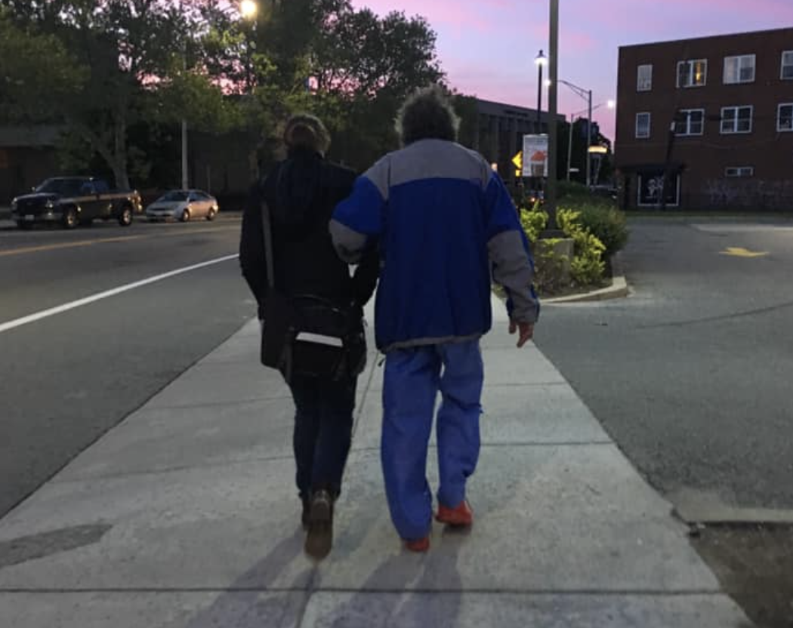
Community Organization Partners
Project Weber/Renew
House of Hope
Notes:
Project Weber/RENEW provides peer-led harm reduction and recovery support services, builds relationships with the people we serve, and fights for systemic change. We empower people who engage in drug use and/or sex work to make healthier and safer choices in their own lives.
Project Weber/RENEW began as two separate organizations, both providing peer support, community, and tools for people in our state who use drugs, engage in sex work, or are unhoused, and people living at the intersections of these experiences.

Slide 8
Harm Reduction Curriculum
Administered March 2023 and 2024
Pre-session materials
3-hour class session:
Panel with harm reduction specialists
Small group practice cases

Slide 9
Pre-session Materials
Harm Reduction Practices Guide
Substance Use Counseling Guide
Reading about local harm reduction practices

Slide 10
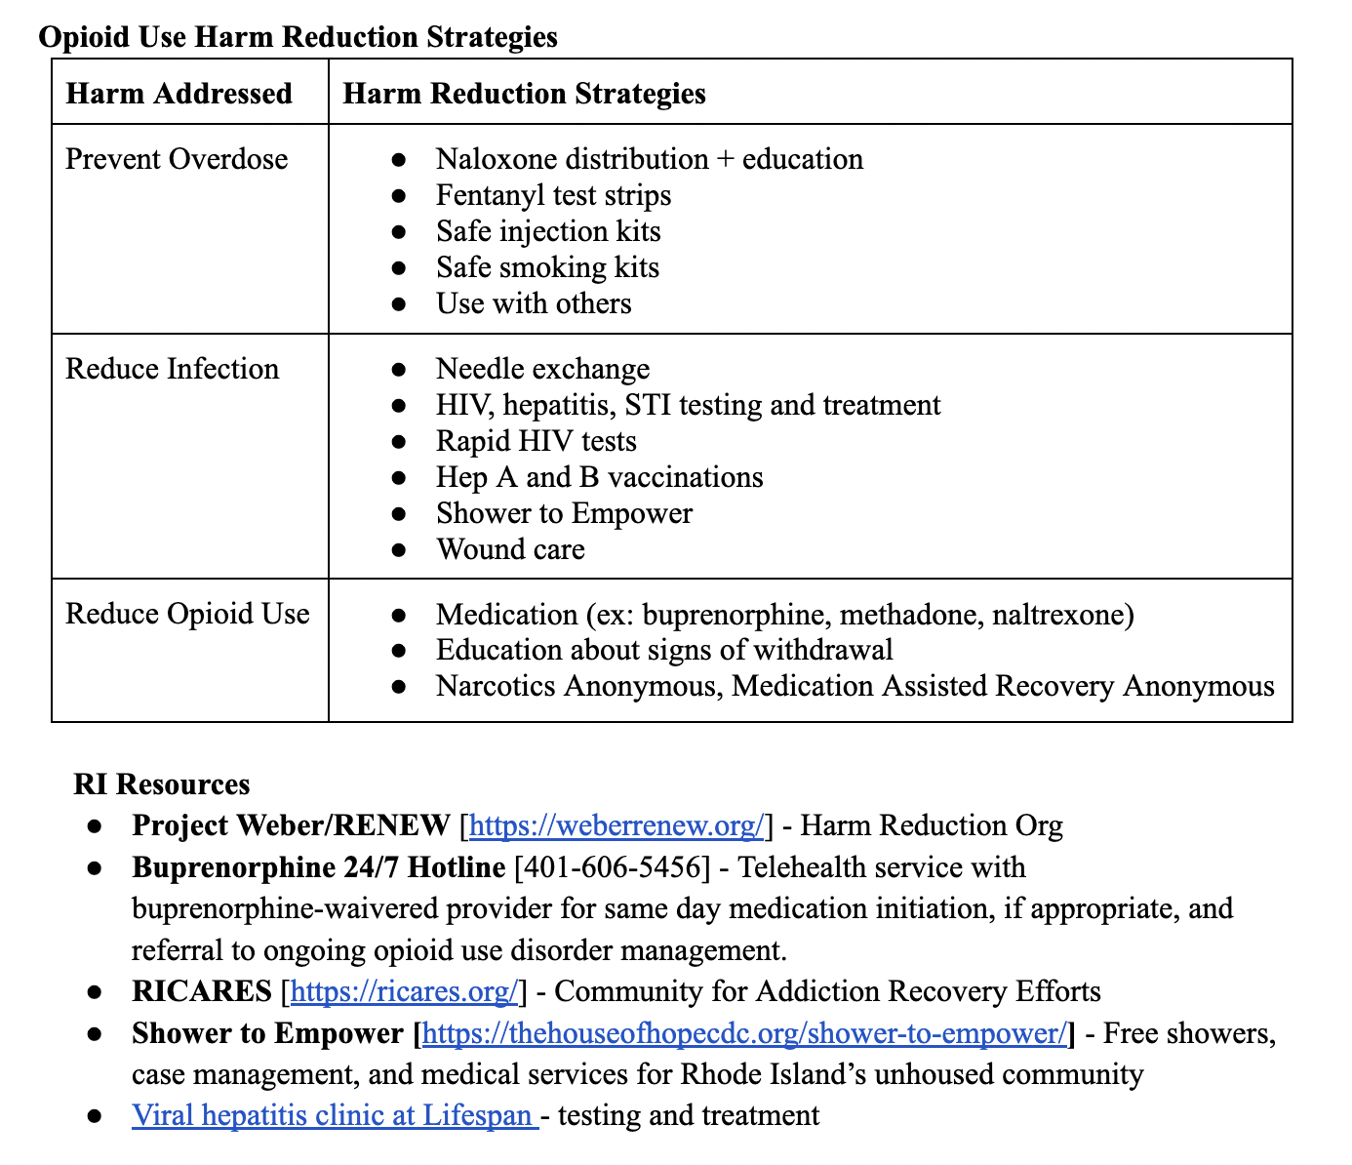

Slide 11
Notes:
Do we want to include any examples from our materials?

Slide 12
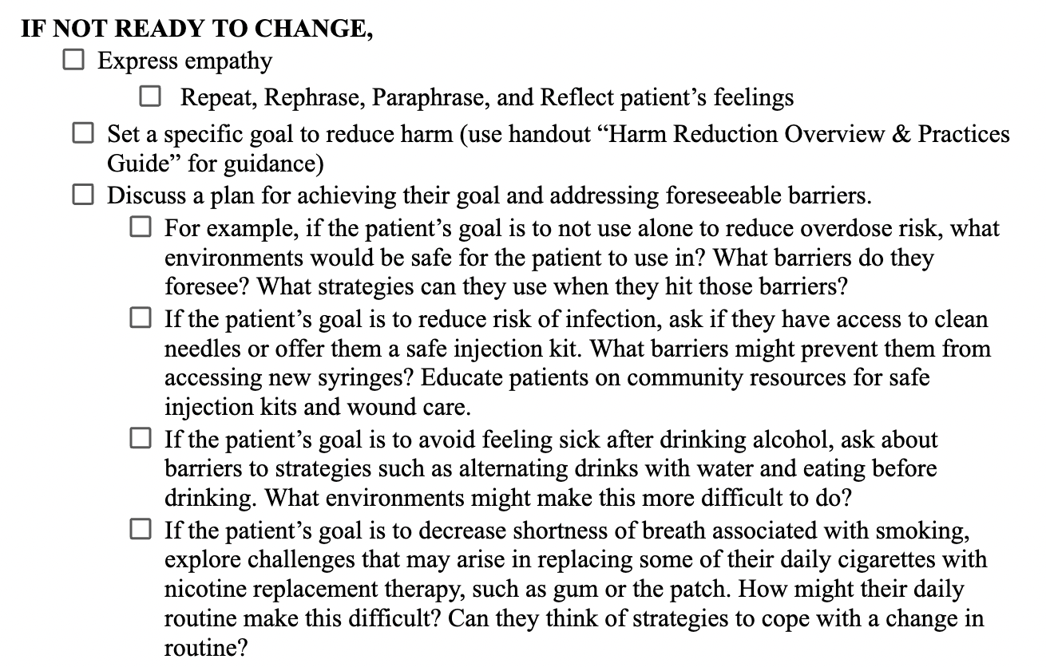

Slide 13
Panel with Harm Reduction Experts
3 panelists:
Overdose Prevention Program Director
Internal Medicine and Addiction Medicine Physician
Community Outreach Coordinator, RI Department of Health

Slide 14
Small Group Practice Cases
17 groups with 18 facilitators
15 facilitators have lived experience with substance use
Opportunity to discuss panel
Counseling practice cases with standardized patients

Slide 15
Survey Methods
14 question pre- / post- Likert-scaled survey
Distributed by email to 144 first-year students
113 responses to pre-survey (78%)
68 responses to post-survey (47%)
57 students responded to both (40%)

Slide 16
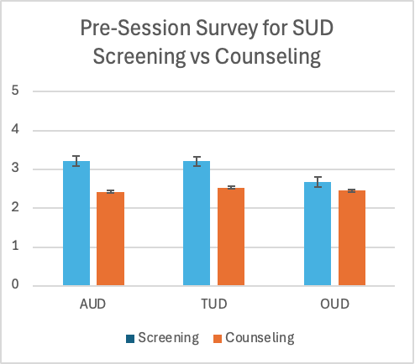
Outcomes
Students were more confident screening for AUD and TUD compared with OUD (p<0.05).
Students with less confident counseling using harm reduction strategies for all three substances with p<0.05 for AUD and TUD.
Notes:
Students were less confident in screening for opioid use disorder (2.67) compared to alcohol use disorder (3.21) and tobacco use disorder (3.21) (p<0.05)
Students were less confident counseling using harm reduction strategies when compared with screening for substance use disorders (p<0.05)
TUD 3.21, 2.52 (p<0.05)
AUD 3.21, 2.46 (p<0.05)
OUD 2.67, 2.46 (not significant)

Slide 17
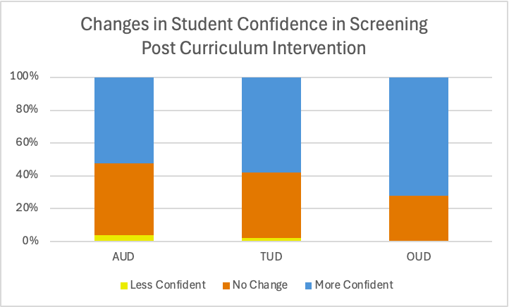
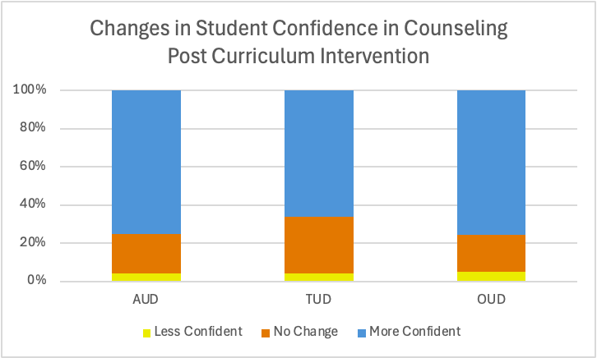
Outcomes
Screening
Counseling using Harm Reduction

Slide 18
Conclusions and Looking Ahead
There is a clear gap in medical education surrounding harm reduction and substance use disorder counseling.
Early integration into Health Systems Science course during first year curriculum
Longitudinal exposure to harm reduction throughout four years
Using student feedback to fine tune counseling curriculum day

Slide 19
References
Gugala, E., Briggs, O., Moczygemba, L. R., Brown, C. M., & Hill, L. G. (2022). Opioid Harm Reduction: A Scoping Review of Physician and System-Level Gaps in Knowledge, Education, and Practice. Substance Abuse, 43(1), 972–987. https://doi.org/10.1080/08897077.2022.2060423
Smith, K. R., Shah, N. K., Adamczyk, A. L., Weinstein, L. C., & Kelly, E. L. (2023). Harm reduction in undergraduate and graduate medical education: A systematic scoping review. BMC Medical Education, 23(1), 986. https://doi.org/10.1186/s12909-023-04931-9

