Slide 1

Changes in Buprenorphine Prescribing Among Pregnant and Postpartum Individuals Following Postpartum Medicaid Extension in South Carolina
AMERSA 2024 Conference
Kristin Prewitt MD MPH, Megan Fuerst MD MPH, Ximena Levander MD, Maria Rodriguez MD MPH
Oregon Health & Science University
Notes:
Kristin

Slide 2
No disclosures
Notes:
Kristin

Slide 3
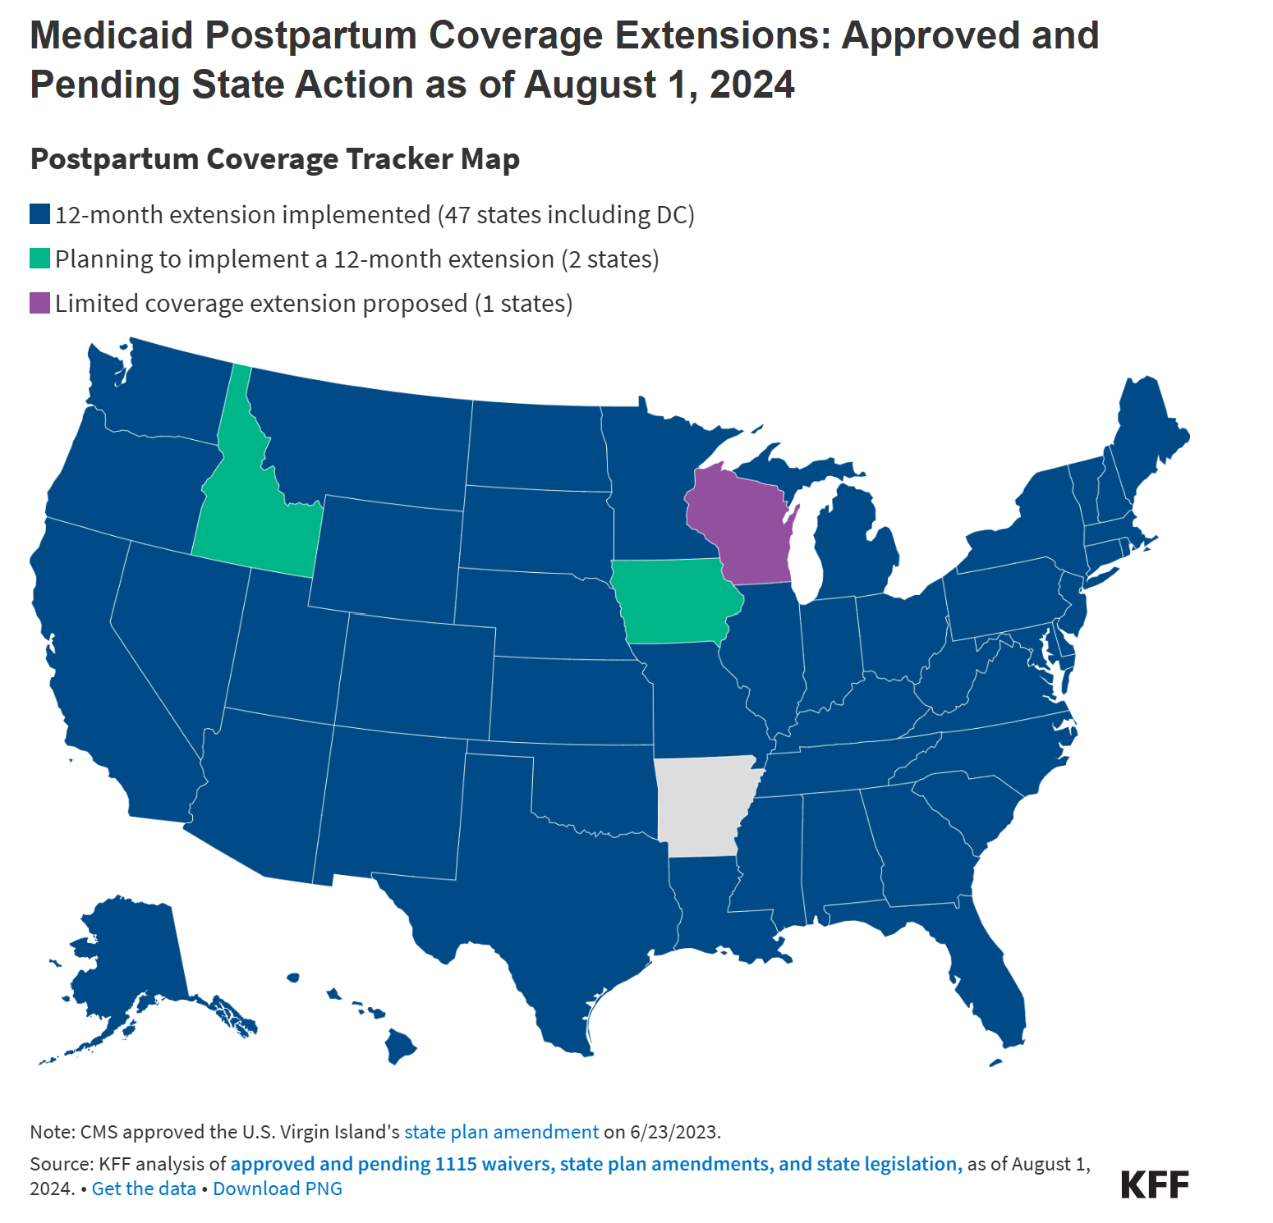
Medicaid covers approximately 40% of births with expanded coverage for low-income individuals
Standard pregnancy-related Medicaid coverage ends at 60 days postpartum leaving many un- or under-insured
Notes:
Kristin
Medicaid covers approximately 40% of births with expanded coverage for low-income individuals
Standard pregnancy-related Medicaid coverage ends at 60 days postpartum leaving many un- or under-insured
Many states have begun to extend Medicaid coverage to 1-year postpartum but the impact of these policies on tangible health outcomes is unknown

Slide 4

March 18, 2020
Notes:
Kristin
During COVID, we had an early window to the potential impact of postpartum Medicaid extension policies. The family first coronavirus response act or FFCRA passed March 18, 2020 allowed Medicaid enrolled inviduals to stay enrolled in their current health plan through the end of the public health emergency

Slide 5

Did the implementation of the FFCRA in South Carolina change buprenorphine prescribing among pregnant and postpartum Medicaid-enrolled individuals?
Notes:
Kristin
As such, we thought to study if the implementation of the FFCRA in South Carolina (a Medicaid non-expanded state) changed buprenorphine prescribing among pregnant & postpartum individuals

Slide 6
Methods
Linked Medicaid, Birth certificate & pharmacy dispensing data from January 1st, 2015 through December 30th, 2022
Included only those with a diagnosis code of opiate use disorder
Analyzed receipt of buprenorphine at 4 distinct time periods (pregnancy, 0-60 days postpartum, 60 days to 6 months postpartum, 6-12 months postpartum)
Secondary analysis to look at opiate related deaths and overdoses and characteristics of those not enrolled in MOUD
Notes:
Megan

Slide 7
Results (N=2,633)
Pre-Policy
N=1,854 (70.4%)
Similar demographic factors between groups including race, parity & pregnancy complications
Post-Policy
N=779 (29.6%)
Notes:
Megan
In total, 2600 included in our study – and the split reflected the longer amount of time in the pre-policy period ( 5 years pre-policy vs 2 years of post-policy data)
Only differences were in age (post-policy 29.5 verus pre-policy 28.5 -- likely not clinically significant)
Higher NICU admissions in post-policy (22.6 versus 17.65%)

Slide 8
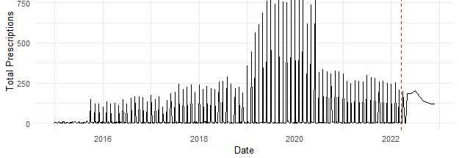
How did buprenorphine prescribing change over time?
Notes:
Megan
In our study time period, there was an overall trend of increased bup prescriptions – especially at the height of the COVID pandemic
Therefore instead of overall prescription rates, we focused on the proportion of those with an OUD disorder receiving therapy

Slide 9
Proportion of individuals with OUD receiving buprenorphine prescription (N=2,633)
 | Pre-Policy | Post-Policy | P-value for chi-squared
During Pregnancy | 214 (11.5%) | 152 (19.5%) | <0.001
0-2 months PP | 119 (6.4%) | 60 (7.7%) | 0.65
2-6 months PP | 155 (8.5%) | 79 (10.1%) | 0.009
6-12 months PP | 180 (9.7%) | 71 (9.1%) | 0.65
Notes:
Megan
Looking at proportion with basic chi-squared tests for pre and post policy, we can see…

Slide 10
Proportion of individuals with OUD receiving buprenorphine prescription (N=2,633)
 | Pre-Policy | Post-Policy | P-value for chi-squared
During Pregnancy | 214 (11.5%) | 152 (19.5%) | <0.001
0-2 months PP | 119 (6.4%) | 60 (7.7%) | 0.65
2-6 months PP | 155 (8.5%) | 79 (10.1%) | 0.009
6-12 months PP | 180 (9.7%) | 71 (9.1%) | 0.65
Notes:
Megan
That difference DURING pregnancy but not during the key delayed PP periods when you would expect to see a change there was a significant increase in the proportion of individuals receiving any buprenorphine prescription

Slide 11
ITS Analysis for proportion (%) of individuals with OUD receiving any buprenorphine prescription by month pre and post policy during different pregnancy and postpartum time periods (N=2,633)
 | ITS Estimate | p-value | 95% CI
Total | 0.4 | <0.001 | 0.01-0.89
During pregnancy | 0.8 | <0.001 | 0.04-1.2
0-60 days PP | 0.5 | 0.05 | 0.02-0.94
60 days – 6 months | -0.2 | 0.75 | -0.45 to + 0.82
Notes:
Megan
This table shows the results of our interrupted time series analysis or ITS which is a form of longitudinal analysis looking at the impact of a policy over time also able to adjust for external factors

Slide 12
ITS Analysis for proportion (%) of individuals with OUD receiving any buprenorphine prescription by month pre and post policy during different pregnancy and postpartum time periods (N=2,633)
 | ITS Estimate | p-value | 95% CI
Total | 0.4 | <0.001 | 0.01-0.89
During pregnancy | 0.8 | <0.001 | 0.04-1.2
0-60 days PP | 0.5 | 0.05 | 0.02-0.94
60 days – 6 months | -0.2 | 0.75 | -0.45 to + 0.82
Notes:
The ITS estimates looks at the proportion increase by month in the post-policy period – we can see a small rise during pregnancy and in the immediate postpartum period but the difference was overall nominal when thinking about clinical outcomes

Slide 13
Proportion (%) of adequate prescription or prescription that would cover > 15 days per month (N=1,039)
 | Pre-Policy | Post-Policy | P-value
During Pregnancy | 36.9% | 32.9% | 0.44
0-2 months PP | 46.2% | 41.7% | 0.64
2-6 months PP | 38.1% | 58.2% | 0.004
6-12 months PP | 40% | 65.8% | <0.001
Notes:
Kristin
Here we’re only looking at those who received bup – so about half of the total study population
We considered those as having “adequate treatment” or being dispensed the amount of buprenorphine to cover at least 15 days per month

Slide 14
Proportion (%) of adequate prescription or prescription that would cover > 15 days per month (N=1,039)
 | Pre-Policy | Post-Policy | P-value
During Pregnancy | 36.9% | 32.9% | 0.44
0-2 months PP | 46.2% | 41.7% | 0.64
2-6 months PP | 38.1% | 58.2% | 0.004
6-12 months PP | 40% | 65.8% | <0.001
Notes:
Here, we did see a difference in the delayed PP period among individuals who received adequate buprenorphine prescriptions
What this shows is that even though the proportion of those receiving any treatment was low (around 10% for this time period as previously mentioned) – there is a subset of individuals who may have benefited from the PP Medicaid extension by being able to receive adequate coverage

Slide 15
Did individuals continue therapy initiated during pregnancy and early postpartum?
Notes:
Megan
In theory, PP Medicaid extension should make it easier for pregnant individuals to continue therapy into the PP period and beyond

Slide 16
Not really…
Continuation rates were low (less than 3%) between time periods and no participants received a buprenorphine prescription in all 4 time periods.
Did individuals continue therapy initiated during pregnancy and early postpartum?
Notes:
Megan
However – continuation rates were very low in our population – at less than 3% for those who started bup during pregnancy and continued through the 1st year PP

Slide 17

There was a statistically significant increase in overdose related admissions (10.1 versus 5.7%) in the post-policy period. The majority of these occurred between 6 and 12 months postpartum.
Notes:
Megan
The overdose related admissions doubled in the PP period – this is likely largely related to poor health access during the COVID-19 pandemic and increasing rates of SUD during this time frame
The majority of admissions were in the delayed PP period again showcasing the high vulnerability of this time

Slide 18
Limitations
Cannot measure prescriptions outside the Medicaid system
Notes:
Kristin
Our study has several important limitations
However methadone not covered by Medicaid in 2019 and bup morecommon in pregnancy
Bigger issue is how LITTLE it is prescribed – people taking it is a whole other story

Slide 19
Limitations
Cannot measure prescriptions outside the Medicaid system
Only studied buprenorphine treatment and not other MOUD (eg: Methadone)
Notes:
Kristin
However methadone not covered by Medicaid in 2019 and bup morecommon in pregnancy
Bigger issue is how LITTLE it is prescribed – people taking it is a whole other story

Slide 20
Limitations
Can measure prescription dispensing but not if the medication was taken as prescribed
Cannot measure prescriptions outside the Medicaid system
Only studied buprenorphine treatment and not other MOUD (eg: Methadone)
Notes:
Kristin
However methadone not covered by Medicaid in 2019 and bup morecommon in pregnancy
Bigger issue is how LITTLE it is prescribed – people taking it is a whole other story

Slide 21
Following postpartum extension of Medicaid, there was little to no change in buprenorphine prescribing in the delayed postpartum period.
Notes:
Kristin

Slide 22
Buprenorphine coverage was inconsistent with low continuation rates. However, among those who received buprenorphine in the delayed postpartum period, there was an increase in adequate monthly coverage.
Notes:
Kristin

Slide 23
As more states are looking to expand Medicaid to 1 year postpartum, it’s important we understand the limitations of policy on tangible access to MOUD and broaden focus to multifactorial barriers to care.
Notes:
Kristin

Slide 24
Questions?
Contact
Kristin Prewitt prewittk@ohsu.edu
Megan Fuerst fuerstm@ohsu.edu
Notes:
Kristin

Slide 25
Average # of days of buprenorphine supplied per month (N=1,039)
 | Pre-Policy | Post-Policy | P-value
During Pregnancy | 19.2 (10.1) | 16.6 (10.5) | 0.001
0-2 months PP | 17.7 (10.8) | 15.4 (9.9) | 0.15
2-6 months PP | 17.6 (10.5) | 18.6 (10.6) | 0.5
6-12 months PP | 18.6 (10.6) | 20.9 (9.8) | 0.12
Notes:
Kristin
We then decided to zero in on those who did receiving treatment which were about half of the individuals in our OUD group sample – we first looked at of those receiving prescriptions, what were the average # of days received per month
First, you can see that it was overall quite low

Slide 26
Average # of days of buprenorphine supplied per month (N=1,039)
 | Pre-Policy | Post-Policy | P-value
During Pregnancy | 19.2 (10.1) | 16.6 (10.5) | 0.001
0-2 months PP | 17.7 (10.8) | 15.4 (9.9) | 0.15
2-6 months PP | 17.6 (10.5) | 18.6 (10.6) | 0.5
6-12 months PP | 18.6 (10.6) | 20.9 (9.8) | 0.12
Notes:
Again decrease during pregnancy – possibly related to COVID
But – no change in the delayed PP group where individuals have insurance who wouldn’t have in the pre-policy group

