Slide 1
Clinicians’ Perceptions and Practices of Urine Drug Testing in Buprenorphine Treatment
Isabel Lamont¹
Mariya Masyukova²
Andrea Jakubowski¹
Shadi Nahvi¹
Tiffany Lu¹
Teresa Lopez-Castro³
Yuting Deng¹
¹ Montefiore Hospital/Albert Einstein College of Medicine
² Project Renewal
³ The City College of New York, CUNY
Notes:
Hi everyone, my name is Isabel Lamont and I’m thrilled to present our research with my colleague Mariya Masyukova here at AMERSA 2023.
**take out titles***

Slide 2
No conflicts to disclose.
Notes:
We have no conflicts to disclose, so let’s get started.

Slide 3
Background
Drug testing, especially urine drug testing (UDT), is common practice in outpatient buprenorphine treatment.
UDT has limited accuracy and precision (false-positives/-negatives, difference between qualitative and quantitative testing)
Clinical use of UDT varies widely
Providers often require patients to do UDT but rarely document speaking to patients about its pros and cons.
Notes:
Urine drug testing is standard practice for providers in outpatient buprenorphine treatment. Though common practice, UDT has limited accuracy and precision.
For example, UDT can give false positives and negatives, and accuracy differs between qualitative, or immunoassay, testing and quantitative, or confirmatory, testing. Clinical use of UDT also varies widely among providers.
While providers usually require UDT for their patients, they rarely document speaking to them about its pros and cons.
Feels very general; when aims come, doesn’t feel like it fits.
More setting up
What is the gap in the research/practice

Slide 4
Background
Confirm bupe adherence
Detect diversion
Monitor non-prescribed substance use
Patient distress
Treatment discontinuation
Criminal-legal system repercussions
Notes:
Urine drug testing can be a useful tool for providers to confirm a patient’s adherence to bupe, detect possible diversion, and monitor a patient’s non-prescribed substance use. However, urine drug testing can also pose significant risks to patients. These include patients feeling stigmatized and not returning to follow-up care and providers discontinuing buprenorphine treatment based on UDT results. Possible legal harms of UDT include parole violations, which increase risk of re-incarceration, or reports to child protective services, which can lead to family separation and loss of support.
UDT has limited accuracy and precision that is largely dependent on, which can result in false-positives and negatives. [Talk about quant/qual testing]
Guidelines for informed consent and mitigation of legal harms are largely absent from published clinical guidance for UDT implementation in OUD treatment.
(false-positives/-negatives, difference between qualitative and quantitative testing)
Too much background?
Added the first 4ish points.

Slide 5
Study Aims
How do clinicians across New York State incorporate (urine) drug testing (UDT) into buprenorphine treatment and clinical decision-making?
What are NYS clinicians’ perceptions of risks vs. benefits of UDT for their specific patients?
Notes:
We sought to assess UDT practices in buprenorphine providers across New York State, especially how providers apply UDT to their treatment practice and clinical decision-making.
Our research also examines provider perceptions of UDT risks and benefits for their specific cohort of patients.

Slide 6
Methods: Participants
Online survey sent to New York-based buprenorphine treatment clinicians (prescribers and non-prescribers)
Disseminated to:
Montefiore Buprenorphine Treatment Network clinician listserv
New York Society for Addiction Medicine member listserv
Eligibility: providers who are involved in delivering buprenorphine care for people with OUD
Included RN, MD/DOs, NPs, PAs, social workers, pharmacists
Notes:
Participants
Methods: Measures
We sent out an online survey to New York-based buprenorphine treatment providers. We disseminated the provider survey to institutional and professional listservs that include bupe clinicians. The only eligibility criteria was that the provider be involved with the delivery of bupe care for people with OUD, so we received responses from prescribers as well as non-prescribing providers.
Try to be brief here as well. NY-based bupe clinicians. Survey included quant and free-text elements. Disseminated to institutional and professional listservs that include bupe clinicians.

Slide 7
Methods: Measures
45 questions
33 quantitative,
3 demographic
6 free-text short answer
3 optional - lived experience
Responses collected from September 2022 to December 2022

Slide 8
Methods: Analysis
Rapid qualitative analysis for free-text responses
Domains based on short answer questions
Subdomains based on provider attitude towards UDT
Codes → Repeating Ideas → Themes → Synthesis
Notes:
Methods: Analyses
Put in text form, bullet form
We analyzed the free-text responses using rapid qualitative analysis. We broadly organized ideas into several domains, which were based on the short-answer questions.
Example domains include how UDT helps clinicians provide clinical care, how providers think patients have benefitted from UDT, and provider experiences of patient negative outcomes related to UDT.
We organized each domain into positive, neutral, and negative subdomains that measured provider attitude towards UDT and will be presenting representative quotes from the analysis.

Slide 9
Results
Notes:
Now, let’s get into the results from the survey.

Slide 10
Sample Characteristics (n= 99)
Sample characteristic
Age, mean | 49 years
Gender | Cisgender women Cisgender men Non-binary people Transgender man | 52% 37% 2% 1%
Race/ethnicity | White Black or African American Hispanic/Latinx Asian | 71% 4% 9% 12%
Position | Physician (MD, DO) Physician Assistant (PA) Nurse Practitioner (NP) Registered Nurse (RN) Social Worker (LMSW, LCSW) Pharmacist (PharmD or equivalent) | 70% 7% 9% 9% 3% 1%
Notes:
Our sample has an average age of 49 years and was half cisgender women, mostly white, and mostly physicians. However, physician assistants, nurse practitioners, registered nurses, social workers, and pharmacists were also included in our sample.

Slide 11
Clinical Practices and Protocols
Clinicians were… | % of Respondents
Expected/not required to perform drug testing | 61%
Aware of clinical protocol re: when to perform UDT | 57%
Aware of clinical protocol re: consent to UDT from patients. | 45%
Aware of guidance about releasing drug test results to non-medical agencies when requested | 24%
Notes:
In assessing the clinical practices and protocols that providers received on drug testing, we found that most respondents were expected to do drug testing, but less than half of respondents have clinical protocol for consenting patients for drug testing.
Less than one-fourth of respondents received any guidance on disclosing drug test results to non-medical agencies.

Slide 12
High risk patients
Providers recently worked with patients who: | % of respondents:
Are under parole/probation | 67%
Have been arrested/incarcerated during treatment | 61%
Have an open family-legal case | 57%
Are pregnant | 49%
Notes:
We asked providers to report how many patients they recently took care of that have certain risk factors. Most providers recently worked with patients who are under parole or probation, patients who were incarcerated during treatment, and patients who had an open family-legal case. About half of respondents recently took care of pregnant patients.

Slide 13
Table 1: Type of drug testing providers use in buprenorphine care (substance/modality)
Substance | Immunoassay Screening | GC/MS Confirmatory Screening
Buprenorphine | 94% | 62%
Opiates | 97% | 42%
Oxycodone | 93% | 43%
Heroin | 89% | 44%
Morphine | 91% | 35%
Methadone | 92% | 32%
Fentanyl | 86% | 51%
Cocaine | 95% | 39%
Amphetamines | 93% | 38%
THC/cannabinoids | 94% | 31%
Benzodiazepines | 92% | 44%
Phencyclidine/PCP | 86% | 32%
Alcohol | 84% | 32%
Notes:
Add “animations” left side vs. right side
Take out tramadol, barbiturates
Take-home point: Lots of qualitative testing being done, but a comparatively small % is confirmed. High rate of false positives.
Higher false-positive rates expected in screens for amphetamines (e.g. trazodone), buprenorphine (hydroxychloroquine, levofloxacin, trimethoprim).
Methadone: diphenhydramine, quetiapine, verapamil
https://www.ncbi.nlm.nih.gov/pmc/articles/PMC7055671
https://tipqc.org/wp-content/uploads/2019/09/ajhp1344.pdf

Slide 14
Table 1: Type of drug testing providers use in buprenorphine care (substance/modality)
Substance | Immunoassay Screening | GC/MS Confirmatory Screening
Buprenorphine | 94% | 62%
Opiates | 97% | 42%
Oxycodone | 93% | 43%
Heroin | 89% | 44%
Morphine | 91% | 35%
Methadone | 92% | 32%
Fentanyl | 86% | 51%
Cocaine | 95% | 39%
Amphetamines | 93% | 38%
THC/cannabinoids | 94% | 31%
Benzodiazepines | 92% | 44%
Phencyclidine/PCP | 86% | 32%
Alcohol | 84% | 32%
Notes:
Add “animations” left side vs. right side
Take out tramadol, barbiturates
Take-home point: Lots of qualitative testing being done, but a comparatively small % is confirmed. High rate of false positives.
Higher false-positive rates expected in screens for amphetamines (e.g. trazodone), buprenorphine (hydroxychloroquine, levofloxacin, trimethoprim).
Methadone: diphenhydramine, quetiapine, verapamil
https://www.ncbi.nlm.nih.gov/pmc/articles/PMC7055671
https://tipqc.org/wp-content/uploads/2019/09/ajhp1344.pdf

Slide 15
Table 1: Type of drug testing providers use in buprenorphine care (substance/modality)
Substance | Immunoassay Screening | GC/MS Confirmatory Screening
Buprenorphine | 94% | 62%
Opiates | 97% | 42%
Oxycodone | 93% | 43%
Heroin | 89% | 44%
Morphine | 91% | 35%
Methadone | 92% | 32%
Fentanyl | 86% | 51%
Cocaine | 95% | 39%
Amphetamines | 93% | 38%
THC/cannabinoids | 94% | 31%
Benzodiazepines | 92% | 44%
Phencyclidine/PCP | 86% | 32%
Alcohol | 84% | 32%
Notes:
Add “animations” left side vs. right side
Take out tramadol, barbiturates
Take-home point: Lots of qualitative testing being done, but a comparatively small % is confirmed. High rate of false positives.
Higher false-positive rates expected in screens for amphetamines (e.g. trazodone), buprenorphine (hydroxychloroquine, levofloxacin, trimethoprim).
Methadone: diphenhydramine, quetiapine, verapamil
https://www.ncbi.nlm.nih.gov/pmc/articles/PMC7055671
https://tipqc.org/wp-content/uploads/2019/09/ajhp1344.pdf

Slide 16
How do providers respond to UDT results?

Slide 17
Provider response when urine drug screen is positive for non-prescribed opioids
Naloxone was dispensed or prescribed
59% of respondents
Buprenorphine dose was increased
45% of respondents
Plan did not change
33% of respondents
Notes:
When providers received a urine drug screen that is positive for non-prescribed opioids, 59% dispense or prescribe Naloxone to the patient. A little less than half of respondents increase the patient’s buprenorphine dose, and a third of respondents do not alter the patient’s treatment plan at all.
**think of repeating themes to highlight with oral presentation, add a little bit of valence, link continuity of results,

Slide 18
Provider response when urine drug screen is positive for cocaine or (meth)amphetamines
Naloxone was dispensed or prescribed
35% of respondents
Fentanyl test strips were dispensed
29% of respondents
Notes:
For a urine drug screen result that is positive for cocaine or methamphetamines, 35% of respondents dispense or prescribe naloxone, while less than third of providers give the patient fentanyl test strips.

Slide 19
Provider response when urine drug screen is negative for buprenorphine
Patient’s goals for treatment were discussed
74% of respondents
Naloxone was dispensed or prescribed
27% of respondents
Buprenorphine was discontinued
19% of respondents
Notes:
Most respondents reported that when they receive a UDT result that is negative for buprenorphine, they discuss the patient’s treatment goals.
Only 27% of providers gave naloxone to patients with bupe-negative results. 19% discontinued buprenorphine when they receive buprenorphine-negative results.

Slide 20
How do providers perceive the risks and benefits of UDT?
Notes:
We looked at how providers assess the risks and benefits of urine drug testing by analyzing the free-text responses.

Slide 21
Theme: UDT is more “objective” than patient report
”[Drug testing] helps me understand what is happening with the patient - sometimes patients feel ashamed to admit that they used."
”[Drug testing] helps me to educate patients on what they are actually using and therefore treat them accordingly."
Notes:
A key theme that emerged from the free-text responses was that providers find clinical value in the “objectivity” of urine drug test results, especially when compared to their patient’s self-report. (read quotes) Using UDT as objective patient data, providers feel comfortable modifying the patient’s treatment plan based on their UDT results.
Include analysis framework before quotes – how analyze
Set up how qual data was sought

Slide 22
Theme: Drug testing represents surveillance or punishment.
“Some of my colleagues use a random, automated call back system. This is viewed by many patients as coercive and punitive. I do not participate in this system.”
“[UDT can lead to] punitive management like stopping care/access to suboxone”
Notes:
Another theme from the short answer responses was that providers are aware that UDT can be viewed as punitive in nature by their patients. (read quotes)
Look for quote for theme “UDT done with punitive intent”– look for theme
Patients received punitive sanctions (e.g. jail time) in response to drug test done by parole/probation, but not when test done in the medical office.

Slide 23
Limitations
Our sample population of buprenorphine providers across NYS may not generalize to other samples
The provider survey only assesses provider perspectives, not patient perspectives
Further research is needed for patient perspective of UDT
Notes:
Added methodological limitations, talking specifically about the way that we had different ‘n’s’ for many of the questions – this was to facilitate participants finishing the survey

Slide 24
Conclusions
Wide variation but limited protocol/guidance about testing, interpretation, results reporting
Clinicians routinely care for patients who are structurally vulnerable to harms resulting from drug testing.
Clinical implementation of drug testing varies widely
Clinical responses to drug test results vary widely and are not always consistent with evidence-based, harm reduction practices.

Slide 25
Implications
Lack of specific guidance for UDT leaves opportunities for systemic and individual bias across settings.
Response to results of UDT must be patient-centered and consistent with evidence-based practice.
Clinicians are aware that UDT may remind patients of carceral experiences
Notes:
Having trouble thinking of implications from the specific data we presented
Qualitative work on patient perspectives on drug testing is being conducted

Slide 26
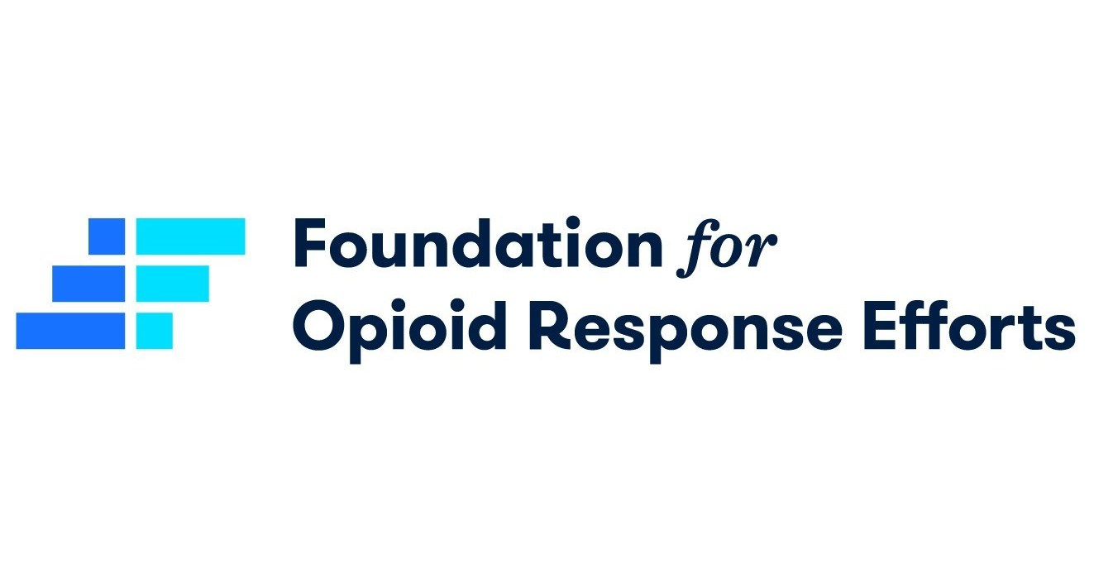
Acknowledgements
Our participants
Montefiore Buprenorphine Treatment Network
Our funders:
Our Research Team:
Andrea Jakubowski¹, MD, MS
Shadi Nahvi¹, MD, MS
Tiffany Lu¹, FASAM, MD, MPH, MSc
Teresa Lopez-Castro³, PhD
Yuting Deng¹
Thank you to Montefiore Division of General Internal Medicine Substance Use Research Affinity Group
Notes:
Add DGIM Substance Use Research Affinity Group

Slide 27
Extra slides

Slide 28
ALTERNATIVE TO PRIOR SLIDE Sample Characteristics (n= 99)
Table 1: Clinician survey participant demographics*
Age | 30-80 years old (average 49 years)
Gender | 37 (52%) cisgender women, 26 (37%) cisgender men, 2 (2%) non-binary people, 1 (1%) transgender man, 2 (2%) preferred not to answer.
Race/Ethnicity | 54 (71%) white, 3 (4%) Black or African American, 7 (9%) Hispanic/Latinx, 9 (12%) Asian, 3 (4%) “other”
Position | 68 (70%) Physician (MD, DO) 7 (7%) Physician Assistant (PA) 9 (9%) Nurse Practitioner (NP) 9 (9%) Registered Nurse (RN) 3 (3%) Social Worker (LMSW, LCSW) 1 (1%) Pharmacist (PharmD or equivalent)
History of substance use | 22 people (32%) identified as a person with lived experience of substance use.
History of substance use disorder/in recovery | 7 people (10%) identified as a person with lived experience of substance use disorder; 7 people (10%) “in recovery”
Practice setting | 59% at outpatient primary care/medical clinics 17% at outpatient substance use disorder (SUD) treatment programs 7% outpatient mental health/psychiatry clinics 10% opioid treatment programs 13% inpatient SUD rehab/residential treatment 16% hospital 2% emergency department 3% correctional setting (e.g., jail, prison).

Slide 29
Notes:
I think if we include this slide, we should change the title to say: Number of pregnant patients per clinician in a 12-month period … or % of clinicians with this many pregnant patients? I’m confused and don’t have access to Qualtrics. Either I’ll get back into Qualtrics, or we can scrap this slide =]

Slide 30
Table 3: Provider response when urine drug screen is positive for non-prescribed opioids
Provider/Team Response | % of Respondents | Count
Patient was asked about the test result | 75% | 55
Patient’s goals for treatment were discussed | 77% | 56
Strategies for safer drug use were discussed | 62% | 45
Naloxone was dispensed or prescribed | 59% | 43
Visit frequency was increased | 52% | 38
Strategies for preventing drug use were discussed | 48% | 35
Buprenorphine dose was increased | 45% | 33
Fentanyl test strips were dispensed | 36% | 26
Drug test frequency was increased | 19% | 14
Patient was informed buprenorphine may be discontinued for repeat opioid-positive test results | 10% | 7
Referral was made* | 19% | 14
Other modification of treatment plan** | 14% | 10
Plan did not change | 33% | 24
*Referral specifications: CASAC, outpatient program, “higher level of care,” rehab, inpatient, methadone program **Treatment plan modifications: addressed mental health issues, discussed DBT skills for psychological triggers, discussed adjunctive supports to participate in such as a peer support group
Notes:
A third of instances of +non-prescribed opioids: plan did not change.
Not enough people are dispensing/prescribing naloxone.
Less than half are increasing buprenorphine dose.

Slide 31
Table 4: Provider response when urine drug screen is positive for cocaine or (meth)amphetamines
Provider/Team Response | % of Respondents | Count
Patient was asked about the test result | 75% | 54
Patient’s goals for treatment were discussed | 71% | 51
Strategies for safer drug use were discussed | 61% | 44
Naloxone was dispensed or prescribed | 35% | 25
Visit frequency was increased | 39% | 28
Strategies for preventing drug use were discussed | 51% | 37
Fentanyl test strips were dispensed | 29% | 21
Patient was informed buprenorphine may be discontinued for repeat stimulant-positive test results | 4% | 3
Referral was made* | 19% | 14
Other modification of treatment plan** | 13% | 9
Plan did not change | 42% | 10
*Referral specifications: outpatient drug treatment, “higher level of care,” inpatient rehab, “relevant mental health or subspecialty medical provider” **Treatment plan modification: “MAT for cocaine,” “asked what the drug did for them and would try medical counseling treatment for the issue,” “discussed adjunctive supports such as peer support groups,” “psych issues addressed”
Notes:
The quality of our testing is only as good as the quality of response to testing. Considering the increases in stimulant-involved mortality, if we are detecting stimulants when testing but mostly not responding with risk reduction tools, what is the actual point of testing?

Slide 32
Free-Text responses: Qualitative analysis
Responses to open-ended questions:
What are the ways that your patients have benefitted from drug testing?
What are the ways that your patients have experienced unwanted, unanticipated, or negative consequences of drug testing?
When (if ever) do you choose not to require a patient to do drug testing?
Has a patient under your care ever declined to do a drug test? (55% ”Yes”)
If "Yes," what did you do when a patient declined to do a drug test?
Please describe any recent challenges you have experienced in ordering, collecting, discussing, or documenting drug tests in buprenorphine management.
Thematic analysis: codes → repeating ideas → themes → synthesis

Slide 33
Free-text response framework
Levels of “Care” | Valence of Clinician Attitude Toward UDT
 | Positive Domain | Neutral Domain | Negative Domain
Patient | Test result may help patient self-assess drug use risk by identifying contaminants (e.g. fentanyl). Some patients receptive to testing if clearly discussed. | UDT may not actually help patients | Patients express distress/ negative emotions about UDT (frustration, anger, anxiety, feeling judged), and do not agree with negative consequences (e.g. prescription termination). Negative legal consequences for pt (going to jail, having children taken away).
Provider | Some providers view drug test results as more “objective” data than patient self-report, and are comfortable modifying treatment plan. | Some providers not sure how to interpret conflicting test results and patient report. | Some providers frustrated with colleagues who misinterpret test results, leading to negative patient consequences.
Patient-Provider Relationship | Testing and discussion of result “opens conversation”. “Patient-driven” drug testing. | Drug test as a negotiating tool. Prescription termination disrupts therapeutic alliance, despite being ”the right thing to do”. | Adds conflict and time to clinical visit. Stigmatizing to ask for urine and to discuss results. Challenging to discuss results that may result in treatment discontinuation.
Clinical Decision Making | Result helps determine if benefits of buprenorphine outweigh risks. | Collect test only if changes management in a particular visit. Sometimes test result does not change management. | Drug testing is flawed (inaccurate, slow turnaround time, missing results, useful tests not available). Documented drug test results may perpetuate bias against patient.
Provider-Staff Relationships | Doing drug testing for every patient, every provider, every visit, to avoid the appearance of favoritism. | Variability in staff/clinician practices. | Conflict arises when diversion is suspected based on test results.
Clinic/Program/ Medical System | Protocols to reschedule or repeat drug test if missed. Increase frequency of visits, decreased prescription duration, more frequent drug tests, if test results not consistent with expectations/goals. | Some providers allow patients to decline testing without negative consequences. | Some providers use drug testing as a way to protect clinic and project accountability.
Provider Perception of Patient | Drug testing exposes patients “in denial”. | Presumed “positive”/aberrant if pt declines test. | Drug testing perpetuates stigma and bias. Some providers find patient self-report sufficient without having to do drug testing.
Community | Drug test results shed light on drug adulterants and contaminants in the community. |  | Tests showing diversion may not be a concern, because diverted buprenorphine is being used by people who need it.
Outside (i.e. legal) agencies | Some providers have never been asked by parole officer or court to provide results. Testing may demonstrate favorable results that positively impact outside agency’s decisions. | Patients received punitive sanctions (e.g. jail time) in response to drug test done by parole/probation, but not when test done in the medical office. | Law enforcement/drug courts punish patients for fentanyl-positive tests due to misinterpretation of timing/result. Punishment, negative legal consequences. Grave psychosocial consequences. Some staff honor law enforcement requests over patient preferences.

Slide 34
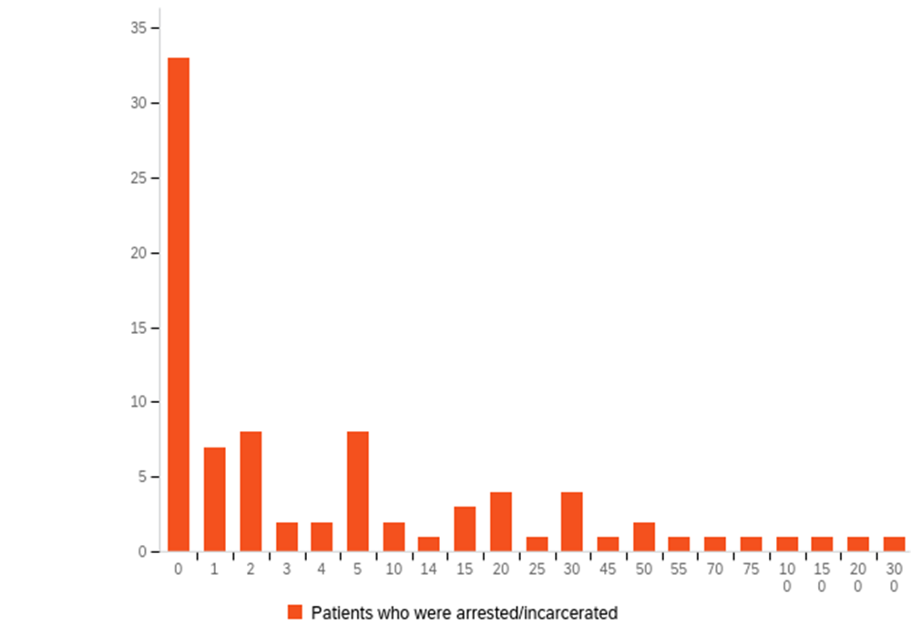
Patients arrested and/or incarcerated in last 12 months
Notes:
Isabel

Slide 35
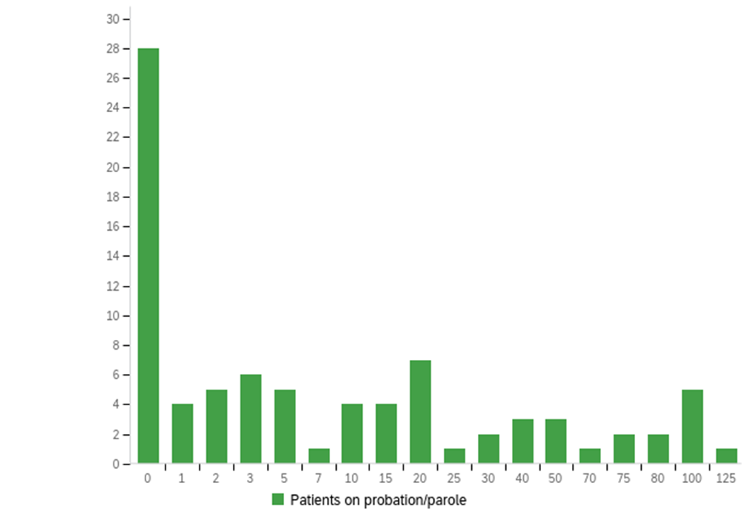
Number of patients on parole/probation (by respondent, in a 12-month period)
Notes:
Isabel

Slide 36
additional emerging themes
Carceral / punitive nature of UDT | COVID-19 pandemic and telemedicine | Conflicting attitudes toward patient autonomy
-Allusions to carceral systems in multiple responses. -Assuming unwanted or aberrant result if patient declines test. -Some providers view all drug use as problematic or pathological. -Use of the drug test itself as a punishment/negative reinforcer, vs. rewarding patients with fewer drug tests. “[Drug testing] feels punitive and carceral.” | -Overall, reports of drug testing decreasing during COVID-19 pandemic. “We still do many telehealth visits and those do not require testing.” -Some drug testing consequences persist in pandemic-era telehealth practices: patients still required to come in to provide sample for drug test; ‘noncompliance’ still results in withheld buprenorphine prescription. | -Drug test results determine intensity of treatment or “level of care”. -Some providers recognize that this may violate patient autonomy, preferences, or goals. ”[drug testing] helps open discussion about substance use that the patient may be reluctant to initiate for fear of unwanted treatment changes.”
Notes:
We may not have room for this slide.

Slide 37
Level of "Care" | Positive Domain | Neutral Domain | Negative Domain
Community​ | Drug test results shed light on drug adulterants and contaminants in the community. ​ | ​ | Tests showing diversion may not be a concern, because diverted buprenorphine is being used by people who need it. ​

Slide 38
Level of "Care" | Positive Domain | Neutral Domain | Negative Domain
Outside (i.e. legal) agencies​ | Some providers have never been asked by parole officer or court to provide results. ​ Testing may demonstrate favorable results that positively impact outside agency’s decisions.​ | Patients received punitive sanctions (e.g. jail time) in response to drug test done by parole/ probation, but not when test done in the medical office. ​ | Law enforcement/drug courts punish patients for fentanyl-positive tests due to misinterpretation of timing/result.​ Punishment, negative legal consequences. Grave psychosocial consequences. ​ Some staff honor law enforcement requests over patient preferences.​

Slide 39
Level of "Care" | Positive Domain | Neutral Domain | Negative Domain
Provider​ | Some providers view drug test results as more “objective” data than patient self-report, and are comfortable modifying treatment plan.​ | Some providers not sure how to interpret conflicting test results and patient report. ​ | Some providers frustrated with colleagues who misinterpret test results, leading to negative patient consequences. ​

Slide 40
Notes:
Is the X axis the % of respondents or # of respondents?

Slide 41
Table 4: Provider response when urine drug screen is negative for buprenorphine
Provider/Team Response | % of Respondents | Count
Patient was asked about the test result | 78% | 57
Patient’s goals for treatment were discussed | 74% | 54
Strategies for safer drug use were discussed | 33% | 24
Naloxone was dispensed or prescribed | 27% | 20
Visit frequency was increased | 38% | 28
Strategies for preventing drug use were discussed | 30% | 22
Buprenorphine was discontinued | 19% | 14
Drug test frequency was increased | 16% | 12
Patient was informed buprenorphine may be discontinued for continued buprenorphine-negative test results | 44% | 32
Referral was made* | 4% | 3
Other modification of treatment plan** | 14% | 10
Plan did not change | 15% | 11
*Referral specifications: “methadone program,” “inpatient residential treatment” **Treatment plan modification: “referral for GC/MS confirmatory testing at lab center,” “switched to sublocade,” “psych issues discussed,” “patient self-discontinued bupe and did not wish to resume,” “referral to methadone”
Notes:
When people test negative for buprenorphine and therefore aren’t maintaining consistent opioid tolerance, we mostly just talk about their ‘goals’ and don’t give them naloxone or talk about the possibility of drug use and overdose. Mmmmkay.

Slide 42
Clinician knowledge of patient risk factors
67% recently worked with patients under parole/probation/community supervision
61% recently worked with patients who were arrested/incarcerated during treatment
57% recently worked with patients who had open family-legal system case
49% recently worked with patients who were pregnant
Notes:
Specify risk factors for what?

Slide 43
Clinical Practices and Protocols
61% reported that they were expected but not required to perform drug testing with buprenorphine patients
57% had clinical protocol re: when to perform drug testing; 45% had clinical protocol re: consent to UDT from patients.
48% had treatment agreements for buprenorphine patients; 74% of these included drug testing.
24% received guidance about releasing drug test results to non-medical agencies when requested (e.g. parole, school, child protective services, etc.).

Slide 44
Clinical Practices and Protocols
61% reported that they were expected but not required to perform drug testing with buprenorphine patients
57% had clinical protocol re: when to perform drug testing
48% had treatment agreements for buprenorphine patients
45% had clinical protocol re: consent to UDT from patients.
74% of these included drug testing.
24% received guidance about releasing drug test results to non-medical agencies when requested
(e.g. parole, school, child protective services, etc.).

Slide 45
Free-text response framework
Levels of “Care” | Valence of Clinician Attitude Toward UDT
 | Positive Domain | Neutral Domain | Negative Domain
Patient
Provider
Patient-Provider Relationship
Clinical Decision Making
Provider-Staff Relationships
Clinic/Program/ Medical System
Provider Perception of Patient
Community
Notes:
We probably don’t need this here, but just LOOK AT HOW THE COLORS CAME OUT

Slide 46
Clinician knowledge of patient risk factors
67% recently worked with patients under parole/probation
61% recently worked with patients who were arrested/incarcerated during treatment
57% recently worked with patients who had open family-legal system case
49% recently worked with patients who were pregnant

Slide 47
Sample Characteristics (n= 99)
Mean age 49 years
52% cisgender women, 37% cisgender men, 2% non-binary people, 1% transgender man
71% white, 4% Black or African American, 9% Hispanic/Latinx, 12% Asian
70% physicians (MD, MO)

Slide 48
Table 2: Provider response when urine drug screen is positive for non-prescribed opioids
Provider/Team Response | % of Respondents | Count
Patient was asked about the test result | 75% | 55
Patient’s goals for treatment were discussed | 77% | 56
Strategies for safer drug use were discussed | 62% | 45
Naloxone was dispensed or prescribed | 59% | 43
Visit frequency was increased | 52% | 38
Strategies for preventing drug use were discussed | 48% | 35
Buprenorphine dose was increased | 45% | 33
Fentanyl test strips were dispensed | 36% | 26
Drug test frequency was increased | 19% | 14
Patient was informed buprenorphine may be discontinued for repeat opioid-positive test results | 10% | 7
Referral was made* | 19% | 14
Other modification of treatment plan** | 14% | 10
Plan did not change | 33% | 24
Notes:
Pie charts or graphics, not so much tables, viewer focus on spoen information – not digest table
QR code.
Don’t mention ediotorializing, implications in the results section
Preface with setting up questions – “how do providers respond to UDS results?”
Point of each slide

Slide 49
Table 3: Provider response when urine drug screen is positive for cocaine or (meth)amphetamines
Provider/Team Response | % of Respondents | Count
Patient was asked about the test result | 75% | 54
Patient’s goals for treatment were discussed | 71% | 51
Strategies for safer drug use were discussed | 61% | 44
Naloxone was dispensed or prescribed | 35% | 25
Visit frequency was increased | 39% | 28
Strategies for preventing drug use were discussed | 51% | 37
Fentanyl test strips were dispensed | 29% | 21
Patient was informed buprenorphine may be discontinued for repeat stimulant-positive test results | 4% | 3
Referral was made* | 19% | 14
Other modification of treatment plan** | 13% | 9
Plan did not change | 42% | 10

Slide 50
Table 4: Provider response when urine drug screen is negative for buprenorphine
Provider/Team Response | % of Respondents | Count
Patient was asked about the test result | 78% | 57
Patient’s goals for treatment were discussed | 74% | 54
Strategies for safer drug use were discussed | 33% | 24
Naloxone was dispensed or prescribed | 27% | 20
Visit frequency was increased | 38% | 28
Strategies for preventing drug use were discussed | 30% | 22
Buprenorphine was discontinued | 19% | 14
Drug test frequency was increased | 16% | 12
Patient was informed buprenorphine may be discontinued for continued buprenorphine-negative test results | 44% | 32
Referral was made* | 4% | 3
Other modification of treatment plan** | 14% | 10
Plan did not change | 15% | 11

Slide 51
Implications
Clinicians must be knowledgeable about the limitations of (urine) drug testing. (e.g., qualitative vs. quantitative testing).
Policies, practices, risks, benefits, and implications of (urine) drug testing in buprenorphine care must be discussed with patients.
Response to results of UDT must be patient-centered and consistent with evidence-based practice.
E.g., overdose prevention tools for patients who test + for stimulants.
For many patients, reactions to UDT are rooted in carceral experiences
Qualitative work about patient perspectives on drug testing is ongoing!
Notes:
MAKE EVERYTHING REALLY OBVIOUS
MAKE CONCLUSIONS REALLY OBVIOUS.

Slide 52
Conclusions
Wide variation but limited protocol/guidance about testing, interpretation, results reporting → opportunities for systemic and individual bias across settings.
Clinicians routinely care for patients who are structurally vulnerable to harms resulting from drug testing.
Clinical implementation of drug testing varies widely
Clinical responses to drug test results vary widely and are not always consistent with evidence-based, harm reduction practices.
Notes:
Structural vulnerability to urine drug testing – frontload???
Set up finding→ conclusion (overstatements)

Slide 53
Theme: Test results showing diversion may not be a public health concern, because diverted buprenorphine is being used by people who need it.
"I don't think our team worries about harm of bupe on the street, we know it is used by people in need."

Slide 54
Provider Survey
Domains addressed clinicians’:
Clinical practice setting and position/specialty/level of care
Patient population and patients’ psychosocial risk factors
Awareness of institutional protocols
Drug testing clinical practices
UDT result disclosure practices
Clinical decision-making based on drug test results
Perception of clinician/patient risks/benefits of drug testing in buprenorphine treatment

Slide 55
Sample Characteristics (n= 99)
Sample characteristic | Value
Age, mean | 49 years
Gender | 52% cisgender women 37% cisgender men 2% non-binary people 1% transgender man
Race/ethnicity | 71% white 4% Black or African American 9% Hispanic/Latinx 12% Asian
Position | 70% Physician (MD, DO) 7% Physician Assistant (PA) 9% Nurse Practitioner (NP) 9% Registered Nurse (RN) 3% Social Worker (LMSW, LCSW) 1% Pharmacist (PharmD or equivalent)
Notes:
Our sample has an average age of 49 years and was half cisgender women, mostly white, and mostly physicians. However, physician assistants, nurse practitioners, registered nurses, social workers, and pharmacists were also included in our sample.
Sample characteristic→ subcatergory→ value
Would spend minimal time on this slide. Can highlight one brief point per chart row. Half cis women, mostly white, mostly physicians but PA, NP, RN, SW, and Pharm included.

Slide 56
Clinical Practices and Protocols
Clinicians were… | % of Respondents
Expected/not required to perform drug testing | 61%
Aware of clinical protocol re: when to perform UDT | 57%
Aware of clinical protocol re: consent to UDT from patients. | 45%
Aware of guidance about releasing drug test results to non-medical agencies when requested | 24%
Notes:
In assessing the clinical practices and protocols that providers received on drug testing, we found that most respondents were expected to do drug testing, but less than half of respondents have clinical protocol for consenting patients for drug testing.
Less than one-fourth of respondents received any guidance on disclosing drug test results to non-medical agencies.
Main points: most clinicians expected to do some UDT, but less than half have any clinical protocol for consenting.
I’d skip the tx agreement stuff I think.
Less than ¼ - guidance – disclosing results to non-medical agencies (one of the main areas of risk)

