Slide 1
Co-Developing and Implementing a Promotor Curriculum: Program for Education in Drugs and Alcohol for Latine (PEDAL)
Marlene Martín, MD
Director, Addiction Care Team
Director, Addiction Initiatives,
Latinx Center Of Excellence
Associate Professor, UCSF
Triveni DeFries, MD
Director, UCSF Health & Human Rights Initiative
Substance Use Warmline
Assistant Professor, UCSF
Additional Authors:
Lupita Ambriz, MPH; Madison Rodriguez, BA; Cindia Diaz; Dairo Romero; Maria Rocha; Jaime Aragon; Andrea Figueroa, RN; Tanagra Melgarejo MSW; Alicia Fernandez, MD

Slide 2
Disclosures
None

Slide 3
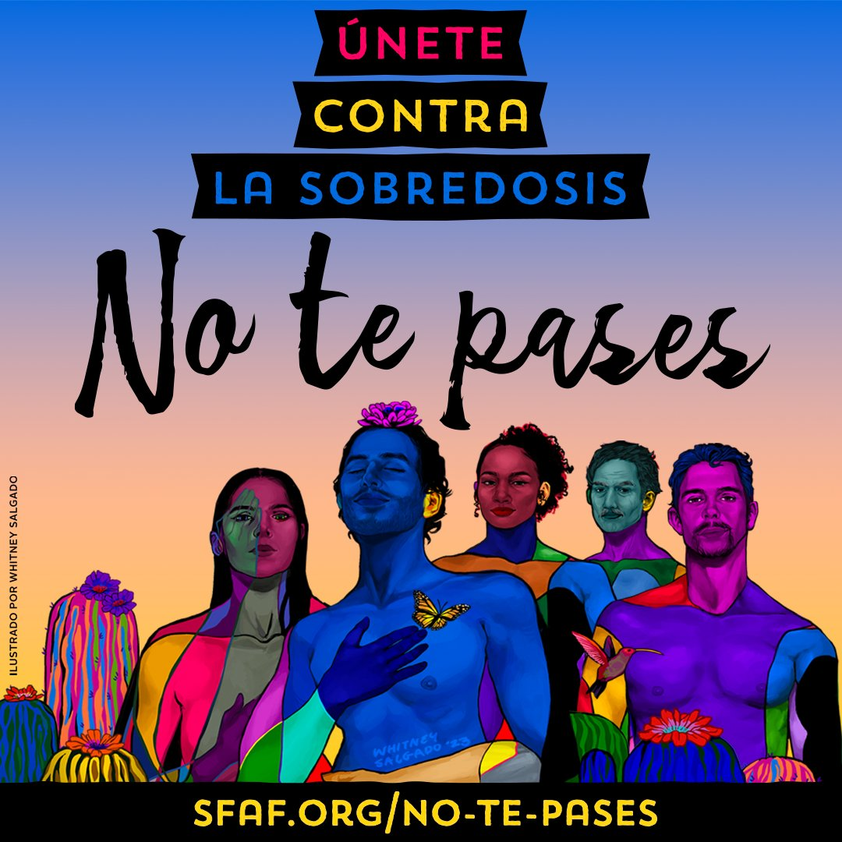
Background
Increasing rates of alcohol-related deaths, overdoses, and worse addiction outcomes among Latine Californians
Underrepresentation of Latine individuals in healthcare workforce
Potential for promotores (community health workers) to fill these gaps, but no existing programs or training focused on substance use
California Department of Public Health, 2024; CDC Wonder;
L Guzman & C Martinez, NHRC y SF AIDS Foundation, Unidos/es Contra la Sobredosis
Art by Whitney Salgado
Moore et al 2016, Cherpitel et al 2016, Ornelas et al 2019, Torres et al 2020
Document et al 2020, Carson et al 2023
Notes:
This program is a response to increasing rates of.
Promotores de salud, also known as community health workers (CHWs), are trusted individuals who educate their communities and connect them to health and social resources.
Promotores can provide cultural- and language-informed interventions to advance health. Promotores have improved outcomes across multiple chronic and infectious diseases with medical and psychosocial complexities. No Spanish promotor curricula focused on addressing substance use disorders
https://docs.google.com/presentation/d/1HfkVtwKdvZsT76g5UH7xMmOEu3-4skqAA6c3NaZDLcQ/edit#slide=id.g2dd503dcb31_2_89
https://journals.sagepub.com/doi/abs/10.1177/29767342241278871?asam.org
Only 5.4% of adults with AUD in the United States utilized AUD treatment in the past year. AUD treatment utilization did not significantly differ between White males and other racial, ethnic, and gender groups; however, we did identify disparities among Medicaid enrollees and those who were uninsured. Among Medicaid enrollees, Latinx females (3.2%) had lower treatment utilization than White males (9.3%, P < .05). Among uninsured individuals, Latinx males (1.8%) had lower treatment utilization than White males (6.2%, P < .05).

Slide 4
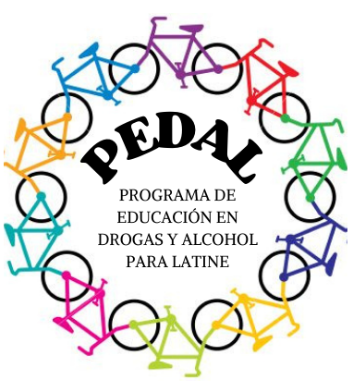
Objectives
Partner with multiple Latine-serving community-based organizations (CBO) in San Francisco to co-design and implement PEDAL, a Spanish-language curriculum to train promotores about addiction
We describe the process and identify early PEDAL outcomes
Notes:
We were grounded in principles of popular education, originated in Latin America in the 1960s and 1970s. Goals of which are to Help each person come to believe that they are capable of changing their world. Step 2: Connect people’s personal problems to national and global realities (develop critical consciousness). Step 3: Motivate people to organize collectively and take action to resolve their common problems.
It is important to create an atmosphere of trust so that people can share their ideas and experiences. • We all know a lot. As educators and organizers, we should always start with what people already know and/or do. • The knowledge we gain through life experience is as important as the knowledge we gain through formal education. • People should be active participants in their own learning process. They should not be passive recipients. • Knowledge is constructed in the interaction between people. • Popular education is an inclusive movement that combines influences from many sources.

Slide 5
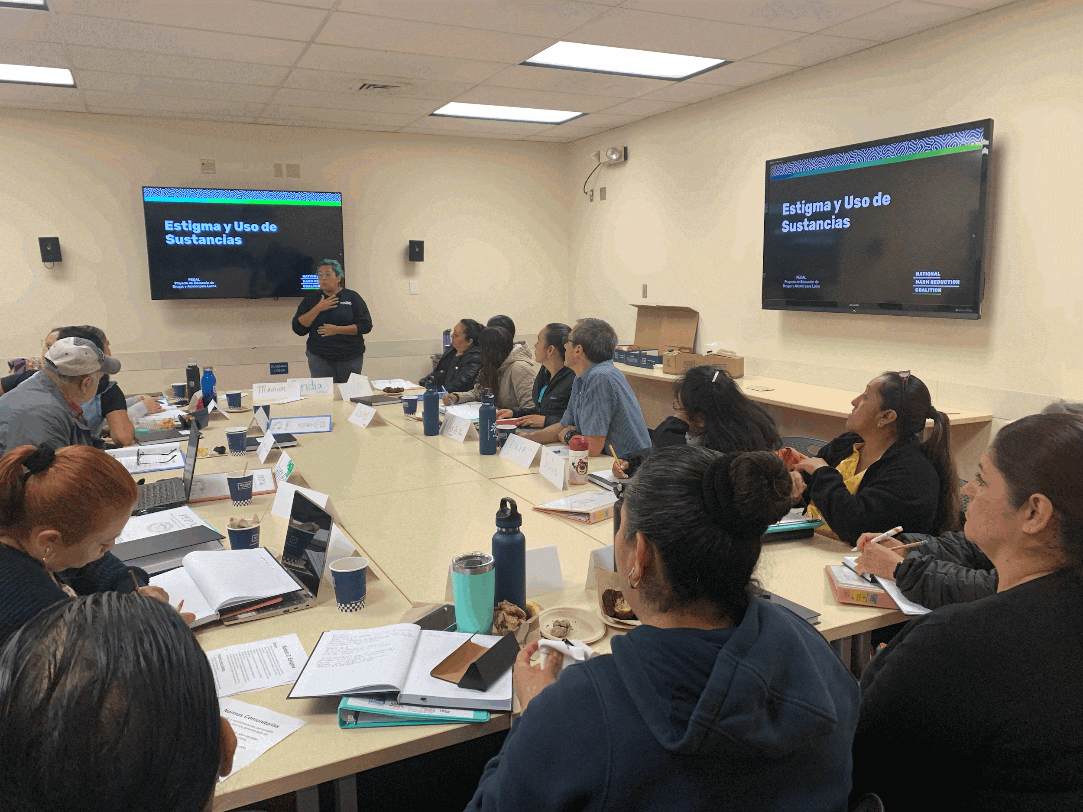
PEDAL Aimed to Empower Promotores to:
Discuss substance use in a culturally, linguistically, and trauma-informed manner
Recognize unhealthy substance use
Link individuals to San Francisco services, including treatment
Educate the Latine community about drugs and alcohol with a focus on destigmatization, prevention, and knowledge dissemination

Slide 6
Methods

Slide 7
Initial Steps
Community members identified addiction as a priority
Conducted a needs assessment of addiction-related needs among Latine San Franciscans in 2022
Gathered Latine-serving CBOs, Department of Public Health, and clinician representatives to inform PEDAL
Secured pilot funding
Notes:
The process of creating this program started during the covid-19 pandemic when this group of promotores working with different organizations were contracted to increase covid-19 testing and vaccination in their communities. Through this convening they identified addiction as a priority, and we gathered…in a needs assessment on addiction related neds among Latine San francisans. And then conceived of PEDAL and secured funding for this pilot through CHCF.

Slide 8
Curriculum Development
Iteratively co-developed 13 linguistically, culturally-informed modules with participating CBOs and the National Harm Reduction Coalition
Delivered in-person, Spanish-language sessions over 4 months
Met weekly with promotor leads to obtain real-time feedback on each session

Slide 9
PEDAL Curriculum
1: Introduction to PEDAL
2: Stigma: Drugs and Alcohol
3: Drugs and Alcohol 101 & Glossary of terms
4: The Continuum of Substance Use
5: Principles of Harm Reduction
6: Taking Care of Yourself while Caring for Others
7: Youth, Substance Use, Prevention, and the Family
8: Overdose Prevention and Harm Reduction in Action
9: Addiction Treatment
10: Local Resources: Site Visits
11: Motivational Interviewing 1
12: Motivational Interviewing 2, Healing Circle
13: PEDAL in Action
Notes:
I want to tell you a little more in depth about what we taught and what teaching strategies we used. We oriented the promotores to why we were gathering, what the statistics in their community were, we grounded in group agreements and prioritized making sure people knew how to get support if they needed it while exploring sensitive topics. Our colleauges form
Cases
Lectures
Large and small group discussions
Hands-on overdose prevention training
Motivational interviewing practice
Videos
Site visits
Group presentations
Homework reflections
Drumming
*add photo

Slide 10
Evaluation
Mixed-methods
Participant demographics and professional backgrounds
Pre- and post-course scores:
Confidence in course goals using a scale of 1-10
Stigma and attitudes using selected items from Alcohol and Alcohol Problems Perception Questionnaire (AAPPQ), Drugs and Drug Problems Perceptions Questionnaire (DDPPQ), and scales by Palamar et al.
Calculated differences in median pre-and post-scores and p-values using Wilcoxon sign rank tests
Modified content analysis of pre- and post- written reflections
Focus groups to assess application of training (forthcoming)
Notes:
Stigma scale questionnaire, Alcohol and Alcohol Problems Perception Questionnaire (AAPPQ), Drugs and Drug Problems Perceptions Questionnaire (DDPPQ), and Palamar et al. scale
This 20-item, Likert-scaled measure was based on the Alcohol Attitudes and Problems Perceptions Questionnaire (AAPPQ; Shaw et al., 1978), which measures the readiness of health professionals for working with problem drinkers. Items relating to role adequacy, role legitimacy, and role support, as well as motivation, work-specific self-esteem, and work satisfaction were included. In addition, the AAPPQ was adapted to use language consistent with the type of intervention proposed (i.e., work with "hazardous/harmful drinkers" rather than "problem drinkers").
Palamar JJ, Kiang MV, Halkitis PN. Development and psychometric evaluation of scales that assess stigma associated with illicit drug users. Subst Use Misuse. 2011;46(12):1457-67.
Fitzgerald et al., 2009

Slide 11
Results

Slide 12
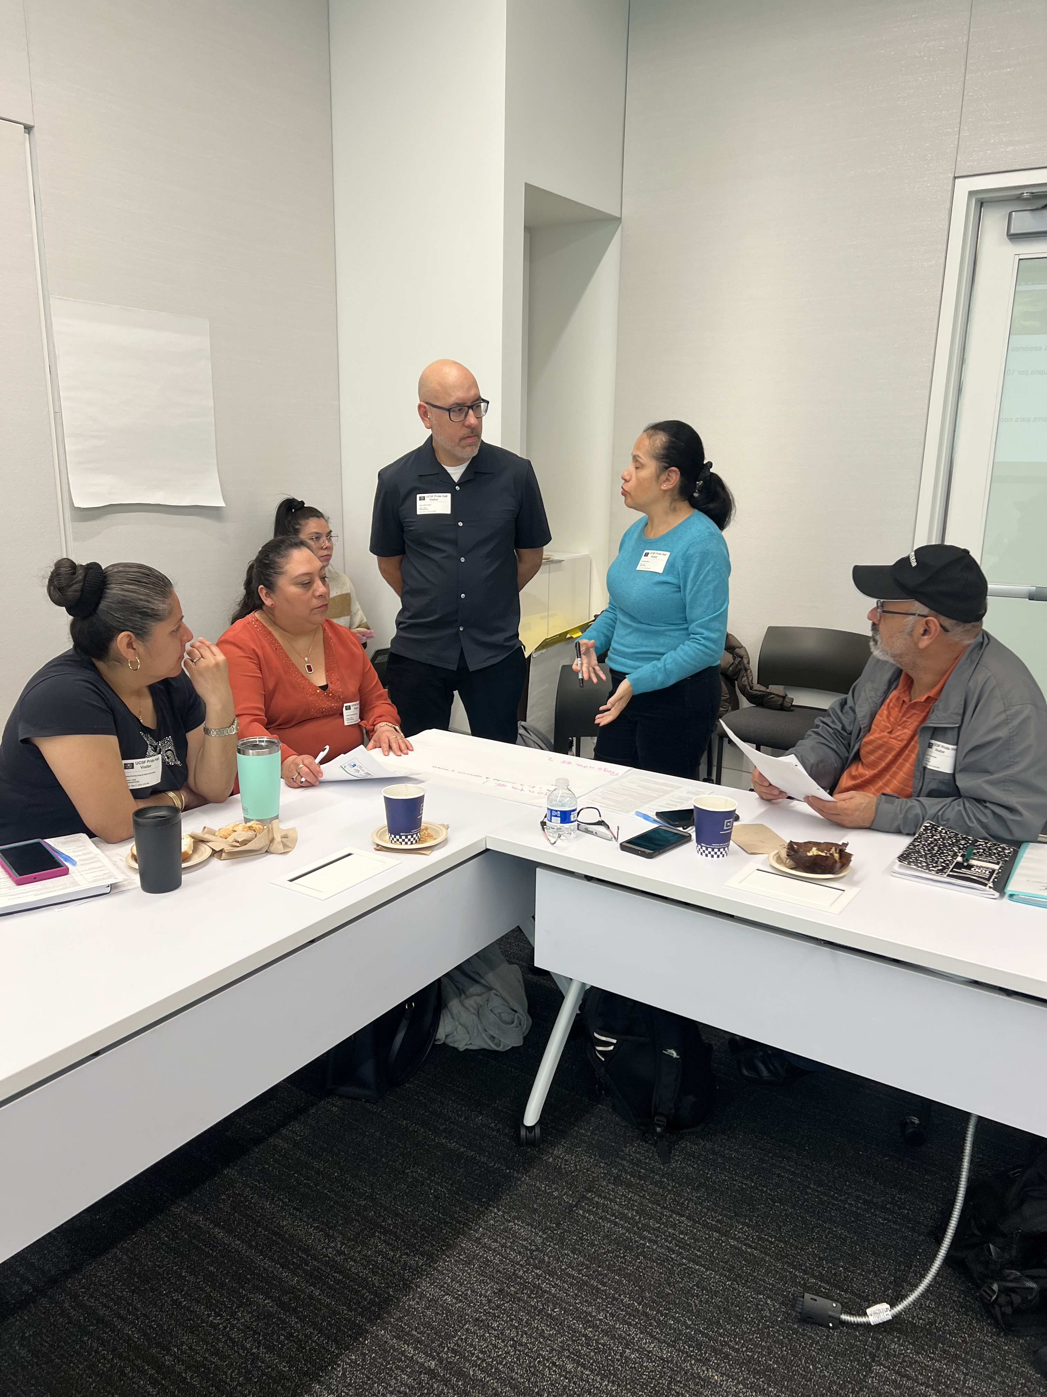
Sessions
20 participants
96% attendance
93% homework completed

Slide 13
Participant Characteristics
Characteristics | N
Total | 20
Age, Mean (SD) | 44 (8.98)
Gender Identity N, (%)
Female | 16 (80)
Male | 4 (20)
Country of Origin N, (%)
Mexico | 12 (60)
Guatemala | 3 (15)
El Salvador | 2 (10)
USA | 2 (10)
Colombia | 1 (5)
Years in the US, mean (SD) | 21.5 (9.99)
English Proficiency N, (%)
Very well | 2 (10)
Good | 5 (25)
Not well | 9 (45)
No English | 4 (20)
Highest Level of Education N, (%)
Primary (K-5) | 3 (15)
Junior High (6-8) | 4 (20)
High School (9-12) | 7 (35)
University outside of the US | 6 (30)
Years as Promotor, Mean (SD) | 7.12 (5.55)
Notes:
Participants had varied levels of English proficiency and education. They brought expertise from working as CHWs with their organizations but also in food service, construction and agricultural services, teaching, and childcare.
Past employment fieldsN (%) Community Health Worker9 (45)Food Service4 (20)Program Coordinator4(20)Construction and agricultural services3 (15)Teacher2 (10)Cleaning Professional1 (5)Nurse1 (5)Therapist1(5)Social Worker1 (5)Homemaker 1 (5)Childcare1 (5)
Not certified as promotores
Populations worked with (non exclusive)N (%)Kids6 (30)Adults19 (95)People experiencing homelessness10 (50)Parents14 (70)Immigrants17 (85)LGBTQ6 (30)Indigenous Populations6 (30)Adolescents6 (30)Other3 (15)

Slide 14
Confidence in Course Goals
 | Difference in pre-post confidence course goals, median (IQR) | p-value*
Recognize unhealthy substance use | 1.5 (-1, 4) | 0.05
Communicate about substance use in a culturally, linguistically, and trauma-informed manner | 2 (-1, 4) | 0.02
Link individuals with unhealthy substance use to services | 3 (0.5, 4) | 0.001
Educate the Latine community about drugs and alcohol | 1.0 (-1, 5) | 0.04
Notes:
There were increases pre vs post in participants confidence to…. the course goals of being able to recognize unhealthy use, communicate about it, links clients to services and educate about drugs and alcohol, and this was statistically significant. All medians are positive values indicating an increase in confidence; there were a lot of upper scores, summarizes data that are not normally distributed, scales are not really continuous
this is a 2 sided non parametric test given small data sample. P value significant on small sample, you can trust that is corrent. Null hypothesis, no change. If change, it was a positive change
* p-values calculated using Wilcoxon signrank test

Slide 15
Stigma Scores
There were no statistically significant changes in median scores for:
Perceived public stigma of alcohol or drugs
Stigmatization of people who use alcohol or drugs
Motivation to work with people who use alcohol or drugs
Adequacy of role, self esteem, satisfaction in this work
Notes:
However, there were no statistically significant changes in their median scores on stigma scales that participants completed pre and post training.
understandable that perceived change did not change. knowledge you can change in short amt of time, but perceptions harder. qualtative data is important here because difficult to capture internal attitudes with scales, cannot express these complex perceptions in scales. This is why mixed methods is helpful.
* p-values calculated using Wilcoxon signrank test

Slide 16
PEDAL impacted stigma, personal change, language
“The first challenge was to change the judgmental thoughts that people are like this for their own pleasure and during the development of each session it made me reflect and change that concept. Stigma is something that everyone has experienced.”
“I have felt more human and started thinking about the other person’s situation as a human…We would like to change people in our own way, but I have changed my way of thinking and I have been more empathetic.”
“I have learned how our words change the ability to connect and humanize.”
Notes:
This was interesting because participants talked a lot about stigma in our qualitative analyses and about how they personally experienced a lot of shifts in their attitudes and perspectives of people who use substances.

Slide 17
PEDAL increased knowledge of substance use, treatment, overdose prevention, and resources
“I will put into practice each of the skills, knowledge and tools that I learned from motivational interviewing, resources, harm reduction, and the importance of not using stigmatizing words in whatever the need of the client I work with.”
“And today I know where to find the resources and I learned to become a much better promotor.”
“The other important point of this training was motivational interviewing…that allows us to be more effective in working with people and to do better work as promotores.”
“I learned about naloxone, what it is for, and how to use it in an emergency”
Notes:
They noted their favorite things were interactive, the site visits

Slide 18
PEDAL increased self-efficacy and motivation to impact the Latine community
“What I learned I can share with the community, but also with my family”
“What we learned will give us many tools to be able to work with our community, especially Latinos, to help and support them to prevent them from arriving at hospitals with drug or alcohol overdoses or not arriving because they died somewhere or on the way to the hospital.”
“I hope soon to be able to put each class into practice, I believe that we will show what was learned through real experience and reinforce it day by day, to attain recovery in our society and especially among the most vulnerable”
Notes:
Ask promotores if anything else they’d like to share

Slide 19
Conclusions

Slide 20
Summary of Findings
Curricula such as PEDAL may equip promotores with skills to provide linguistically and culturally informed addiction services to their own communities and address equity gaps

Slide 21
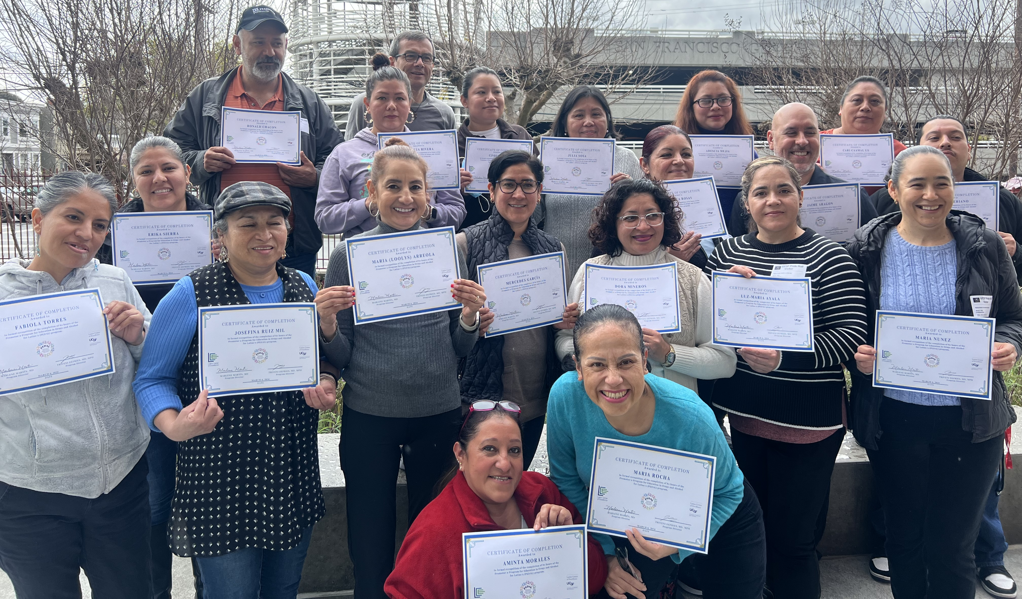
Next Steps
Support PEDAL participants in ongoing training and implementation of PEDAL in community
Implementing at new sites to develop PEDAL 2.0 toolkit and train-the-trainer model
Explore financial sustainability
“We are going to fight for this to be expanded and for many more to have the opportunity. Because that is our wish, for our community to be included in this, because we alone are not going to be able to do the work.”
Notes:
From our early analysis of focus group data, we know that Certification, More hands on – visits and MI practice,
Professional development opportunities usually offered to staff/not promotores, not to undocumented individuals, and not in Spanish.

Slide 22
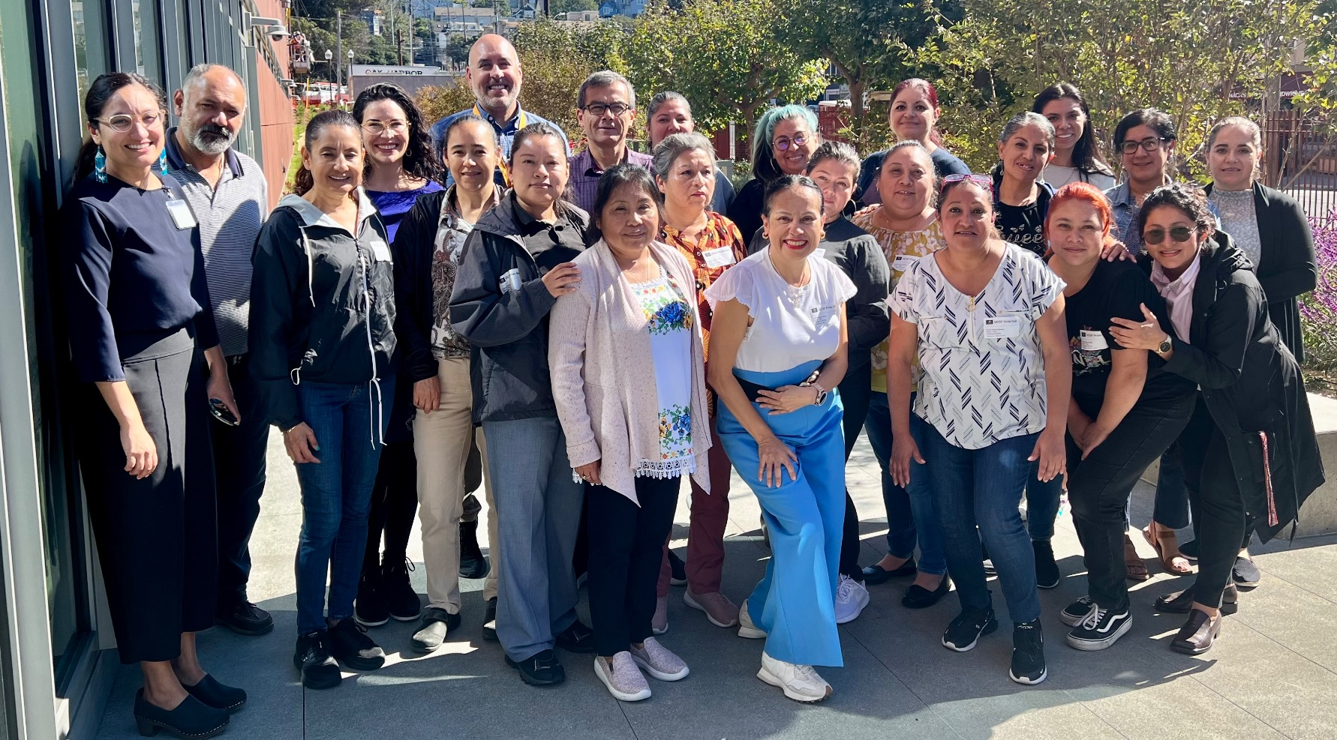
Thank you! Gracias!
Promotores
Maria Arreola
Luz-Maria Ayala
Cari Caamal
Ronald Chacon
Mercedes Garcia
Rene Interiano
Dora Mineros
Aminta Morales
Maria Nunez
Arescia Mejia
Martiza Rivera
Angelica Rosas
Josefina Ruiz Mil
Erika Sierra
Julia Sosa
Fabiola Torres
CBO Leads
Jaime Aragon
Cindia Diaz
Maria Rocha
Dairo Romero
NHRC Leads
Andrea Figueroa
Tanagra Melgarejo
UCSF LCOE
Lupita Ambriz
Triveni DeFries
Marlene Martin
Madison Rodriguez
Maria Solorzano
Alicia Fernandez
Stephanie Rivera
Connie Calderon Jenson
Francine Rios-Fetchko
CHCF
Mariana Torres
Carlina Hansen
Diana Camacho
Michelle Schneidermann
And many others who contributed!
Contact Marlene.Martin@ucsf.edu and Triveni.DeFries@ucsf.edu

Slide 23
Limitations
Quantitative stigma scores were not validated in this population and did not correlate well with qualitative findings
Small, limited sample: Highly self-motivated, Few men
Participants wanted more time for ongoing training and motivational interviewing practice
Limited of Spanish language, culturally competent treatment services to link clients to
Lack of funded opportunities for promotores
Notes:
Limitations: some promotores were self selected for interest, not all may be self motivated
The stigma scores we used were bonk
Wanted to see more ppl with lived experience
Want more training, coaching, practice/practicum, mentorship, MI practice,
Not enough Spanish language cultural competent addiction treatment services available where promotores can link clients to or train in
Lack of sustainable work, renumeration for promotor work
Lack of funding or prioritization in CBO
strengths: in person sessions, lots of opportunities for promotores to provide anonymous feedback, lot of resources (ie: glossary, handouts), very motivated and eager to learn group
limitations: Didn't have even distribution of men and women participate, first of its kind program

Slide 24
Focus Group Themes
Comfort/confidence addressing unhealthy substance use
Knowledge
Community resources for unhealthy substance use
Stigma & Attitudes towards drugs, alcohol, people who use them
Impact
Impact of PEDAL on professional level
Application of PEDAL in work as promotor
Impact of PEDAL on organizational level
Impact of PEDAL on personal level
Impact on community level:
Applicability of PEDAL to Latine community
Assessment of curriculum and its development
Positive feedback on PEDAL
Feedback to improve PEDAL
The co-creation process
Relationship between UCSF and community
Improvement for future next steps
Barriers to implementation
Ideas/Next steps from PEDAL (for organizations, etc)

Slide 25
Background: Promotores
Promotores can provide cultural- and language-informed interventions to advance health
Promotores have improved outcomes across multiple chronic and infectious diseases with medical and psychosocial complexities
No Spanish promotor curricula focused on addressing substance use disorders
Moore et al 2016, Cherpitel et al 2016, Ornelas et al 2019, Torres et al 2020, Document et al 2020, Carson et al 2023
Notes:
Promotores de salud, also known as community health workers (CHWs), are trusted individuals who educate their communities and connect them to health and social resources.
CDPH: In 2022, Drug overdose was by far the leading cause of years of life lost, and a leading cause of increase in deaths and years lived with disability. ■ Alcohol-related conditions were a leading cause of years of life lost and a leading contributor to racial and ethnic disparities in deaths.
Promotores: también llamados trabajadores de salud comunitaria, facilitan servicios incluyendo educación médica y apoyo social
Informados con el lenguaje y la cultura de las personas a las que apoyan
Experiencia vivida
Estudios enseñan que los promotores en los EEUU han ayudado a:
Reducir hospitalizaciones
Mejorado la salud de nuestra comunidad: presión alta, diabetes, sobrepeso en los niños
Apoyar a la salud mental

