Slide 1
Code Bupe: Implementing Post-Overdose EMS Buprenorphine Programs across Missouri
Rachel P. Winograd., Maria Paschke, Liz Connors., Gerold Carroll, Saad Siddiqui, Josh Wilson, Greg Boal, Aila Al-Maliki, & Brad Ray
University of Missouri, St. Louis

Slide 2
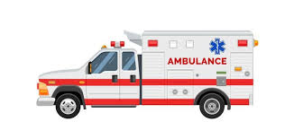
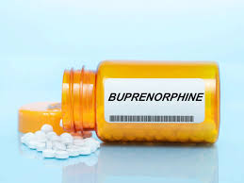
Notes:
Start with - THIS IS HAPPENING YOU”VE PROBABLY HEARD OF IT – but here and there, not statewide approach across diverse districts
Also implementing Bupe in all sorts of settings – EMS is a unique setting

Slide 3
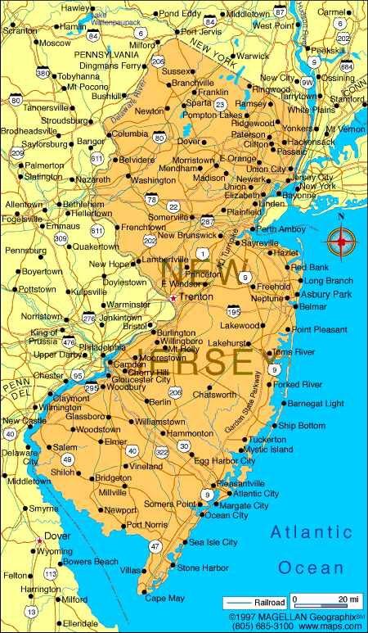
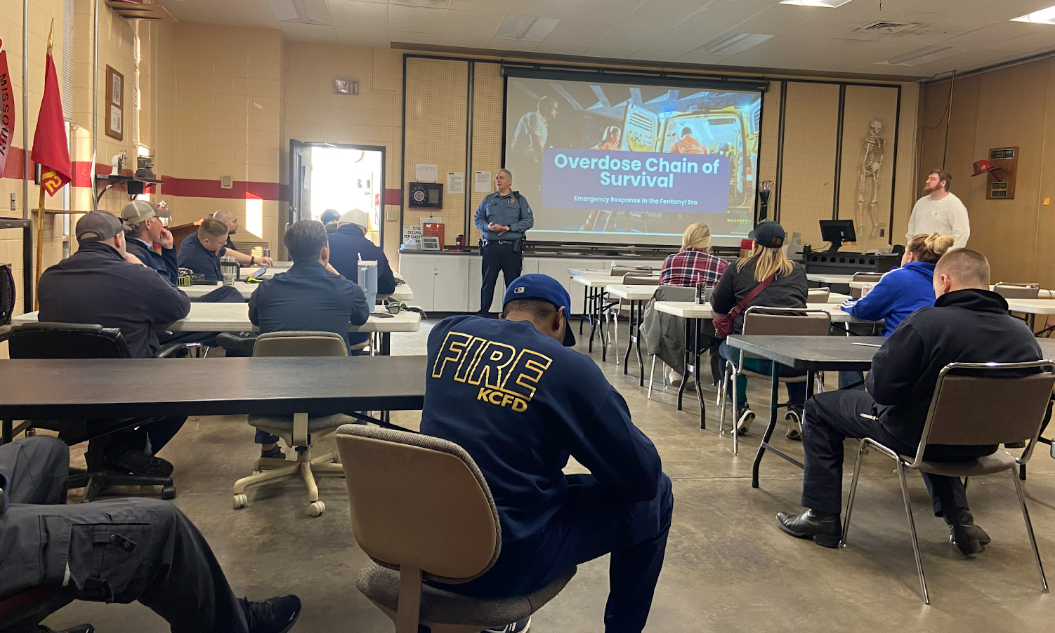
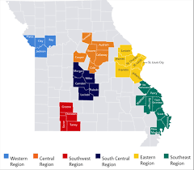
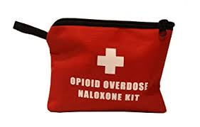
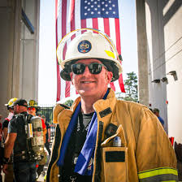
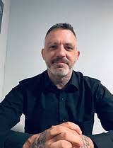
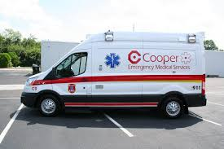
Notes:
Baseline ingredients: existing naloxone/training work with FRs, EPICC, NJ Gerry

Slide 4
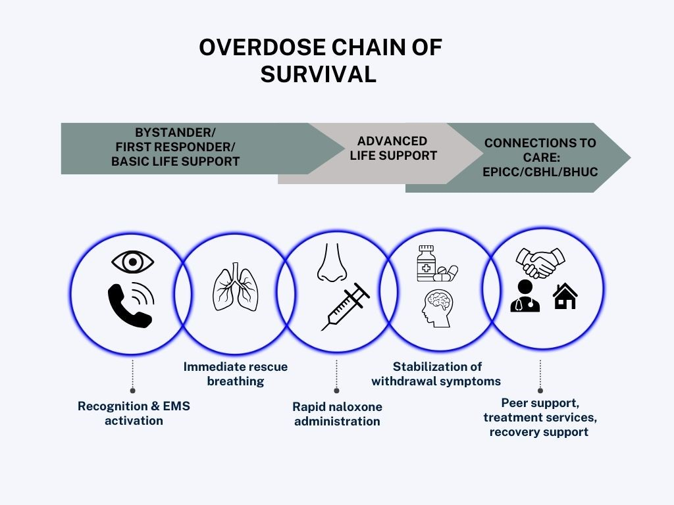
Foster & Frame
Support workforce learning and innovating through information and administration
(Foster)
Make that learning and innovation easy to remember through a common framework (Frame)
Notes:
The state COULD just throw money at them directly to cover the meds and say “do this” but INSTEAD…

Slide 5
Prior to funding
Built on existing relationships
Selected 6 districts who wanted MORE
Communities of Practice led by NJ experts
‘Readiness Checklist’
Medical Protocol
Connections with EPICC
Train-the-trainer
Moullin, J. C., Dickson, K. S., Stadnick, N. A., Rabin, B., & Aarons, G. A. (2019). Systematic review of the exploration, preparation, implementation, sustainment (EPIS) framework. Implementation Science, 14, 1-16.
Notes:
Add animated pop ups for E & P
Exploration
In the Exploration phase, a service system, organization, research group, or other stakeholder(s) consider the emergent or existing health needs of the patients, clients, or communities and work to identify the best EBP(s) to address those needs, and subsequently decides whether to adopt the identified EBP. In addition, consideration is given to what might need to be adapted - at the system, organization, and/or individual level(s), and to the EBP itself.
preparation
In the Preparation phase, the primary objectives are to identify potential barriers and facilitators of implementation at the outer and inner contexts (described later), further assess needs for adaptation, and to develop a detailed plan to capitalize on implementation facilitators and address potential barriers. Critical within the Preparation phase is planning of implementation supports (e.g., coaching, audit and feedback) to facilitate use of the EBP in the next two phases (Implementation and Sustainment) and consideration of how best to develop an implementation climate that indicates that EBP use is expected, supported, and rewarded in the system and organization

Slide 6
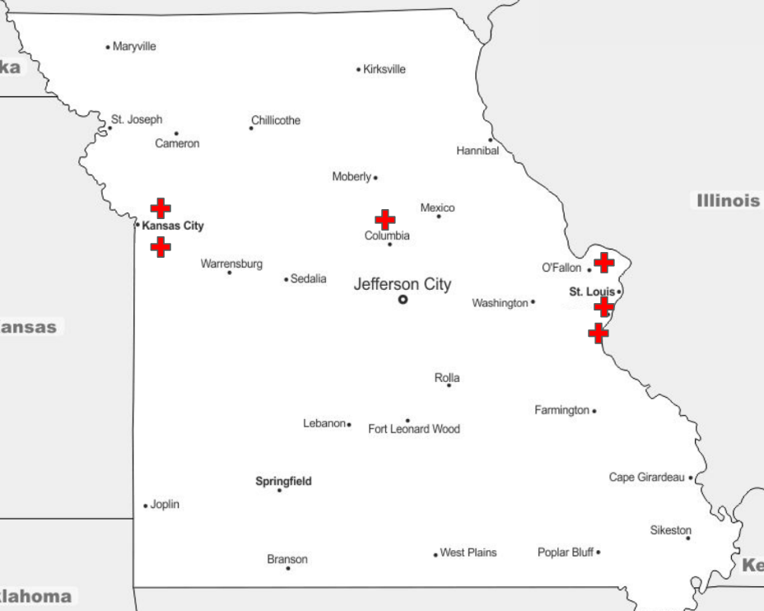
Urban & Rural
Big & Small
With & Without Community Paramedic programs
Range of OD call volume

Slide 7
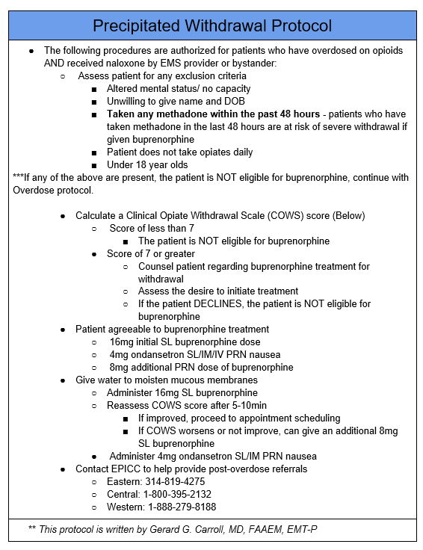
Readiness Checklist & Med Protocol
Notes:
https://docs.google.com/document/d/1MoBnnKHQ8OnKbVBXYMHEcufmU0RK5XenZkPfN29Rnio/edit?tab=t.0

Slide 8
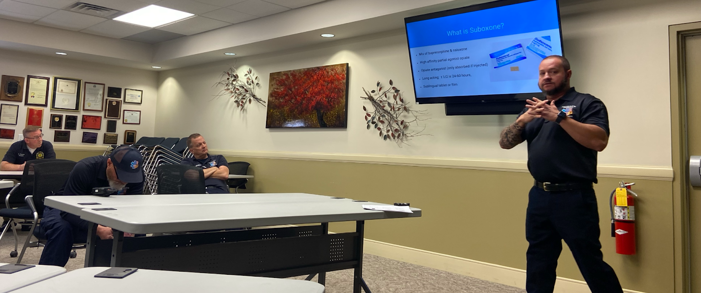
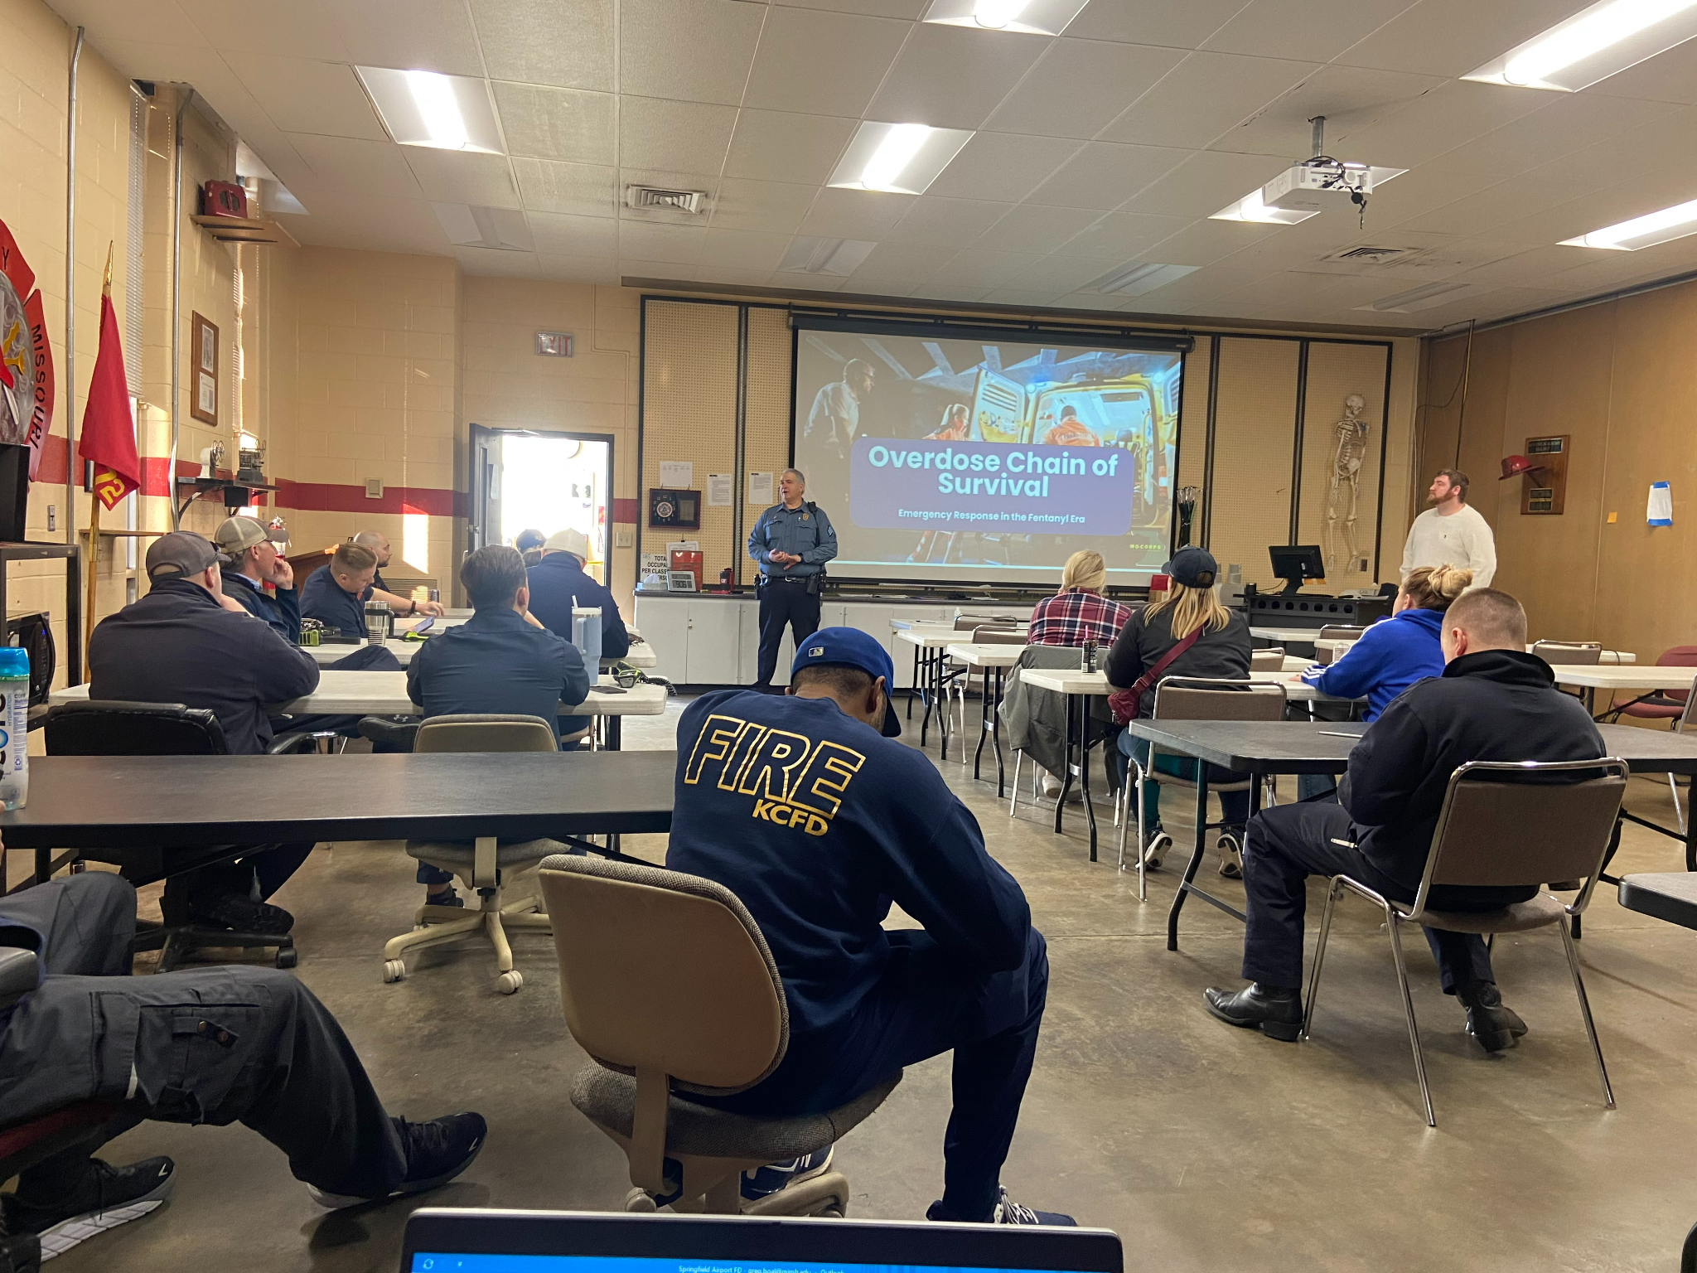
Agencies in action

Slide 9
Methods - Check in Calls
District semi-structured interviews prior to implementation
Medical directors, Chiefs, Paramedic supervisors, etc.
Items adopted from EPIS framework
Training
Staffing
Capacity to implement
Local context
Medic receptivity
Coding using a deductive organizing framework
2 coders
Assessed “inner” and “outer” factors

Slide 10
Facilitators
“There's a capability of getting several million dollars for the whole county, you know. Why not? You know, we've got a problem epidemic and it's horrible... we've got to make a difference and it starts with us.”
“It definitely got better after we had [previous] training. Not everybody. But there was a lot of people that they came up to us afterwards, and they told us that it was eye opening to actually talk to somebody who had the experience of being woken up by paramedics.”
Outer
Financial investment to address the opioid overdose crisis
Prior exposure to harm reduction training and supplies
Guidance from NJ EMS practice experts
Inner
Integration with community paramedic programming
Leadership buy-in & advocacy
Support of protocol adoption and adherence
“When I’m trying to talk to doctors, they just want to hear from other doctors. They don't want to hear from me, and so medics are the same way. We like hearing from other medics. So I think [bringing in EMS experts] was a really good addition.”
“I mean, that's some of the beauty of [the community paramedic] role is you have more flexibility to navigate all these systems.”
“Well, our leadership is 100. They are all in. We sort of do any kind of initiative that is just to better the patient care. … I'm the one that is 100%. But then when I go to my leadership and say, “Hey, this is what we're gonna do,” they're good with it.”
“We should be good as long as we follow our protocols. And we're the ones who control our protocols.”
Notes:
Might need to cut back on the quotes

Slide 11
Barriers
“[Paramedics] were not following up correctly with [care coordinators]. So that's probably a failure point … and then once they do get into the hospitals, the hospitals are so fatigued with insurgents of people coming in that I think these people are falling through the cracks.”
Outer
Inconsistent linkage to care post-overdose
Limited availability of long-term treatment
Inner
Stigma toward people who use drugs
Staff resistance to new responsibilities
Compassion fatigue and secondary trauma
“As we get started, gaps with people being able to get additional dosing and stay on the medication is going to emerge across communities as an issue.
“You wake the same person up with Narcan, and they say, “Oh, I've never even used drugs.” And so, you know, they immediately look at that as a dishonest, lying person that isn't worth their time. Instead of looking at this entire picture of somebody.”
“I think some hesitancy here right now, when I first mentioned this whole bupe, and having to sit on the scene a little bit longer. Red flags went up.”
“Our clinicians, it's not that they don't care. Don't get me wrong. I think they're probably burned out and beat down.”
Notes:
Might need to cut back on the quotes

Slide 12
Summary take-aways
Facilitating EMS buprenorphine:
Foster and Frame learning model provides key support
Internal advocates drive capacity for implementation
Hindering EMS buprenorphine:
EMS uncertainty about long-term patient outcomes
Reluctance among paramedics to carry out the intervention
STRATEGY & SUPPORT ARE IMPORTANT – can’t just give money and snap fingers!

Slide 13
What’s next?
Better understanding feasibility and uptake
Adding the I & S to the E & P
What predicts this taking off vs. stalling?
If other agencies want to do this, what should they know going into it?
What is the qualitative experience of all parties?
Medics administering the bupe
Peer coaches meeting at the scene following bupe admin
People who use drugs being offered the bupe
Long term… does this save and improve lives?

Slide 14
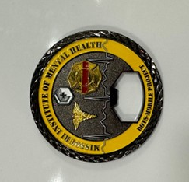
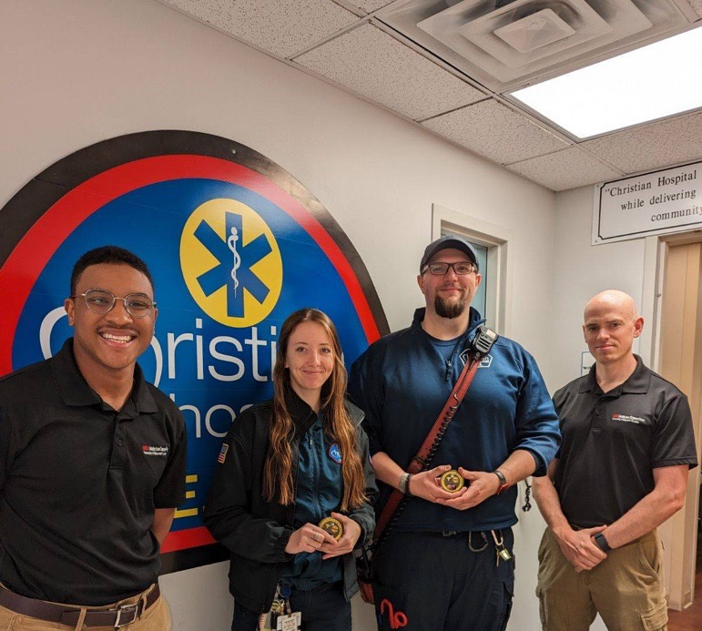
Thank you!
DOTS+MOBILE team at UMSL (Josh, Saad, Greg, Aila, Maria!) Districts! (CJC, Christian, Raytown, Mehlville, Rock Township, MU Health, Joachim Plattin)
Dr. Gerry Carroll & Eric Tuttle from NJ Cooper Health
Dr. Brad Ray from RTI
UMSL-MIMH Addiction Science team: www.MIMHAddSci.org
Missouri Department of Mental Health

