Slide 1



Perinatal Resources for Opioid Use Disorder (PROUD)
Philadelphia: The Heart of the Opioid Epidemic
Nia Bhadra-Heintz, MD, MS
Navid Roder, MD
Co-Directors: Perinatal Resources Opioid Use Disorder (PROUD) at Penn Medicine
Notes:
Nia

Slide 2
Disclosures
  No Disclosures
Notes:
Navid

Slide 3
Learning Objectives
Describe the distinctive medical and social needs of pregnant and postpartum populations with Opioid Use Disorder (OUD) in Philadelphia
Describe the clinical and wraparound services offered through the Perinatal Resources for Opioid Use Disorder (PROUD) program to address unique medical and social needs
Understand how PROUD is committed to furthering perinatal OUD care through interdisciplinary teaching and robust research
Notes:
Navid

Slide 4
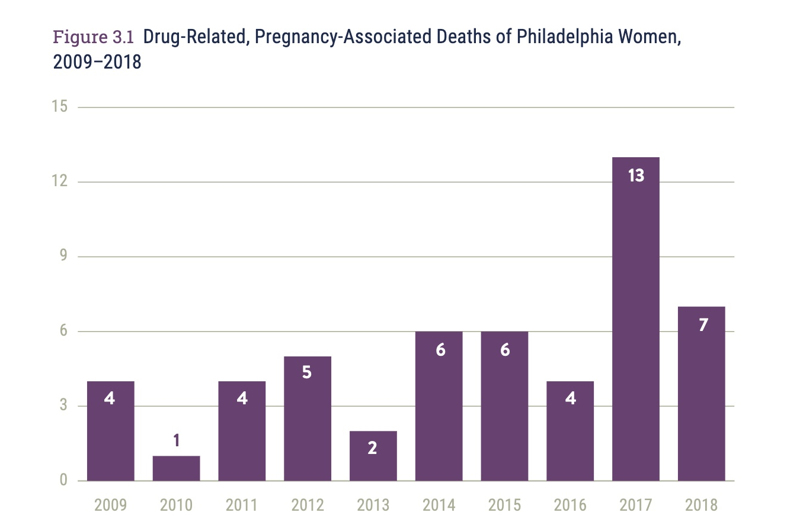
Brief background
Opioid and stimulant related deaths have steadily increased in Philadelphia over the last 20 years, with over 1,400 deaths reported in 2022
Between 2009 and 2016, accidental overdoses made up 25% of pregnancy associated deaths. Between 2017-2018 this increased to 39%
21% of people who had a pregnancy-associated death had no prenatal care
66% of pregnancy-associated deaths that were drug related occurred after the 6-week postpartum period
https://www.phila.gov/media/20210322093837/MMRReport2020-FINAL.pdf
Notes:
Navid

Slide 5

Needs of population
Access to prenatal and postpartum care
Access to medications for opioid use disorder (MOUD)
Emphasis on harm reduction in care
Stigma-free and nonjudgemental care
Social resources such as housing, childcare, transportation, etc.
Notes:
Navid

Slide 6
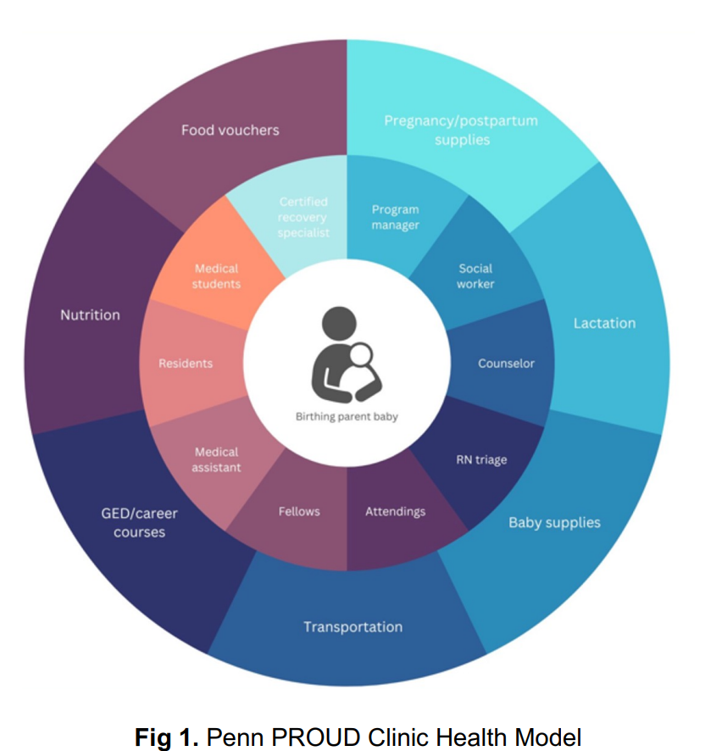
Perinatal Resources for Opioid Use Disorder (PROUD) at Penn Family Care
Started in 2021, PROUD is a comprehensive outpatient prenatal and addiction medicine clinic serving people with opioid use disorder (OUD) who are pregnant or up to 2 years postpartum
PROUD also provides dyadic care with parent and infant
As a part of Penn Medicine, PROUD serves as an interdisciplinary teaching clinic
Partially funded by Pennsylvania’s Department of Drug and Alcohol Programming (DDAP)
Copay support
Notes:
Navid

Slide 7
Wraparound services
Social work
Therapy services
Certified Recovery Specialists
Transportation to PROUD and other prenatal appointments
New baby supplies (strollers, car seats, pack and plays)
Diapers and wipes at every appointment
Copay support at pharmacy
Support for GED and educational classes
Harm reduction supplies (Narcan, fentanyl test strips, safe sex kits, etc)
Lactation and nutrition counseling
Clinical Pharmacy support
Evaluation
Notes:
DDAP funding has provided the opportunity for wraparound and social services to be provided at PROUD
Navid

Slide 8
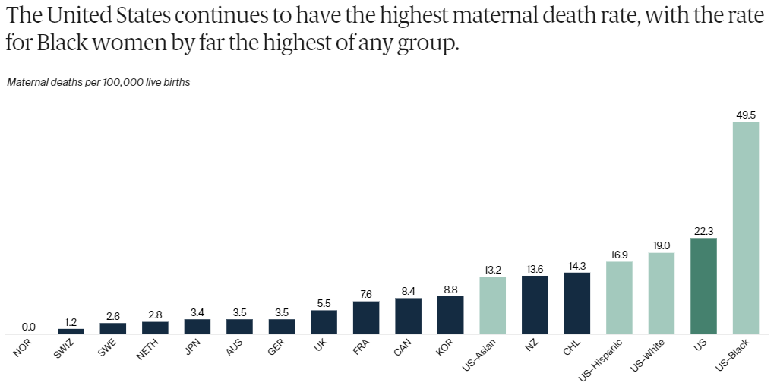
Maternal Mortality – US Exceptionalism
Munira Z. Gunja et al., Insights into the U.S. Maternal Mortality Crisis: An International Comparison (Commonwealth Fund, June 2024). https://doi.org/10.26099/cthn-st75
Notes:
Unfortunately, the United States is exceptional by leading in maternal morbidity and mortality when compared to countries with comparable GDPs. Importantly, when looking at our birthing people of color, these rates are more than doubled.
Nia

Slide 9
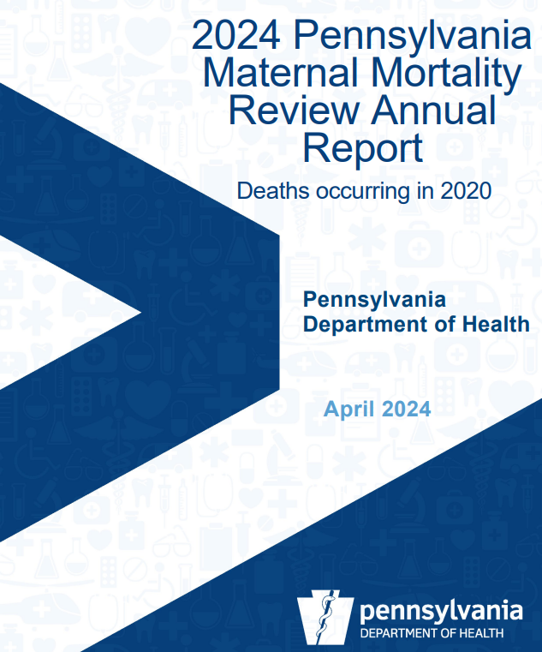
Maternal Mortality
41% of cases identified substance use disorder as a contributing factor in the death
Notes:
In Philadelphia, these trends hold true when looking at our birthing population. We are seeing higher rates of maternal morbidity and mortality in our birthing people of color with concurrent substance use compared to white birthing people with similar rates and types of substance use.
In the most recent citywide maternal mortality review, 41% of all maternal deaths were found to have substance use as a contributing factor, resulting in the state and city declaring substance use treatment in pregnancy and postpartum as a dire need.
Nia

Slide 10
Patient Demographics
 | N | %
Age (mean 32.8 SD 4 years) | 80
Race
Black or African American | 51 | 61.4
White | 22 | 26.5
American Indian or Alaskan Native | 1 | 1.2
Native Hawaiian or Other Pacific Islander | 1 | 1.2
Other | 4 | 4.8
Unknown | 4 | 4.8
Ethnicity
Hispanic or Latino | 4 | 5.0
Not Hispanic or Latino | 76 | 95.0
Primary Coverage
Medicaid | 73 | 91.25
Private Insurance | 4 | 5
Medicare | 2 | 2.5
Other | 1 | 1.25
 | N | %
Gestational Age at Delivery
Less than 28 Weeks | 3 | 3.7
28-37 Weeks | 22 | 27.2
37-40 Weeks | 48 | 59.3
40+ Weeks | 8 | 9.9
Mode of Delivery
Vaginal | 48 | 60.8
C-Section | 27 | 34.2
VBAC | 4 | 5.1
Notes:
As you have heard, the PROUD program was created to address this need.
Greater than 70% of PROUD patients identify as people of color, and greater than 90% have Medicaid coverage.
I will show in the next few slides our interim analysis showing significant impact of the program. Our sample size is too small to measure any meaningful impact on birthing outcomes but to give you a general idea of this population: we have a baseline 30% rate of preterm birth (national rate is 10%) with about a 34% cesarean rate (around national average)
Nia

Slide 11
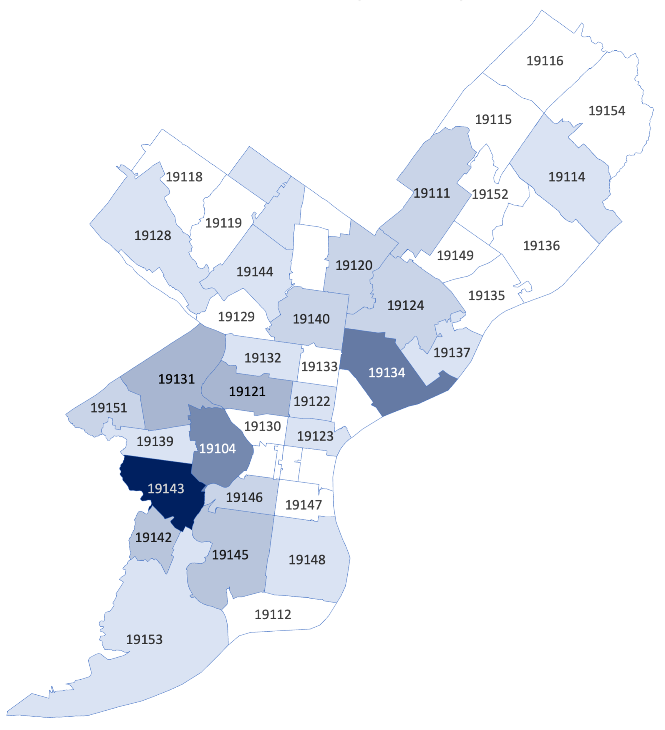
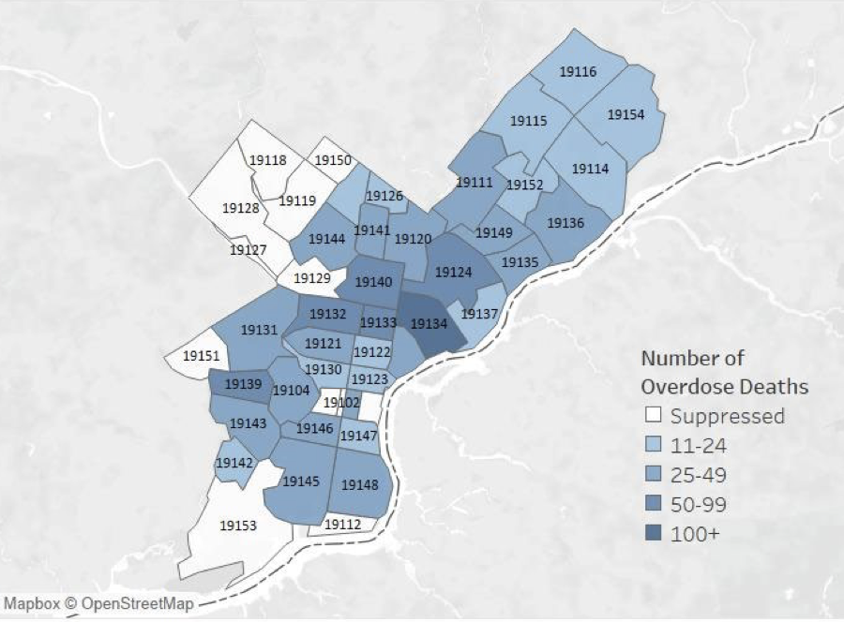
Number of Overdose Deaths in Philadelphia by Location, 2022
Concentration of PROUD Patient Population by Philadelphia ZIP Code
https://www.phila.gov/media/20231002090544/CHARTv8e3.pdf
Notes:
On the right you can see the overdose rates in our city with dark blue being the highest zipcodes
On the left you can see concentration of our patients by zipcode, which matches the overdose match. This demonstrates that we are giving access to care in the highest need areas, largely due to the transportation support that we have described.
Nia

Slide 12
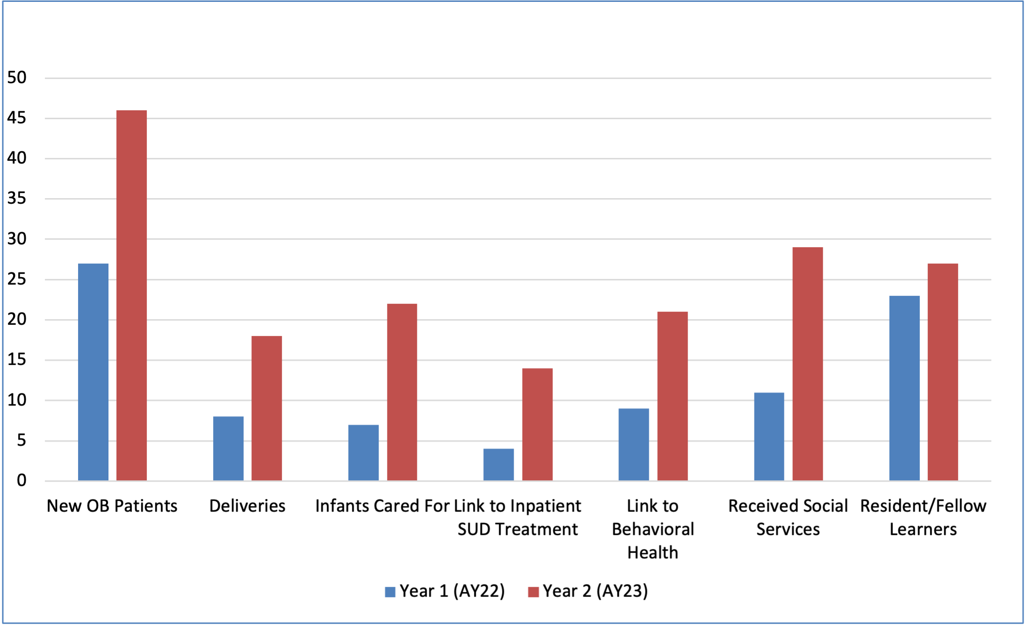
Impact
Retention rate increased from 46.8% to 76.7%
Notes:
In terms of significant impact with the enaction of the service grant: Retention rate, Described as three or more visits, increased from *
We have also increased our linkage to outpatient mental health and recovery services, inpatient treatment services, and social services support.
Nia

Slide 13
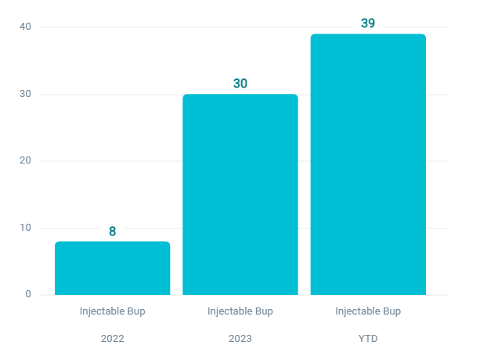
Injectable Buprenorphine
Impact
Rates of MOUD uptake have increased by 86.7%
No show rates have decreased by 42.6%
Notes:
While we have not yet seen a difference in birth outcome neonatal and maternal- small sample size- we have seen *
Patients have also increasingly utilized injectable buprenorphine during pregnancy, and we should be publishing a case series soon as a result.
Nia

Slide 14
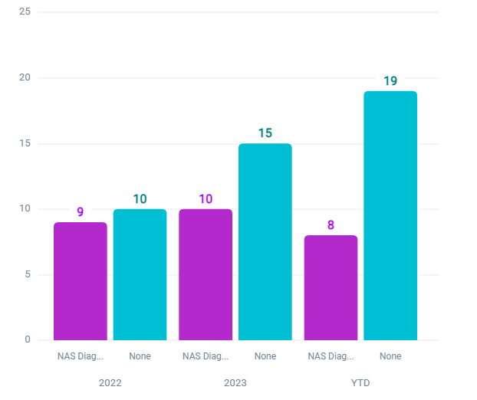
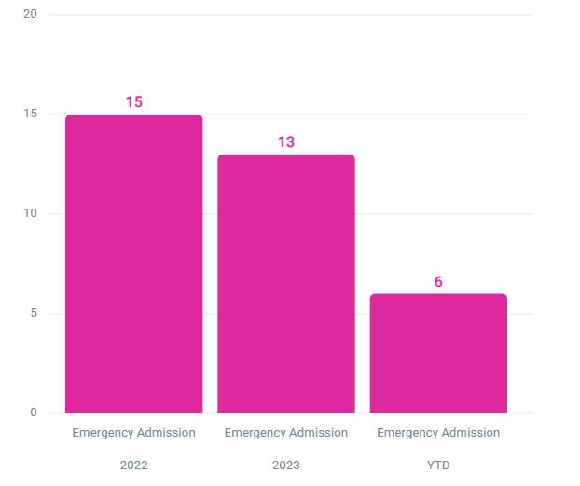
Neonatal Abstinence Syndrome
Emergency Room Admissions
Notes:
Exciting for us is significant decrease in NAS rates as well as emergency room utilization since since implementation of the grant. These are both state, city, and hospital wide metrics that are particularly paid attention to.
Nia

Slide 15
Learners in PROUD
Medical Students | Residents | Fellows
Family medicine rotation | Family Medicine | Addiction Medicine
Specialized electives | PROMOTE track | Addiction psychiatry
 | OB/Gyn | Maternal Fetal Medicine
Notes:
Finally, important to us is training a variety of learners to be comfortable with the treatment of perinatal OUD. This includes early exposure with medical students, core outpatient blocks with ob/gyn and family medicine residents, and rotations for addiction medicine, addiction psychiatry, and MFM fellows
Nia

Slide 16
Future Work
Notes:
I also want to highlight the breath of research and experiences we are lucky to have after just two plus years of the clinic

Slide 17
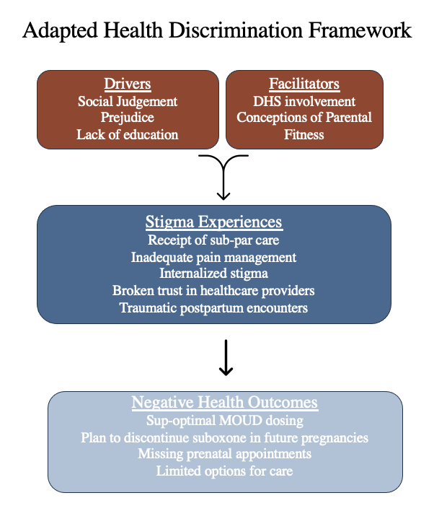
Navigating Discrimination: Experiences of
Pregnant Patients with Opioid Use Disorder
Interim Analysis
Lower levels
Higher levels
Integrated pregnancy and OUD care may result in lower levels of discrimination, especially for non-white patients.
Missed MOUD dose(s)
p=0.452
Did not miss a dose
White
p=0.026
Non-white
Non-Hispanic/Latinx
Hispanic/Latinx
Notes:
We have examined quantitative and qualitatively healthcare based stigma and discrimination experiences our patients have had- Which have led to changes on how we counsel about DHS outpatient, and has informed DHS huddle practices on the inpatient side

Slide 18

Adapting the Penny Chatbot for Perinatal OUD Patients: COPILOT
Notes:
We are in the first year of a NIDA funded grant examining the utility of AI technology on social support, birthing, and recovery outcomes, for those with perinatal OUD

Slide 19
Qualitative Study: Pregnancy Options Counseling Experiences while in OUD Treatment
“It was kind of like they would push for the better option of what they thought… they would be like, oh, you should just probably do adoption or just get it over with now...”
Notes:
With our Family planning colleagues and a qualitative study- we have created guidelines for pregnancy options counseling for non obstetrics based addiction med practitioners who often first diagnose unplanned pregnancies in this population. Now are leading trainings for interested clinics, especially important with the recent roe v wade and continuing proposed legislative changes in early pregnancy management

Slide 20
Determining the Contribution of Pharmacokinetic Alterations to
Subtherapeutic Buprenorphine Levels in Pregnant Patients
Background
Buprenorphine is prescribed to pregnant patients for the treatment of OUD
Efficacy is reduced in late pregnancy increasing the risk of relapse
Background
Objective
Test the hypothesis that pregnancy-induced altered pharmacokinetics reduces
buprenorphine to subtherapeutic levels.
Background
BUMiP Study
Enrollment: patients treated with buprenorphine for OUD and less than 26 weeks GA
Sample Collection: monthly blood, urine, body weight, and cravings scores
Primary Endpoint: test for a correlation between buprenorphine and metabolite blood levels and gestational age.
Secondary Endpoints:
  correlation between urine levels and gestational age
  correlation between blood or urine levels and body weight gain
Background
McCabe Award and Pregnancy and Perinatal Research Center Pilot Award
Funding
McCabe Award
Pregnancy and Perinatal Research Center
Funding
Notes:
In partnership with pharmacy- first study to examine buprenorphine pharmacokinetics throughout pregnancy by trimester for better dosing and treatment recommendations

Slide 21
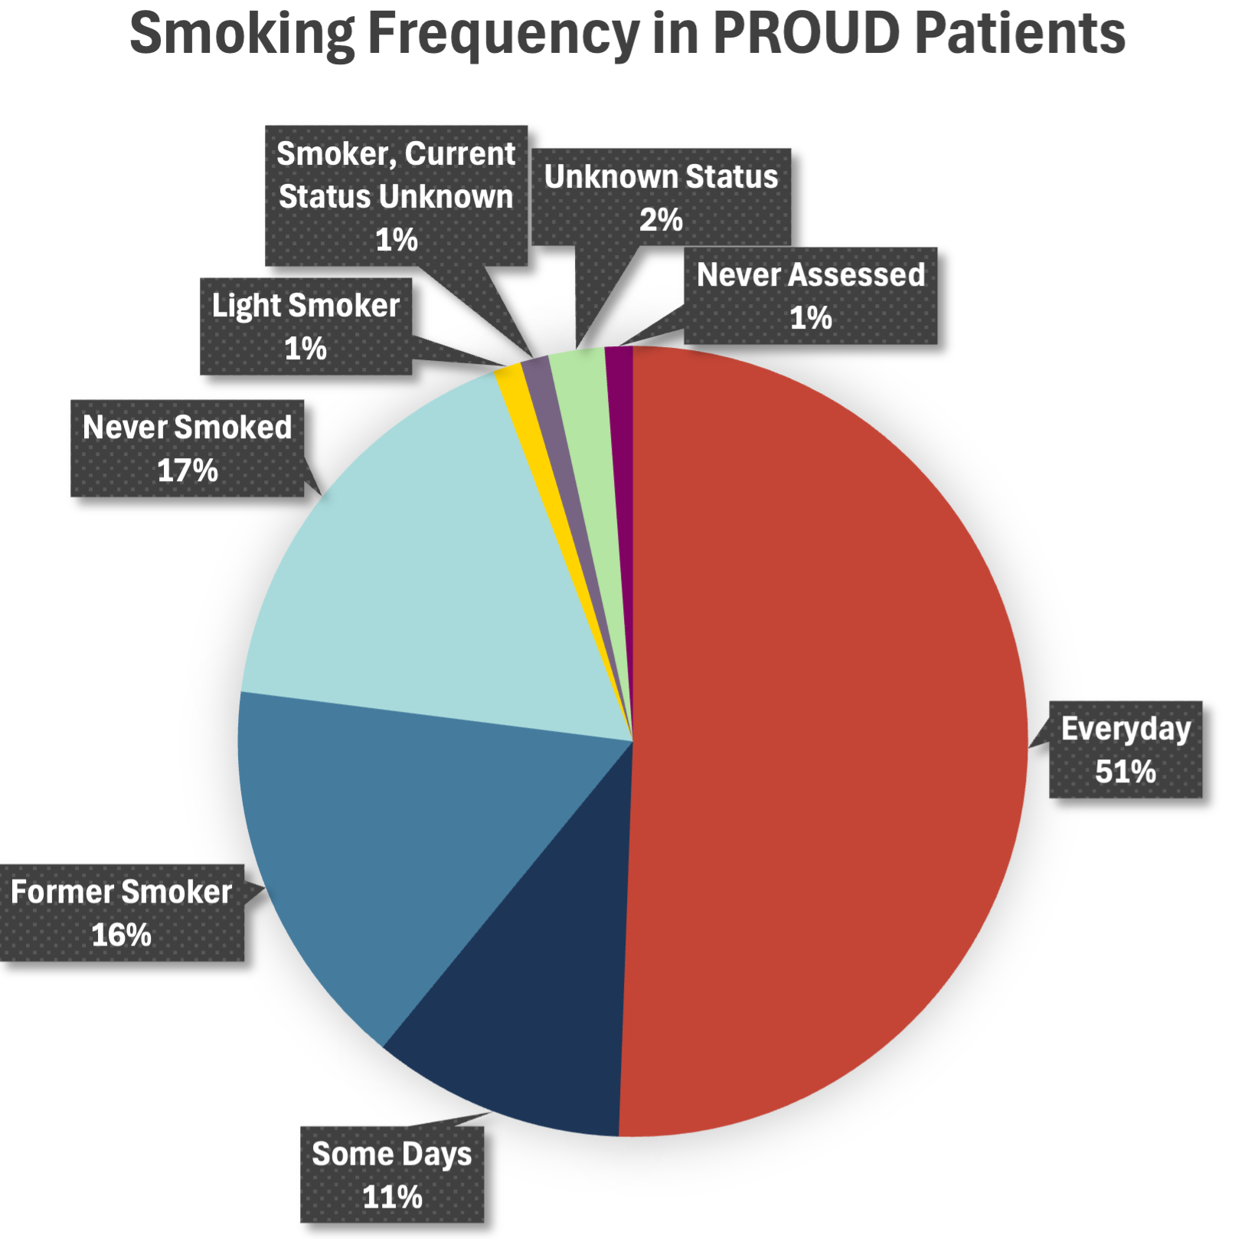
Smoking Cessation and Contingency Management
Carbon Monoxide Monitoring
> 12 ppm indicates recent smoking
Randomized testing to determine eligibility for incentive
Mixed-Method Questionnaires
Tobacco Cravings Questionnaire -Short Form (TCQ-SF)
Contingency Management Schedule
Financial incentives are provided to encourage smoking cessation
Maximum to be obtained is $300 in six months
Notes:
Google grant to see of contingency management can decrease tobacco use
Greater than 80 percent of our patients in proud use tobacco-can affect maternal and fetal outcomes
Prelim data is showing 86% decreased use, and 30% cessation

Slide 22

Group Based Care
March of Dimes Supportive Care Curriculum
Codman Pediatric Curriculum
Recovery Groups lead by our CRS
Notes:
Finally through an institutional grant, and after hearing the requests of our patients, we have launched group based care- integrating prenatal, recovery, and pediatric groups. Most exciting is collaboration with W. Philadelphia community organizations that attend group sessions.
Nia

Slide 23
Summary
The PROUD Program is an innovative model to meet the specific needs of perinatal and post partum patients in recovery
This model increases MOUD use and engagement outcomes
Dyad care is an important tool for engaging families in recovery and reducing barriers to pediatric care
Future work: effect on delivery outcomes, interdisciplinary research
PROUD continues to expand with group-based prenatal and recovery care model
Notes:
Navid

Slide 24

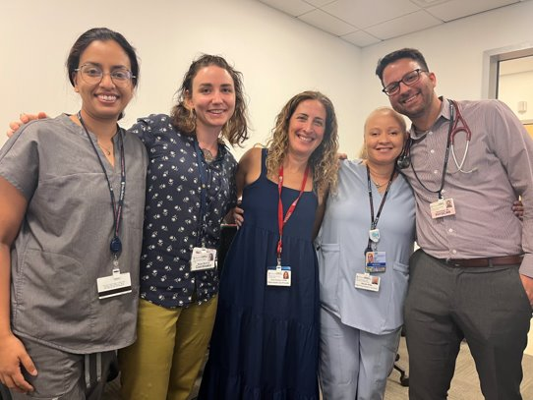
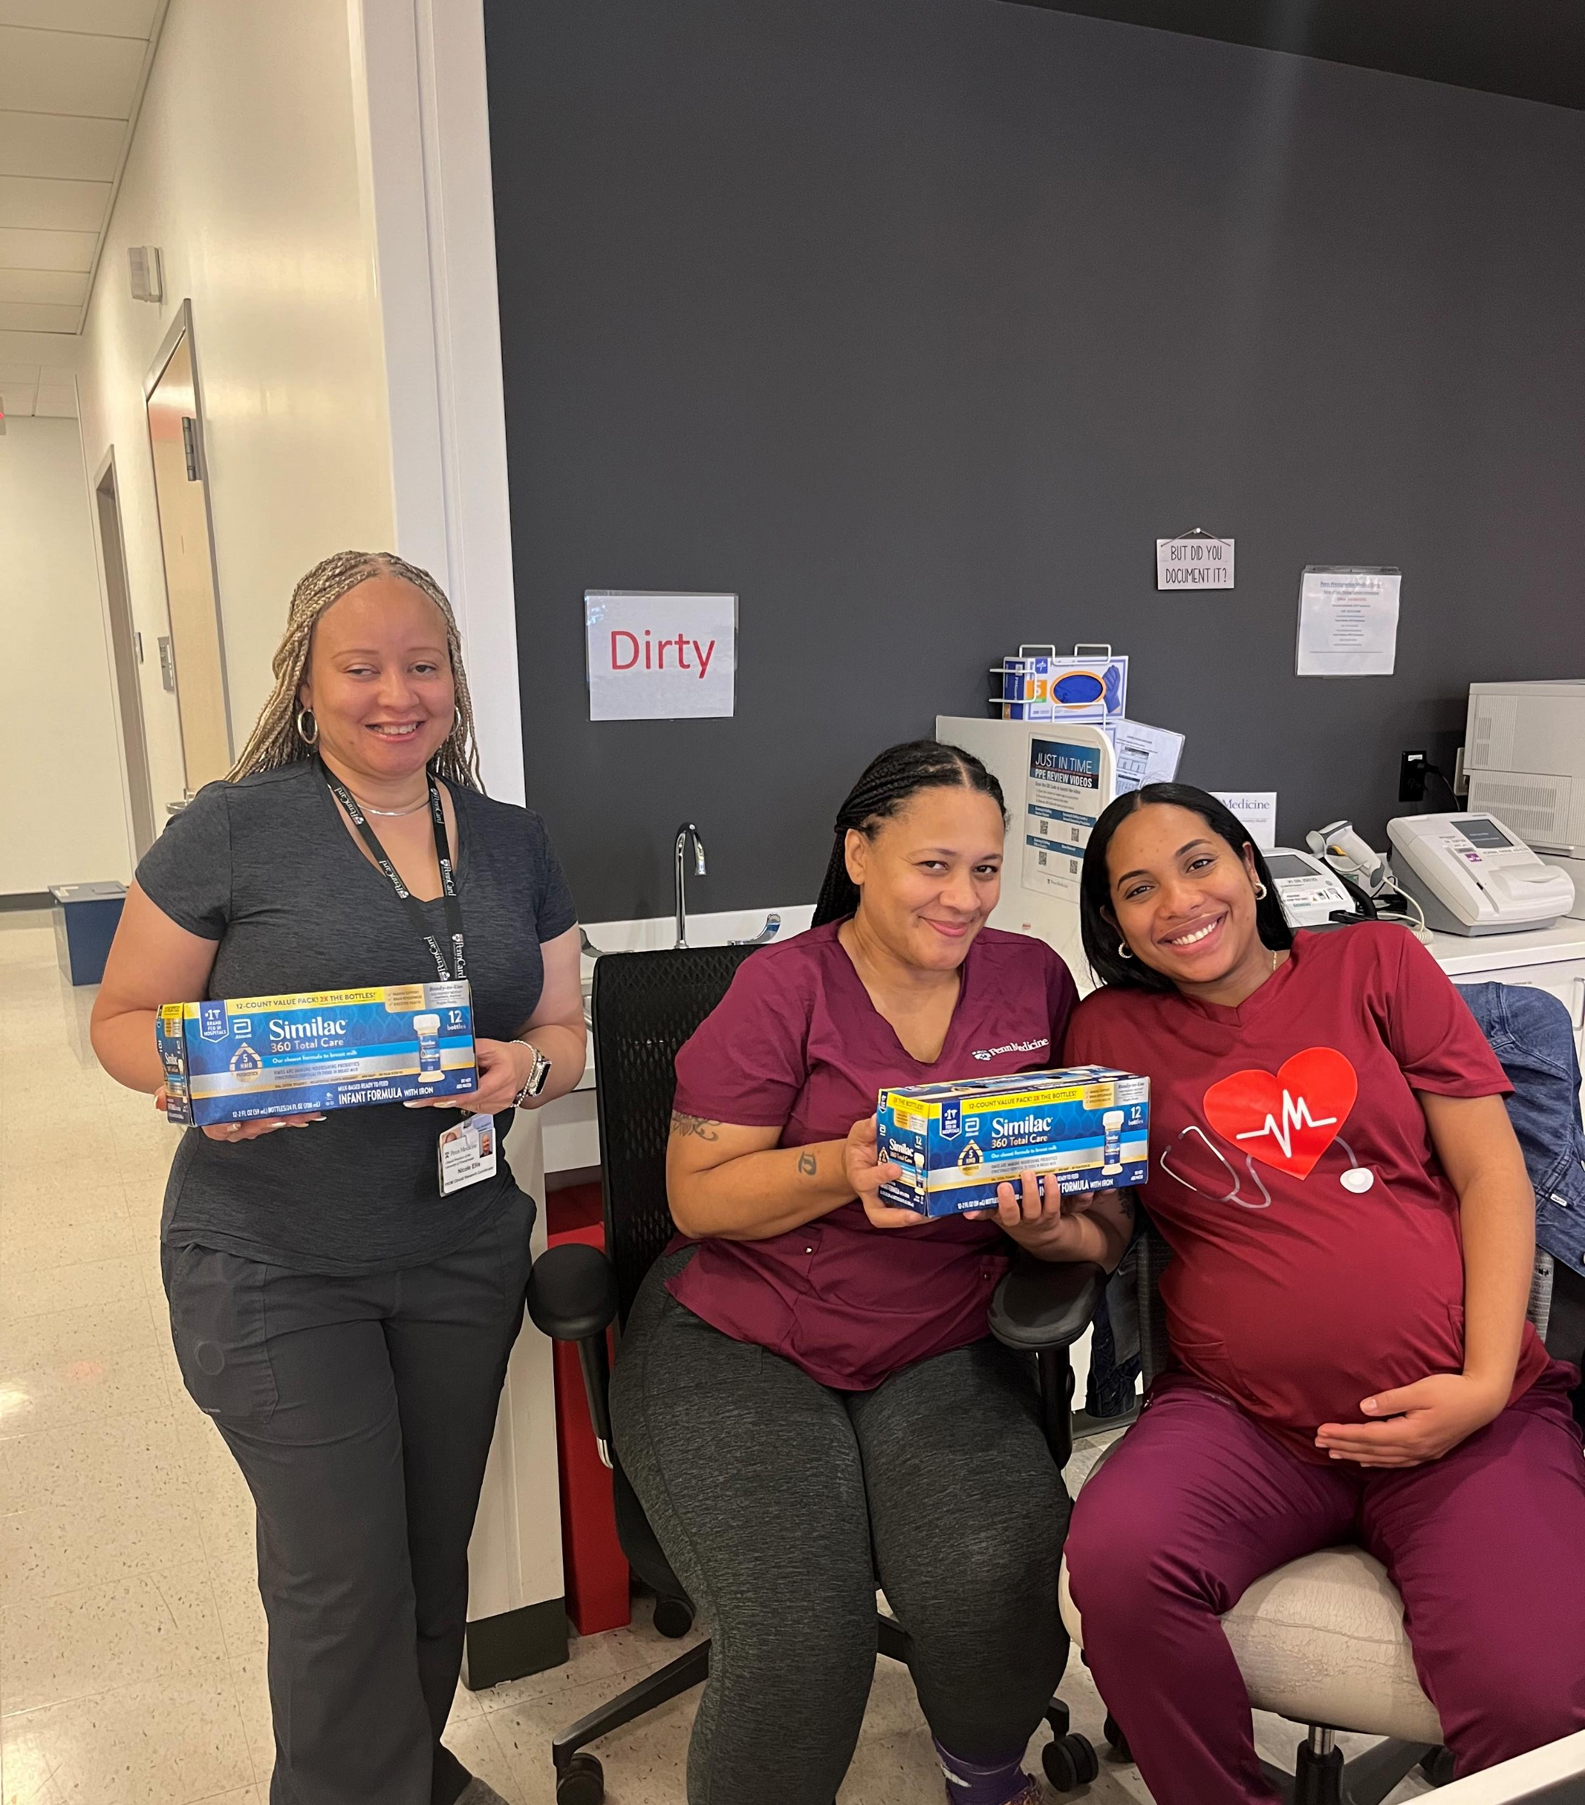

Questions
“The clinic is always there for us, you know, everyone sees me for me now, and not what I’ve done or who I was [in the past]. I feel safe cared about.”
- PROUD Patient

