Slide 1
Combined Contingency Management for Stimulant Use Disorder & ART Adherence
An Implementation-Effectiveness Pilot in HIV Primary Care
Gabriela Steiner, Stefan Baral, Elise Riley, Gabriel Chamie, Steve Shoptaw, Monica Gandhi, Phillip Coffin, Ayesha Appa
Notes:
Hello everyone, my name is Gaby Steiner, I’m a fourth year at UCSF applying into internal medicine this year
I’m thrilled to talk to you today about our implementation-effectiveness pilot, offering Contingency Management incentivizing both stimulant use reduction and ART adherence in HIV primary care

Slide 2
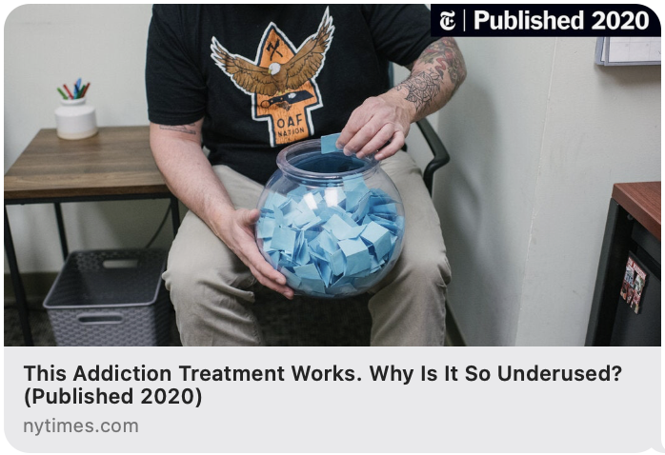
Implementation Gap
Only 1 in 10 addiction specialists provide CM!
Why?
Feasibility concerns
Notes:
CM is gold-standard care for StUD
With hundres of trials demonstrating its efficacy in promoting abstinence from both methamphatemine and cocaine
And In 2023, the American Society of Addiction Medicine recommended CM as first-line treatment for stimulant use disorder.
Despite this, accessibility of first-line treatment is poor, with
Only 1/10 addiction specialists provide CM
Why is this the case? A lot of reasons, but the barrier we will focus on today: Feasibility concerns, largely stemming from the lack models integrating CM into ambulatory community settings

Slide 3
Two missed opportunities…
Lack of CM in high-need community settings
CM can also target medication adherence
Like HIV primary care
Why not offer dual incentives, targeting related behaviors?
5-32% prevalence of StUD
Methamphetamine linked with worse outcomes
Stimulant use
ART Adherence
Notes:
In designing our study, we identified two missed opportunities we wanted to address:
First, lack of CM integration in high-need community settings keeps this tx from reaching the people who most need it
HIV ambulatory care represents one such setting, largely b/c
The high prevalence of StUD amongst PLWH
And the fact that methamphetamine use is linked to the poorest HIV outcomes of all substances
Second, CM has also been shown to successfully promote adherence to medications, but no studies to date have used tenofovir point care testing to incentivize ART adherence through CM
Doing so offers the opportunity to target the two related behaviors of stimulant use and ART non-adherence through one combined intervention
This background has largely motivated the CoMBO Study

Slide 4
Objectives
Pilot once-weekly CM in safety-net HIV primary care, providing incentives for stimulant use reduction and ART adherence
Evaluate pilot implementation using the RE-AIM framework, focusing on reach, implementation, and effectiveness
Notes:
The objectives of this study were one
1. Pilot once-weekly CM in safety-net HIV primary care, providing incentives for stimulant use reduction and ART adherence
2. Evaluate pilot implementation using the RE-AIM framework, focusing on reach, implementation, and effectiveness

Slide 5
Intervention Design
Who & Where?
Pts with Stimulant Use Disorder + living with or at high risk of HIV
2 ambulatory HIV clinics at San Francisco General Hospital
What?
12 weeks of individual + walk-in + once-weekly CM
Targeting stimulant use reduction AND tenofovir adherence
Escalating incentives
Notes:
We offered the intervention to patients with StUD and who were living with or at high risk for HIV
The intervention was hosted within two county HIV ambulatory care clinics
We offered 12 weeks of individual, walk-in, once-weekly CM targeting stimulant use reduction AND tenofovir-based ART adherence
To do so, we used urine POC tests to detect tenofovir and stimulants
Depending on testing results, participants had opportunity draw incentives from fish bowl
Half of which were affirmations, half of which were giftcards to grocery stores, mostly for $10
We provided escalating incentives, meaning each consecutive week in which participants achieved behavior goals, they had the opportunity to draw more incentives from the fishbowl

Slide 6
RE-AIM Program Evaluation
Notes:
Moving on to our RE-AIM program evaluation…

Slide 7
Reach
Will safety-net patients enroll and return?
Table 1: Enrollment
37 people with stimulant use disorder enrolled
25 were eligible for tenofovir incentives
All but 9 returned after enrollment
Recruitment
51% referred
49% walked-in
Notes:
I’ll first discuss our program Reach, describing who enrolled and participated
Over 4-month recruitment period, 37 patients with StUD enrolled in the pilot
25 were eligible to receive incentives for tenofovir adherence
All but 9 pts returned after enrollment, resulting in a cohort of 28 active participants
Of all patients who were enrolled, 51% were referred by a provider in the safety-net and 49% walked-in without previously knowing about the study

Slide 8
Reach
Who will participate?
Race/Ethnicity Black Latinx White | 43% 30% 41%
Gender Cisgender men Cisgender women Transgender women | 41% 32% 19%
Substance Use Methamphetamine Cocaine Fentanyl Hx overdose | 73% 37% 19% 41%
HIV History Living with HIV Detectable VL | 84% 38%
Other Unhoused Access to phone Primarily Spanish-speaking | 57% 53% 8%
Notes:
In terms of socio-demographics, I’d like to highlight a few notable features:
One, 43% of our pariticpants identified as black and 30% as Latinx
Transgender women represented about 20% of our cohort
Most people were using methamphetamine at 70%
Nearly 40% had a detectable VL at enrollment
A high proportion of participants were unhoused at almost 60%, and approx half of people did not have consistent access to a phone

Slide 9
Implementation
What are the resource costs?
Average Length:
178
visits
23 min (SD 12)
$3335
Average Attendance:
Urine provided in 98% of visits
52% for Tenofovir
5 visits
(SD 4)
48% for Stimulants
$19/visit
Notes:
Regarding implementation metrics:
We conducted 178 visits over eight months, during which participants provided urine for POC tests in almost all visits
Approximately $3300 were spent on gift-cards, averaging at $19 per visit.
Visit length averaged at 23 min, and avg attendance was 5/12 visits.

Slide 10
Effectiveness
How will health behaviors change?
57% of Stimulants tests were Negative
17 patients tested Negative at least 1x
Participants reported reduced stimulant use on Timeline Follow-back
98% of Tenofovir tests were Positive
Notes:
Looking at effectiveness, we observed that 57% of all stimulant POC tests were unreactive,
with 17 participants contributing at least one unreactive test
Additionally, on weekly timeline follow-back assessing frequency of use, participants reported a significant reduction in stimulant use at week 12 compared to baseline
Regarding tenofovir adherence, nearly all poc tests werfe positive for tenofovir, which is notable in this group with high rates of detectable VL at enrollment

Slide 11
Limitations
Fidelity → once weekly testing does not ensure abstinence
What outcomes matter beyond abstinence?
Implementation → restrictions on use of incentives in healthcare
Maintenance → sustainable funding is an ongoing issue
Notes:
Some limitations to consider include
One: Fidelity => once weekly testing does not ensure abstinence form stimulants, as most POC tests detect substances within a 3-4 day window
Even so, it is worth considering other outcomes that once weekly CM might facilitate – like stimulant-use reduction and global engagement with care
Second: one barrier to implementation that we don’t address is that your ability to provide financial incentives in healthcare depends on the restrictions in your state and county
Third: maintenance – this pilot was funded as a research study, and my mentor Dr. Ayesha Appa is pursuing clinic-based funding to implement the program permanently

Slide 12
Conclusions
First demonstration of dual-incentive contingency management using tenofovir POC testing
Feasible to implement in safety-net HIV primary care
Reached a complex, high-needs population
Demonstrated benefit of tailoring CM to specific populations
Participants reduced stimulant use while improving ART adherence
Notes:
With that said, some conclusions to draw from our work include:
1. this pilot represents the first demonstration of dual-incentive CM targeting stimulant use reduction AND ART adherence through one intervention, facilitated by tenofovir POC testing
2. this CM intervention was feasible to implement in the safety-net HIV primary care setting, Successfully reaching a complex, high-needs, and diverse population
This Highlights the importance of bringing this first-line tx into spaces where people using stimulants are already receiving their healthcare
3. Lastly, this study demonstrates the benefit of tailoring CM interventions to meet the needs of specific populations
In this case, we saw that as participants achieved reduced stimulant use, they also made progress in the related behavior of art adherence

Slide 13
Next Directions… Sneak Peak at Qualitative Analysis
Motivating to have two chances to succeed
Co-located addiction & primary care is convenient
Led to other positive changes
Notes:
Regarding next directions – we are currently conducting qualitative interviews with participants and clinic staff, in part to better understand facilitators and barriers of CM integration in HIV ambulatory care setting
Some early themes we’re seeing from participant interviews are that
Participants like co-location of addiction treatment with their primary care b/c makes tx accessible and convenient
Participants found it motivating to have two options to win incentives instead of just one
Participating in this program helped people make other significant changes in their lives, like connecting with mental health resources and housing

Slide 14
Acknowledgements
Ayesha Appa
Monica Gandhi
Phillip Coffin
Steve Shoptaw
Elise Riley
Gabriel Chamie
Kate Roberts
Lauren Suchman
Meghan Muprhy
Kelly Knight
Jan Oskarsson
Heneliaka Jones
Elizabeth Imbert
Caycee Cullen
Christy Camp
And Our Study Participants!
Notes:
I’d like to end by thanking everyone who worked so hard to make this pilot happen, and in particular highlight
Dr. Ayesha Appa as the senior leader of this work
Dr. Monica Ganhdi for supporting this work at Ward 86
Dr. Phillip Coffin for advising this trial
And Dr. Steve Shoptaw for providng guidance around CM

