Slide 1
Comparing Long-Acting Injectable versus Oral HIV Antiretroviral Therapy for People Who Use Drugs
November 14, 2024
AMERSA Chicago
Kathleen O’Connor, Sarah Strieff RN, Alix Strough RN, Sydney Yoon, Stephen Matzat MD, Barry Zevin MD, Joanna Eveland MD, Nicky Mehtani MD MPH

Slide 2
Disclosures
None

Slide 3
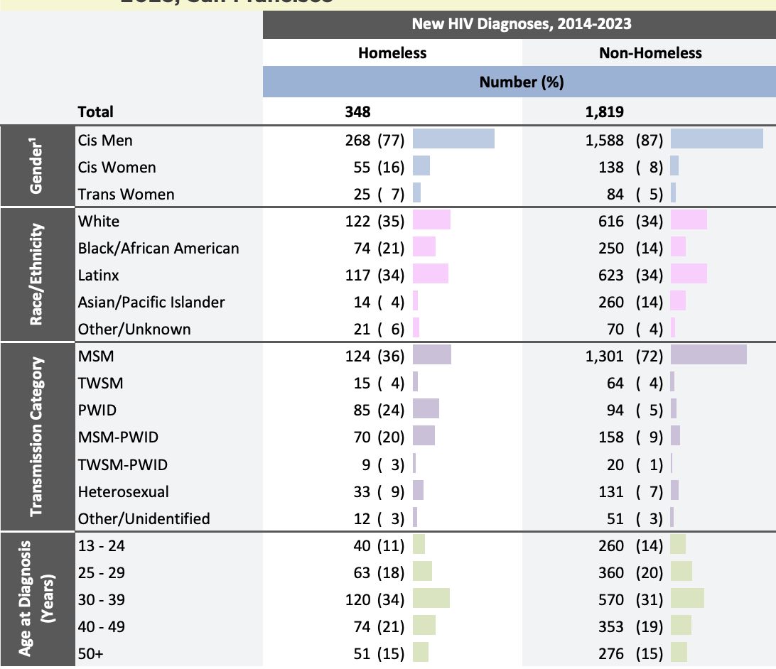
Background
People experiencing homelessness (PEH) accounted for 23% of new HIV infections in San Francisco in 2023
SFDPH 2023 HIV Epidemiology Report
Notes:
In San Francisco, PEH accounted for 23% of new HIV infections in 2023 despite making up less than 1% of the population. PEH also had decreased rates of viral suppression and linkage to care relative to housed populations.
As we can see from this data from SFDPH’s 2023 epidemiology report, injection drug use has been an overrepresented mode of transmission among PEH in the last decade.
Of note, black/ Latinx San Franciscans overrepresented both in base rates of homelessness and in new infections

Slide 4
Trauma
Stigma
Gentrification
Racism
Mental Health Issues
Encampment Sweeps & Property Loss
Substance Use Disorder
Oral Medication & Care Engagement Challenges
Notes:
-Disparities in HIV infections and treatment are influenced by a wide range of systemic factors, ultimately more virulence within a given community is going to lead to more transmissions.
-PEH and PWUD face multiple compounding barriers that can make taking oral medications every day very challenging
-Ex: backpack stolen
-Loss of privacy in congregate settings
-no pharmacy in your neighborhood due to chronic disinvestment etc.

Slide 5
 | Comparing Antiretroviral Therapy Options for People Living with HIV
 | Oral ART | Long-Acting Injectable ART
Route | A pill taken once daily | One intramuscular injection generally every 4 or 8 weeks depending on formulation
Administration | Self-Administered | Administered by healthcare providers
Common Barriers | Requires safe medication storage, remembering to take a pill every day | Requires regular clinic visits, needles
Responsibility of Medication Provision | Person with HIV | Health system
Notes:
Long acting injectables are a relatively recent treatment option for PLWH, have the potential to counteract some of the barriers PEH/PWUD face in getting HIV care but also pose their own challenges
-pros: less frequent dosing, potentially increased privacy for pt, reduced risk of missed days
-cons: frequent health care provider visits, needles, greater burden on health system to manage dosing schedule

Slide 6
Objectives
To compare rates of HIV virologic suppression and number of medical encounters between PEH receiving LA-ART vs. oral ART at a low-barrier clinic and Street Medicine program serving a high proportion of PEH and PWUD
Whole Person Integrated Care (WPIC): Predominantly Maria X Martinez Clinic & SFDPH Street Medicine Team
Notes:
Lots of people on long acting anti-psychotics and buprenorphine

Slide 7
Methods
Data extracted through retrospective chart review of all patients with HIV (January-December 2023):
Demographics
Program-specific (WPIC) medical encounters
HIV viral loads
Co-morbidities
Excluded patients:
With ≤1 WPIC visit in 2023
Established in HIV care elsewhere
Illustration by Kimberly Carney / Fred Hutch News Service

Slide 8
145 unique patients with HIV seen at WPIC between January and December 2023
Of the remaining 94 patients
Excluded:
36 established in HIV care elsewhere
15 with only one visit
87 Were receiving Oral ART*
20 Were receiving LAI ART
2 Were not receiving any form of ART
*Includes 15 patients who started on oral ART and switched to LAI

Slide 9
Results
 | Demographics
 | Oral ART (n=87) | LA ART (n=20)
Transgender/Gender Non-Binary | 16% (n=14) | 30% (n=6)
Psychotic Disorder | 28% (n=24) | 40% (n=8)
Other Mental Health Disorder | 48% (n=42) | 60% (n=12)
Cisgender Male | 66% (n=57) | 60% (n=12)
Non-White Racial Identity | 71% (n=62) | 75% (n=15)
Stimulant Use Disorder | 71% (n=62) | 75% (n=15)
Opioid Use Disorder | 28% (n=24) | 30% (n=6)
Mean Age | 43.9 (SD 11.69) | 41.5 (SD 9.59)
Notes:
The populations were similar with regard to age, race/ethnicity, and the prevalence of stimulant, and opioid use disorders
Selection bias but not necessarily in favor of ”healthier” population

Slide 10
Results
Notes:
We also looked at viral load as a marker of HIV virologic suppression in each population
on the left we have percentage of each population who had a viral load under 30 at any time during 2023
on the right we have people who had a viral load under thirty at their most recent lab draw
-you can see that viral suppression was both achieved and maintained with higher frequency among people on LAI

Slide 11
Results
Significantly increased mean visits per person-year (p<.001)
Notes:
Finally we evaluated mean program visits per person per year- we see that people on LAI have on average more than twice the rate of health visits
LAI REQUIRES more visits but this number is greater than # you would need for LAI alone
-double edged sword- possibility for more regular health care access, STI testing, general health screenings etc, but also means quite a lot of time spent with a provider for patients and quite a lot of burden on health providers

Slide 12
Limitations
Retrospective analysis with key population differences
LAI generally only prescribed to individuals with history of care engagement
WPIC LAI patients may have higher rates of intensive case management support to help navigate to clinic (though not all do)
LAI injections easier to incentivize
Retrospective analysis with key population differences
LAI generally only prescribed to individuals with history of care engagement
WPIC LAI patients may have greater use of intensive case management support to help navigate to clinic as well as closer monitoring by LAI team
LAI injections incentivized
Analysis is clinic-specific
May not translate to other settings
Notes:
$10/ labs $10/ inj
Scaffold for this program already existed

Slide 13
Conclusions
Compared to oral ART, receipt of LA-ART was associated with increased HIV viral suppression among PEH and PWUD—demonstrating significant potential of LA-ART to address care disparities
LA-ART required significantly more clinic visits, which is unlikely to be acceptable to all PWH but may also provide more opportunities for care engagement
Ultimately, these data support increased public health investment in LA-ART implementation

Slide 14
Thank you! Questions?
Special thank you to WPIC HIV team: Sarah Strieff, Alix Strough, Nicky Mehtani, Sydney Yoon, Stephen Matzat, Joanna Eveland, and Barry Zevin
References
San Francisco Department of Public Health, Population Health Division. HIV Epidemiology Annual Report 2023. San Francisco, CA 2023
Reddon H, Socias ME, Justice A, et al. Periods of Homelessness Linked to Higher VACS Index Among HIV-Positive People Who Use Drugs. AIDS Behav. 2022;26(6):1739-1749.

