Slide 1
Contingency Management 2.0:
Novel Strategies for Implementing Contingency Management
in Diverse Settings
Presented at the 47th Annual Conference of the Association for Medical Education and Research in Substance Abuse (AMERSA)
November 3rd, 2023
Washington, DC

Slide 2
Our Team
Dominick DePhilippis, PhD
VA Deputy National Mental Health Director, Substance Use Disorders
VA Office of Mental Health and Suicide Prevention
Amy J. Kennedy, MD, MS and Courtney Tuegel, MD
University of Washington School of Medicine
VA Puget Sound Health Care System
Sara Chaudry, LICSW and Sergio Flores, PsyD
VA Puget Sound Health Care System
Gabriela Khazanov, PhD
Center of Excellence in Substance Addiction Treatment and Education
Philadelphia VA Medical Center

Slide 3
Disclosures
No conflicts of interest or relationships to disclose

Slide 4
Objectives
The participant will be able to:
Define contingency management (CM) and describe evidence supporting implementation of CM in a variety of practice settings.
Apply a framework for implementing CM treatment for diverse care settings.
Identify two strategies to facilitate implementation of CM within your practice setting.

Slide 5
Agenda
Background on CM
Case 1 – Attendance
Case 2 – Adherence
Case 3 – Abstinence
Wrap Up

Slide 6
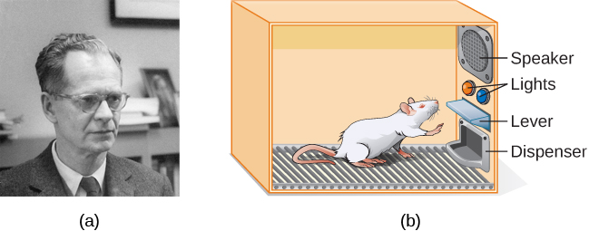
The Organizing Principle of Contingency Management: Operant Conditioning
https://psyc1100.pressbooks.com/chapter/operant-conditioning/

Slide 7
CM Makes Early Recovery Rewarding
CM brings immediate, reliable reinforcement for engaging in recovery-supportive behaviors, e.g. abstaining from substances, recovery activities, or medication adherence.
CM engages patients in treatment and gives their brains a chance to heal.
Reinforcing the target behavior provides de facto reinforcement of retention.

Slide 8
How does CM work?
Select a specific, objective target behavior, e.g. abstinence.
Measure the target behavior objectively and frequently.
Provide immediate, tangible, desirable reinforcement when the target behavior occurs.
Escalate the size of the reinforcement for consistent behavior.
Withhold reinforcement when the target behavior does not occur.
Re-set the size of the reinforcement for the next occurrence of the target behavior.

Slide 9
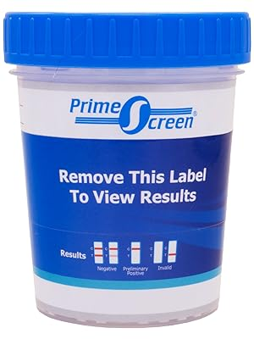
$3
$20
good job!
good job!
good job!
$20
$3
$3
$100

Slide 10
Choosing a Behavior to Reinforce
Because CM is an application of operant conditioning, in theory, any volitional behavior can be a target of CM.
However, the devil is in the procedural details, i.e. defining and monitoring the behavior so reinforcement can be delivered with immediacy when it occurs and withheld when it does not occur.
It’s also crucial that the target behavior be one the patient can successfully perform.
Thankfully, in SUD treatment, two behaviors integrally associated with recovery, abstinence and treatment attendance, can be monitored reliably, validly, objectively, and frequently.
Other behaviors like medication adherence are appropriate targets of CM, but monitoring these behaviors can be more complicated, e.g. blister packs vs. MEMS caps vs. biomarkers vs videorecording.
Recovery activities also can be effectively targeted with CM, but objective verification that the behavior occurred can be a challenge. Furthermore, the activities to be completed for reinforcement should be able to be accomplished on a frequent basis, e.g. weekly, so behavioral shaping through frequent reinforcement is possible.

Slide 11
CM is Effective Across Many Patient Populations
Homeless:
Tracy et al., 2007, Am J Drug Alcohol Abuse, 33(2), 253-258.
People with serious mental illness:
Murphy et al., 2015, DAD, 153, 293-299.
People with PTSD:
Mancino et al., 2010, Am J Addict, 19(2), 169-177.
People with HIV disease:
Petry et al., 2001, JSAT, 21(2), 89-96.
Justice involved patients:
DeFulio et al., 2013, JSAT, 45(1), 70-75.
Veterans:
DePhilippis et al., 2018, DAD, 185, 367-373.
People on MOUD:
Bolivar et al., 2021, JAMA Psychiatry, 78(10), 1092–1102.
Ainscough et al., 2017, DAD, Sep 1;178, 318-339.
Across ages:
Weiss and Petry, 2011, Exp Clin Psychopharmacol, 19(2), 173-181.
Across races*:
Montgomery et al., 2015, JCCP, 83(3), 473-481.
Across sexes:
Petry and Rash, 2015, Exp Clin Psychopharmacol, 23(5), 369-376.
Pregnant women:
Schottenfeld et al., 2011, DAD, 118(1), 48-55.
LGBT community:
Reback et al., 2021, AIDS and behavior, 25(Suppl 1), 40–51.
Zajac et al., 2020, PAB, 34(1), 128-135.
Across income levels:
Rash et al., 2009, DAD, 104(3), 249-253.
Notes:
* Montgomery and colleagues (2015, JCCP, 83(3), 473-481) found an interaction effect of race, CM, and baseline UDS. African American patients who begin CM treatment with a positive sample did not have better outcomes than patients in standard care. May be a function of severity of SUD.

Slide 12
Checklist for creating a CM program
What behavior to reinforce
Which CM protocol to use (voucher vs. prize)
What type of reward (merchandise vs. gift cards vs. clinic privileges)
Implementation concerns (procedural, organizational)

Slide 13
Case 1 – Primary Care
You are a primary care provider seeing a patient in his mid-forties with stimulant-associated heart failure. His left ventricular ejection fraction is 30% (half of normal).
He is currently using methamphetamines. He is not interested in cessation because he is currently unhoused and uses methamphetamines to remain alert at night.
He has been treated in the emergency department (ED) for heart failure symptoms four times in the last six months but has not attended outpatient cardiology appointments.
He tells you that he is taking one blood pressure medication (out of the four recommended treatments for heart failure).
How would you design a contingency management program to help encourage this patient to start the treatments for his heart failure?

Slide 14
How would you design a CM program to help encourage this veteran to start the treatments for his heart failure? Protocol
Behavior: __________
Protocol (voucher vs. prize): ______
Reward (merchandise/gift cards/clinic privileges): ________
Implementation concerns: ________

Slide 15
Protocol
Behavior: Attendance
Protocol (voucher vs. prize): Voucher
Reward (merchandise/gift cards/clinic privileges): Gift cards to hospital store
Implementation concerns:
How to help a patient experiencing homelessness get to appointments?
Buy-in from primary care leadership
What metrics to measure? And how to measure?
ED utilization? Primary care engagement?
Starting guideline directed treatments for heart failure ?
Stimulant reduction or cessation?

Slide 16
Sample Protocol
12-week program
Weekly meetings with a primary care provider
Review heart failure symptoms, stimulant use
Perform volume exam
Medication adjustments and counseling
Given Veterans Canteen Service coupons (escalating values between $4-$7) **
Remote chart review done by expert cardiology consultant
** Participants did NOT need to report substance abstinence to receive incentives, and urine drug screenings were not collected.
Tuegel, C., Farris, S. D., Kantner, C. W., Leyde, S., DePhilippis, D., & Kennedy, A. J. (2023). An Attendance-based Contingency Management Pilot Program for Veterans Experiencing Homelessness With Stimulant-associated Cardiomyopathy in Primary Care. Journal of addiction medicine, 17(5), 627–628.

Slide 17
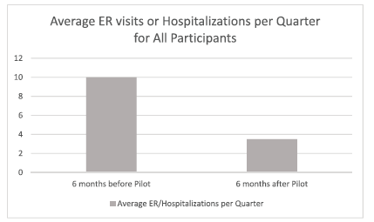
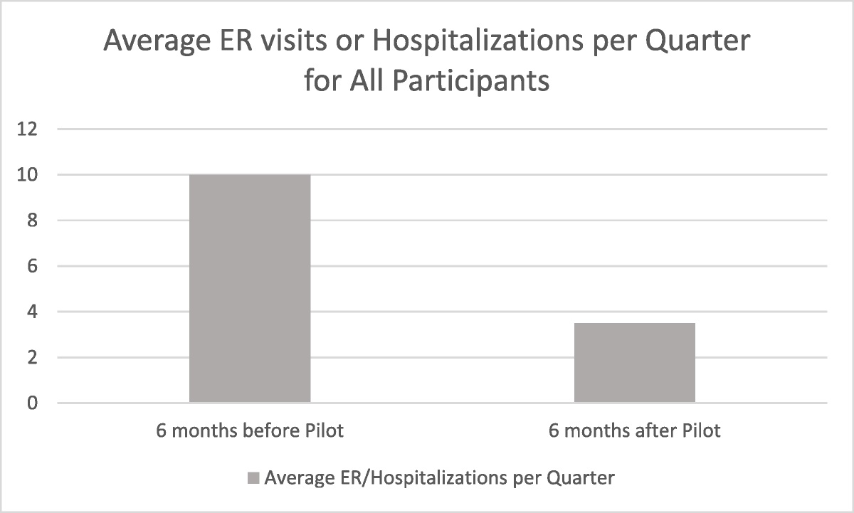
Outcomes: Pilot of 8 Participants
Average attendance rate: 7 of 12 sessions
Total monetary vouchers: $297 (range of vouchers/person: $4 to $75)
Participants were on a mean of 3 heart failure treatments at end of program
60% reduction in mean number of ER visits or hospitalizations after participation
Tuegel, C., Farris, S. D., Kantner, C. W., Leyde, S., DePhilippis, D., & Kennedy, A. J. (2023). An Attendance-based Contingency Management Pilot Program for Veterans Experiencing Homelessness With Stimulant-associated Cardiomyopathy in Primary Care. Journal of addiction medicine, 17(5), 627–628.

Slide 18
Case 2: Opioid Treatment Program
VA Puget Sound Health Care System – Seattle
Opioid Treatment Program
“Providing compassionate care and instilling hope in recovery”
N = 111 Veterans enrolled in OTP
Mean age = 62.7
Age range = 28 -78 years
Male (92.8%)
Caucasian (82.9%)
Notes:
Next, we want to talk about a unique application of CM we’re piloting at the Seattle VA Opioid Treatment Program at VA Puget Sound.
But first, we want to give you a little information about our clinic/setting for context…
Opioid Treatment Programs are often referred to as “OTPs” or “methadone clinics.” OTPs can dispense both methadone and buprenorphine; though, at the Seattle VA we solely dispense methadone.
[briefly reference demographics]
Our treatment philosophy is aimed at providing a Veteran-centered approach to care. We try to “meet our veterans where they are at,” and we are constantly looking at ways to decrease barriers and increase access to care. One way we have done this is by starting new admissions on a 3 day/week dosing schedule for example (instead of 6 days/week). We also provide same day admissions to our program including rapid readmissions for Veterans who have disengaged from treatment. Despite the implementation of these protocols, retention has been problematic.
In February of 2023, we began using a CM protocol we developed with the aim of increasing engagement and retention in our OTP.
We are the 1st VA OTP to pilot this protocol within the VA health care system.
In the next few slides, we will provide you with more context of the concerns our OTP had in regards to engagement and give you an opportunity to share your own ideas for developing a CM protocol. We will then share with you our own protocol, things that have gone well, things that have been challenges, and some of our initial outcome data.

Slide 19
Defining the problem
Notes:
I’m going to spend the next few minutes defining a problem that our OTP has been exploring over the last 12 months.
I’d like you to imagine that you are a program manager, administrator, or perhaps a medical director of an opioid treatment program, and you are meeting with your staff following the death of a patient who recently returned to treatment. His death is suspected to be from an accidental overdose on fentanyl.
This patient is well known to your team, he was started on methadone about 2.5 weeks ago, and was in the process of being titrated onto a stable methadone dose. Just a couple days ago your team was discussing how glad they were he was returning to treatment after declining engagement for several years.
Additionally, your team learns he was one of two individuals who died at the same housing site on the same day. This building specifically houses Veterans who were previously homeless or unstably housed. You and your team know that there are several other Veterans at that housing site that are using fentanyl, who all have significant medical and psychiatric co-morbidities. Despite collaboration with other providers in the VA, AND despite removing the requirement for daily dosing for new admissions, these other Veterans have not consistently engaged in treatment since prior to the COVID pandemic.
Your staff are feeling demoralized and concerned that Veterans (patients) just don't seem like they are engaging in treatment in the way that they use to prior to 2020. You, in your leadership position, decide to have a look at basic retention data and this is the information you obtain.
As an administrator, the data that stands out most to you is the dramatic change in retention between 2021 and 2022. While in 2021, 76% of Veterans admitted to the OTP were staying in treatment for at least 6 months, this dropped by approximately 50% in 2022. Additionally, though admissions increased in 2022, 60% of admissions were leaving treatment within the first 90 days.

Slide 20
Defining the problem
Notes:
After looking at admission/retention information, you look at data regarding the primary opioid being reported by Veterans at admission to your OTP. When you look at this data, it becomes evident that there was a significant change in self report of fentanyl use from 2021 to 2022 (15% to 80%).
Looking at this information, your team is wondering: is there something we can do to better engage Veterans at the start of treatment? You know, as the administrator of this program, that the longer a patient engages in treatment, the better the outcomes are. So far, it appears that a less restrictive dosing schedule and ability to earn take home doses quicker than prior to COVID, is not enough of a reinforcer to keep Veterans engaged in treatment in the age of synthetics.
A staff member on your team wonders aloud: "what if we tried CM"?

Slide 21
How would you design a CM program to increase OTP engagement?
Behavior: __________
Protocol (voucher vs prize): ______
Reward (merchandise/gift cards/clinic privileges): ________
Implementation concerns: ________
Notes:
What behavior do you want to reinforce? How frequent do you want to reinforce that behavior? What implementation concerns might you have?

Slide 22
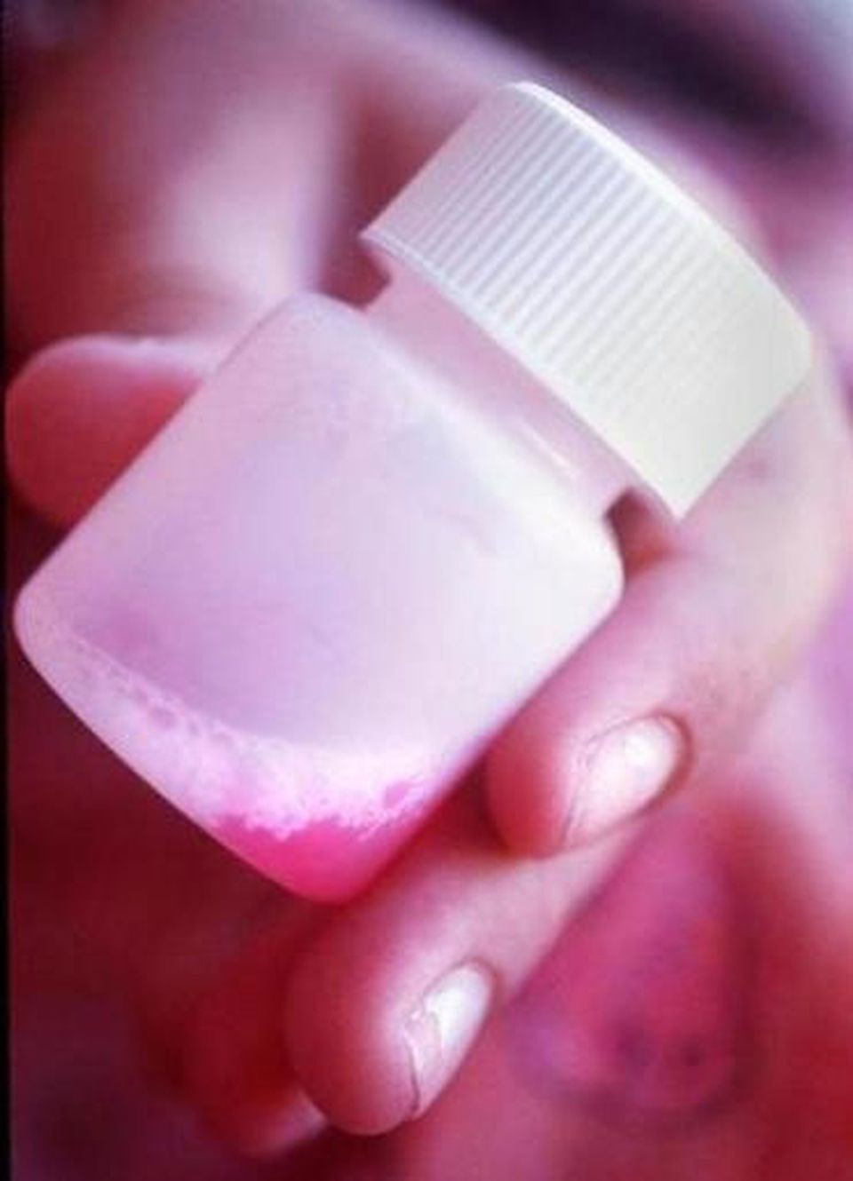
CM Implementation for OTP
Behavior:
Observed Methadone Dosing
Protocol:
Adherence to Methadone - Voucher Based CM – Fishbowl Method
Reward:
Veterans Canteen Service Coupons that can be redeemed for Food, Coffee, and Merchandise from VA Patriot Store
Supervised ingestion of methadone?
Draw until you get a prize
Additional consecutive supervised ingestion of methadone?
0 draws
Escalate to 2 draws (continue up to 8 draws)
Revert back to 1 draw
Yes
Yes
No
No
8-week protocol
CM appts 3x/week (or, whatever dosing schedule Veteran is started on)
Max 164 draws for an average of $501 in earnings
Notes:
Our protocol targets adherence to methadone and was based on previous protocols developed for adherence to injectable medications like naltrexone
Our protocol is an 8-week protocol that is delivered during the first 2 months of treatment (we hypothesize this is key for facilitating stabilization and engagement).We targeted the first 2 months of treatment after consulting with several VA OTP medical directors & theorizing that this time period is instrumental as this is where titrations are most frequent and stabilization occurs
The protocol provides draws from a “prize bowl” to Veterans each time they come into our OTP and complete a supervised ingestion of Methadone.
A typical starting schedule in our OTP calls for vets to complete supervised ingestion of Methadone 3 times a week… They receive “take-home” methadone doses on the other days.
Each completed ingestion is incentivized using our CM draw schedule
For the first dose of methadone, all veterans get 1 “priming draw” (draw until they win a prize)
Additional, consecutive supervised ingestions of methadone result in escalated draws from the prize bowl (i.e., escalate the size of the reinforcement for consistent behavior). Caps at 8 draws.
If a veteran is scheduled to complete a supervised dose but does not do so, draws are reset to 1 except when the absence is excused. (i.e., we re-set the size of the reinforcement when the target behavior does not occur).
If reset to 1 draw, after two consecutive sessions of adherence they revert back to the number of draws they would have earned at the time of the reset.
Veterans have an opportunity to ear a max of 164 draws for an average of $501 in earnings.

Slide 23
CM Implementation for OTP: Concerns and Challenges
Tracking: Need robust tracking system
Staff: Need staff to be willing/excited/invested in implementation and maintenance
Regular check-ins/consultation:
Ensure staff are adhering to the protocol (i.e., maintaining fidelity)
Adjusting protocol to manage your clinic’s particular dosing procedures
Notes:
Implementation Concerns:
Tracking
Can be hard to track what day folks are on & how many draws they have earned – need tracking system
We use our weekly team meeting as a touch point to talk about CM cases
We have a “CM Team Chat Group” so we can communicate b/w dispensary pharmacist & CM clinicians (i.e., CM vets expected for the day, # of draws, etc.)
We also cue our pharmacy staff using alters in our methadone dosing software system
We’re a smaller program (approx. 110-112 enrolled; approx. 15 new admission per year). Consideration for if you’re program is much larger or you have more admissions…
Staff
Need “buy in” and investment from staff willing to implement CM
Regular check-ins/consultation
In the context of the “day-to-day” challenges of working in an OTP (i.e., drop-in appointments, crises, folks wanting to leave prior to CM draws, or vets calling to say they can’t make it), ensuring staff are adhering to the protocol (i.e., maintaining fidelity)
We have a monthly consultation call with CM expert to trouble shoot

Slide 24
Calendar Year 2023 so far….
45% of admissions still enrolled
Notes:
2023 OTP Admissions this far:
20 admissions (4 excluded from data as they have all been in treatment less than 30 days)
Out of 20 admission, CM was offered to 19 (one admission prior to implementation of CM)
17 opted into CM and out of that 17, 8 are still dosing (47%)
2021: review and meta analysis of retention in MOUD treatment utilizing CM
Only 1 of the studies (out of 74) targeted methadone adherence (2018, Kroger et al)
Compared outcomes of Routine Care; Voucher based routine care; and low threshold
No significant differences in retention
methadone titration: 5mg weekly
vouchers provided weekly for both counseling AND methadone adherence
mean days in treatment across all conditions = 105-115
Engagement Comparison:
Preliminary results appear to show improvements in retention but not at pre-pandemic levels – the number of Veterans leaving treatment within the first 30 days has decreased by ½
Our data seems to be trending towards better engagement however, it is important to note the following:
1.) CM is not going to be the answer to eradicate access issues to medications for OUD
2.) CM seems to be a “tool” in a toolbox that may work well for a certain subset of a population seeking admission to our OTP (unstably housed, low/fixed income)
3.) CM is not going to address structural inequities that exist for accessing treatment for minority/marginalized populations
4.) But, CM is fun, Veterans really enjoy it, staff enjoy it, and it appears to be having a positive effect on both retention and staff morale
2021 meta analysis on treatment retention (Klimas et al)
compared retention rates for both buprenorphine and methadone
found that retention rates between both medications was generally equal
wide variation in retention rates:
bup = 20%-70% retention
methadone = 48% to 75% retention

Slide 25
Case 3 – Specialty Care
You are a provider who has been referred a patient in her mid-forties who has had multiple surgeries postponed due to substance use.
She has a history of bipolar disorder, cocaine use disorder, alcohol use disorder, and PTSD. She is actively using cocaine and has attempted to abstain unsuccessfully.
The patient also has severe orthopedic and dental co-morbidities (with concomitant pain and loss of function) and cocaine use has resulted in postponement of orthodontic and orthopedic surgeries as providers have requested a minimum of 90 days of abstinence.
How would you design a CM program to support patients towards abstinence in order to be eligible for surgery?

Slide 26
How would you design a CM program to support patients towards abstinence in order to be eligible for surgery?
Behavior: __________
Protocol (voucher vs. prize): ______
Reward (merchandise/gift cards/clinic privileges): ________
Implementation concerns: ________

Slide 27
How would you design a CM program to support patients towards abstinence in order to be eligible for surgery?
Behavior: Abstinence from Stimulants
Protocol (voucher vs. prize): Either would be appropriate; VA largely uses Prize
Reward (merchandise/gift cards/clinic privileges): Veterans Canteen Service Coupons
Implementation concerns:
Need to determine requisite period of pre-operative abstinence to qualify for the surgery.
What happens with CM during the inpatient surgical stay?
Need to promote continuity of abstinence post-operatively.

Slide 28
Pre-Operative (Pre-Op) CM: Rationale
Patients who do not want to enroll in SUD specialty care but need to maintain abstinence to qualify for surgery.
Pre-Op CM can be offered as a stand-alone service.
Helps patients qualify for surgery and may help support abstinence during the post-operative period.

Slide 29
Pre-Op CM: Procedures
Surgeons and anesthesiologists can identify and refer patients whose surgeries have been cancelled or may be cancelled due to ongoing substance use.
The surgical team recommends a duration of abstinence for each patient as a prerequisite for undergoing surgery or anesthesia.
CM is delivered until the pre-op abstinence criterion is met or 12 weeks of CM elapses.
CM resumes upon the patient’s discharge from the inpatient surgery stay.
12-week CM period pauses during inpatient stay.

Slide 30
Pre-Op CM: Procedures
Typical CM procedures with the addition of…
$40 bonus for testing negative in the CM session at which the prescribed period of pre-op abstinence is achieved
$100 bonus for testing negative at the first CM session upon discharge from inpatient surgery stay (discharges against medical advice does not qualify)

Slide 31
Pre-Op CM: Challenges
Need to admit patient for surgery as soon as possible after reaching prescribed period of abstinence.
High level of coordination/contact with medical team.

Slide 32
Outcome
The patient earned a total of $683 and bought gifts for her family members.
Achieved and maintained abstinence and was able to complete surgeries.
Patient reported that sobriety helped repair damaged relationships with adult children.
At an appointment with SUD Case Manager following successful prosthodontic and orthopedic surgeries, the patient arrived smiling broadly to show off her new teeth. The patient also shared that she had been in recovery for 6 months.

Slide 33
Final Breakout Group:
Identify two strategies to facilitate implementation of CM within your practice setting.

Slide 34
Why implement CM? For at least 6 reasons…
It’s needed and it works!
It’s not limited to providers from particular disciplines!
It’s brief! Sessions can be completed in as little as 6-10 minutes.
It’s low-cost! Prize CM costs an average of $250 in incentives per patient.
It can be combined with any other SUD treatment, e.g. medication, psychotherapy, self-help, etc.!
It’s fun! Prepare for smiles, shouts, and happy dances.

Slide 35
Thank You
Please Submit Your Workshop Evaluations!
Contact Information:
Dom DePhilippis: dominick.dephilippis@va.gov
Amy Kennedy: amy.kennedy@va.gov
Sergio Flores: sergio.flores@va.gov
Sara Chaudhry: sara.chaudhry@va.gov

Slide 36
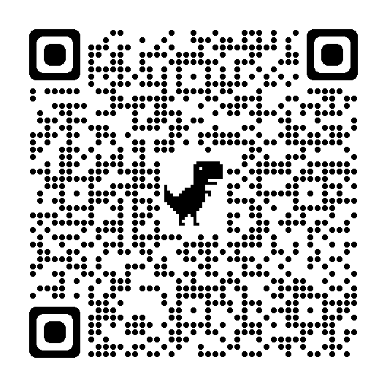
Implementation Resource: Addiction Technology Transfer Center Network Contingency Management for Healthcare Settings
https://attcnetwork.org/centers/northwest-attc/product/contingency-management-healthcare-settings-online-training

Slide 37
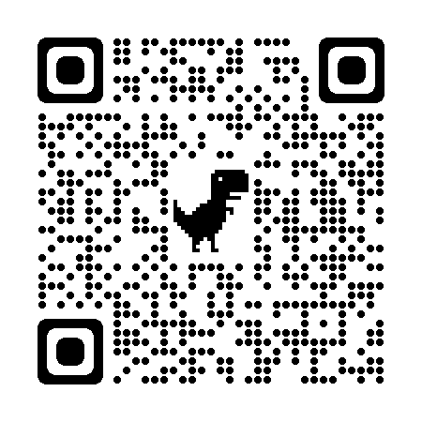
Implementation Resource: Checklist of Principles of Motivational Incentives
https://attcnetwork.org/sites/default/files/2021-01/Checklist.pdf

Slide 38
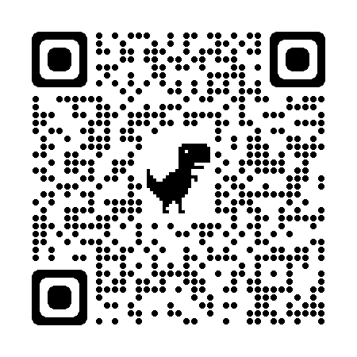
Implementation Resource: Motivational Incentives Suite
https://collaborativeforhealth.org/bettertxoutcomes/

