Slide 1
Creating Clinical Partnerships with Law Enforcement to Support People Who Use Drugs Using a Harm Reduction Lens
Pat Dooley, CRS (he/him)
Lead SUN, Center for Addiction Medicine and Policy, University of Pennsylvania
Gilly Gehri, BA, MBE (c) (they/them)
Project Manager, Center for Addiction Medicine and Policy, University of Pennsylvania
AMERSA Annual Meeting
November 14, 2024
Notes:
Gilly

Slide 2
Disclosures
This work funded by the City of Philadelphia
We have no potential conflicts of interest to disclose
Notes:
Gilly

Slide 3
Background
Stigma in medical and law enforcement settings toward people who use drugs (PWUD)
Addressing harms caused to individuals, families, and communities
CAMP and the City of Philadelphia’s partnership with law enforcement through the Police-Assisted Diversion (PAD) program
Notes:
Pat

Slide 4
Project Goals
Assess feasibility of clinical partnerships with law enforcement
Enhance substance use care and connect community members to needed resources
Reduce downstream criminal justice involvement by addressing medical and social needs
Notes:
Gilly
1.

Slide 5
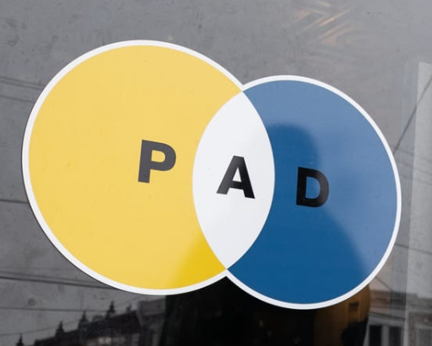
Program Overview
Resources provided as an alternative to arrest for low-level, non-violent offenses
Substance use navigators tailoring care plans
Same-day telehealth bridge clinic for buprenorphine and connection to long-term care
ED warm handoffs, harm reduction and treatment, food, clothing, transportation, and co-pay assistance
Notes:
Gilly

Slide 6
Program Overview
Resources provided as an alternative to arrest for low-level, non-violent offenses
Substance use navigators tailoring care plans
Same-day telehealth bridge clinic for buprenorphine and connection to long-term care
ED warm handoffs, harm reduction and treatment, food, clothing, transportation, and co-pay assistance
Notes:
Gilly
Highlight ED warm hand offs and copay assistance
-Really grateful for our city funders for helping address these gaps in care for such a vulnerable patient population.

Slide 7
Methods
Referral Pathways
Police referral for arrest-diversion
Social referrals (e.g., word of mouth or other service providers)
No requirements for program involvement
Evaluation Process
Reviewing clinical records and state prescription monitoring data
Reporting patient characteristics, services, and resources offered
Notes:
Gilly

Slide 8
Social vs Diversion Referrals
Referral Pathways
Police referral for arrest-diversion
Social referrals (e.g., word of mouth or other service providers)
No requirements for program involvement
Evaluation Process
Reviewing clinical records and state prescription monitoring data
Reporting patient characteristics, services, and resources offered
5% of patient referrals
95% of patient referrals
Notes:
description about how the referrals happen (i.e. more detail about how we used the funds for social referrals). I think people wold be interested to know that the police support a lot of care via this indirect pathway

Slide 9
Methods
Referral Pathways
Police referral for arrest-diversion
Social referrals (e.g., word of mouth or other service providers)
No requirements for program involvement
Evaluation Process
Reviewing clinical records and state prescription monitoring data
Reporting patient characteristics, services, and resources offered
Notes:
Gilly

Slide 10
Patient Characteristics 5/2023-9/2024
515 patients
60% male
Mean age = 39
30% Black, 49% White
9% Hispanic/Latino
41% Uninsured, 47% Medicaid
24% unhoused or unstably housed
Notes:
Pat

Slide 11
Patient Characteristics 5/2023-9/2024
515 patients
60% male
Mean age = 39
30% Black, 49% White
9% Hispanic/Latino
41% Uninsured, 47% Medicaid
24% unhoused or unstably housed
Notes:
Pat

Slide 12
Outcomes 5/2023-9/2024
60%
Received Naloxone
Notes:
Pat
Key Outcomes:
60% of patients received naloxone through the program
Buprenorphine engagement: 178 patients
43% maintained buprenorphine prescription 30 days post-engagement

Slide 13
Outcomes 5/2023-9/2024
60%
446
Received Buprenorphine RX
Received Naloxone
Notes:
Pat
Key Outcomes:
60% of patients received naloxone through the program
Buprenorphine engagement: 178 patients
43% maintained buprenorphine prescription 30 days post-engagement

Slide 14
Outcomes 5/2023-9/2024
60%
446
49%
Received Buprenorphine RX
Active Bupe RX at Day 30
Received Naloxone
Success of low-barrier, harm-reduction services in meeting patient needs
Notes:
Pat
Key Outcomes:
60% of patients received naloxone through the program
Buprenorphine engagement: 178 patients
43% maintained buprenorphine prescription 30 days post-engagement

Slide 15
Conclusion
Clinical-law enforcement partnerships can amplify reach and mitigate harms
Reach of arrest diversion and social referral pathways
Supporting marginalized individuals with comprehensive services
Enhanced connection to medical, social, and harm reduction resources
Notes:
Gilly
To conclude, clinical and law enforcement partnerships can help amplify reach of programming and mitigate harms from SUD and poverty.
Secondly, arrest diversion and social referral pathways demonstrate unique ways to provided individuals with enhanced connection to medical, social, and harm reduction resources.
Finally, this program shows a few routes to help support marginalized and under-resourced individuals with comprehensive services to ultimately decrease engagement with the criminal justice system.

Slide 16
Acknowledgements
Nicole O'Donnell
Center for Addiction Medicine and Policy
Law enforcement partners
All our community partners!
PAD providers (ODAAT, Salvation Army, and Merakey)
City of Philadelphia
Kurt August
Jasmine Barnes
Dr. Jeanmarie Perrone
Dr. Maggie Lowenstein
Pat Dooley:
patrick.dooley@pennmedicine.upenn.edu
Gilly Gehri:
gilly.gehri@pennmedicine.upenn.edu
Notes:
Gilly

