Slide 1
Demand and Supply of Telemedicine Services for Racial and Ethnic Minority High Schoolers Affected By Violence and Substance Use During the Pandemic
Chuka Nestor Emezue, PhD, MPH, MPA, CHES®
Assistant Professor of Women, Children and Family Nursing,
Rush University, College of Nursing,
Chuka Emezue, Ph.D., MPH, MPA, CHES ®; Niranjan S. Karnik, MD, Ph.D., DFAPA, DFAACAP; Bushra Sabri, Ph.D., MSW, Adaobi Anakwe, Ph.D., MPH, CHES ®; Andrew Froilan, MSc, RN; Jessica C. Bishop-Royse, Ph.D., MS; Dale Dan-Irabor, Ph.D.; Qing Li, MD, DrPH; Wrenetha Julion, Ph.D., MPH, RN, FAAN, CNL
AMERSA 2024 Presentation
This document is privileged and confidential under the Illinois Medical Studies Act and should not be shared or distributed other then through the Rush Quality Assurance Committee structure.

Slide 2
Disclosures
No commercial interest to disclose
No relevant conflicts of interest or financial relationship with commercial.
This document is privileged and confidential under the Illinois Medical Studies Act and should not be shared or distributed other then through the Rush Quality Assurance Committee structure.

Slide 3

Background/Context
Double Threat: Racial and Ethnic Minority (REM) highschoolers face increased risks of youth violence and co-occurring substance use.
  Youth violence – Intentional use of physical force/power to threaten or harm others by young people ages 10-24. It can include fighting, homicides, firearm violence, (cyber)bullying, threats with weapons, and gang-related violence.
Homicide – 3rd leading cause of death for all youth aged 10 to 24 years, and the leading cause of death for Young Black boys and men, ages 15 to 24 years (CDC, MMWR 2022).
2023 Youth Risk Behavior Survey (YRBS) - showed a decrease in SU among AYA over the past decade (2013-2023)
Female and LGBTQ+ students reported experiencing more violence, poor mental health, and suicidal thoughts compared to their peers (YBRS 2023).

Slide 4
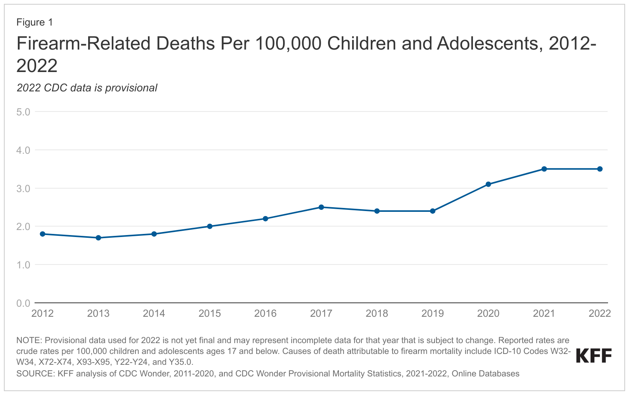
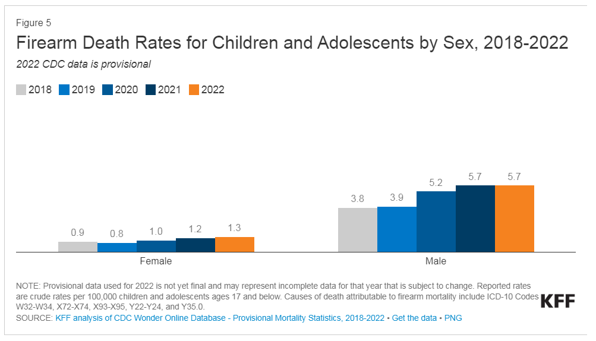
Where We Are
Bernardin et al., 2023; Chadha et al., 2020; Kegler, 2022; McCrea et al., 2019

Slide 5
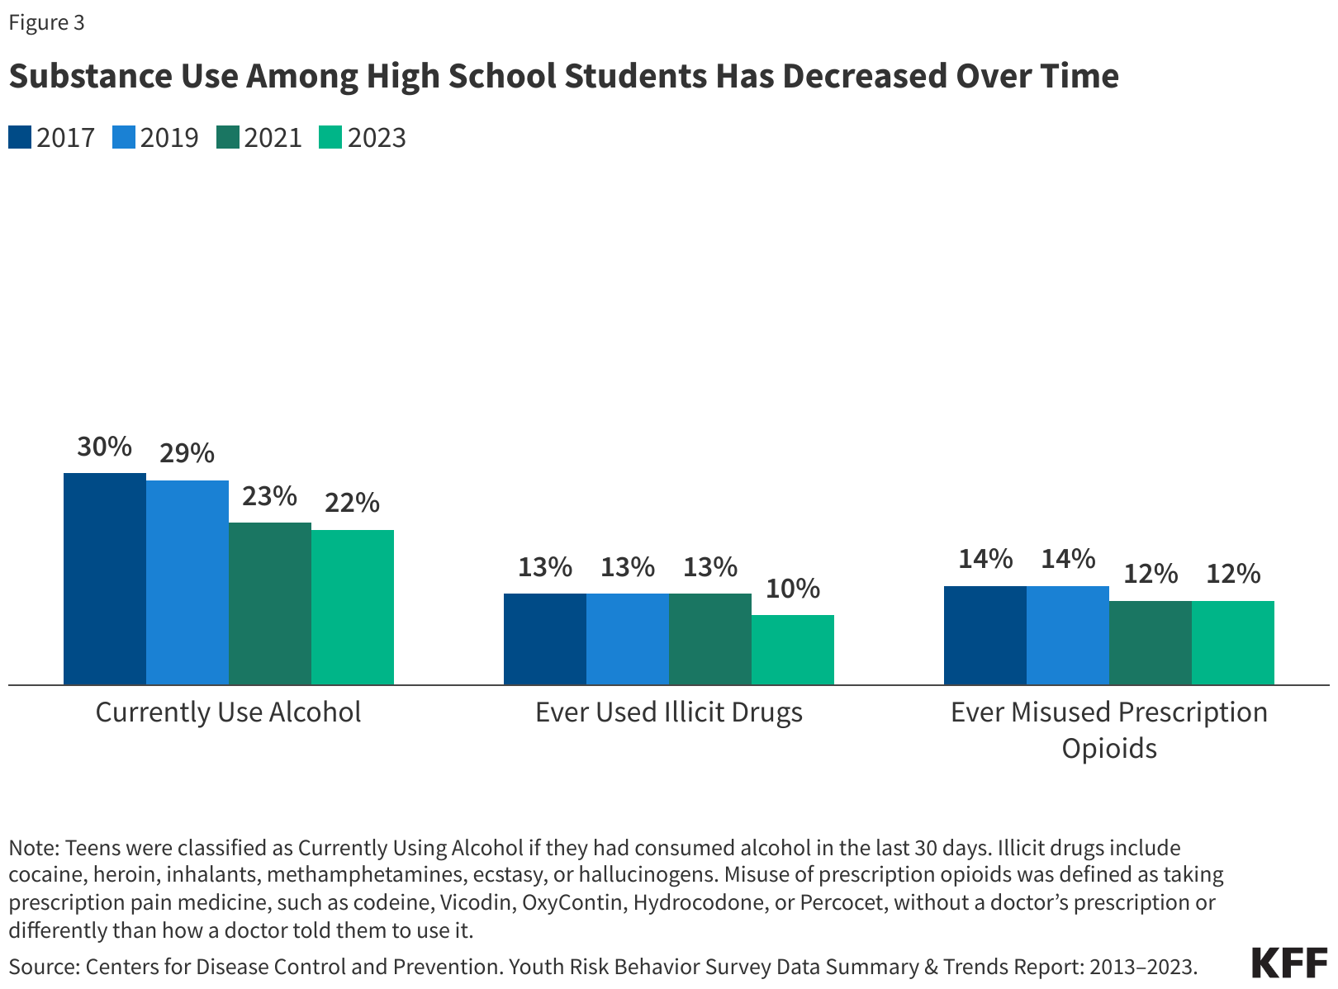
Substance Use
Decline in last decade (2013-2023)
Female and LGBTQ+ students were more likely than their peers to engage in most substance use behaviors (YBRS 2023).
Annually, 700,000 ED visits among urban youths for assault-related injuries
~20% of assault-injured youth report recent substance use (AOD) in 3 hours preceding injury
Cunningham et al., 2020; Crane et al., 2014
Credit: Kaiser Family Foundation

Slide 6
The Pandemic Pivot to DHIs
Racial and Ethnic Disparities Persist:
REM groups were less likely to adopt telemedicine compared to White patients (Adepoju et al., 2022).
Telemedicine usage remained highest among AYA, high-income earners, and with private insurance (Marcin, 2022).
Equitable access remains a challenge for REM youth (structural barriers to service access, access issues, internet connectivity, trust/confidentiality, stigma w/ risky behaviors, service disruptions
Elephants in the Room (Emotional Avoidance, Service Avoidance, Avoidant Coping (Emezue et al., 2024)

Slide 7
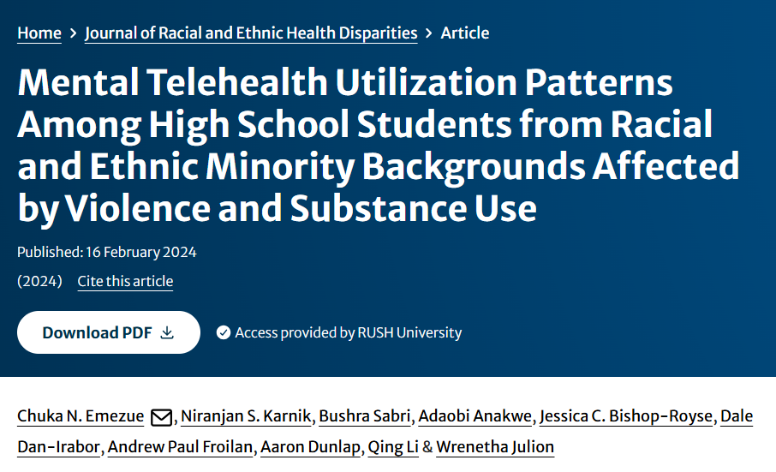

Study Objectives
Assess the frequency and prevalence of co-occurring youth violence (YV) and substance use (SU) among REM adolescents.
Examine differences in YV and SU patterns based on race/ethnicity, age, and sex.
Explore the relationship between these issues and mental telehealth utilization during the pandemic.
Minority Stress Theory (MST: distal and proximal stressors)
Self-Determination Theory (SDT) to support an additive stance on REM youth help-seeking.
Reported using the Strengthening Reporting of Observational Studies in Epidemiology (STROBE) checklist for cross-sectional studies
Emezue, C. N., et al. (2024). Mental Telehealth Utilization Patterns Among High School Students from Racial and Ethnic Minority Backgrounds Affected by Violence and Substance Use. Journal of Racial and Ethnic Health Disparities.
Rush Systems of Health | 8/10/2023

Slide 8
One-time rare dataset, January–June 2021
N=7,705, national sample of 9th-12th graders - 50 U.S. states and DC
n=3241 (REM youth)
High schoolers, grades 9–12 - U.S. public and private schools
110-item CDC Adolescent and Behavioral Experiences Survey (ABES), completed online, ~30 minutes.
CDC Adolescent and Behavioral Experiences Survey (ABES), 2021

Slide 9
Seven Youth Violence victimization outcomes,
Methodology
US High Schoolers (n=3241),
9th-12th grades
Racial and Ethnic Minority
Four Youth Violence perpetration outcomes,
Sample
Outcomes
Two family violence outcomes,
Univariate (frequency distribution),
Six substance use outcomes
Methods
Bivariate (X²),
Telehealth use for mental health (DV)
Multivariate logistic regression models.

Slide 10
RESULTS

Slide 11
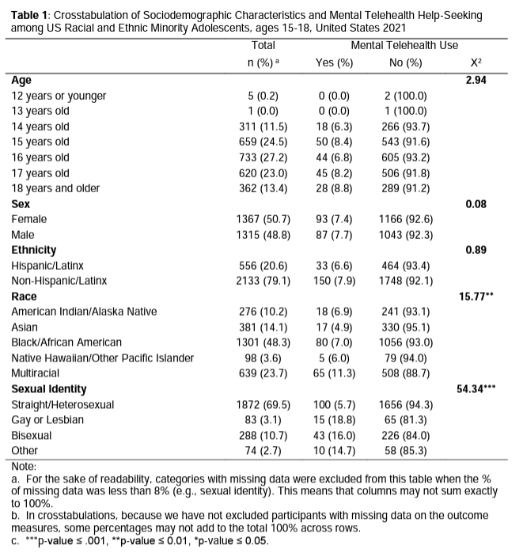
Sociodemographic characteristics and mental telehealth help-seeking among U.S. REM adolescents, 15–18, US2021
Gender: 50.7% female (Binary sex)
Race/Ethnicity: 48.3% Black/AA; 20.6% Hispanic or Latinx.
Sexual Orientation: 69.5% identified as straight or heterosexual.

Slide 12
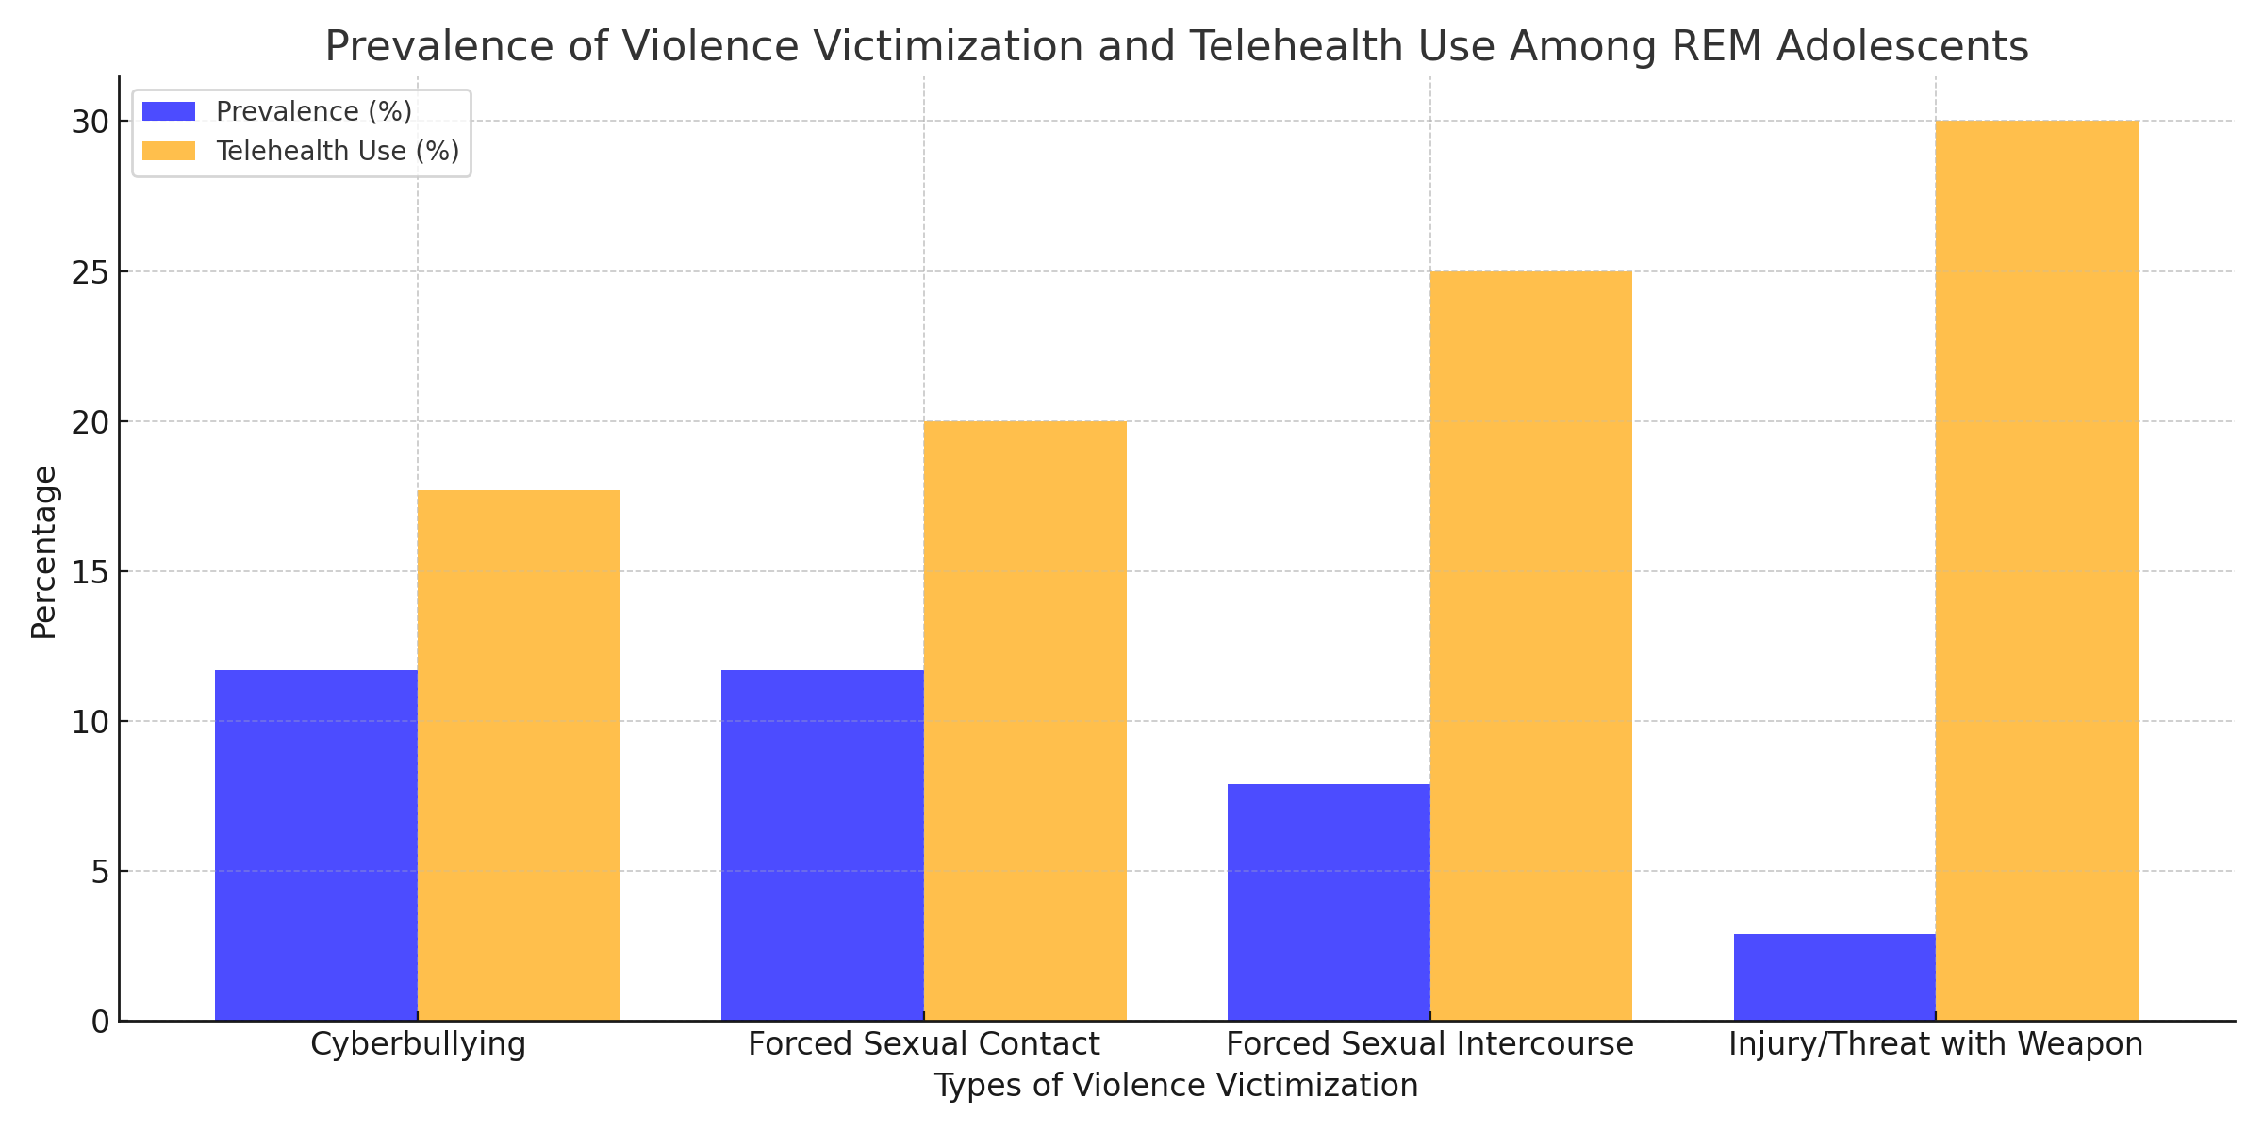
Prevalence of Violence Victimization and MTU among REM Teens

Slide 13
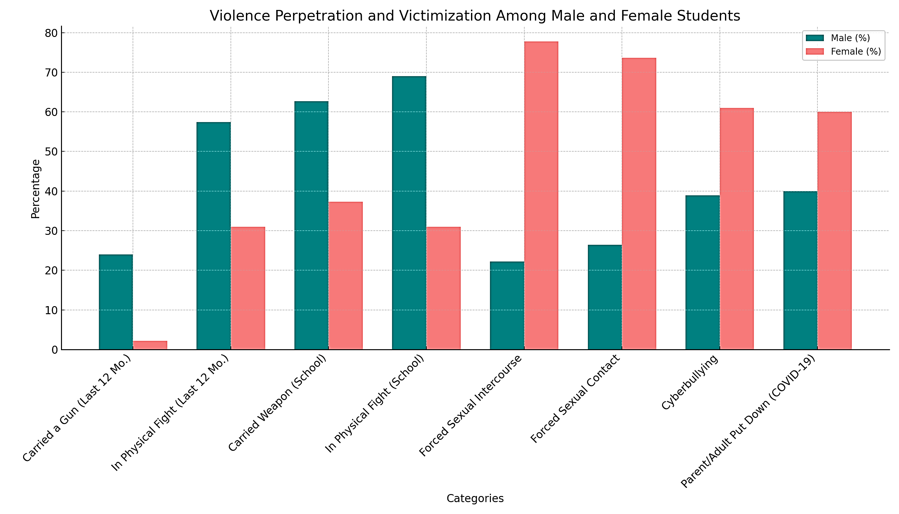
Gender: Violence Perpetration and Victimization Among Male and Female Students

Slide 15
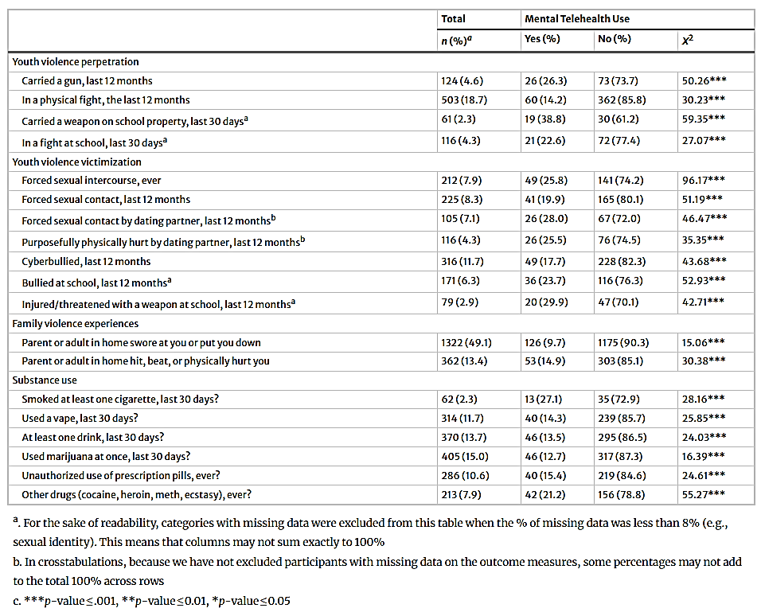
Pearson’s
Chi-Square Test of Association

Slide 16
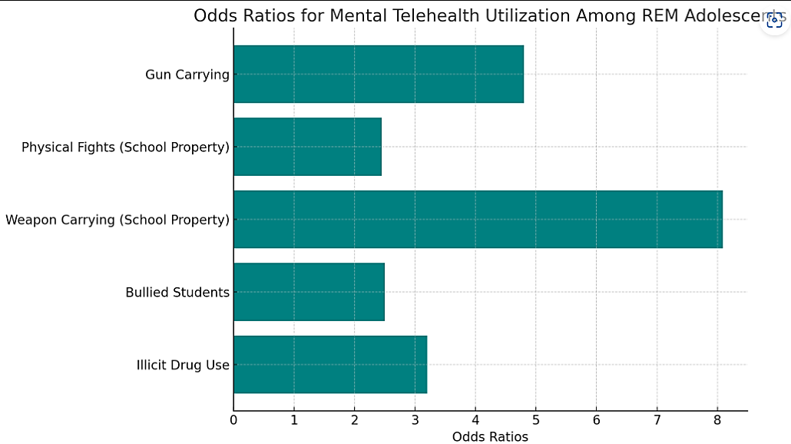
Specific Associations
MTU significantly associated with Substance Use (p-value =.001).
  Illicit drug use (cocaine, heroin, methamphetamines, and ecstasy) was associated with a higher likelihood of Telehealth use for MH (AOR = 1.3, p-value =.05).
MTU significantly associated with all peer and family violence outcomes (p < 0.001).
Controlling for covariates, Gun Carrying was associated with 4.8x higher odds of using Telehealth for MH.
Students in a physical fight or carrying a weapon (gun, knife, or club) on school property were 2.45x and 8.09x more likely to use Telehealth use for MH.
Bullied students were 2.5 times more likely to use mental telehealth.

Slide 17
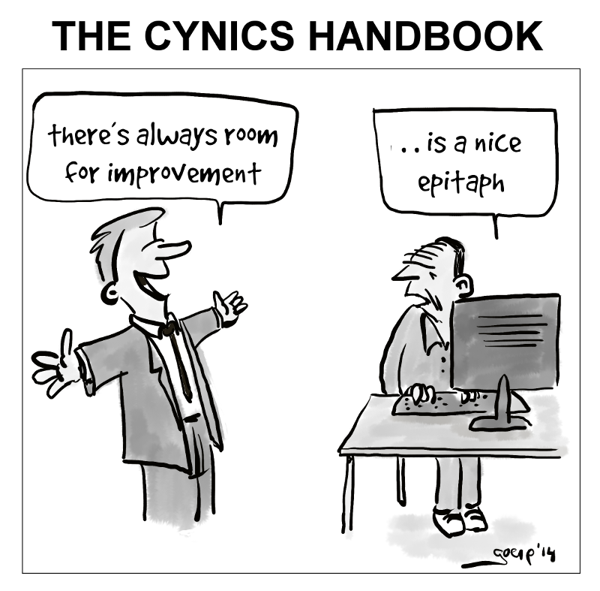
Conclusion/Implications
Findings highlights the importance of mental telehealth as a crucial avenue of support for REM adolescents.
Mental telehealth can complement in-person services to address these challenges effectively, in real-time.
Culturally tailored interventions and strategies to address health disparities in mental health, substance use, and violence among REM youth (Gattamorta et al., 2019).
  Operationalization of cultural competence in real-world settings.
If you build it they will come? ↑ Service Avoidance, ↑ Emotional Avoidance, ↑ Psychological Inflexibility, ↓ Service Integration

Slide 18
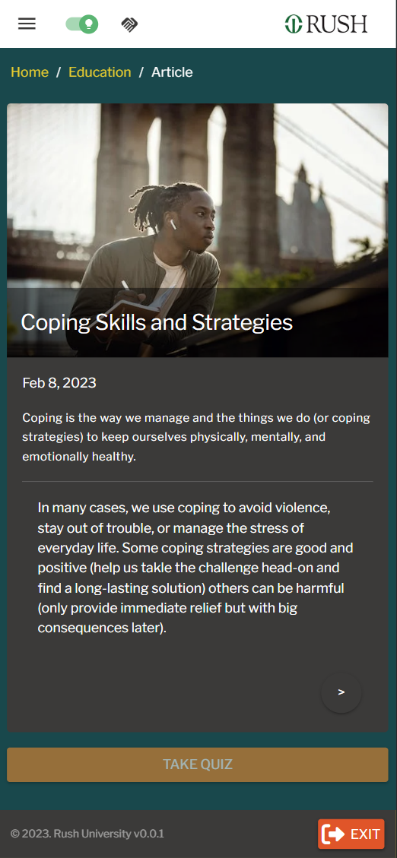
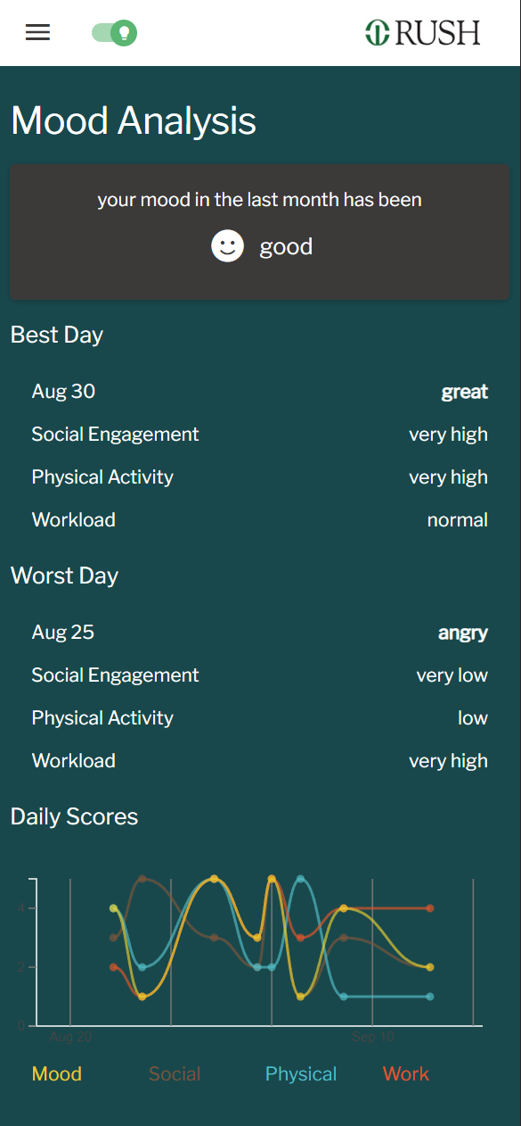
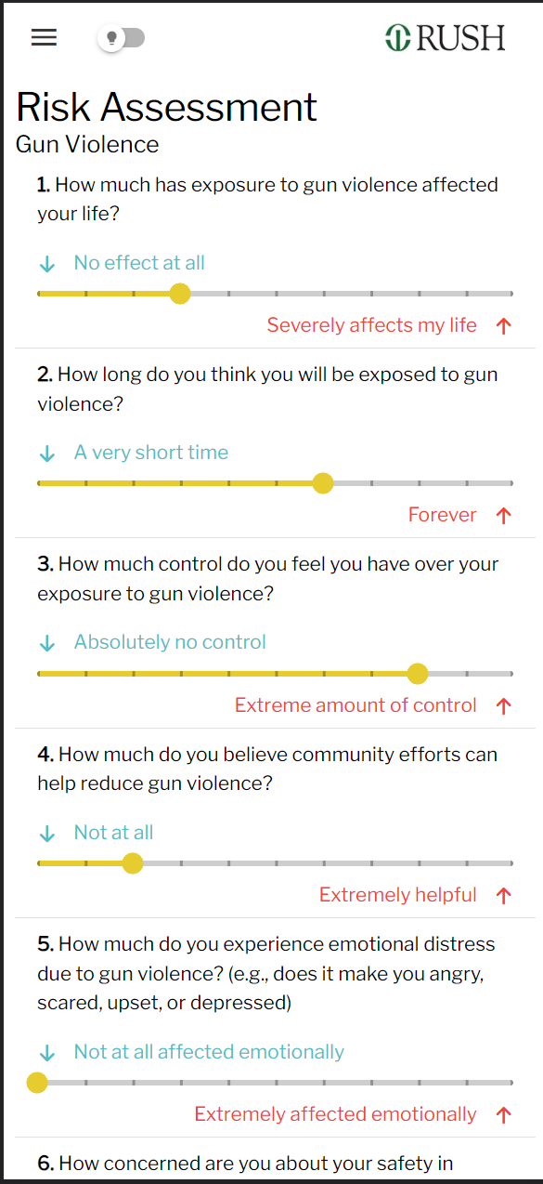
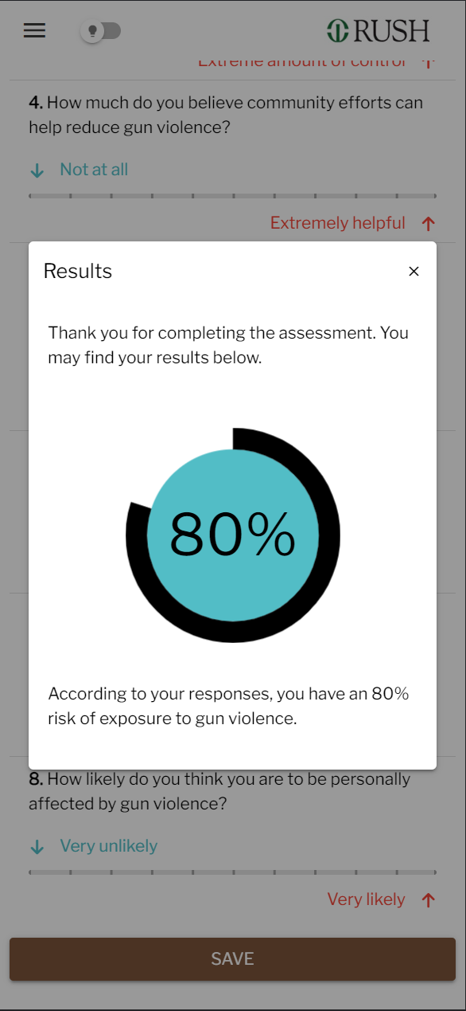
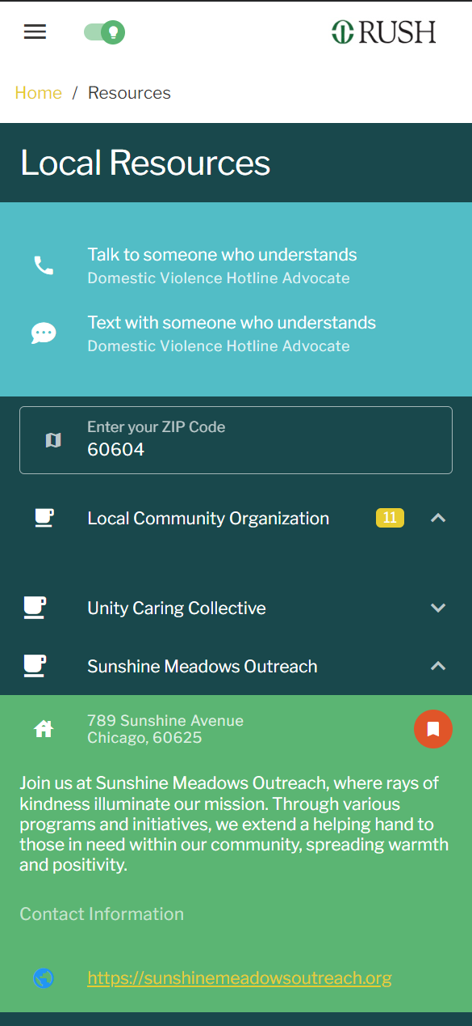
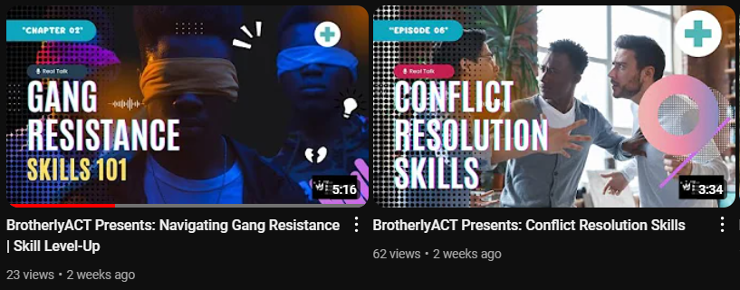
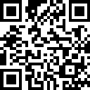
The BrotherlyACT app: Acceptance & Commitment Therapy (ACT)
Psychoeducational Modules [A]
Mood and Emotional Tracking [B]
In-App Risk Assessment [C]
Personalized Output [D]
Zip-Code Based Support [E]

Slide 19


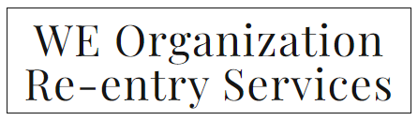


ACKNOWLEDGMENTS
COMMUNITY PARTNERS
RESEARCH AND COMMUNITY TEAM
Study participants
Wrenetha A. Julion, PhD, MPH, RN, FAAN, CNL
Niranjan S. Karnik, MD, PhD, DFAPA, DFAACAP, PhD, MSW
Dale Dan-Irabor, PhD
Andrew Paul Froilan MSN, RN
Aaron Dunlap, MSc
Rickey Layfield, Urban Male Network
Hekademeia Research Solutions (Technology Partner)
FUNDING AGENCIES
Chicago Chronic Conditions Equity Network (Pilot & Mini Grant; NIMHD; 5P50MD017349-02)
Institute for Translational Medicine (ITM), Pilot Grant
Rush-BMO Institute for Health Equity
Cohn Fellowship and Rush RRPM

Slide 20

Thank you
Chuka Nestor Emezue, PhD, MPH, MPA, CHES®
Assistant Professor, Rush University, College of Nursing,
Chuka_emezue@rush.edu
@DrChukaEmezue

