Slide 1
Developing a Computable Phenotype to Identify Opioid Use Disorder in Emergency Department Visits
Erin Kim - Aaron Krumheuer, MD - Alex M. Nickel, MD - Emily E. Ager, MD, MPH - Carrie Bailes, MD - Jessica Baker - Eve D. Losman, MD, MHSA - Christopher Fung, MD
Department of Emergency Medicine, University of Michigan, Ann Arbor, MI
Notes:
What are the predictors you put in -

Slide 2
No listed authors have financial relationships to disclose.
This work was a side project related to the MOUD Curriculum Impact project presented on Thursday and so peripherally supported by a SAEMF / NIDA Mentor-Facilitated Training Award.

Slide 3
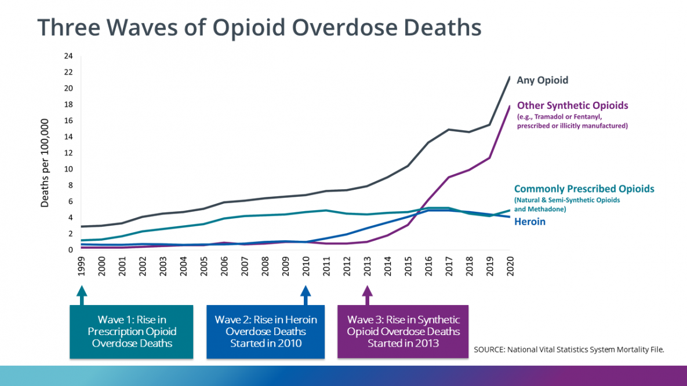
Prevalence of OUD & Deaths
Goal: To develop a computable phenotype for identifying OUD in the ED and determining eligibility for MOUD interventions.
Notes:
Despite the growing prevalence of OUD, only 10% of those diagnosed receive any type of treatment.
Given that the majority of patients who present to the ED with OUD-related health issues may present with an alternate chief concern, the objective of study was to develop a computable phenotype for identifying untreated OUD patients from the EHR to link these patients to treatment.

Slide 4
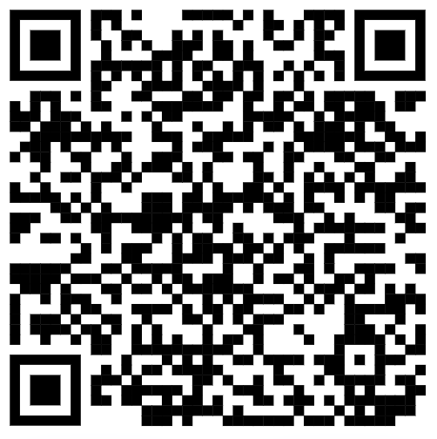
Past Efforts Identifying OUD related ED visits focused on post overdose patients
Algorithm 1: billing codes – opioid-related ICD-10 diagnostic codes
Algorithm 2: ED chief complaint suggestive of OUD, containing heroin, opiate, opioid, or naloxone / narcan
Chartash et al.
Notes:
Other efforts have been led by a group of clinicians at Yale, who designed an EHR-based algorithm to look for acute overdose patients. This group used a combination of ICD 10 codes and chief complaints to identify these individuals.
Our target population was more comprehensive, not only including those who may have overdosed, but also patients with alternate opioid-related billing codes and those with chief concerns that were OUD-related.

Slide 5
Our Objective:
To develop an algorithm to identify discharged ED patients with OUD who may be eligible for an MOUD intervention
To test the algorithm at Michigan Medicine
Notes:
Our objective was to develop an algorithm to identify patients who may be eligible for an MOUD intervention, out of individuals who presented to the Michigan Medicine ED with an OUD-related concern and were subsequently discharged.
We subsequently tested this algorithm within our single institution.

Slide 6
Our Methodology to Identify Patients Eligible for an ED based MOUD Intervention
Retrospective, chart review-based cohort study
Single urban academic medical center
Consecutive ED visits between 10/1/2020 - 9/30/2022 meeting the inclusion criteria
Patients who were discharged after care
Inclusion Criteria
Any occurrence of opioid & overdose keyword together
F11 or
T40 code
Any occurrence of naloxone keyword
Notes:
We screened all patients in a 2-year period who were discharged after receiving care at our ED for a visit that could be related to OUD.
A 2+1 examiner review was conducted my members of the study team, with the attending PI to break the ties.
Several analysis techniques were screened against gold standard human review: ICD codes alone, chief complaints alone, and other machine learning methods
Our inclusion criteria included patients presenting with other chief concerns related to OUD, such as cellulitis or abscess related to injection site. We were also interested in patients presenting with AUD or co-morbidities with other substances.
We used any opioid or naloxone-related keywords in CC or triage, alongside ICD codes.
T40 codes were included to capture opioid users who may be co-morbid for other drug use.
While other studies excluded AUD patients, we included them, due to the number of patients co-morbid with alcohol use and opioid use.
.

Slide 7
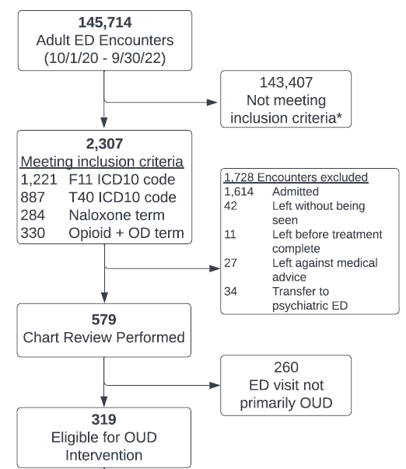
Enrollment Diagram
579 ED visits of discharged patients whose primary reason for coming to the ED was potentially related to OUD.
Notes:
We were interested in patients who were seen in the ED, treated, and discharged – which yielded 579 total consecutive patients eligible for MOUD intervention.
We excluded patients who were admitted and those who left AMA.
While we focused on discharged patients is to inform outgoing ED therapy but the same principles can be applied to admitted patients as well.

Slide 8
Results: Characteristics of Eligible Patients
 | Eligible (%) | Not eligible (%) | SMD
Total | 319 | 260
Age (mean (SD)) | 40.0 (12.8) | 43.4 (15.7) | 0.24
Male | 214 (67.1) | 158 (60.8) | 0.132
Race |  |  | 0.163
White | 251 (78.7) | 192 (73.8)
Black | 51 (16.0) | 51 (19.6)
Other Race | 8 (2.5) | 12 (4.6)
Unknown | 9 (2.8) | 5 (1.9)
Ethnicity |  |  | 0.08
Non-Hispanic | 302 (94.7) | 250 (96.2)
Hispanic | 7 (2.2) | 5 (1.9)
Unknown | 10 (3.1) | 5 (1.9)
EMS Arrival | 177 (55.5) | 124 (47.7) | 0.156
Eligible patients were:
Slightly younger
Male
Non-hispanic
Likely to arrive via EMS
Variable | Agreement (%) | Kappa
Eligibility | 93 | 0.85
Notes:
The eligible patients were more likely to be slightly younger, male, non-hispanic, and more likely to arrive via EMS
Analysis of our results demonstrated a 93% of raw agreement which yielded a kappa of 0.85, demonstrating an excellent chance of agreement
*SMD: standardized mean difference – take the means and divide the difference by standard deviations – 0-1 score on how different the columns are
An SMD of zero means that the new treatment and the placebo have equivalent effects. If improvement is associated with higher scores on the outcome measure, SMDs greater than zero indicate the degree to which treatment is more efficacious than placebo, and SMDs less than zero indicate the degree to which treatment is less efficacious than placebo.

Slide 9
Results: Characteristics of Eligible Patients
 | Eligible (319) | Not eligible (260) | SMD
F11 Code | 194 (60.8) | 119 (45.8) | 0.305
T40 Code | 93 (29.2) | 48 (18.5) | 0.253
“Naloxone” term in chief concern or triage note | 117 (36.7) | 52 (20.0) | 0.377
”Heroin” or “opioid” in chief concern | 25 (7.8) | 1 (0.4) | 0.382
“Heroin” or “opioid” term in triage note |  |  | 1.195
No mention | 71 (22.3) | 189 (72.7)
“Heroin” | 120 (37.6) | 23 (8.8)
Other “opioid” | 128 (40.1) | 48 (18.5)
Eligible patients were more likely to have:
“Heroin” or “opioid” in triage note
Notes:
Included common mis-spellings; click box as well as free text in the triage note
Several of the codes were combined and separately analyzed, such as heroin and opioid.
Heroin, combined with any opioid term, was the most import variable in predicting the outcome (of the random forest classifier).
The keyword “overdose” in chief concern is also predictive of eligibility for MOUD.

Slide 10
Results: Characteristics of Eligible Patients
 | Eligible (319) | Not eligible (260) | SMD
”Overdose” term in chief concern |  |  | 0.717
No mention | 173 (54.2) | 142 (54.6)
Altered Mental Status | 13 (4.1) | 35 (13.5)
Intoxication | 31 (9.7) | 52 (20.0)
Overdose | 100 (31.3) | 23 (8.8)
Syncope | 2 (0.6) | 8 (3.1)
“Overdose” term in triage note |  |  | 0.453
No mention | 212 (66.5) | 182 (70.0)
Altered Mental Status | 0 (0.0) | 6 (2.3)
Intoxication | 19 (6.0) | 30 (11.5)
Overdose | 48 (15.0) | 12 (4.6)
Syncope | 40 (12.5) | 30 (11.5)
Eligible patients were more likely to have:
“overdose” in the chief concern
Notes:
In our cohort – just “overdose” would have missed two thirds of our eligible patients

Slide 11
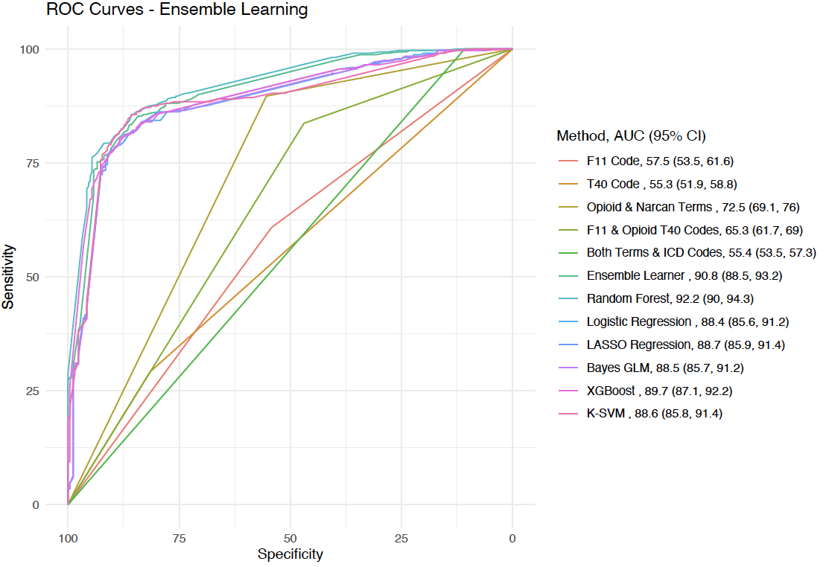
Results: Machine Learning Classification Screening
Notes:
Outcome – eligible – yes or no regarding OUD related ED visit – more encompassing that just post overdose eval
Lots of techniques to get a computer to figure out if a patient is eligible - - the ICD codes, the terms in the triage, etc
Random forest looks a thousands of possible combinations of terms – it performed the best - - we found that this was the best performance based on the AUC
Multiple decision trees
In order to find the best algorithm, we used an ensemble learning package in R to screen a bunch of different algorithms to screen who was eligible or not – to optimize both sensitivity and specificity
Out of the machine learning classification methods, the random forest plot was the most superior.
* AUC = Area under curve
Algorithm or 1-2 of terms
Diagnostic test terms
Sensitivity and specificity boils down to 2x2 terms
Test for the outcome
Logistic regression and LASSO regression (machine-learning algorithm)
Power of computers to evaluate the different combinations
Randomly creates the order in which you assess the variables, some parameters -> optimized test characteristics
AUC >90 is good = few false positives, few false negatives
*Inflection point of L-shape represents the highest point of sensitivity and specificity
Line curves are binary vs L-curves are continuous variables
We’re screening different algorithms to identify who’s eligible vs who isn’t

Slide 12
Results: Random forest classifier outperformed others
Top 5 important predictors of eligibility:
Heroin or opioid term in the triage note
Overdose term in the triage note or chief concern
F11 ICD-10 code
Naloxone term in either CC or triage note
Random forest outperformed other algorithm, regression and ML based techniques.
AUC 92.2
(95% CI 90.0 – 94.3)
Notes:
Random forest outperformed other algorithm, regression and ML based techniques.
The most important predictors of eligibility were: Heroin or opioid term in the triage note, overdose chief concern, F11 ICD-10 code, overdose term in the triage note, and Naloxone term in either CC or triage note

Slide 13
Limitations and Future Directions
Limited scope
Pre-selected opioid, overdose, naloxone terms may change
Need for external validation
Single urban academic center with 2-year study period
Future work should include multi-center, multi-region validation
Terms related to opioids are regional and may change over time
Notes:
Our study is limited by its (1) scope and (2) need for external validation, given that it was conducted at a single urban academic center, and (3) limited by the pre-selected terms that may vary based on region or time.

Slide 14
Final Takeaways
Classifying OUD visits from the EHR is feasible and may facilitate research, QI and QA projects
Our random forest classifier yielded superior test characteristics when compared to other methods
Notes:
We did a chart review – it was a ton of work – this is a way of creating the denominator to understand the number of patients you might be looking at when you do a QI project - - this is easier, your IT team can find the charts using this method
Our future aims include repeating the study in a bigger dataset, such as MEDIC CQI or some other large source of notes, codes, chief complaints text.
MEDIC just received funding to do OUD, and last year they’ve been working on a way to identify patients who might be eligible – CQI – care about ER A performs compared to ER B.

Slide 15
Thank you for your time!
Questions?
Notes:
*What now? We’re thinking about validating in other datasets, use the inpatients as validation

Slide 16
