Slide 1
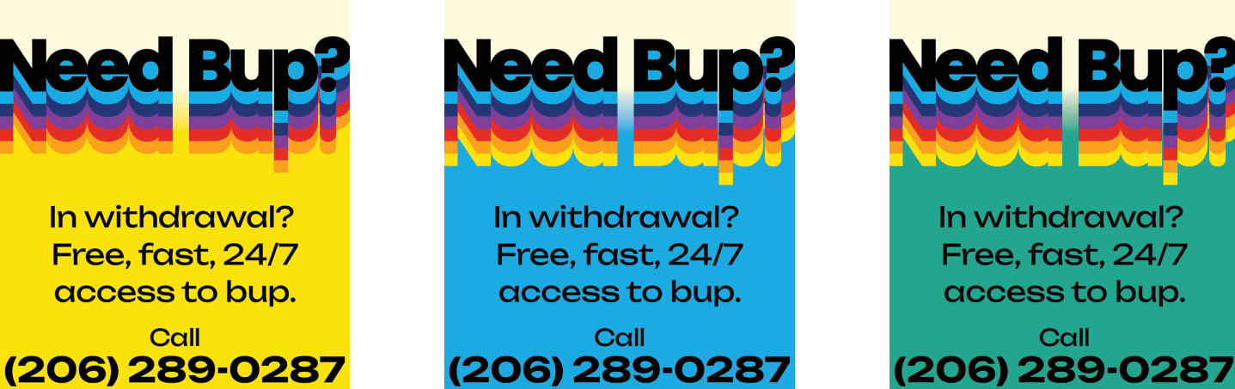
Telehealth for Opioid Use Disorder: Initial Outcomes from a 24/7 Buprenorphine Hotline
Olivia Hood, Chris Buresh, Lauren Whiteside, Callan Fockele, Elizabeth Samuels, Jessica Knuttel, Meg Flohr, and Herbie Duber
,

Slide 2
Disclosures
This work is funded and supported through Seattle King County Public Health (SKCPH)
Dr. Whiteside receives funding from NIDA and SAMHSA

Slide 3
Background
Opioid Use Disorder (OUD) remains a public health crisis with rising mortality rates
Buprenorphine is an evidence-based treatment but remains underutilized due to access barriers
Rural, low-income, and recently incarcerated individuals face heightened challenges
Telehealth improves access in underserved areas

Slide 4
Reduce overdose
Reduce ED visits and inpatient hospitalization
Reduce illicit drug use
Reduce mortality
Improve engagement in treatment
Increase quality of life
For patients with opioid use disorder, buprenorphine can:

Slide 5
In 2021:
2.5 million adults in the US had OUD in the past year
Only 1 in 5 received medications to treat OUD

Slide 6
Objective
Describe our program experience regarding design, purpose and outcomes
Provide information as we consider expansion

Slide 7
UW Telehealth Buprenorphine Program Launched: January 2, 2024
Staffed by 13 Emergency Medicine Physicians trained in OUD care and telehealth best practices
Staffed by 1.5 Linkage to Care Coordinators & 1 Program Manager
24/7 availability for patients (audio/video) - Low barrier & the visit is free
RFP to develop and implement telehealth services to prescribe buprenorphine for patients with OUD

Slide 8
Prescribing Practice
High-dose initiation: 32mg-24mg on Day 1, then 24mg daily
Patients provided with clear discharge instructions and follow-up encouragement
Training for prescribers included trauma-informed approaches and cultural competence
Focus on immediate stabilization of withdrawal symptoms and cravings

Slide 9
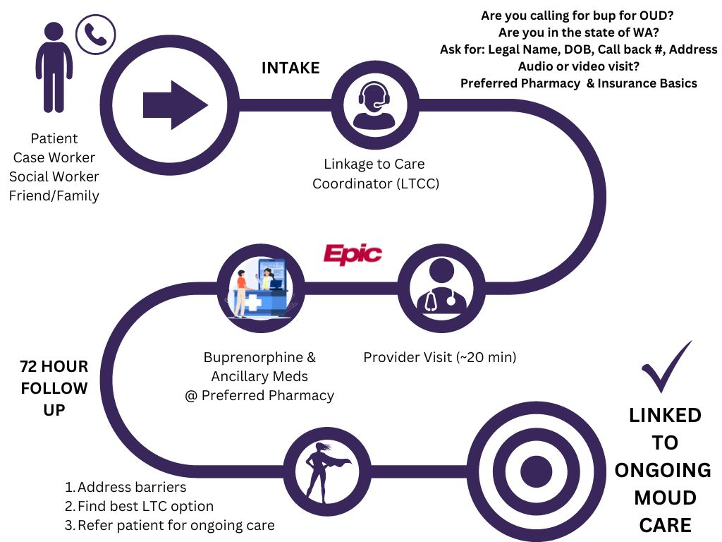
Hotline Workflow

Slide 10
Linkage To Care for MOUD
LTCC role: vital in bridging the gap between telehealth initiation and ongoing care
Follow-up call within 72 hours to confirm medication pickup
Assistance in scheduling or referral to walk-in clinics for ongoing treatment
Active problem-solving for barriers such as transportation or pharmacy access
Support for patients preferring in-person follow-up care

Slide 11
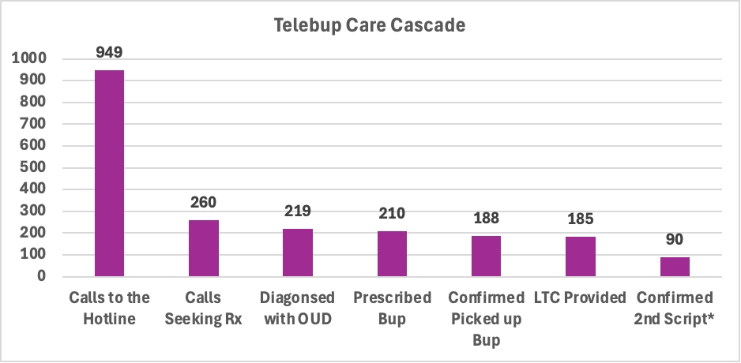
January-July 2024
85% Linkage to Care
*Limited information

Slide 12
Demographics
21.4% of patients have been recently incarcerated

Slide 13
Demographics

Slide 14
Discussion
Telehealth proved effective for initiating buprenorphine in a high-risk population
High prescription pickup rates suggest the program met urgent needs
Challenges: patient preferences for in-person care (80% prefer in-person) and long-term engagement
Importance of follow-up systems like LTCCs in ensuring continuity of care
Need for further evaluation of barriers in telehealth engagement and preferences

Slide 15
Challenges & Limitations
Follow-up engagement: only 60% answered LTCC calls
Preference for in-person care highlights the need for hybrid care models
Geographic and logistical challenges in rural follow-up care
Need for scalable solutions to maintain patient trust and continuity of care

Slide 16
DEI FOCUS
- Telehealth hotline expanded access to rural and marginalized populations - Focus on equity: addressing barriers faced by recently incarcerated individuals - Staff training emphasized cultural humility and trauma-informed care for diverse patients - Goal: reduce health disparities in OUD treatment access across Washington

Slide 17
Key Takeaways
Telehealth can reduce barriers to OUD treatment, offering timely care
High prescription pickup and care linkage rates show early success
Importance of follow-up systems and patient-preferred care pathways
DEI focus ensures the program aligns with health equity goals

Slide 18
Acknowledgements & Questions
Thank you to Seattle King County Public Health, our telehealth providers, and staff!
Thank you to our patients and partners who support the program.
We invite questions and discussion for further insights or collaboration.
Olivia Hood ohood@uw.edu
Lauren Whiteside laurenkw@uw.edu

