Slide 1
AMERSA Discourse: Methadone Deregulation
Moderator:
Michelle Geier, PharmD, BCPP, APh
Presenters:
Denis Antoine II, MD
Ruth A. Potee, MD, FASAM

Slide 2
Objectives
Outline alternative approaches to methadone dispensing
Examine the anomaly of 42 CFR, Part 8.12, Opioid Treatment Program (OTP) Regulations
Summarize the potential harms of prescribing methadone to pharmacies for opioid use disorder (OUD)

Slide 3
Presenters
Denis Antoine II, MD
Director
Addiction Treatment Services Clinic
John Hopkins Bayview Medical Center
Ruth A. Potee, MD, FASAM
Medical Director
Franklin County House of Crrections
Director of Addiction Services
Behavioral Health Network
Notes:
Denis Antoine is board certified in both Psychiatry and Addiction Medicine. He has spent nearly 20 years in Baltimore involved in the treatment and research of severe substance use disorders and co-occurring conditions. He is currently the director of a methadone clinic and a community-based clinic with office based burprenorphine.
Ruth Potee is a family and addiction physician. She has provided direct patient care for 25 years in rural and urban settings. She currently oversees five methadone clinics, including one at a county jail, in western Massachusetts.

Slide 4
Expectation Setting
Education is the main goal of this presentation
There are no individual winners or losers in this debate
Hold questions to designated question times
To maintain a safe educational space, please be polite to others with differing viewpoints than your own

Slide 5
Methadone Deregulation Background

Slide 6
Era of Fentanyl
Fentanyl and fentanyl analogues are driving the opioid epidemic
Buprenorphine and methadone are associated with improved mortality
Fentanyl use is associated with increased risk of precipitated withdrawal when using traditional dosing strategies for buprenorphine
CDC, SUDORS, 2023
Larochelle et al. Ann Intern Med. 2018
Varshneya et al. J Addict Med. 2021

Slide 7
Growing Need for Methadone Access
Self reported opioid withdrawal after traditional buprenorphine initiations in people using fentanyl
N = 1679
Comparator group: switch to methadone
24 hours after fentanyl use: OR = 5.202, P = 0.001
48 hours after fentanyl use: OR = 3.352, P = 0.017
Growing body of evidence for alternate dosing strategies for initiating buprenorphine
With buprenorphine becoming harder to start in people using fentanyl, access to methadone is imperative to address the opioid epidemic
Varshneya et al. J Addict Med. 2021
Suen et al. J Addict Med. 2022
Noel et al. J Addict Med. 2023

Slide 8
The Modernizing Opioid Treatment Access Act (MOTAA) – H.R. 1359
Bipartisan bill introduced in March 2023
Allows:
Board-certified physicians in addiction medicine or addiction psychiatry to prescribe methadone for OUD outside an OTP
Community pharmacies to dispense methadone for OUD
Supported by multiple organizations: AMERSA, American Society of Addiction Medicine, American Medical Association, American Pharmacists Association, American Association of Psychiatric Pharmacists, Big Cities Health Coalition

Slide 9
Proposition 1: What are the pro’s and con’s of changing regulations from an OTP only model to an OTP and office-based and pharmacy model?

Slide 10
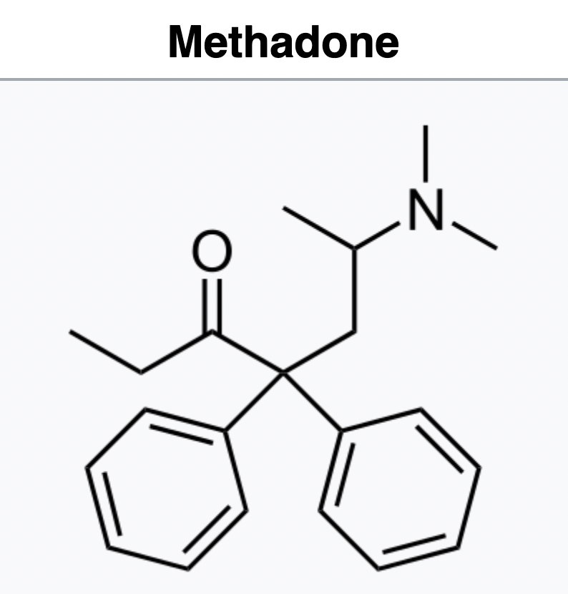
Notes:
Methadone = SuperDrug. Works against fentanyl. Likely to work against the next deadly street opioid coming our way.
Risk of death decreases by 50%
Decreases chaos. People use less or people stop using. Decreased incarcerations. Decreased hospitalizations. Increased going to work. Increased attending birthday parties. Increased helping your mom shovel the driveway in January.

Slide 11
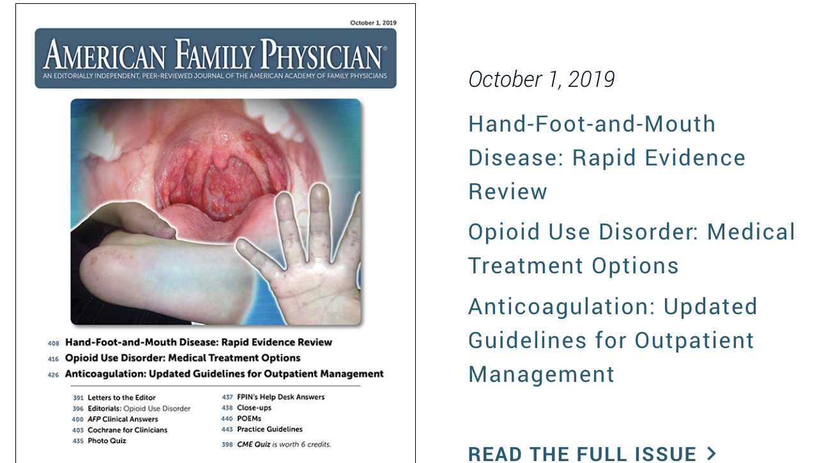
Notes:
This is kind of a miraculous drug. If the health and societal benefits of this medication were applied to any other disease process, we would be figuring out a way to get it into the hands of as many people as possible. Medical professionals would be highly skilled in its dosing, pharmicokinets and administration. There are more people who know how to use botox in the US than know how to use methadone.

Slide 12
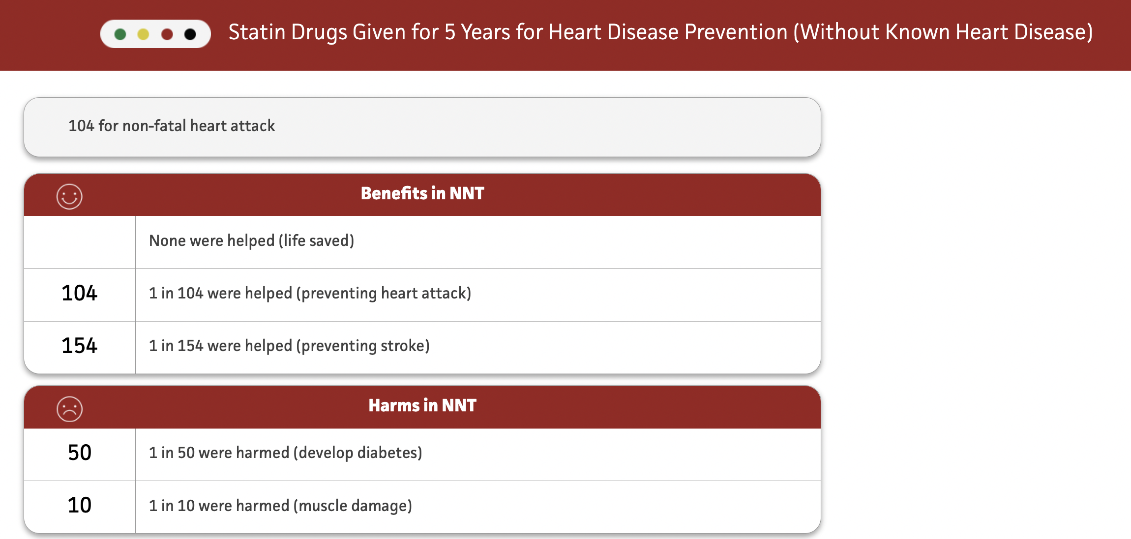
The NNT: thennt.com. Retrieved September 3, 2023

Slide 13
Methadone
NNT to prevent Death
40
1 in 40 were helped (prevention of death)
This study looked at data prior to 2012, well before fentanyl became the commonly available illicit opiate

Slide 14
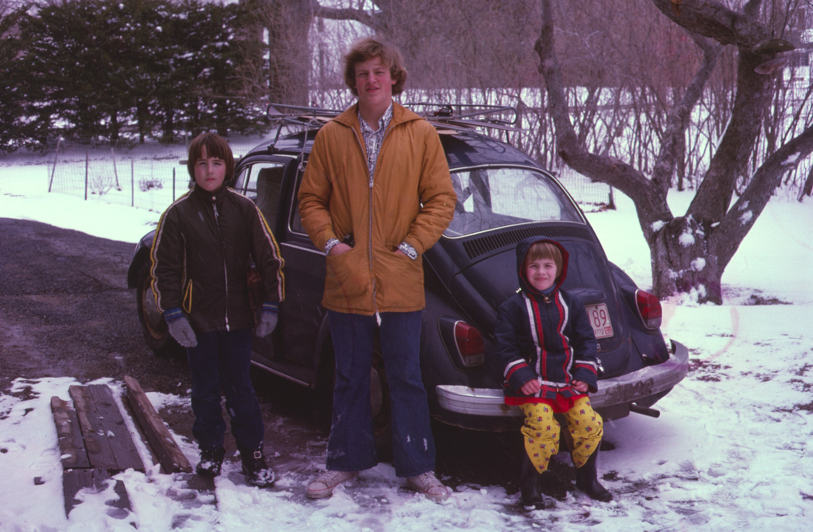
Notes:
That car held 5 kids and 2 adults. No seat belts, no airbags, no snow tires. There is very little from 1973 that we need to hold onto.

Slide 15
Notes:
Happy Birthday, Regulations
What in medicine from 1973 do we still do???
Fatal Flaw is the creation of Part 8.12 in 42 CFR.

Slide 16
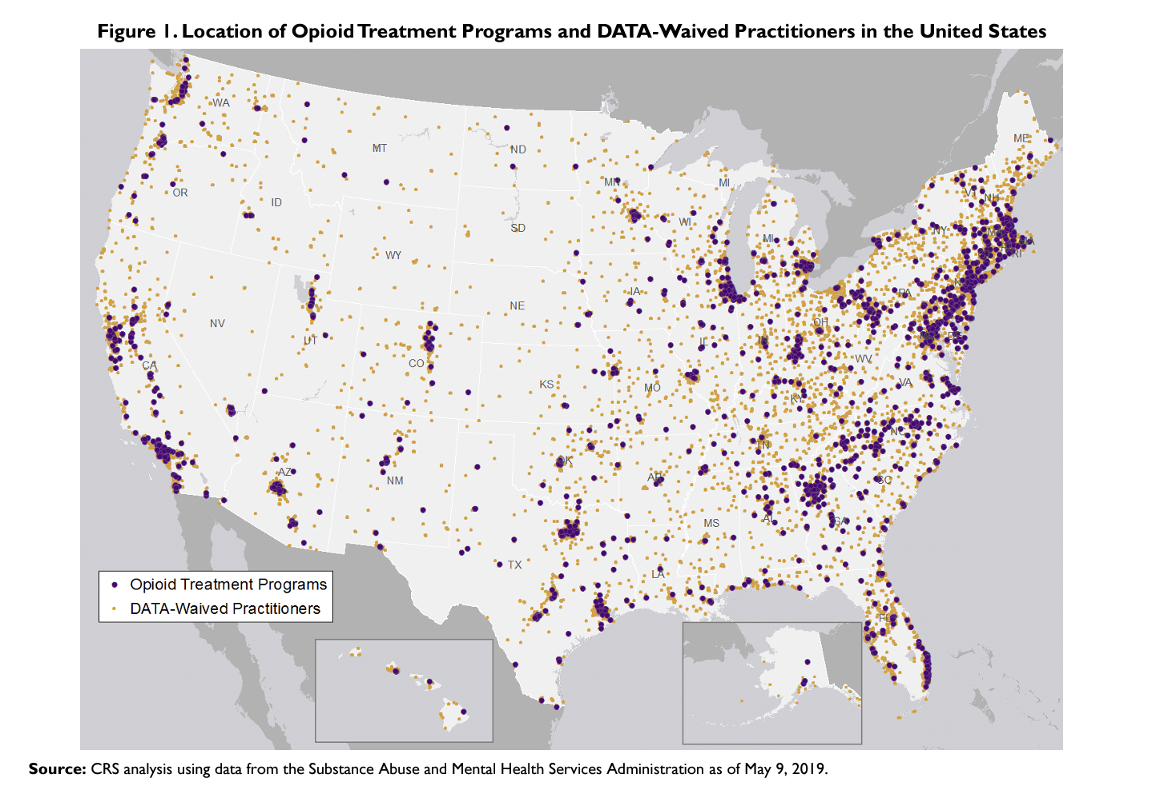
Duff, J., Carter J. (2019). Location of Medication-Assisted Treatment for Opioid Addiction: In Brief
(CRS Report No. R45782). Congressional Research Service. www.crs.gov
Notes:
Massive problem
Super effective treatment
Nearly 2,500 counties (80% nationally), populated by an estimated 77.5 million people (24% of the population), had no OTPs and 1,202 counties (38%), populated by 16.8 million people (5.2%), had neither an OTP nor a DATAwaived practitioner.

Slide 17
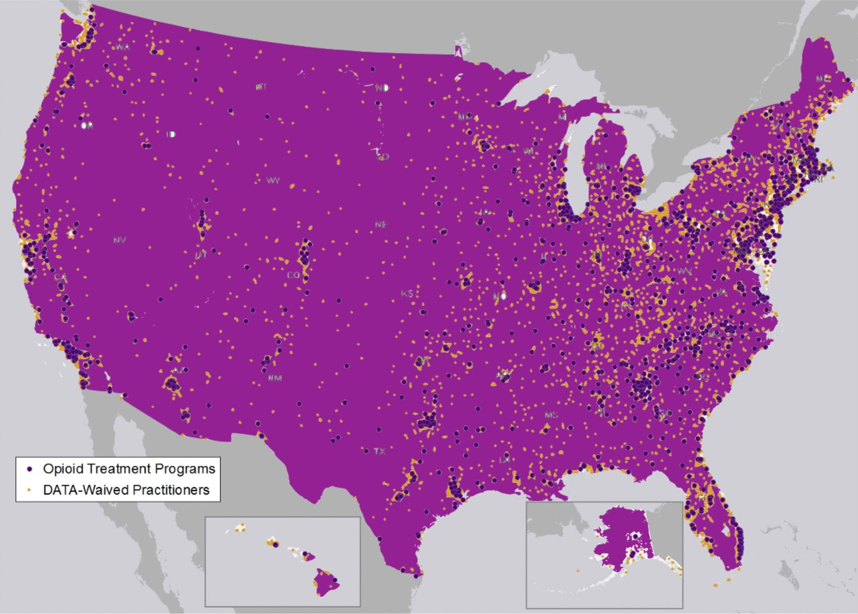
Notes:
This is what the country needs to look like in terms of access to methadone. Everyone with a DEA license to prescribe controlled substance can write a prescription. Every pharmacy can fill it.

Slide 18
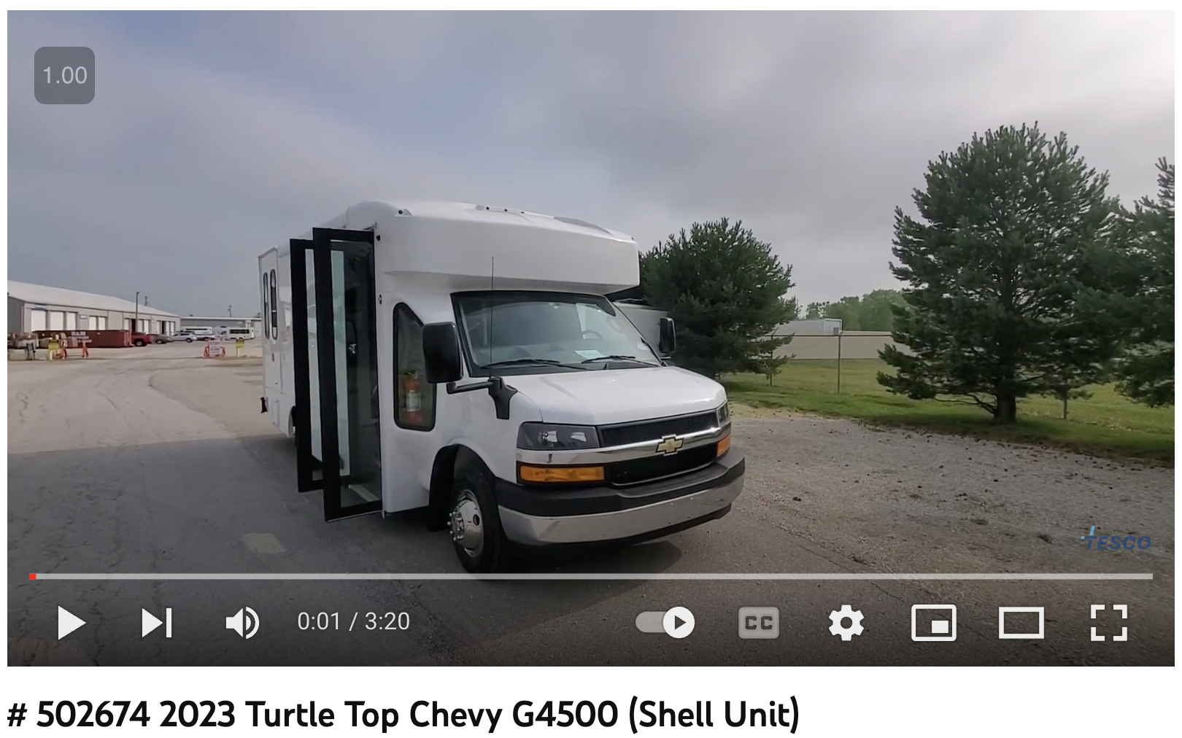
Notes:
Building more OTPs is NOT SCALABLE. They are super expensive. Putting Vans on the road is not SCALABLE. This is our new van that is going to hit the methadone deserts in western Mass. 130,000, used, empty shell. We think it will cost 30k to outfit it. Every answer that the DEA and SAMHSA gives us is too hard, too expensive, too much of a “heavy lift”.

Slide 19
Notes:
Pharmacies willing to dispense + Doctors willing to Prescribe + The right doses
Pharmacies, Hospital Pharmacies, FQCHC, Veteran Administration Health Centers dispense the medication
Government incentivizes multiple dose formulations of methadone: makes it look like thyroid medication.
ACGME Requirements for SUD Treatment has case-based modules on dosing methadone

Slide 20
WHY TO MAINTAIN METHADONE REGULATION
Denis Antoine II, M.D.

Slide 21
COMPLEXITY OF CARE
Access treatment to ancillary professionals
Nurses
Psychiatrists
Counseling (requirement of 42 CFR § 8.12)
Training Requirements for Medical Director Leadership

Slide 22
OVERDOSE POTENTIAL
Methadone (full-agonist)
Review of co-morbid Medications
Awareness of emerging medications
Fentanyl
Isotonitazine (Schedule I as of 2020)
Close monitoring of dose titration

Slide 23
XYLAZINE
Alpha 2 Agonist
Not impacted by methadone
Edinoff AN, Martinez Garza D, Vining SP, Vasterling ME, Jackson ED, Murnane KS, Kaye AM, Fair RN, Torres YJL, Badr AE, Cornett EM, Kaye AD. New Synthetic Opioids: Clinical Considerations and Dangers. Pain Ther. 2023 Apr;12(2):399-421.

Slide 24
EXPLORATION OF TAKE HOME FLEXIBILITIES
During the first 14 days of treatment, the take home supply is limited to 7 days
From 15 days of treatment, the take home supply is limited to 14 days.
From 31 days of treatment, the take home supply provided to a patient is not to exceed 28 days.

Slide 25
STANDARDIZATION OF TREATMENT
Justice (Ethical principles)
Distributive justice--Resources equitable distributed
Continuous quality improvement
Pregnant patients
Decrease the ability to define “Treatment as usual”
Make comparative study more difficult

Slide 26
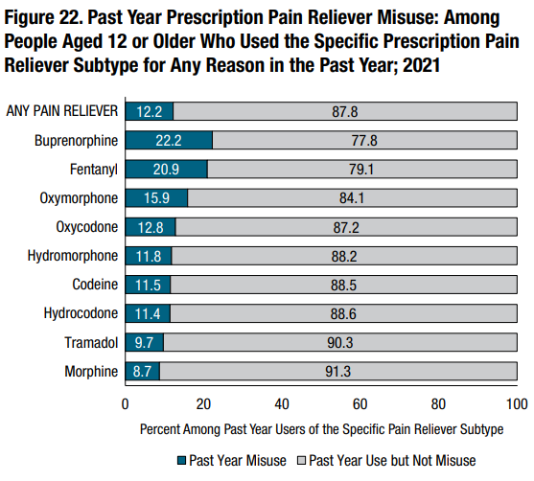
HAVE WE LEARNED OUR LESSON?
Substance Abuse and Mental Health Services Administration. (2022). Key substance use and mental health indicators
in the United States: Results from the 2021 National Survey on Drug Use and Health (HHS Publication No.
PEP22-07-01-005, NSDUH Series H-57).

Slide 27
HAVE WE LEARNED OUR LESSON?
994,641 patients between 2-17-2019
Non-Hispanic Black people, non-Hispanic American Indian or Alaskan Native/Asian/ Hawaiian/Pacific Islander people, and Hispanic people had 42%, 12%, and 22% lower odds of buprenorphine receipt and 47%, 12%, and 20% lower odds of Vivitrol receipt, respectively, than non-Hispanic White people, controlling for clinical and demographic patient variables.
Dunphy, C. C., Zhang, K., Xu, L., & Guy Jr, G. P. (2022). Racial‒ethnic disparities of buprenorphine and vivitrol receipt in Medicaid. American journal of preventive medicine, 63(5), 717-725.

Slide 28
Rebuttal

Slide 29
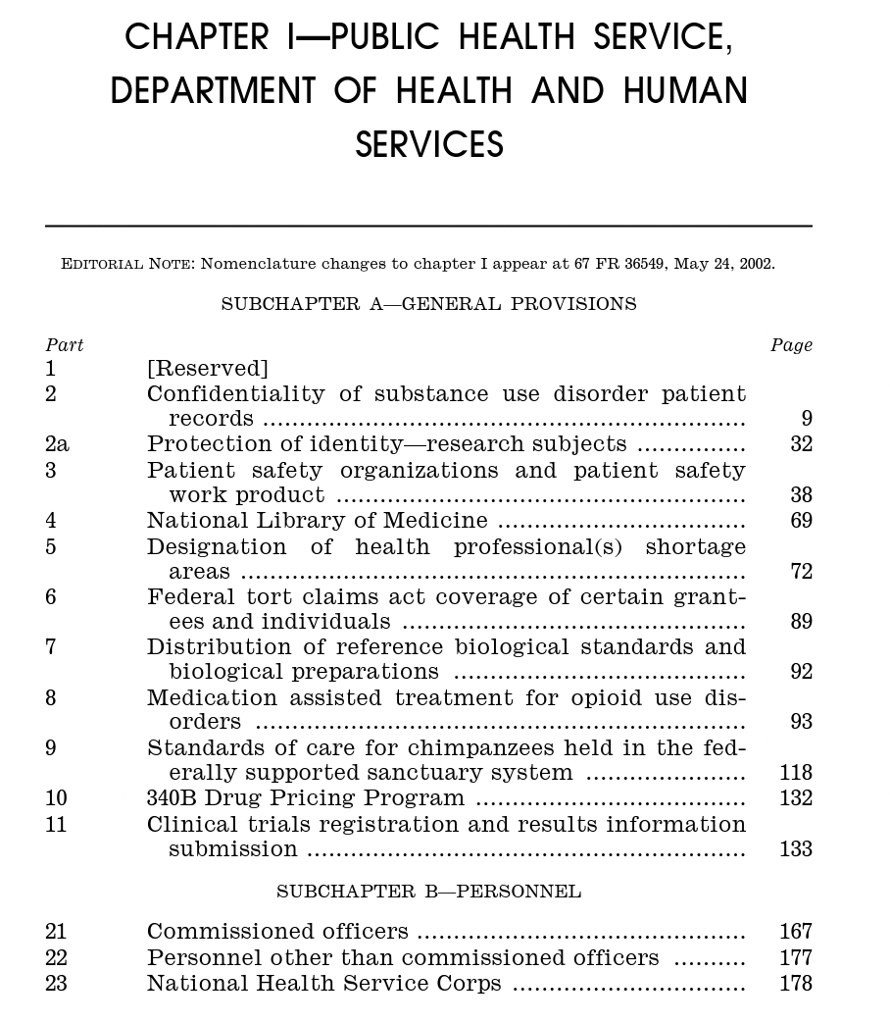
Notes:
This Document – 42 CFR “PUBLIC HEALTH” is One Thousand Pages. Mentions a medication only one other time – referencing the treatment of Non Human Primates (NHPs) with an anesthetic.
Medications for OUD belong in CFR 21 with every other medication. The creation of 42 CFR Part 8.12 was and remains un-necessary, bizarre,

Slide 30
42 CFR 8.12 Strike It!
21 CFR Food and Drugs
Notes:
Brick and morter, highly secured buildings are established, mostly in urban neighborhoods in some states. Heavy security presence. Highly controlled and Highly Controlling. These are not harm reduction places. This model of care is pricey. It makes money for the people who run them.
Treatment for OUD needs to be part of the treatment for all other medical conditions. It belongs in 21 CFR – Food and Drugs, “Drugs for Human Use”, Part 300 - 499
While there are federal regulations, there will be state regulations, while there are state regulations, there will be OTPs doing their own thing – mostly for profit.
Academic medicine, evidence-based medicine does not get to work its way into this infrastructure to prove or disprove treatment efficacy.

Slide 32
Pew Charitable Trusts September 2022

Slide 33
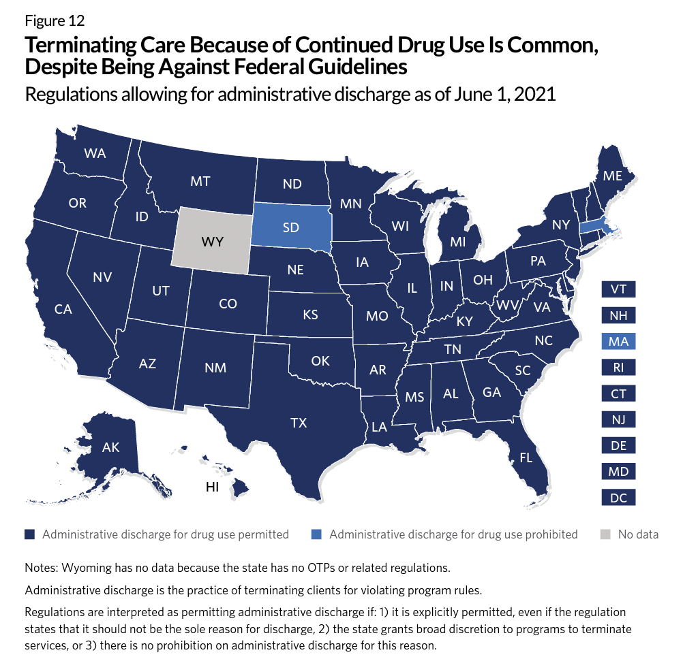
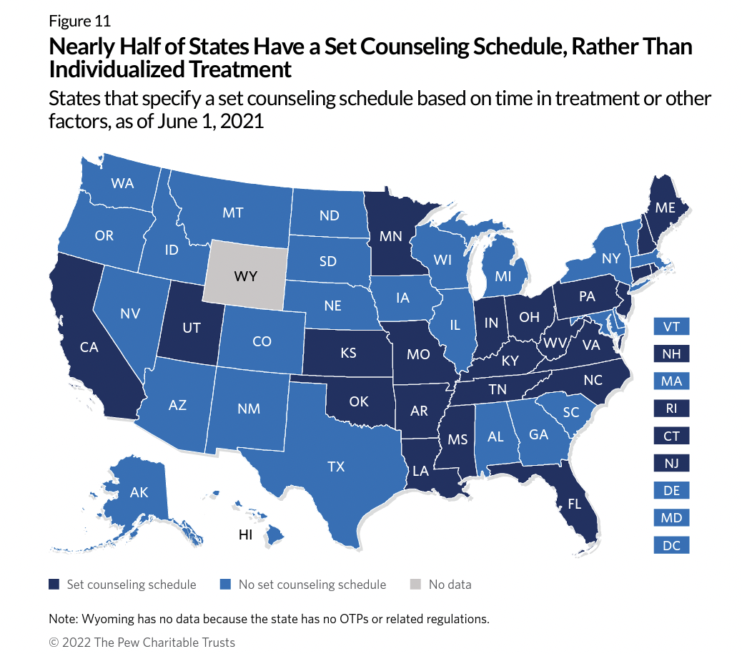
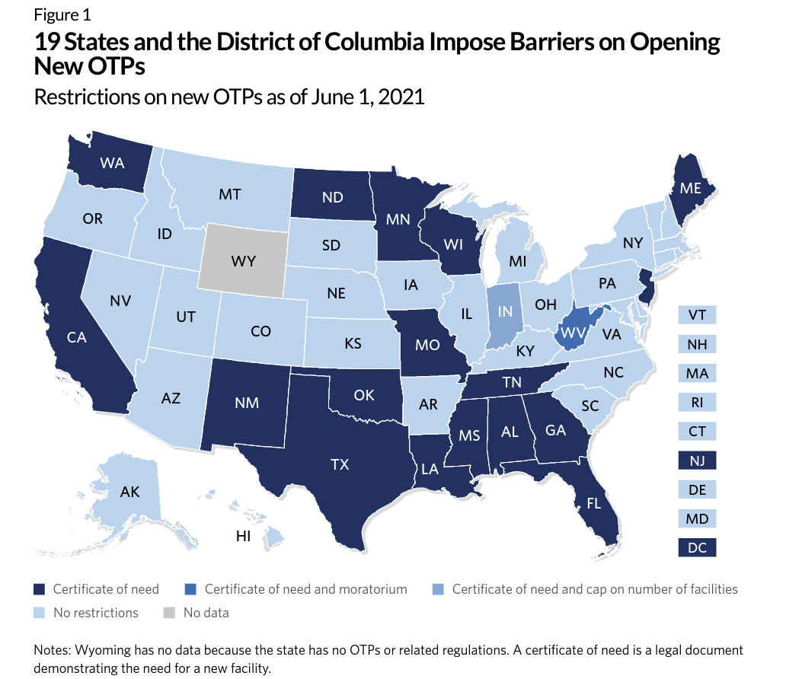
Overview of Opioid Treatment Program Regulations by State Restrictive rules put evidence-based medication treatment out of reach for many
Pew Charitable Trust, September 2022

Slide 34
“However, challenging the stigmatizing views of some medical professionals and of society at large will require not only better treatment access but educational and advocacy efforts at many levels.”
Brands, B., & Marsh, D. C. (1997). Methadone maintenance treatment: a Canadian perspective. Cmaj, 157(4), 399-401.

Slide 35
Proposition 2: If we deregulate methadone, what will be the impact on the opioid epidemic?

Slide 36
WHAT WOULD BE THE IMPACT OF MAINTAINING METHADONE DEREGULATION?
Denis Antoine II, M.D.

Slide 37
ONGOING STIGMA
A Barrier to Communication and Information Sharing
A Need for Updated Regulations
More patient input needed

Slide 38
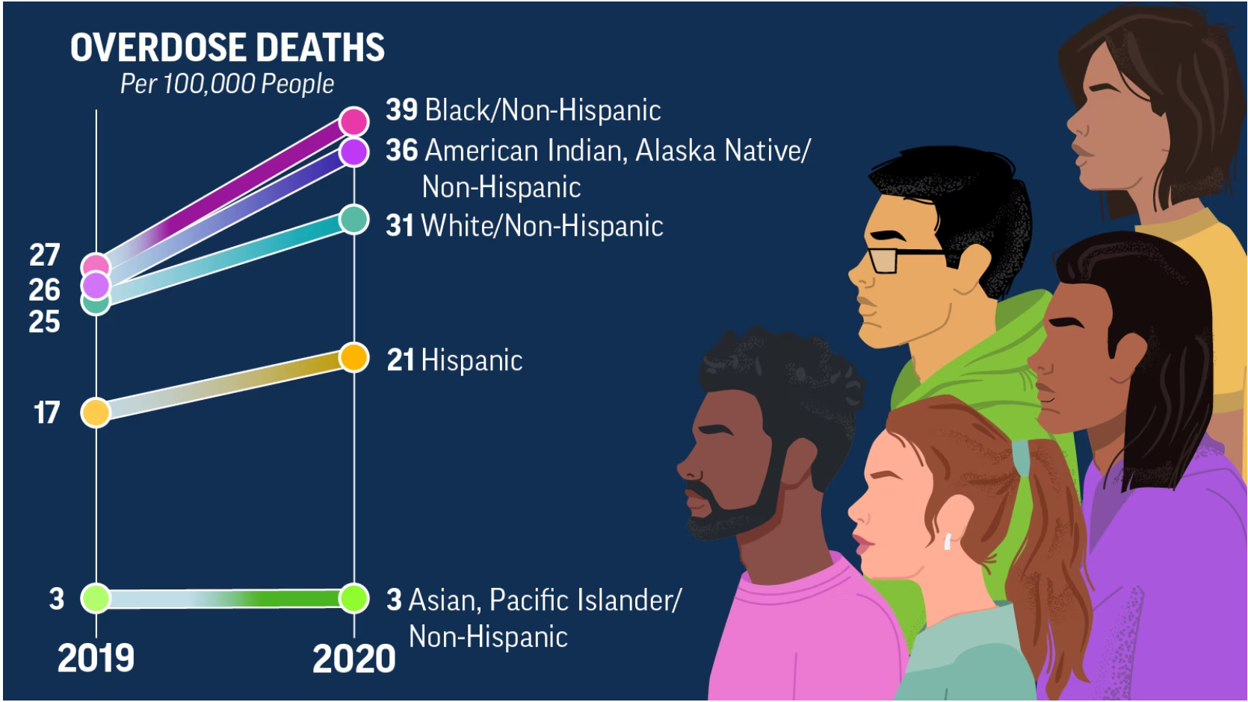
HEALTH DISPARITIES
Kariisa M, Davis NL, Kumar S, et al. Vital Signs: Drug Overdose Deaths, by Selected Sociodemographic and Social Determinants of Health Characteristics — 25 States and the District of Columbia, 2019–2020. MMWR Morb Mortal Wkly Rep 2022;71:940–947

Slide 39
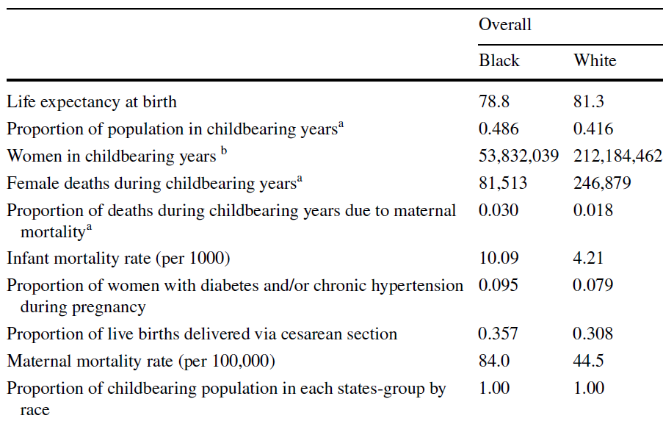
MATERNAL MORTALITY
Patterson, Becker, Baluran, 2022

Slide 40
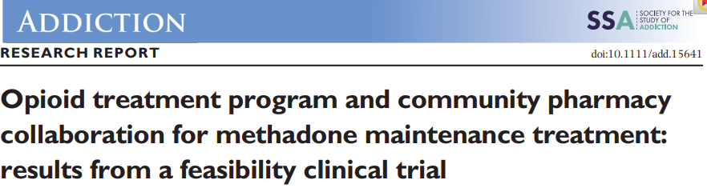
INNOVATION
“Pharmacy administration and dispensing of physician-prescribed methadone for methadone maintenance treatment to be feasible and acceptable”
Wu, L. T., John, W. S., Morse, E. D., Adkins, S., Pippin, J., Brooner, R. K., & Schwartz, R. P. (2022). Opioid treatment program and community pharmacy collaboration for methadone maintenance treatment: results from a feasibility clinical trial. Addiction, 117(2), 444-456.

Slide 41
HELPING UP MISSION 2023
Women and Children’s center
250 beds
200 Women
50 Children
Johns Hopkins Bayview Center for Addiction And Pregnancy
Community Academic Partnership

Slide 42
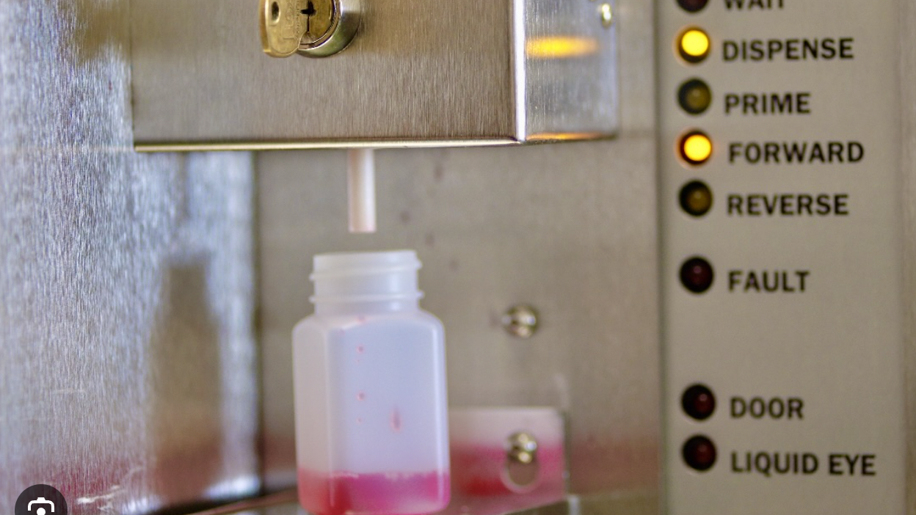
Notes:
You need to know about methadone to dose it. You need to know your local drug supply. You need to know your patients. The story that is always told is the increase in methadone deaths in West Virginia when primary care doctors were told they couldn’t prescribe oxycontin any more and they had to replace it with methadone

Slide 44
METHADONE MORTALITY: A 2010 REASSESSMENT
Sponsored by the Substance Abuse and Mental Health Services Administration Washington, DC July 29-30, 2010
Notes:
More people will die who have methadone in their system. Some will be people who are opioid naïve – children, family members, the curious.
There will be more overdoses for PWUD with methadone in it.
There will be more diverted methadone.
This could have unintended consequences that are serious.

Slide 45
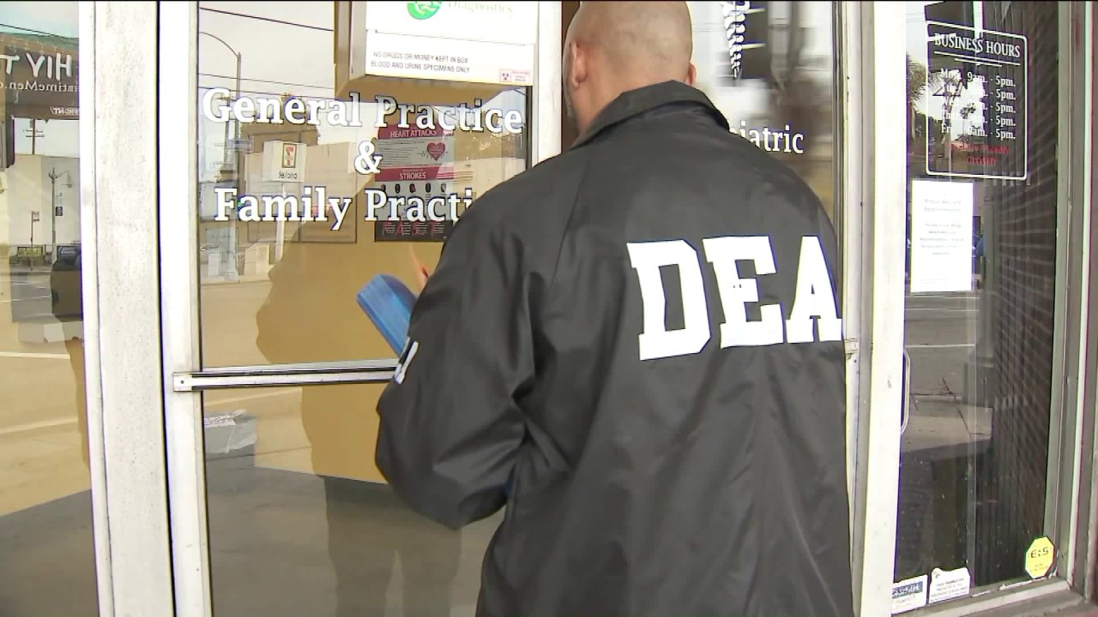
Notes:
The last thing we want to do is to create any circumstance where the DEA comes after methadone as a dangerous drug. The pendulum can swing very far in public health when fear gets involved

Slide 46
Notes:
Pharmacies willing to dispense + Doctors willing to Prescribe + The right doses
Pharmacies, Hospital Pharmacies, FQCHC, Veteran Administration Health Centers dispense the medication
Government incentivizes multiple dose formulations of methadone: makes it look like thyroid medication.
ACGME Requirements for SUD Treatment has case-based modules on dosing methadone

Slide 47
Rebuttal

Slide 48
Reflections from Presenters

Slide 49
Questions?

