Slide 1
Distance as a Barrier to Addiction, Mental Health and Primary Care for Persons with Recent Homeless Experience
Stefan Kertesz, MD, MSc
Birmingham Alabama VA Healthcare System
UAB Heersink School of Medicine
Work supported by VA HSR&D 15-065
Notes:
Carlos points: background
coulkd add a picture of a homeless and include LESS wording
Ho - could change to Objective (for this audience)
Pause here to have people digest
Main variables
(I dont get it)
Looking for a simple 1-2 slides of Methods
who (inc/ exclusion), when (time), where (BVAMC), what
geo distance - is that results ** perceived distance seems very important**

Slide 2
Disclosures
Funded by US Department of Veterans Affairs Health Services Research & Development Branch
Views are those of the authors only
Dr. Kertesz: royalties for editing the UpToDate chapter on Homeless Health Care from Wolters-Kluwer

Slide 3
Collaborators
3
Birmingham VA & UAB |  | VA Salt Lake City & UUtah | VA Greater Los Angeles & UCLA | Pittsburgh VA & Pitt | Strategic Research Group (SRG)
Aerin deRussy | April Hoge | Adam Gordon | Lillian Gelberg | John Blosnich | Tina Kassebaum (lead)
Erika Austin | Allyson Varley | Audrey Jones | Sonya Gabrielian
David Pollio | Ann Elizabeth Montgomery | Adi Gundlapalli
Young-il Kim | Kevin Riggs
 | Sally Holmes
Views do not represent formal positions of the United States Department of Veterans Affairs
Dr. Kertesz:
No pharmaceutical grants, honoraria, or history of such
Previously owned stock in Abbot & Merck companies (<3% of assets), sold in 12/2017. Dr. Kertesz’s wife has same + Johnson & Johnson, has not sold her stock.

Slide 4
Background
For many homeless persons, ending homelessness entails
Subsidized rental apartments
Buttressed by services
These are often in low-rent areas far from medical centers
Impact of distance on care access has not been studied for this population
Distance can be objective or subjective, and both could matter
Notes:
Homeless persons have negative experiences (NEs) in primary care (PC) that can contribute to poor patient and system outcomes. A homeless-tailored PC model (Homeless-Patient Aligned Care Teams, H-PACTs) offers smaller panels, outreach, dedicated staff, tangible need support, and linkage to social services. In the Veterans Administration (VA), H-PACTs operate alongside regular VA PC clinics (“Mainstream”) also serving homeless-experienced Veterans (HEVs). Although some data suggest better PC experience in H-PACTs, it’s unclear whether tailored clinics avert adverse care experiences among HEVs with vulnerabilities such as severe chronic pain, history of overdose, severe mental distress, or unsheltered living situation.

Slide 5
Objectives
We examined whether
Geographic distance from residence to VA was associated with a Perceived Distance Barrier to care
A Perceived Distance Barrier was associated lower primary care (2A), mental health (2B) and SUD visits (2C) over 12 months
Notes:
Pause here- let people absorb it

Slide 6
Methods
6
Cross-sectional large survey
Included: homeless-experienced Veterans (HEVs), primary care 26 VA medical centers, 2018
Data: Surveys + VA utilization database
We focus here on 83% who affirmed not being homeless on survey date
Up to 4
Up to 5
$1 preincentive
Up to 98 items
$10 gift card
Notes:
Mention the primary study purpose (to compare tailored vs non-tailored care) Orally
Alonso: is there a picture- flow tree in Smart Art format?
Less TEXT per SLIDE
I can infographic this
2 slides for methods is suggested by Dr. Estrada – simplify:
“Cross-

Slide 7
Main Variables
7
Hypothesis | Outcome | Predictor
1 | Perceived Distance Barrier “Does the distance you have to travel make it difficult to receive care at __________?” (Yes/No) | Geographic Distance “as the crow flies” from survey address to VAMC site of primary care (Miles)
 | 12-month primary care visit count | Perceived Distance Barrier
Covariates | ….
Model | Logistic regression
Notes:
Dependent: Perceived Distance Barrier
“Does the distance you have to travel make it difficult to receive care at __________?” (Yes/No)
Predictor: Distance “as the crow flies” from geocoded address to VAMC site of primary care
Dependent: 12-month primary care visit count (centered on survey date)
Predictor: Perceived Distance Barrier

Slide 8
Hypothesis 1 Variables
8
Hypothesis | Outcome | Predictor
1 | Perceived Distance Barrier | Geographic Distance (miles, as crow flies from address survey was received)
 | 12-month primary care visit count | Perceived Distance Barrier
Covariates | Predisposing: gender, race/ethnicity, age (<50, >50 to <65, >65 years)
 | Enabling/Impeding: difficulty affording basic needs, employment, social support (6 item total), recent criminal justice experience, medical center station, clinic type
 | Need: emotional distress (6 items, # of days), chronic pain, general self-reported health, drug or alcohol problem (2-item self-report), chronic homelessness, 23 Elixhauser comorbidities, including drug dx, alcohol dx, TBI dx, PTSD dx
Model | Logistic regression
Site random effect (n=29) included
Notes:
Dependent: Perceived Distance Barrier
“Does the distance you have to travel make it difficult to receive care at __________?” (Yes/No)
Predictor: Distance “as the crow flies” from geocoded address to VAMC site of primary care
Dependent: 12-month primary care visit count (centered on survey date)
Predictor: Perceived Distance Barrier

Slide 9
Hypothesis 2A-2C Variables
9
Hypothesis | Outcome | Predictor
2A | primary care visit count (12 months) | Perceived Distance Barrier
2B | mental health visit count (12 months) | Perceived Distance Barrier
2C | substance use disorder visit count (12 months) | Perceived Distance Barrier
Covariates | Same as before
Model | Mixed linear model
Visit count centered on date of survey response 2B & 2C analyses are restricted to persons with applicable VA dx category 6 to 24 months prior to survey date
Site random effect (n=29) included
Notes:
Dependent: Perceived Distance Barrier
“Does the distance you have to travel make it difficult to receive care at __________?” (Yes/No)
Predictor: Distance “as the crow flies” from geocoded address to VAMC site of primary care
Dependent: 12-month primary care visit count (centered on survey date)
Predictor: Perceived Distance Barrier

Slide 10
Results

Slide 11
Results: Distance Breakdown
Not Currently Homeless (n=4,654)
Currently Homeless (n = 706)
Distance “as crow flies” from survey address to VA primary care clinic

Slide 12
1. Perceived distance barrier and geographic distance among formerly homeless Veterans
Distance “as crow flies” from survey address to VA clinic. Study led by Stefan G. Kertesz, VA HSR&D IIR 15-095
Notes:
I can say “predicted probability I sa fancy way to adjust “
I can say that lots of patient characteristisc were statistidcal

Slide 13
Remember:
models controlled for allsurvey-derived and diagnostic code indicators of the MH and SUD problems
p<0.01, p<0.01 & p=0.02.
Notes:
Also tested using negative binomial distribution, results not meaningfully different and similar fit statistics
Say- “results did not change much when we included geograpihc distance in the model”

Slide 14
Disparities by race or gender
Race and ethnicity (self-reported) were not statistically significant in any model
Gender was significant for perceived distance barrier
(aOR for men vs women: 0.81, 0.68-0.96)
for women, distance more likely to be a barrier
What it could mean
Affirming a barrier about “the distance I have to travel” can reflect more than physical distance.
“it’s not safe for me to walk this one mile”
“I can’t take my kid to this appointment because of the carseat requirement for the Lyft”

Slide 15
Limitations & Strengths
Perceived distance barrier (yes/no) not previously validated
We lacked measures for car ownership or public transportation
But we did control for self-reported economic status
A survey study of homeless & formerly homeless clients of this size has not been done before

Slide 16
Conclusions
Among 4654 Veteran respondents, 60% had addressses >5 miles from VA primary care
Perception of distance barrier rose with distance
13% (<5 miles) to 60% (>20 miles)
Distance barrier → less primary, mental health & SUD care

Slide 17
Implications
This study informs the need for:
transportation (e.g. rideshare)
mobile medical vans
telehealth
Any program housing formerly homeless persons must consider distance to care, one way or another

Slide 18
Extras

Slide 19
Visits, with and without geographic distance
P-value =0.02

Slide 20
Quotes from Unsolicited Written Comments
From Veterans affirming that distance is a barrier to care
“Not easily available to get around w/o a car - Bus is an ALL DAY event”
“When in severe pain”
“By car 20 mins, by public trans 2.5 hours”
“Sometimes the bus ride is long when you don't feel well”
“Because I have no income”
“Cost to get there, not distance”
From Veterans denying that distance is a barrier to care
“Take DAV (disabled American Veterans) or VTS (Veterans Transportation Service)”
“Transportation provided”
“If they can come and pick me up”
“I'm 86 and still drive”

Slide 21
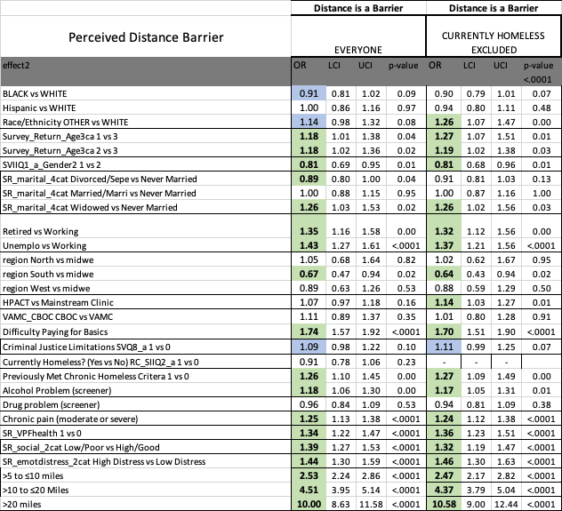
Detailed Model

Slide 22
1. Perceived Distance Barrier
p<0.0001
At >5 miles, 37% report a distance barrier to care
Distance “as crow flies” from survey address to VA primary care clinic

Slide 23
Social Support Detail
 | No | Yes
I have someone who will listen to me when I need to talk.
I have someone who makes me feel appreciated.
I have someone to talk with when I have a bad day.
I have someone to confide in or talk to about myself or my problems.
I feel isolated from others.
I have someone who I can borrow $20 from if I need it.

Slide 24
Psychological Distress Detail
1. Over the last 2 weeks, how often have you been bothered by the following problems? | Not at all | One or Two Days | Several days | More than half the days | Nearly every day
Feeling nervous, anxious or on edge
Not being able to stop or control worrying
Feeling down, depressed, or hopeless
Little interest or pleasure in doing things
Being told by others that you acted paranoid or suspicious
Hearing voices, or hearing things that other people didn’t think were there

Slide 25
Perceived Distance Barrier (currently homeless)

