Slide 1
Early Results of Implementing a Rapid Methadone Titration for Hospitalized Patients: A Case Series
Marlene Martín, MD
Director, Addiction Care Team, Division Of Hospital Medicine, San Francisco General Hospital
Director, Addiction Initiatives, Latinx Center Of Excellence
Associate Professor Of Clinical Medicine, UCSF
Additional Authors:
Taylor Baisey, MPH; Sasha Skinner, MPH; Leslie Ly, Pharmd; Kristin Slown, Pharmd, Kristin Harter, Pharmd, Oanh K Nguyen, MD, MAS; Scott Steiger, MD; Leslie W. Suen, MD, MAS

Slide 2
Disclosures
None

Slide 3
Background
Fentanyl and its potent analogues have complicated opioid withdrawal and opioid use disorder (OUD) treatment during hospitalization
Undertreated opioid withdrawal leads to negative outcomes—delayed hospitalizations, self-directed discharges, and in-hospital drug use
Management of opioid withdrawal and OUD during hospitalization is evolving to meet these challenges
Thakrar AP et al, JAMA 2023. Grewal HK et al, Drug Alcohol Rev 2015. Englander H et al, JAMA IM 2024.

Slide 4
Background: Changes in OUD/withdrawal Management among Hospitalized Patients using Fentanyl
Buprenorphine: Low-dose, overlap and injection methods
Methadone: Rapid methadone titrations (RMT)
Full opioid agonists
OR
We developed and piloted a RMT for patients with OUD and daily fentanyl use
Sokolski E et al, JAM 2023. Thakrar AP et al, Addiction Sci Clin Practice 2023. Liu P et al, JAM 2024.

Slide 5
Objectives
Improve opioid withdrawal and OUD treatment among hospitalized patients initiating methadone through RMT
Understand RMT implementation and adverse events during the first 12 weeks of this pilot
Notes:
And what does this mean for us in hospitals. It's no surprise only risen with what is happening in our country,
How many of you regularly care for hospitalized patients with an opioid use disorder in the last last month
In this nationally representative study of hospitalizations, 1 in 9 hospitalizations, 1 in 11 ED visits was due to SUD and there was a 57% increase during the study period.
This touchpoint people have with hospitals is critical
$13.2 billion
Oregon Medicaid patients who were admitted to one of 62 Oregon hospitals at least once between April 2015 and December 2017 study, all people discharged between 4/2015-12/2017. 7.8% died in 12 months – OUD, 13% from overdose ,42% non drug causes, comparable to heart attack
Systems of care, hospital dc for sud
7 t imes more likely to be hospitalized - Lewer D, Freer J, King E, et al. Frequency of health-care utilization by adults who use illicit drugs: a systematic review and meta-analysis. Addiction. 2020;115(6):1011–1023.
So this was a retrospective, observational study using National Hospital Ambulatory Medical Care Survey NAHMCS as our dataset.
Since 2014, NHAMCS identifies the presence of AUD and SUD through chart review of all available medical record data, not just ICD-9 and ICD-10 diagnoses codes.
Not surprisingly, with what is happening in our country, SUD are also prevalent among hospitalizations.
In this nationally representative study of hospitalizations, 1 in 9 hospitalizations, 1 in 11 ED visits was due to SUD and there was a 57% increase during the study period.
$13.2 billion
I’m curious if the knowing nods in the room are because this is the same frequency of hopsitalizations for sud you see
So this was a retrospective, observational study using National Hospital Ambulatory Medical Care Survey NAHMCS as our dataset.
Since 2014, NHAMCS identifies the presence of AUD and SUD through chart review of all available medical record data, not just ICD-9 and ICD-10 diagnoses codes.

Slide 6
Methods

Slide 7
Setting
Urban, safety-net academic hospital with an electronic health record (EHR) in San Francisco
Interprofessional Addiction Consult Team (ACT)
Fentanyl is the prominent opioid in the drug supply

Slide 8
RMT Development & Implementation
Interprofessional Addiction Pharmacy & Therapeutics Subcommittee
Limited to patients followed by Addiction Consult Team
Day | Traditional Methadone Dosing | Rapid Methadone Dosing
1 | Up to 40mg | Up to 60mg
2 | Up to 50mg | Up to 80mg
3 | Up to 60mg | Up to 100mg
4+ | Increase by 5-10mg up to every 3-5 days thereafter for opioid withdrawal/cravings | Increase by 10-20mg up to every 3 days thereafter for opioid withdrawal/cravings
Note: Daily doses of methadone 80-100mg associated with improved outcomes (Strain, JAMA 1999)

Slide 9
Inclusion and Exclusion Criteria
Inclusion
Exclusion
Adults 18-64
Self-reported daily fentanyl use
Newly initiating methadone between 9/11/23 and 12/3/23
Followed by ACT
End-stage organ damage (kidney, heart, lung) or critical illness (sepsis)
For this case series we also excluded:
Pregnant, incarcerated, active opioid treatment program enrollment
Started on methadone by primary team $≥$48h before initial ACT visit or started RMT $≥$48h after ACT visit
Received RMT but met exclusion criteria
Notes:
Inclusion and exclusion criteria to reduce the risk of oversedation from methadone
To identify a representative sample of patients initiating methadone via the RMT

Slide 10
Data Sources & Outcomes
Abstracted electronic health record data including demographic, clinical, and hospitalization characteristics
Substance use disorders, daily hospital methadone doses, and additional full acting opioid doses in morphine milliequivalents (MME)
Primary outcome of interest: adverse events
Chart documented adverse event of sedation, falls, naloxone administration, intensive care unit transfer, intubation, and death
Secondary outcomes:
Median time to 100mg of methadone,
Full agonist opioid doses during each hospital day
Self-directed discharge

Slide 11
Adverse Events
For patients with adverse events, we reviewed:
Additional sedating medications
Acute kidney injury
Day of occurrence of adverse event within hospitalization
Subsequent clinician intervention
Author group determined likelihood of being related (unrelated, possibly, probably, or definitely related) to RMT by majority consensus

Slide 12
Results

Slide 13
Consort diagram of Hospitalizations Assessed for New Methadone Initiation & those that Received Rapid Methadone Titration (RMT)
Hospitalizations assessed for methadone initiation (n=85)
Excluded from study (n=30 hospitalizations representing 25 unique patients)
Pregnant (n=16)
Incarcerated/in custody (n=4)
Received methadone ≥48 hours before ACT evaluation (n=5)
Began RMT ≥48 hours after ACT evaluation (n=3)
Received RMT but had contraindications (n=2)
Assessed for RMT (n=55 hospitalizations representing 47 unique patients)
Excluded, did not receive RMT (n=36 hospitalizations representing 30 unique patients)
End stage organ damage/severe illness (n=17)
Did not report daily fentanyl use (n=12)
Somnolence (n=4)
Unknown (n=3)
Eligible for and received RMT (n=19 hospitalizations representing 17 unique patients)

Slide 14
Sociodemographic & Clinical Characteristics of Patients who received RMT (n=17)
Race/Ethnicity, n (%) | N (%)
Black or African American | 1 (5.9)
Latine | 0 (0.0)
White | 14 (82.4)
Other | 2 (11.8)
Gender Identity, n (%)
Female | 2 (11.8)
Male | 15 (88.2)
Age (years), median (IQR) | 40.0 (34.0-43.0)
Housing status, n (%)
Housed | 4 (23.5)
Houseless | 13 (76.5)
Concurrent SUD, n (%)
Alcohol | 3 (17.6)
Benzodiazepine | 3 (17.6)
Tobacco | 11 (64.7)
Stimulants | 13 (76.5)
History of past medication for addiction treatment, n (%)
Both | 10 (58.8)
Buprenorphine | 13 (76.5)
Methadone | 14 (82.4)
Neither | 0 (0.0)

Slide 15
Characterization of adverse events, responses, and likelihood of each resulting from RMT among hospitalizations who received RMT (n=19)
# | Type | Day of methadone titration | Methadone dose during event (mg) | Concurrent Substance Use Disorders | Other sedating medications/ factors | Response | Likelihood related to RMT
1 | Oversedation | 2 | 60.0 | Methamphetamine, Tobacco | Hydromorphone, Oxycodone | Monitoring | Possibly
2 | Oversedation | 2 | 40.0 | Methamphetamine, Tobacco | Hydromorphone, Oxycodone | Methadone dose maintained for a day | Possibly
3 | Oversedation | 6 | 80.0 | Methamphetamine, Benzodiazepines | Gabapentin, Hydromorphone, Acute Kidney Injury | Methadone dose decreased by 10 mg | Probably
4 | Oversedation | 14 | 120.0 | Alcohol, Methamphetamine | Gabapentin, Hydromorphone, Olanzapine, Oxycodone | Methadone dose decreased by 10mg | Possibly

Slide 16
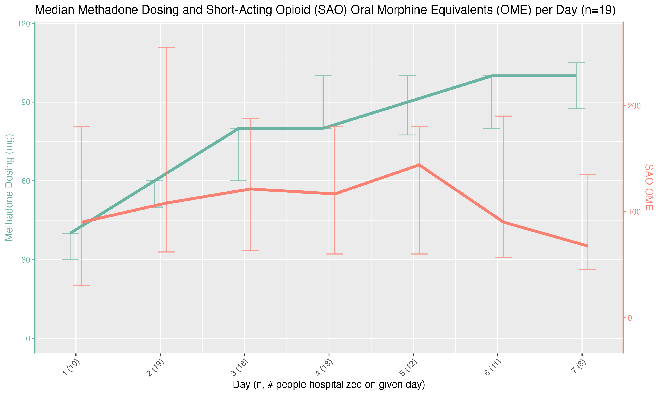

Slide 17
Median daily methadone doses and Morphine Milliequivalents (MMEs) of Additional Full Agonist Opioids (FAO) among hospitalizations who receive the RMT (n=19)
 |  | Methadone |  | FAO
Day* | Total N** | N who received methadone | Median (IQR) | N who received FAO | Median (IQR)
1 | 19 | 19 | 40.0 (30.0-40.0) | 18 | 90.0 (30.0-180.0)
2 | 19 | 19 | 60.0 (50.0-60.0) | 19 | 108.0 (61.9-255.0)
3 | 18 | 18 | 80.0 (60.0-80.0) | 17 | 121.3 (63.0-187.5)
4 | 18 | 18 | 80.0 (80.0-100.0) | 17 | 116.6 (60.0-180.0)
5 | 12 | 12 | 90.0 (77.5-100.0) | 12 | 144.0 (60.0-180.0)
6 | 11 | 11 | 100.0 (80.0-100.0) | 10 | 90.0 (57.0-190.0)
7 | 8 | 8 | 100.0 (87.5-105.0) | 8 | 67.5 (45.3-135.0)
*Represents day in hospitalization first received methadone
**Represents number remaining hospitalized

Slide 18
Additional Findings
1 (5.3%) self-directed discharge
2 patients received RMT despite meeting exclusion criteria
1 had end-stage renal disease and had sedation that was thought to be possibly RMT-related

Slide 19
Conclusions

Slide 20
Summary of Findings
1 in 3 assessed for RMT received it and those who did not receive it were appropriate excluded
1 in 4 patients who received RMT experienced sedation though no other adverse events witnessed during hospitalization
Median methadone dose 100mg by day 6
Low self-directed discharge rates
Notes:
low rate of self directed discharge compared to prior local data showing rates between 11-24% and national data showing rates up to 44% among patients with substance use disorders, though may be due to overall adequate opioid withdrawal management which may reduce the rate of self directed d/c

Slide 21
Limitations
Small case series based on retrospective chart review reporting observational data, limiting causality and generalizability
No outcome and follow-up data to show impact (e.g., linkage, treatment retention) beyond hospitalization
In-hospital substance use could have contributed to some of the oversedation
RMT initiated by the ACT, potentially limiting implementation among hospitals without a consult service

Slide 22
Conclusions
Adds to the growing evidence for RMT with careful patient selection for patients with fentanyl use disorder initiating methadone
Well tolerated, even in patients receiving FAO and with high rates of concurrent substance use disorders without critical illness
RMT may relieve opioid withdrawal and help patients complete hospitalization

Slide 23
Thank You! Questions? ACT.UCSF.EDU marlene.martin@ucsf.edu @MarleneMartinMD

