Slide 1
Exploring Barriers and Facilitators to Embedding and Sustaining Peers in Emergency Departments
Nicole O’Donnell, BA, CRS, (she/her),
Project Manager, Center for Addiction Medicine and Policy, University of Pennsylvania
James Sherman, CRS, CHW (he/him)
Substance Use Navigator, Center for Addiction Medicine and Policy, University of Pennsylvania
Jasmine Barnes, MPH, CFRS, (she/her)
Project Manager, Center for Addiction Medicine and Policy, University of Pennsylvania
AMERSA Annual Meeting
November 14, 2024

Slide 2
Disclosure
This work was funded through the National Association of County and City Health Officials (NAACHO) Sustaining Peers in Emergency Departments (S-PED) initiative and implemented in partnership with the Philadelphia Department of Public Health (PDPH)

Slide 3
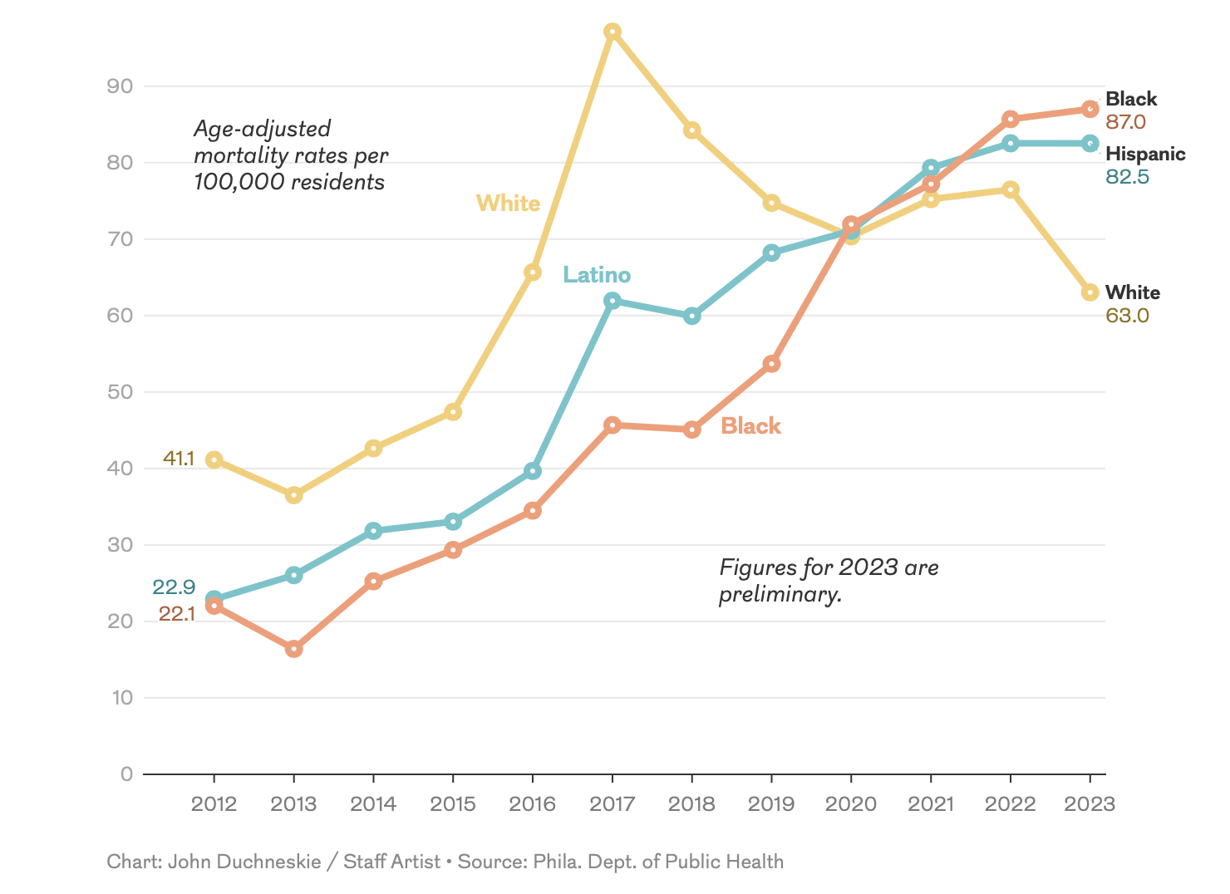
Background
Overdose Mortality Rate in Philadelphia by Race/Ethnicity , 2012-2023
The Hospital of the University of Pennsylvania Cedar Campus (HUP Cedar) is located within a predominantly black community with few care touchpoints and harm reduction services
Peer Recovery Specialists (PRSs) provide advocacy and support to initiate and sustain recovery; challenges remain to integration within acute care settings
Sources: Gormley, M. A., Pericot-Valverde, I., Diaz, L., Coleman, A., Lancaster, J., Ortiz, E., ... & Litwin, A. H. (2021). Effectiveness of peer recovery support services on stages of the opioid use disorder treatment cascade: a systematic review. Drug and Alcohol Dependence, 229, 109123.
Philadelphia Department of Public Health. Unintentional Drug Overdose Fatalities in Philadelphia, 2022.
CHART 2023; 8(3):1-7
Notes:
Overdose fatalities peaked in Philadelphia in 2022 with 1,413 deaths, while overdose fatalities slightly decreased for NH Whites in 2023, overdose remains a top cause of death for black and Latinx Philadelphians as disparities in care access widen
Expanding recovery support in West and Southwest Philadelphia is a growing priority to address disparities in fatal overdoses and MOUD access
While peers in recovery offer enhanced support and advocacy to patients navigating recovery, there remains challenges to fully integrating peers as advocates within acute care settings. Addressing the overdose crisis requires an “all hands on deck” approach, with Peers on the frontlines, peer support services include:
Counseling on multiple pathways to recovery
Resource connection and support from those with lived experience
Advocacy within the health system to make MOUD more accessible
Warm-handoff and aftercare coordination

Slide 4
Why do we focus on the Emergency Department (ED)?
Overdose
Screening
Seeking Treatment
Notes:
ED utilization is high among PWUD, often the first line of care
Enables us to capture patients who experience overdose and other SUD-related complications
Offers 24 hour care in an environment that is well suited to support complex care needs and navigation
- Specifically relevant to methadone initiation because patients are generally unable to self-refer to clinics but pts are able to get intake testing in the ED

Slide 5
Capturing Community Input
“…you can put your buprenorphine truck in front of a crack house and they’ll walk out the door and won't use it. Because they don't want the community to see them use that…”
- West Philadelphia Community Leader
Qualitative Needs Assessment
May-August 2022
Recommendations to improve care/SUD services:
Emphasis on low barrier care, walk-in access
Centrally located
Addresses SDoH
Culture/safety/vulnerability
Not just buprenorphine, not just opioids
Confidentiality

Slide 6
Objectives
Highlight strategies to integrate peers in acute care settings
Describe implementation of peer recovery specialist support for warm handoffs to methadone and buprenorphine in an urban ED
Notes:
Our goals today are to highlight some strategies we’ve implemented to integrate peers in acute care settings and describe program components and outcomes for initiating MOUD through this initiative In an urban ED

Slide 7
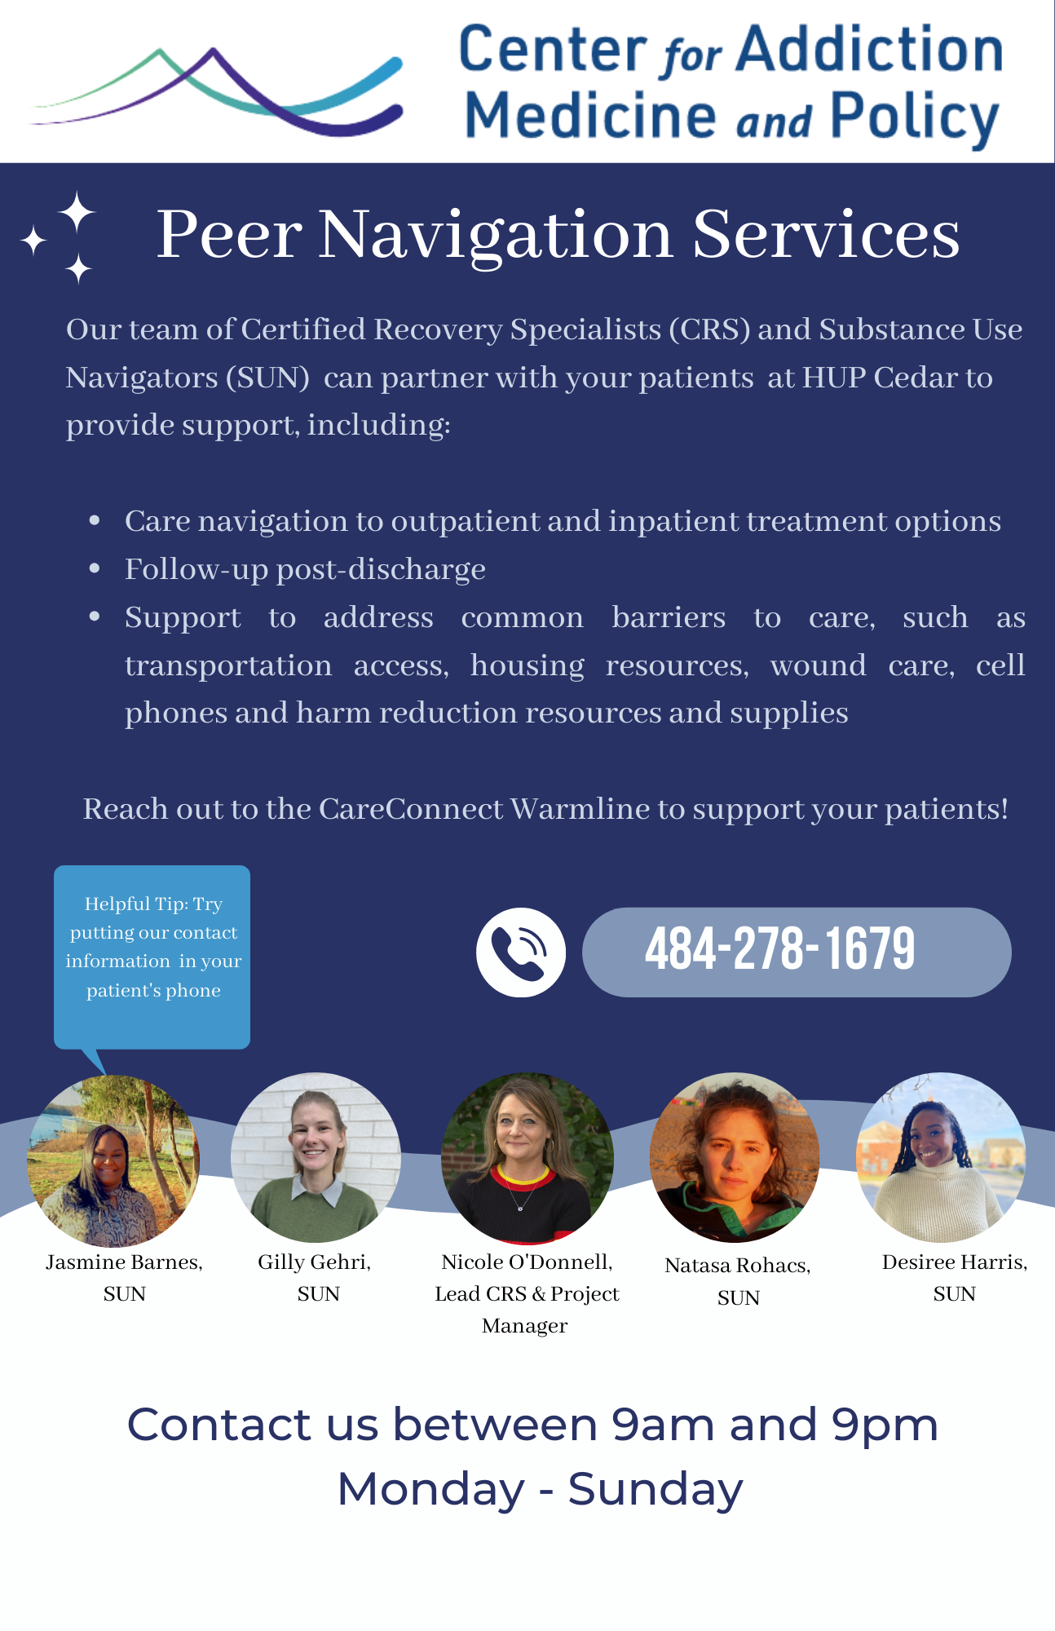
Sustaining Peers in Emergency Departments (S-PED) Overview
In-person substance use navigation services at HUP Cedar
Program components:
Care navigation to outpatient and inpatient treatment
Connection to MOUD
Linkage with support for social needs
Discharge planning and care coordination
Post-discharge follow-up
Notes:
Addressing the overdose crisis requires an “all hands on deck” approach, with Peers on the frontlines, peer support services include:
Counseling on multiple pathways to recovery
Resource connection and support from those with lived experience
Advocacy within the health system to make MOUD more accessible
Warm-handoff and aftercare coordination
Sustaining Peers in Emergency Departments (S-PED) project aimed to leverage partnership between the University of Pennsylvania Health System (UPHS), Philadelphia Department of Public Health (PDPH) and National Association of County and City Health Officials (NAACHO) to increase access to MOUD and address critical care gaps at HUP Cedar

Slide 8
Program Implementation
Meeting HUP Cedar leadership to identify stakeholders and care gaps
Drafted & disseminated clinical pathways for
ED Buprenorphine
and Methadone
Initiation
PRSs identified
and engaged
patients
Notes:
I’ll begin by giving an overview of the steps we took to implement the S-PED program at HUP Cedar. Our first step was to meet leadership to identify stakeholders and care gaps. We worked closely with social work, nursing and ED leadership to generate buy-in and ensure that our workflow included close collaboration with all members of the care team.
Our clinical leadership then drafted and disseminated MOUD pathways to provide support to ED docs initiating Buprenorphine or methadone in the ED. Our providers were pretty comfortable prescribing buprenorphine but less familiar with the more novel aspect of this work, which was our methadone pathway.
Lastly, our Peer recovery specialists identified and engaged with patients who presented in the ED to offer care navigation and resource linkage.

Slide 9
ED Buprenorphine Initiation and Linkage
PRS available to answer questions, make discharge plan
Pharmacy navigation
ED provider initiates buprenorphine and writes prescription for a 7-day supply
On discharge, the patient is linked to the CareConnect Warmline
Cell phones
Wound care supplies
Safer use supplies
Patient is connected to long-term care
Shelter / Housing
Transportation
Telehealth buprenorphine
Notes:
Following initial engagement with our peer team, providers were made aware that a patient prefers to initiate buprenorphine. When appropriate, patients were started in the ED and discharged with a 7 day supply.
At the point of discharge, patients were provided with

Slide 10
ED Methadone Initiation and Linkage
ED provider orders EKG, urine drug screen, urine pregnancy
Patient is given a first dose of methadone
ED provider sends patient information to CareConnect Warmline
CareConnect Warmline sends referral to Merakey
Patient returns to ED for “bridge dosing” over the weekend
Patient presents to Merakey on Monday for intake
Fri & Sat
Mon - Thurs
Patient presents to Merakey next day, M-F for intake
Notes:
Similarly, patients initiating methadone received intake testing and an initial methadone dose during theor ED visit. A peer recovery specialist would then send the required clinical information over to our partner OTP and patients would be scheduled for same or next day intake. I want to highlight one challenge that often presents itself as we are navigating patients over the weekend. In the event that a patient is expected to be discharged on Friday, peers would also coordinate weekend methadone bridge dosing in the ED, which we achieve by leveraging the 72 hour rule which allows for methadone to be dispensed for up to 72 consecutive hours to prevent gaps in care.
Mention standing 1pm appointment
Lastly, We measured program feasibility and outcomes using chart review, review of state prescription data monitoring program data, and follow-up data from our partner OTP.

Slide 11
S-PED Patient Characteristics (n=166)
Characteristic, n (%) | Patients Engaged
Mean Age | 40 (SD 11)
Female Gender | 95 (57%)
Hispanic or Latino Ethnicity | 21 (13%)
Race*
White | 59 (35%)
Black | 93 (56%)
Other/Unknown | 14 (9%)
Housing Status
Permanently Housed | 96 (58%)
Unstably housed | 50 (30%)
Unknown/Other | 20 (12%)
Insurance Status
Medicaid | 137 (83%)
Medicare | 9 (5%)
Private/Commercial | 4 (2%)
Uninsured | 16 (9%)

Slide 12
S-PED ED Medication Starts (n=166)
Notes:
Also, patients were more commonly insured through Medicaid and 30% of patients reported housing insecurity at the time of engagement.
Patients accessed additional support services available through peers and substance use navigators. Of these services, patients utilized case management, pharmacy navigation and referrals to address their housing needs aside from MOUD more frequently than other services.
In terms of MOUD pathway implementation, about half of all patients were started on buprenorphine in the ED, roughly 32% of all patients initiated methadone treatment and about 2% of patients were started on Naltrexone for AUD. All patients were counseled on harm reduction techniques and offered drug checking supplies and Narcan at the point of discharge in addition to the ongoing support available through peers and substance use navigators.

Slide 13
S-PED Outcomes
Care Trajectory:
72% discharged to outpatient
care
16% Inpatient Detox/Rehab
13% Medical Admission
Care Retention:
Overall, 43% of patients were retained in care at 30 days (n=70)
55% of patients started on methadone in the ED (n=28)
51% of patients started on buprenorphine in ED (n=42)
Post-Discharge Engagement:
83% of all patients engaged with S-PED navigation services post-discharge
Notes:
Of the 166 patients we engaged within the first year, 43% remained engaged in care at 30 days.
55% of all patients who initiated methadone and 51% of all patients who initiated buprenorphine in the ED were engaged in care at 30 days.

Slide 14
Sustainability
Grant funding
Partnering with MCOs for funding to support their members
Insurance reimbursement
Ongoing peer training to support peer workforce development
PCB Accreditation
Notes:
Future plans to sustain this work include

Slide 15
Patient Success Story
36 y.o. male awaiting medical admission for complications of substance use was engaged by the peer team in the ED. The S-PED peer team partnered with the social work and medical teams to support discharge planning to inpatient rehab, including securing documentation to ensure smooth transition to his OTP at discharge. Patient transitioned to rehab and reached out to CareConnect following completion of inpatient treatment for support.
Patient was provided with transportation, a cell phone and linkage to medical care and close follow-up. Patient remains engaged in care with his OTP, has secured stable employment and is well on his recovery journey! He continues to engage with the CareConnect peer team for ongoing support.

Slide 16
Conclusions & Future Directions
Key facilitators of the program have been development of relationships with clinician and social work champions at HUP Cedar
Crucial for assisting patients with complex medical and social needs
Barriers included variable ED clinician adoption and comfort with MOUD initiation
Ongoing evaluation work and methadone pathway toolkit dissemination
Notes:
In summary,
Embedding PRSs in EDs can enhance treatment for people who use drugs from marginalized groups and those disconnected from traditional healthcare settings
Close collaboration with Opioid Treatment Program facilitates same-day intake and eases aftercare coordination
Key barriers included variable clinician adoption and comfort with MOUD induction, often addressed through peer-peer consults with our clinician leadership
Why Methadone?
…methadone is an alternative to buprenorphine ….more about what we have learned

Slide 17
Contacts & Questions
Acknowledgements
Samantha Huo, MD
samantha.huo@pennmedicine.upenn.edu
Jeanmarie Perrone, MD, FACMT
Jeanmarie.Perrone@pennmedicine.upenn.edu
Margaret Lowenstein, MD, Mphil
lowenstm@pennmedicine.upenn.edu
CAMP Team
Philadelphia Department of Public Health
NAACHO
Nicole O’Donnell, CRS
Nicole.o’donnell@pennmedicine.upenn.edu
Gilly Gehri, BA
Gilly.gehri@pennmedicine.upenn.edu
James Sherman, CRS, CHW
James.Sherman@pennmedicine.upenn.edu
Daniel Teixeira da Silva, MD, MSHP
daniel.tdasilva@phila.gov
Philadelphia Department of Public Health (PDPH)
Jasmine Barnes, MPH, CFRS
Jasmine.barnes@pennmedicine.upenn.edu
​
www.penncamp.org​
​
CareConnect Warmline 484-278-1679​
9am-9pm, 7 days/week​
www.substanceusephilly.com
​
Notes:
Contact and questions

Slide 18
S-PED Patient Characteristics
163 Patients engaged within one year
Notes:
Tohighlight a few key outcomes of the S-PED program:
We have engaged a total of 163 patients within one year
A little of ½ of those patients identified as black/AA, 13% reported Hispanic ethnicity

Slide 19
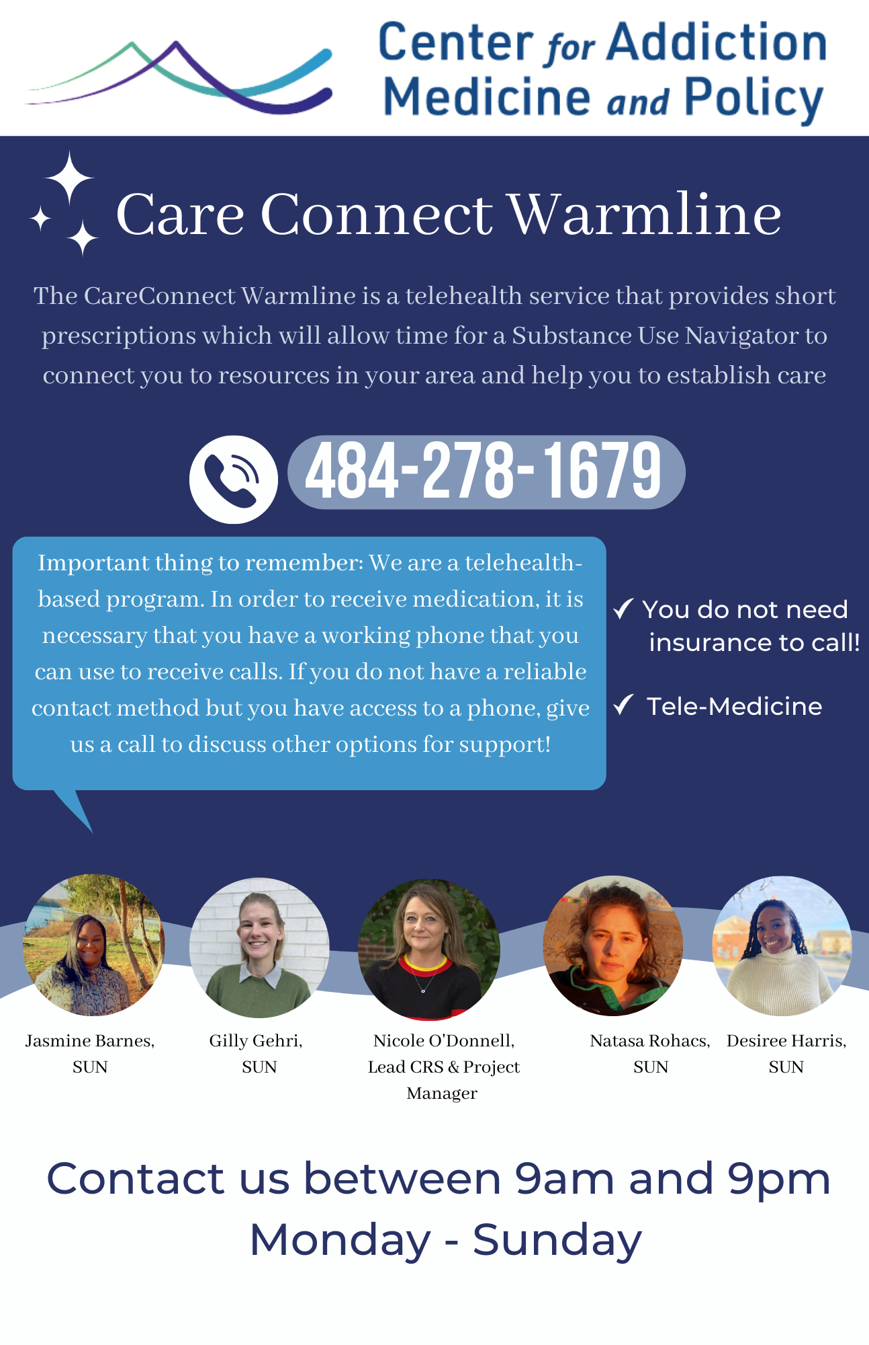
CareConnect Warmline
Available to patients, providers, family members
Same day access to telehealth buprenorphine
new starts or continuation of treatment
Short-term case management (ID, transportation, etc.)
Support navigating to other services (methadone, wound care)
Tailored referral to longitudinal treatment
Staffed by a group of trained, compassionate professionals (SUNs and CRSs)

