Slide 1
Emergency Medicine Resident Experiences, Perceptions, and Beliefs Regarding Medications for the Treatment of Alcohol Use Disorder
Joshua Reed Bia, MD
Kathryn Hawk, Md, MHS

Slide 2
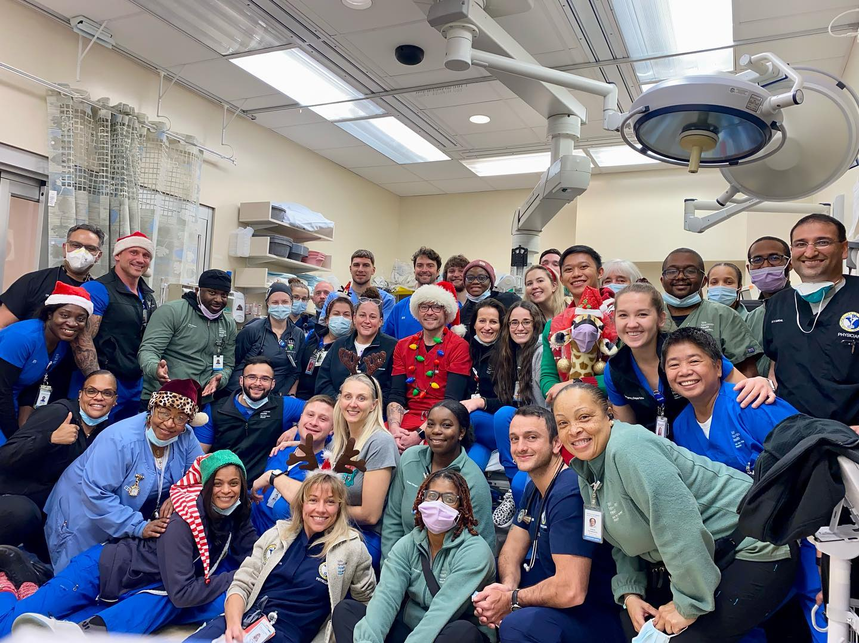

Slide 3
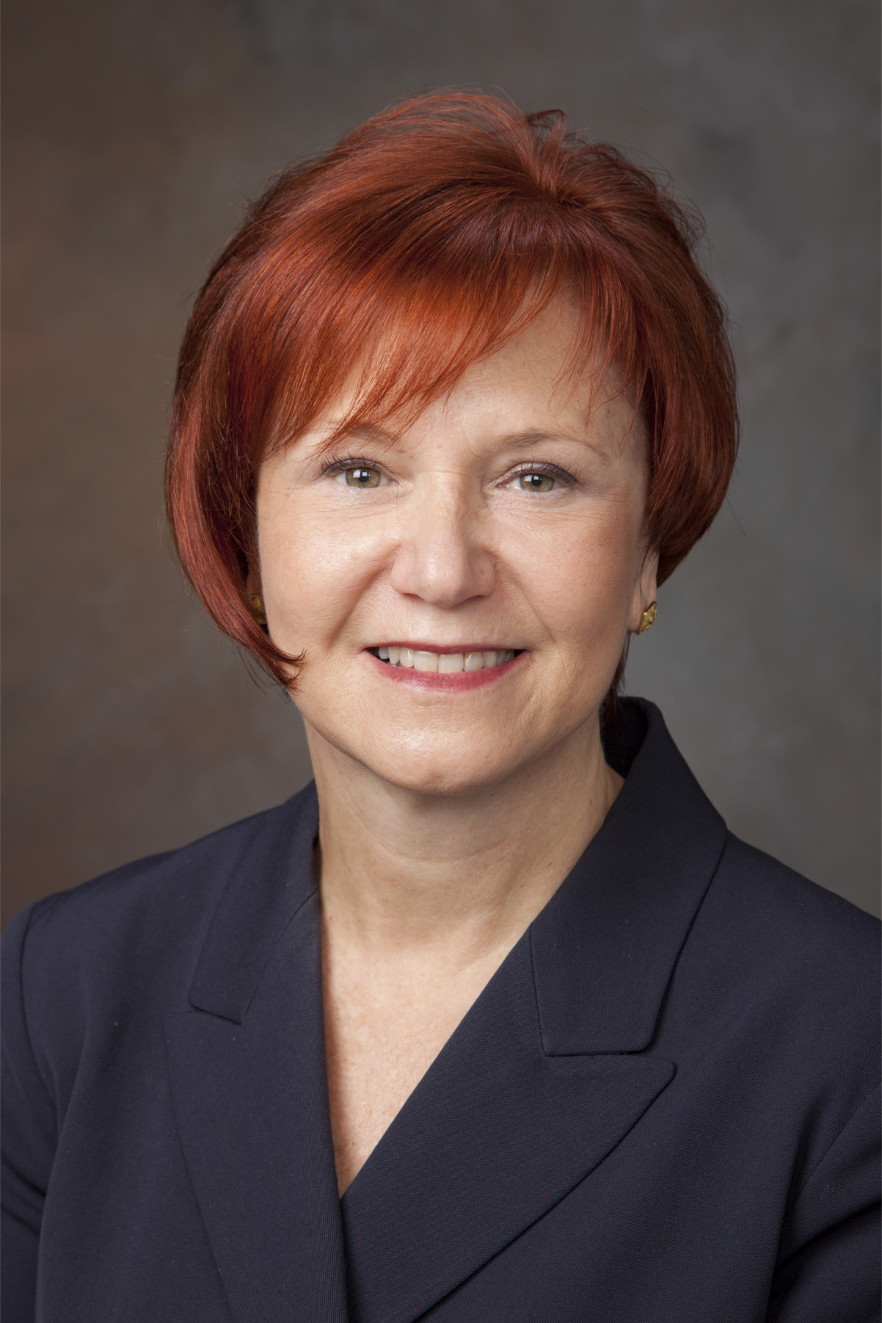
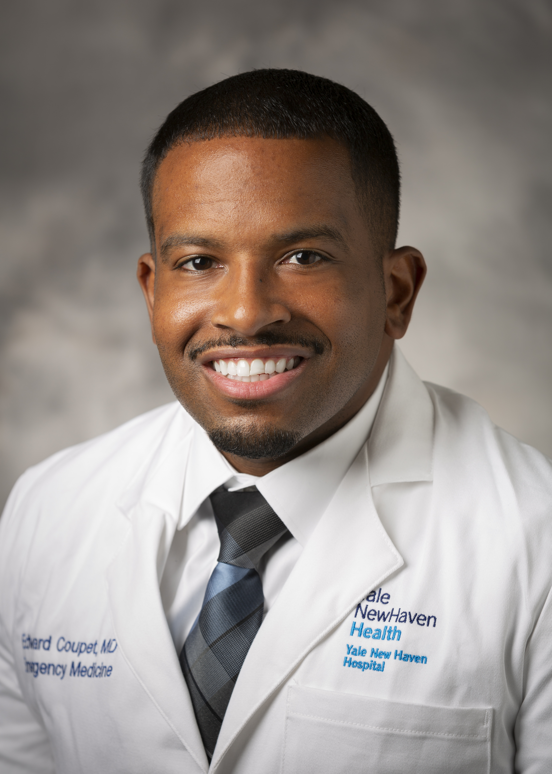
Gail D'Onofrio, MD, MS
Kathryn Hawk, MD, MHS
Edouard Coupet II MD, MS

Slide 4
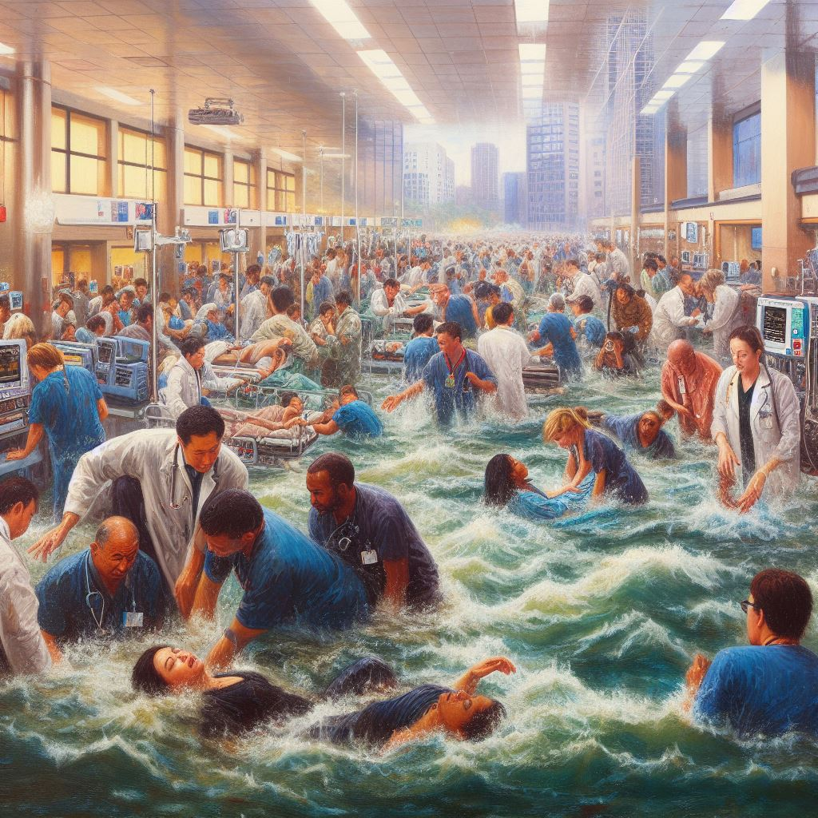
EM in 2023: A Resident’s Perspective

Slide 5
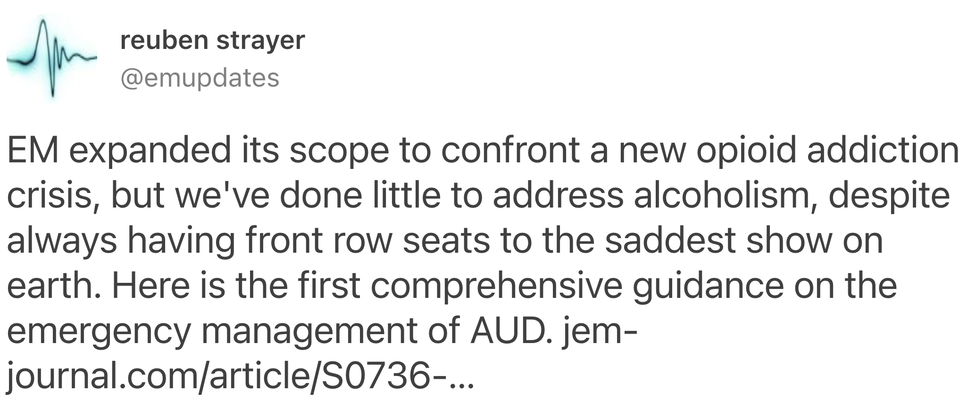
Alcohol Use Disorder in the ED: An Underserved Population
AUD accounts for the majority of substance use-related ED visits and a massive number of total ED visits annually in the United States.
EM clinicians see countless manifestations of AUD’s sequalae, both acute and chronic.
Critical location to diagnose and intervene on patients who may otherwise not interact with healthcare system.

Slide 6
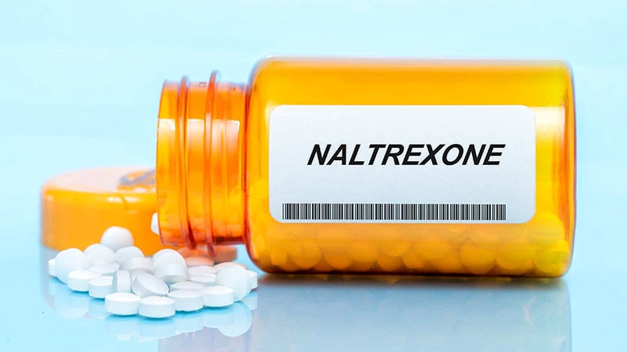
Pharmacotherapy
EM clinicians are very comfortable with treating alcohol withdrawal using benzodiazepines or phenobarbital.
Despite improved outcomes including reduced craving and heavy drinking days with naltrexone, initiating treatment for AUD in the ED is still uncommon.

Slide 7
Methods
Online survey distributed to Emergency Medicine residents between January 2023 and April 2023.
22 questions pertaining to resident knowledge, beliefs and experiences using pharmacotherapy for AUD in the ED.
Majority of questions were multiple choice, apart from the final two which allowed for open ended text responses.

Slide 8
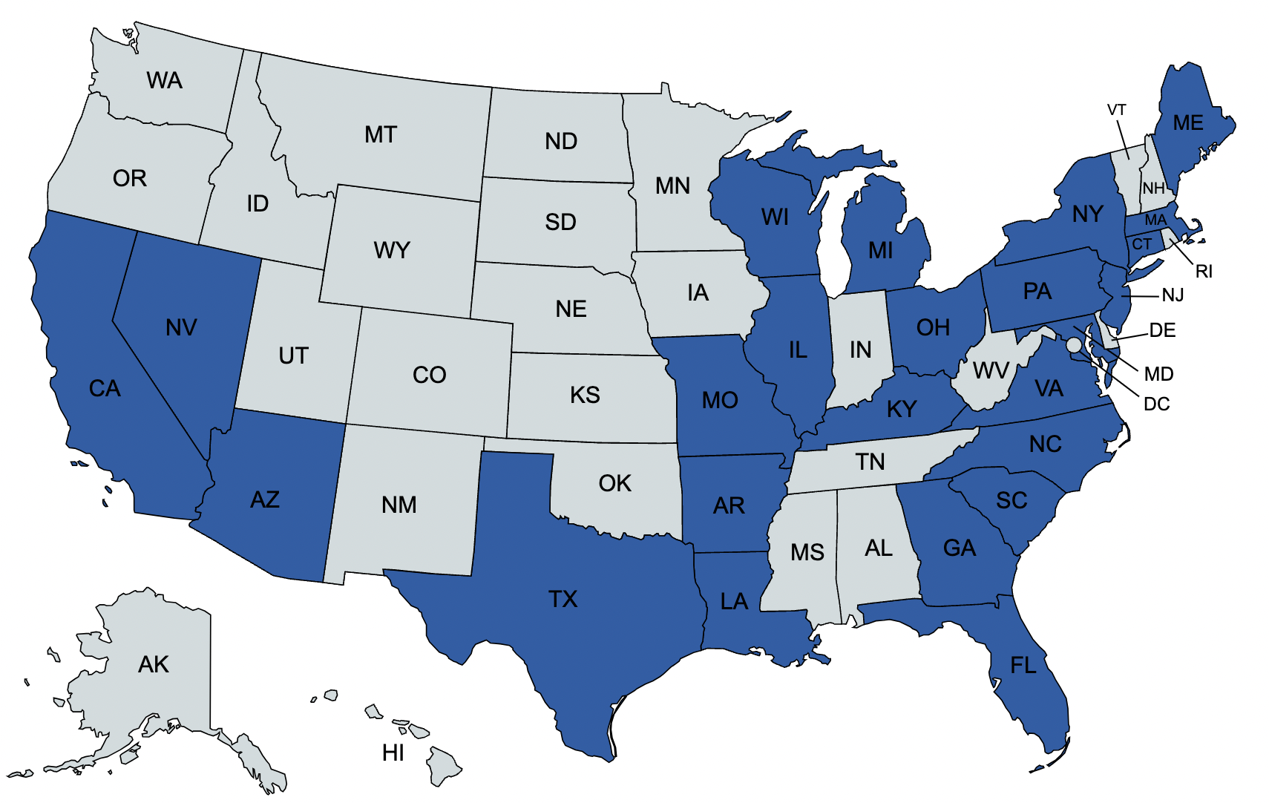
Demographics
78 individual responses from EM residents representing 24 different US States.

Slide 9
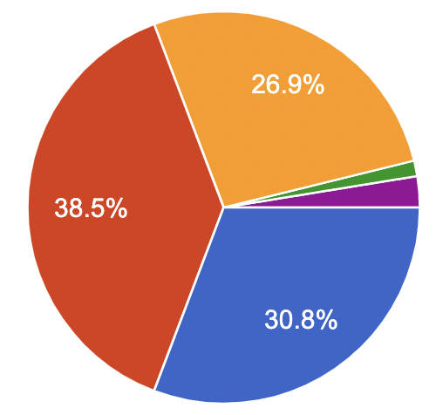
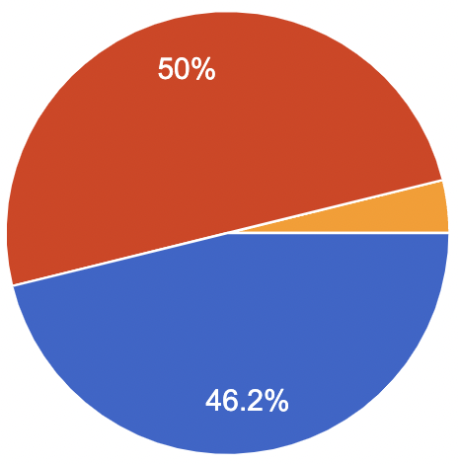
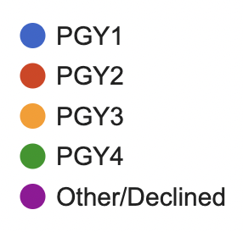
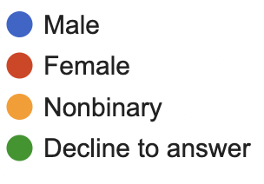
Demographics

Slide 10
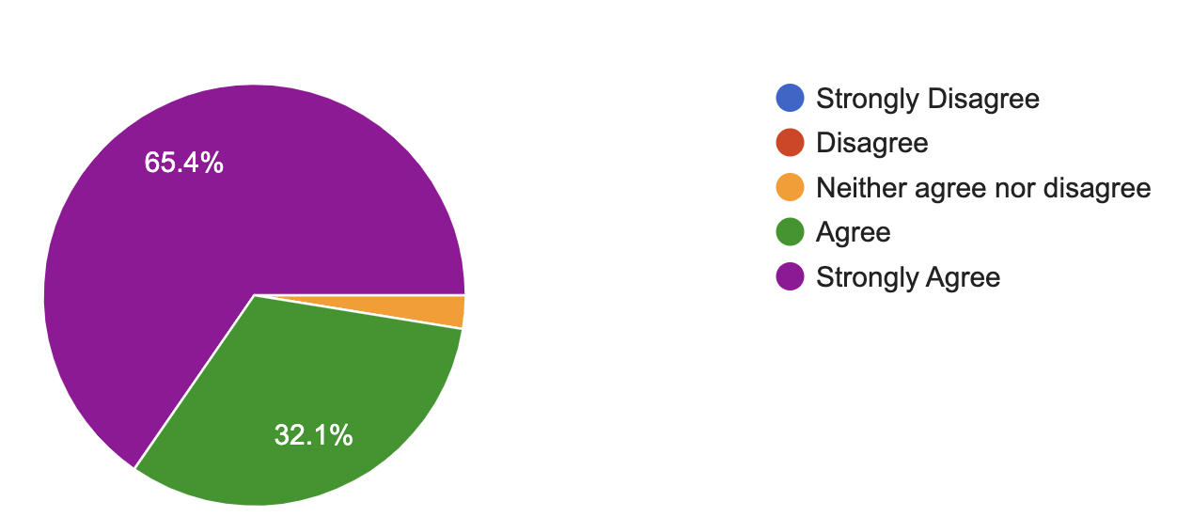
Results
1) It is important for Emergency medicine residents to be trained in the use of medication treatment for alcohol use disorder.

Slide 11
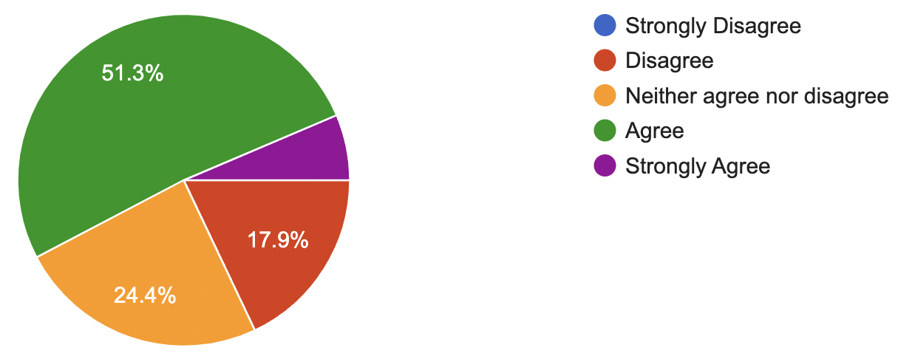
Results
2) I feel confident in my ability to provide evidence-based treatment to ED patients with alcohol use disorder.

Slide 12
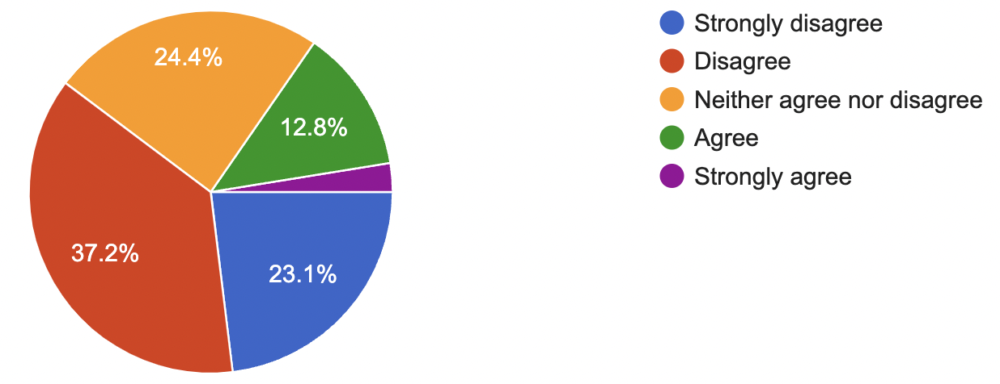
Results
3) I feel comfortable prescribing naltrexone in the emergency department to treat alcohol use disorder.

Slide 13
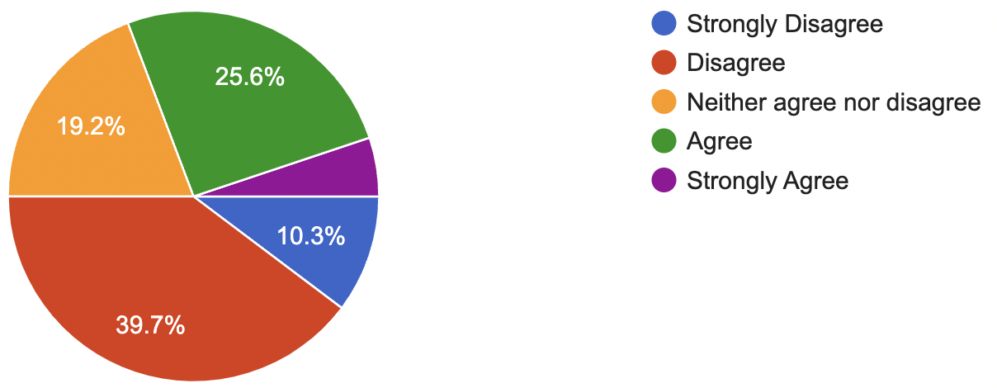
Results
4) I have received formal training in residency regarding the use of treatments for alcohol use disorder

Slide 14
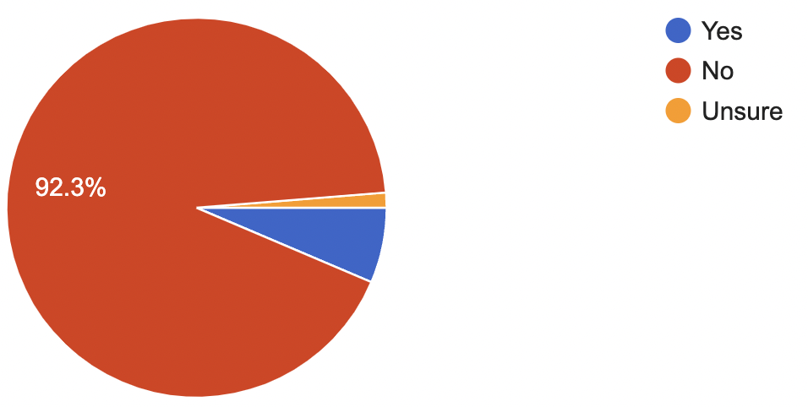
Results
5) I have prescribed naltrexone to treat alcohol use disorder

Slide 15
Open Ended Responses Barriers to Treatment:
“Lack of resources for follow up.”
“Attendings not being comfortable.”
“Time and education.”
“Many faculty and ancillary staff are very judgmental of patients with substance and mental health diagnoses.”
“When we are drowning in patients it is hard to not focus on those that are sick/dying acutely, even when knowing of the harm reduction that we could give to patients by addressing their substance use disorder.”

Slide 16
Barriers to Treatment: Themes
Lack of education/training
No appropriate follow-up for patients
Insufficient amount of time to spend with patients
Lack of modeling from attendings/senior residents

Slide 17
Next Steps
Continued research regarding efficacy of AUD treatments initiated in the ED.
Focused integrated didactic sessions.
ED clinicians who are certified/knowledgeable in Addiction Medicine and can model care to junior residents.
Implementation of easy to navigate practice pathways.

Slide 19
Thank You!

