Slide 1
Enhancing Family Engagement in Substance Use Disorder Treatment: A Training Intervention for Addiction Professionals
Alicia S. Ventura, MPH
Co-authors: Matthew Heerema, MS, LMHC; Justin Alves, MSN, FNP-BC, CARN; Samantha Blakemore, MPH; Kira Goodwin, BS; Tavita Hristova, BS; Andrea Jodat, DNP, FNP-BC, CARN-AP; Vanessa L. Loukas, MSN, FNP, CARN-AP; Jeff Pham, BS; Annie Potter, MSN, MPH, FNP-BC, CARN-AP; Nancy Regan-Brooks, FNP, CNM, CARN-AP; Victoria Rust, BS; Colleen T. LaBelle, MSN, RN-BC, CARN
2024 AMERSA National Conference
November 16, 2024

Slide 2
Funding provided by
Funding for this initiative was made possible (in part) by grant no. 1H79TI085588-02 from SAMHSA. The views expressed in written conference materials or publications and by speakers and moderators do not necessarily reflect the official policies of the Department of Health and Human Services; nor does mention of trade names, commercial practices, or organizations imply endorsement by the U.S. Government.

Slide 3
Disclosures
None of the authors have any relevant financial or other conflicts of interest to disclose relating to this presentation.

Slide 4
Introduction
Social support, particularly from biological and chosen family, is crucial for improving health outcomes in individuals with substance use disorder (SUD).¹⁻³
Many SUD professionals lack the training to engage families effectively, compounded by stigma and misconceptions about family involvement in SUD.⁴
Family members often receive inadequate attention and information from SUD treatment systems, undermining their ability and desire to improve SUD health outcomes.^{5,6}
Dobkin PL, et al. Addiction. 2002.
Petterson H, et al. Subst Abuse. 2019.
Kumar N, et al. J Subst Abuse Treat. 2021
Pielech M, et al. Addict Sci Clin Pract. 2024.
McCann TV, et al. Int J Ment Health Nurs. 2018.
Corrigan PW, et al. J Fam Psychol. 2006.

Slide 5
Objective
To assess the impact of a one-hour virtual training session for SUD professionals focused on integrating family members into SUD treatment.

Slide 6
Methods: Description of Training
Developed as part of an existing training and technical assistance (TTA) program
Advertised through large listserv
Online system for registration, evaluation, and continuing education credits
Conducted virtually via Zoom
60 minutes (45 minute didactic, 15 minute Q&A)
Free to attend and free continuing education credits
Notes:
Move away from blame and guilt by association
Move toward understanding family members as normal people, responding to stressful situations, with desire and ability to help loved ones with SUD

Slide 7
Methods: Training Objectives
Emphasize the influence of family members on individuals with SUD
Dispel myths related to family members and SUD (e.g., codependency, enabling)
Illustrate the impact of information provided to family members on SUD outcomes
Introduce strategies to engage families in SUD care

Slide 8
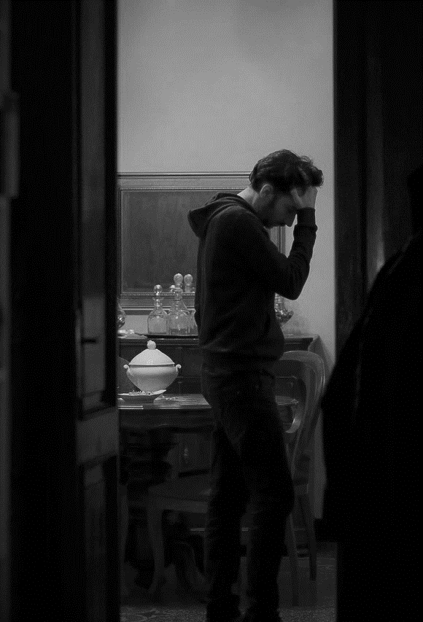
Methods:
Training Curriculum
Pat’s beloved wife of 12 years just recently received a cancer diagnosis. He and his wife have two kids under the age of seven. Pat has taken on two jobs, quit his exercise program, resigned from the company softball team, and stopped seeing friends to address this unexpected family crisis. He finds himself constantly obsessing over her cancer diagnosis.
Would anyone in Pat’s life call him enmeshed or enabling?
If Pat went to a therapist for support, would they ask him to explore the ways in which his dysfunctional childhood might be pushing him into an “unhealthy obsession” with his wife’s cancer diagnosis?
Would anyone label or judge him for doing everything possible—even to the point of giving up important parts of his life—to keep his family stable and relatively happy?
Probably not!
Adapted from: Weiss, R. (2018). Prodependence: Moving Beyond Codependency. Simon and Schuster.
Notes:
It is likely that Pat would be looked upon with great sympathy, and even thought of as a hero for putting the needs of his family before his own.

Slide 9
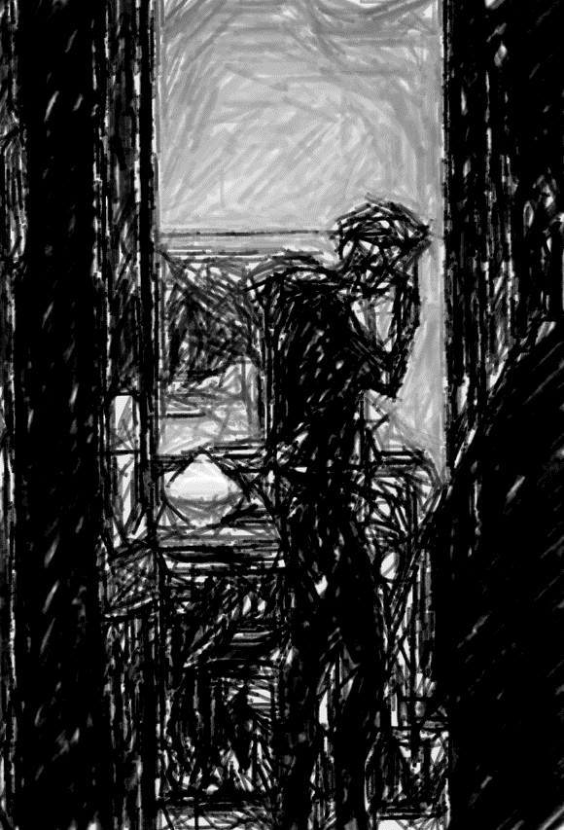
Pat’s beloved wife of 12 years is addicted to alcohol and opioids. His wife lost her job for using at work. Because she is often intoxicated, Pat can no longer trust his wife to care for their two children. Pat has taken on two jobs, quit his exercise program, resigned from the company softball team, and stopped seeing friends to address this unexpected family crisis. He finds himself constantly obsessing over her alcohol and drug use.
Would anyone in Pat’s life call him enmeshed or enabling?
If Pat went to a therapist for support, would they ask him to explore the ways in which his dysfunctional childhood might be pushing him into an “unhealthy obsession” with his wife’s substance use disorder diagnosis?
Would anyone label or judge him for doing everything possible—even to the point of giving up important parts of his life—to keep his family stable and relatively happy?
Probably!
Adapted from: Weiss, R. (2018). Prodependence: Moving Beyond Codependency. Simon and Schuster.
Notes:
Families dealing with substance use are treated differently than caregivers of people with other chronic health conditions. Family members affected by addiction remain a stigmatized population, rarely supported by the community, often assumed to be part of the problem rather than recognized for the potential they have to be part of the solution.

Slide 10
Methods: Training Evaluation
Demographic data (registration system) analyzed to assess program reach
All participants emailed post-training survey to gauge perceptions of impact on professional development, clinical practice, and patient outcomes
Post-training survey responses were analyzed using inductive and deductive thematic analysis
What impact do you predict participation in this educational experience will have on your professional development, practice or patient outcomes?
Framework and codebook created and updated
50% reviewed by both coders (ASV and MH), 100% reviewed by ASV

Slide 11
Results: Training Attendance 5/10/2022 to 4/8/2024
Total no. of trainings | 31
Total no. of participants | 2,135
Median no. of participants per training (IQR) | 64 (56-88)
No. of US states represented | 48
% of participants who completed post-training survey | 70%

Slide 12
Results: Professional Role and Location of Participants
Characteristic | n (%)
Professional role (n=2,135)
Advanced Practice Provider ª | 113 (5)
Community/Peer Support ^{b} | 554 (26)
MD/DO | 46 (2)
Mental Health Professional ^{c} | 585 (27)
Other Clinical ^{d} | 99 (5)
Nurse | 353 (17)
Other | 385 (18)
Location (n=2,135)
Massachusetts | 1115 (52)
Other state | 1020 (48)
Includes APRN, CNM, CNS, DNP, MSN, NP, PA
Includes CADC, CARC, CHW, LADC, CADAC, CASAC, Recovery Coach, Peer/Patient Navigator, Outreach Worker, Harm Reduction Specialist
Includes LCSW, LICSW, LMHC, MSW, LDC, LMFT, LPC, LSW, Psychologist, PsyD
Includes MA, OT, PT, Case Manager, RPN, RPH, PharmD

Slide 13
Results: Demographics of Training Participants
Characteristic | n (%)
Gender (n=950)
Female | 765 (81)
Male | 130 (14)
Other | 17 (2)
Prefer not to answer | 38 (4)
Race (n=950)
Asian | 27 (3)
Black | 122 (13)
White | 667 (70)
More than one race | 27 (3)
Other | 31 (3)
Prefer not to answer | 76 (8)
Ethnicity (n=798)
Hispanic | 94 (12)
Not Hispanic | 658 (63)
Prefer not to answer | 46 (6)

Slide 14
Results: Post-session survey themes
What impact do you predict participation in this educational experience will have on your professional development, practice or patient outcomes?
1. Intention to educate clients and colleagues
2. Understanding of the importance of family and social support
3. Awareness of stigma and bias toward family members
4. Intention to integrate family and social support into current SUD services

Slide 15
Results: Post-session survey themes
1. Intention to educate clients and colleagues
“I loved the breakdown of "co-dependent" behavior and that "rock-bottom" is not a reliable or healthy mechanism of desire to make change. I also loved the comparisons to how we would advise support systems to help folks manage other chronic diseases. I will pass these insights along to the families of our patients, when involved in care, and my coworkers.”
RN, Vermont

Slide 16
Results: Post-session survey themes
2. Understanding of the importance of family and social support
“As clinical staff in a recovery residential program, we have to approve passes for weekend outings. A lot of them want to go with their families, but we often get hung up on how many hours they are granted based on their current "phase." I want to bring back to the team a reminder that social supports increase the likelihood of successful outcomes, because I think this gets overlooked when we are making decisions.”
LCSW, Massachusetts

Slide 17
Results: Post-session survey themes
3. Awareness of stigma and bias toward family members
“…I knew there was bias and stigma with families of those struggling with SUD but this presentation greatly expanded on my current knowledge. I never realized how the term "codependency" is harmful, especially to family members of those with SUD. I will improve my practice by reflecting on my possible biases with SUD families and reflecting on how I can better incorporate them into treatment plans.”
RN, Massachusetts

Slide 18
Results: Post-session survey themes
4. Intention to integrate family & social support into current SUD services
“I will incorporate my new perspective on family support for people with SUD. Instead of pathologizing them, however unconsciously, I will keep in mind what a resource they are…I will thank them more and include them in education…I will view them as part of the team.”
RN, California

Slide 19
Conclusions
Addiction professionals need education to:
Recognize the importance of family and social support
Understand the impact of pervasive stigmatizing views about family members and SUD
Engage supports in meaningful ways
A single training session within an existing virtual TTA platform can enhance knowledge, challenge stigma, inspire practice changes, and boost the confidence of SUD professionals to incorporate family and social support into SUD care.

Slide 20
Questions and Contact Information
Alicia.Ventura@bmc.org

