Slide 1
Impact of a Medication for Opioid Use Disorder Curriculum for Emergency Residents
Notes:
The purpose of this talk is to describe our efforts at developing a curriculum for EM residents regarding the management of patients with opioid use disorder and use of buprenorphine to treat OUD.

Slide 2
Authors & Affiliations
Aaron Krumheuer, MD Emergency Medicine Resident, University of Michigan
Alex M. Nickel, MD PM&R Resident, Corewell Health
Erin Kim Medical Student, University of Michigan
Carrie Bailes, MD Emergency Medicine Resident, University of Michigan
Emily E. Ager, MD, MPH Emergency Medicine Resident, University of Michigan
Ella Purington, MD Emergency Medicine Resident, University of Michigan
Syed M. J. Mahmood, MD Assistant Professor, Department of Emergency Medicine, Division of Pain Medicine, UC-Davis
Mitchell T. Hooyer, MD Emergency Medicine Resident, University of Michigan
ML Ryan, MD Emergency Medicine Resident, St. Luke's University Health Network
Jessica Baker Medical Student, University of Michigan
Megan Purdy, MD Emergency Medicine Resident, Denver Health
Carolyn Commissaris, MD Assistant Residency Program Director, Brigham & Womens Hospital/Harvard Medical School
Shawna Smith, PhD Assistant Professor, School of Public Health, University of Michigan
Alexander Janke, MD, MHS Fellow, National Clinician Scholars Program, University of Michigan
Christopher Fung, MD, MS Assistant Professor, Department of Emergency Medicine, University of Michigan
Eve D. Losman, MD, MHSA Clinical Associate Professor, Department of Emergency Medicine, University of Michigan
Department of Emergency Medicine
Notes:
We are a large team of residents, medical students and faculty.

Slide 3
Disclosures
No listed authors have financial relationships to disclose.
This work was supported by a SAEMF / NIDA Mentor-Facilitated Training Award.
Department of Emergency Medicine

Slide 4
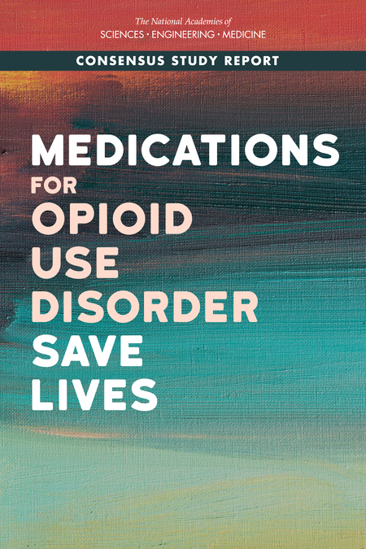
For many patients, the ED is a potential point of entry for initiating Opioid Use Disorder treatment.
Post ED visit for opioid OD, 5.5% of patients died within one year; of those patients, 20% of deaths occurred within 1 month of discharge.
SG Weiner et al. AnnEmergMed. 2020 Jan; 75(1): 13–17.
Department of Emergency Medicine
Notes:
Often, the ED functions as a gateway to healthcare for vulnerable and marginalized populations. This includes people who use drugs.
Our ED started Take Home Naloxone (THN) initiatives. Despite these resources, the fatal opioid overdose rate in our country has only increased.

Slide 5
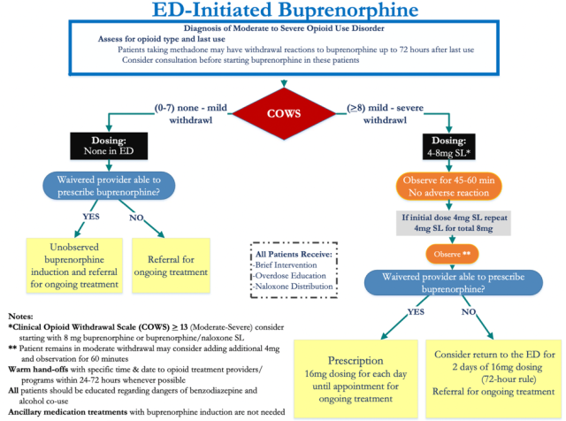
MOUD is the evidence based, gold standard treatment for OUD
Department of Emergency Medicine
Notes:
This is the Yale / ACEP flow chart – there are many others as well.

Slide 6
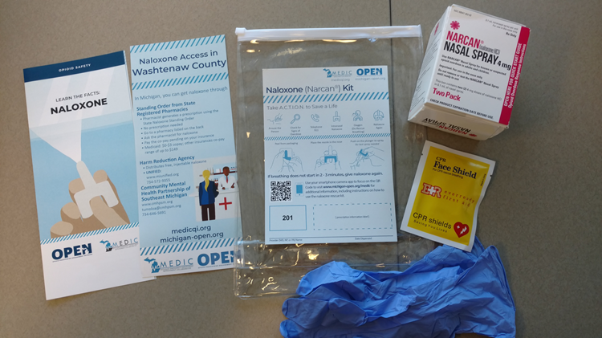
Our ED was slow to adopt MOUD . . .
We started dispensing free Take Home Naloxone kits in June 2020.
We started conversations regarding the need for ED based MOUD in Spring 2020 and our MOUD initiation order set went live in October 2021.
Department of Emergency Medicine
Notes:
We distributed surveys to our residents, measuring knowledge as well as attitudes and opinions at the beginning, midpoint, and end of our curriculum.
There were several domains that we analyzed. These included:
- Use of Naloxone and Buprenorphine in the ED, along with legal aspects of prescribing
- Harm reduction strategies for people who use opiates
- Familiarity with our institutional policies and outpatient referral clinics
- Counseling patients and leading conversations about MOUD
We then used descriptive statistics to examine our results with regression models to evaluate changes over time

Slide 7
Residents as Change Agents
4 year training program; 64 residents who were already exposed to the concept of overdose risk reduction via an ED based Take Home Naloxone program.
What might happen at the bedside if our residents were given the knowledge and skills to be agents of change for patients with OUD. Could a MOUD / Harm Reduction curriculum change clinical practice?
Department of Emergency Medicine
Notes:
We conducted a needs assessment to understand residents’ perceived barriers for treatment of patients with OUD. Our survey was based on a 4-point Likert scale, assessing residents’ comfort level and level of concern with various aspects of OUD and harm reduction, and 87% (56 of 64) of EM residents completed it.
Results showed that residents already feel confident in their ability to identify patients at risk for opioid overdose. They are comfortable with airway management for patients with respiratory failure secondary to opioids, and they know how to safely treat patients with naloxone.
Yet there were several areas of significant discomfort that residents routinely expressed, and these results mirrored the barriers illustrated in the existing literature.

Slide 8
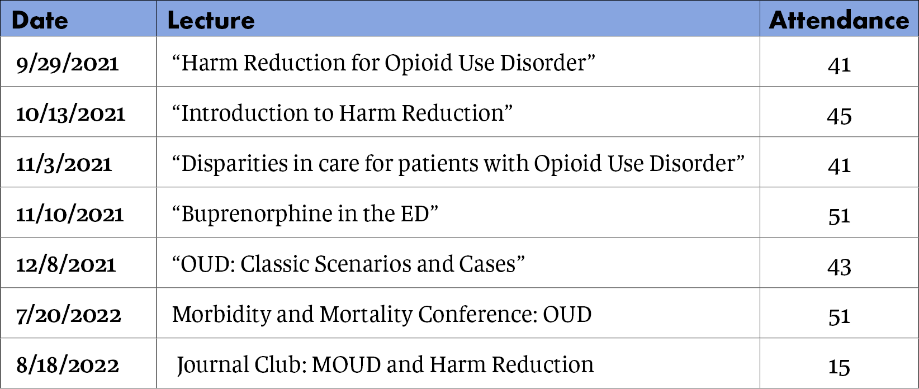
The curriculum and # of residents in attendance at each session
Department of Emergency Medicine
Notes:
Just a quick reminder . . .

Slide 9
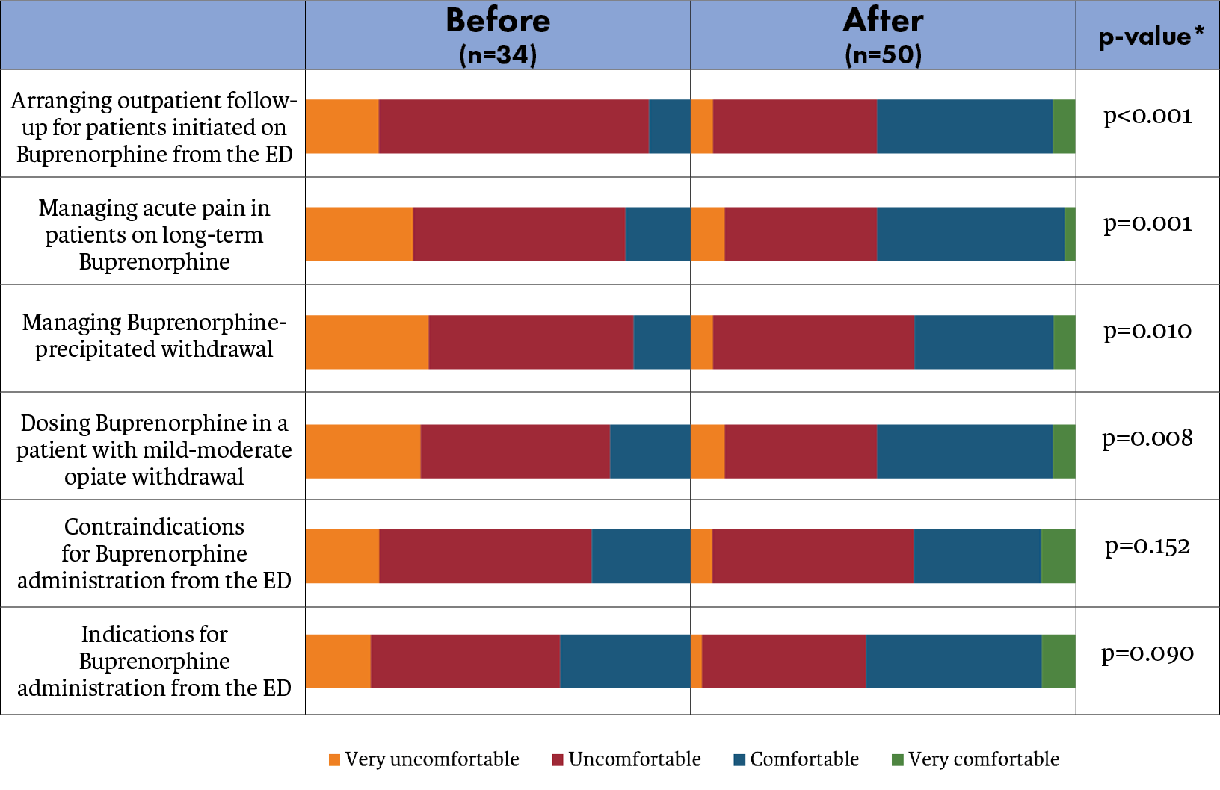
Department of Emergency Medicine
Notes:
Again . . . There was a statistically significant increase in levels of comfort with the main components of prescribing MOUD, such as arranging follow-up for patients started on bup, managing acute pain in patients already on bup, managing precipitated withdrawal, dosing buprenorphine for patients in withdrawal, and the indications for initiating bup in the ED.

Slide 10
Attitudes & comfort related to OUD and MOUD demonstrated positive change.
We then looked at clinical process measures . . .
Buprenorphine given / offered
Take Home Naloxone kit offered
MOUD outpatient referral / linkage to services provided
https://www.wsj.com/articles/do-younger-or-older-doctors-get-better-results-25800b7c
Department of Emergency Medicine
Notes:
We defined several outcomes that were most relevant to our educational intervention, and we set out to analyze patient data regarding how our department performed. The three main outcomes were related to buprenorphine, naloxone and linking patients to outpatient providers to continue their care.

Slide 11
First, we defined our population
Department of Emergency Medicine
Notes:
In order to define our population, we developed a set of search terms. These included ICD10 codes from the F11 range.

Slide 12
“naloxone”
“opioid overdose”
“heroin”
“Narcan”
Department of Emergency Medicine
Notes:
… As well as natural language from triage notes.

Slide 13
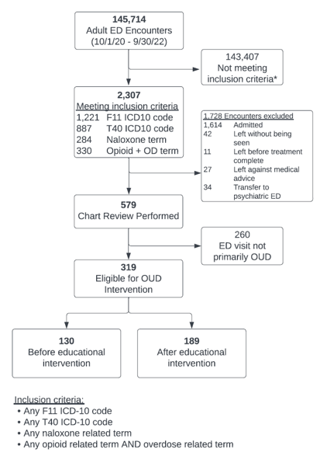
N=579
Interrater reliability:
Agreement: 93%
Kappa 0.85
Department of Emergency Medicine
Notes:
We started with 145,714 charts for one year before and one year after the start of our curriculum.
2,307 met our inclusion criteria
We excluded those patients who were admitted to the hospital. We also excluded AMAs, those who left before being seen or before their treatment was complete, and those who were transferred to the psychiatric ED. This was because we wanted to focus on only those patients who the ED primarily cared for.
There was a two-examiner review for eligibility, conducted by myself and our Co-PI, assessing whether the presentation was one in which the patient would be eligible for an OUD intervention such as distribution of take-home Naloxone or initiation of MOUD. Our wider chart review team also included other residents, attendings and a few medical students.
We did a double review of the eligibility and a third reviewer broke ties. The kappa and raw agreement were high, with 93% of charts in agreement.

Slide 14
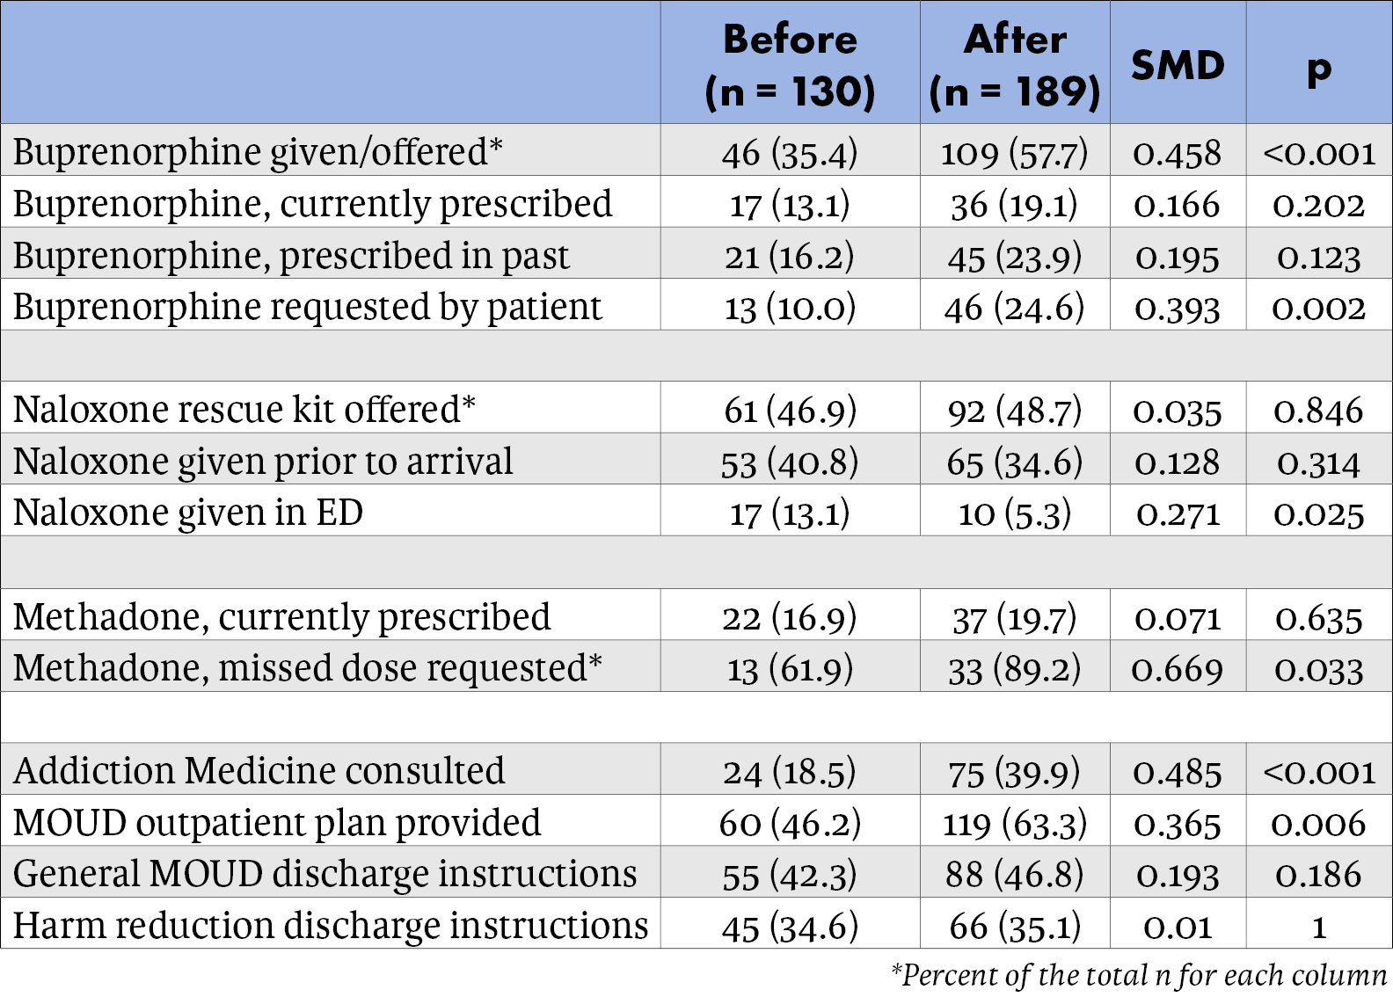
Clinical Process Measures Before and After Educational Intervention
Department of Emergency Medicine
Notes:
These were the main clinical process measures we analyzed from both before and after we started our educational intervention.
The first grouping deals with buprenorphine. We identified significant change in the percent of eligible patients that were either given or offered buprenorphine. There were also increased requests for buprenorphine across this time scale.
The second grouping details naloxone distribution. There was no significant change in the rate of rescue kits offered. In our initial needs assessment, residents indicated they were already quite comfortable identifying patients who were at risk of opioid overdose, so this did not come as much of a surprise.
The third grouping was not an outcome so much as a description of our patient population. More patients presented to the ED requesting doses of their maintenance methadone, often from missing the window on their clinic hours.
Finally, the fourth grouping analyzes the care we provided patients for after their discharge. There was a significant increase in the consultation and referral to our addiction medicine colleagues. There was also an increase in the development of a specific plan for connecting a patient to outpatient addiction services.

Slide 15
Conclusions
After targeted educational interventions, EM residents offered buprenorphine to more patients with OUD and connected more patients to outpatient addiction providers.
This chart review dataset can be used to revise and target ongoing educational interventions to improve care delivery.
Department of Emergency Medicine
Notes:
The legislative changes surrounding the X-Waiver presented the perfect opportunity to revisit the subject, and we hope we can help fill the needs that the X-waiver left unmet, specifically through an institution-specific curriculum.
After targeted educational interventions, EM residents offered buprenorphine to more patients with OUD and connected more patients to outpatient addiction providers.

Slide 16
References
Vivolo-Kantor AM, et al. Vital Signs: Trends in Emergency Department Visits For Suspected Opioid Overdoses—United States, July 2016–September 2017. Morbidity and Mortality Weekly Report. 2018; 67(9): p.279.
Samuels EA, Coupet E, D’Onofrio G. (2021) Emergency Department Treatment of Opioid Use Disorder. In: Wakeman SE, Rich JD. (eds) Treating Opioid Use Disorder in General Medical Settings. Springer, Cham.
Larochelle MR, et al. Medication for Opioid Use Disorder After Nonfatal Opioid Overdose and Association with Mortality: A Cohort Study. Annals of Internal Medicine. 2018; 169 (3): 137-145.
Morgan JR, et al. Overdose Following Initiation Of Naltrexone And Buprenorphine Medication Treatment For Opioid Use Disorder In A United States Commercially Insured Cohort. Drug and Alcohol Dependence. 2019; 200: 34-39.
Weiner SG, Baker O, Bernson D, Schuur JD. One-year mortality of patients after emergency department treatment for nonfatal opioid overdose. Annals of Emergency Medicine. 2020; 75(1): pp.13-17.
Olfson M, et al. Causes of Death After Nonfatal Opioid Overdose. JAMA Psychiatry. 2018; 75(8): 820–827.
D'Onofrio G, et al. Emergency department-initiated buprenorphine/naloxone treatment for opioid dependence: a randomized clinical trial. JAMA. 2015; 313(16): 1636-44.
Kaczorowski J, et al. Emergency Department–Initiated Interventions for Patients With Opioid Use Disorder: A Systematic Review. Academic Emergency Medicine. 2020; 27(11): 1173-1182.
Department of Emergency Medicine

