Slide 1
Evaluation of the Clinical Efficacy of an Application to Support Prescribing of Medication for Addiction Treatment
Samantha Blakemore, MPH; Andrea Jodat, DNP, FNP-BC, CARN-AP; Alicia S. Ventura, MPH; Tavita Hristova, BS; Victoria Rust, BS; Colleen LaBelle, MSN, RN-BC, CARN; Annie Potter, MSN, MPH, FNP-BC, CARN-AP
2024 AMERSA National Conference
November 16, 2024

Slide 2
Funding provided by
Funding for this initiative was made possible (in part) by grant no. 1H79TI085588-02 from SAMHSA. The views expressed in written conference materials or publications and by speakers and moderators do not necessarily reflect the official policies of the Department of Health and Human Services; nor does mention of trade names, commercial practices, or organizations imply endorsement by the U.S. Government.

Slide 3
Disclosures
None of the authors have any relevant financial or other conflicts of interest to disclose relating to this presentation.

Slide 4
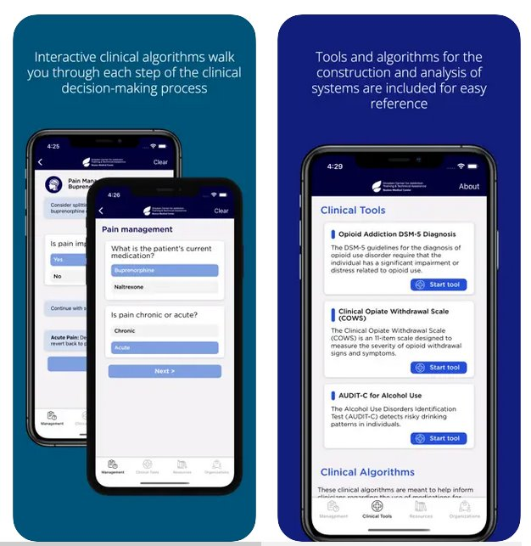
App in Review
Medications for addiction treatment (MAT) are underutilized
Barriers to MAT prescribing include inadequate training, education, and clinical support
The Boston Medical Center (BMC) MAT Quick Start app is a free mobile & online clinical tool to enhance provider confidence in prescribing MAT for opioid use disorder (OUD) and alcohol use disorder (AUD)
Notes:
We know that MAT is underutilized despite their remarkable benefits in terms of reducing mortality, reducing illicit substance use, and retaining people in treatment.
Data from the 2023 NSDUH study indicates that only about 1 in 5 received any MOUD in the past year, and far fewer received MAUD (about 2% of the almost 29 million people aged 12 and older meeting criteria for a past-year AUD.)
The perceived barriers of MAT prescribing are also well documented in the literature and include factors such as inadequate training, education on addiction and these meds, and lack of clinical support. Other barriers include lack of time and also administrative and institutional support.

Slide 5
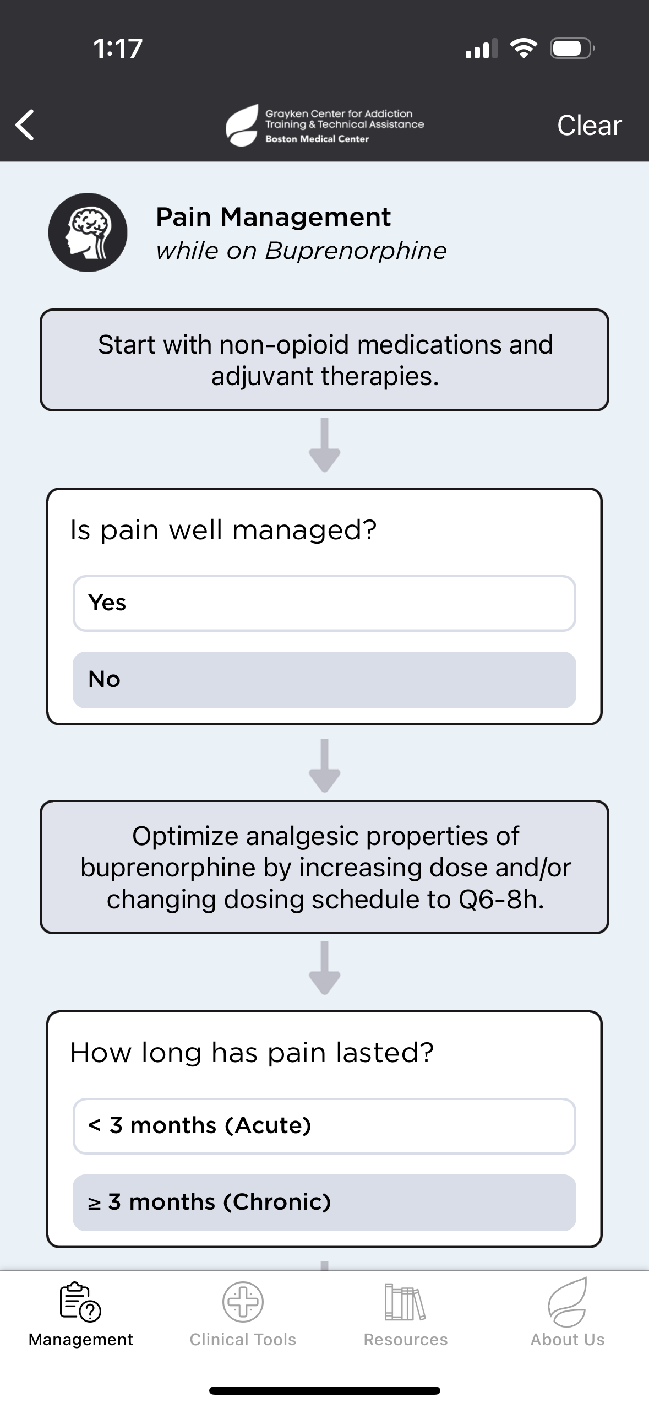
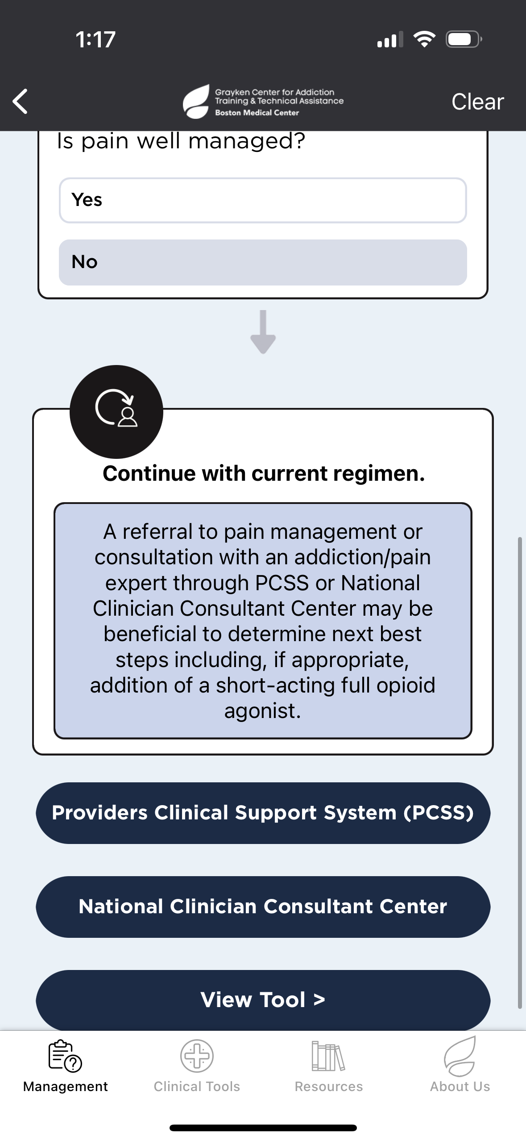
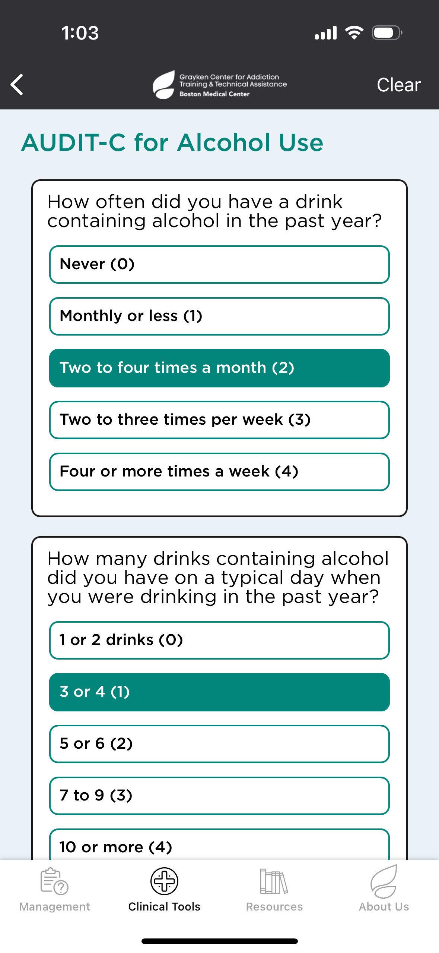
Clinical Tools
Validated tools such as the Clinical Opiate Withdrawal Scale (COWS) and the Alcohol Use Disorders Identification Test-Concise (AUDIT-C)
Clinical algorithms to assist providers with initiation of buprenorphine and ER naltrexone for OUD, naltrexone for AUD
Pain management recommendations
Notes:
To give an overview of the application, there are 4 main tabs – management, which is the bulk of the app – but also clinical tools, resources, and an About Us section which directs you to our main training page.
there are tabs for Clinical Tools with helpful resources like the DSM-5 critieria and the COWS scale to assess for opioid withdrawal. So they are embedded directly within the app. There are also helpful resources and addiction-related organizations in the app too.

Slide 6
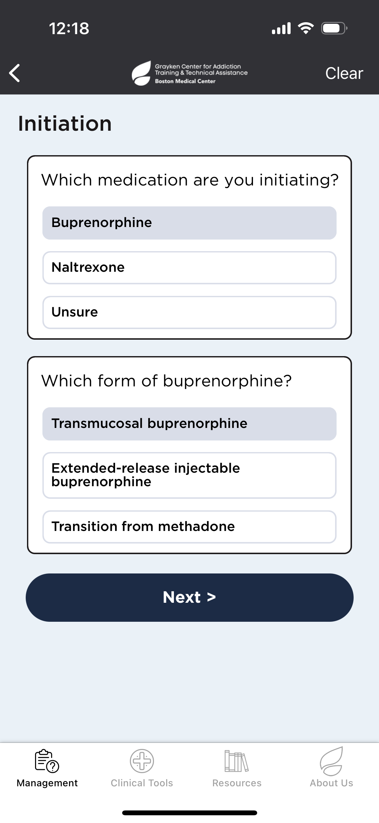
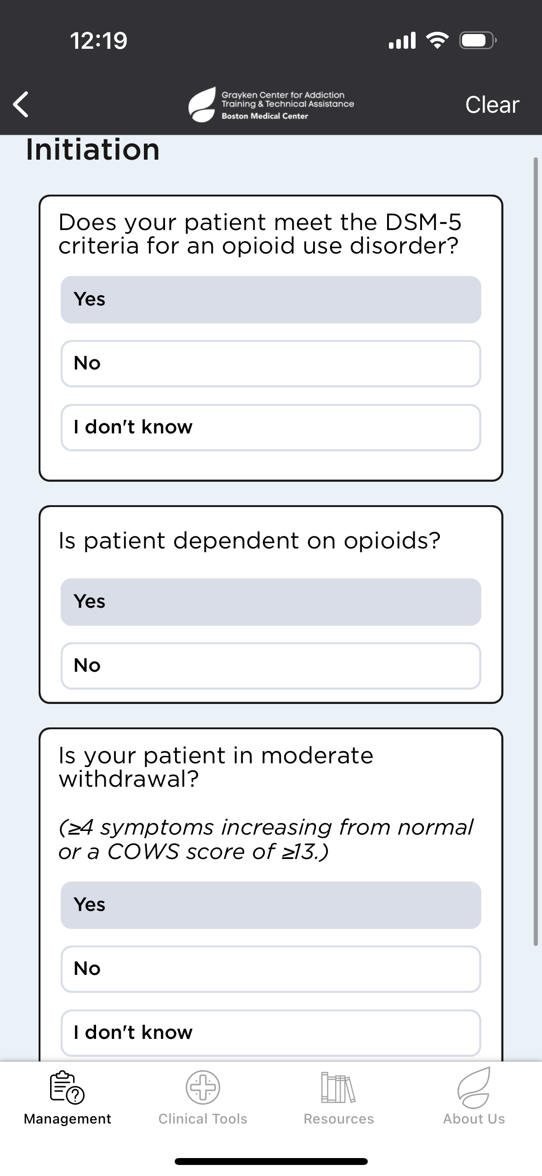
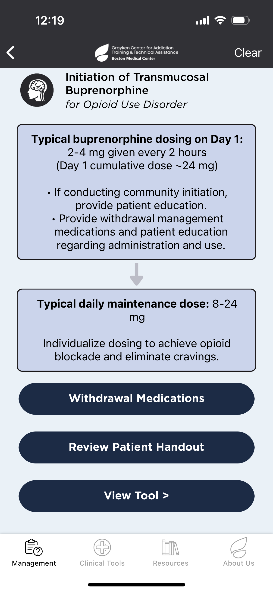
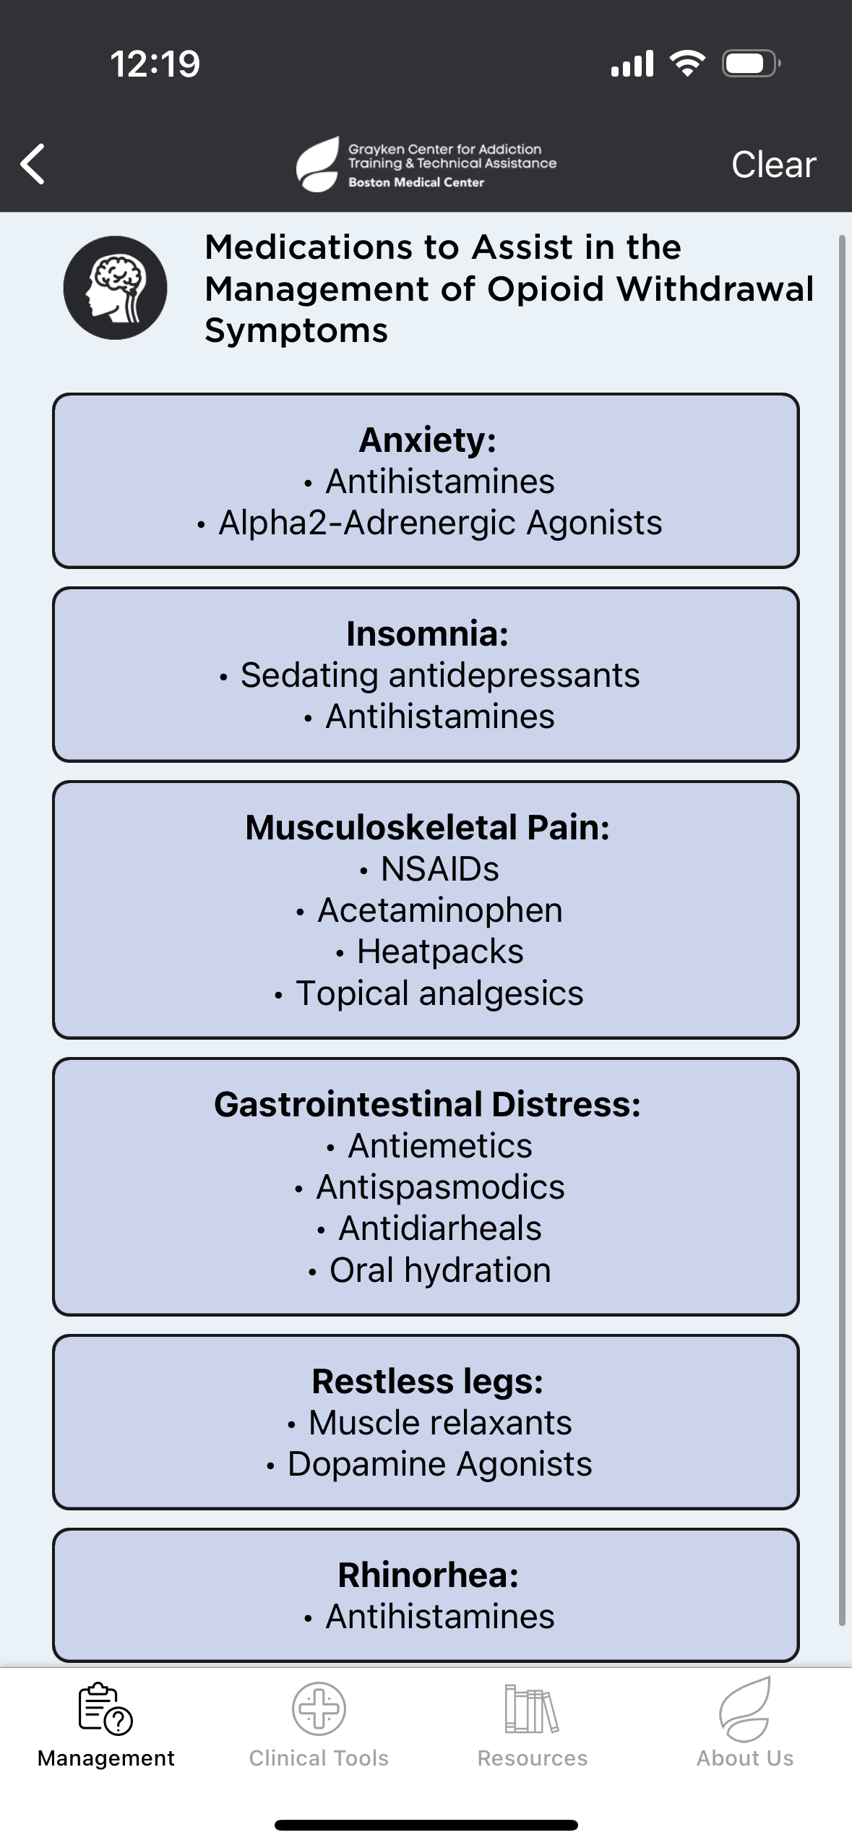
Management – Initiation of MAT
Notes:
- The main tab is labeled as “Management” and within this section there are interactive clinical algorithms to help assist in clinical decision making for starting patients on meds for OUD – specifically buprenorphine and naltrexone – as they are the only ones that can be Rxed in the outpatient setting.
There is also clinical guidance offered for people with concurrent SUD and pain, as well as patients with AUD.
The way that you would utilize this part of the app is by going through each question, inputting the relative information for your patient, such as – “Is this person in active opioid withdrawal – YES OR NO.” If you respond yes, it will continue with initiation support. If NO, it provides guidance on the importance of waiting to be mild to moderate withdrawal before buprenorphine initiation.
We are in the process of updating the app right now to add in guidance on high dose or macrodosing for bupe initiations. And we do have the ability for a pretty quick turnaround with that in working with our app developer – within a few weeks.

Slide 7
Objective
The purpose of this study was to evaluate the clinical utility of and satisfaction with the BMC MAT Quick Start app for providers prescribing MAT.
Notes:
We wanted to know if this was actually helpful to providers, and we also continue to make iterations to the application with our an app developer, integrating changes as buprenorphine initiations evolve with the contamination of the illicit drug supply with high-potency synthetic opioids such as fentanyl.

Slide 8
Methods
In May 2023, 1,186 prescribers who completed a BMC waiver training between January 2019 and December 2022 were emailed about the BMC MAT app and encouraged to use it.
Four weeks later, a follow-up email with an electronic survey link was sent requesting feedback on the app.
Reminder emails were sent between June and August 2023.
The survey assessed the following domains:
Clinical utility
Impact on practice
Prescriber satisfaction
Ease of use
Survey data were cleaned, aggregated, and summarized
Notes:
These waiver trainings were previously required in order for physicians, NPs and PAs to prescribe buprenorphine.
And this waiver requirement was removed in Dec of 2022.
We emailed providers who completed this training as we had their emails from our listerv of attendees to the training, and we briefly explained the purpose of the app, how to access it, and encouraged use of it.
4 weeks after the initial email, we sent a follow-up email wit a link to a feedback survey.
Reminder emails were sent between June and August of 2023.

Slide 9
Participant Characteristics (N=43)
Professional Credential, N (%) Advanced Practice Provider Physician Nurse Pharmacist | 27 (67.4) 12 (27.9) 1 (2.3) 1 (2.3)
Practice Setting, N (%)ª Outpatient addiction treatment Office Based Addiction Clinic Community Health Center Psychiatry/Dual Diagnosis Private Practice Other Outpatient Addiction Treatment Non-addiction outpatient clinic Inpatient addiction treatment/acute treatment Non-addiction inpatient unit Emergency department Urgent care Bridge clinic (specific to addiction/mental health) Other | 17 (39.5) 7 (16.3) 4 (9.3) 3 (7.0) 2 (4.7) 2 (4.7) 10 (23.3) 6 (14.0) 5 (11.6) 3 (7.0) 1 (2.3) 1 (2.3) 6 (14.0)
Years in Profession, Median (IQR) | 8.50 (3.00, 17.75)
DEA licensed, N (%) | 41 (95.3)
DEA waivered (prior to January 2023), N (%) | 39 (90.7)
Age, N (%) 25-34 35-44 45-54 55-65 65+ Prefer not to answer | 6 (14.0) 14 (32.6) 10 (23.3) 11 (25.6) 1 (2.3) 1 (2.3)
Gender, N (%) Female Male Prefer not to answer | 35 (81.4) 6 (14.0) 2 (4.7)
Race/Ethnicity, N (%) White or Caucasian Hispanic or Latino Black or African American Asian or Pacific Islander Multiracial or Biracial Prefer not to answer | 24 (55.8) 6 (14.0) 5 (11.6) 2 (4.7) 1 (2.3) 5 (11.6)
ª Not mutually exclusive (check all that apply)
Notes:
Of the 120 respondents, 43 had used the BMC MAT app in clinical practice and were included in analyses.
Most participants were advanced practice providers (67%),
40% worked in outpatient addiction treatment settings and this included OBAT setting, CHCs, psych or dual diagnosis programs, private practice, and other outpatient addition treatment.
Lower numbers were working in ED, urgent care, and bridge clinics – places where we know people with SUD may seek care.
The median number of years in the profession was 8.5.
95% of respondents had a DEA license and almost 91% had a DEA x waiver to prescribe buprenorphine (before removal of the waiver).
So in theory, this group had a foundational knowledge of addiction and meds for addition treatment, based on having to complete 8 or 24 hrs of training to obtain a waiver, as well as the settings in which many were practicing in.

Slide 10
OUD Prescribing Patterns (N=43)
 | N (%)
Currently prescribing Buprenorphine for OUD | 35 (81.4)
Average # of patients prescribed Buprenorphine for OUDª 1-5 6-10 11-20 21-30 More than 30 | 10 (28.6) 6 (17.1) 1 (2.9) 5 (14.3) 13 (37.1)
Currently prescribing Naltrexone for OUD | 16 (37.2)
Average # of patients prescribed Naltrexone for OUD^{b} 1-5 6-10 11-20 21-30 More than 30 | 6 (37.5) 5 (31.1) 2 (12.5) - 3 (18.8)
ª Only asked for those prescribing Buprenorphine for OUD (N=35)
^{b} Only asked for those prescribing Naltrexone for OUD (N=16)
Notes:
More than 81% of respondents were currently Rxing bupe
and about half of those were prescribing to more than 20 patients at any particular time
37% were Rxing naltrexone for OUD
ª Only asked for those prescribing Buprenorphine for OUD (N=35)
^{b} Only asked for those prescribing Naltrexone for OUD (N=16)

Slide 11
AUD Prescribing Patterns (N=43)
 | N (%)
Currently prescribing Naltrexone for AUD | 23 (53.5)
Average # of patients prescribed Naltrexone for AUD^{c} 1-5 6-10 11-20 21-30 More than 30 | 8 (34.8) 9 (39.1) 1 (4.3) 3 (13.0) 2 (8.7)
^{C} Only asked for those prescribing Naltrexone for AUD (N=23)
Notes:
Approximately 54% of providers (23 in total) were Rxing naltrexone for AUD, typically Rxing for 10 or fewer patients at one time.
This finding is particularly encouraging, as only around 2% of individuals with AUD received any MAUD in the past year.
It was outside the scope of this study but we did not capture those who were Rxing campral or disulfiram for AUD.
^{c}Only asked for those prescribing Naltrexone for AUD (N=23)

Slide 12
Impact of BMC MAT Quick Start Application (N=42)
I think the MAT Quick Start app is a useful tool for professionals treating substance use disorder.
I think the MAT Quick Start app has been a positive addition to my clinical practice.
Notes:
- The majority (or 91%) agreed or strongly agreed that the app was (1) a useful tool for treating substance use disorder and (2) was a positive addition to their clinical practice (79%). SO this allowed us to evaluate the clinical utility of the tool.
** orient people to the graphs
- One participant did not respond to impact questions so this is why we have an N of 1 less (N=42) than the bulk of our analyses with an n of 43.

Slide 13
User Satisfaction and Comfort (N=42)
I am comfortable with my ability to use the MAT Quick Start app
Notes:
Additionally, most agreed or strongly agreed that they were (1) satisfied with the app as a tool for caring for patients with addiction (86%) and (2) were comfortable with their ability to use the app (86%). These questions allowed us to evaluate the satisfaction of the app.
It would have been very helpful but outside the scope of this project so we did not ask people WHY they were not satisfied with the app.
One participant did not respond to user satisfaction and comfort questions (N=42)

Slide 14
Conclusions
Prescribers need accessible information and support to feel confident prescribing MAT.
The BMC MAT Quick Start app is an example of a free, online clinical support tool designed to address barriers to MAT prescribing.
Our findings suggest that clinical decision tools such as the BMC MAT Quick Start application can support evidence-based practice and prescribing of life-saving medications including buprenorphine and naltrexone.

Slide 15
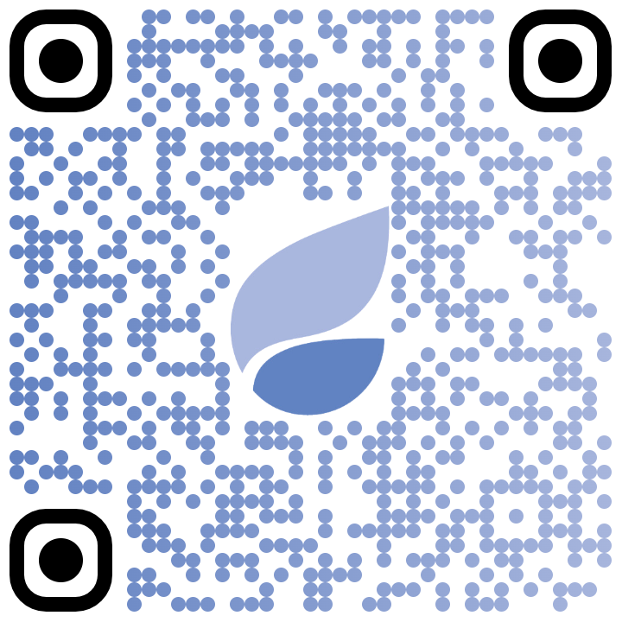
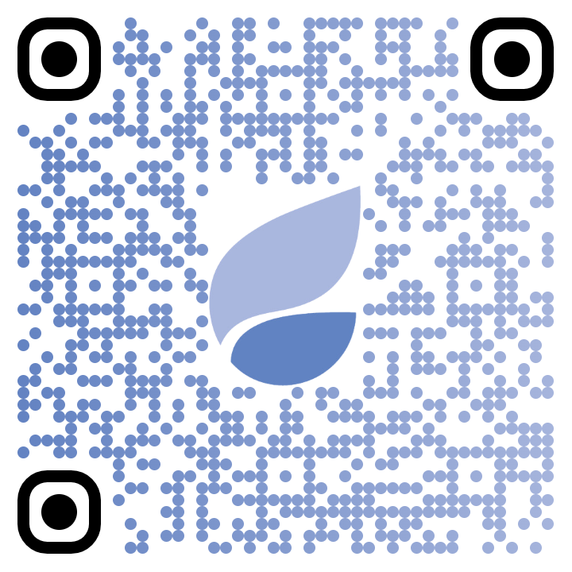
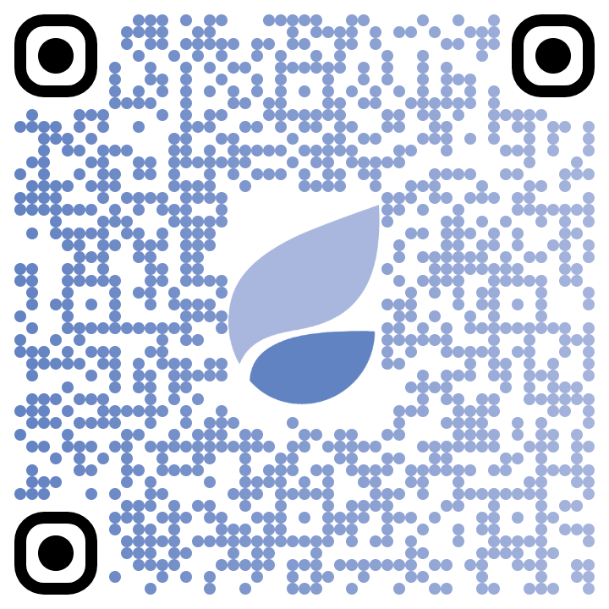
Questions and Contact Information
Andrea.Jodat@bmc.org
Access the BMC MAT Quick Start App today!
Web application on the Grayken TTA website: | Download from the Apple App Store: | Download from the Google Play Store:

