Slide 1
Expanding Access to Addiction Knowledge: Engaging High School Students with Addiction Education
Sophia Ly, MS & Amanda Fitzpatrick, MPH
Boston Medical Center
November 15, 2024

Slide 2
Conflict of Interest - Disclosures
The authors did not have any relevant conflicts of interest or disclosures related to this presentation.

Slide 3
Objectives
Review data and trends of youth alcohol and substance use
Assess early learners' prior exposure to and knowledge of addiction medicine educational content
Understand how early addiction medicine curriculum impacts early learners' perceptions of addiction medicine topics and potential careers

Slide 4
Substance Use in Youth
Notes:
According to the 2023 National Survey on Drug Use and Health, the percentage of people aged 12 or older in 2023 with a past year SUD, AUD, or DUD differed by age group. The percentage was highest among young adults ages 19-25 followed by adults 26 or older, then by adolescents 12 to 27 years.
(Skip if not a lot of time)
Other US surveys show that:
24% of 12th graders had engaged in binge drinking in the past two weeks.
42% had consumed at least some alcohol in the past month. 11% of eight graders, 28% of sophomores had tried alcohol as well.
1% of 12th graders had tried meth, and almost 3% had used cocaine in the past year.
There have been some trends in decreasing substance use in young adults but that should not be a cause for celebration since certain substances are increasing such as vaping nicotine, and risk of unhealthy alcohol use and other substance use are still at higher numbers than ideal from a public health perspective.

Slide 5
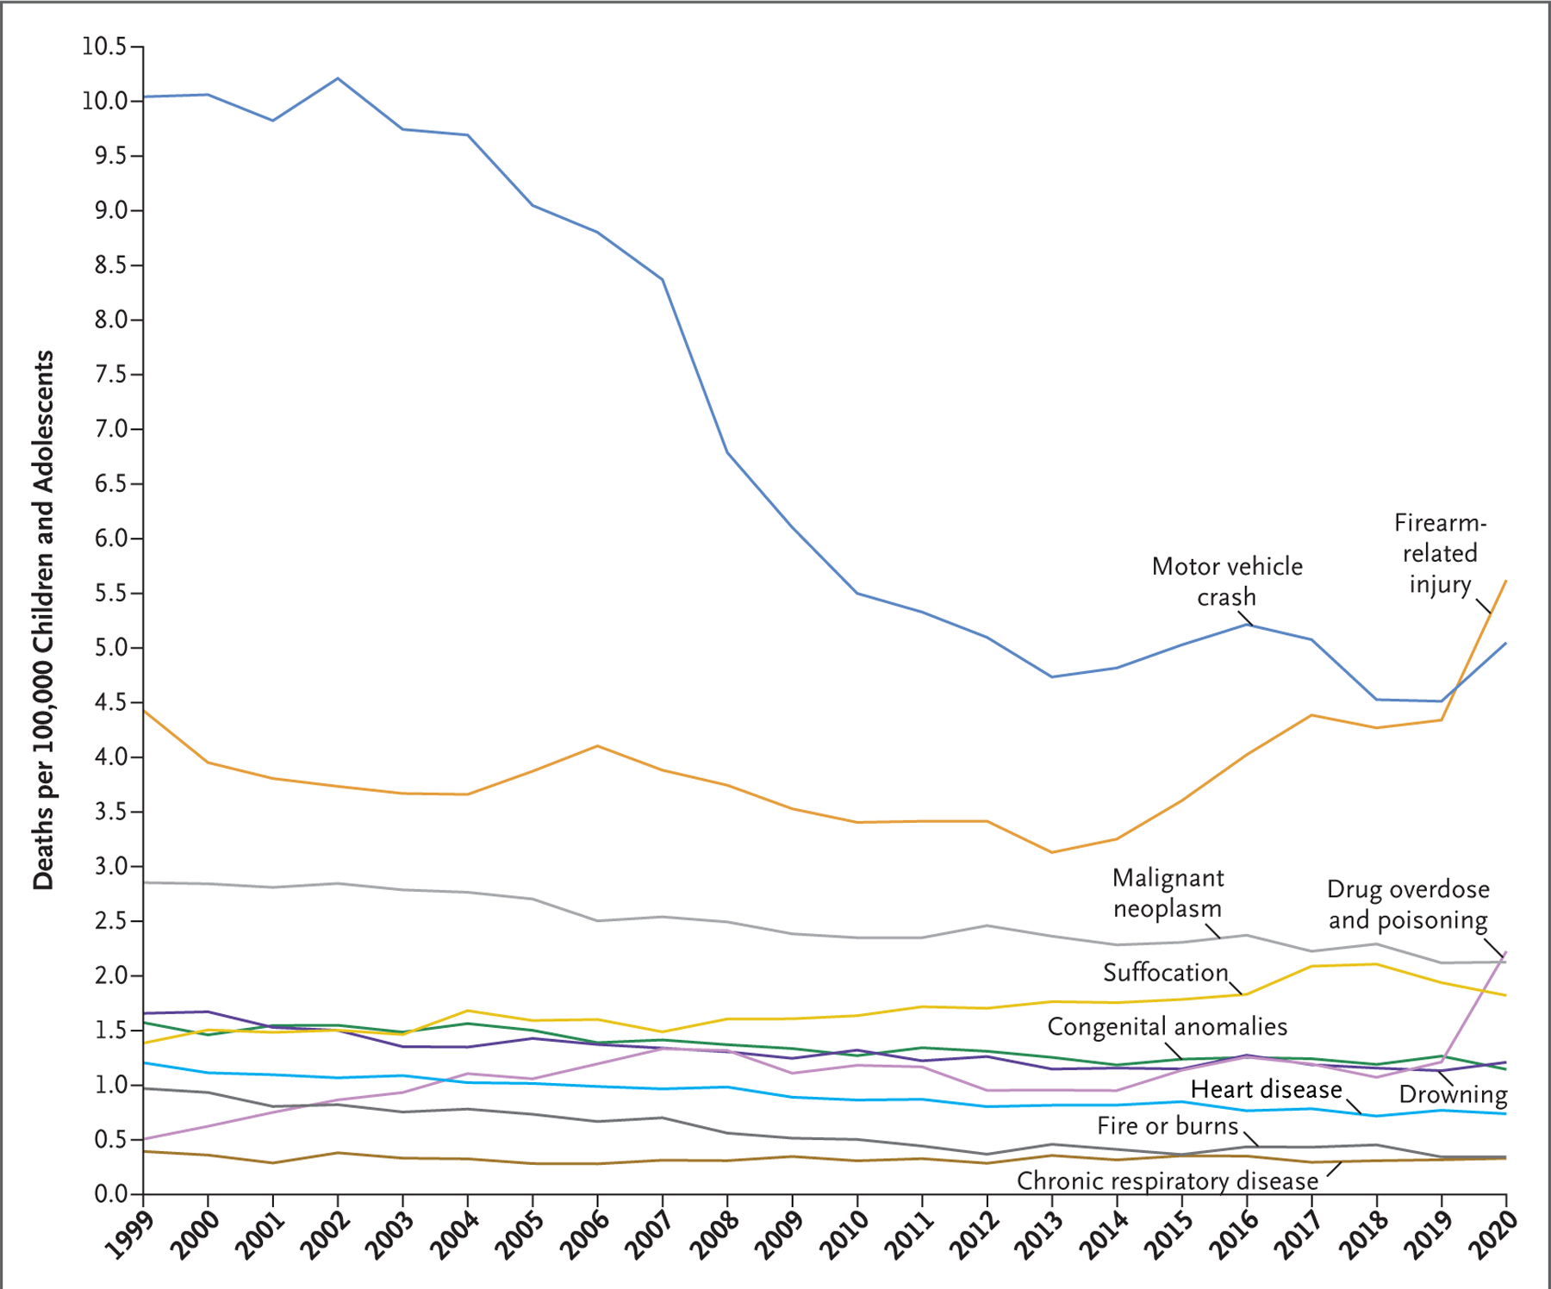
Youth Overdose Rates
Drug overdose death in children 10-19Y increased by 109% from 2019 – 2021 ⁵
An average of 22 adolescents (14 to 18Y) died in the U.S. each week in 2022 from drug overdoses
Death rate for this group raised to 5.2 per 100,000
Notes:
In recent years (2020), drug overdose and poisoning has become the third leading cause of death in pediatric and adolescent individuals following firearms and motor vehicle collisions. The increase in overdose deaths is evident by the jump in the graph that occurs at 2019 (purple line).

Slide 6
Addiction Education
Just Say No & Drug Abuse Resistance Education (DARE) Program ⁶
Safety First: Real Drug Education for Teens (Drug Policy Alliance) ²
Pediatricians and clinicians recommended to ask about drug use, risk reduction, and naloxone
Adolescents usually only see their pediatrician or PCP once a year ^{2, 9}
Notes:
The DARE program was born out of Los Angeles in 1983 and was implemented in many schools across the US, but studies have shown that the program actually had little impact on future drug use. In 2001, the Surgeon General put D.A.R.E in the category of “ineffective primary prevention programs.” Additionally, it must be noted that being born out of the War on Drugs, minority communities were more heavily policed and targeted, leading to a disproportionate rate of criminalization. The impacts of the War on Drugs and the DARE program still impacts many today.
While there aren’t many drug education programs, one that is notable is the Drug Policy Alliance's Safety First, which aims to provide skills for youth to make informed decisions about substances vs. prioritizing abstinence-only logic of addiction education. It is the nation’s first harm reduction-based drug education curriculum for high school students. The program attributes its effectiveness to being honest with students by providing scientific facts without minimizing or exaggerating risks of drug use and being compassionate recognizing students may have family or friends that used/sold substances.
Pediatricians and primary care providers are essential to preventative care which includes providing education on drug use and risks. However, they only see their patients once a year and this excludes populations that lack access to healthcare or a regular provider. It is important to consider other avenues and environments for addiction education.

Slide 7
Need to Educate and Empower Youth
Abstinence only education is ineffective; youth needs skills to make informed decisions about substance use ^{2, 4, 6}
Addiction workforce shortage
Workforce does not reflect race and ethnic diversity of patients with SUD ⁷
Cultivating interest in addiction medicine and providing resources such as educational opportunities could offer a sustainable pipeline to address workforce shortage ⁷
Notes:
At the intersection of abstinence-only and ineffective education and the addiction workforce shortage, there is opportunity to invest in a sustainable pipeline through providing honest, factual addiction education coupled with career exploration activities. Additionally, this is an opportunity to provide education and resources for communities most at risk and most affected by the workforce shortage which are predominantly racially and ethnically diverse people.
We should empower rather than underestimate youth by giving them accurate information about substance use, validating their experiences through conversation, and connecting topics to their own community and the larger public health crisis.

Slide 8
Early Learners Education Sessions
4 sessions from February 2022 through April 2023
Content:
Didactics
Experiential sessions
Career panels

Slide 9
Didactics
Opioids and SUD – evolution of opiates to synthetic
Cannabis – myths, cognitive effects and addictive properties
Vaping/Nicotine - downstream health effects of "better" option, cartridges compared to packs of cigarettes
Alcohol Use – drinking culture, binge drinking, physical health consequences in older age
Notes:
Didactics were not just about specific drugs, but also integrated community and public health knowledge.
In the opioids and SUD presentation, they learned about the evolution of opioid use in the US and the transition from heroin to fentanyl. Additionally, students are taught about the evolution of treatment for SUD including methadone, buprenorphine, and harm reduction. Barriers to care were also addressed.
In the cannabis presentation, they learned about myths surrounding the components (THC and CBD) and addictive qualities of marijuana and its cognitive effects. We shared that the field of research of marijuana is novel due to drug scheduling and the potential benefits vs harms are not well understood.
In the vaping and nicotine presentation, they learned about how e-cigarettes came to be as a harm reduction material for people who smoke tobacco and the evolution of e-cigarettes over time. We also discussed how the industry has freedom to market and focus on appealing to adolescents and young adults. The health impacts of vaping on the lungs as well as the nicotine content of a cartridge compared to a pack of cigarettes was discussed.
In the alcohol use presentation, they learned about short, long term, and delayed effects of alcohol use as well as binge drinking. The use of alcohol in different cultures, American drinking culture, and American public perception of alcohol as low risk was discussed.

Slide 10
Experiences
Naloxone Training – interactive with use of CPR dummies; participants received Narcan
Clinical and Harm Reduction Site Visits – AHOPE, Roundhouse, Methadone clinic, Emergency Department
Career Panel – diverse panelists and interprofessional representation at various stages of education or career
Notes:
Apart from didactics, students were able to participate in more hands-on activities.
In the Naloxone training, students were able to practice how to administer Naloxone on a dummy led by a peer educator with lived experience. Students were informed of where they can access Naloxone, and received Narcan to take home to take care of their community if needed.
Students visited a variety of sites including AHOPE which is a harm reduction and needle exchange site, Roundhouse which was a location that provided low barrier housing to people in Boston, a Methadone clinic, and the emergency department at Boston Medical Center. At each location, students were able to engage with providers and see the diverse settings in which addiction medicine care is provided.
In the career panel, students discussed working in addiction medicine or healthcare as a whole with a group of diverse panelists. The panel also had a diverse interprofessional representation including doctors, nurses, social workers, researchers, program coordinators, graduate students, etc at various stages of education and career. Each panelist was able to share their path to addiction medicine, the education needed for their role, and career growth.

Slide 11
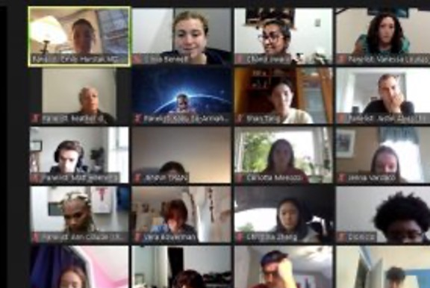
Early Learners Education Sessions
Notes:
Here are some images from our sessions. We started on Zoom but were able to transition to in-person sessions which expanded the experiences we could provide.
Amanda start here

Slide 12
Evaluation
Students’ perceptions of addiction
Knowledge of specific addiction topics (before and after session)
Feedback on session quality after sessions
Interest in addiction medicine career or other learning opportunities
Qualitative free text responses
Notes:
Evaluation was done via REDCap surveys. Students rated their perceptions of addiction, knowledge of addiction, and their agreement with the following statements (Addiction is an important topic for young people to learn about, Addiction impacts my community, and Addiction is a stigmatized health problem) on a Likert scale. Interest in addiction medicine career and other learning opportunities as well as satisfaction with each didactic were rated on a scale of 0-100. Students were able to provide qualitative responses to the following questions: what do you hope to take away from today's presentations, name 1 thing you learned from the presentation that you were surprised about, what do you wish we talked about more, what is 1 thing you learned in this session that may change how you think about addiction in the future, if there are future sessions what other topics would you like covered, and what other questions/comments/suggestions do you have.

Slide 13
Quantitative Results: April 2022 & April 2023
How much did you enjoy? (Addiction Topic) | Average (Scale 0-100) | n
Introduction to Addiction Presentation | 81 | 17
Narcan Demo | 81 | 17
Cannabis and Harm Reduction | 73 | 15
Addiction Career Panel | 73 | 15
How much did you enjoy? (Addiction Topic) | Average (Scale 0-100) | n
Addiction 101 Presentation | 82 | 7
Cannabis | 79 | 5
Vaping and E-cigarettes | 84 | 6
Alcohol | 83 | 7
Opioid Overdose, Opioid Prevention, and Narcan Demo | 88 | 9
Addiction Career Panel | 89 | 1
Harm Reduction as a Treatment Strategy | 100 | 1
Notes:
Overall, students rated all sessions highly (73+). Of the sessions in which several students participated in the survey, students enjoyed the Opioid Overdose, Opioid Prevention, and Narcan Demo most. Pairing an interactive Narcan session with a didactic on opioid use seems to be effective and interesting to students. This may reflect the importance of not just educating but engaging students in their learning. Another highly rated session was the vaping and e-cigarettes session – it is important to note this is a relevant topic to them as they can connect it to their own personal experiences given many of their peers are using vapes and its increasing popularity.

Slide 14
Quantitative Results: Likert Scale Persistent Themes
Media (i.e., TV shows, Social media, etc.) was the most common way student learned about addiction (if not through school specifically).
Most could not define or describe opioids, opioid overdose, or Naloxone prior to sessions.
Most lacked accurate information about cannabis health risks and uses.
Most could not define harm reduction.
Most, if not all, "agree" or "strongly agree" that addiction is important to learn about, impacts their community, and is a stigmatized condition.
Notes:
Common themes showed...

Slide 15
Qualitative Results
Interest in Addiction Prevention:
Knowledge Learned:
“Fentanyl is the drug that is more commonly seen when someone overdoses. This knowledge makes me want to have more sympathy for those battling with addiction.”
”What’s things we can [do to] prevent out friends from using e-cigs?”
”What’s things we can [do to] prevent our friends from using e-cigs?”
”What’s things we can [do to] prevent out friends from using e-cigs?”
“Where [can] we or someone we know go to get help?”
“[Naloxone] can save someone going through an overdose.”
Notes:
In free response, many students demonstrated new knowledge learned and an interest in addiction prevention.

Slide 16
Qualitative Results
Public Health:
”What’s things we can [do to] prevent out friends from using e-cigs?”
"The new rising addiction is altered nicotine that has often [attracted] minors and young adults the most. This can cause a bad influence on those younger but the market for nicotine will continue to rise drastically in the future."
Myths Busted:
"I learned that weed could be a big addiction."
"I learned that the strength and potency of weed is stronger than ever."
”What’s things we can [do to] prevent out friends from using e-cigs?”
"I learned about Narcan and honestly now I know how to react when I see someone or know someone that is using."
"How different terms can be harmful to refer to people who are struggling with drug or alcohol use disorder.
”What’s things we can [do to] prevent out friends from using e-cigs?”
"The TV presentation of things are so fake, like I knew but I didn’t know it was that fake..."
Notes:
In free response, many students shared previously held beliefs or misconceptions that were proven false and gained information that empowers them to be public health leaders in their own community.

Slide 17
Takeaways
Exposing students to addiction medicine topics has the potential to:
Increase students’ knowledge about addiction and how it impacts their communities.
Help students make safer decisions around substance use.
Increase students’ interest in viewing addiction research and/or medicine as a career path.

Slide 18
Limitations
Small sample size n=104
Surveys were optional
COVID-19
Initial sessions on Zoom (2021-2022)
Notes:
Sample size includes significant overlap. Many students attended multiple sessions.
Not only were surveys optional, but there was survey fatigue seen in the significant drop off of surveys taken for sessions held early in the day compared to the end.
The data includes both virtual and in-person events.

Slide 19
Acknowledgements
The IDEAAA Team: Emily Hurstak, MD, PhD; Kaku So-Armah, PhD; & Jules Canfield, MPH
Boston Area Health Education Center
Upward Bound Math & Science
Boston Public Schools: Acceleration Academy

Slide 20
References
2023 NSDUH Annual National Report. SAMHSA.gov. July 30, 2024. Accessed November 10, 2024. https://www.samhsa.gov/data/report/2023-nsduh-annual-national-report.
Fischer, N.R. School-based harm reduction with adolescents: a pilot study. Subst Abuse Treat Prev Policy 17, 79 (2022). https://doi.org/10.1186/s13011-022-00502-1
Friedman J, Hadland SE. The Overdose Crisis among U.S. Adolescents. N Engl J Med. 2024;390(2):97-100. doi:10.1056/NEJMp2312084
Gaines LV, Cohen N. “Just say no” didn’t actually protect students from drugs. Here’s what could. NPR. Published November 9, 2023. Accessed November 14, 2024. https://www.npr.org/2023/11/09/1211217460/fentanyl-drug-education-dare
Goldstick JE, Cunningham RM, Carter PM. Current Causes of Death in Children and Adolescents in the United States. N Engl J Med. 2022;386(20):1955-1956. doi:10.1056/NEJMc2201761
History.com Editors. Just Say No. HISTORY. Published August 21, 2018. https://www.history.com/topics/1980s/just-say-no
McNeely J, Schatz D, Olfson M, Appleton N, Williams AR. How Physician Workforce Shortages Are Hampering the Response to the Opioid Crisis. Psychiatr Serv. 2022;73(5):547-554. doi:10.1176/appi.ps.202000565
Sandelich S, Hooley G, Hsu G, et al. Acute opioid overdose in pediatric patients. J Am Coll Emerg Physicians Open. 2024;5(2):e13134. Published 2024 Mar 7. doi:10.1002/emp2.13134
Rivero E. About 22 high school age adolescents died each week from overdoses in 2022, driven by fentanyl-laced prescription pills. www.uclahealth.org. Published January 8, 2024. https://www.uclahealth.org/news/release/about-22-high-school-age-adolescents-died-each-week
‌Vasilenko SA, Evans-Polce RJ, Lanza ST. Age trends in rates of substance use disorders across ages 18-90: Differences by gender and race/ethnicity. Drug Alcohol Depend. 2017;180:260-264. doi:10.1016/j.drugalcdep.2017.08.027

Slide 21
Thank you!
Questions?

