Slide 1
“Expedited Referrals” from SSP to OTP:
Innovative Approaches to
Reducing Barriers to Methadone Treatment
for Patients Who Use Opioids
and Experience Homelessness
Natalie Stahl, MD, MPH (nstahl@glfhc.org)
Dianna Conole, MS, LADAC
Rebecca Weiner, MD
Amy Bositis, RN, MSN
Avik Chatterjee, MD, MPH

Slide 2
Disclosures
Lawrence Comprehensive Treatment Center is a for-profit opioid treatment program that provides methadone maintenance therapy. It employs Dianna Conole as clinic director and Rebecca Weiner as a physician.
This intervention was funded by the NIH HEAL Initiative, a multi-site study in 67 communities across 4 states (OH, MA, KY, NY) with coalition-supported interventions, under the Communities that HEAL (CTH) intervention focused on reducing overdose deaths.

Slide 3
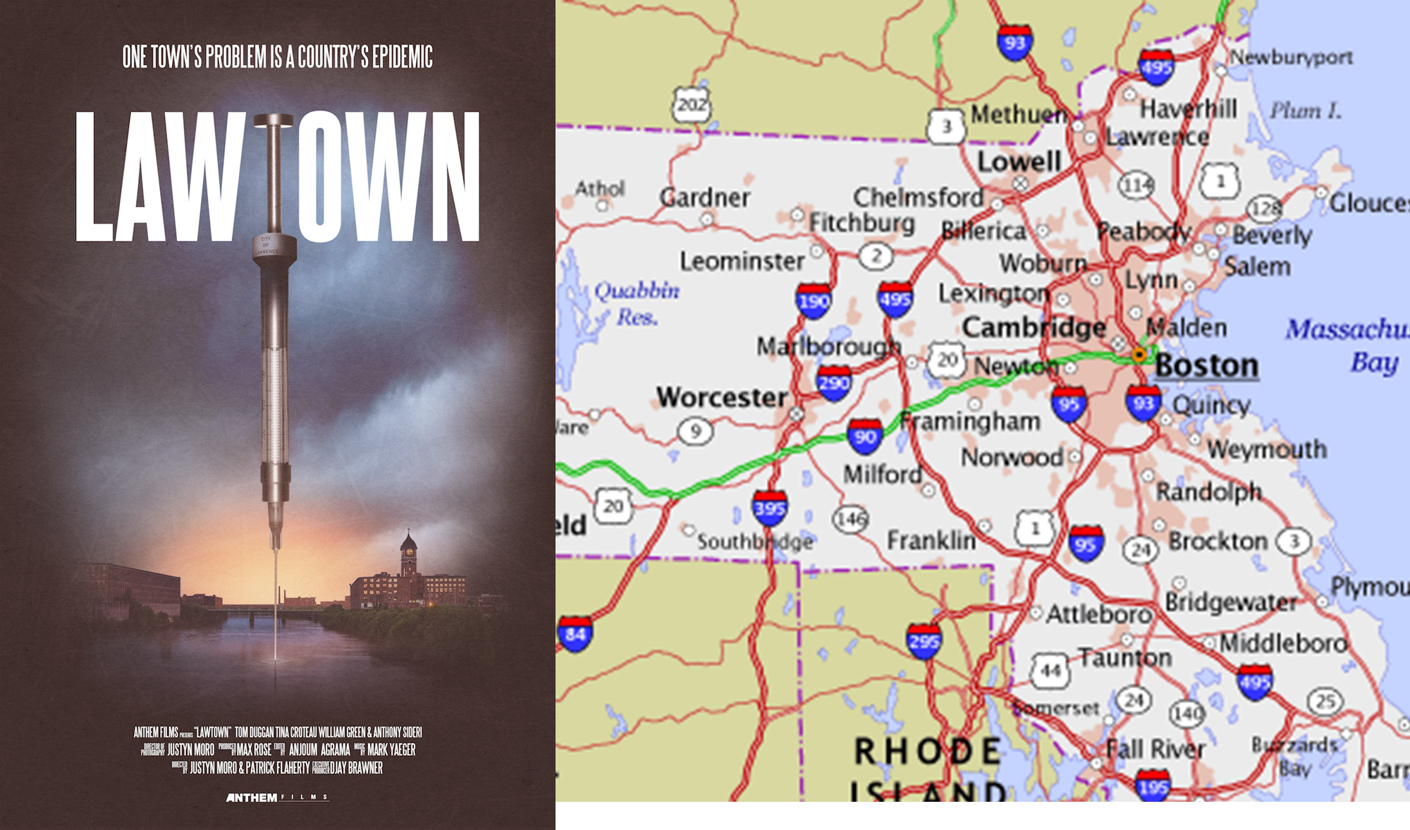
Lawrence, Massachusetts
Notes:
Background on Lawrence (Natalie/Bec)
Small mill city on the banks of the Merrimack River created by industrialists seeking to harness the power of the river and kept alive by a waves of immigration
Currently 82% Spanish speaking majority Dominican.
One of the poorest cities in MA, surrounded by middle class and upper middle class suburban towns
“230” unhoused per 2020 count - likely an underestimation even then. We have 1 small shelter. Many living in encampments.
(https://www.bostonglobe.com/2022/09/13/business/dire-situation-surging-rents-housing-shortage-spark-homelessness-lawrence/)
At the intersection of highways, drugs corridors pass through Lawrence on their way to NH and Maine.
Because of this we were hit earlier than the majority of the nation by fentanyl crisis which promoted the stigma of Lawrence being an “epicenter” of the opioid crisis in New England.
Generally it’s perceived that that (predominantly white) outsiders from neighboring towns, southern NH come to Lawrence to buy drugs, access resources and services. So much so that a provocative “ documentary” was made about it.
As a community we are held hostage with this tension: because we are on the frontlines of the epidemic - adjacent cities/county authorities see this as a “Lawrence” problem while Lawrence city officials frustrated by lack of a regional response.
Minimal county infrastructure to support regional interventions, we have only one small shelter, lots of encampments that frequently get broken up and moving around.

Slide 4
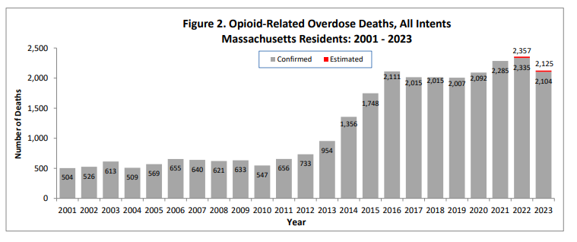
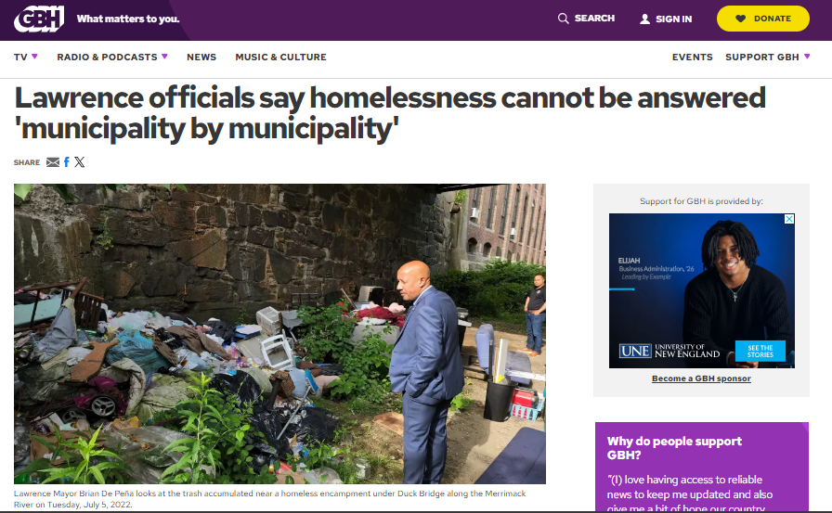
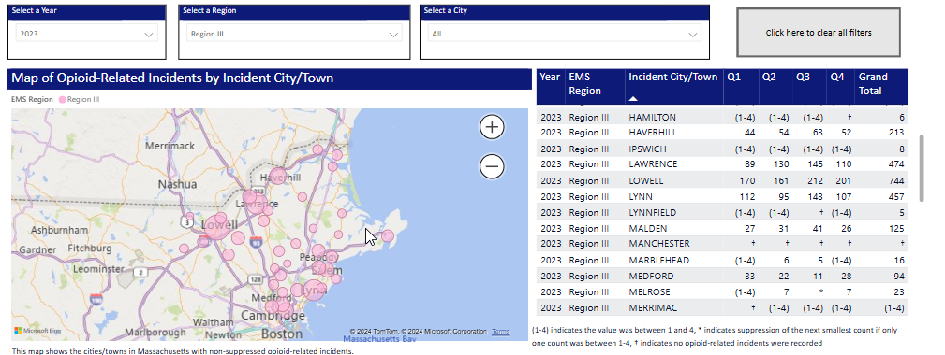
OPIOID OVERDOSE CRISIS
Data Brief MA DPH, June 2024 https://www.mass.gov/doc/opioid-related-overdose-deaths-among-ma-residents-june-2024-0/download
Notes:
(point of this side isn’t to go through in detail but more b/c the timing of overdose/fentanyl crisis really varied across the country and this shows how early we were)
We’ve all seen these graph but this is how MA experienced the overdose crisis
While nationally the crisis starts to take off around 2015/2016 - you can see an earlier start for us (2012/2013)
From the time I (Natalie) in residency, overdose deaths TRIPLED, heroin disappeared
Of these deaths, at height of crisis, 40-60 were in Lawrence (2.5% of overedose deaths in MA, only 1.2% of MA population)
E.g. 2020 - 481 opioid related incidents in Lawrence vs. 33 in North Andover. Only Lowell has more (86 more), city twice our size by sq mi
https://www.mass.gov/info-details/ems-regional-opioid-related-incident-dashboard

Slide 5
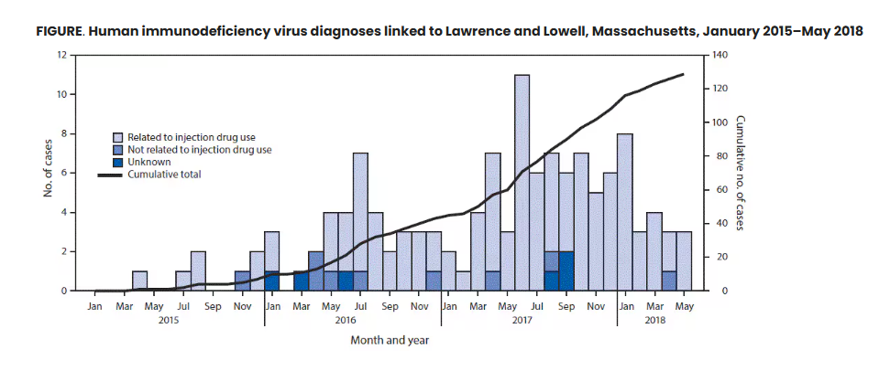
Historically, SSP programs in MA were limited.
Summer 2016: HIV cluster identified in Lawrence and Lowell
June 2017: MA Supreme Court rules syringe distribution programs legal without restriction
Cranston K, Alpren C, John B, et al. Notes from the Field: HIV Diagnoses Among Persons Who Inject Drugs — Northeastern Massachusetts, 2015–2018. MMWR Morb Mortal Wkly Rep 2019;68:253–254.
Notes:
Not long after, and not unforeseeable, an HIV outbreak involving > 120 cases in Lawrence and Lowell mostly involving people who use injection drugs.
Thankfully MA nonprofits had already started suing the state to remove restriction on syringe exchange programs. Previously programs needed local public health approval and were very limited. Lawrence had an unsanctioned SSP run by people driving between Lowell and Lawrence. In 2017 the MA Supreme Court made syringe exchange legal and without restriction.
In 2015 a nonfit in Cape Code sued to be able to continue SSP services…. In aftermath, GLFHC moved towards opening SSP and increasing focus on harm reduction. In 2015, an nonprofit in Barnstable *in cape cod* sued to be able to continue an SSP that the local board of health had tried to short down.
In 2017 the MA Supreme Court affirmed a 2006 MA law that removed all prohibitions on needle possession and distribution. Thus, making such syringe exchange legal without restriction and not limited to only those programs approved by local or state health boards..
On June 14, 2017, the Massachusetts Supreme Judicial Court ruled that needle access and distribution programs such as those run by HIV service groups, community health initiatives or other social service providers are legal without restriction under state law, and are not limited to programs implemented by the Department of Public Health and approved by local boards of health.
GLFHC responded by (quietly) opening up a SSP and started to move towards harm reduction approach at our community services center at 100 Water Street
Cranston K, Alpren C, John B, et al. Notes from the Field: HIV Diagnoses Among Persons Who Inject Drugs — Northeastern Massachusetts, 2015–2018. MMWR Morb Mortal Wkly Rep 2019;68:253–254.

Slide 6
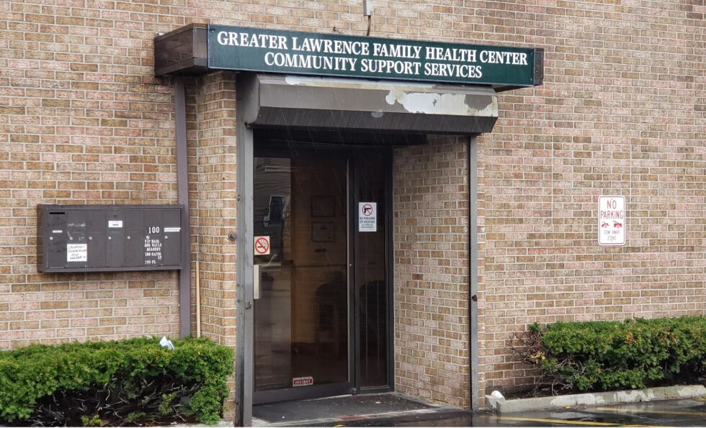
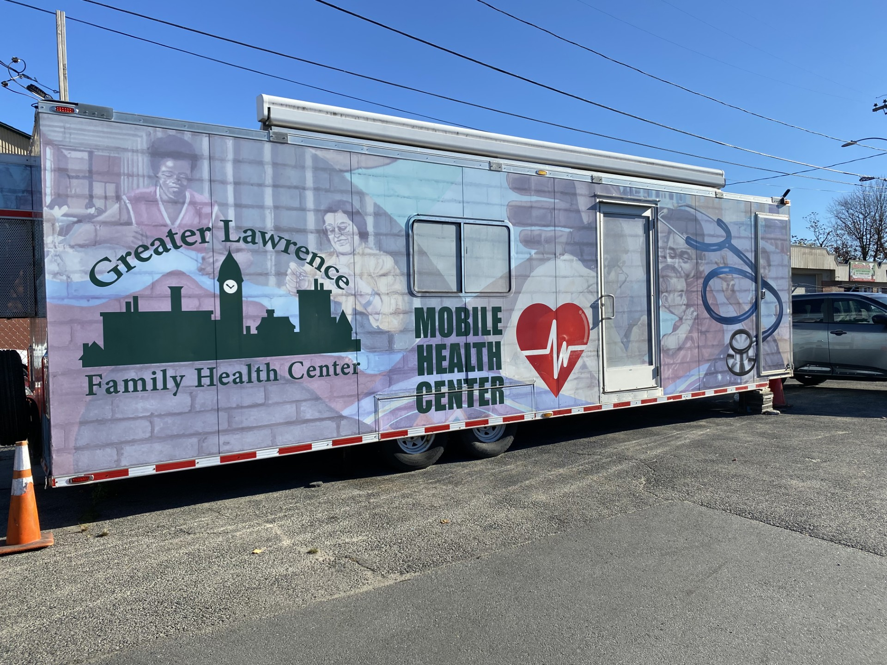
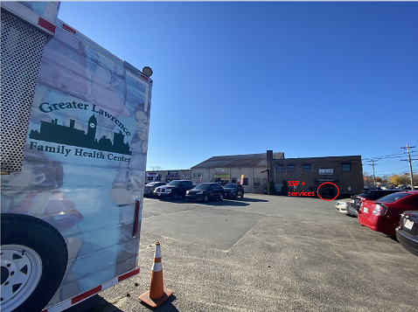
Greater Lawrence Family Health Center
Notes:
Greater Lawrence Family Health Center (GLFHC) is a federally qualified health center (FQHC)
58,000 patients in the Merrimack Valley of Massachusetts.
7 “brick and mortar” clinics
Healthcare for the Homeless Program provides health care to 750 patients in local shelters, drop-in centers and on two MHU’s, ~200 of clinic’s OBAT patients get buprenorphine through MHU
GLFHC also operates a community-based services center located at 100 Water St.
that offers syringe services programs, confidential HIV and STI testing, naloxone distribution, drug sample testing, recovery coaching, and other services.
Parking lot is the home of the Mobile Health “Bridge clinic”

Slide 7
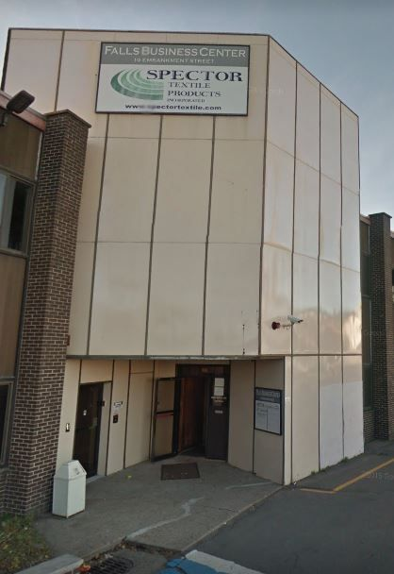
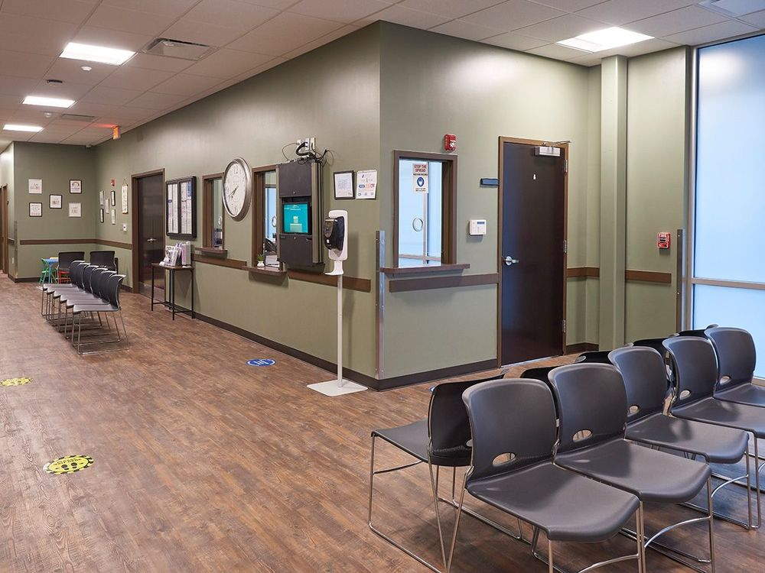
Lawrence Comprehensive Treatment Center
Notes:
Slide describing CTC and it’s services, doses
Long term community presence (> 25 years)
~650 clients every month
Provides methadone, buprenorphine-based therapy including sublocade, vivitrol
Most days open 5:45 AM - 12 PM

Slide 8
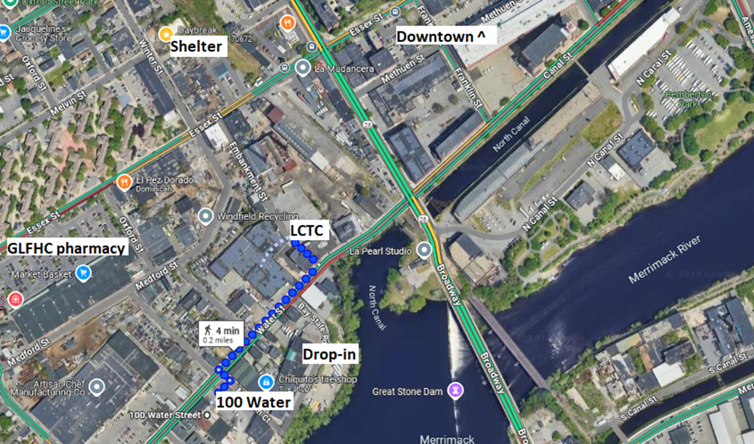
Notes:
Everything very close
Area with mostly car / tire places, some furniture stores, factories
Encampments along the river that are often displaced
4 minutes 0.2 miles from CTC to 100 WAter Street, similar distance to pharmacy

Slide 9
Many of the unhoused/unstably housed
people who use drugs in our community spend part of their day a 7-minute walk away from an OTP.
What stops people who WANT methadone
from taking those steps?
Notes:
OLD VERSION OF SLIDE: What did methadone initiation process look like for unhoused or unstably housed individuals prior to the intervention?
[] Diana → CTC side of the process
What we hear from our patients:
- “I have no ID so I can’t get methadone”
- Taking too many days to get dosed → OTP staffing limitations, what time pt presents
- intake too arduous
- Hours limited
- Intimidated to return if they “fell out” of treatment prior

Slide 10
GOAL:
Reduce opioid overdose deaths by
making access to methadone easier for people experiencing homelessness
COMMUNITY PARTNERS:
Lawrence CTC (OTP)
&
Greater Lawrence Family Health Center (FQHC)
Multi-site study in 67 communities across 4 states (OH, MA, KY, NY) with coalition-supported interventions.
Communities that HEAL(CTH) intervention focused on reducing overdose deaths.
Lawrence was funded from 1/2023-12/2023.
Our initiative, specifically focussed on increasing access to medications for OUD for PEH.
Notes:
HCS: HEAL (Helping to End Addiction Long-term) Communities Study
CTH (Communities that HEAL) Intervention, 1/2023 - 12/2023
4 states Ohio, (Massachusetts, Kentucky, and New York), 67 communities
Communities that HEAL (CTH) intervention - Goal the aim of reducing opioid overdose deaths.
Coalition-supported interventions - this one focused on increasing access to medications for OUD.

Slide 11
Methadone access intervention: The “Expedited Referral” from FQHC to OTP
BARRIER | INTERVENTION
Limited Hours | FQHC commits 20 afternoon MD hours on a mobile health “Bridge Clinic” unit at the SSP parking lot. Walk-in based. Full spectrum care. Do not have to be pt of FQHC.
Wait for medical evaluation | Completed by FQHC MD. Appropriate medical evaluation + assessment of candidacy for methadone faxed to OTP same-day.
Lack of ID | OTP accepts FQHC facesheet including pt photo as temporary ID (SOTA). Faxed in with medical evaluation. Funding to help with formal IDs
Wait to dose | OTP BH clinician stationed at SSP in afternoons to do intake paperwork, biopsychosocial profile. Patient often able to be dosed next day after brief exam by OTP medical provider.
Notes:
6/2023-12/2023
Intangibles:
- familiar faces/environment, nonjudgemental staff who’s mission is harm reduction
- OTP clinician very friendly
- opportunity for frequent touches, frequent motivational interviewing (Bridge team includes MD, MA and Recovery Coach. Also Harm reduction staff team at SSP)
- capturing pt and just the right moment they are ready

Slide 12
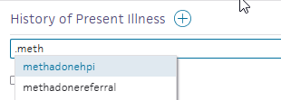
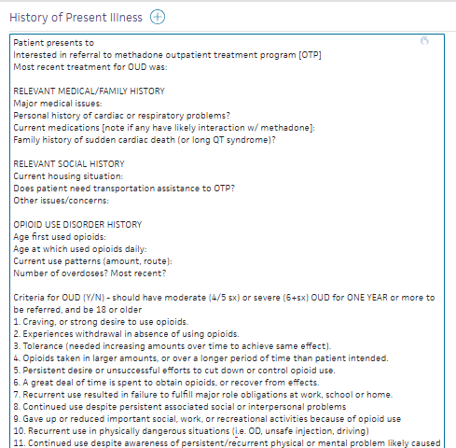
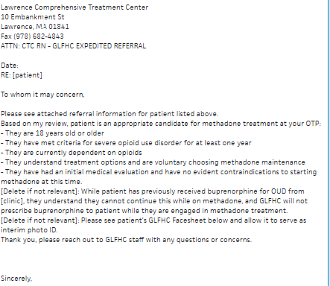
Streamlining the EMR
Notes:
Bridge clinic staffed by 4 MDs with varying levels (but higher than average) comfort with addiction medicine particularly methadone evaluation
Dot phrase or smartphrase
Initially some MD’d nervous (“I’m not methadone-trained!”)
2 key dot phrases which help MD perform an HPI and assessment in-line with OTP medical evaluation and assessment for MMT
Very easy to suddenly pivot to “expedited referral” by typing “.meth” the moment someone struggling says “I’m sick of this”

Slide 13
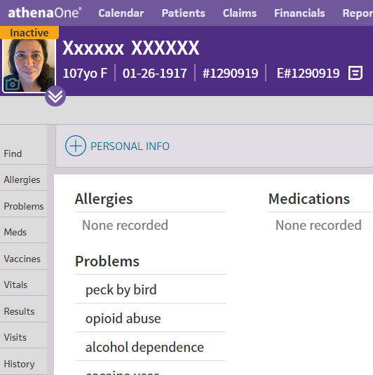
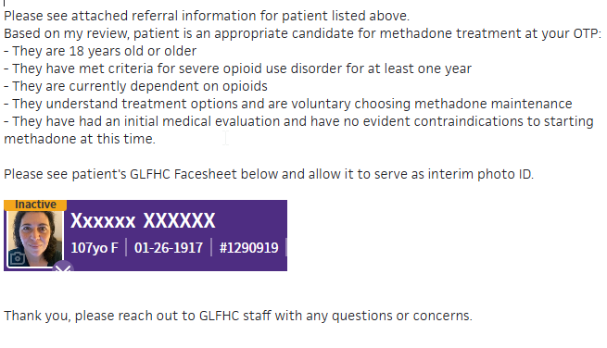
How to Create Temporary ID: screenshot, copy/paste
Notes:
What we heard MOST often from patients was - “I can’t do methadone b/c I don’t have an ID”
We don’t have a formal facesheet in our EMR so we created one
We took a good picture of patient, zoomed in to banner, and pasted screenshot in a letter that we faxed to OTP
OTP had process & funding in palace to help with IDs afterwards

Slide 14
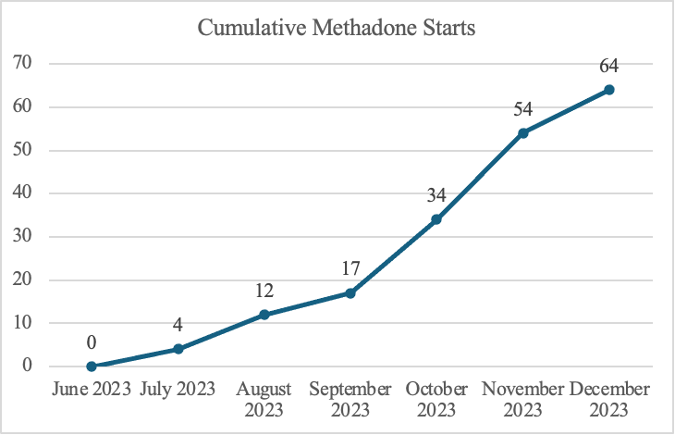
75 referred, 84% got initial dose
Of 64 who started methadone:
56% male
39% Latinx/Hispanic
27% ages 18-34
48% ages 35-54
Notes:
75 individuals referred
64 of them had initial dose (85%)
Individuals were 56% male, , 39% Hispanic/LatinX,
27% from ages 18-34
48%, from ages 35-54

Slide 15
What changed about our practice?
Notes:
Practice change:
GLFHC continues to support the initiative, particularly the Bridge clinic stationed outside the SSP, despite the end of the HEAL grant. It has sought alternative grant funding (currently BSAS) and continues to investigate avenues of growing our involvement in methadone treatment.
Clinicians beyond just “bridge clinicians”, e.g. brick and mortar sites, more comfortable discussing methadone and utilizing the expedited referral process.
[] CTC’s thoughts:
Expedited
Transportation
Transpotriton together
WE talk to one another
Sustaining program as pace of referrals has slowed, remains grant-funding reliant
Transition to BSAS/Bureau of Substance Abuse Services funding
FQHC: continuing to bill appropriately
OTP: utilized changes to OTP/42 CFR P. 8. Not just a major innovation for breaking down barriers for patients but increases staffing availability/access for OTPs - many of whom are for profit and face staffing pressure.
(iii) A full in-person physical examination, including the results of serology and other tests that are considered to be clinically appropriate, must be completed within 14 calendar days following a patient's admission to the OTP. The full exam can be completed by a non-OTP practitioner, if the exam is verified by a licensed OTP practitioner as being true and accurate and transmitted in accordance with applicable privacy laws.
(v) The screening and full examination may be completed via telehealth for those patients being admitted for treatment at the OTP with either buprenorphine or methadone, if a practitioner or primary care provider, determines that an adequate evaluation of the patient can be accomplished via telehealth
Next Steps
Expanding the “bridge” service via 72 hour rule

Slide 16
Under new methadone regulations, many/most OTPs could adopt expedited referral models!
Limited hours | OTPs can complete psychosocial evaluations and other aspects of intake via TH, in collaboration with FQHC, SSP, or other referring partners.
Wait for medical clearance | Non-OTP practitioners examination findings (within 7 days prior to admission) can be used to expedite medical clearance if shared with patient consent, reviewed by OTP practitioner, and integrated into OTP record.
Lack of ID | Most states do not have an explicit requirement for government ID and SOTAs could explicitly encourage OTPs to accept alternatives.
Wait to dose | All of above interventions. FQHCs and hospitals could lower barriers to first dose via 72h or 3-day rule.
States requiring ID as of 2021: MN, IL, IN, TX, OK, AR, KS, AL https://www.pewtrusts.org/en/research-and-analysis/issue-briefs/2022/09/overview-of-opioid-treatment-program-regulations-by-state
Notes:
the non-OTP practitioner’s examination findings can be transmitted to the OTP, where the examination can be reviewed, verified, and integrated by the OTP practitioner into the patient’s records.
Within 14 days of admission, a full physical examination must be conducted. This ensures a complete assessment of the patient’s health and allows for any necessary adjustments to the medication type or dose, and development of a more refined treatment plan. A full physical examination completed by a non-OTP practitioner can also be utilized with the patient's consent, shared with the OTP and reviewed, verified, and documented accurate and thorough by the OTP practitioner

Slide 17
Thank you!
Natalie Stahl, MD, MPH* (nstahl@glfhc.org)
GLFHC doc, BSky: @drnataliestahl
Dianna Conole*, MS, LADAC - LCTC Director
Rebecca Weiner, MD - GLFHC & CTC doc
Amy Bositis, RN, MSN - GLFHC Director of Clinical Programs
Avik Chatterjee, MD, MPH - BMC HEAL

Slide 18
