Slide 1
Cannabis use among individuals treated with medication for opioid use disorder: Correlates, patterns, and motivations for use
Sarah Leyde, Anna Treadway, Kenneth Pike, Joe Merrill, Cynthia Price

Slide 2
Conflicts of interest
None

Slide 3
Background
Approximately half of individuals
treated with buprenorphine or methadone for OUD use cannabis
Streck et al, 2022, Substance Use & Misuse
Bawor et al, 2015, Biol Sex Differences

Slide 4
Background
Cannabis use during MOUD treatment is NOT associated with worse MOUD outcomes
(retention, non-prescribed opioid use, QOL)
Bagra et al, J Addiction Med, 2018
Lake et al, PLoS Med, 2019
Costa et al, Am Journ Drug Alcohol Abuse, 2024

Slide 5
Background
Among people with active OUD, cannabis is used for:
Management of opioid withdrawal
Substitution of opioids for a less harmful substance
Treatment of pain, insomnia, depression, anxiety
There is very little research exploring how and for what reasons individuals treated with MOUD use cannabis
Lake et al, Clin Psychol Review, 2020
Meacham et al, PLoS One, 2022
Lo et al, Can Jour Psychiatry, 2023
Duhart Clarke et al, Harm Reduct J, 2023

Slide 6
Objectives
Among patients stabilized on MOUD
1) Describe differences in demographic and clinical attributes between individuals who use cannabis frequently (≥3x/week) versus less frequently/not at all
2) Explore the use patterns and motivations of individuals who use cannabis frequently
Notes:
In this study we sought to describe cannabis use among individuals stabilized on MOUD. Our first objective was to…

Slide 7
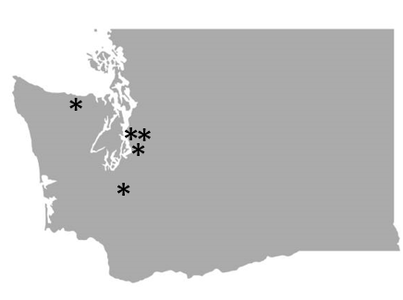
Methods
Analysis of BASELINE data from a 2 group RCT of a mind-body adjunct treatment to MOUD
Recruited from 5 WA state clinics, including one OTP
Inclusion criteria = Adult patients w/ MOUD dose stability*
WA legalized cannabis for medicinal use in 1998, recreational in 2012
*Bup: 4 wks of MOUD and appt frequency <1x/wk
*Methadone: 12 wks in treatment + min dose of 60mg + <= 3 missed doses in 30 days
Notes:
Bellingham, port angeles, seattle country hmc ets

Slide 8
MEASURES
Outcome | Scale
Substance use | 90 Day Timeline Follow-Back
Depression | PHQ-9
Anxiety | GAD-7
PTSD | PCL-5
Chronic pain presence | Patient self-report of pain >3 mo
Pain Severity & Interference | Brief Pain Inventory (BPI)
Emotional well-being/regulation | Difficulties in Emotional Regulation Scale Short Form (DERS-SF)
Mindfulness and interoceptive awareness | Multidimensional Assessment of Interoceptive Awareness (MAIA)
Physical symptoms | Medical Symptom Checklist

Slide 9
Methods
Phone survey:
Participants retained in the study at 12 months who indicated frequent cannabis use

Slide 10
PHONE SURVEY
Reasons for use (recreation, symptom management, or both)
Symptoms/conditions cannabis is used to treat & whether cannabis adequately treats them
Cannabis source (dispensary, street/dealer, self-grown, etc.)
Routes of use (smoking, vaporizing, eating, topical, dabbing, etc.)
Content of cannabis (more THC or CBD)
Desire to decrease cannabis use
Cannabis Use Disorder Identification Test Short Form (CUDIT-SF)
Notes:
Probably add short form

Slide 11
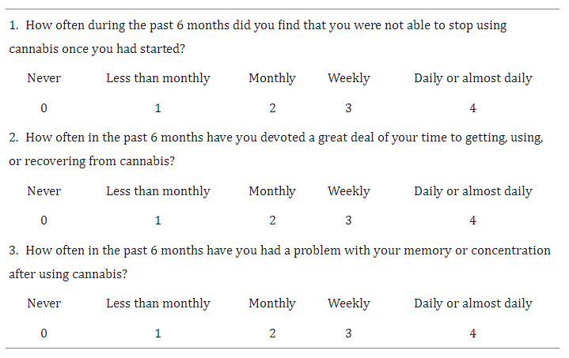
CUDIT-SF: Positive Screen = Score of 2 or higher
Bonn-Miller et al, Cannabis and Cannabinoid, 2016
Notes:
Sensitivity/specificity approaching 77%
Verbalize what each ? Represents

Slide 12
Results: Demographic characteristics
N = 303
Male (48%), Female (52%), Non-binary (1%)
Mean age 42.3 (12.2)
79% white, 9% >1 race, 5% Black, 4% AI/AN, 1% Asian, 1% NH/PI
9% Latinx
97% reported stable housing
66% unemployed

Slide 13
Results: Demographic characteristics by cannabis use frequency
No significant differences in gender identity, age, race, ethnicity, or housing by cannabis use frequency
Frequent cannabis use was associated with unemployment
 | Total | No or infrequent cannabis | Cannabis ≥3x weekly | P
Employment |  |  |  | 0.03
Unemployed | 199 (66%) | 138 (62%) | 61 (75%)
Working (full or part-time) | 104 (34%) | 84 (38%) | 20 (25%)

Slide 14
Results: Clinical characteristics N = 303
48% used cannabis in the last 90 days
27% used cannabis ≥3x weekly
High rates of abstinence from non-cannabis substances and heavy drinking
90 day follow-back: Days abstinent from opioids = 96%
90 day follow-back: Heavy drinking + other substance use = 88%
97% were retained in MOUD care ≥12 months
Common co-occurring conditions: Depression (49%) Anxiety (40%), PTSD (41%), chronic pain (57%)

Slide 15
Results: Clinical characteristics by cannabis use frequency
No significant differences in MOUD type, treatment retention, non-prescribed substance use, heavy alcohol use, pain severity, pain interference, depression, PTSD, physical symptom frequency, insomnia, fatigue, interoceptive awareness, emotional regulation
Frequent cannabis use was associated with anxiety and nausea/vomiting
 | Total | Cannabis ≤3x weekly | Cannabis ≥3x weekly | P
Anxiety* | 121(40%) | 81 (37%) | 40 (49%) | 0.04
N/V | 0.7 (0.9) | 0.6 (0.8) | 1.1 (1.1) | <0.001
*mod-severe anxiety by GAD-7
Notes:
Be able to describe MSC N/V and what it means, clinically significant?

Slide 16
Multivariable Logistic Regression of Frequent (≥3x weekly) Use of Cannabis
 |  | 95% CI
Characteristic | Odds Ratio | Lower | Upper | P value
Age | 1.00 | 0.98 | 1.02 | 0.86
Male | 1.41 | 0.82 | 2.42 | 0.22
Education High school or above | 0.68 | 0.40 | 1.18 | 0.17
Employed | 0.54* | 0.29 | 0.99 | 0.049
Anxiety | 1.49 | 0.84 | 2.64 | 0.17
% Days abstinent heavy drinkingª | 0.85 | 0.69 | 1.06 | 0.15
% Days abstinent non Rx opioidsª | 1.22 | 0.98 | 1.53 | 0.08
% Days abstinent non-Rx non-opioid drug useª | 0.92 | 0.82 | 1.02 | 0.12
MAIA (total) | 0.64* | 0.43 | 0.96 | 0.03
Physical Symptom Frequency (MSC) | 1.33 | 0.77 | 2.29 | 0.31
Variables in model: age, sex, education, employment, anxiety, % days w/o heavy drinking, % days abstinent from non-Rx’d opioid use, % days abstinent from non-Rx’d substance use (except cannabis), MAIA, MSC frequency total
Notes:
Dbl check

Slide 17
Results: Phone Survey
Response Rate = 63% (N=27)
10 unreachable
1 declined to participate
1 no longer met criteria for frequent cannabis use
Notes:
Bellingham, port angeles, seattle country hmc ets

Slide 18
Survey Results: Reasons for cannabis use
Recreation +Symptom management
(56%)
Recreation Only (15%)
Symptom management only (30%)
Notes:
Venn Diagram??
Reasons for use
Recreation only
4 (15)
Symptom management only
8 (30)
For both recreation and symptom management
15 (56)

Slide 20
Survey Results: Method of Obtaining
Notes:
Bullet saying vast majority got from dispensaries
THC/CBD content
Route

Slide 21
Survey Results: Cannabis Content
Notes:
Bullet saying vast majority got from dispensaries
THC/CBD content
Route

Slide 22
Survey Results: Route
Route | Total
Smoking | 25 (93%)
Vaporizing | 17 (63%)
Eating | 14 (52%)
Topical | 13 (48%)
Drinking | 9 (33%)
Dabbing | 6 (22%)
Notes:
Bullet saying vast majority got from dispensaries
THC/CBD content
Route

Slide 23
Results: Cannabis Use Disorder Screen
52% of participants indicated that they wanted to cut down or discontinue cannabis use
42% screened positive for cannabis use disorder on the CUDIT-SF*

Slide 24
CUDIT-SF: Positive Screen = Score of 2 or higher
Bonn-Miller et al, Cannabis and Cannabinoid, 2016
Notes:
Sensitivity/specificity approaching 77%

Slide 25
Conclusions
Among patients stabilized on MOUD
Cannabis use is common and is often used to treat stress, pain, and mental health conditions
Higher interoceptive awareness/mindfulness and employment were associated with a lower odds of frequent cannabis use
Many want to cut down or discontinue their use and nearly half screened positive for cannabis use disorder
Notes:
There are few* differences in clinical/demographic characteristics between those with frequent vs no/infrequent cannabis use
4 sections with MAIA/employment

Slide 26
STRENGTHS
- Multisite study
- Patients stabilized on MOUD
LIMITATIONS
- Cannot comment on directionality
- Most patients on buprenorphine
- May not be generalizable to people who are actively using drugs, states that have not legalized cannabis
- CUDIT-SF not well validated in this population

Slide 27
Acknowledgements
Study participants and clinics
Anna Treadway
Kenneth Price
Cynthia Price
Joe Merrill
Funder: NIDA, NCCIH, NINDS (R01 AT010742)

Slide 28
Inequities in cannabis arrests abound (despite legalization)
Rates of cannabis use among white and Black populations are similar, yet Black individuals are 3.6x more likely to be arrested for possession (7.6x in Illinois)
Legalization is associated with decreased (but not resolved) inequities
Police reform, expungement, and re-sentencing are also needed to address disproportionate harm from the War on Drugs
Source: ACLU Report - A Tale of Two Countries: Racially Targeted Arrests in the Era of Marijuana Reform

Slide 29
Thank you! Questions? Sarah Leyde, MD sleyde@uw.edu

