Slide 1

AMERSA 47th Annual Conference
November 3, 2023
Washington DC
Fetal Alcohol Spectrum Disorders (FASDs)
Common, Complex and Unrecognized
Notes:
UPDATE

Slide 2
Agenda
Overview………………………………………….................Daniel P. Alford, MD, MPH
Personal Experience ………………………………………………Susan Terwey, MS
The State of the Science ………………………………….Jeffrey Wozniak, PhD
Clinical Presentation & Treatment…...Vincent C. Smith, MD, MPH
Prevention, Resources & Advocacy…..............Kendra Gludt, MPH
Final Thoughts…………………………………………………………..Susan Terwey, MS

Slide 3
Learning Objectives
Describe the full spectrum and prevalence of FASDs
Summarize the neuropathology of prenatal alcohol exposure (PAE)
Discuss stigma and shame as it relates to PAE
Describe clinical presentations and evidence informed care of individuals with an FASD
Name prevention efforts and national resources that support individuals and families affected by FASDs

Slide 4
Fetal Alcohol Toxicity
Experimental and clinical studies demonstrate alcohol is a teratogen
Prenatal alcohol exposure can impair brain development throughout all stages of gestation
    Alcohol quickly equilibrates between the maternal and fetal compartments and rapidly reaches the fetus
    The amniotic sac serves as a reservoir for alcohol, prolonging fetal exposure
    Approximately 1 in every 13 infants prenatally exposed to alcohol will develop FASD
Variables leading to fetal damage are complex and interrelated
    Maternal and fetal genetics, maternal health and nutrition
    Alcohol dose, pattern and timing of exposure
    Binge drinking (4+ drinks/occasion) is associated with more severe effects
Lemoine P et al. Ouest Med. 1968
Jones K et al. Lancet 1973
Abel EL et al. J Pharm Exp Ther 1978
Chernoff GF Teratology, 1977
Lebel C, et al. Neuropsychol Rev. 2011
Petrelli B, et al. Biochem Cell Biol. 2018
Warren KR et al. Alc Res & Health. 2011
Popova S, et al. Biochem Cell Biol 2018

Slide 5
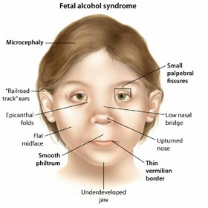

Fetal Alcohol Spectrum Disorders (FASDs)
FAS
FAS: Fetal Alcohol Syndrome
pFAS: Partial FAS
ARND: Alcohol-Related Neurodevelopmental Disorder
ARBD: Alcohol-Related Birth Defects
ND-PAE*: Neurobehavioral Disorder associated with Prenatal Alcohol Exposure
pFAS
ARND
ARBD
ND-PAE
*included in DSM-5 appendix under “conditions for further study.”
Notes:
May PA, Chambers CD, Kalberg WO, Zellner J, Feldman H, Buckley D, Kopald D, Hasken JM, Xu R, Honerkamp-Smith G, Taras H, Manning MA, Robinson LK, Adam MP, Abdul-Rahman O, Vaux K, Jewett T, Elliott AJ, Kable JA, Akshoomoff N, Falk D, Arroyo JA, Hereld D, Riley EP, Charness ME, Coles CD, Warren KR, Jones KL, Hoyme HE. Prevalence of Fetal Alcohol Spectrum Disorders in 4 US Communities. JAMA. 2018 Feb 6;319(5):474-482. doi: 10.1001/jama.2017.21896. PMID: 29411031; PMCID: PMC5839298.
ARND should be changed to ND-PAE/ARND. ND-PAE stands for neurobehavioral disorder associated with prenatal alcohol exposure This was new to DSM V. The diagnosis of ND-PAE encompasses the behavioral, developmental, and mental health aspects of FASDs
Diagnosis of ND-PAE is appropriate if a child presents with impairment in neurocognition, impaired self-regulation, 2 impairments of adaptive functioning, and a history of more than minimal exposure to alcohol in utero (Table 1), as long as the disorder is not better explained by other factors (eg, genetic or teratogenic syndrome). Although these broad domains overlap with other disorders of childhood, specific deficits within them are indicative of ND-PAE. As
ICEBERG IMAGE: iStock photo ID:452595535 purchased 4/27/21 $12.00

Slide 6
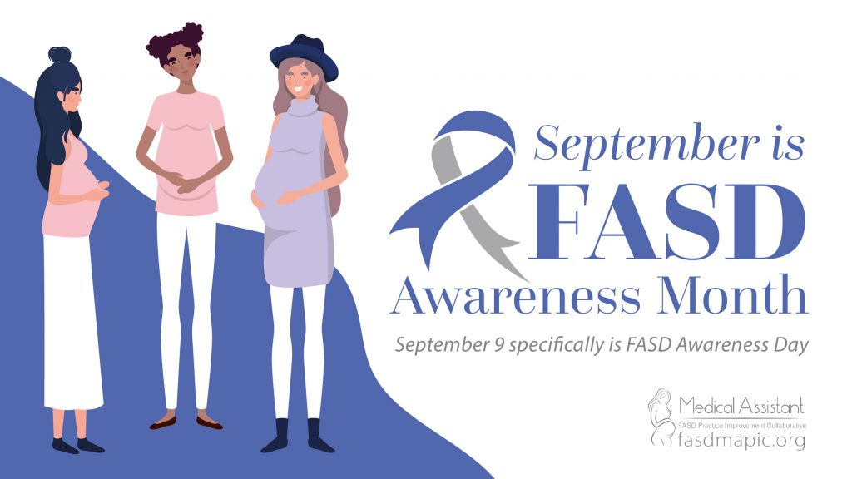
Fetal Alcohol Spectrum Disorders (FASDs)
FASDs are a range of conditions attributable to prenatal alcohol exposure that include behavioral, learning, and physical problems
In the US, FASDs are the most common preventable developmental disabilities
FASDs are permanent
In the US, an estimated 1-5% of 1st grade children may have an FASD¹
FASDs occur in all socioeconomic and ethnic groups²
May PA et al. JAMA. 2018
Popova S et al. BMC Public Health. 2019
Notes:
Although the prevalence of FAS in the United States during the 1980s and 1990s was reported as 0.5 to 2 cases per 1000 live births, recent studies aggressively diagnosing FASD have reported FAS rates and FASD estimates of 6 to 9 cases and 24 to 48 cases per 1000 children (or up to 5%), respectively, while continuing to consider these rates underestimates.14–16 Rates as high as 9 cases per 1000 live births
have long been documented among vulnerable populations, usually related to isolation and socioeconomic impoverishment, such as can be more often found among certain American Indian and other racial/ethnic minority populations.17–19

Slide 7
Comparison of FASDs and Other Conditions
Affects 1 in 20 SCHOOL AGED CHILDREN
5%
Actual FASD numbers unknown, these are likely conservative estimates
Affects 1 in 44 CHILDREN
Affects 1 in 700 BIRTHS
Affects 1 in 2,758 BIRTHS
www.healthline.com/health/birth-defects
www.cdc.gov/ncbddd/autism/data.html
www.ndss.org/about-down-syndrome/down-syndrome/
www.cdc.gov/ncbddd/spinabifida/data.html
May JA, et al. JAMA. 2018
Popova S, et al. Lancet Glob Health. 2017
Williams JF, et al. Pediatrics. 2015
Notes:
Updated
May et al. Prevalence of Fetal Alcohol Spectrum Disorders in 4 US Communities, JAMA. 2018;319 (5):474-482.
Popova S, Lange S, Probst C, Gmel G, and Rehm J. Estimation of National, Regional, and Global Prevalence of Alcohol Use During Pregnancy and Fetal Alcohol Syndrome: A Systematic Review and Meta-analysis. The Lancet Global Health. 2017;5(3), e290-e299.
Popova S, Lange S, Probst C, Gmel G, Rehm J. Estimation of national, regional, and global prevalence of alcohol use during pregnancy and fetal alcohol syndrome: a systematic review and meta-analysis. Lancet Glob Health. 2017 Mar;5(3):e290-e299. doi: 10.1016/S2214-109X(17)30021-9. Epub 2017 Jan 13. Erratum in: Lancet Glob Health. 2017 Mar;5(3):e276. PMID: 28089487.
National Down Syndrome Society. Down Syndrome. https://www.ndss.org/about-down-syndrome/down-syndrome/
Centers for Disease Control and Prevention. Data and statistics on autism spectrum disorder. https://www.cdc.gov/ncbddd/autism/data.html
Williams JF, Smith VC. Fetal Alcohol Spectrum Disorders. Pediatrics. 2015;136(5):e1395-406.
Williams JF, Smith VC; COMMITTEE ON SUBSTANCE ABUSE. Fetal Alcohol Spectrum Disorders. Pediatrics. 2015 Nov;136(5):e1395-406. doi: 10.1542/peds.2015-3113. Epub 2015 Oct 19. PMID: 26482673.
Healthline. Birth Defects. https://www.healthline.com/health/birth-defects
Centers for Disease Control and Prevention (CDC). Spina bifida: Data & statistics on spina bifida. https://www.cdc.gov/ncbddd/spinabifida/data.html
SLIDE CONTENT
FASDs affects 1 in 20 (FAS 6-9/1000) school aged children *
Autism spectrum disorder affects 1 in 54 children
Down syndrome affects 1 in 700 births
Spina bifida affects 1 in 2,758 births
* Actual FASD numbers unknown, these are more likely conservative estimates

Slide 8
Prevention Challenge
Non-Pregnant Women of Reproductive Age
Unintended Pregnancies
Pregnant Women
  54% report alcohol use in previous 30 days¹
  18% report binge drinking in previous 30 days ¹
  49% of pregnancies are unplanned¹
  Pregnancy may not be known for up to 6 weeks or later into the pregnancy²
  13.5% report alcohol use in previous 30 days³
  5% reported binge drinking in previous 30 days³
Tan CH, et al. Morb Mortal Wkly Rep. 2015
Green PP, et al. Morb Mortal Wkly Rep. 2016
Gosdin LK et al. Morb Mortal Wkly Rep 2022
Notes:
UPDATE
https://www.nytimes.com/2020/10/03/style/am-i-drinking-too-much.html
https://www.rand.org/news/press/2020/09/29.html
Gosdin LK, Deputy NP, Kim SY, Dang EP, Denny CH. Alcohol Consumption and Binge Drinking During Pregnancy Among Adults Aged 18–49 Years — United States, 2018–2020. MMWR Morb Mortal Wkly Rep 2022;71:10–13. DOI: http://dx.doi.org/10.15585/mmwr.mm7101a2external icon
Tan CH, Denny CH, Cheal NE, Sniezek JE, Kanny D. Alcohol use and binge drinking among women of childbearing age - United States, 2011-2013. MMWR Morb Mortal Wkly Rep. 2015 Sep 25;64(37):1042-6. doi: 10.15585/mmwr.mm6437a3. PMID: 26401713.
Green PP, McKnight-Eily LR, Tan CH, Mejia R, Denny CH. Vital Signs: Alcohol-Exposed Pregnancies--United States, 2011-2013. MMWR Morb Mortal Wkly Rep. 2016 Feb 5;65(4):91-7. doi: 10.15585/mmwr.mm6504a6. PMID: 26845520.
Denny CH, Acero CS, Naimi TS, Kim SY. Consumption of alcohol beverages and binge drinking among pregnant women aged 18–44 years – United States, 2015–2017. MMWR Morbidity and Mortality Weekly Report 2019; 68(16): 365-368.

Slide 9
Reasons for Alcohol Use During Pregnancy
4 Themes
Theme 1: Influence of individual beliefs
  Belief alcohol has beneficial properties
  Belief alcohol is harmful only in specific types and quantities
  Belief alcohol is less harmful than other prenatal exposures (e.g., smoking)
Theme 2: Influence of culture
  Social acceptability and pressure for alcohol consumption
  Alcohol consumed as part of tradition and custom
  Alcohol consumed based on intuitive decision making influenced by personal/peer experiences in the community
Popova S et al. Drug Alcohol Rev. 2022

Slide 10
Reasons for Alcohol Use During Pregnancy
4 Themes
Theme 3: Influence of knowledge and advice
  Consumed alcohol for other health conditions (e.g., nausea)
  Lack of awareness/knowledge of the adverse impacts of alcohol on the fetus
  Insufficient or mixed advice from medical practitioners
Theme 4: Influence of pregnancy circumstances
  Consumed alcohol as a coping mechanism for adverse events during pregnancy
  Unplanned or unwanted pregnancy
  Alcohol use disorder
Popova S et al. Drug Alcohol Rev. 2022

Slide 11

Education Gaps & Mixed Messaging
Lack of education and awareness among health care providers
  Only 16% of pregnant persons with known past 30-day alcohol consumption were advised by a health care provider to quit or reduce their alcohol use (Luong J, et al. MMWR 2023)
Mixed messaging…
  “more than the occasional drink is likely perfectly fine,...Specifically, one to two drinks a week in the first trimester, and up to a drink a day in the second and third trimester, is likely safe”
  Expecting Better by Emily Oster
Campaigns that use blaming and shaming language, such as “FASD is 100% preventable”, can stigmatize and isolate pregnant individuals who use alcohol

Slide 12
Personal Experience
Susan Terwey, MS

Slide 13

Image
Atypical?
Caucasian
Middle class
Master Level education
Professional in the FASD Field – 13 years
Social Drinker
Infertility issues - adoptions, unplanned pregnancy

Slide 14
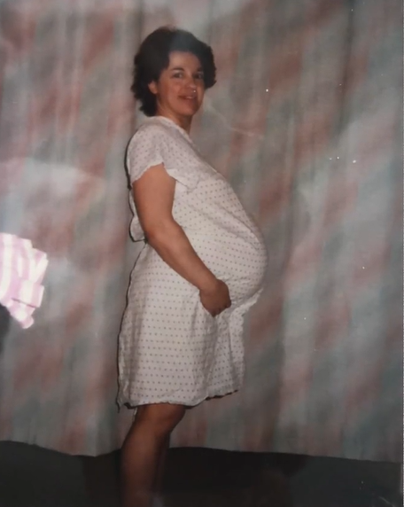
Image
Parenting History
Foster mom to kids with FASD and prenatal alcohol exposure
Infertility issues - adoptions, unplanned pregnancy
Prenatal care

Slide 15
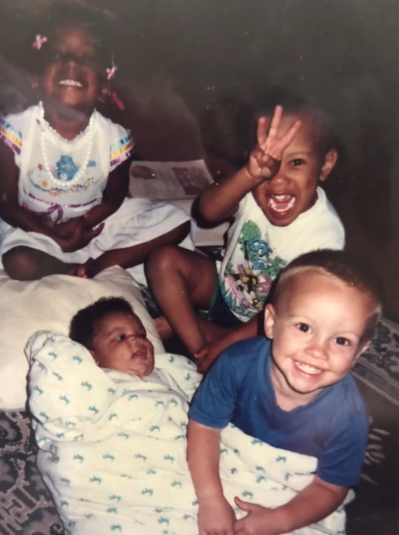
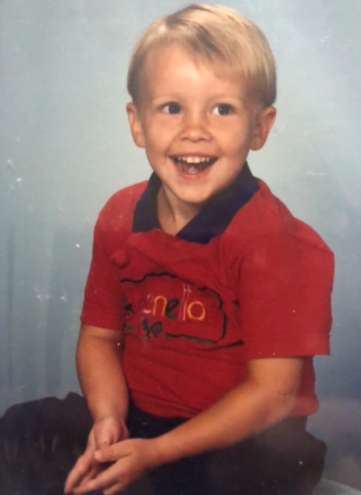
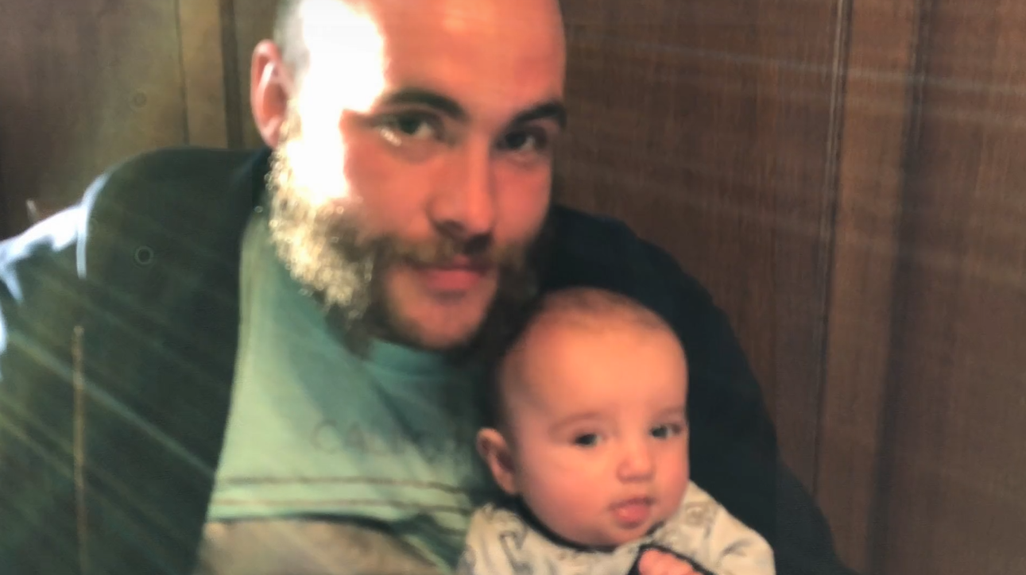
Image
Realizing I was a “Birth Mom”
Bio son was the most challenging of all: sensory, high risk, refusals/hiding, behavior room, learning gaps
School Special Ed assessments (504), Psych eval - no questions about prenatal alcohol exposure
Anger management, 2 school changes
Neighborhood alcohol use
FASD lightbulb flickers
1st detox at age 14 – intake interview
Juvenile court charges – County social worker, FASD Assessment
Adult detox interview
Awareness of adults with SUD dealing with undiagnosed FASD issues

Slide 16
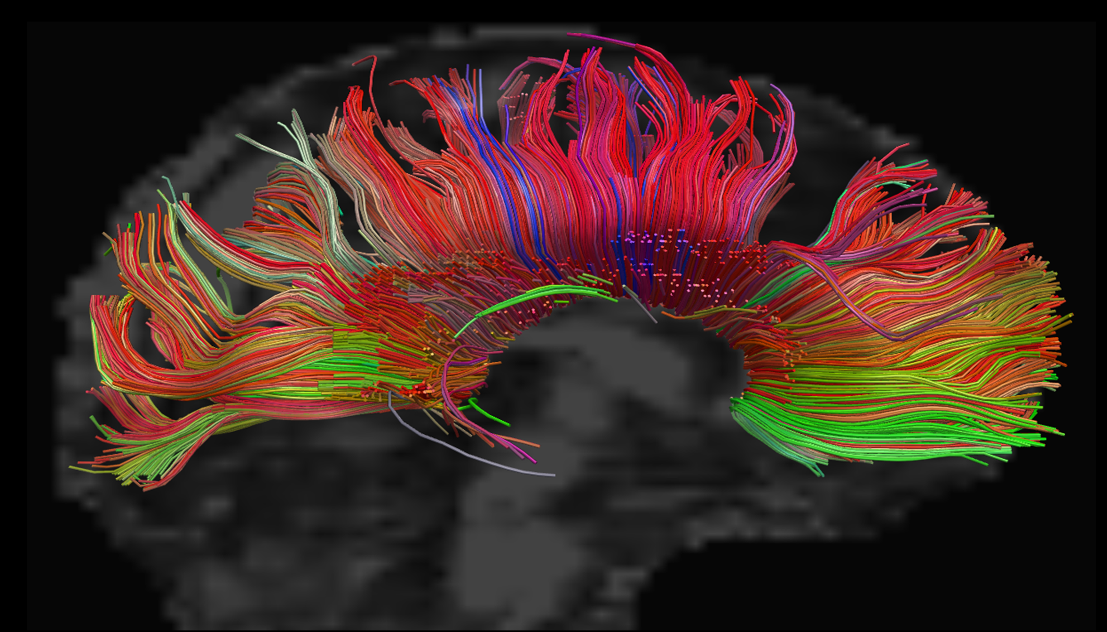
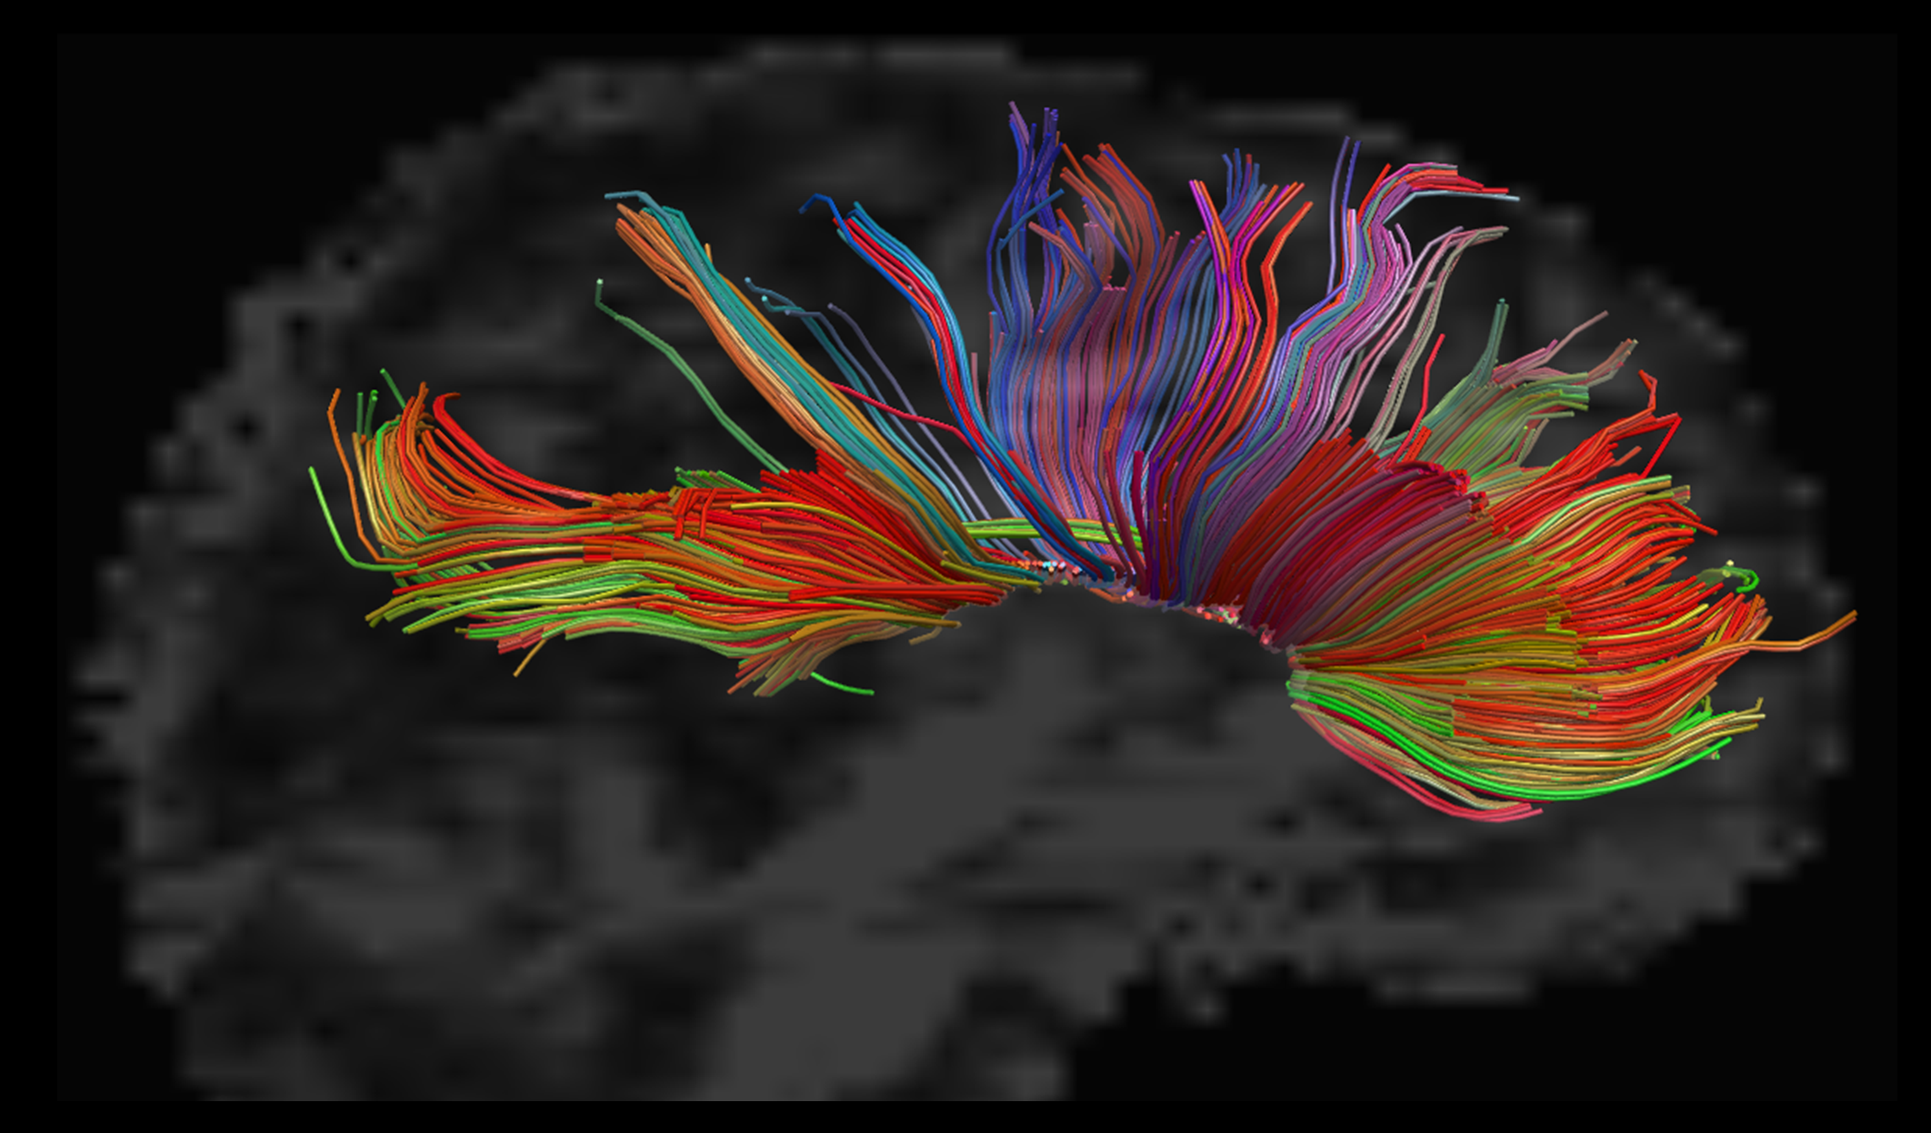



The state of the science of Fetal Alcohol Spectrum Disorders
Jeffrey R. Wozniak, Ph.D.
Professor
Department of Psychiatry & Behavioral Sciences
University of Minnesota

Slide 17
How and when does alcohol disrupt neurodevelopment?

Slide 18
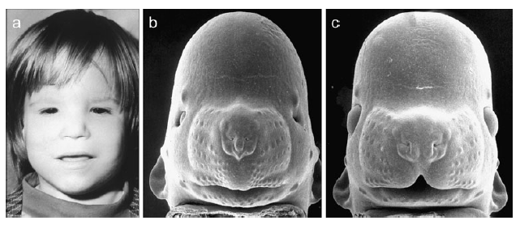
1. First trimester (gastrulation):
Pregnancy loss
Impact on the neural tube
Small brain, eye defects, facial dysmorphology
2. Second trimester (neurogenesis):
    Impact on cell multiplication
    Abnormal migration of neurons
  3. Third trimester (synaptogenesis):
  Impact during the brain’s growth spurt
  Effects on synaptogenesis / long lasting impacts on plasticity
Miller et al. (1989), J. Comp Neurol., 287, 326-338
Medina, A.E. The Neuroscientist, 17(3): 274-287
Ieraci & Herrera (2006), PLoS One

Slide 19
Sulik et al. 1981: Gastrulation model
Day 7 (day 17 or 18 in human); 0.2 BAC (5-6 drink equiv. two doses)
Craniofacial effects
Forebrain, midline brain anomalies, callosum, hippocampus, basal ganglia
  Day 8.5: equivalent to week 4 (day 21-24) in humans -> different pattern of anomalies
Sulik, K.K. et al, 1981, Science 214: 936-938; Lipinski et al., 2012, PLoS One 7(8):e43067

Slide 20
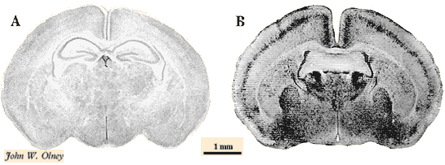
Apoptosis from ethanol exposure (single “binge” model)
- Third-trimester model (brain growth spurt; 7-day-olds)
- Millions of neurons are signaled to self-destruct (apoptosis)
- Significant behavioral and learning deficits
Olney JW, Tenkova T, Dikranian K, Qin YQ, Labruyere J, et al. Ethanol-induced apoptotic neurodegeneration in the developing C57BL/6 mouse brain. Brain Res Dev Brain Res. 2002;133:115–126.

Slide 21
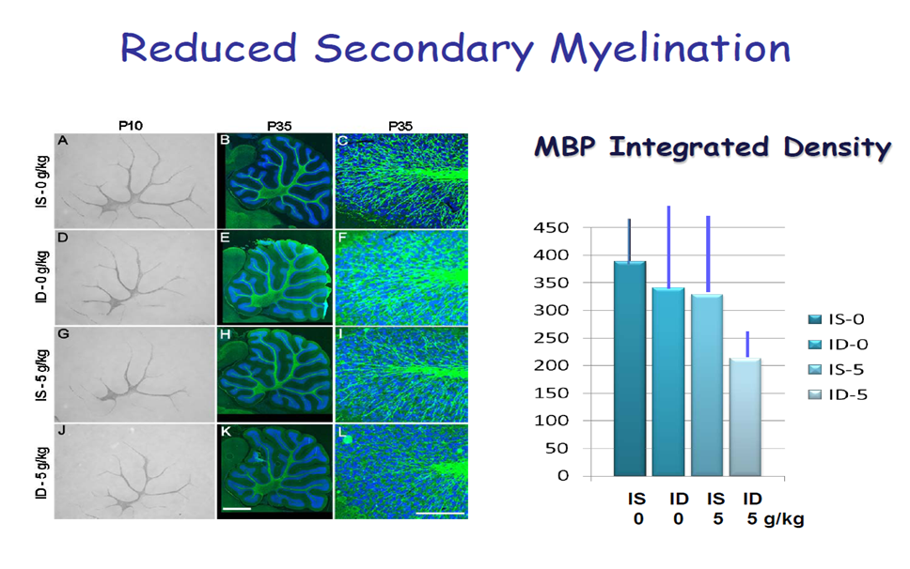
An example of co-occurring risk factors in PAE
Third-trimester model in rats: Iron deficiency exacerbates damage from alcohol (myelination, in this case); In humans, myelination occurs from week 14 into adolescence.
Rufer ES, Tran, TD, Attridge, MM, Andrzejewski, ME, Flentke, GR, & Smith, SM. (2012) PLoS One, 7(10), doi: 10.1371/journal.pone.0047499.

Slide 22
Mouse model - single exposure
Disruption in fetal blood flow
Altered gene expression in the placenta
Intrauterine growth restriction
Ethanol-exposed fetuses were shorter and weighed less

Slide 23
The influence of paternal alcohol consumption on offspring
In large human cohort: association between father’s drinking and child behavior (anxiety & aggression)
Animal studies have shown:
  Paternal peri-conception alcohol consumption is associated with offspring hyperactivity (Abel et al. 1993)
  Histone modifications (epigenetic effects) (Cambiasso et al. 2022)
Luan et al. (2022); Sci Rep; 12(1): 1508; Abel et al. (1993); Neurotoxicol Teratol;15(6):445–9. Cambiasso et al., 2022; J. Assist Reprod Genet; 39(2): 441-459.

Slide 24
What have we learned about neurodevelopmental impacts of alcohol from people with FASD?

Slide 25
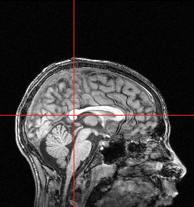
Major structural anomalies sometimes occur in FASD
Typical Development
Fetal Alcohol Syndrome

Slide 26
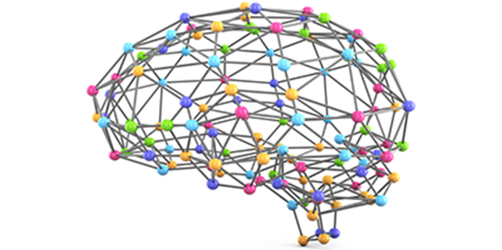
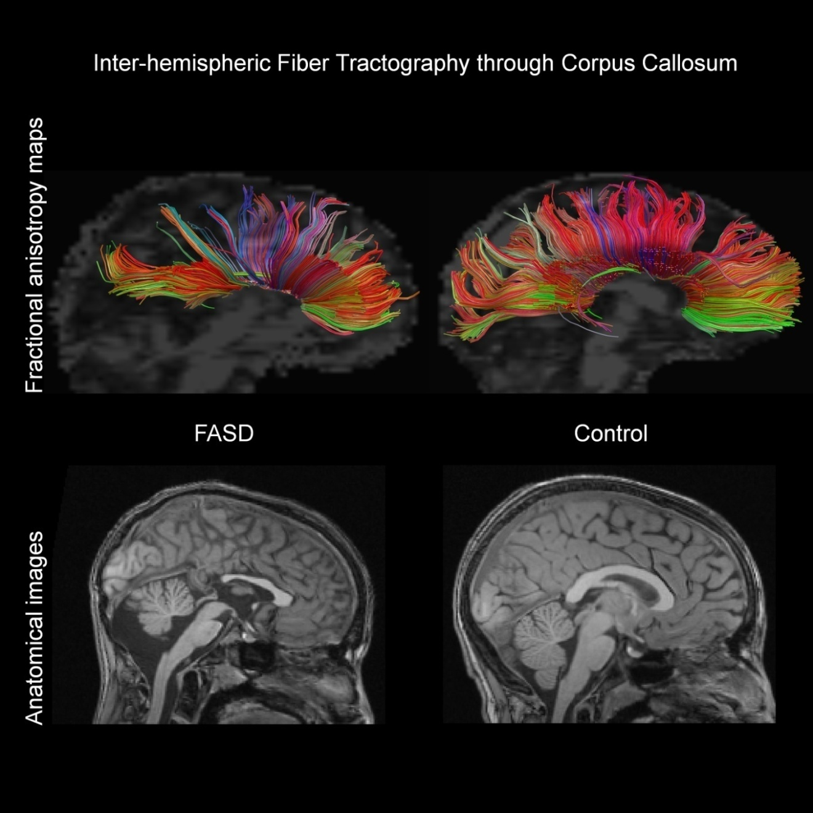

Diffusion imaging reveals white matter anomalies in FASD
Wozniak, J.R. & Muetzel, R.L. (2011). What Does Diffusion Tensor Imaging Reveal About the Brain and Cognition in Fetal Alcohol Spectrum Disorders? Neuropsychology Review, 21(2), 133-147.
Notes:
We began to apply Diffusion Tensor Imaging (DTI) to the study of FASD because it had the capacity to go well beyond what we could see with traditional clinical MRI scans. Rather than simply making an anatomically-correct image of the brain that would allow us to see gross structural abnormalities in the brain, DTI was a tool that visually presented and allowed us to quantify the microscopic level construction of brain tissue – especially the white matter. The white matter is the brain’s wiring in a sense – it is the backbone of the network.

Slide 27
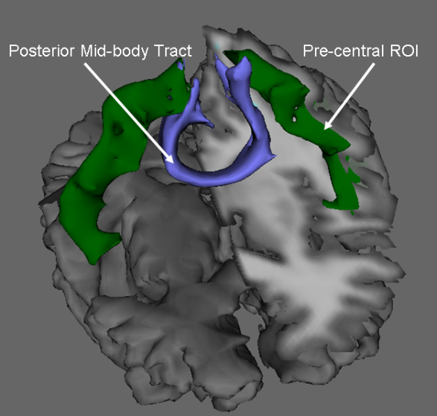
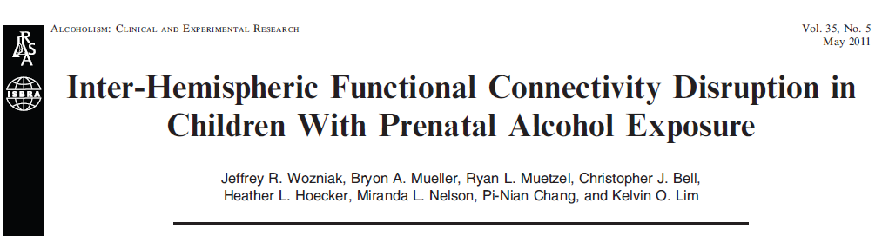
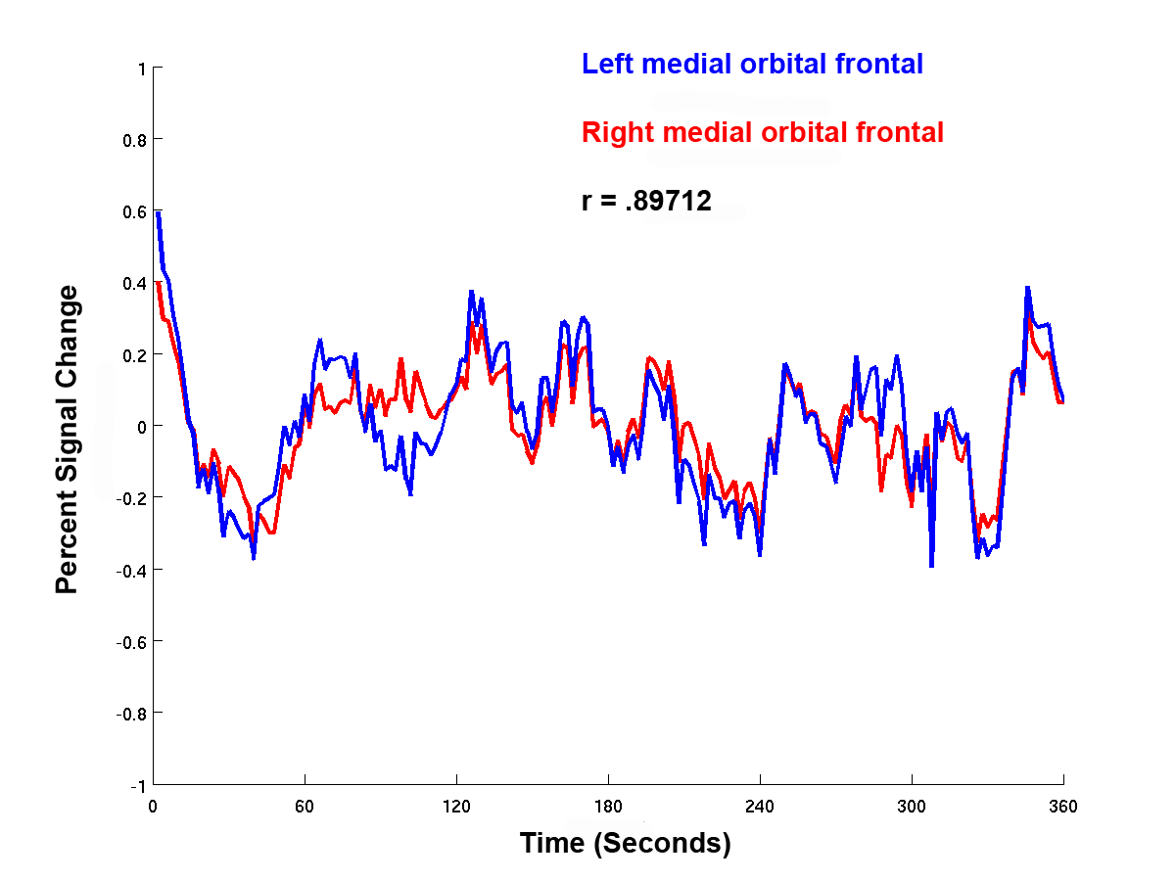
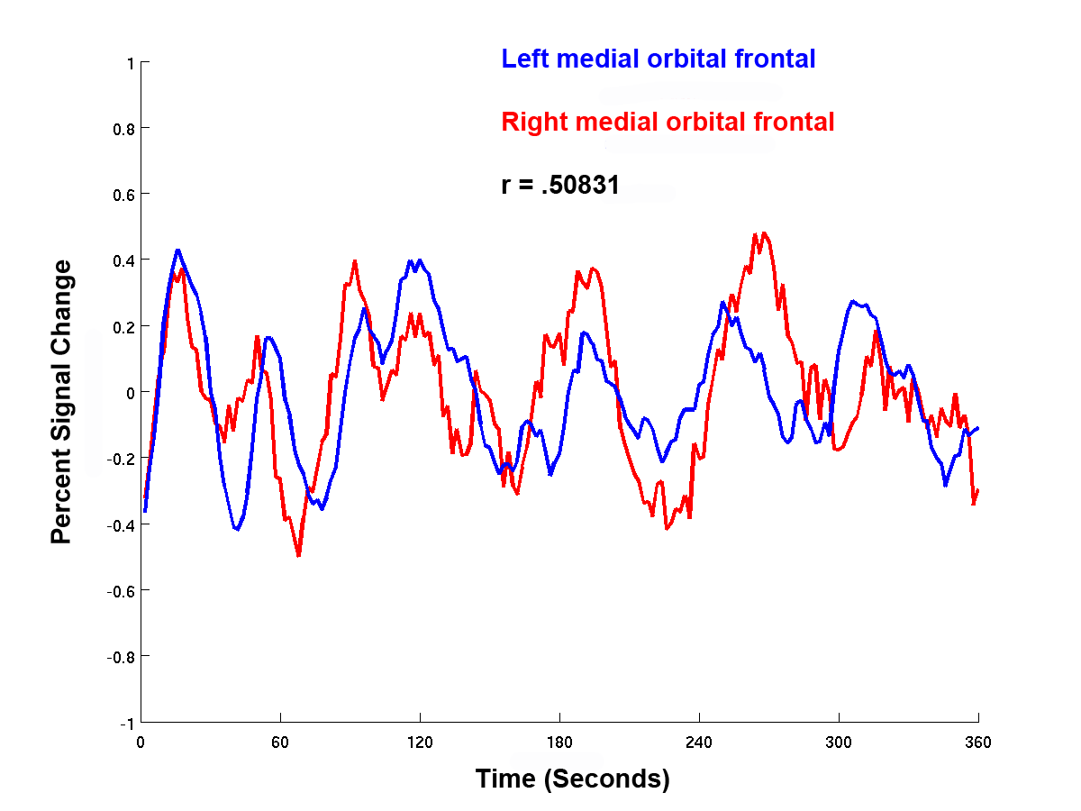
Figure 1. fMRI time-series from one control subject illustrating high correlation between BOLD signal change in right and left medial orbital frontal cortex.
Figure 2. fMRI time-series from one FASD subject illustrating low correlation between BOLD signal change in right and left medial orbital frontal cortex.

Slide 28

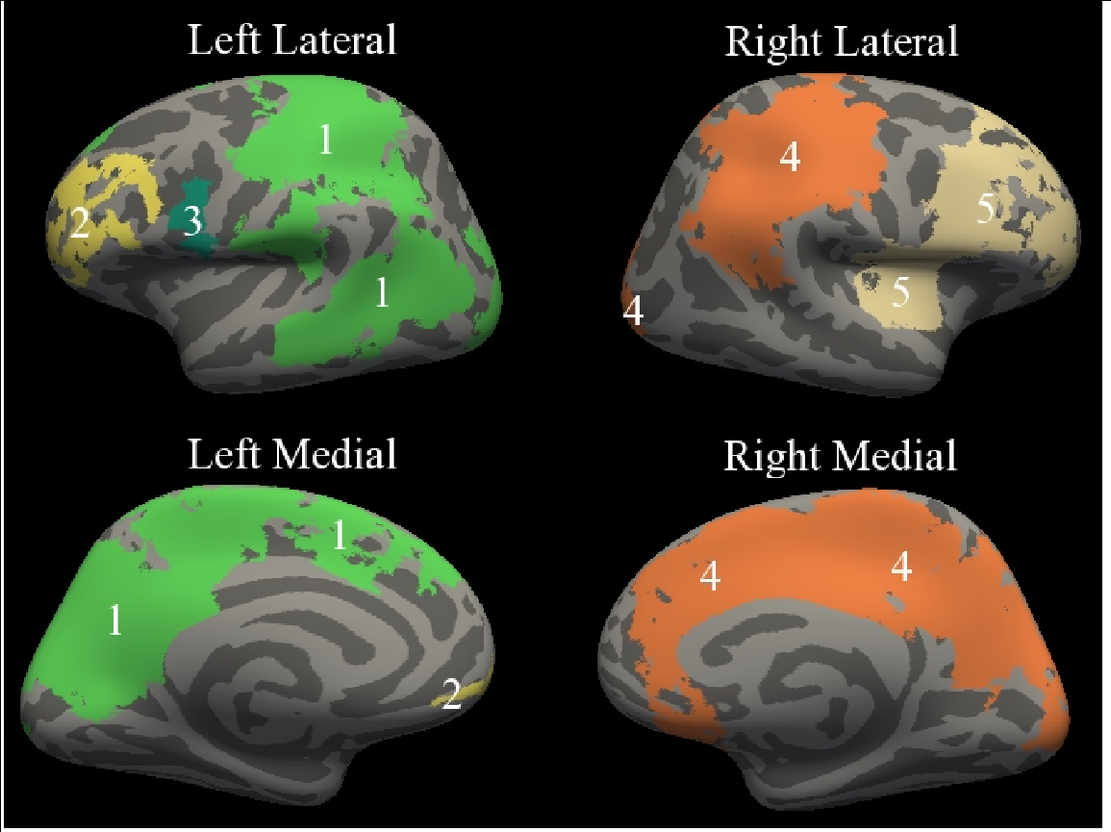
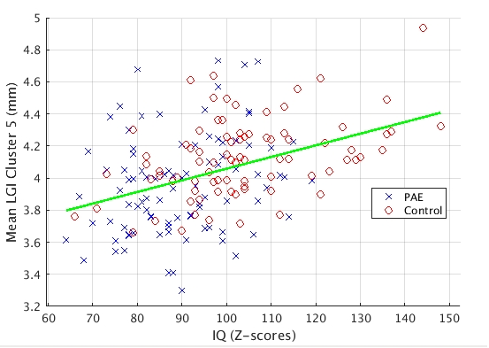
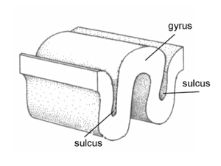
Cortical complexity is altered in FASD
Typical cortical folding
Alcohol’s impact on cortical folding
Cortical folding and cognition
Hendrickson, et al. (2017). Cortical gyrification is abnormal in children with Prenatal Alcohol Exposure. Neuroimage: Clinical. 15, 391-400.

Slide 29
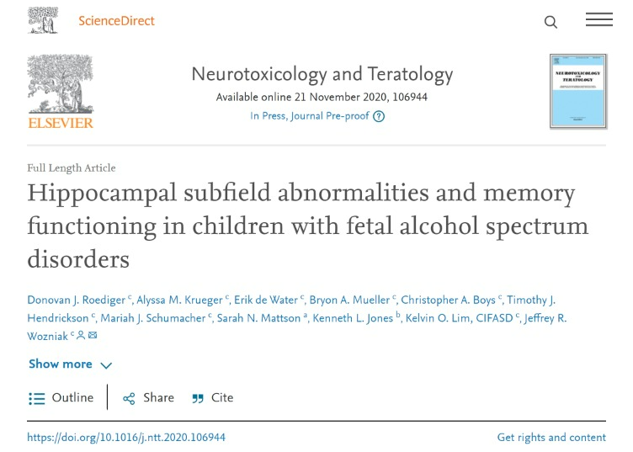
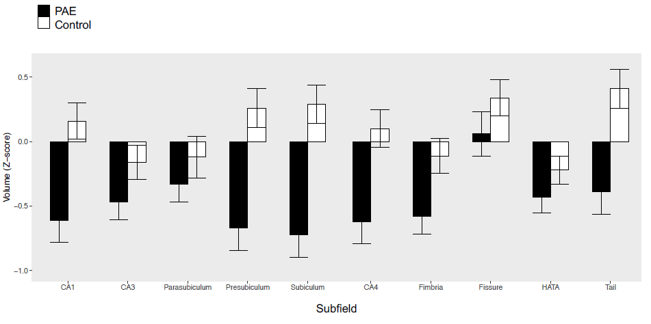
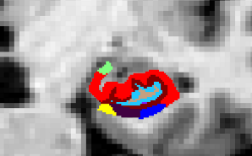

Slide 30
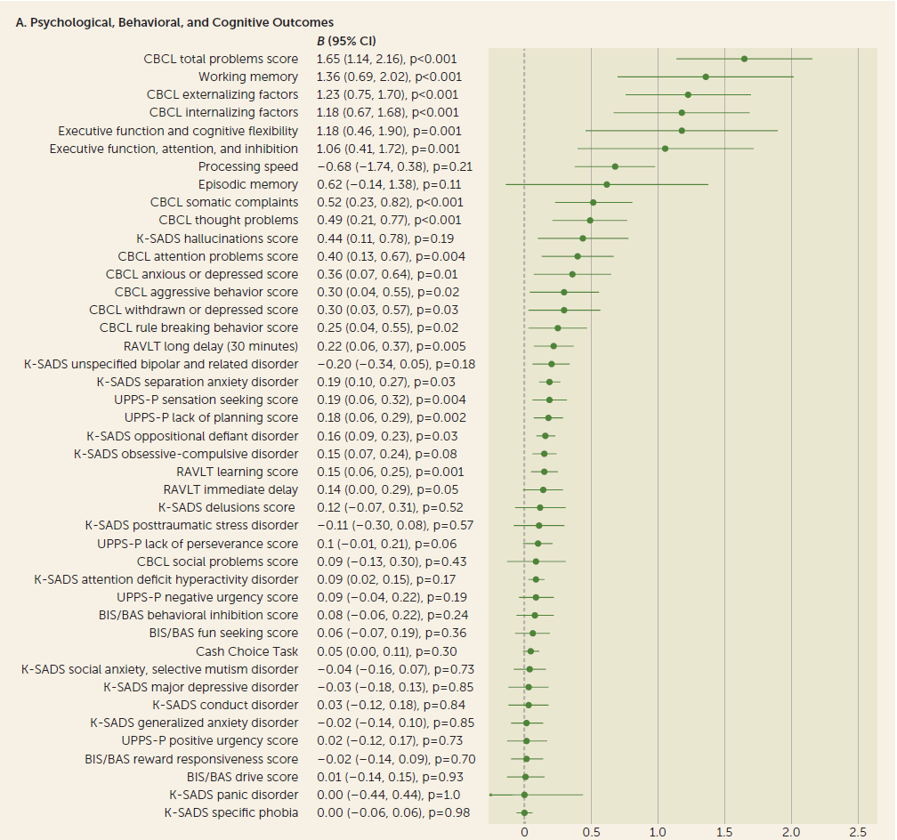
Lees et al. 2021 Association of prenatal alcohol exposure with psychological, behavioral, and neurodevelopmental outcomes in children from the ABCD study; American Journal of Psychiatry, 177:11
An example from a non-clinical sample
Adolescent Brain Cognitive Brain Development (ABCD) Birth Cohort Study:
7201 unexposed
2518 exposed
Figure shows relative behavioral and cognitive deficits for exposed vs. unexposed children

Slide 31
Example of the cycle of secondary disability
Early Develop-mental disruption
Behavior regulation / learning probs.
Peer rejection
Low self-esteem
Drug / alcohol use

Slide 32
FASD and predisposition for substance use?
Those with FASD are at high risk for substance use from:
  Genetic / early life adversity
  Physiological change (GABA receptor sensitivity; Dopamine)
Alati et al. (2008. Drug Alcohol Depend 98:136–143; Baer et al. (1998). J Stud Alcohol 59:533–543; O’Connor, Quattlebaum, Castaneda, & Dibble (2016). ACER, 40; Chotro et al (2007). Neurosci Biobehav Rev 31:181–191.

Slide 33
Is medication effective for FASD?

Slide 34
Medications for FASD
Animal studies – prenatal ethanol exposure leads to hyper-sensitivity to methylphenidate later in life
  Means et al. (1984)
  Ulug & Riley (1983)
Human studies:
  Oesterheld et al (1998): stimulants treated hyperactivity, but not attention deficits in those with FASD
  Poor responsivity to stimulants:
    O’Malley & Hagermann (1998)
    O’Malley & Nanson (2002)
    Snyder et al. (1997)

Slide 35

Psychotropic medication algorithm for FASD
(Mansfield Mela, MBBS; U. Saskatchewan: canfasd.ca/algorithm)
Consensus-based comprehensive decision-tree addressing four common symptom clusters in FASD:
  Hyperarousal
  Emotion dysregulation
  Hyperactivity / inattention
  Cognitive inflexibility
First and second line medications recommended
Mela M, et al. (2918). The utility of psychotropic drugs on patients with Fetal Alcohol Spectrum Disorder (FASD): a systematic review. Psychiatry and Clinical Psychopharmacology. 2018:1-10)
Mela et al. (2020). Treatment algorithm for the use of psychopharmacological agents in individuals prenatally exposed to alcohol and/or with diagnosis of fetal alcohol spectrum disorder (FASD). J. Popul Ther Pharmacol, 27(3):e1-e13.

Slide 36
How do we target neurodevelopment in FASD?

Slide 37
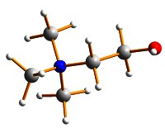

Example: Choline is an essential nutrient for humans
Classified as essential nutrient
Cells die by apoptosis without it
Multiple needs:
          Cell membrane
  Lipid metabolism
  Precursor to acetylcholine
  Gene expression (development)
  Deficiency -> neural tube disorders
(Albright et al., 1998; Eagle, 1955; Zeisel et al., 1997; Cho et al., 2006); Zeisel et al., 2003; (Shaw et al., 2004; Smithells et al., 1976; Zeisel, 2009b; (Albright et al., 1999a; Albright et al., 1999b

Slide 38
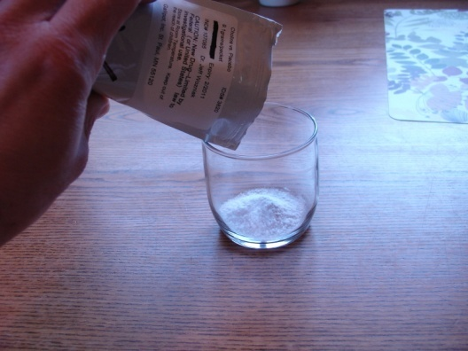

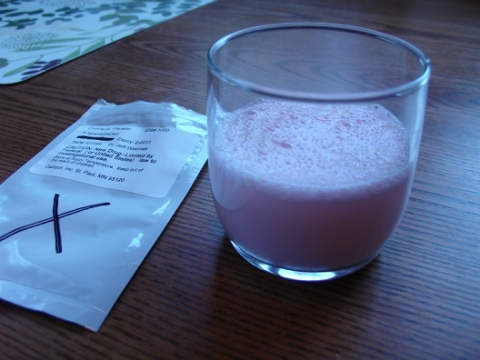

2009 Phase 1 study: delivery system development
Two arms: 500 mg. choline vs. placebo per day
    Based on adequate intake of 200-250 mg. per day
  Fruit-flavored drink mix
  9 month duration

Slide 39

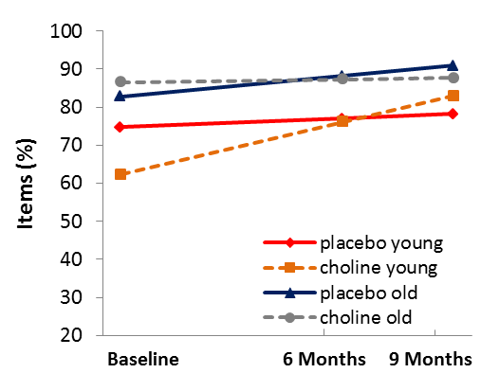
Elicited Imitation (memory) performance
Fig 1. EI items after short delay
21 point increase for young choline
γ= -16.05, 95% CI [-31.71, -0.40], t(84.7)= -2.09, p=0.045.

Slide 40
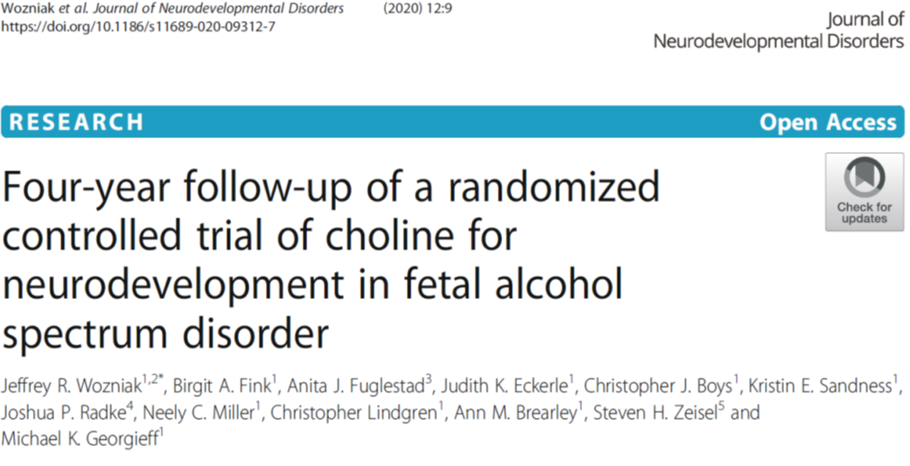
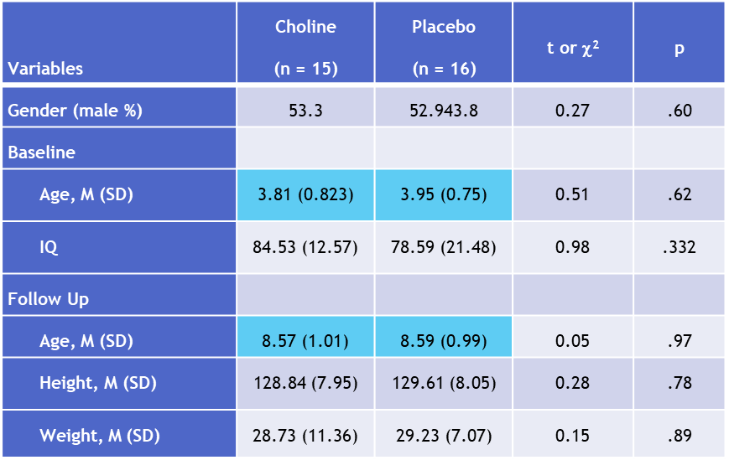
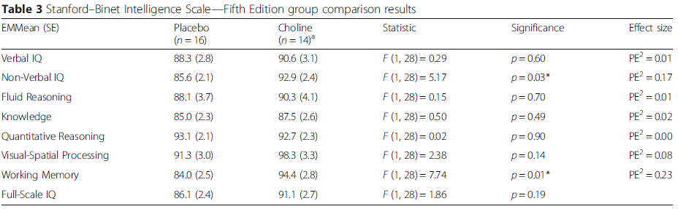
Notes:
Ludwig Maximilian University in Munich

Slide 41
Summary
Alcohol has numerous negative impacts on the developing brain
Even single episodes can be harmful
Cognitive & behavioral effects are often present, even when the craniofacial elements are not
We’ve learned a great deal by collaborating with individuals with lived experience of FASD who contribute to research
New interventions may take advantage of windows of neuroplasticity and opportunities to optimize remaining brain development

Slide 42



FASDs Clinical Presentation and Evidence-Informed Treatment
Vincent C. Smith, MD, MPH
Division Chief of Newborn Medicine
Boston Medical Center
Professor of Pediatrics
Boston University Chobanian & Avedisian School of Medicine
Notes:
UPDATE

Slide 43
Clinical Presentation

Slide 44
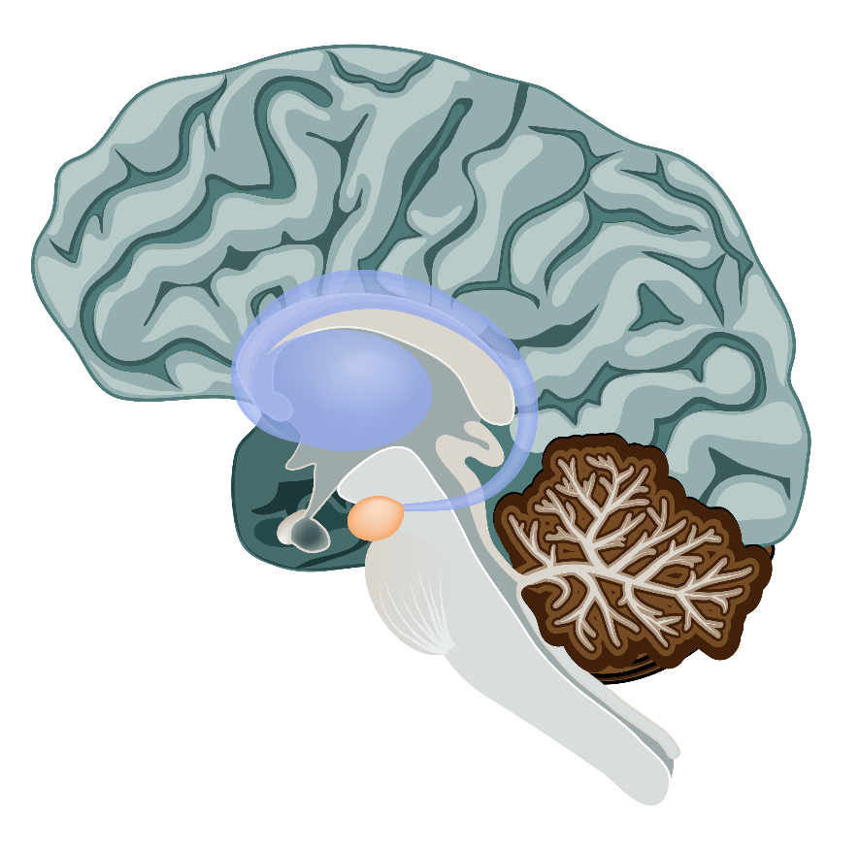
Brain Areas Affected By Prenatal Alcohol Exposure
Frontal Lobes impulses and judgment; controls executive function
Corpus Callosum
passes information from the left brain (rules, logic) to the right brain (impulse, feelings) and vice versa
Hypothalamus appetite, emotions, temperature, and pain sensation
Hippocampus
memory, learning, emotion
Amygdala
emotions
Cerebellum coordination
and movement
Basal Ganglia
spatial memory, switching gears, working toward goals, predicting behavioral outcomes, and the perception of time
Source: Dr. Sarah Mattson, University of San Diego

Slide 45
Neurobehavioral Disorder
Neurobehavioral Characteristics
Physical Characteristics
  Neurocognition Learning, memory, math, executive functioning, visual-spatial, IQ/DD
  Self-regulation Attention, impulsivity, emotional lability, outbursts
  Adaptive Functioning Communication, social, daily living skills, motor
  ~20% of children affected
  Growth restriction
  Facial features:
    Smooth philtrum
    Thin upper lip
    Short palpebral fissures
Kuehn D, et al., Alcohol Clin Exp Res. 2012
Notes:
Pick either slide 19 or 20
FASDs are brain-based disorders
Neurobehavioral consequences that will be the focus of treatment, care and management
In light of the opioid crisis, important to keep in mind that alcohol is so harmful
Taken from AAP FASD Champions slide deck
Kills brain cells, causes early cell death, both at the overall level and the level of individual structures.
Prevents proper brain growth
Prevents brain cells from forming in the right place → problems in thinking and information processing
Prevents brain cells from forming the right connections

Slide 46
Facial Features
It's a common myth that all people with an FASD have a specific set of facial features
The fact is, only a small percent of people with FASD have these facial features; for the vast majority of individuals with an FASD, their disability is invisible
Examples of facial phenotypes across
race and age
Copyright Susan Astley Hemingway 2012.
https://depts.washington.edu/fasdpn/htmls/fas-face.htm
Notes:
We will give a brief overview of screening for FASDs… if you would like more in-depth information on this, we would be happy to come back and present again if it works for your clinic
Thin upper lip, smooth philtrum: the groove between the nose and the upper lip, and small palpebral fissures, or the distance between the inner and outer part of the eye.
In fact, the facial features only happen if the pregnant person drank alcohol during the small window of time when the facial features were being formed. If the alcohol was consumed during other parts of the pregnancy outside of that window, the facial features would not be changed at all, but the brain could still be impacted.
That is why, when screening for FASD, we cannot rely on looking for facial features.
The most serious effect of prenatal alcohol exposure is the invisible brain injury.

Slide 47
Diagnosis of FASD

Slide 48
FASD Diagnostic Schema Available
Currently available guidelines:
Updated Clinical Guidelines for Diagnosing FASD (Hoyme et al, Pediatrics, 2016)
Canadian guidelines for FASD diagnosis (Cook et al, CMAJ, 2015)
National Task Force on Fetal Alcohol Syndrome and Fetal Alcohol Effect (CDC 2004)
FASD 4-digit diagnostic code (Astley and Clarren, Alcohol, 2000)
Historically available guidelines:
A practical clinical approach to diagnosis of FASD: clarification of the 1996 Institute of Medicine criteria (Hoyme et al, Pediatrics, 2005)
FASD: Canadian guidelines for diagnosis (Chudley et al, CMAJ) 2005
Fetal Alcohol Syndrome (The Lancet, 1973)
The Diagnostic and Statistical Manual version 5 published by the American Psychiatric Association also proposes criteria for neurobehavioral disorder associated with prenatal alcohol exposure.
Notes:
Each guideline is a valid diagnostic tool.
Professionals have varying reasons for choosing one over another.
Choose a method you are comfortable with and that works well in your practice.
REFERENCES
Jones KL, Smith DW, RECOGNITION OF THE FETAL ALCOHOL SYNDROME IN EARLY INFANCY, The Lancet, Volume 302, No. 7836, p999–1001, 3 November 1973
Dysmorphology Unit, Department of Pediatrics, University of Washington School of Medicine, Seattle, Washington 98195, U.S.A..
DOI: http://dx.doi.org/10.1016/S0140-6736(73)91092-1
Hoyme HE, May PA, Kalberg WO, et al. A practical clinical approach to diagnosis of fetal alcohol spectrum disorders: clarification of the 1996 Institute of Medicine criteria. Pediatrics.2005;115 :39– 47
Centers for Disease Control and Prevention, National Center on Birth Defects and Developmental Disabilities, National Task Force on Fetal Alcohol Syndrome and Fetal Alcohol Effects. Fetal alcohol syndrome: guidelines for referral and diagnosis. Available at: www.cdc.gov/ncbddd/fas/documents/FAS_guidelines_accessible.pdf. Accessed April 13, 2005
Chudley AE, Conry J, et al., Fetal alcohol spectrum disorder: Canadian guidelines for diagnosis. CMAJ March 1, 2005 vol. 172 no. 5 suppl doi: 10.1503/cmaj.1040302
Cook JL, Green CR & Canada Fetal Alcohol Spectrum Disorder Research Network. Fetal alcohol spectrum disorder: a guideline for diagnosis across the lifespan. CMAJ 2015. DOI:10.1503/cmaj.141593
Astley SJ, Clarren SK. Diagnosing the full spectrum of fetal alcohol-exposed individuals: introducing the 4-digit diagnostic code. Alcohol Alcohol. 2000 Jul-Aug;35(4):400-10.

Slide 49

Assessment Domains for Diagnosis
History of Prenatal Alcohol Exposure
CNS (structural, neurologic, functional)
Growth
Dysmorphic Facial Features
Notes:
Four domains for making a FASD diagnosis:
Evidence of PAE
CNS abnormalities and impairments
Growth retardation
Presence of specific dysmorphic facial features
Signs and symptoms range from mild to severe for each component.
Variability in presentation should be considered.
Multiple factors impact this variability, including:
Amount of prenatal alcohol exposure.
Timing of exposure.
Pattern of exposure (chronic or binge drinking).
Postnatal experiences (parenting style, educational opportunities, and poverty).

Slide 50

Screening Concepts or Information Needed to Understand Potential PAE
General alcohol use in the home
Amount and type(s) of alcohol consumed before finding out they were pregnant
Amount and type(s) of alcohol consumed after finding they were pregnant
Occurrence of binge drinking (4 or more drinks in one sitting)
  Women more likely to disclose this behavior
  Indicative of general drinking
  Most harmful to the fetus

Slide 51

When to Consider a FASD Diagnosis?
Developmental, cognitive, or behavioral concerns
Complex medical concerns (e.g., cardiac)
Growth deficits
History of maternal alcohol or drug use
History of adoption or child welfare involvement
A sibling diagnosed with a FASD
Dysmorphic facial characteristics associated with FAS are present
Notes:
Children with FASDs will present with a range of characteristics or parental concerns:
Developmental, cognitive, behavioral concerns – the most likely concerns raised by parents and caregivers.
Complex
Growth deficits
History of maternal alcohol use discovered or reported by parent or foster/adoptive parent.
Reporting often means parents/caregivers are looking for reassurance or searching for explanation of problems.
Specific dysmorphic facial characteristics
Consider FASDs in the differential diagnosis for all children with growth, developmental, or behavioral problems.
Children known to have been exposed to alcohol should be assessed for a FASD.

Slide 52
Diagnostic Dilemmas
FASD
Unpredictable inconsistent
Social communication difficulty
Restricted and repetitive behaviors
Difficulty relating to others
Inattentive
Externalizing Hyperactivity Impulsivity
ADHD
ASD

Slide 53
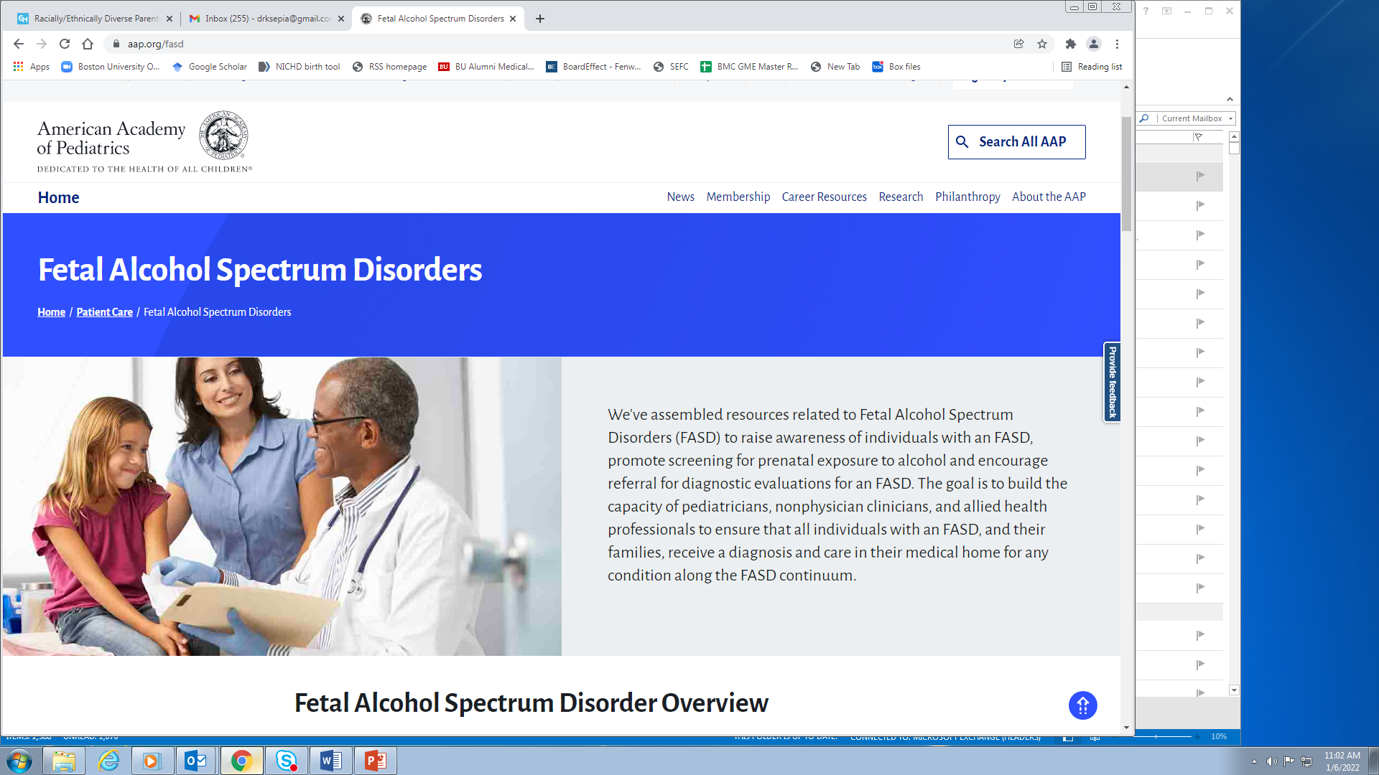
FASDs Resources
The AAP FASD Toolkit: aap.org/fasd
Comprehensive, one-stop resource

Slide 54
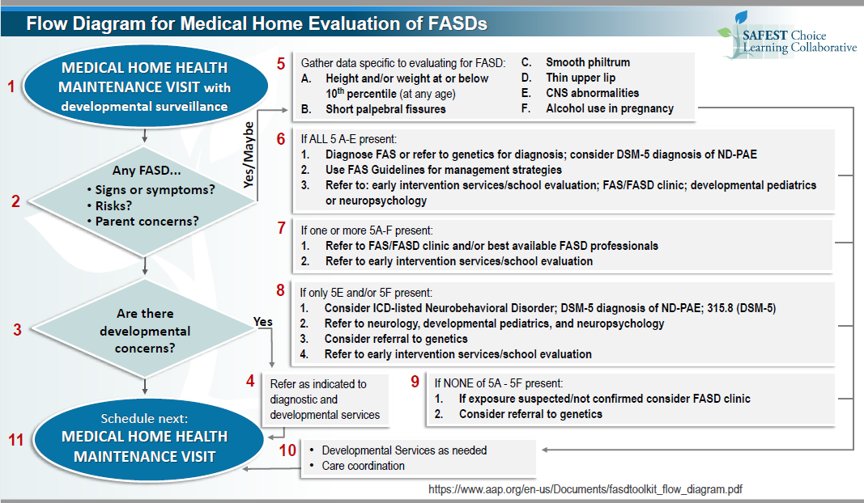

Slide 55

Potential Benefits of a Diagnosis
Parental relief
Access to evidence-based interventions
Avoids unnecessary testing, referrals, and interventions
Reduce recurrence
Notes:
Value in these diagnoses are:
Biological explanation for problems a child is having.
Reduced parental stress – child’s behavior not result of poor parenting or willful disobedience.
Early identification and intervention lead to better life outcomes.¹
Will lead to appropriate, evidence-based interventions specifically designed for FASDs.
Precludes unnecessary or ineffective testing, referrals, and interventions.
Helps reduce recurrence of FASDs in subsequent pregnancies.
Resources
Streissguth AP, Bookstein FL, Barr HM, Sampson PD, O’Malley K, Young JK. Risk factors for adverse life outcomes in fetal alcohol syndrome and fetal alcohol effects. Developmental and Behavioral Pediatrics 2004;25(4):228-238

Slide 56
Non-Pharmacologic Treatments

Slide 57
Evidence Informed Programs for FASD
Zones of Regulation (late preschool thru adulthood)
Math Interactive Learning Experience (MILE)
Go FAR
Parents and Children Together (PACT)
Families Moving Forward
Good Buddies
Access to some of these programs remains limited in many communities
A fundamental element is teaching parents how to interact with their children at home

Slide 58
The Zones of Regulation
Teaches skills & strategies
Includes parent education and skill building
Teaches children in group settings
Can be modified for the pediatric setting
Zone of Regulation
(modified for children with FASDs)
Zones of Internal states
  Blue = low/under arousal
  Green = optimal
  Yellow = increased arousal
  Red = high arousal, low emotional control
Practical skills and strategies provided for each Zone
Created by an occupational therapist, Leah Kuypers
Zones of regulation: systematic, cognitive-behavioral approach to teach how to regulate feelings, energy & sensory needs
https://zonesofregulation.com/index.html
Notes:
The Zones of Regulation curriculum incorporates Social Thinking® (www.socialthinking.com) concepts and numerous printable visuals to support students in identifying their feelings/level of alertness, understanding how their behavior impacts outcomes, problem solving conflicts and learning what tools they can use to regulate their Zones.
The Red Zone is used to describe extremely heightened states of alertness and intense emotions. A person may be elated or experiencing anger, rage, devastation, or terror when in the Red Zone.
The Yellow Zone is also used to describe a heightened state of alertness and elevated emotions, however one has more control when they are in the Yellow Zone. A person may be experiencing stress, frustration, anxiety, excitement, silliness, the wiggles, or nervousness when in the Yellow Zone.
The Green Zone is used to describe a calm state of alertness. A person may be described as happy, focused, content, or ready to learn when in the Green Zone. This is the zone where optimal learning occurs.
The Blue Zone is used to describe low states of alertness and down feelings such as when one feels sad, tired, sick, or bored.
group formats to teach children how to identify their internal states. Zones focuses on arousal states using a color mapping paradigm. PACT uses a “how is your engine running” metaphor for arousal and also helps children identify other states such as hunger or tiredness.
teach strategies and skills to manage states through activities. For example, listening to music and having the child reflect on how it changes his or her state. Or, drawing a variety of specific emotions.
incorporate parent education and skill building.
Although both these interventions have specific curriculum, the constructs from each can be adapted to the pediatric setting by explaining to parents about teaching their child to recognize internal states using either colors or the engine metaphor and having ready strategies for dealing with those states. It would helpful to tell parents that using such strategies takes time, consistency and LOTS of practice.

Slide 59
Math Interactive Learning Experience (MILE)
Ages: 3-9 years
6-week intervention
Improves math skills and handwriting
Improves behavior per parent report
Educate parents and teachers about FASD
1:1 instruction for children
http://msacd.emory.edu/Research/MILE.html

Slide 60



GoFar
Ages 5-10 years
FAR: “F” Focus/Plan, “A” Act, “R” Reflect
  Improves behavioral and educational outcomes in FASD
Parents/Caregivers learn parenting strategies
Incorporates a computer game to teach children to control impulsive and problematic behavior
10 weekly sessions
http://msacd.emory.edu/Research/GOFAR.html
Notes:
The GoFar program focuses on a core area of deficit identified in FASD; that is, on disorders of affective and cognitive control that are central to behavioral and adaptive disorders from infancy through young adulthood. By school age, such problems often present as attentional problems, deficits in executive functioning and disorders in conduct and behavior. GoFAR develops methods to address these problems in young children by bringing together computer game technology and behavioral techniques for affective and cognitive control. The methodology is based on previous work that suggests that a metacognitive technique (FAR: “F” Focus/Plan, “A” Act, “R” Reflect) is helpful in improving behavioral and educational outcomes in FASD. An important element is the GoFAR computer game, a “serious game” that supports the understanding and development of metacognitive control techniques and reinforces its use by clinically-referred children, ages 5 to 10 years. This game is incorporated into a 10 week, manualized intervention program which focuses on improving adaptive functioning and behavior. We carried out a clinic trial of a pilot group of 30 alcohol-affected children and their caregivers. Outcome measures included both standardized assessments suitable for a clinical setting and measurement of changes in physiological response. Pre and post testing allowed a preliminary understanding of the usefulness of the program elements, including the GoFAR game, as well as the suitability of the outcome measures selected. More comprehensive evaluation of the efficacy of this methodology in treating the neurodevelopmental disorders associated with FASD is planned.

Slide 61
Parents and Children Together (PACT)
Ages: 6-12 years
12-week group therapy intervention
  Equal time spent training parent & child separately, parent & child together
Parent goals:
  Understand brain changes due to PAE
  Prevent/intervene in child’s behavioral difficulties
Child goals:
  Improve executive function
  Improve emotional regulation
https://www.cebc4cw.org/program/parents-and-children-together-pact/
Notes:
Targeted to foster and adopted children and their parents/caregivers

Slide 62
Families Moving Forward
Ages: 3-12 years
Caregiver support and coaching
  Education about PAE effects
  Teaching proactive parenting strategies
School/provider consultation
Community resource linkage
Training and support provided through Seattle office
https://familiesmovingforwardprogram.com/
Familiesmovingforward@seattlechildrens.org

Slide 63

Good Buddies
Teaches social skills
12-week group sessions for child and parents
Instruction + practice + homework
Build a play date
Explicit, “in-your-pocket”
https://alaskacenterforfasd.org/wp-content/uploads/2020/07/Good-Buddies-Trainer-Workbook-final.pdf-5-14.pdf
Notes:
Maybe look at Mary J. O’Connor’s work at UCLA. She had a program called “Bruin Buddies” which may be the same as this one?
https://alaskacenterforfasd.org/wp-content/uploads/2020/07/Good-Buddies-Trainer-Workbook-final.pdf-5-14.pdf
OPTIONAL SLIDE
Good Buddies – A children’s friendship training to teach individuals with an FASD appropriate social skills1
Children with FASDs often have difficulty learning subtle social skills from their own experiences; those kinds of skills are typically “learned by osmosis” on the playground, such as how to slip into a group, appropriate sharing, or dealing with teasing. This intervention uses a group format to teach age-appropriate social skills over 12 weekly sessions for parent and child. Sessions are organized around and toward each child hosting a play date with a classmate or peer.
Workbook
https://alaskacenterforfasd.org/wp-content/uploads/2020/07/Good-Buddies-Trainer-Workbook-final.pdf-5-14.pdf
http://www.nofas.org/wp-content/uploads/2014/04/NOFAS_Brochure_4_Programs_Final.pdf
Not intended that pediatricians conduct the intervention, rather that they be aware it exists and that several evidence-based interventions targeting different skills exist.
Good Buddies
Targets social skills and peer relationships
GB = Good Buddies intervention group (formerly Bruin Buddies & Best Buddies)
CG = Control group

Slide 64
Evidence Informed Programs for Child Behavior Problems (not specific for FASD)
Parent/Child Interaction Therapy (PCIT)
Parenting through Change
Incredible Years
Attachment and Biobehavioral Catch-up (ABC)
Guided Growth
Notes:
Links

Slide 65
Parent-Child Interaction Therapy (PCIT)
For young children with emotional/behavioral disorders
Improve quality of parent-child relationships and interaction patterns
Live-coaching model (parents in room with child, therapist watching by one-way mirror or video, coaching through an earpiece)
pcit.org
Notes:
Links
**not specific for FASD
Cyrano de Bergerac for parents

Slide 66
Parenting Through Change
Target: parents of 2-18 yo
Group parenting intervention
  weekly lessons (10, 12, and 14 week formats)
Oppositional/defiant, conduct problems
ADHD symptoms
Delinquency, deviant peer associations
Substance use
Depression
Academic problems
skill encouragement
limit setting
monitoring
problem solving
positive involvement
active communication
emotional regulation
academic promotion
https://www.cebc4cw.org/program/parenting-through-change/detailed
https://www.generationpmto.org/
Notes:
Links

Slide 67
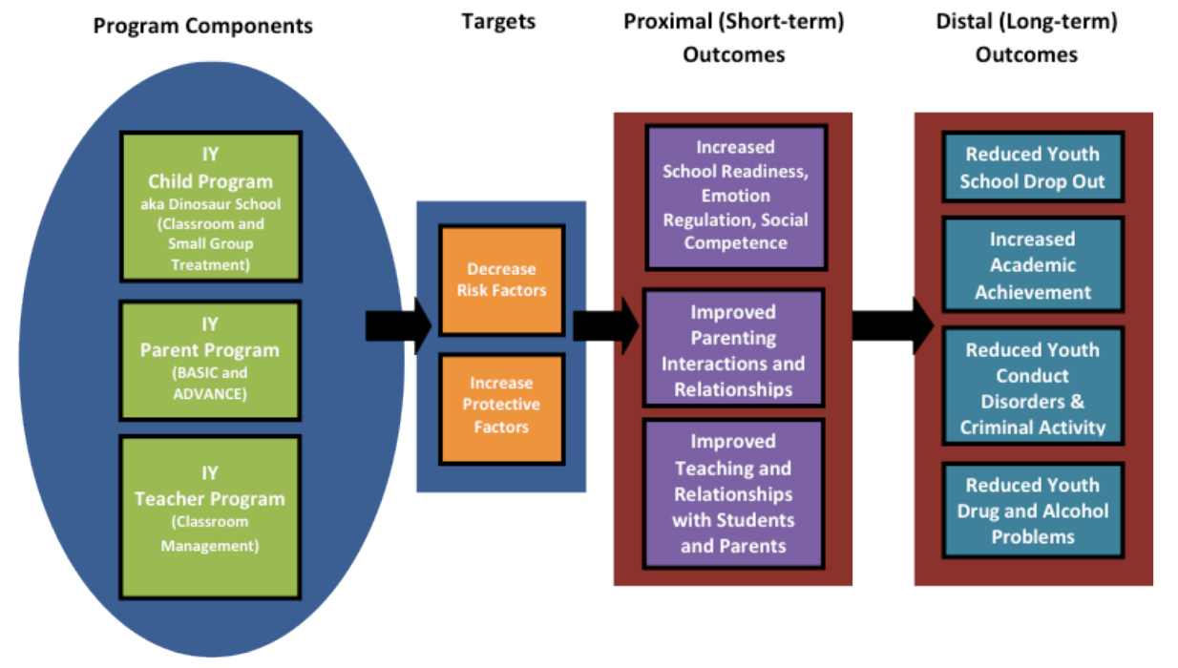
The Incredible Years (Programs for 0-18 y)
https://incredibleyears.com/programs/
Notes:
https://incredibleyears.com/programs/
Not specific for FASD
The Incredible Years® is a series of interlocking, evidence-based programs for parents, children, and teachers, supported by over 30 years of research. The goal is to prevent and treat young children's behavior problems and promote their social, emotional, and academic competence. The programs are used worldwide in schools and mental health centers, and have been shown to work across cultures and socioeconomic groups.

Slide 68
Attachment and Biobehavioral Catch-up (ABC)
6-24 months
Home visiting program
Caregiver intervention to help caregivers nurture infants and toddlers, foster their development, and form strong and healthy relationships
Adapted for telehealth
ABC team provides training for parent coaches.
http://www.abcintervention.org/

Slide 69
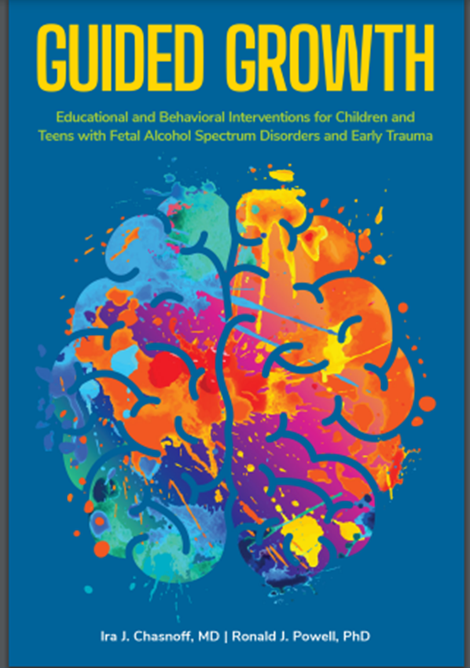
Guided Growth: Educational and Behavioral Interventions for Children and Teens with FASDS and Early Trauma
Interactive training and prerecorded webinars, videos, books
Leadership Institute – technical assistance for creating system of care for families at risk for/affected by prenatal substance exposure
Ntiupstream.com
Notes:
https://pubmed.ncbi.nlm.nih.gov/22251828/

Slide 70

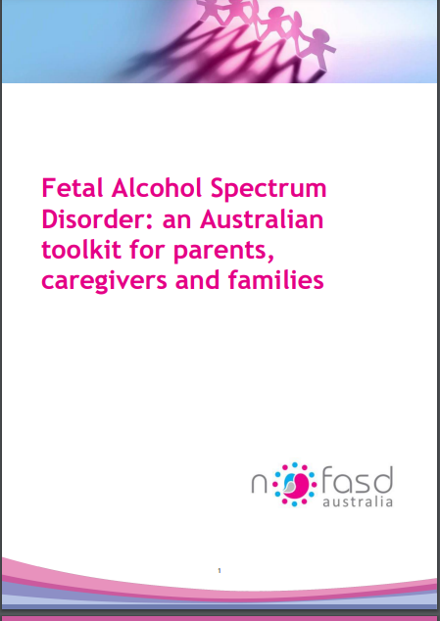
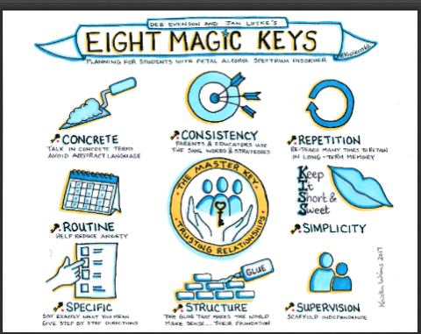
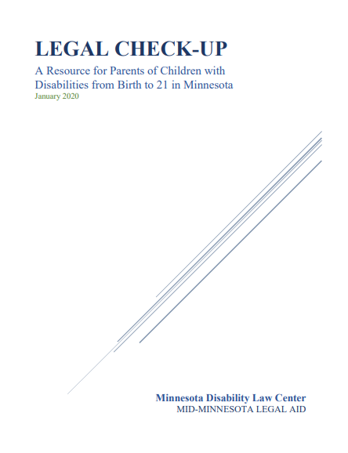
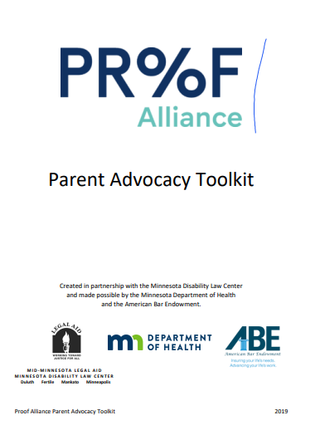
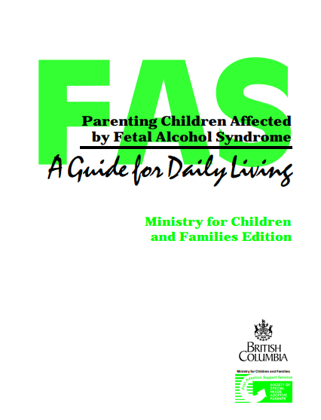
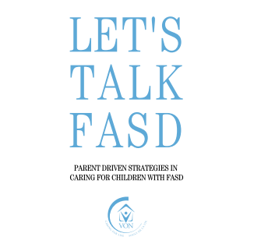
FASD Tools for Parents
Notes:
There are useful tools and resources for parents with a child who has an FASD
Check out FASD United (formerly NoFAS list of resources)
https://nofas.org/parents/
There are also apps which are in the making as well
The list of these tools will also be available on the padlet
http://www.fasdnetwork.org/uploads/9/5/1/1/9511748/all_about_me..pdf
https://www.fasdoutreach.ca/resources/all/0-9/8-magic-keys
https://www.dfps.state.tx.us/Adoption_and_Foster_Care/pdf/fas-2.pdf
https://www.von.ca/sites/default/files/files/_fasdtool_fullproof_final_1.pdf
https://www.nofasd.org.au/wp-content/uploads/2021/02/NOFASD-Parent-Carer-Toolkit-2021.pdf

Slide 71
Take Home Points
Prenatal alcohol exposure is the most common preventable cause of intellectual disability and behavior disorder
The effects of prenatal alcohol exposure are lifelong
Documentation of prenatal alcohol exposure is often a limitation of in the diagnosis of FASD
There are benefits to making a FASD diagnosis
There are evidence-informed programs to support individuals, families, and providers affected by FASD

Slide 72

FASD Prevention, Resources, and Advocacy
Kendra Gludt, MPH
Director of National Programs

Slide 73


Our mission is to prevent
fetal alcohol spectrum disorders (FASD) and to support all impacted.
Notes:
Exhibit table, copy of slides, you heard Vincent talk about resources from the clinician, I’ll take us to what is happening beyond the clinic setting.

Slide 74
FASD Resources
Identification of FASD:​
Screening ​
Diagnosis
FASD Informed Professionals and Parents
Prevention of Prenatal Alcohol Exposure
Culturally Responsive Programs
Policy Change

Slide 75
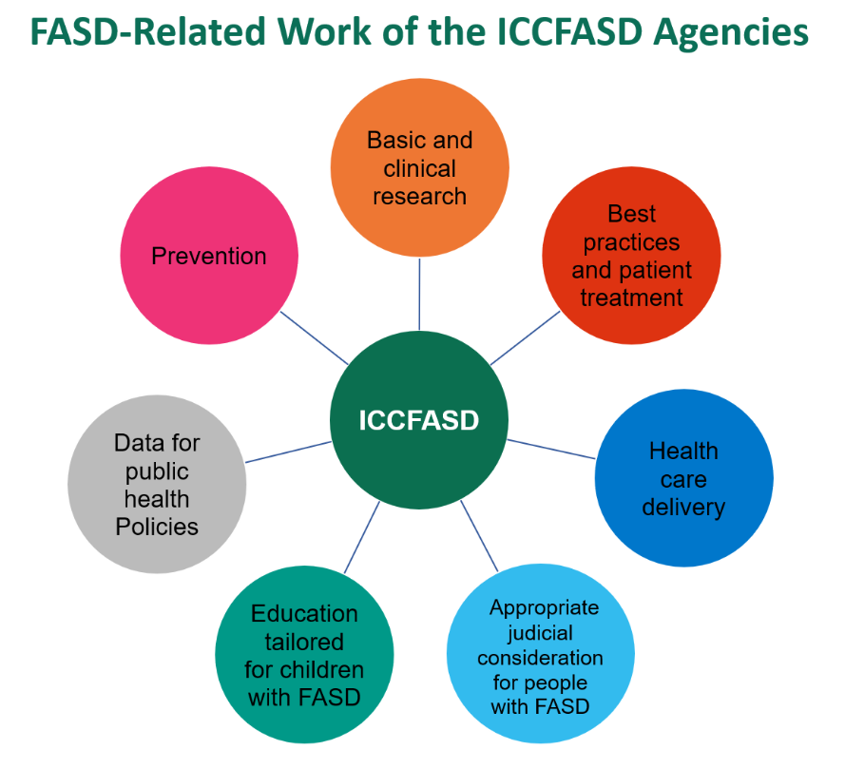
Image
Interagency Coordinating Committee on FASD
CDC Centers for Disease Control and Prevention
IHS Indian Health Service
HRSA Health Resources and Services Administration
NIH National Institutes of Health
ACF Administration for Children & Families
CMS Centers for Medicare & Medicaid Services
DOJ United States Department of Justice
SAMHSA Substance Abuse and Mental Health Services Administration
https://www.niaaa.nih.gov/interagency-coordinating-committee-fetal-alcohol-spectrum-disorders​

Slide 76
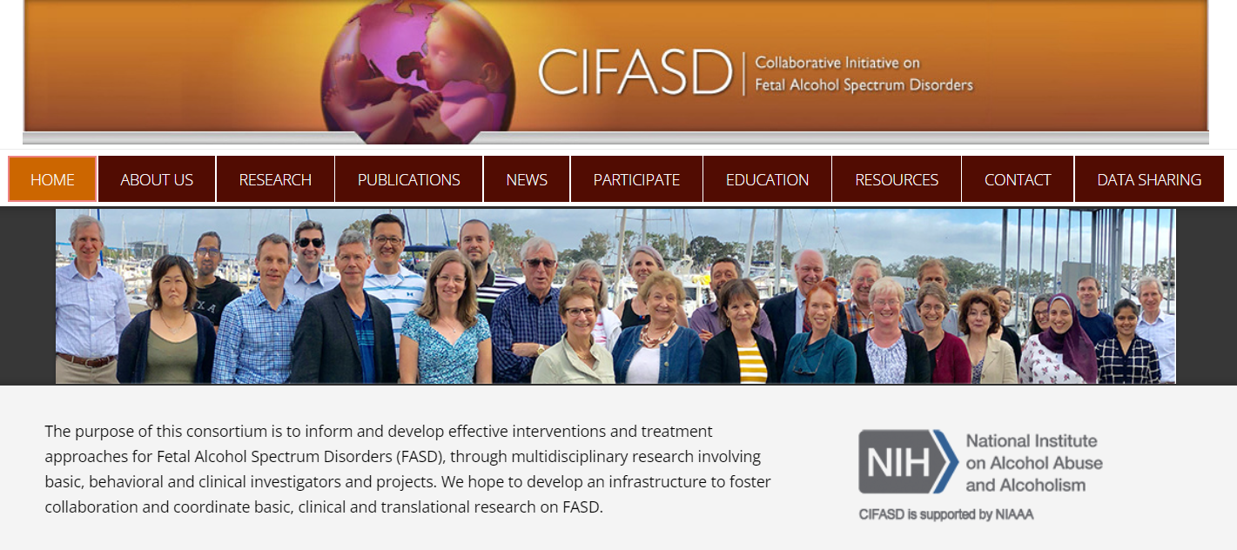
FASD Research: Collaborative Initiative on FASD
cifasd.org​

Slide 77
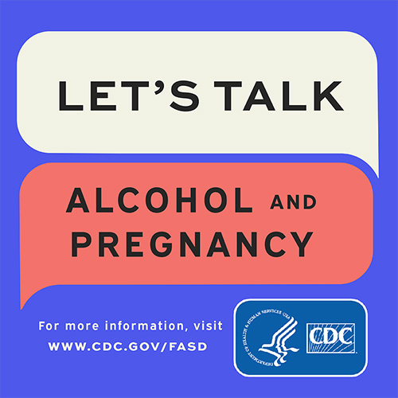
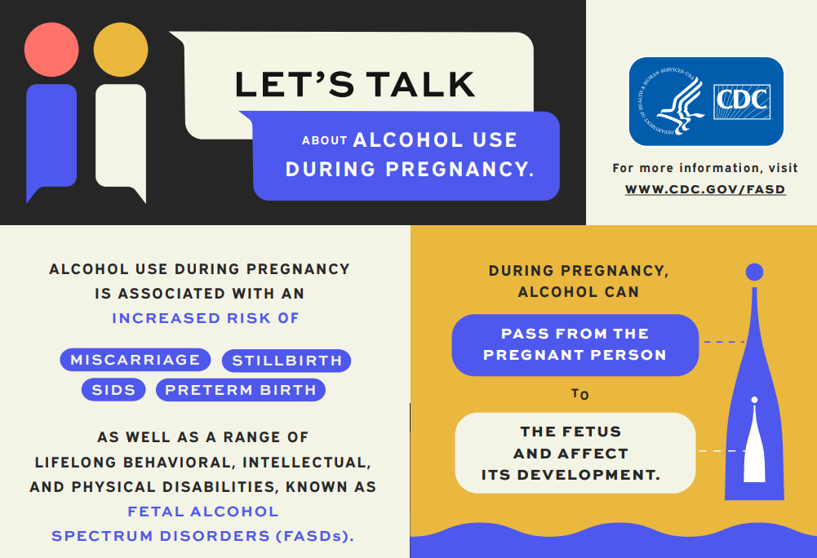
CDC FASD Communication Materials
https://www.cdc.gov/ncbddd/fasd/partners-tools.html

Slide 78
CDC FASD Project: Building FASD Surveillance
Understanding Clinical Data and Pathways to Inform Surveillance of Children with FASD
A feasibility project that will
Characterize information accessible within health-related data systems for children suspected of or diagnosed with FASD.
Describe the referral, evaluation, and diagnosis processes.
Findings will be used to inform the development of future public health surveillance activities.
Recipients:
Emory University
Minnesota Department of Health and Proof Alliance
Period of Performance: 9/1/2022 – 8/31/2025
https://www.cdc.gov/ncbddd/fasd/partnerships.html

Slide 79
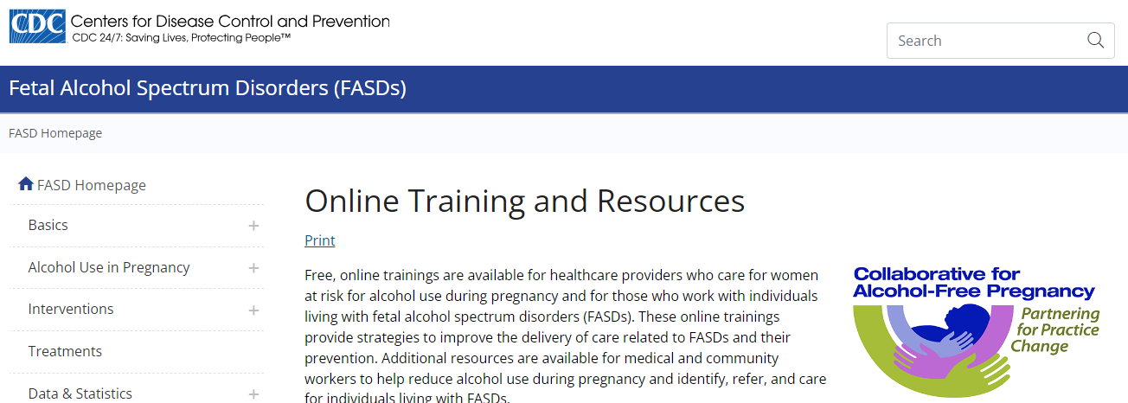
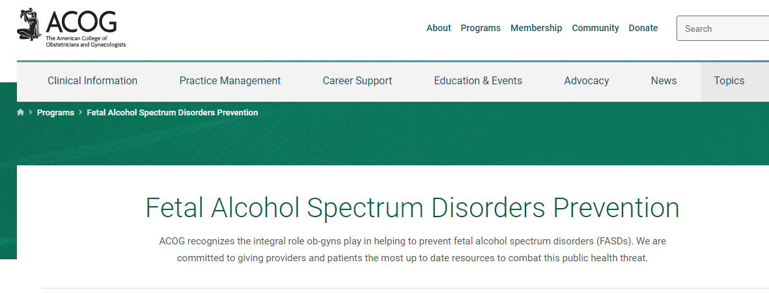
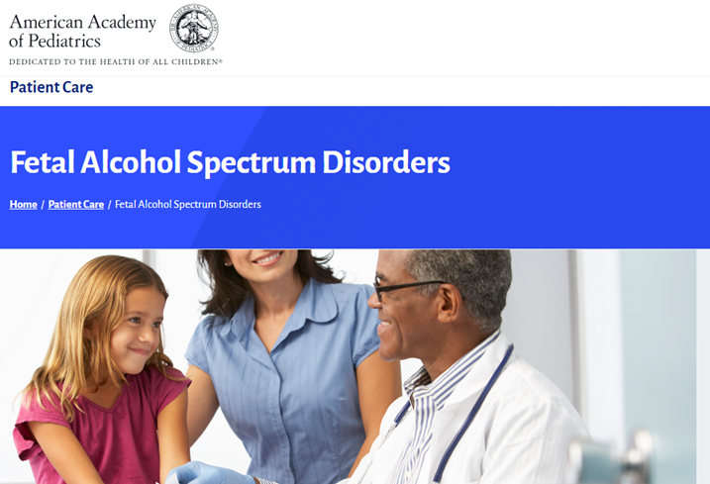


Online Training and Resources for Medical Professionals
Collaborative for Alcohol-Free Pregnancy
ACOG FASD Champions
www.acog.org/programs/fasd
www.cdc.gov/ncbddd/fasd/searchable-training/index.html
AAP FASD Toolkit and Resources
B-SMART Podcast on FASD
www.aap.org/en/patient-care/fetal-alcohol-spectrum-disorders/
www.bmc.org/addiction/training-education/b-smart

Slide 80



safestchoice.org
Prevent FASD and care for children affected by it
HRSA funded virtual ECHO® sessions for pediatric and prenatal practices, 2020-2024.
Collaboration between Proof Alliance and Boston Medical Center.
Teaches healthcare teams how to screen for prenatal alcohol exposure, counsel on FASD, and care for patients impacted by FASD.
Free Continuing Education Credits.
Since it started three years ago, 57 clinic practices participated across 15 states.
Currently recruiting for prenatal practices to enroll, starts in February 2024.

Slide 81

Trainings available for:
Caregivers and foster caregivers
Social service providers
Medical professionals
Substance use treatment providers
People in treatment for substance use disorders
Justice and corrections professionals
Educators, paraprofessionals, after-school programs
Middle/ high school students
College students
General Population
Proof Alliance Online Training
learn.proofalliance.org

Slide 82

Creative FASD Prevention: Being in Unexpected Places
Not just pregnancy related spaces, not just women​.
    Liquor stores​
    College campuses​
    Beer tasting events​
    Special Olympics​
    Pride festival
Going where people are getting their information.
    Social media
    Influencers

Slide 83





Slide 84

Social Media Campaign:
Pregnancyalcoholcalculator.org
Drinkingwhilepregnant.org
Fasdproof.org

Slide 85


Proof Alliance FASD Communication Materials
https://www.proofalliance.org/article/fact-sheets-and-strategy-guides/

Slide 86


https://store.samhsa.gov/sites/default/files/d7/priv/sma13-4803.pdf

Slide 87

Support for Families, Youth, and Caregivers
Support groups
Retreats
Social events
Life skills
Advocacy
Caregiver conference
Online support spaces
Panel presentations
Podcasts
Resource navigation

Slide 88





Proof Alliance Family Support
Visit Events Calendar: proofalliance.org/events

Slide 89


FASD United Affiliate Network
fasdunited.org
recoveringmothers.org

Slide 90


Slide 91


Mandated Reporting: Alcohol Use During Pregnancy
Policy changes are happening all the time and vary from state to state.
Conclusions: "Most policies targeting alcohol use during pregnancy do not appear to be associated with less alcohol consumption during pregnancy."
2015
https://projects.propublica.org/graphics/maternity-drug-policies-by-state

Slide 92

National Policy Advocacy: FASD RESPECT ACT
The FASD Respect Act (H.R. 3946/S.1800) is legislation addressing FASD on a national level.
Bi-partisan legislation:
Co-sponsored in the Senate by Senator Amy Klobuchar (D-Minnesota) and Senator Lisa Murkowski (R-Alaska)
Co-sponsored in the House of Representatives by Representative Betty McCollum (D-Minnesota, 4th District) and Representative Don Bacon (R-Nebraska, 2nd)
https://nofaspolicycenter.org/the-fasd-respect-act/

Slide 93
National Policy Advocacy: FASD RESPECT ACT
The FASD Respect Act (H.R. 3946/S.1800) would allow the US Department of Health and Human Services to provide:
Funding for education, awareness, and services across community agencies and systems of care for infants to adults
Provide funding to state and tribal systems for FASD services throughout the lifespan
Create Centers for Excellence to guide states and other systems of care in
  Expanding diagnostic capacity
  Public awareness and outreach about FASD
  Training and technical assistance on prevention
  Supports and interventions for people diagnosed with FASD
https://nofaspolicycenter.org/the-fasd-respect-act/

Slide 94
FASD Resources:
Identification of FASD:​
Screening ​
Diagnosis
FASD Informed Professionals and Parents
Prevention of Prenatal Alcohol Exposure
Culturally Responsive Programs
Policy Change
All of these improve when we increase awareness and decrease stigma.

Slide 95
Closing Comments
Susan Terwey, MS

Slide 96
Image
Closing Comments
Biggest regret of my life
Typical? Yes – a lightbulb may be going off for some of you - Clear message, no message, inaccurate message
Biases often based on class and culture
Uncomfortable asking – “don’t want to damage the relationship”
We don’t disclose unless asked – repeatedly
“Make it okay” – your openness may open the door for disclosure
Kids don’t blame their moms, we shouldn’t either.

