Slide 1
Facing Mortality: Understanding Palliative and End-of-Life Care Needs for Patients with Medical Complexity and Substance Use Disorders
AMERSA 2023
November 2, 2023
Authors: Meg Devoe, Eileen Vinton, Priya Srikanth, Anna Geduldig, Andrew Nelson, Todd Korthuis, Brian Chan​
Presenter: Meg Devoe, MD
Notes:
So honored to be able to present here today.

Slide 2
Disclosures
I have nothing to disclose.
The development of and research into the SUMMIT Ambulatory-ICU Team is a collaboration between Central City Concern, CareOregon, and Oregon Health & Science University (OHSU).
Notes:
Presenting quality work within an ongoing clinical intervention that was studied in a waitlist randomized control trial.

Slide 3
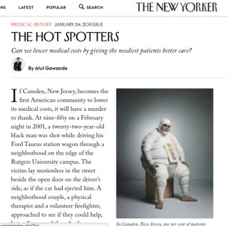
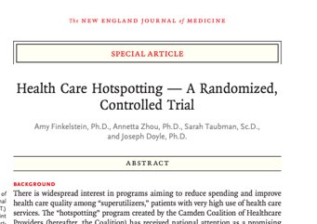
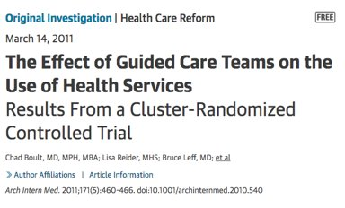
Background
Ambulatory-ICUs (A-ICUs) and Intensive Primary Care programs are often implemented with the goal of reducing utilization and cost for "high-needs high-cost" patients
These patients are at risk of poor health outcomes despite high healthcare utilization
Notes:
Ambulatory ICUs and Intensive Primary Care Programs are often implemented with the goal of reducing utilization and cost. These patients are at risk of poor health outcomes despite high healthcare utilization.

Slide 4
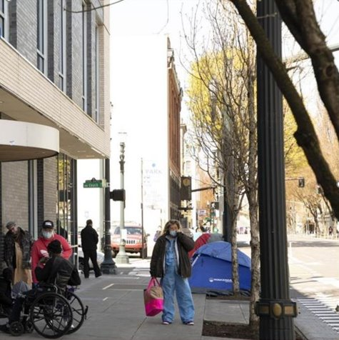
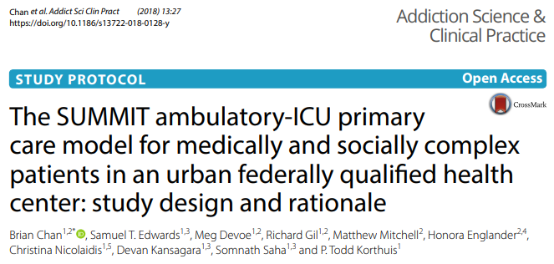
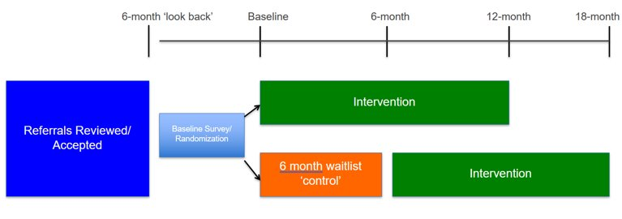
Background: SUMMIT A-ICU
Central City Concern’s Old Town Clinic
Urban FQHC and Healthcare for the Homeless Setting in Portland, OR
Serves patients with high rates of houselessness and substance use
Chan et al. 2018
Notes:
In 2015, we recognized that we were increasingly serving a very medically complex patient population within Old Town Clinic, an urban federally qualified health center and healthcare for the homeless setting serving patients with high rates of houselessness and substance use. We developed the Summit Ambulatory ICU for medically and socially complex patients and were able to study the intervention using a waitlisted randomized control design.

Slide 5
Background: SUMMIT A-ICU Trial
“Send us the patients who keep you up at night”
At 6 months:
10% mortality in both immediate and waitlist arms of trial
SUMMIT A-ICU patients compared to usual primary care had:
CLINICAL/RESEARCH INCLUSION | RESEARCH EXCLUSION
1+ hospitalization in prior 6 months AND | No hospitalization in prior 6 months
2+ chronic medical conditions OR 1 medical condition + mental health condition OR 1 medical condition + substance use disorder | Metastatic cancer diagnosis
OR 1 medical condition + mental health condition | <6 month prognosis at consent
OR 1 medical condition + substance use disorder | Inability to ”teach back” consent
Increased primary care engagement *
Improved mental health functioning *
Improved patient quality of life *
No change in ED/hospital utilization
Target medical conditions:
CHF, COPD, Cirrhosis, CKD/ESRD, Uncontrolled Diabetes Mellitus, Recurrent Skin/Soft Tissue Infections
Chan et al.
Publication forthcoming
Notes:
Briefly, we asked PCPs to send us "the patients who keep them up at night". You can see the chronic medical conditions we targeted. While we tried to exclude patients with limited prognosis, we found that there was a 10% mortality in both the immediate and waitlist arms of the trial. While there was no difference between Summit A-ICU and usual care in terms of the primary outcome of ED/hospital utilization at 6 months, patients who received immediate A-ICU care had significant improvements in secondary outcomes of patient reported quality of life, mental health functioning, and primary care engagement. So, big picture, this was a group of patients with high mortality; they were engaging with the AICU more than with usual care and also having some measurable health improvements.

Slide 6
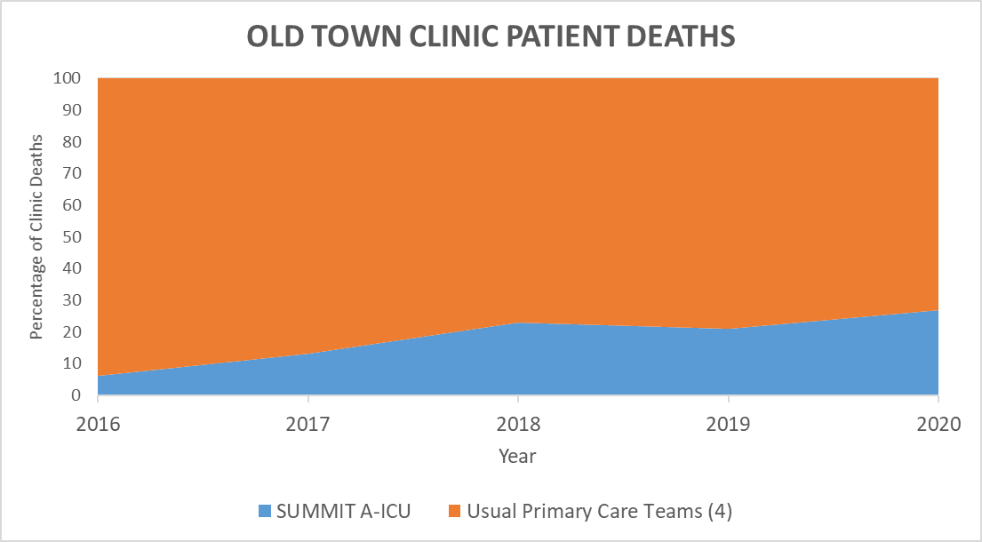
Background: SUMMIT A-ICU Team
Mortality Differences
Data from Old Town Clinic Annual Remembrance Ceremony, 2016-2020
Notes:
I want to emphasize the high mortality experienced by patients referred to the Summit A-ICU. Each year, our clinic has a remembrance ceremony, and you can see that despite caring for less than 5% of the patients at Old Town Clinic, the Summit AICU was experiencing up to 25% of the patient deaths within the clinic. In many ways, the SUMMIT A-ICU had become a defacto palliative care team within our clinic.

Slide 7
Background: Palliative & End-of-Life Care
People with substance use disorders and housing instability:
Experience increased mortality​
Are at higher risk for chronic illness or life-threatening conditions​
Often experience other psychiatric disorders​
Can experience multiple problems in several life-domains​
No clear funding or pathways for people with SUDs+ to access palliative care
Racial disparities extend to mortality from SUDs, high quality care for serious illness and access to end-of-life care
People with SUDs and serious illness (SUDs+) may have unique palliative needs
Ebenau et al. 2019
Jones C et al. 2020
Jones T et al. 2021
Notes:
People with substance use disorders, housing instability and serious illness (SUDs+) may have unique palliative needs.
There aren't clear pathways for accessing palliative care or finanical resources for people with SUDs+
AND
We know disparities extend to mortality from SUDs and access to high quailty care for serious illness and end-of-life care.

Slide 8
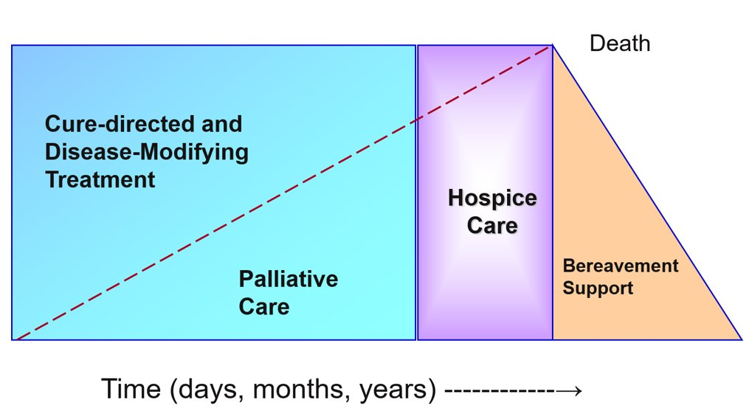
Objective
Concurrent/integrative model of palliative care
Does this model apply to patients with SUDs+?
National Quality Forum Report 2006
Notes:
So with that in mind, we wanted to learn more about the deaths of patients cared for in the Summit AICU, this defacto palliative care team. This is the classic integrative model of palliative care with cure-directive/disease-modifying treatment that we think of for any chronic illness like cancer or heart failure and we wondered, "Does this model apply to patients with SUDs+?"

Slide 9
Objective
Conduct a formative evaluation of SUMMIT A-ICU patients who died
Explore how the SUMMIT A-ICU Team evolved its approach to palliative and end-of-life care for patients with SUDs+
SUMMIT Team Rose Ritual
Portland, OR
Notes:
To that end, we conducted a formative evaluation of patients who died and explored how Summit AICU evolved its approach to palliative and end-of-life care.
I'll just share this photo on the right reflects a ritual the team has developed - they display a unique rose for each patient who died and build time into their weekly meeting to reflect on that person's life and care. They then display the dried roses and when the team feels its necessary, they gather at the river to scatter the rose petals in honor of their patients.

Slide 10
Methods
Retrospective chart review of all patients enrolled in care with SUMMIT A-ICU who died
Age at time of death
Median time to death
Race/ethnicity
Types of substance use
Housing status at enrollment
Location of patient deaths (eg. community, hospice, hospital)
SUMMIT Team Rose Ritual
Portland, OR
Notes:
In terms of methods, we conducted a retrospective chart review of all Summit AICU patient who have died since 2016.

Slide 11
Methods
An investigator not part of the team recorded observations, used ethnography, and interviewed SUMMIT team members to obtain contextual stories about palliative and end-of-life care for SUMMIT patients
SUMMIT Team Memorial Service
Portland, OR Willamette River
Notes:
Additionally, we recorded observations, used ethnography and interviewed team members to obtain contextual stories about palliative and EOL care for Summit patients.

Slide 12
Results: SUMMIT Analysis of Patient Deaths
Since 2016 57% (n=164/288) of SUMMIT patients have died
Median age at time of death was 59 years (equal to average age)
Median # months with SUMMIT before death 23 months
(average 26 months)
Data from retrospective chart review, 2016-ongoing
Notes:
I'm going to try to run through these results quickly given the time, but you can see the median age at time of death was 59 and median time patients were enrolled on the team before death was just under 2 years.

Slide 13
Results: SUMMIT Analysis of Patient Deaths
RACE/ETHNICITY | MEDICAID ADULT | SUMMIT A-ICU MEDICAID MEMBERS
White | 50.53% | 52.05%
Black or African American | 5.62% | 13.70%
Hispanic | 13.39% | 4.11%
American Indian or Alaska Native | 1.47% | 4.11%
Asian or Pacific Islander | 5.90% | 1.37%
Unknown | 20.28% | 24.66%
SUMMIT A-ICU ALL DECEDENTS
73%
15%
7%
2%
<1%
2%
Note: Undocumented immigrants not eligible for OR Medicaid 2021-2022
Data from CareOregon Medicaid, 2021-2022
Data from retrospective chart review, 2016-ongoing
Notes:
I will caution that it was difficult to gather good demographic data from chart review on all SUMMIT patients going back to 2016 given our tracking systems, so we have 2 different data sets here. Something you probably don’t want to do in a crowd like this, but here it goes.
On the left, we have Medicaid data and you can see that compared to the adult Medicaid population in Portland, people identifying as black/AA and Native American are disproportionately represented in the SUMMIT A-ICU team likely reflecting racial disparities in serious illness care. While this data seems to show we have lower enrollment rates of people of hispanic or latin-x backgrounds, this should be interpreted with caution as undocumented folks weren't eligible for Medicaid in OR until earlier this year.
And finally, its not apples to apples, but you can see the demographics of SUMMIT decedents on the right.

Slide 14
Results: SUMMIT Analysis of Patient Deaths
n = 164
Data from retrospective chart review, 2016-ongoing
Notes:
In terms of substance use, most Summit patients had multiple substance use disorder diagnoses and about a third of our patients were unhoused on enrollment. What this data doesn't capture is the dynamic reality of substance use being active or in remission and housing instability in this patient population.

Slide 15
Results: SUMMIT Analysis of Patient Deaths
30% patients found dead (unsupported death)
In hospital deaths often reflect high care needs
n = 164
Data from retrospective chart review, 2016-ongoing
Notes:
About 30% of SUMMIT AICU patients experienced an unsupported death – or found dead in the community. Some of these were probably overdoses but not all of them. The most common place our patients died was in the hospital with about 2/3 of patients receiving comfort measures in the hospital.

Slide 16
Results: SUMMIT Team Member Perspectives
Palliative and end-of-life scenarios for patients with SUDs+
Tension between self-determination and “systems of neglect”
Life-limiting illness is not addiction;
Substance use contributes to complexity
Life-limiting illness is addiction;
Harm reduction may be palliative and life-prolonging
Notes:
Summit AICU Team members highlighted some palliative and end-of-life scenarios that helped them prioritize needs.
There was an over-arching theme of this tension between self-determination and "systems of neglect".
So for example, the team shared examples where patients goals were aligned with less aggressive medical approaches or hospice, but they weren't able to access home hospice supports given concerns around lack of caregivers and safety concerns with providing services within low barrier housing buildings where there may be public drug consumption.

Slide 17
Results: SUMMIT Team Member Perspectives
Premature Death in SUDs +
Social determinants affect prognosis and life span
May encounter patient with “end stage” social determinants of health
Notes:
Something that continued to come up was that social determinants affect prognosis and life span and so while the team is always trying to balance good symptom management and harm reduction with disease modifying treatment, they just may not be able to get their arms around all the issues. They even felt like they were sometimes encountering patients with “end stage” social determinants of health.

Slide 18
Results: SUMMIT Team Member Perspectives
Key features of multi-disciplinary teams to improve quality of life and health outcomes for people with SUDs, housing instability and serious illness
~150 patients
Care Coordinator
Provider
Social Worker
Complex Care Nurse
Pharmacist
Health Coordinator
Team Manager
High Dose of Supportive relationships
Consistency & Non-abandonment
Iterative goals of care conversations
Advocacy to address discriminatory care
Supportive structures for high-risk prescribing
Intensive housing supports
Assertive outreach/care management
Harm Reduction
Notes:
I want to stress the team’s recognition that for so many of our patients, the bio-medical model of health care is a negative social determinant for our patients and this team works because its is a SOCIAL intervention first and foremost. I won’t list all of the features they identified but things that might be interesting for this group is supportive structures for high risk prescribing and thinking about goals of care conversations as iterative to help integrate a patient’s values/life experience into advanced care planning.

Slide 19
Limitations
Experience of a single A-ICU
Data on outcomes by race/ethnicity was limited
No comparison to palliative and end-of-life care within usual care structures
We did not interview patients with SUDs+ at the end-of-life

Slide 20
Conclusions
Patients with SUDs+ die prematurely and often experience unsupported deaths in the community
A-ICU teams can provide care that improves quality of life for patients with SUDs+
SUMMIT A-ICU team members identified important palliative frameworks and needs for this patient population
Racial/ethnic disparities in high quality palliative care for people with SUDs and serious illness require more study. A-ICU teams can potentially play a role in improving care outcomes.

Slide 21
Questions? devoem@ohsu.edu Meg.Devoe@ccconcern.org

Slide 22
References
Chan et al. The SUMMIT ambulatory-ICU primary care model for medically and socially complex patients in an urban federally qualified health center: study design and rationale. Addiction Science and Clinical Practice; 13(1):27, 2018
Ebenau et al. Palliative care for people with substance use disorder and multiple problems: a qualitative study on experience of patients and proxies. BMC Palliative Care; 18:56, 2019
Christopher M. Jones, Rita K. Noonan, Wilson M. Compton, Prevalence and correlates of ever having a substance use problem and substance use recovery status among adults in the United States, 2018, Drug and Alcohol Dependence, Volume 214, 2020
Jones T et al. Advance Care Planning, Palliative Care, and End-of-Life Care Interventions for Racial and Ethnic Underrepresented Groups: A Systematic Review. Jounal of Pain and Symptom Management. 62(3), 2021
Concurrent/integrative model of palliative care. A National Framework and Preferred Practice for Palliative and Hospice Care Quality: A Consensus Report. Chapter 1. Framework. National Quality Forum. Washington DC, 2006

