Slide 1
NYU Multidisciplinary Addiction Training Program -NYU MAT-
Talia Rosen, Shane Gallagher DNP, Diana Lee MD, Selena Gilles DNP, Dale Maglalang PhD LCSW, Katherine Mullins MD, Kathleen Hanley MD, James Grigg MD, Hiren Bhakta MD, Andrew Chansky MD, Ky Herz LMSW, Joshua Lee MD MSc
11/16/2024
AMERSA - Chicago, IL

Slide 2
Disclosures
Joshua D Lee MD MSc:
In-kind study drug for NIH/NIDA trials: Indivior, Alkermes
Science Advisor: Oar Health (oarhealth.com)
Talia Rosen
None

Slide 3
Introduction + Aims
Addiction workforce recruitment and retention is lacking and is a health service public priority (HRSA, Behavioral Health Workforce, 2023)
Models full-time addiction training programs of RN, NP and PAs (UBC, MGH, Yale, BMC)
Multidisciplinary addiction medical education may:
Reflect real-world, collaborative practice
Foster learning from other disciplines
Encourage co-solving complex patient problems through diverse perspectives
Project Aim: To implement and evaluate the feasibility of a multidisciplinary addiction training and career development program for non-physician health professionals, with the goal of increasing the addiction workforce and improving patient outcomes
Long-term: Does a multidisciplinary addiction medicine training program lead to sustained, addiction-focused careers?

Slide 4
Methods: Program Characteristics
Sponsor: NYS Office of Addiction Supports and Services (OASAS) funding to SOMs Timeline: 1-year program x2 years, 2023-2025 Personnel: 2 cohorts of allied health Scholars & licensed Fellows
Cohort 1: 15 students, 3 Fellows + 3 current Addiction Med Physician Fellows
Cohort 2: 20 students, 3 Fellows + 3 AMF MD’s
Stipends: $10k/student; full-time Fellow benefits
Key Disciplines: Nursing, Social Work, Psychology, Occupational Therapy, CASACs, CRPAs, Mental Health Counseling
Partner Schools: NYU, Columbia, Hunter, City College, Mercy University
Faculty: NYUGSOM, NYU Rory Nursing, NYU Silver SW, NYU OT
Recruitment Strategy: Targeted outreach via email, faculty, student engagement

Slide 5
Methods: MAT Fellows 1-year clerkship in addiction medicine
Recruitment of which professionals?
Disciplines of interest: Nursing, Social Work, Psychology, Occupational Therapy, CRPA, Mental Health Counseling, CASACs
Rotations and blocks, vs. longitudinal placements?
Can we adapt an ACGME Addiction Medicine Fellowship Model? Answer: NO!
Different roles and licenses - They can’t all do the same rotations -
Creating 3 different fellowships for PNPs, LMSWs, CRPA
Outpatient vs. inpatient experiences
ED and street medicine
Smaller vs. larger NGOs for placements and supervision

Slide 6
Methods: MAT Curriculum for Scholars and Fellows
Sample Monthly Learner Schedule
Notes:
Our 6 MAT fellows are participating in and co-leading a curriculum with our 35 part-time scholars
-They are in the lectures, doing the readings, but also leading journal clubs, and developing and leading workshops
9 month 'addiction 101' curriculum - Collaboratively developed and taught by NYU Schools of Medicine, Social Work and Nursing -Curriculum by an interprofessional group and for an interprofessional group
Curriculum Sources: ACAAM, ASAM, Interprofessional Education Collaborative (IPEC), SAMSHA, NYU Team expertise and research
I’ll use a sample schedule to discuss each curriculum component
The first 2 weeks are virtual lectures from faculty members and guest speakers
The 3rd week is small-group virtual journal club facilitated by our fellows on articles related to the unit
Interprofessional lecture every month - ensure every learner discipline has teacher representation
Each scholar is required to volunteer every month at an addiction field- related community organization
We have in person workshops to give them practical skills - MI, SMART Recovery
Monthly Multidisciplinary meetups- networking opportunities with organizations on next slide

Slide 7
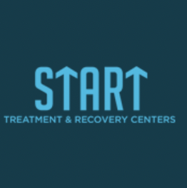
Community Engagement: NYC Addiction Providers and Harm Reduction Agencies
Notes:
-These are the organizations in NY that we have partnered with.
We have fellows rotating full-time at some of them, scholars volunteering part-time,
and for others, we’ve just included them in our events and had them speak to our learners about what they do and job opportunities

Slide 8
Data Collection: Baseline and Monthly Data Gathering
Recruitment (Applications, interviews, finalists)
Baseline Demographics
Pre-assessment
Attitude/confidence re: addiction medicine and re: interprofessionalism
20 likert items
2 short answer career/SMART Goal
Monthly Journals
8 prompts (satisfaction, logistics, SMART goals)
Free-text responses
Simulated Interactive Modules (SIM) / Interprofessional Collaborative Competencies Attainment Survey (ICCAS) Pre/Post assessment
Interprofessional confidence/attitude
20 likert scale questions
Notes:
-Collecting standard data as we go along
-Our recruitment data- everyone that applied
-Demographics of our learners
Pre-assessment- not knowledge based, assessing attitudes and confidence in addiction medicine and interprofessionalism, gave them the opportunity to set SMART Goals that they can track throughout the program
-Monthly journal entries used for continuous program improvement
-We do an interprofessional opioid simulation at NYU Rory School of nursing and use the pre and post ICCAS tool

Slide 9
Results: Recruitment, Demographics
Category | Positions | Applications | Interviews | Job Offers | Declines
Full-Time Fellows | 3 NPs, 2 LMSWs, 1 CRPA | 35 applications | 15 interviews | 6 job offers | 0 declines
Scholars (Cohort 1 + 2) | MSW, OT, RN, NP, Psych PhD, other allied health students | 400+ applications | 60 interviews | 35 offers | 0 declines
Notes:
Significant recruitment result- 400+ applicants- showing strong interest and need for addiction education for allied health students and professionals
Diversity prioritized in recruitment - sought out candidates passionate about working with underserved and vulnerable communities
OASAS had a priority to hire bilingual learners, to add more bilingual professionals in the addiction workforce- so we also looked for that in our candidates

Slide 10
Results: Baseline, Simulation, and Qualitative Data
Pre-Program Survey Results:
“Learning about AUD helped me expand my view on addiction and my tools to use. Also, working at the volunteer site has allowed me to interact directly with the NYC community.”
Knowledge in Addiction Medicine: | 61.1% neutral or disagree about having ample knowledge.
Explaining Treatment Options: | 42.8% lack confidence
“NYU MAT is an incredible program. The multidisciplinary meet up was unlike any event I've ever been to. Keep up the great work!”
“Engaging with the patient in the simulation and working with the interdisciplinary team helped me to feel more comfortable in this setting and learn more from my peers in the program.”
Clinical Simulation Results:
Notes:
Pre Survey results predictably showed general lack of knowledge in addiction medicine and lack of experience and confidence in interprofessionalism
We don't have post data yet, since our first cohorts are still active
Clinical Simulation- Results show improvement in interprofessional competencies across the board
-most notably- strongly agree increased for confidence in promoting effective communication from 0 to 72.7%
Qualitative feedback used for program improvement from their monthly journals. This highlights the importance of each component of our program and how they interact

Slide 11
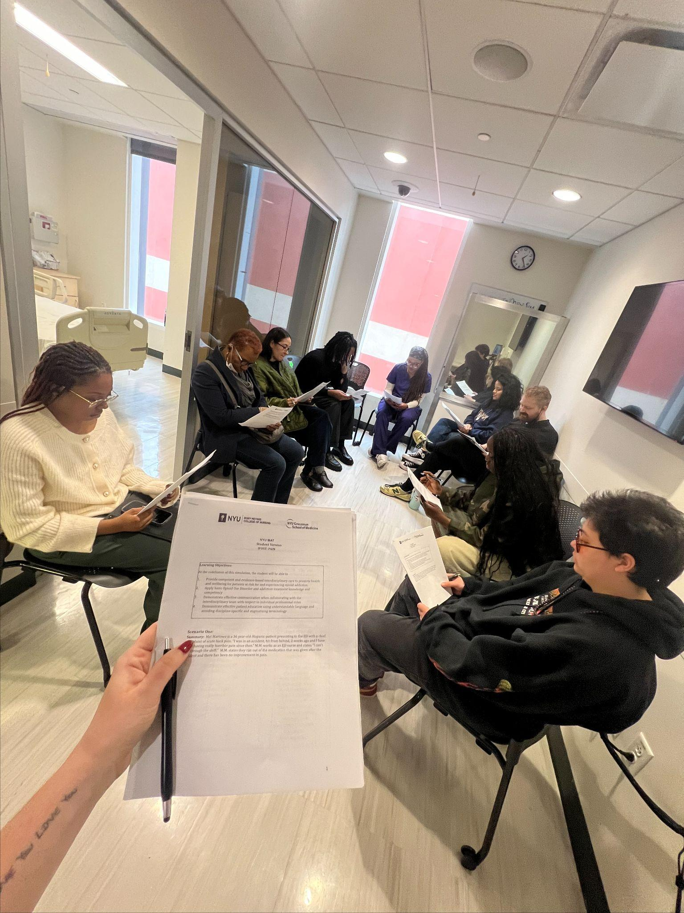
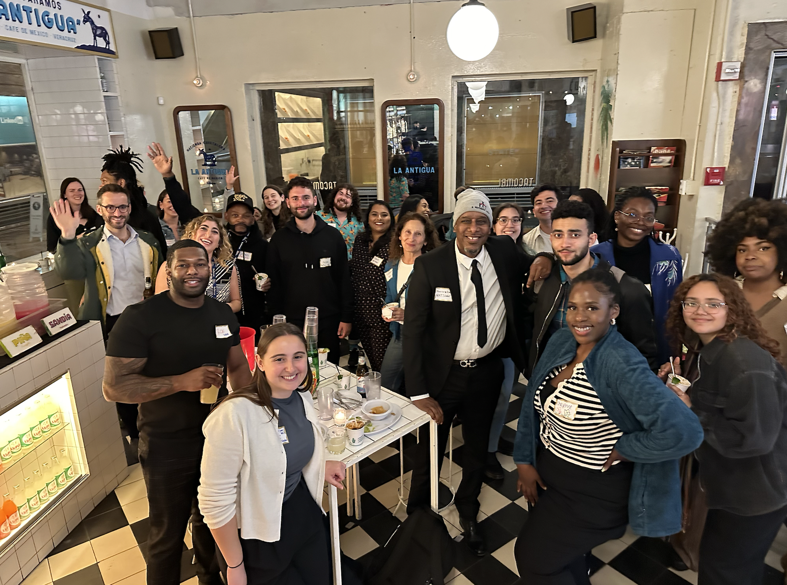
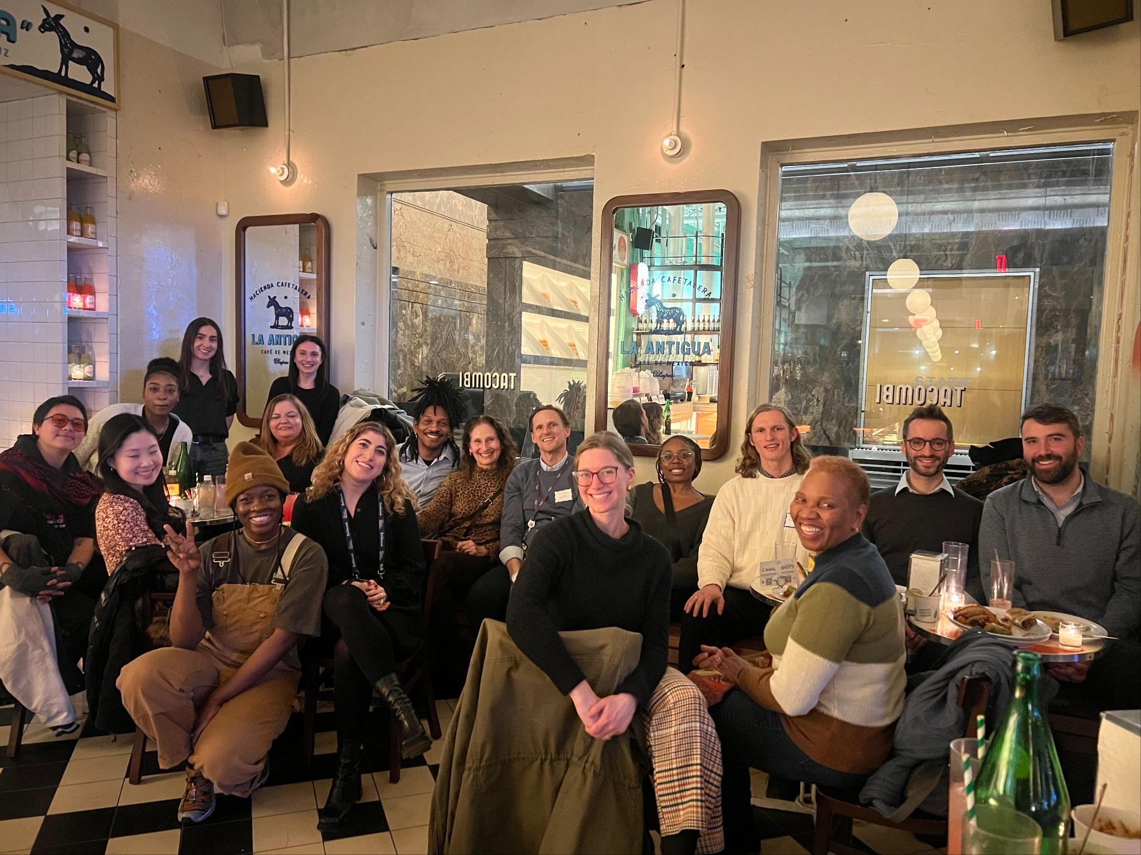
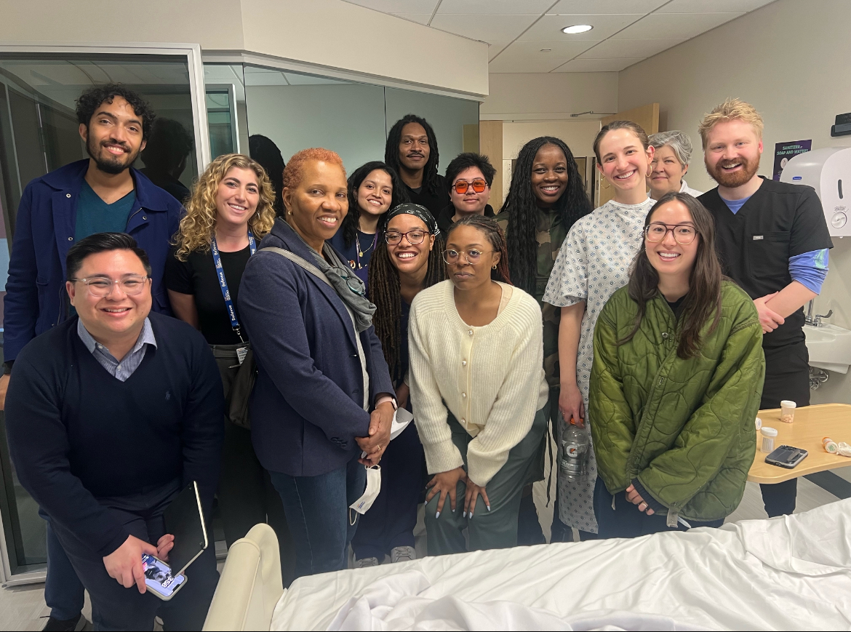
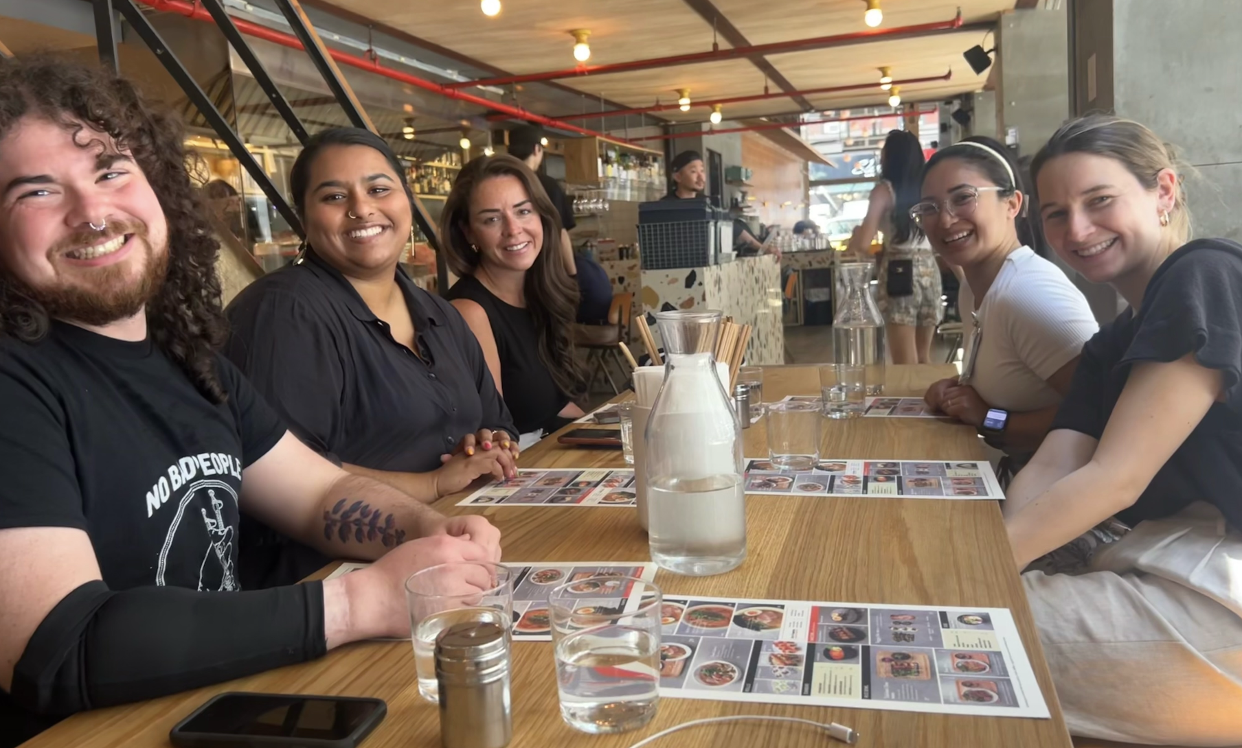
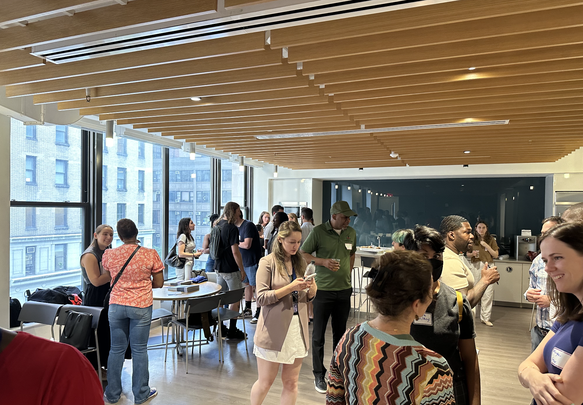
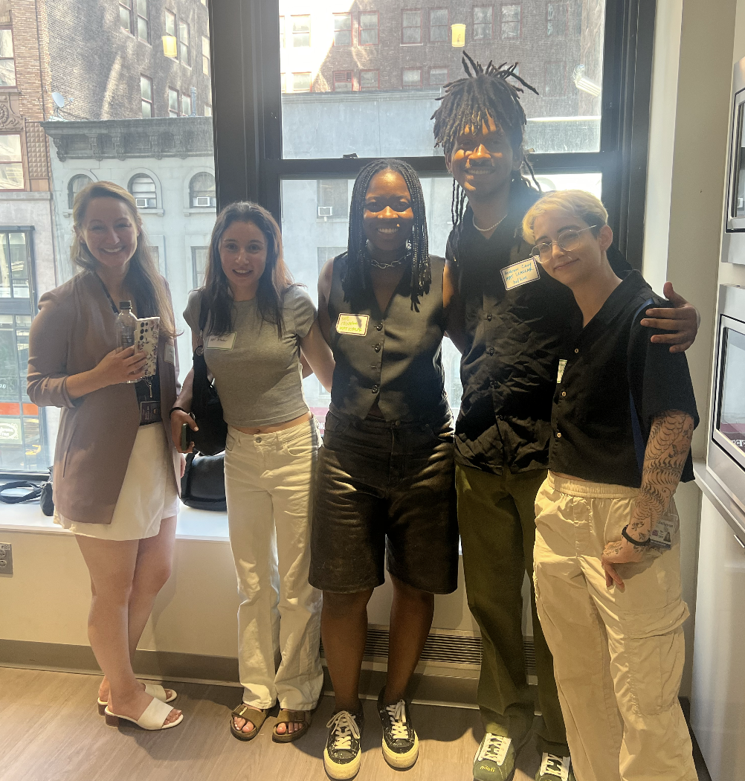
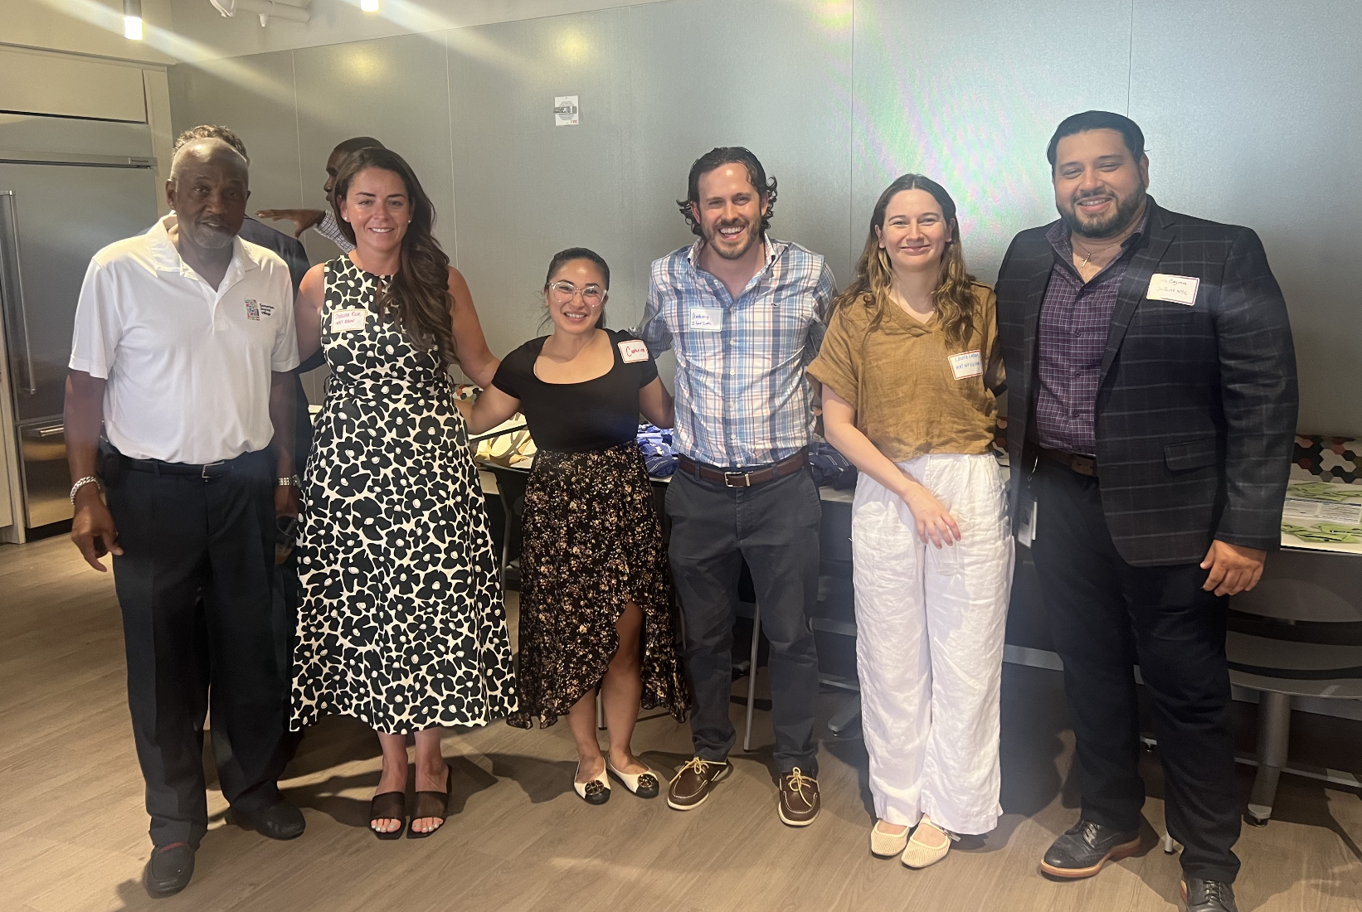
Results: Photos from Workshops, Simulations, Meetups
Monthly Multidisciplinary Meetup!!

Slide 12
Conclusion
Limitations and Lessons Learned - MAT Fellowship
Integrating non-MDs into SOM rotations is challenging.
Importance of early and consistent diplomacy with HR/leadership.
Successes:
Recruited 41 MAT learners (35 Scholars, 6 Fellows).
Developed and taught interprofessional addiction curriculum.
Built partnerships with NYC academic and community organizations.
Enhanced interprofessional competence and confidence
Future Directions:
National expansion to underserved students and communities.
Increased focus on community involvement and advocacy.
Pursue support for Year 3 and beyond.
Notes:
-Building a non physician fellowship within a school of medicine is tricky and requires collaboration with leadership, flexibility, and a lot of time and patience
-The traditional addiction medicine physician fellowship model needs to be adjusted to fit the discipline
Successes!
-We currently have 41 MAT Learners training with us
-We developed and are teaching a hybrid addiction curriculum - that we hope to publish someday
-We’ve built meaningful partnership with NYC academic and community organizations
-Our results show enhanced competence and confidence in interprofessionalism and treating addiction medicine
In the future- we want to expand nationally, bring this to areas in high need, filling the education gaps in underserved communities that have even more severe addiction workforce development needs
-We’ll increase our focus on community engagement and continuous advocacy throughout the program
-As our current OASAS funding it time-limited, we’re actively pursuing support for the future and to make this program sustainable

Slide 13
Thank you
joshua.lee@nyulangone.org @DrJoshuaDLee
talia.rosen@nyulangone.org

