Slide 1
Feasibility of an inpatient split-dose rapid methadone induction protocol for pregnant individuals.
DATE: Nov 14, 2024 PRESENTED BY: Erin Nacev MD MPH, OBGYN Resident PGY-4, Kristin Prewitt, MD MPH, MFM Fellow PGY-8????

Slide 2
Background
Opioid use disorder (OUD) is associated with adverse perinatal outcomes
Medication for OUD (MOUD) is critical
Limited data exists on rapid methadone induction for pregnant patients
Pregnant individuals may benefit from split dosing
2
Notes:
Opioid use disorder is associated with adverse perinatal outcomes, including low birth weight and preterm birth.
Medication for OUD or MOUD can mitigate these adverse outcomes and is critical for patients. Pregnancy is also a critical touchpoint during which patients can be engaged in treatment.
Pregnancy is also time limited! Limited data exists on rapid methadone induction for pregnant patients, but speed at which patients are stabilized is particularly critical for this population.
Additionally, due to physiologic changes of pregnancy and increased metabolism, pregnant patients may benefit from split dosing of methadone.

Slide 3
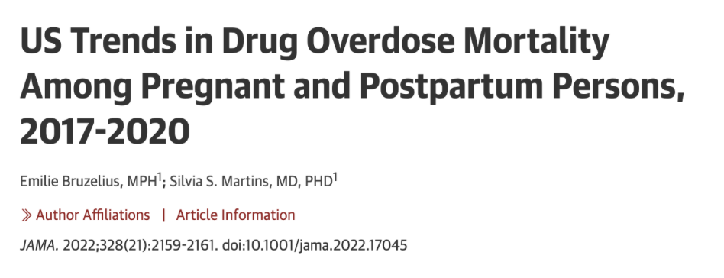
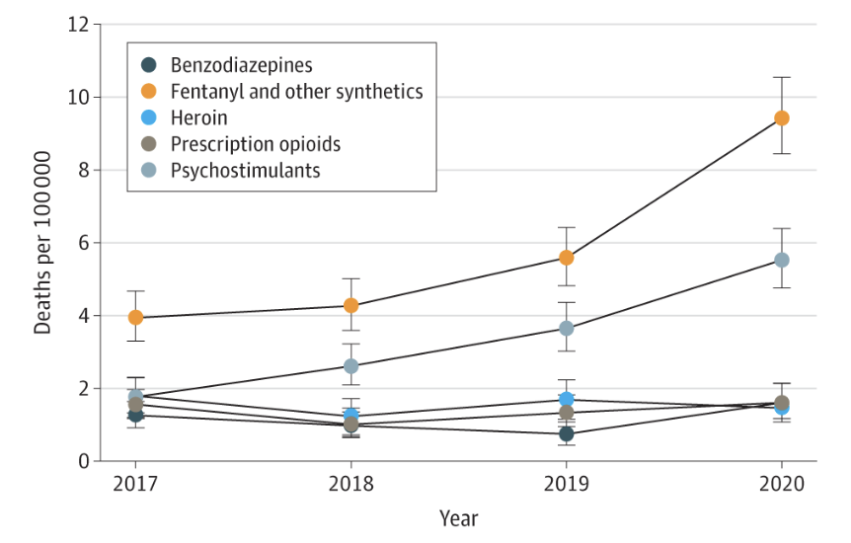
OUD in Pregnancy
More than 16% of pregnancy-associated deaths are overdose related
Fatal overdose from fentanyl + other synthetics increased 81%
Notes:
More than 16% of pregnancy-associated deaths are overdose related
Fatal OD from fentanyl + other synthetics increased 81%
Fatal OD most common in postpartum period

Slide 4
OUD in Pregnancy
Fatal overdose most common in the postpartum period
Notes:
This graph is from the same study and shows the timing relative to pregnancy of overdose deaths. The black line shows overdose deaths during pregnancy, the orange line shows deaths in the early postpartum period (0 to 60 days) and the blue line shows deaths in the late postpartum period (from 60 days through 1 year).
As you can see in the graph, deaths in the late postpartum period were the most common.

Slide 5
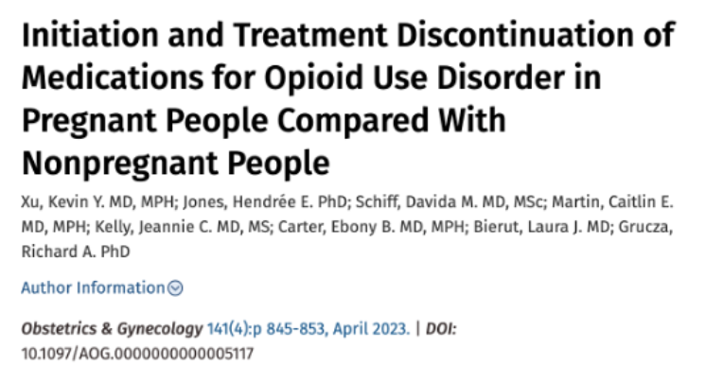
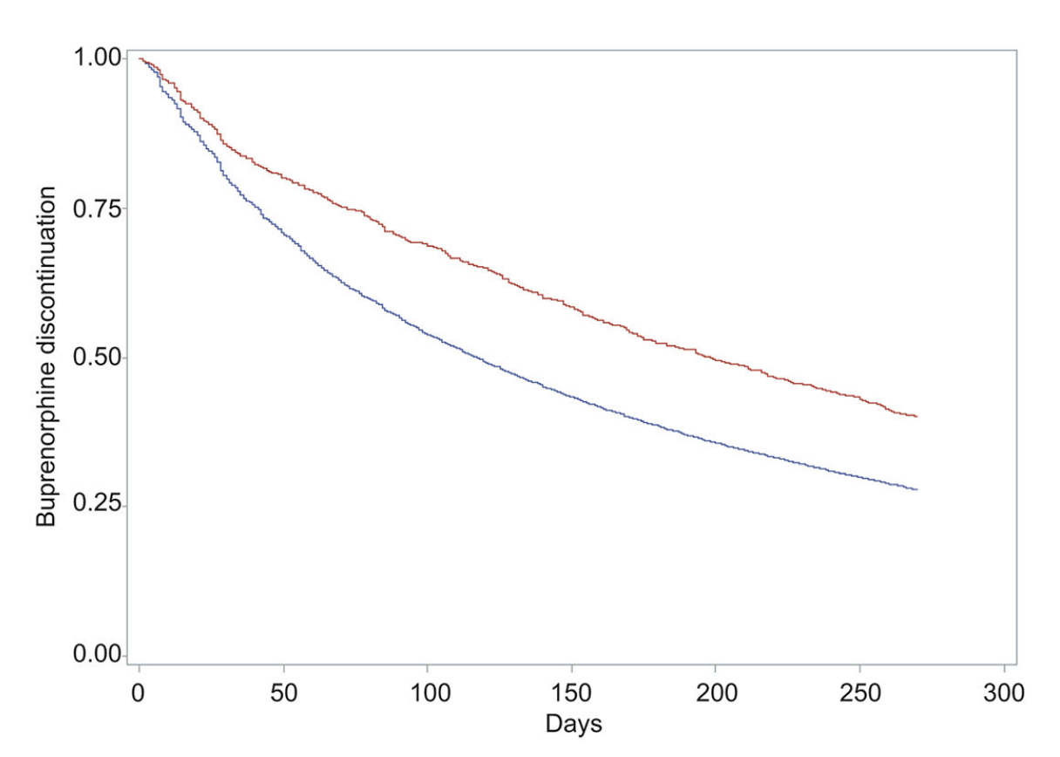
OUD in Pregnancy
Pregnant
Non-pregnant
Pregnant individuals 2x as likely to initiate methadone in adjusted models

Slide 6
Rapid methadone induction
Hospitalization allows for close monitoring and more rapid up-titration
Traditional inpatient methadone initiation protocols do not exceed 40 mg on day 1, 50 mg on day 2, and 60 mg on days 3–6
More rapid induction seems to be safe and feasible for appropriately selected patients
6
Notes:
Rapid inpatient methadone induction has been shown to be feasible in a study from our institution published earlier this year. In
This was a study

Slide 7
Rapid methadone induction
171 patients with fentanyl use desiring methadone initiation
Patients up-titrated methadone more quickly than traditional protocols
No adverse events
7
J Addict Med • Volume 18, Number 4, July/August 2024
Notes:
Rapid inpatient methadone induction has been shown to be feasible in a study from our institution published earlier this year. In
This was a study

Slide 8
Methadone in pregnancy
Physiologic changes in pregnancy:
Increased total body fluid, blood volume, body fat
Increased enzyme activity of hepatic CYP3A4 and 2B6
Methadone plasma levels begin to decline ~10 weeks gestation, with biggest decline in the 3rd trimester
It can take 8-12 weeks for hepatic metabolism and total body fluid to return to pre-pregnancy levels after pregnancy
Pregnant (and recently postpartum) patients may benefit from split dosing of methadone.

Slide 9
We describe the experience of a split-dose, rapid methadone induction protocol among hospitalized pregnant patients with OUD at one tertiary care center.
Notes:
We describe the experience of a split-dose, rapid methadone induction protocol among hospitalized pregnant patients with OUD at one tertiary care center.

Slide 10
Our Study
Retrospective cohort via chart review 6/2023 – 4/2024
Hospitalized pregnant patients with OUD and active fentanyl use desiring inpatient methadone induction
Improving Addiction Care Team (IMPACT)
10
Notes:
We conducted a retrospective cohort study

Slide 11
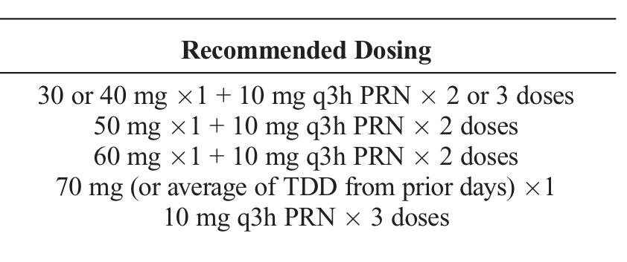
Rapid methadone protocol
11

Slide 12
Rapid methadone protocol
Consideration of split dosing for pregnant patients
12

Slide 13
Results
16 patients initiated on methadone for OUD
All reported fentanyl use

Slide 14
Results
13 patients received rapid protocol
Notes:
13 of these patients received the rapid protocol (based on the doses outlined)

Slide 15
Average daily dose of methadone after IMPACT consult
Dose (mg)
Notes:
Average total daily doses of methadone on days 1-5 after ACS consult were 62mg, 80mg, 86mg, 94mg, 105mg, respectively

Slide 16
Adverse events
One patient had titration slowed due to symptomatic bradycardia
No other adverse events

Slide 17
Post-discharge follow up
7 patients (53%) attended OTP intake appointment
Five (39%) remained on methadone at 30 days.

Slide 18
Conclusions
Split dose, rapid methadone induction protocol for pregnant individuals admitted to the hospital is well-tolerated and feasible
Despite quick up-titration, a minority of patients remained on methadone at 30-days post-discharge
18
Notes:
Opioid use disorder is associated with adverse perinatal outcomes, including low birth weight and preterm birth.
Medication for OUD or MOUD can mitigate these adverse outcomes and is critical for patients. Pregnancy is also a critical touchpoint during which patients can be engaged in treatment.
Pregnancy is also time limited! Limited data exists on rapid methadone induction for pregnant patients, but speed at which patients are stabilized is particularly critical for this population.
Additionally, due to physiologic changes of pregnancy and increased metabolism, pregnant patients may benefit from split dosing of methadone.

Slide 19
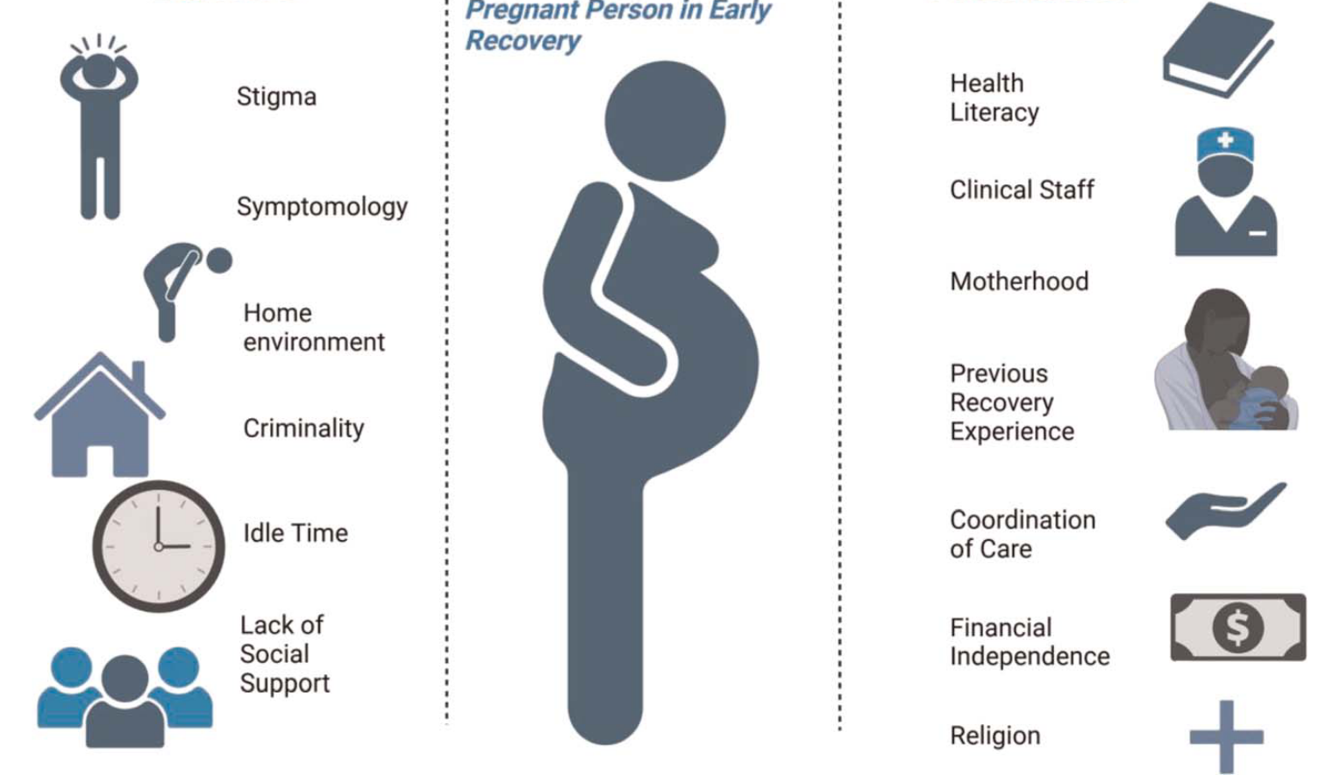
Barriers
Facilitators
J Addict Med • Volume 18, Number 2, March/April 2024

Slide 20
Thank You

Slide 21
Thank You

