Slide 1
Female Veterans: 17-year Trends of Access and Episodes of Buprenorphine for Opioid Use Disorder Within the Veterans Health Administration
(CTN 0087)
Presenting: Sophia Huebler
Authors: Sophia Huebler, Jacob D Baylis, Andrea Stofko, Ajay Manhapra, Stefan Kertesz, Jennifer Betts, Michael Incze, Andrew Saxon, Adam J Gordon
Special Acknowledgments: Audrey Jones
Family and Women’s Health 2
Saturday, November 16, 2024
1:30pm Radisson Blu – Agean Room
Notes:
Hello, thank you for listening today to this discussion of 17 year trends of access and episodes of buprenorphine for opioid use disorder within the veterans health administration for female veterans.

Slide 2
Funding and Disclosures
Research reported in this publication was supported by Helping to End Addiction Long-term® Initiative or NIH HEAL Initiative® under award numbers 3UG1DA040316-04S3 and 1UG1DA049444-01 of the National Institute on Drug Abuse (NIDA) Clinical Trials Network.
No conflicts of interest to report
Notes:
This research was funded by the NIH Heal initiative and the NIDA clinical trials network. I have no conflicts of interest to report.

Slide 3
A Note on Language
The electronic health records utilized for this study range from 2006 through 2023. Although records in more recent years record self identified gender, the availability of sex assigned at birth is more widespread within the cohort. Throughout this presentation, references to sex should be understood as sex assigned at birth.
Notes:
I’d like to start with a note on language. This study ranged from 2006 to 2023, so sex assigned at birth was much more available within the whole cohort compared to self identified gender which was more common in record from later years. Throughout this presentation, references to sex should be understood as sex assigned at birth.

Slide 4
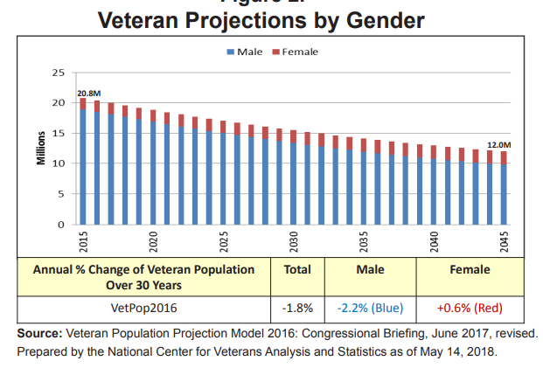
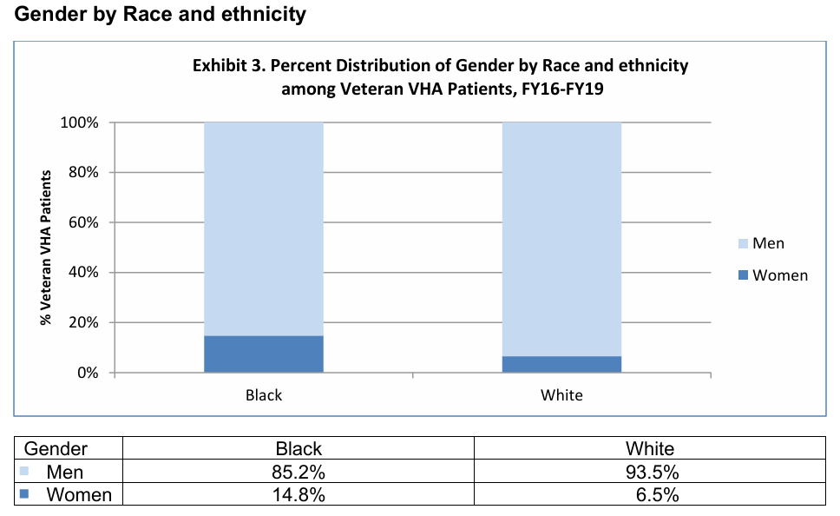
Changing VHA Demographics
VetPop 2019
National Veteran Health Equity Report - Black or African American Chartbook (va.gov)
Notes:
Often when we think of patients within the Veterans Health Administration we think of white men of non-Hispanic or Latino ethnicity. Although this group still makes up the majority of patients, women and racial or ethnic minority veterans have been a fast growing group within the VHA, as we can see from the graph on the left showing projections of growth of female veterans up through the next 20 years. We can see from the graph on the right that racial minority veterans comprise a greater proportion of female veterans than they do of male veterans. Disparities in practices lead to disparities in outcomes, so identifying and rectifying disparities in quality and access to healthcare has been the source of numerous reports and initiatives within the VA

Slide 5
Opioid Use Disorder Care for Women
Efficacy of Buprenorphine medication for OUD (B-MOUD)
Overdose
ED visits
Opioid related death
Why focus on women only?
Identified vulnerable population
High rates of intersectionality
Differences in OUD trajectory
Stratification to inform service intervention in women’s health clinics
Notes:
The aim of our study was specifically to identify disparities in access to care for opioid use disorder, which carries a high risk of overdose and which has been trending upwards in diagnoses per year over the past 2 decades in both the general and veteran populations. Buprenorphine medication for OUD (B-MOUD) is the most efficacious treatment to reduce negative health outcomes associated with OUD, which motivated our choice of study outcome. Prior work has shown that disparities across ethnic groups exist, with those belonging to minority racial and ethnic groups receiving B-MOUD care at lower rates. Analyses are often adjusted for sex, but we wanted to focus specifically on patterns within a female only cohort. Women generally are a particularly vulnerable group within the VA. The proportion of female veterans that belong to racial and ethnic minorities is higher than male veterans. There is evidence that women typically experience oud at an accelerated trajectory and present with more mental health comorbidities. And the existence of dedicated women’s health clinics within VA facilities motivates the use of stratified analysis rather than adjusted analysis.

Slide 6
Study Goals:
We examined temporal trends in buprenorphine prescriptions in a national sample of female Veterans to answer:
Is B-MOUD prescribing keeping up with increasing numbers of female veterans with OUD?
Do disparities in rates of B-MOUD prescribing exist for racial and ethnic minorities among female veterans?
If disparities do exist, are they increasing or decreasing with time?
Notes:
Our goals are summarized here (Is B-MOUD prescribing keeping up with increasing numbers of female veterans with OUD?
2. Do disparities in rates of B-MOUD prescribing exist for racial and ethnic minorities among female veterans?
3. If disparities do exist, are they increasing or decreasing with time?)

Slide 7
Study methodology
Retrospective cohort 2006-2023 (VHA patients)
Identified sex, race, and ethnicity
Cross sectional analysis: B-MOUD receipt at any point with in 10 years
Time trend analysis: B-MOUD receipt over time
Absolute scale (linear regression, change in percentage point year to year)
Relative scale (logistic regression, change in likelihood from year to year)
Notes:
In order to answer these questions, we took a cohort of veterans in the VHA who had an ICD 9/10 code diagnosis associated with OUD between 2006 and 2023. We identified demographics based on most frequent answers and then restricted the cohort to females. We categorized race by Black, White, and Other because there was heavy imbalance in the dataset. The other race category included Asian, American Indian or Alaska Native, Native Hawaiian or other Pacific Islander, or Mixed race. We categorized ethnicity as Hipanic/Latina or non-Hispanic/Latina. Then we took 3 modeling approaches. First we did a cross sectional look where we identified B-MOUD receipt at any point within the analytic period. Then we did an analysis were we looked at the trends across time on both a relative or an absolute scale. I’ll talk more about this choice in a couple of slides.

Slide 8
Cohort
 | All Women | Factor = Race |  |  | Factor = Ethnicity
 |  | White | Black | Other | Hispanic/ Latina | Non-Hispanic/ Latina
N (%) | 21,374 (100%) | 16,076 (75.2%) | 4,405 (20.6%) | 893 (4.2%) | 930 (4.4%) | 20,444 (95.6%)
Age | 50.3 (12.3) | 49.7 (12.6) | 52.8 (10.7) | 47.8 (12.5) | 47.1 (12.3) | 50.4 (12.3)
Receiving Any B-MOUD ( %) | 4,331 (20.3%) | 3,597 (22.4%) | 553 (12.6%) | 181 (18.4%) | 169 (18.2%) | 4,162 (20.4%)
p < 0.001
p = 0.1048
p < 0.001
p = 0.4226
Notes:
Here are the results of our cohort finalization and the cross sectional results. In the first row we have the population sizes.

Slide 9
Percent of Female Veterans Receiving Buprenorphine
Linear Scale
Yearly percentage points increase:
0.48 (0.43-0.53)
Log Scale
Yearly relative risk increase:
1.055 (1.045-1.062)
Notes:
Here we move on to viewing the results across time rather than cross sectionally. We begin by noting that the number of female veterans living with an oud diagnosis (seen on the x axis) increases drastically from under 2,000 in 2006 to over 17,600 in 2022. The model on the linear scale indicates that the proportion of female veterans with OUD who receive a buprenorphine prescription increases by 0.48 percentage points each year. This corresponds on the log scale to an average 5.5% yearly increase in the probability of an individual receiving a B-MOUD prescription. Note that although the visualization is shown for the entire cohort, the models are age adjusted.

Slide 10
Percent of Female Veterans Receiving Buprenorphine
Linear Scale
Yearly percentage points increase:
White: 0.51 (0.46-0.55)
Black: 0.35 (0.23-0.46)
Other: 0.56 (0.43-0.70)
Log Scale
Yearly relative risk increase:
White: 1.05 (1.04-1.06)
Black: 1.07 (1.05-1.09)
Other: 1.06 (1.02-1.09)
Notes:
Here we see the yearly percentage of female veterans receiving buprenorphine broken down by race. The x axis shows the number of individuals in the cohort living with OUD, with the number of white individuals increasing 9.6 fold, black individuals increasing 7 fold, and individuals of other races increasing 14 fold. Based on our cohort alone we cannot infer whether the change in relative increase is due to the changing demographics of the underlying population of female veterans or due to differential affectation of OUD between the groups. What we can see though is that on the linear scale, the precent of white and non-black minority veterans receiving B-MOUD increases faster than the percent of black veterans receiving B-MOUD prescriptions. On the relative risk scale, we actually see very similar estimates of the increase in relative risk from one year to the next in each racial group, with overlapping confidence

Slide 11
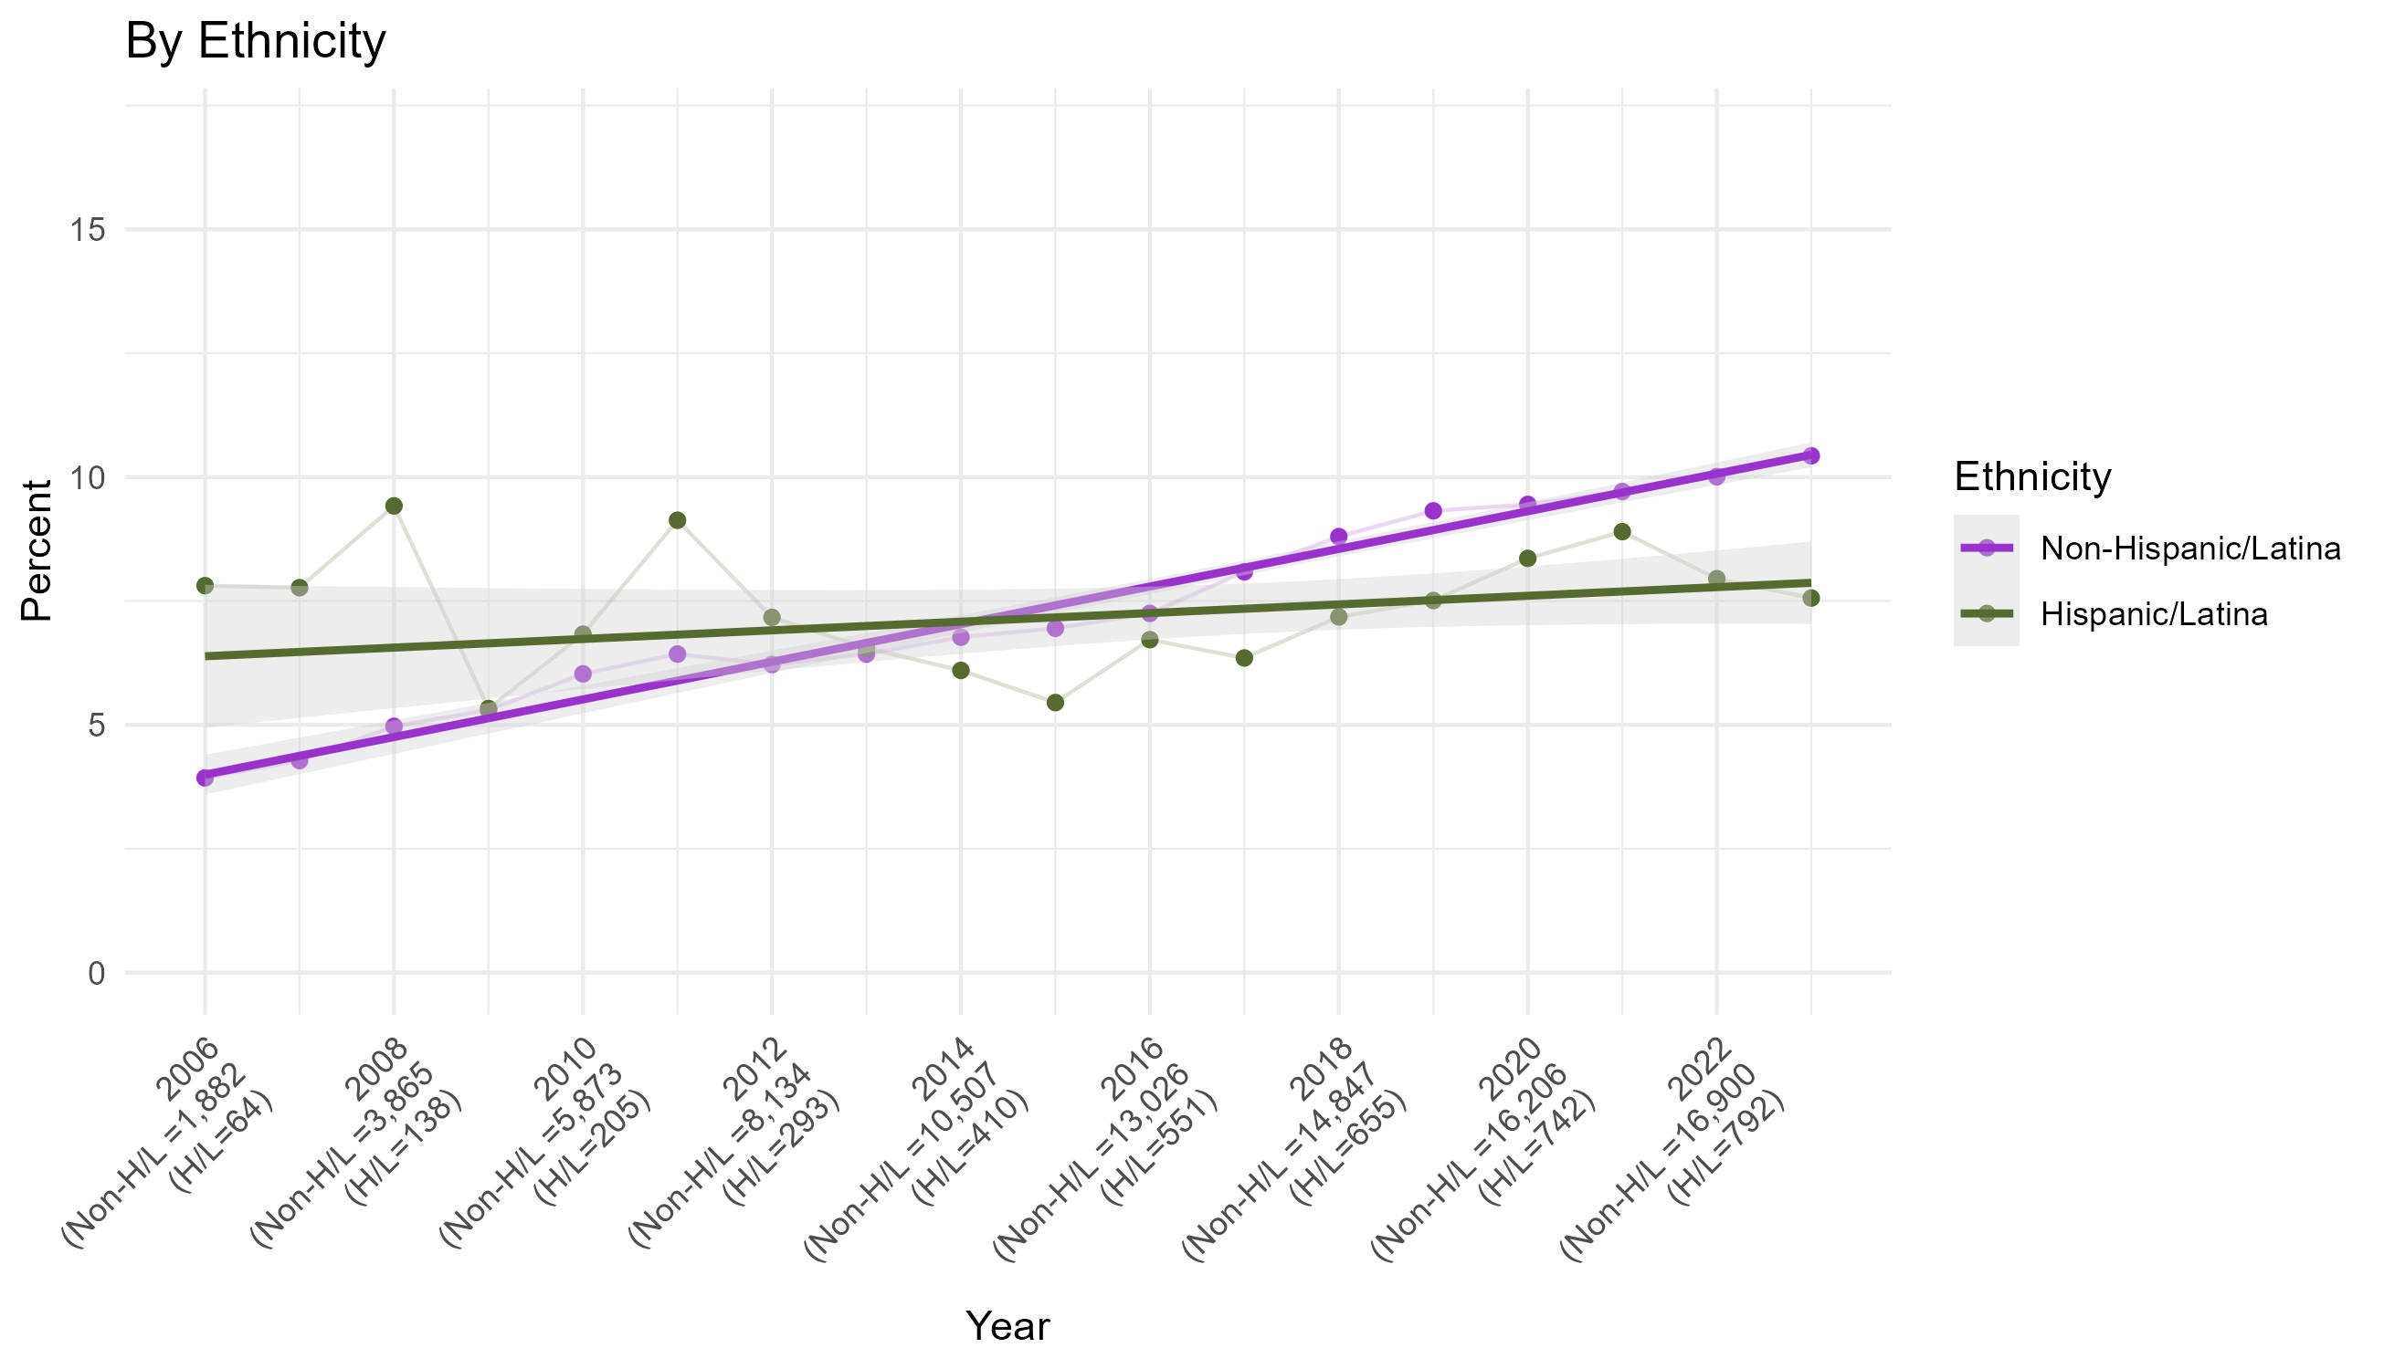
Percent of Female Veterans Receiving Buprenorphine
Linear Scale
Yearly percentage points increase:
Non-Hispanic/Latina: 0.50 (0.45-0.55)
Hispanic/Latina: 0.16 (-0.2-0.35)
Log Scale
Yearly relative risk increase:
Non-Hispanic/Latina: 1.06 (1.05-1.06)
Hispanic/Latina: 1.02 (0.99-1.06)

Slide 12
Answering Study Questions
Is B-MOUD prescribing keeping up with increasing numbers of female veterans with OUD?
Yes. The number of patients receiving B-MOUD is growing more quickly than the number of patients receiving new OUD diagnoses as evidenced by the upward trend in percent receiving care.
Do disparities in rates of B-MOUD prescribing exist for racial and ethnic minorities among female veterans?
If disparities do exist, are they increasing or decreasing with time?
Notes:
there have been improvements over time, but the majority of women with an OUD dx are still not receiving this evidence-based treatment.

Slide 13
Answering Study Questions
Is B-MOUD prescribing keeping up with increasing numbers of female veterans with OUD?
Do disparities in rates of B-MOUD prescribing exist for racial and ethnic minorities among female veterans?
Black female veterans on average are less likely to receive a B-MOUD prescription than their White counterparts. Female veterans of Non-Black racial minorities do not experience disparities on average.
Hispanic/Latina and non-Hispanic/Latina female veterans currently do not significantly differ in prescribing rates.
If disparities do exist, are they increasing or decreasing with time?

Slide 14
Answering Study Questions
Is B-MOUD prescribing keeping up with increasing numbers of female veterans with OUD?
Do disparities in rates of B-MOUD prescribing exist for racial and ethnic minorities among female veterans?
If disparities do exist, are they increasing or decreasing with time?
Disparities in B-MOUD prescription rates between White and Black female veterans may be decreasing on the relative risk scale, but are increasing in terms of absolute risk difference, with White female veterans showing faster growth in prescribing rates.
Disparity in B-MOUD prescription rates between Hispanic/Latina and non-Hispanic/Latina veterans is growing, with Hispanic/Latina veterans showing much slower growth in prescribing rates.

Slide 15
Future Directions
Analyze male cohort to compare patterns of disparities
Incorporate self identified gender rather than sex alone
Examine patterns of dosing and retention
Incorporate outside data sources to capture those receiving B-MOUD from non-VHA facilities

Slide 16
Questions?

Slide 17
Study Methodology: Cohort and Variable Selection
Retrospective cohort of veterans who have at least 1 recorded OUD diagnosis between 2006-2023
Had to be of known sex, race, and ethnicity
Patients were eligible to be in the population once for each year between their OUD diagnosis and year 2023 or death
Binary variable of interest: Any-B-MOUD
A patient who had any outpatient prescription within a calendar year would have a value of 1 for that year.
Buprenorphine formulation had to be one indicated by the FDA for use to treat OUD
Variables of interest:
Race (White, Black, Other)
Ethnicity (Hispanic/Latina, Non-Hispanic/Latina)

Slide 18
Study Methodology: Statistical Analyses
${\text{χ}}^{2}$ tests for a cross sectional analysis of those who ever received B-MOUD during the study period
Bonferroni correction for multiple comparisons between races
Linear models to estimate average percentage point change in percent of population receiving B-MOUD across years
Weighted by size of the yearly cohort
Robust sandwich estimators
Adjusted for age category
Log-binomial models to estimate change in relative risk of receipt of B-MOUD across years within groups
Autoregressive correlation structure
Fit by GEE
Adjusted for age

Slide 19
Model Results-Linear Models
Notes:
.

Slide 20
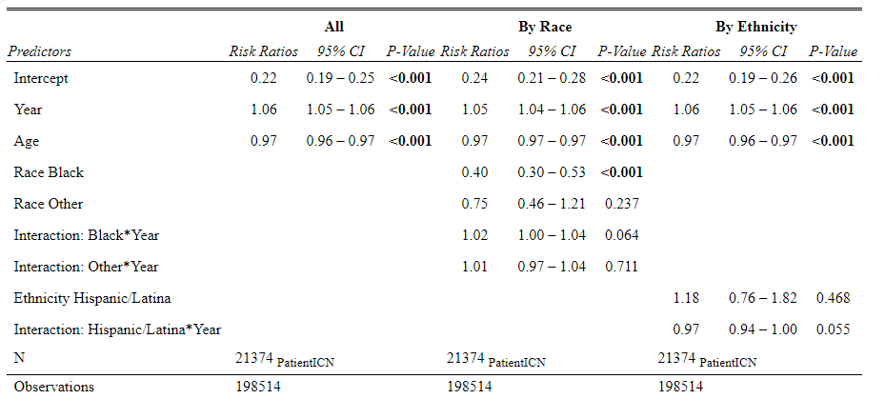
Model Results-Logistic Models

Slide 21
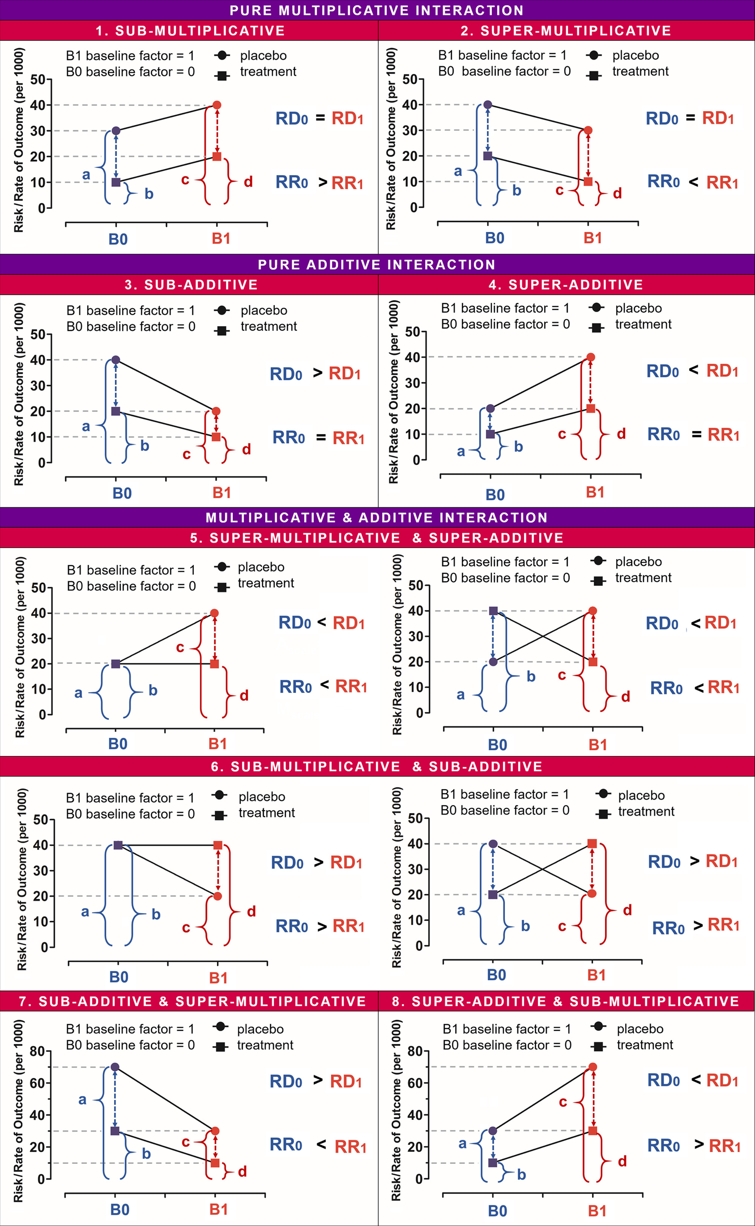
Relative vs Absolute
Relative vs absolute risk in subgroup analysis when there is an interactive effect can be a bit counterintuitive to interpret.
The marginal probability of receipt of buprenorphine in the Black veteran group started out so low that even the slower growth constituted a larger relative risk increase year to year.
I wanted to report both because I often see results on a relative risk or odds ratio scale.
Eur J Clin Investigation, Volume: 49, Issue: 8, First published: 28 May 2019, DOI: (10.1111/eci.13145)

