Slide 1
The first five years of Missouri’s Medication First approach to Opioid Use Disorder treatment: Plateaus, regressions, and underbellies of progress
Rachel Winograd, PhD., Zach Budesa, PhD., Brittany Blanchard, MPH, Paul Thater, Schyler Newman, Kortney Gertner & Christine Smith

Slide 2
Missouri’s State Targeted Response/State Opioid Response (STR/SOR) Grants
BIG federal grants – went to every state & territory
Began in 2017, ongoing in 2-year increments
Led by Missouri Department of Mental Health
Covers prevention, treatment, recovery support, and harm reduction services

Slide 3
Notes:
People who are chronically homeless have experienced homelessness for at least a year – or repeatedly – while struggling with a disabling condition such as a serious mental illness, substance use disorder, or physical disability.
Over half a million people are homeless on any given night – about 17 ppl for every 10,000 in the general population

Slide 4
Housing first

Slide 5
Prior Approach to OUD Treatment
Detox
Residential and group therapy
Acute care rather than chronic care
Buprenorphine and Methadone as last resort (& low doses, short term)
Notes:
The sign is animated – doesn’t show up until you click (view in slide show)

Slide 6
Missouri’s Medication First Approach
1) People with OUD receive medical treatment as quickly as possible, prior to lengthy assessments or treatment planning sessions;
Low-barrier MOUD
2) Maintenance pharmacotherapy is delivered without arbitrary tapering or time limits;
3) Individualized psychosocial services are offered but not required as a condition of pharmacotherapy;
4) Do not discontinue medical treatment unless it is clearly worsening the patient’s condition.
Winograd et al., 2019a, AJDAA; Winograd et al., 2019b, JSAT;
High et al., 2019 JSAT

Slide 7
Take-aways from Year 1
receive medication
get medication sooner
receive fewer psychosocial services
be engaged in treatment at 1, 3, 6, & 9 months
1
Individuals enrolled in MedFirst were more likely to…
2
3
4
Winograd et al., 2019a, AJDAA;
Winograd et al., 2019b, JSAT;
High et al., 2019 JSAT
Notes:
Still not seeing the retention we want
OD deaths plateaued despite continued increase in fentanyl but haven’t gone down
Future work – we know what works, how come not everyone’s doing it? For those who are doing it, why isn’t it working like we’d expect it to?
Implementation science questions that may not be served by more service dollars

Slide 8
But what about 5 years later…? And were these benefits felt by all groups?

Slide 9
Comparison Groups & Outcomes of Interest
Within MedFirst (STR/SOR)
MedFirst (STR/SOR) to non-MedFirst
Full Population over time
By Race
Outcomes of interest: same as the first time around!
MOUD (Yes/No) utilization rates
Time-to-medication (days to first Rx)
Volume of psychosocial services (controlling for length of treatment episode)
Retention (days in treatment)

Slide 10
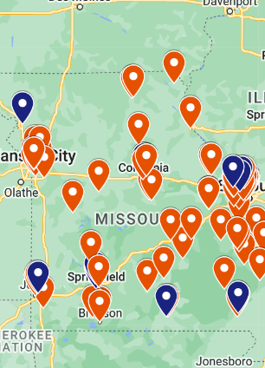
Methods
Uninsured individuals with OUD
Traditional publicly-funded SUD treatment programs (not primary care, not hospitals)
Models varied depending on outcome:
outcome = years + MedFirst(yes/no) + race + MedFirst*race + MedFirst*years
Binary logistic regression
Zero-inflated negative binomial regression
Negative binomial hurdle model

Slide 11
Sample characteristics across years, total population (Pre-MedFirst, Year 1, Year 5)
 | FY2017 (Pre-MedFirst) | FY2018 (MedFirst Year 1) | FY2022 (MedFirst Year 5)
Total enrollment across races (N) | 2,728 | 3,530 | 2,209
White | 2,160 (79%) | 2,708 (77%) | 1,537 (70%)
Black | 470 (17%) | 677 (19%) | 419 (19%)
Non-White/Non-Black | 98 (4%) | 145 (4%) | 253 (11%)
MedFirst (STR/SOR enrollment) (N, %) | 0 (0%) | 1,321 (37%) | 1,019 (46%)
% receiving MOUD | 43% | 61% | 56%
Time-to-medication (Days) | 7 | 2 | 1
Days in Treatment | 70 | 117 | 85
Weekly psychosocial hours | 2.3 | 1.0 | 0.3

Slide 12
Results: MedFirst (STR/SOR) 2018 vs. 2022
~ Within MedFrist, Year 1 vs Year 5 ~
 | 2018 (MedFirst Year 1) | 2022 (MedFirst Year 5) | Difference | Direction
MOUD utilization | .82 probability | .77 probability | -.053 (95% CI: -.074, -.032) | 2018 higher MOUD
Time-to-medication | median 1 day | median 0 days | -1 (95% CI: -4.16, 2.16) | no difference
Psychosocial Hours | 33.3 hours | 15.5 hours | -17.8 (95% CI: -25.1, -10) | 2018 greater hours
Retention (Days in treatment) | 208 days | 168 days | -38.2 (95% CI: -50.0, -26.4) | 2018 longer retention
Notes:
MOUD: On average, STR/SOR clients in FY22 had a lower probability of receiving MOUD than STR/SOR clients in FY18 (-0.053, 95% CI -0.074, -0.032). In both years, though, it remained likely that clients would recieve MOUD, with FY18 clients having a 0.82 probability (95% CI 0.80, 0.83), while FY22 clients had a probability of .77 (95% CI 0.75, 0.78)
TIME-TO-MEDICATION: On average, STR/SOR clients in FY18 and FY22 received MOUD in similar amounts of time (diff = -1, 95% CI -4.16, 2.16). On average, STR/SOR clients in FY18 received their MOUD a median of 1 day days (95% CI 0.55, 1.45), and STR/SOR clients in FY22 received their medication in median of 0 days (95% CI -3.29, 3.29).
PSYCHOSOCIAL: On average, STR/SOR clients in FY22 participated in fewer psychosocial hours STR/SOR clients in FY18 (-17.8, 95% CI -25.1, -10.5). On average, STR/SOR clients in FY18 had an average psychosocial volume of 33.3 (95% CI 18.05, 48.5), and STR/SOR clients in FY22 had a psychosocial volume of 15.5 hours (95% CI 7.27, 23.7).
RETENTION: On average, STR/SOR clients in FY22 remained in treatment fewer days than STR/SOR clients in FY18 (-38.2, 95% CI -50.0, -26.4). On average, STR/SOR clients in 2018 remained in treatment 208 days (95% CI 198, 218), and STR/SOR clients in 2022 remained in treatment 167 days (95% CI 157, 178).

Slide 13
Results: MedFirst (STR/SOR) vs non-MedFirst
~ collapsed across all 5 years ~
 | MedFirst (STR/SOR) | non-MedFirst) | Difference | Direction
MOUD utilization | .82 probability | .49 probability | .32 (95% CI: .309, .337) | MedFirst higher MOUD
Time-to-medication | median 0.4 days | median 6.5 days | -6.1 (95% CI -7.73, -4.47) | MedFirst sooner to medication
Psychosocial Hours | 23.5 hours | 56.7 hours | -33.1 (95% CI: -52.5, -13.7) | MedFirst fewer hours
Retention (Days in treatment) | 198 days | 166 days | 31.8 (95% CI: 24.3, 39.3) | MedFirst longer retention
Notes:
MOUD: On average, STR/SOR clients are more likely to receive MOUD than non-STR/SOR clients (.32, 95% CI .309, .337).
TIME-TO-MEDICATION: On average, STR/SOR clients received their medication a median of 6.1 days sooner than non-STR/SOR clients.
PSYCHOSOCIAL HOURS: On average, STR/SOR clients had 33.1 fewer psychosocial hours than non-STR/SOR clients (95% CI -52.5, -13.7).
RETENTION: On average, STR/SOR clients remain in treatment on average 31.8 more days than non-STR/SOR clients (95% CI 24.3, 39.3).

Slide 14
Results: Combined (MedFirst with non-MedFirst)
~ Before STR/SOR started, to most recent year ~
 | 2017 (Pre-Med First) | 2022 (MedFirst Year 5) | Difference | Direction
MOUD utilization | .56 probability | .54 probability | -.02 (95% CI: -.044, .011) | no difference
Time-to-medication | median 5.1 days | median 3.1 days | -2 (95% CI: -4.93, 0.93) | no difference
Psychosocial Hours | 59.8 hours | 23.8 hours | -36.1 (95% CI: -55.3, -16.9) | 2022 fewer hours
Retention (Days in treatment) | 137 days | 151 days | 13.9 (95% CI: 2.29, 24.9) | 2022 longer retention
Notes:
MOUD: On average, clients receiving state funded substance use treatment were no more likely (-.02, 95% CI -.044, .011) to receive MOUD in FY22 (.54, 95% CI .52, .56) than clients in FY17 (.56, 95% CI .54,.57).
TIME-TO-MEDICATION: On average, clients receiving state funded substance use treatment received their medication in similar amounts of time (-2, 95% CI -4.93, 0.93) in FY22 (3.15, 95% CI 0.39, 5.91) and FY17 (5.15, 95% CI 3.30, 7.00).
PSYCHOSOCIAL: On average, clients receiving state funded substance use treatment had a lower volume of psychosocial hours (-36.1, 95% CI -55.3, -16.9) in FY22 (23.8, 95% CI 8.03, 39.5) and FY17 (59.8, 95% CI 25.3, 94.3).
RETENTION: On average, clients receiving state funded substance use treatment remained in treatment an average of 13.9 days (95% CI 2.92, 24.9) longer in FY22 (151, 95% CI 142, 160) than clients in FY17 (137, 95% CI 130, 144).

Slide 15
Results Differences by Race, by Program
~ Collapsed across all 5 years ~
 | MedFirst (STR/SOR) |  |  |  | non-MedFirst
 | Black (N = 1,523) | White (N = 5,048) | Difference | Direction | Black (N = 2,039) | White (N = 9,853) | Difference | Direction
MOUD utilization | .82 prob. | .82 prob. | -.005 (95% CI -.017, .028) | no difference | .62 prob. | .46 prob. | -.164 (95% CI: .188, -.141) | Black higher MOUD
Time-to-medication | mdn. 0 days | mdn. 0 days | 0 (95% CI: -.77, .77) | no difference | 3 days | 7 days | -4 (95% CI: 2.67, 5.33) | Black sooner to medication
Psychosocial Hours | 25.3 hours | 24.8 hours | -.48 (95% CI: -2.89, -1.93) | no difference | 45.1 hours | 56.5 hours | 11.3 (95% CI: 1.23, 21.43) | White more hours
Retention (Days in treatment) | 153.1 days | 216.6 days | 62.75 (95% CI: 50.6, 74.9) | White longer retention | 159.7 days | 163.7 days | 3.74 (95% CI: -5.64-13.1) | White longer retention
Notes:
MOUD:
TIME-TO-MEDICATION:
PSYCHOSOCIAL:
RETENTION:

Slide 16
Overview of Findings
Overall, things are better than they were before MedFirst
More and faster MOUD & longer retention
BUT! MedFirst program outcomes regressed toward baseline since original launch
Black people have equal or better MOUD access, but are not in treatment as long as White people

Slide 17
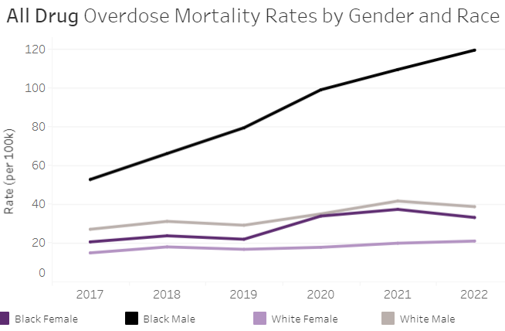
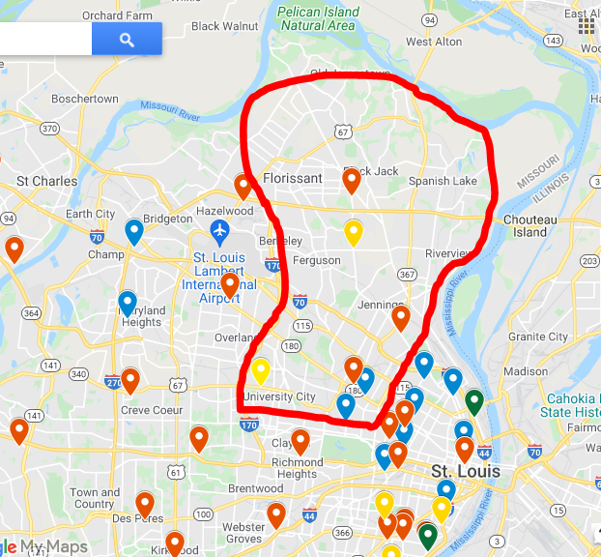
Racial Disparities
Racial Disparities
Widening inequities in overdose deaths in MO, especially among Black men
Resource deserts in predominantly poor, Black areas
& minimal access to housing & transportation
Complex views toward medicalization in Black communities

Slide 18
What’s going on with MedFirst??
MedFirst fidelity “drift” over time, a la Housing First “drift”
Growing resentment toward belief of ‘medication only’
Fiscal challenges, perverse reimbursement incentives
Traditional SUD programs not set up for longterm medical care
Sicker client base → challenging for staff to adjust
The lower your threshold, the poorer the health of the sickest person you treat
Notes:
Ppl who still don’t have Medicaid – significant healthcare needs, going without Medicaid which could provide broader health benefits

Slide 19
Take Aways
Overall, we’re better than where we started…
~ BUT ~
Radical changes in clinical approach require changes in reimbursement structures
“MedFirst” for Black people & in Black communities requires deeper, culturally responsive work & framing
Must prioritize client SURVIVAL and meeting basic needs (transportation, income, physical health, HOUSING!!!)

Slide 20
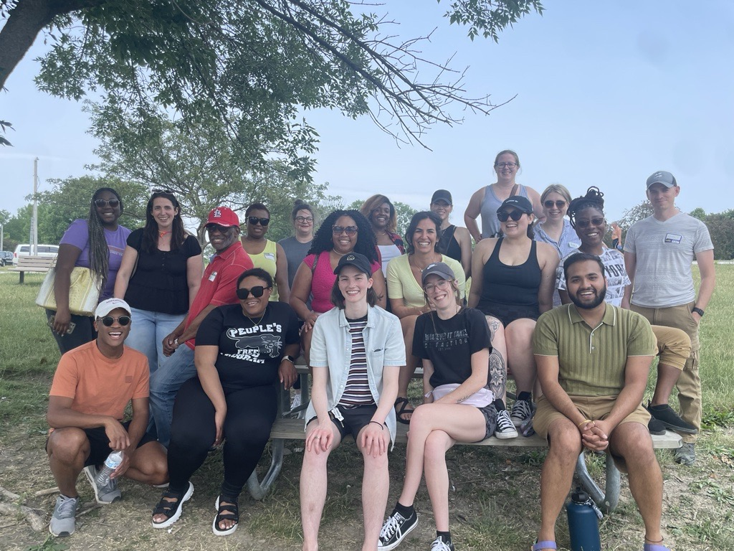
Thank you!
Brandon Park
SOR data team
UMSL Addiction Science
MO Department of Mental Health
SAMHSA

Slide 21
Critical feedback on Med First
Medication First = Medication “Only”
… what about root causes?
Adjusting to “sicker” client base because more people retained
Medically-focused treatment isn’t fiscally sustainable in traditional treatment programs

Slide 22
What happened in 2022?
Medicaid expansion changed the makeup of 2022 population

