Slide 1
From Clinic to Consult Service: Navigating a Case of Ketamine Withdrawal
Alejandro Castellanos MD​
Johanna Sluser NP
Notes:
20 seconds
Johanna: My name is Johanna Sluser, I use she/her pronouns, and I am a nurse practitioner with UCSF, on San Francisco General Hospital’s inpatient addiction consult service, also known as ACT.
Alejandro:
This is our presentation, from Clinic to Consult Service, and today we’re going to walk through a case of ketamine withdrawal and management.

Slide 2
We have no disclosures.
Identifying details of this case have been changed.
Notes:
10 seconds
We have no disclosures, and identifying details have been changed to protect anonynmity.

Slide 3



Objectives
Learn about ketamine’s action as an N-methyl-D-aspartate receptor (NMDAR) antagonist
Recognize signs & symptoms of ketamine withdrawal
Apply this knowledge to devise and implement a ketamine withdrawal treatment plan​
Notes:
30 sec
After this presentation, we hope you’ll walk away knowing about ketamine’s action as an N-methyl-D-aspartate receptor antagonist;
Be able to recognize the signs and symptoms of ketamine withdrawal;
And finally, be able to apply this knowledge to devise and implement a ketamine withdrawal treatment plan like we did

Slide 4
Roadmap
1
2
3
4
Ketamine uses & NMDAR action
Lessons learned
Case study: In clinic
Case study: Inpatient
Notes:
30 sec
We wanted to lay out a quick roadmap today – we’ll first be meeting our patient Sam in clinic, and then reviewing ketamine and it’s uses. We’ll return to our patient, and conclude with lessons learned from this case.

Slide 5
1
Case study:
In clinic

Slide 6


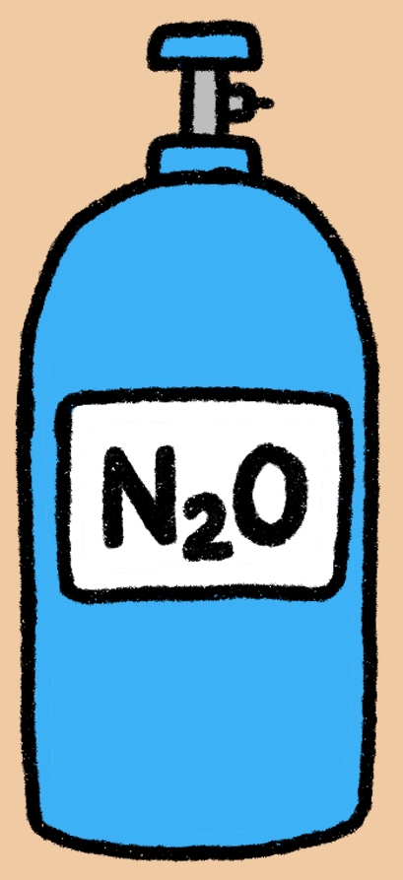


Meet “Sam”
Substance use
46 y/o man
T2DM, Asthma, OSA
Lives with partner
Mental Health
Bipolar 2
ADHD
Anxiety
K
Notes:
CJ (1 min)
Sam is a 46 yo man who has used non-prescribed substances since age 12, including alcohol, stimulants, fentanyl, and nitrous oxide. Although he’s in sustained remission from OUD and tapered off buprenorphine a few years ago, he has continued to use cocaine. He began using Ketamine 2 years ago, but his use substantially increased after he heard that ketamine can potentially help people with a wide variety of mental health problems – he felt like it could help him reduce his cocaine use. At the time of this case, he was using 2-3 grams of ketamine intranasally daily for several months.

Slide 7
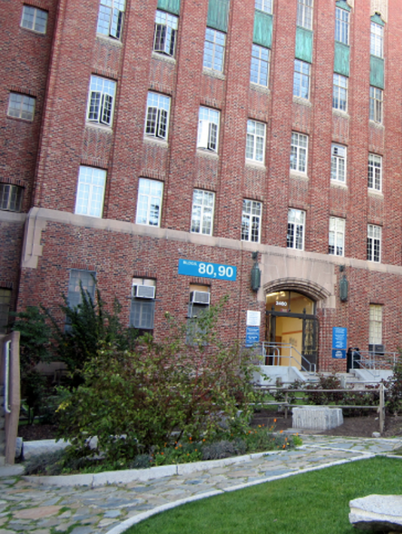
"He is here for an URGENT visit"
Multiple attempts to stop ketamine, using nitrous oxide
Treatments explored
    Weekly therapy
    IOP/residential programs
    Outpatient SUD clinic
New onset seizures?
Notes:
JS (45 sec)
Sam recognized that his ketamine use was becoming unmanageable and causing relationship issues. He was also using a liter of nitrous oxide daily. He had explored a variety of treatment options with his PCP Cory Johnson—he was seeing Cory weekly for therapy, he had declined referrals to IOP and residential programs, and he was also being seen in our outpatient substance use Bridge Clinic.
Then, one day, he came in to clinic for an urgent visit, complaining of new onset “seizures” that his partner had witnessed. At this point, it was decided that more intensive management was needed. His PCP Cory was able to facilitate a direct admission to inpatient medicine for ketamine withdrawal, with the support of our hospital's addiction consult service.

Slide 8
2
Ketamine uses & NMDAR action
Notes:
5 sec
When Sam’s PCP got in touch about a direct admission, our addiction care team was tasked with formulating a treatment plan for ketamine withdrawal. In order to do this, we realized we needed to brush up on ketamine and really dive into Its effects and action on receptors. Let’sl take a moment now to review this.

Slide 9

Ketamine uses
Prescribed
analgesic & sedative
antidepressant, ketamine-assisted therapy
Non-prescribed
Social/psychedelic settings
Self-treat mood symptoms
Notes:
JS (1 min)
Ketamine has long been used in medicine as an analgesic and sedative, but more recently, it has become a treatment option for treatment resistant depression. Notably, it has also become much more widely available for people to self-administer at home via a nasal spray – there has been a proliferation of at home ketamine therapy companies that have a heavy ad presence on social media – if your algorithm is like mine, you might have seen some of these targeted ads on Instagram or tiktok.
Ketamine has also been commonly used in social and psychedelic focused settings as a tool to dissociate, or “k-hole”. People are also self-treating their depression and PTSD symptoms with non-prescribed ketamine as well.

Slide 10



2008
2019
Notes:
Palamar et al (2021) found that rates of non-medical ketamine use increased – from 2008 to 2019, self-reported past year use increased from 0.1% to .9% - while ketamine use is still relatively uncommon, on on a population level, there are serious implications - law enforcement drug seizures of ketamine increased exponentially during this time as well.
It’s important to note that historically excluded communities are less likely to have access to prescribed ketamine-assisted mental health treatment. As a result, they may be more likely to suffer the consequences of non-prescribed ketamine use, including developing a use disorder and face legal issues – there is a privilege gap in who is able to access to ketamine treatment and who is not, and as ketamine use becomes more widespread, this gap is likely to grow.

Slide 11
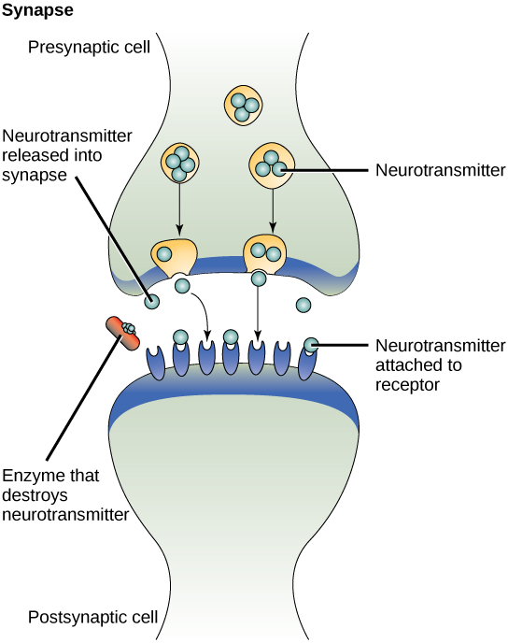
Chronic
ketamine use
Gaba
Glutamate
NMDA receptors
K
K
K
X
X
X
K
K
Ketamine
This Photo by Unknown Author is licensed under CC BY
Notes:
JS (30 sec)
Ketamine's primary and most well-understood effects come from its role as a non-competitive N-methyl-D-aspartate antagonist, which is the same receptor that glutamate acts on.
Normally, there's a balance between synaptic glutamate and gaba and receptors – there is an even regulation of excitation and inhibition in the brain. We need glutamate to activate neurons – it’s an essential piece of cognitive function and memory. Gaba does the opposite, by dampening activation and calming things down. Keeping these systems balanced helps maintain normal brain function.
When ketamine binds to the NMDA receptor, it blocks calcium influx, which then stops glutamate from entering the neuron. With chronic ketamine use, prolonged NMDA receptor blocking can lead to glutamate dysregulation. Extra calcium ion channels are also created, and even more glutamate is released - but it has no where to go. This leads to excessive pre-synaptic glutamate, which becomes a problem if someone stops using ketamine, and those channels open up again…

Slide 12
Ketamine
withdrawal
Gaba
Glutamate
NMDA receptors
No
Ketamine
Excitation
=
This Photo by Unknown Author is licensed under CC BY
Notes:
JS (30 sec)
As you can see in this slide, when ketamine is stopped, all the excessive glutamate causes overactivation of NMDA receptors, and there's an influx of calcium in all those extra channels that were created. This image really illustrates the gaba/glutamate imbalance caused by chronic ketamine use. There's a lot more glutamate hanging out in comparison to gaba, and there arealso more sites for that glutamate to act on and cause over-excitation. This leads to the symptoms we associate with ketamine withdrawal, as we'll see in the next slide and discuss more when we return to our case study...

Slide 13
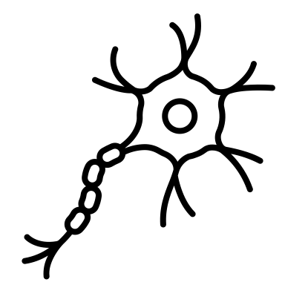






Ketamine withdrawal
Tremors
Agitation Insomnia
Myoclonus Hyperreflexia
Myoclonus
Hyperreflexia
Anxiety Dysphoria
Diaphoresis
Palpitations
Notes:
AC 30-45 sec
Ketamine withdrawal actually looks a lot like alcohol or benzodiazepine withdrawal – there's autonomic dysregulation, and patients might experience physical symptoms like tremors, sweats and palpitations, as well as psychiatric symptoms like agitation and anxiety.
In the case of our patient Sam, he was experiencing anxiety and tremors, as well as abdominal cramping or "k cramps" and urinary issues, thought to be related to chronic ketamine use.

Slide 14
3
Case study:
Inpatient
Notes:
Now that we know how ketamine works, we can start discussing how we treated this case of ketamine withdrawal.

Slide 15
Minimal literature describing ketamine withdrawal!
Stanford case report (Prekupec et al., 2017)
AJP case report (Roxas et al., 2021)
Sx: Agitation, tremors, hallucinations, diaphoresis, myoclonus
Sx: Agitation, confusion, suicidality, dysphoria
Tx: dexmedetomidine, olanzapine, valproic acid
Tx: lorazepam, olanzapine, valproic acid
Notes:
AC - 1 min

Slide 16
Day 1
Anxiety​, tremors, abdominal pain​, urinary urgency, nocturia
Phenobarbital (PHB) 97.2mg PO q4hr (x6)
Clonidine 0.2mg PO q6hr (x4)
Inpatient Timeline
Day 2
Improved: ​
anxiety, tremors, abdominal pain​
PHB 64.8mg PO q6hr (x4) ​
Clonidine 0.2mg PO q6hr (x4)​
​
​
Persistent: urinary urgency​, nocturia
Day 3
PHB 64.8mg PO q6hr (x3)
Clonidine 0.2mg PO q6hr (x4)
Improved: Urinary urgency Nocturia x1
Day 4
Self-directed D/C
Stopped PHB
Oxcarbazepine 150mg BID
Notes:
AC 4 min
Priority was neuro-protection in setting of reported seizures – though there were no witnessed seizures during his hospitalization.
Benzo-sparing withdrawal management based on Kawasaki's (2012) protocol for benzodiazepine "detoxification” was used
We also started clonidine to manage glutamatergic rebound excitation during acute withdrawal
Contingency plan if w/d worsened: consider ICU transfer for IV dexmedetomidine
Our team recommended starting oxcarbazepine after completion of PHB to reduce seizure risk/manage post-acute w/d
After discharge:
↓ use of ketamine & cocaine , stops nitrous oxide use
Vitamin B12
Therapy weekly with PCP
Refuge recovery meetings

Slide 17
4
Lessons learned

Slide 18
Ketamine withdrawal: Lessons learned
Similar to alcohol or benzo withdrawal
Limited treatment evidence
Consider targeting gaba/ glutamate
Notes:
AC – 60-90 sec?

Slide 19
Our other case study members:
Cory Johnson, Sam's PCP
Paula Lum, our case study advisor
“Sam” who shared his story with us, and allowed us to share it with you
Thank you to

Slide 20
References
Arnsten, A.F.T., Ishizawa, Y. & Xie, Z. Scientific rationale for the use of α2A-adrenoceptor agonists in treating neuroinflammatory cognitive disorders. Mol Psychiatry 28, 4540–4552 (2023). https://doi.org/10.1038/s41380-023-02057-4
Morgan CJ, Curran HV; Independent Scientific Committee on Drugs. Ketamine use: a review. Addiction. 2012 Jan;107(1):27-38. doi: 10.1111/j.1360-0443.2011.03576.x. Epub 2011 Jul 22. PMID: 21777321.
Morris H, Wallach J. From PCP to MXE: a comprehensive review of the non-medical use of dissociative drugs. Drug Test Anal. 2014 Jul-Aug;6(7-8):614-32. doi: 10.1002/dta.1620. Epub 2014 Mar 26. PMID: 24678061.
Palamar JJ, Rutherford C, Keyes KM. Trends in Ketamine Use, Exposures, and Seizures in the United States up to 2019. Am J Public Health. 2021 Nov;111(11):2046-2049. doi: 10.2105/AJPH.2021.306486. Epub 2021 Oct 7. PMID: 34618543; PMCID: PMC8630483.
Prekupec, M.P., Sussman, R.S., Sher, Y., & Lembke, A. (2017). Relapse on ketamine followed by severe and prolonged withdrawal: A cautionary case and review of potential medical therapies. Journal of Nature and Science, 3, 450.
Roxas N, Ahuja C, Isom J, Wilkinson ST, Capurso N. A Potential Case of Acute Ketamine Withdrawal: Clinical Implications for the Treatment of Refractory Depression. Am J Psychiatry. 2021 Jul;178(7):588-591. doi: 10.1176/appi.ajp.2020.20101480. PMID: 34270337.
Wolff K, Winstock AR. Ketamine : from medicine to misuse. CNS Drugs. 2006;20(3):199-218. doi: 10.2165/00023210-200620030-00003. PMID: 16529526.

