Slide 1
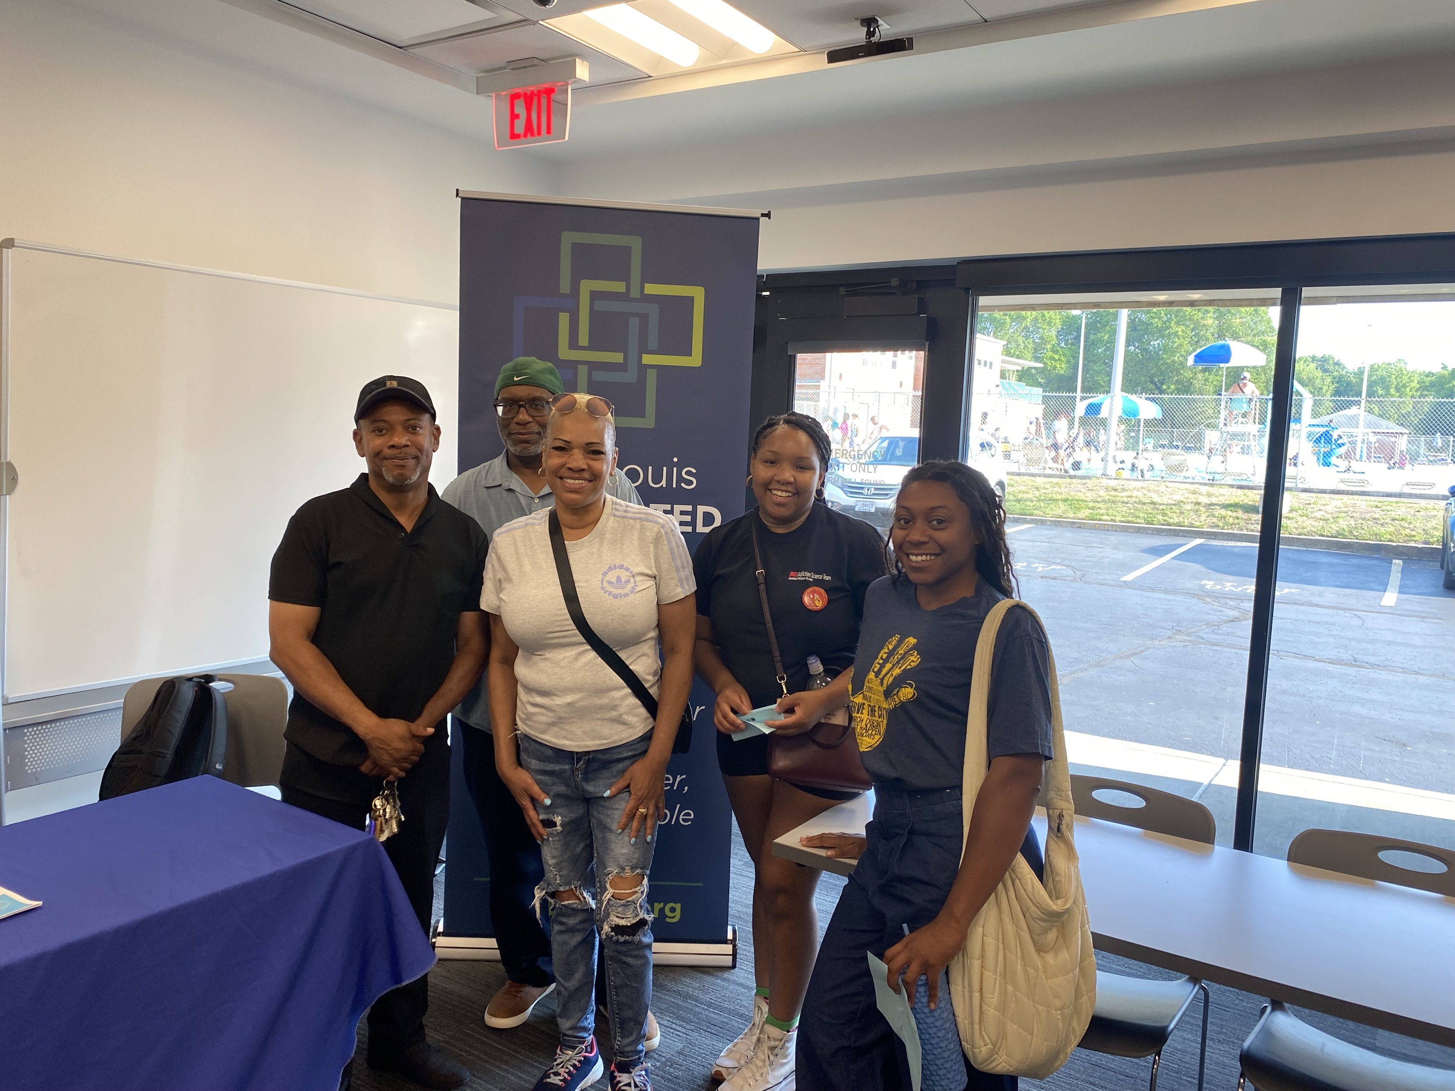
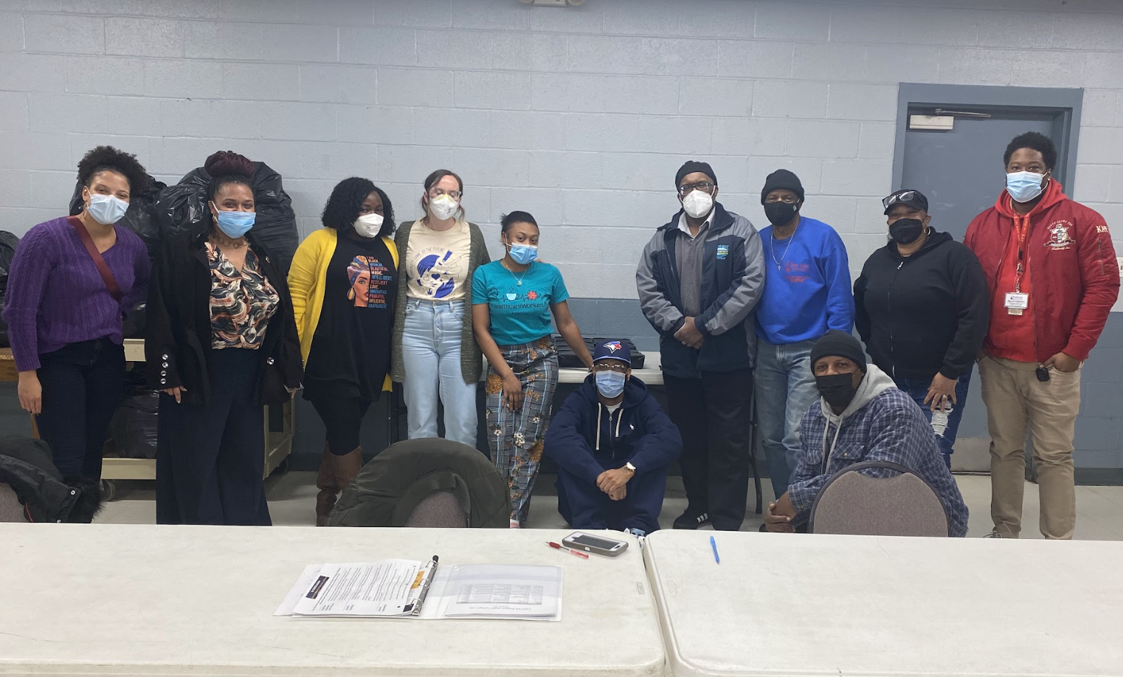
From Conception to Dissemination Utilizing a
Black-led Community Advisory Board to Advance Racial Equity in Substance Use Research
Kaytryn D. Campbell, Devin E. Banks, Maria E. Pashke,
Daje D. Bradshaw-Glenn; Jameala L. Jones, Kyra E. Robinson,
Rashmi Ghonasgi, Rachel P. Winograd

Slide 2
Aim of the current study:
Objectives
The Community ENgagement, Trauma, Equity, and Renewal (CENTER) Initiative
To describe the feasibility of using a Black-led CAB across each step of the research process

Slide 3
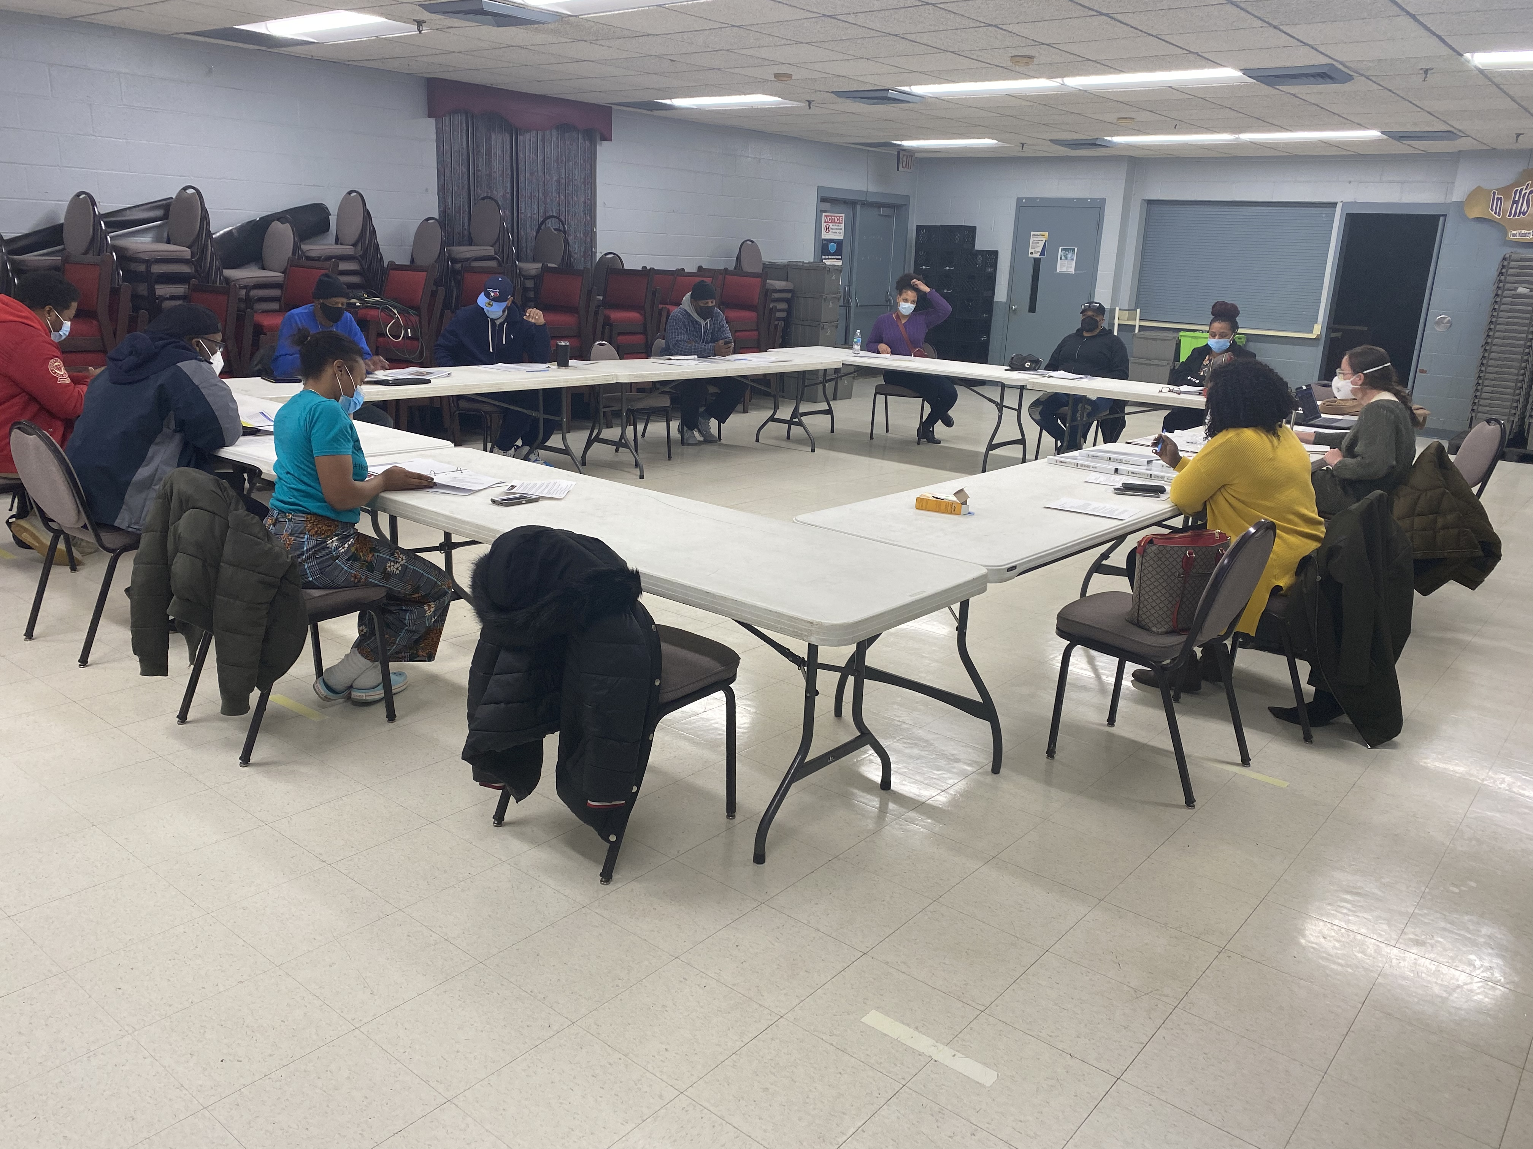
Methods
The CAB comprised 10 Black individuals with direct or indirect experiences with drug use/SUD
Recruited through word of mouth and local community organizations

Slide 4

Results
Study Enrollment
Data Collection
40 PWUD recruited and enrolled in research interviews
28% of interviews included a CAB interviewer
30% of CAB members helped interpret transcripts
All CAB members participated in dissemination of findings
Analysis
Dissemination

Slide 5
Research Design & Recruitment
Interview Guide Question
Researcher Generated | CAB Revised Questions
Narcan/naloxone is one way to prevent an active opioid overdose. What do you know about Narcan? | Tell me about experiences you’ve had responding to an overdose or using Narcan?
What role does your social circle play in your drug use and/or recovery? What about your neighborhood/ where you live? | What kinds of support do you have in your neighborhood/ where you live? Is there anything in your neighborhood that makes things worse for you?
Can you tell me what you know about fentanyl test strips? | How do you react when you hear about a bad batch of drugs? How do you know if fentanyl is in your drugs?

Slide 6
Data Collection: Serving as Community interviewers
Research Staff: “May I ask who you trust to get information or help about your drug use? Is there anyone that you trust?”
Interviewee asks for clarification
CAB Interviewer: “Anyone. Like just the people you trust in terms of knowledge about things that are happening in the community.”

Slide 7
Analysis: Serving as Community Coders
“This seems to be driven by drug user stigma. This really gets into system failures and how you must be in an extremely bad condition before you get help. He’s pointing a finger at the system that is failing him. He doesn’t even get what he needs out of the system, because it’s not trying to give it to him…”
“Seems to be driven by program requirements. He’s describing how treatment should work, and the different modalities needed.”
…

Slide 8
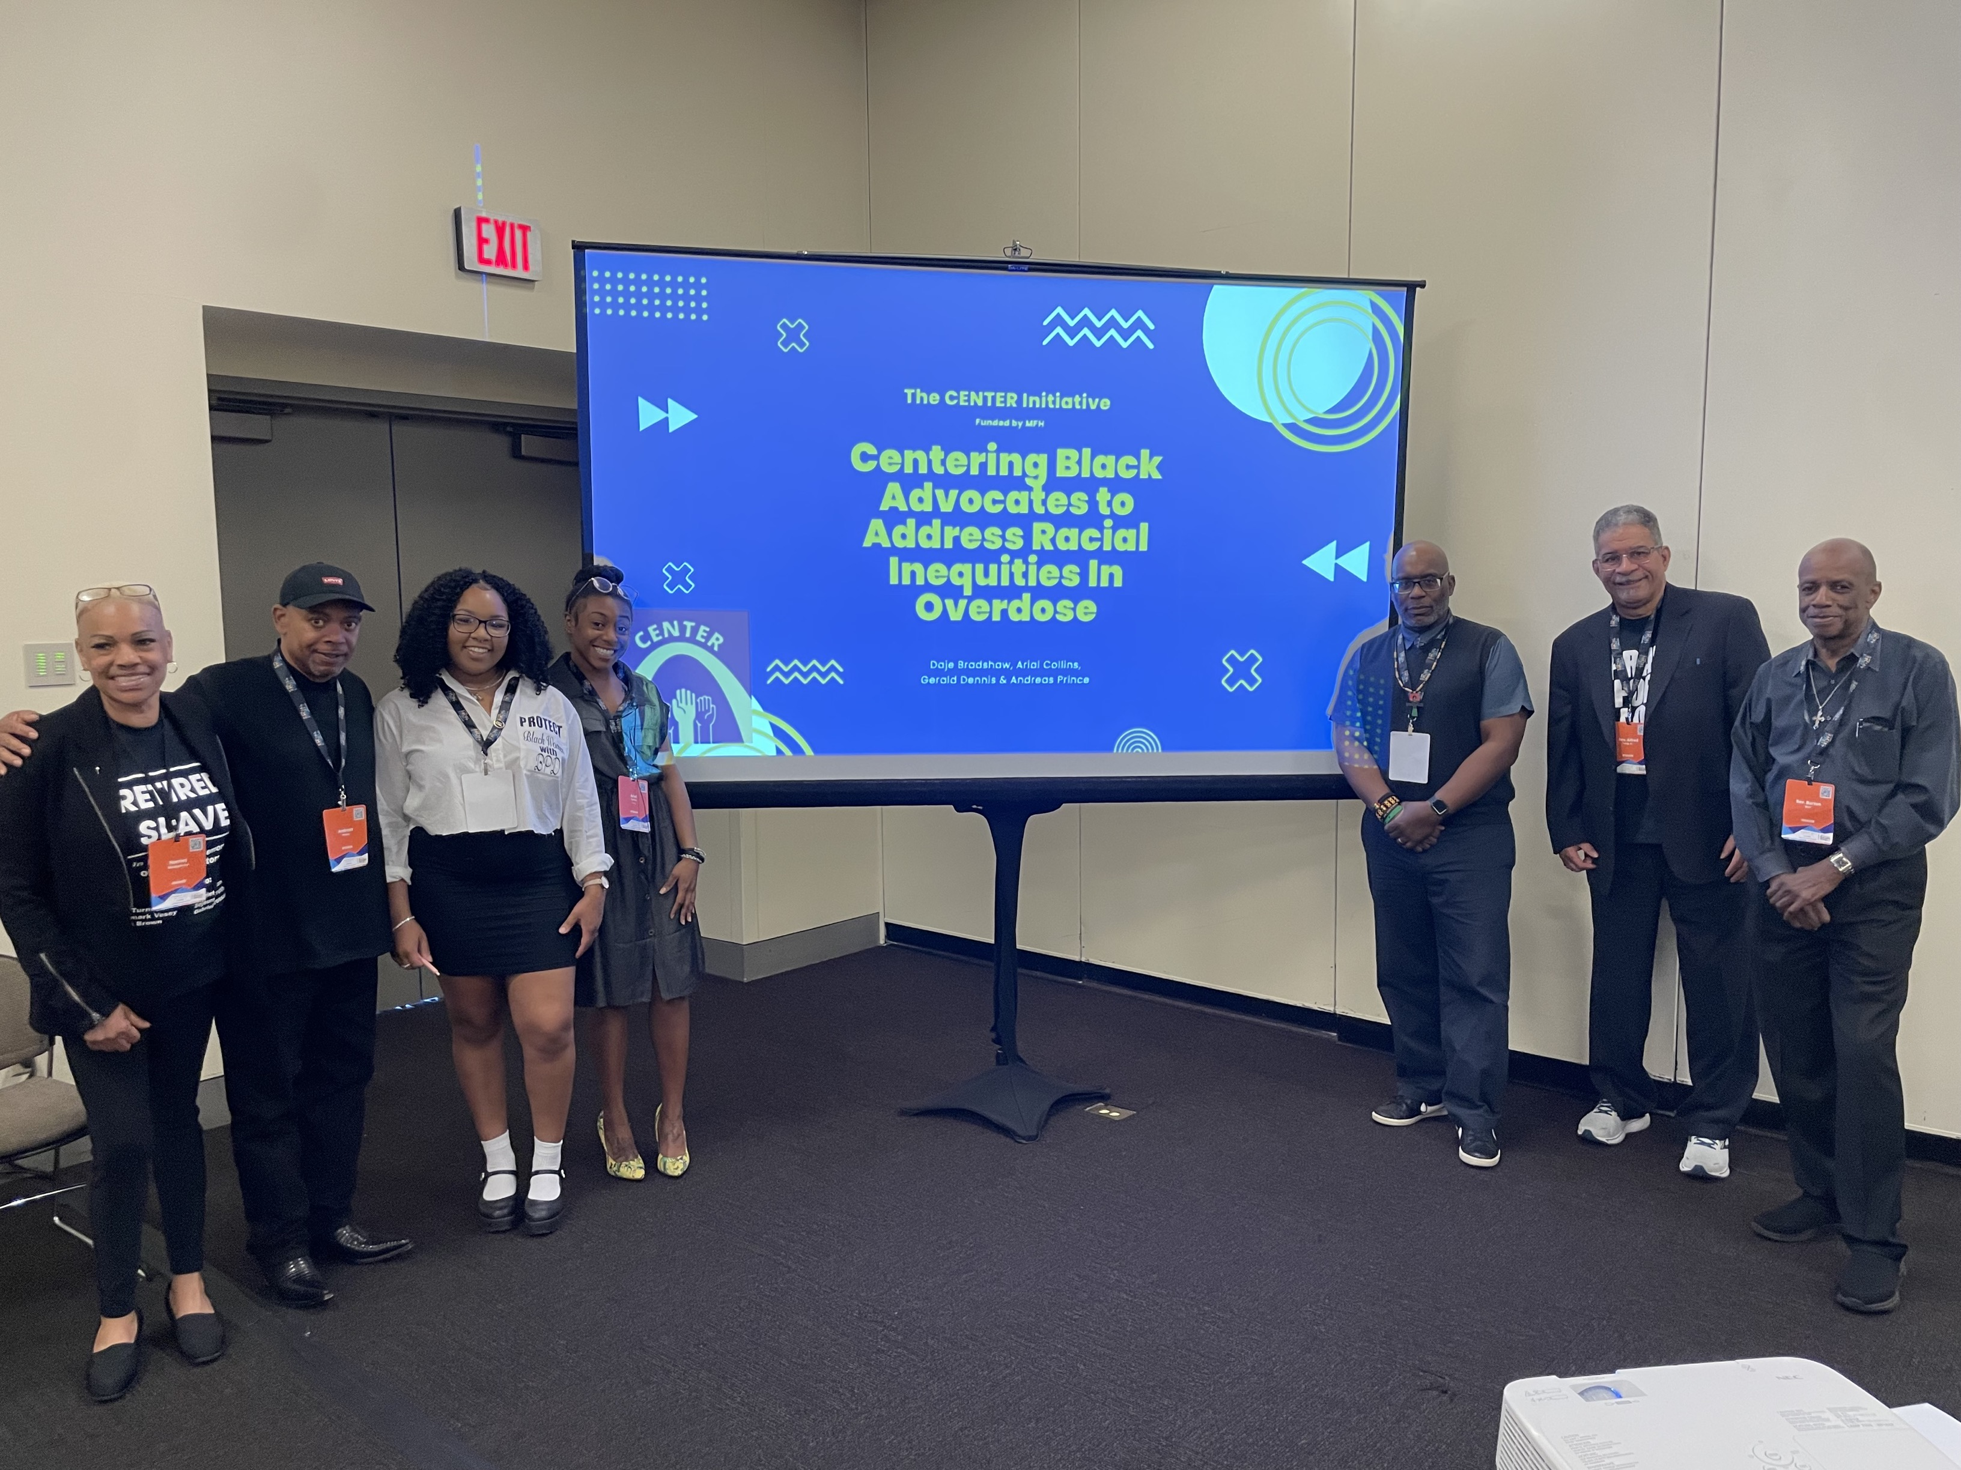
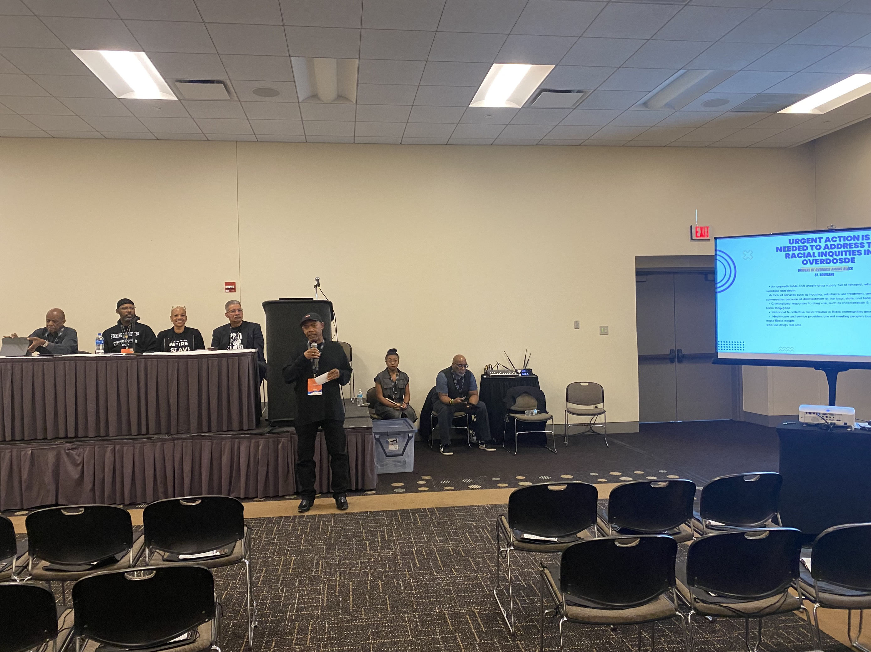



Dissemination: Transferring Knowledge to the Community

Slide 9
CONCLUSIONS
Employing a CAB, with lived experience, in all aspects of the research process is a
promising strategy
01
Implementing effective and equitable strategies (e.g., professional development) are vital for maximizing CAB contributions
02
Research institutions and funders must implement policies to strengthen ties between academics and PWUD
03

Slide 10
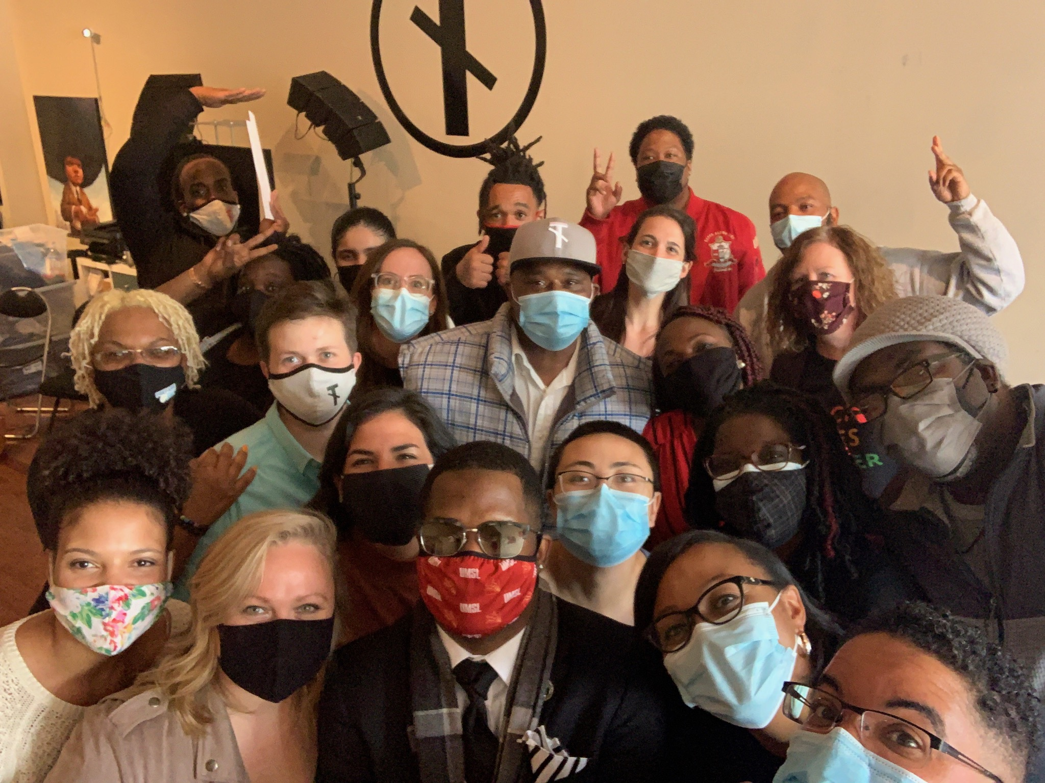

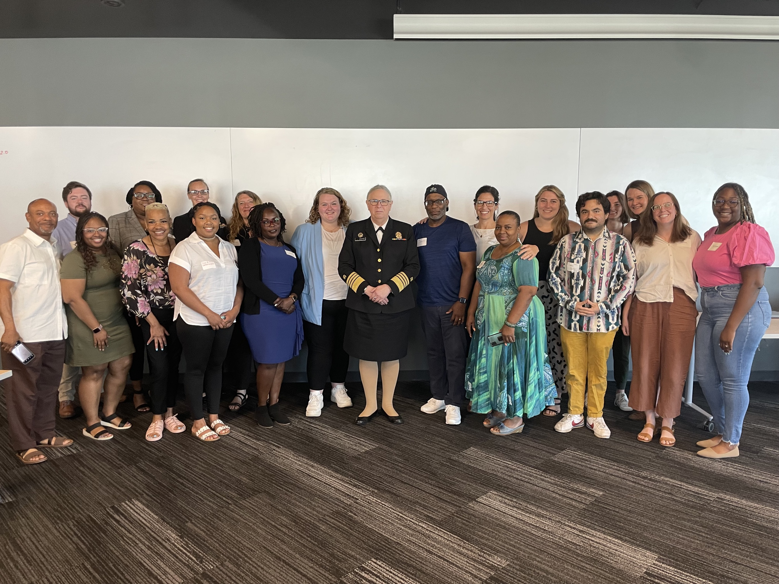
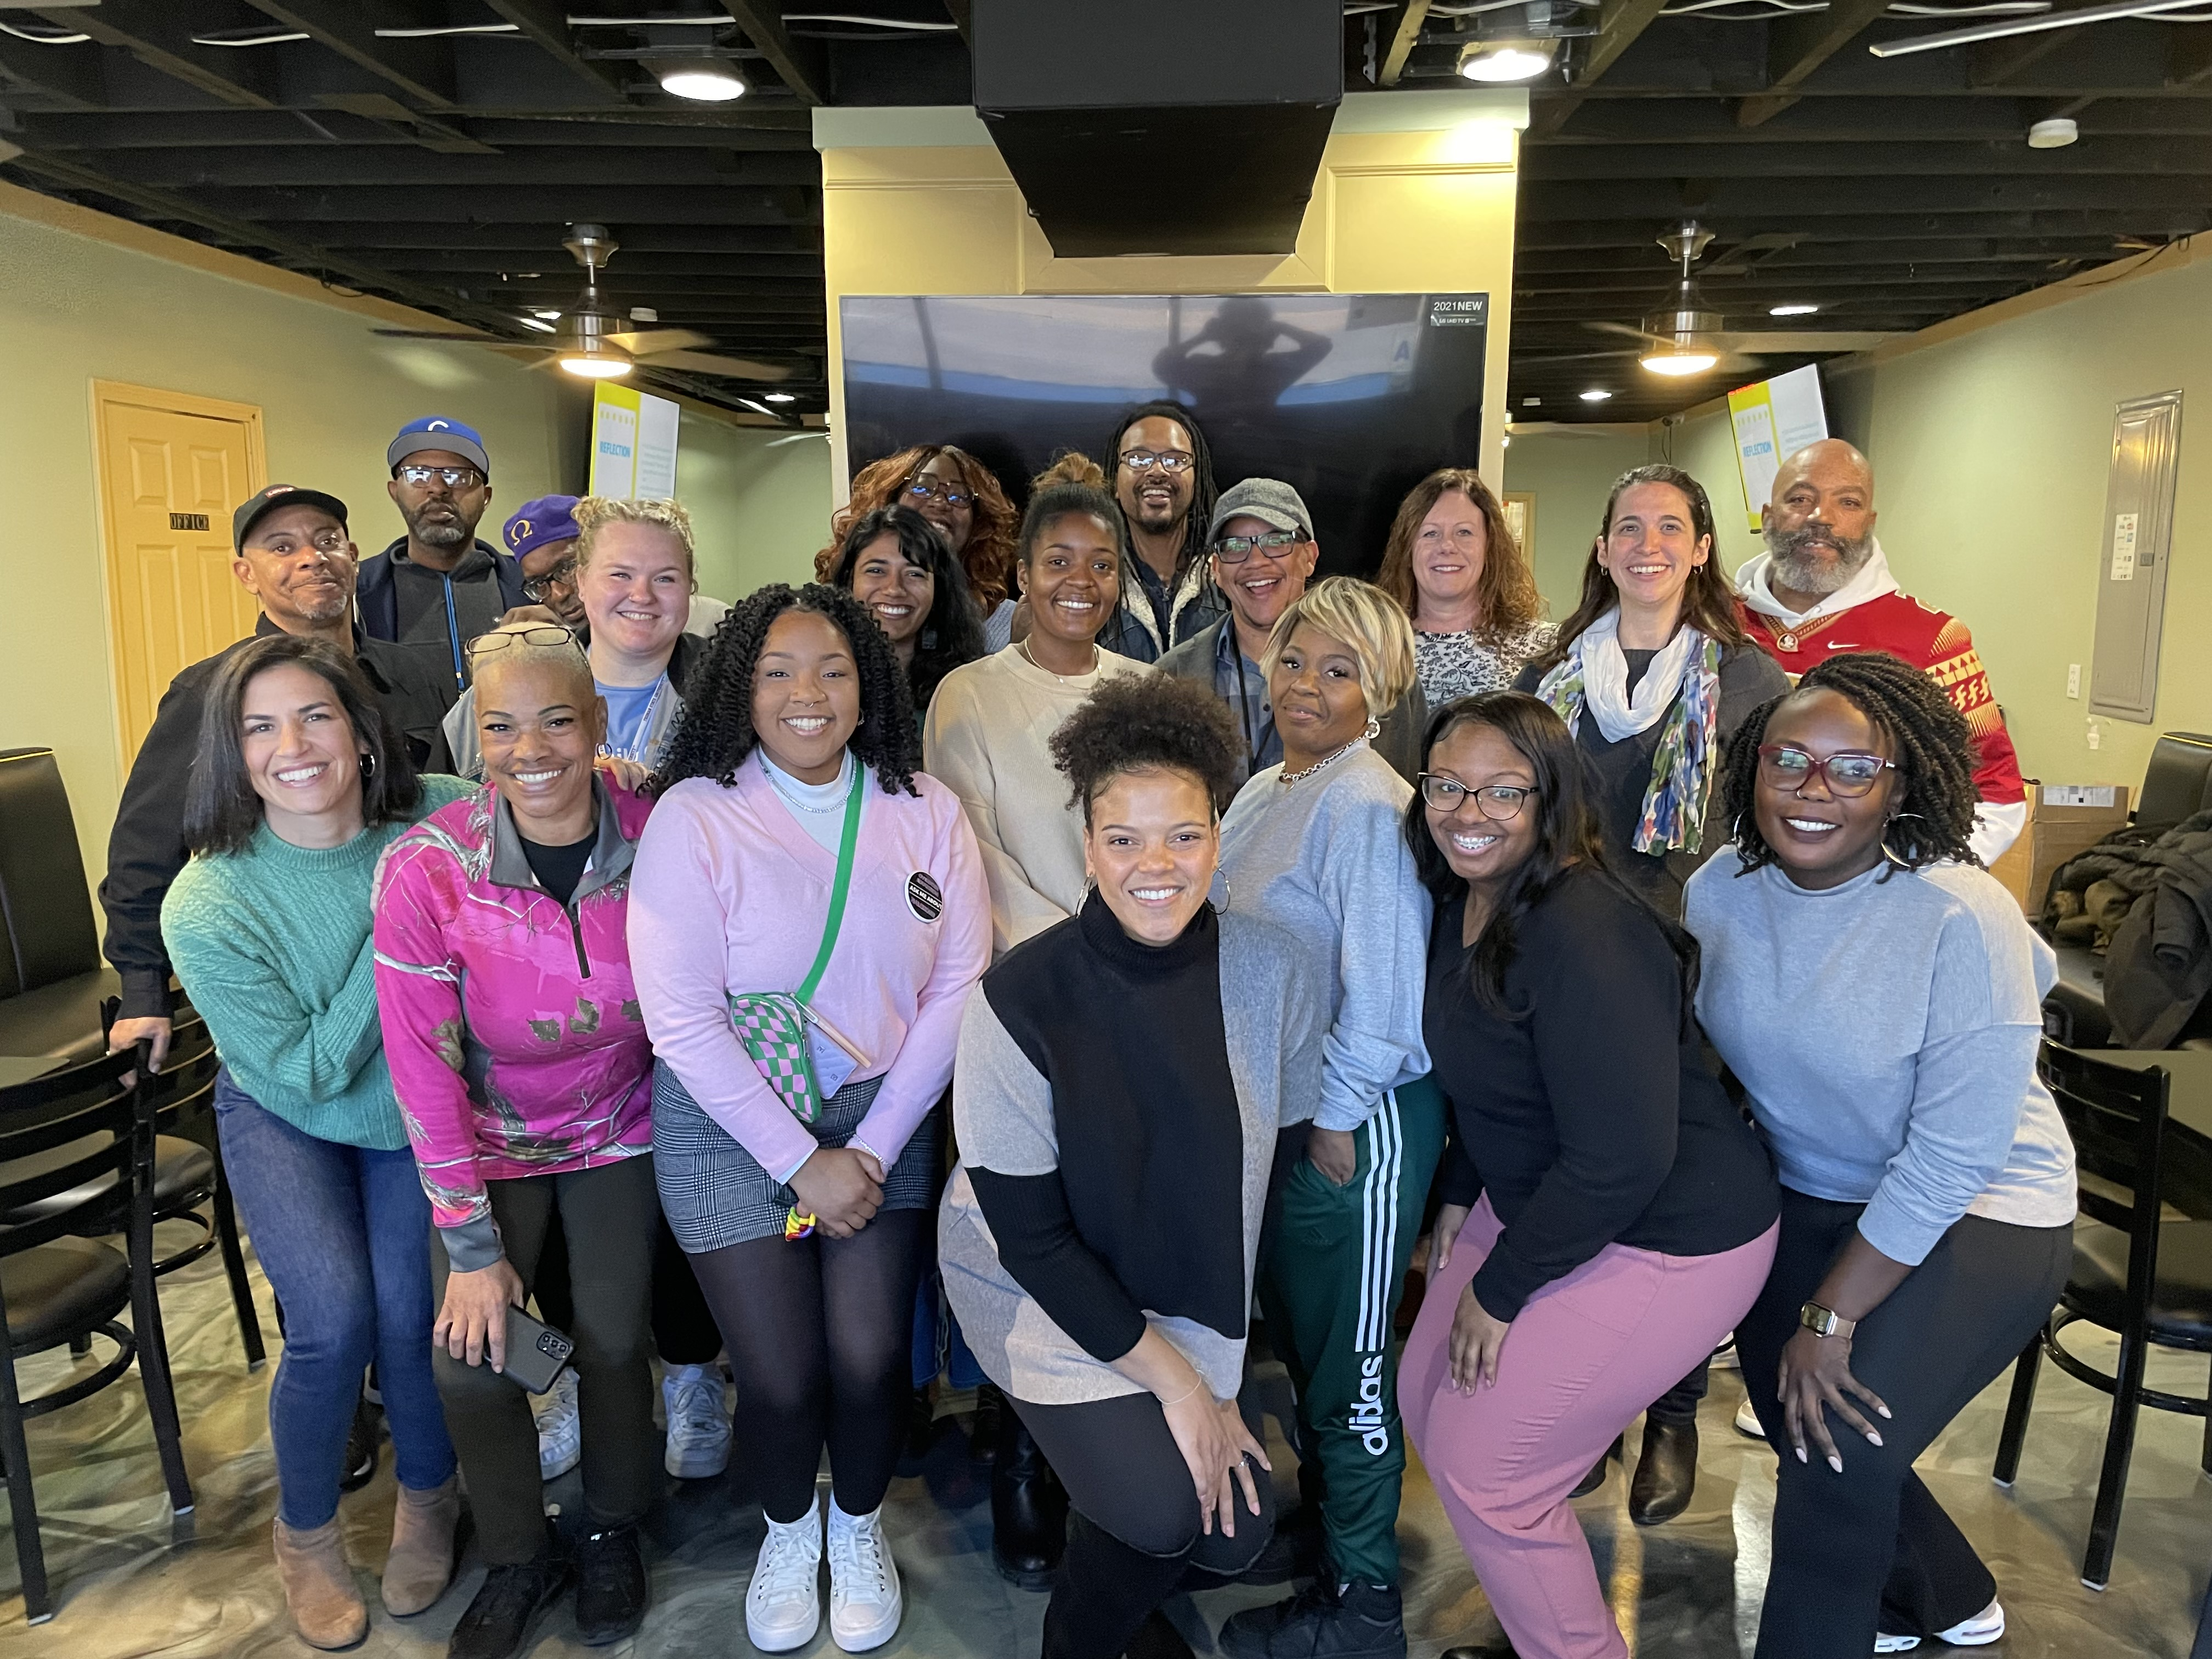
Research to Praxis
Community-based presentations, and engagement with news media and government officials
Contribution to financial sustainability
Advocacy
Funding
Capacity
& Power Building
Direct Intervention
Relationship-building and professional development
Active community engagement and direct service to Black people who use drugs

Slide 11




THANKS!
“Quite often, we’re not involved in the solution side of talking to people who have been through some of the things we’ve been through. We have been in that lifestyle and so some of the questions and things being asked, they’re things the CAB has lived through before or things they’re helping people through now.”
– Burton Barr, CAB Member
DO YOU HAVE ANY QUESTIONS?
“Being able to present and let people know that, first of all, it's not just researchers. It’s people with lived experience that have lived through this and is actually coexisting in this space to where now we're starting to help.”
- Keith Lofton, CAB Member
Presenter Contact Information:
kaydcampbell@umsl.edu
@KaytrynCampbell
www.centerstl.org

