Slide 1
Harm Reduction-Based Contingency Management for Stimulant Use Disorder
Dr. Surabhi Nirkhe and Dr. Meredith Adamo
San Francisco Department of Public Health

Slide 2
No disclosures

Slide 3
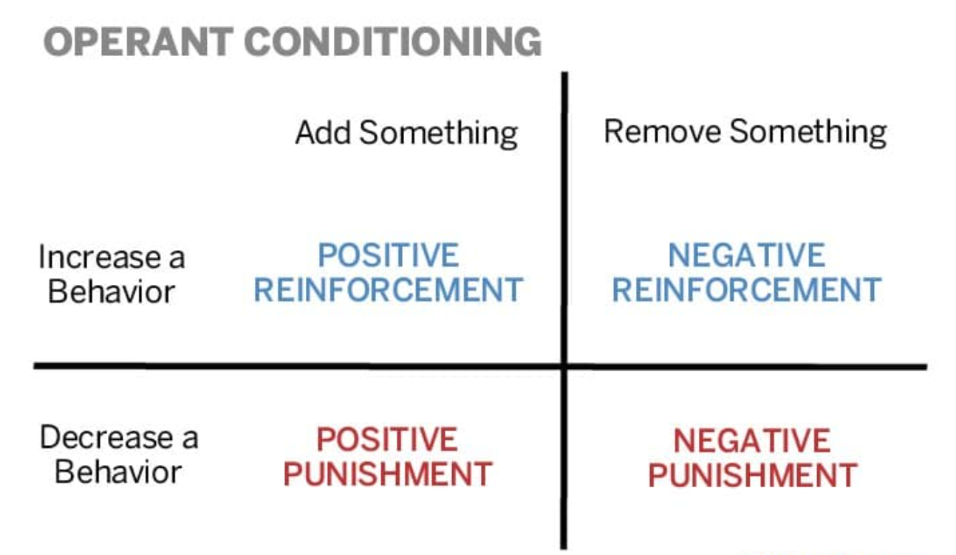
What is Contingency Management (CM)?
An evidence-based behavioral treatment that uses positive rewards to reinforce stimulant use cessation
Rewards = usually monetary
Abstinence = negative UDS

Slide 4
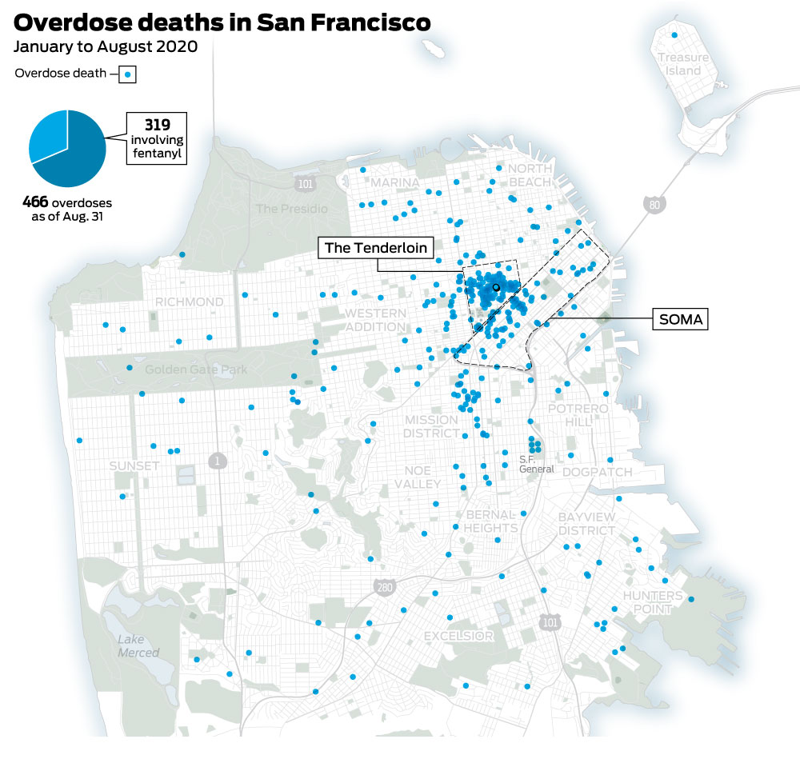
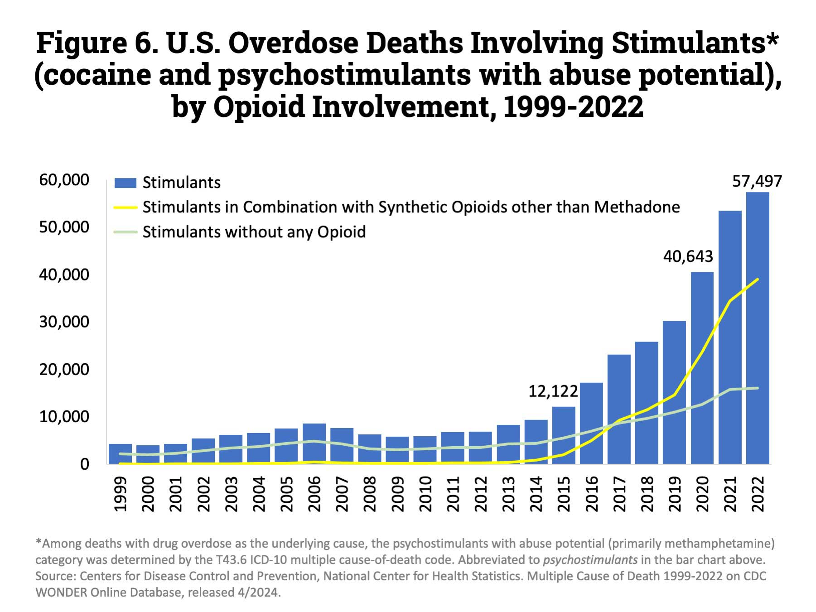
Tom Waddell Urban Health Center (TWUHC)
Maria X. Martinez Health Resource Center
(MXM)
Notes:
outdated….

Slide 5
Goals of Harm Reduction-Based CM
Goal | How?
Including people who are interested in reducing use but not necessarily abstinence
Lowering the barrier for people experiencing homelessness or housing instability
Retention in care
Engaging people in care for co-occurring conditions (medical, co-occurring SUD, psychiatric)
Creating a safe and supportive community

Slide 6
INSPIRE (INcentive Support Program for Improvement and REcovery)
1 year of planning: needs assessment, creating workflow & protocols, securing funding, identifying staffing and space
Funded independently through SF Department of Public Health
Funds allocated for overdose prevention
Overseen by Office of Behavioral Health Services
Not externally grant-funded
Not linked to CalAIM funding
Staffing (no new hiring)
Available team members: Providers (MD/SW), community health worker, Americorps, peer support specialists
Space: hosted at Maria X. Martinez Health Resource Center (low barrier walk-in clinic in SoMA)

Slide 7
Goals of Harm Reduction-Based CM
Goal | How?
Including people who are interested in reducing use but not necessarily abstinence | Independently incentivizing both attendance and abstinence via guaranteed rewards for both
Lowering the barrier for people experiencing homelessness or housing instability | Drop-in hours instead of appointment-based sessions, located within a walk-in clinic
Retention in care | Increasing rewards for consistent attendance
Engaging people in care for co-occurring conditions (medical, co-occurring SUD, psychiatric) | 1:1 check-ins with a medical and behavioral health provider
Creating a safe and supportive community | Community space led by peers and community health workers
Notes:
Providers (MD / SW: one-on-one participant meetings)
Program coordinator (CHW: gift card management, budget management)
Program navigator (Americorps: enrollment, outreach)
Peer support specialists (group space facilitators)

Slide 8
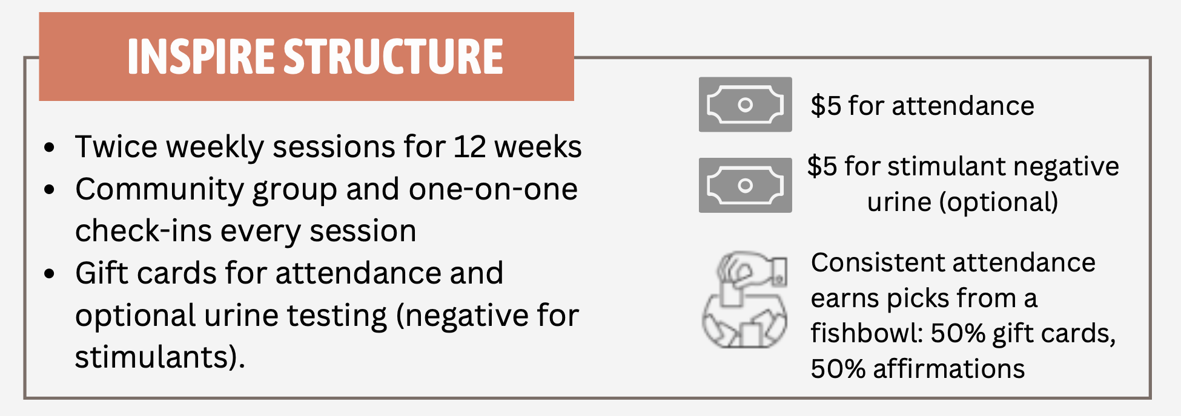
Referrals from both TWUHC and MXM clinics
If there are 3 missed visits in a row, participant will be disenrolled, but can be re-referred at a later time.
The maximum number of picks is 5.
Count resets to 1 for missed visit
(excused absences are ok).

Slide 9
Participant checks in at front with navigator, welcomed to back of clinic
Program coordinator and navigator provide gift cards, reminders for next visit; can then return to group or leave
One-on-one check in with provider + fishbowl draws in clinic room
Greeted by program coordinator, optional urine sample
Informal group / conversation room with peers/health worker
Snacks
Activities
Kindness
Provider (MD/SW) role:
MI + CM incentives
Off-label Rx
Connection to care for stimulant-related medical conditions
Overdose prevention counseling

Slide 10
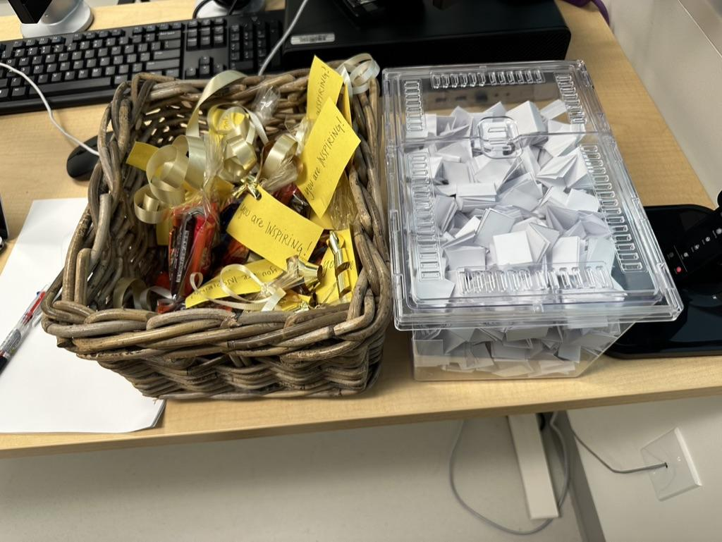
“I am prioritizing my health and happiness”
“I am resilient”

Slide 11
(Graduation = completing 12 weeks of the program or 24 visits)

Slide 12
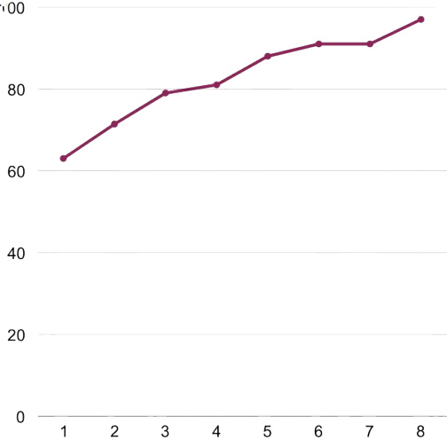
12 month data for INSPIRE:
October 2023 - October 2024
Graduation rate per minimum # of sessions attended
100
Overall graduation rate: 48%
Percentage
Total enrolled: 62
Total graduated: 30
# of sessions attended
Notes:
I dont think the x axis here is the correct label but i’m not sure what to call it!

Slide 13
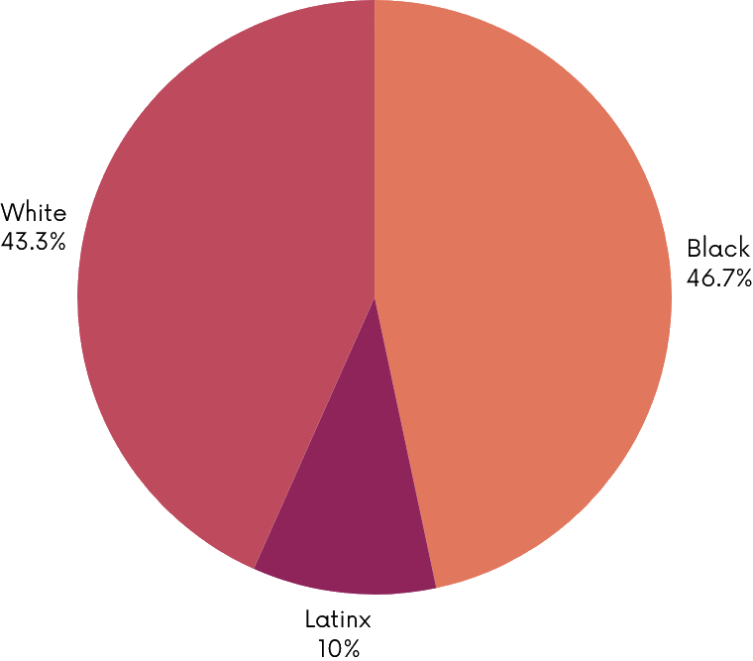
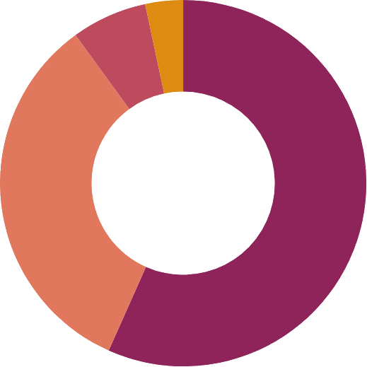
12 months of INSPIRE:
Graduate demographics
Non-binary
3%
Trans women
7%
Average age: 52
Age range: 30-64
White
43%
Black
47%
>96% have a stimulant-related comorbidity
Latinx
10%
Cis women
33%
Cis men
57%
53% have had a prior accidental opioid overdose
Notes:
Of 32 graduates, 7 with co-morbid OUD, 5 “more” engaged with MOUD during time in INSPIRE, 1 not interested in MOUD at the time, 1 decreased engagement in MOUD

Slide 14
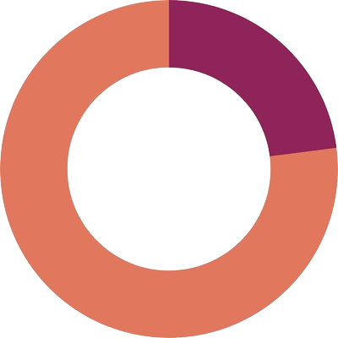
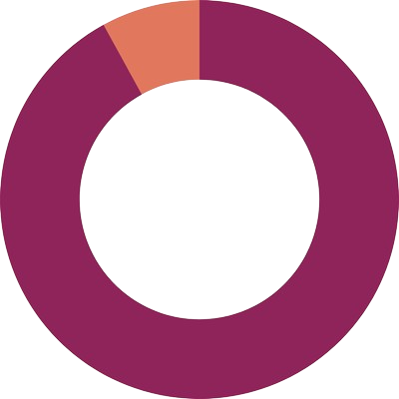
12 months of INSPIRE:
Graduate participation data
Average incentive earned | Range of incentives earned
$347 | $80-$599*
Average visits attended: 18 of 24 (75%)
*max incentive is $599 for tax purposes
23% of graduates gave
non-reactive UDS at any point
(Range of # of NR UDS given per participant: 1-20)
92% of graduates reported subjective
decrease in stimulant use
Notes:
Of 8% that did not report subj decrease: 1 person reported no change, 1 person reported increased use

Slide 15
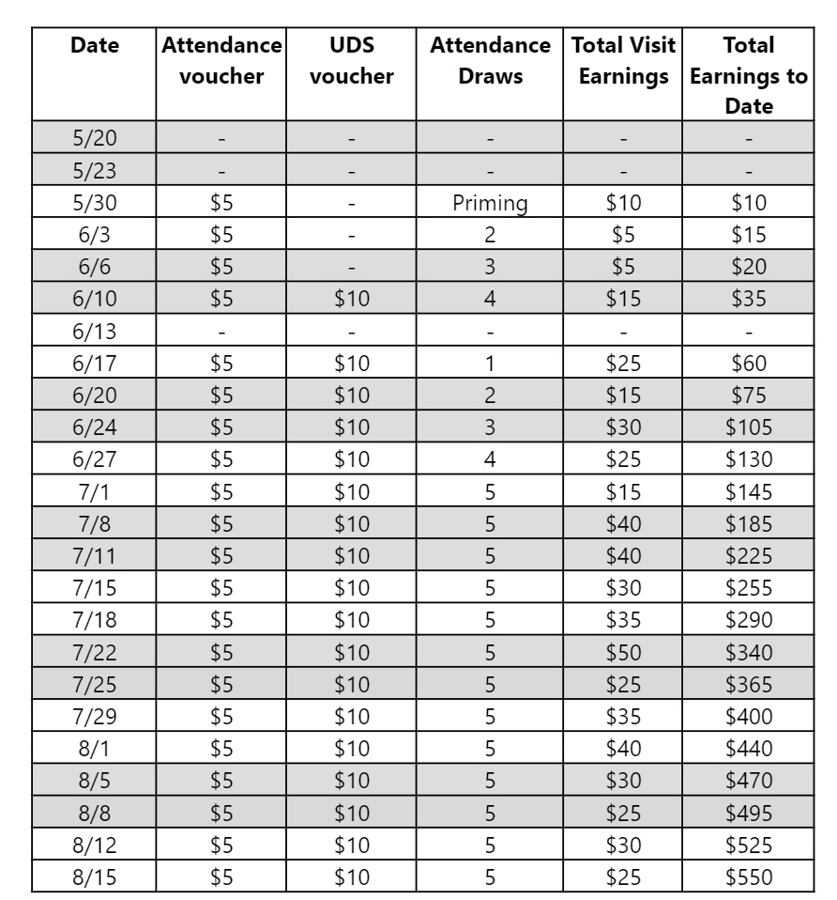
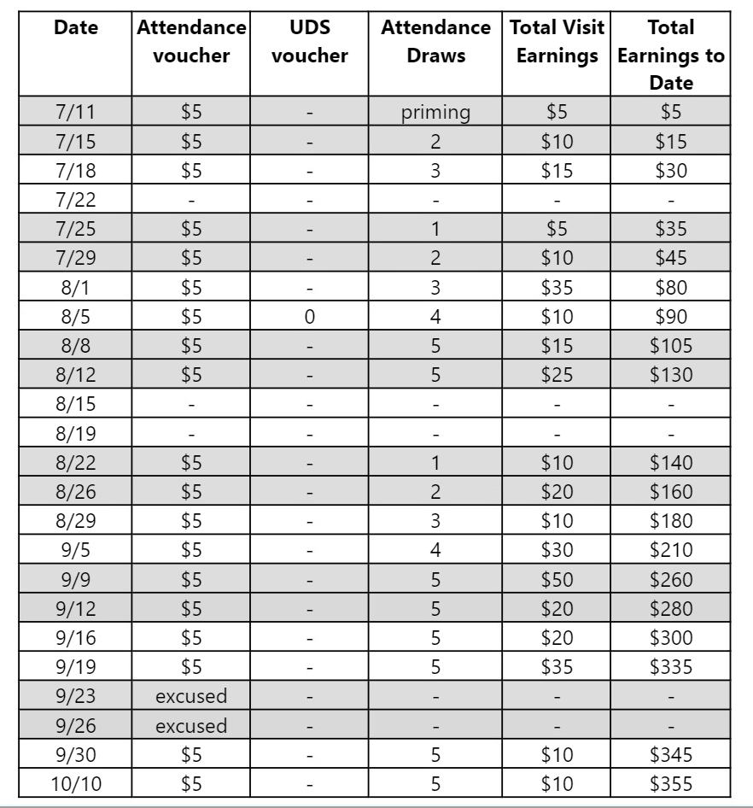
Patient A
Patient B

Slide 17
Lessons learned:
Harm reduction-based contingency management programming is possible, effective, and desired by patients.
Programs can accommodate a variety of participant goals.
Interdisciplinary involvement yields creative programs.
Tailor programs to the specific needs of the community. One size does not fit all!
Invite participant feedback – they have the best ideas!

Slide 18
Next steps for harm reduction-based contingency management:
Expanding to more clinics
Formal program evaluation, data dissemination (qualitative and quantitative)
Publication of protocols
Advocacy for non-abstinence based CM
Securing stable funding sources (eg. CalAIM)

Slide 19
Thank you!
Further questions / collaboration:
nirkhes@nychhc.org
meredith.a.adamo@sfdph.org

