Slide 1
Harm Reduction Supply Distribution via Vending Machines: 8-Month Outcomes for a California Veterans Affairs Health Care System
AMERSA National Conference, Chicago, IL, November 2024
Presenting Author | Co-Author
Tessa Rife-Pennington, PharmD, BCGP Pronouns: she/her/hers Harm Reduction Coordinator San Francisco Veterans Affairs Health Care System Volunteer Assistant Clinical Professor University of California, San Francisco, School of Pharmacy 2024 Dr. Dawn K. Smith HIV Prevention Clinical Fellow American Academy of HIV Medicine | Michael Douglas, MS Pronouns: he/him/his Program Manager/Researcher Oni-Orisan Lab Rife-Pennington HRVM Study TRANSPERS Center (Phillips, Jansen, Mrig) Wilson Lab Research Support Program Department of Clinical Pharmacy University of California, San Francisco
Notes:
Good afternoon, my name is Tessa Rife-Pennington. I am honored to moderate this afternoon’s oral presentation session focused on Viral Illness and Syringe Access. I will start us off today with the first presentation. A bit about me – I’m a pharmacist by training, Harm Reduction Coordinator at the San Francisco VA, and volunteer faculty at UCSF School of Pharmacy. My research and quality improvement work centers on implementation and evaluation of harm reduction interventions among people who use substances, experience related infections and overdoses, and housing insecurity. Today I am presenting Harm Reduction Supply Distribution Via Vending Machines: 8-Month Outcomes for a California Veterans Affairs Health Care System.

Slide 2
Disclosures
The views expressed in this presentation are those of the authors and do not necessarily reflect the position or policy of the Department of Veterans Affairs or the United States government.
The authors have no conflicts of interest to disclose.
Funding:
  National VA Pain Management, Opioid Safety, Prescription Drug Monitoring Program
  National VA Office of Mental Health and Suicide Prevention
  San Francisco Veterans Affairs Health Care System
  UCSF Benioff Homelessness and Housing Initiative grant
Notes:
My co-author, Michael Douglas, and I have no conflicts to disclose. This work represents our own views and not those of the government or the VA. You can see our funding sources listed.

Slide 3
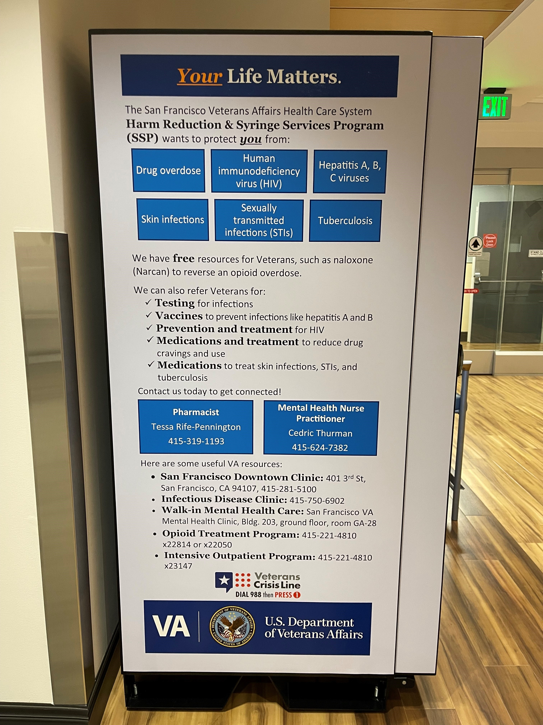
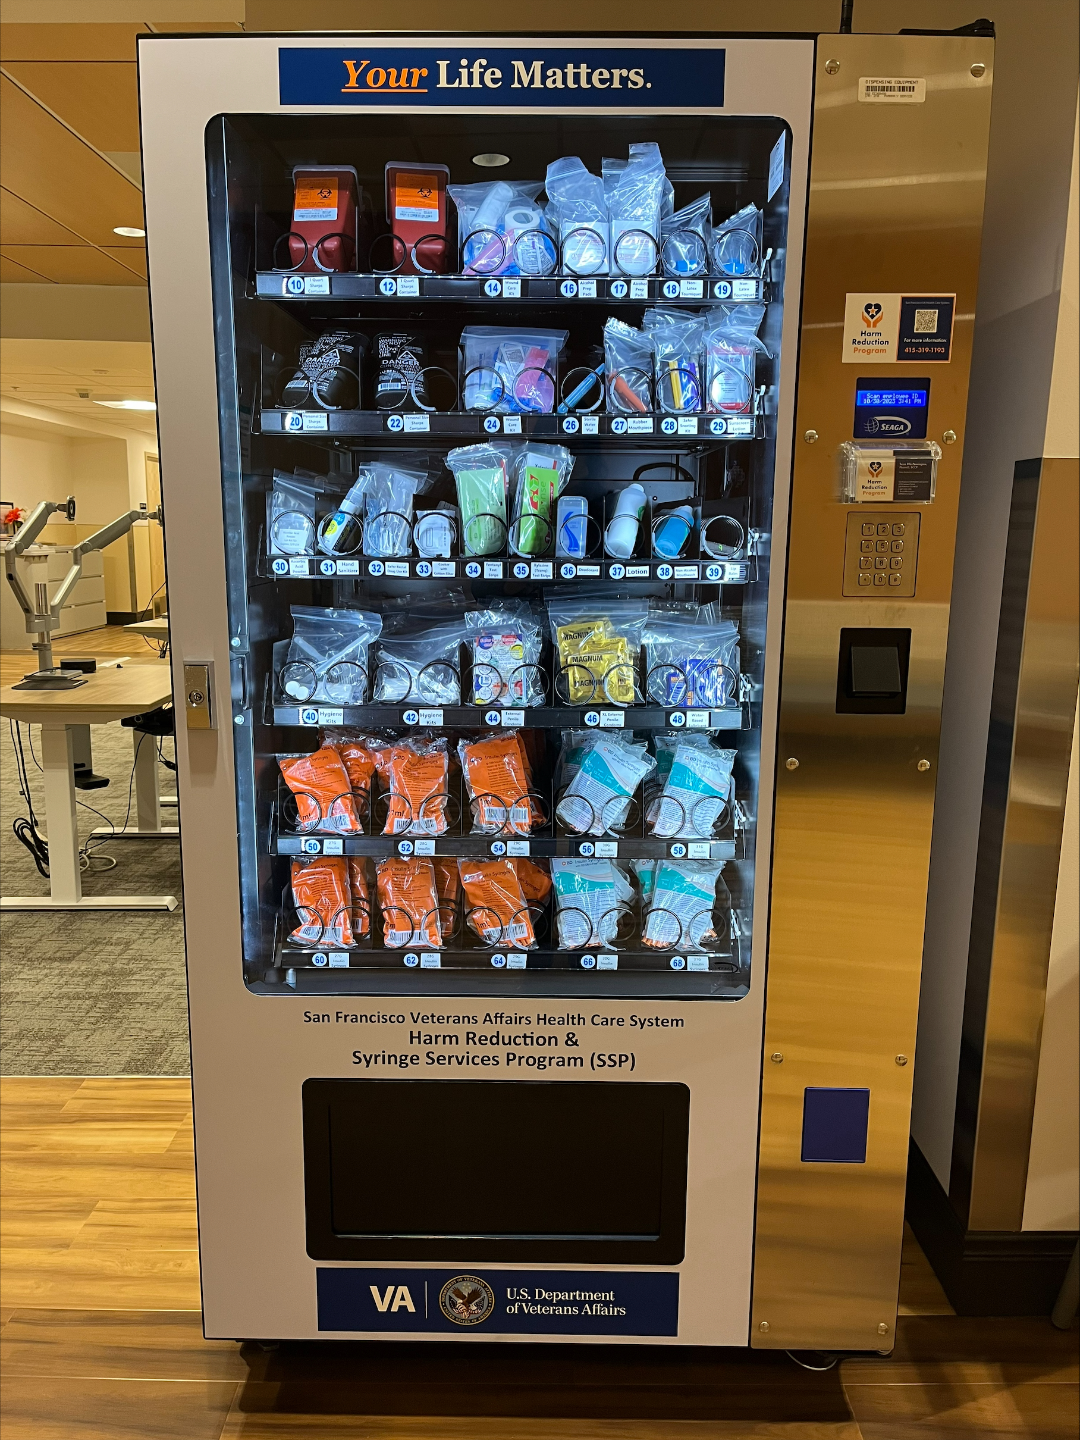
Aims
Evaluate 8-month outcomes of supply distribution via 15 harm reduction vending machines (HRVMs) in northern California
Notes:
Our aims for this project were to evaluate 8-month outcomes of distributing supplies through 15 harm reduction vending machines located across northern California

Slide 4
HRVM Locations
2 San Francisco VA Medical Center
Opioid Treatment Program Clinic
7 community-based outpatient clinics
Clearlake
Mental Health, Occupational Therapy, Physical Therapy Clinic
Oakland primary care
6 Veterans housing buildings
Oakland behavioral health
Eureka
Downtown San Francisco
South Santa Rosa
Ukiah primary care
Veteran residents only
Maceo May Apartments
Veteran and civilian residents
Colma Veterans Village
Edwin M. Lee Apartments
Stanford Hotel
Veterans Academy
Veterans Commons
Notes:
We have 2 machines located at our main hospital, 1 each in 7 northern California community-based outpatient clinics, and we have 6 located inside San Francisco Bay Area housing sites where veterans live.
Placing vending machines in locations where veterans live was really important to me. Many of these veterans have been living outside for many years, and when they become housed, they often do not have essentials needed for survival or means to purchase them. This was a way to bring the resources to those veterans in a way that brings dignity, autonomy, and respect.

Slide 5
HRVM Go Live Timeline
August 2023
10 HRVMs
September 2023
4 HRVMs
March 2024
1 HRVM
3 VA settings
1 supportive housing building
6 VA settings
4 supportive housing buildings
1 supportive housing building

Slide 6
HRVM Supplies
Safer Injection
External latex condoms (2 sizes)
Water-based lubricant
Hygiene
Hygiene kits
Lotion
Alcohol-free mouthwash
Other Safer Use
Syringes (5 sizes)
Sharps containers (2 sizes)
Tourniquets
Alcohol swabs
Safer Sex
Snorting kits
Rubber mouthpieces
Rectal use kits
Deodorant
Hand sanitizer
Cookers with cottons
Sterile water
Ascorbic acid powder
Wound care kits
Fentanyl and xylazine test strips
Lip balm
Notes:
Our vending machines dispense a variety of harm reduction supplies. We have 5 sizes of syringes, 2 sizes of sharps containers, wound care kits, and other resources for safer injection use. We also have safer snorting, smoking, and rectal use kits and drug testing strips. We have 2 sizes of latex condoms, lubricant, and a range of hygiene supplies.
One of my goals was to have something in the machine that any veteran could use, whether or not they use substances, to help normalize and reduce stigma surrounding the machines.

Slide 7
Methods
VA REDCap survey
Number of Veterans with HRVM access
Sociodemographics
Resource acceptance
VendNovation web-based software
Descriptive statistics evaluated results
Total supplies dispensed by type, location, and day/time of day
August 1, 2023, - March 31, 2024
Notes:
I designed a REDCap survey to register Veterans for access to the machine which collects some very minimal information and optional demographics. Veterans are also offered some resources when they gain vending machine access.
We track total number and type of supplies distributed, as well as date and time of day, through the vending machine company web-based software.
We used descriptive statistics to evaluate our 8-month results.

Slide 8
Results
281 Veterans registered for HRVM access
199 (70.8%) Veterans accessed ≥1 item
3567 products were dispensed
Notes:
At 8-months, 281 Veterans had access to the vending machines. Over 70% of those accessed one or more supplies out of the vending machines. Over 3500 products were dispensed across all 15 machines.

Slide 9
Sociodemographics at the time of HRVM Registration (n=281) |  | n (%)
Age, years (mean ± SD) |  | 60.2 ± 13.8
Gender | Man Woman Transgender, gender non-conforming, or other Unknown or not provided | 229 (81.5) 20 (7.1) 5 (1.8) 27 (9.6)
Race/Ethnicity | White or Caucasian Black or African American Hispanic or Latinx Multiple Asian Other American Indian, Native American, or Alaska Native Native Hawaiian or Other Pacific Islander Unknown or not provided | 101 (35.9) 78 (27.8) 27 (9.6) 13 (4.6) 11 (3.9) 8 (2.8) 7 (2.5) 6 (2.1) 30 (10.7)
6 months prior to HRVM registration | Experienced ≥1 unhoused night Experienced ≥1 opioid overdose | 36 (12.8) 11 (3.9)
Notes:
Here is a summary of our Veteran demographics. They were an average age of 60, primarily male, about 36% were White or Caucasian, and 28% black or African American.
In the 6 months before getting access to the vending machines, nearly 13% reported experiencing one or more unhoused nights and 4% experienced one or more opioid overdose.

Slide 10
Notes:
When Veterans register for access to the vending machines they are offered these resources. The most common accepted was naloxone, followed by overdose education. Many Veterans are familiar with naloxone and have personal experience using it, so not everyone needs new training.
Importantly, some were also connected to community-based harm reduction programs, substance treatment resources, and infection testing and care.

Slide 11
Locations & Timing of HRVM Access
HRVM Location | Total Items (Packages) Dispensed, n (%) | Accessed During Business Hours, n (%) | Accessed During Non-Business Hours, n (%)
Supportive housing | 2194 (61.5) | 733 (33.4) | 1461 (66.6)
VA hospital or clinic | 1373 (38.5) | 1289 (93.9) | 84 (6.1)
Business Hours: Monday – Friday, 8am – 4:30pm
Notes:
Over 61% of total products were dispensed through the 6 vending machines located in supportive housing buildings, compared to 9 in VA settings. Supportive housing vending machines were also most access outside regular business hours, over 66% of the time. We defined business hours as Monday to Friday, 8am to 4:30pm. As you might expect, vending machines in VA settings were most access when those clinical areas were open for patient care. About 6% of the time people did access them outside regular hours, and that was typically a few minutes before clinic opening or after closure.

Slide 12
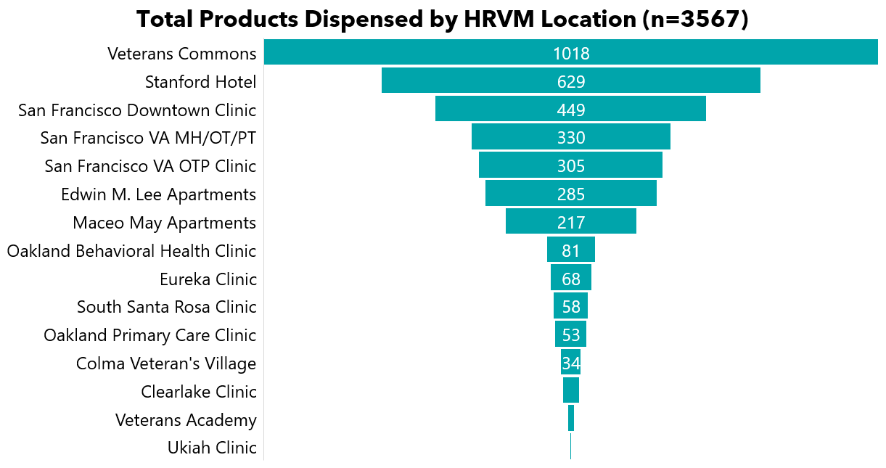
27
11
2
Notes:
Here you can see the total products dispensed by location. The most common locations accessed were Veterans Commons and Stanford Hotel, which are two supportive housing buildings. The San Francisco Downtown Clinic came next. This is important because this clinic serves a large number of our Veterans at risk or experiencing homelessness.
I also want to point out that Veterans Academy, which is a supportive housing building, went live near the end of our data collection period. That’s why the number is so low, next to last. Since then, this is one of our most accessed machines.

Slide 13
10/package
3/package
1/package
Notes:
Here you can see total products dispensed. Total insulin syringe packages, hygiene kits, condom packages, and wound care kits were most common.
Some of the items are stocked in packs of 10, and one in a pack of 3, so you can multiply to get the total number of syringes dispensed, which was over 4200.

Slide 14
Conclusions
Access to harm reduction resources outside regular business hours
Access for Veterans with housing insecurity
Challenges
Item backorder (hand sanitizer)
Next Steps
Add state-funded naloxone to HRVMs
Lack of wi-fi connectivity at Veterans Academy
Inability to put VA naloxone in HRVMs
↑ syringe distribution
↑ Harm Reduction Program engagement
Evaluate Veteran and staff feedback on HRVMs, supplies, and impacts
Funding
Staffing
Notes:
In conclusion, Veterans most accessed vending machines located where they live, which are also accessible 24/7. This program also supported those who often experience housing insecurity and access services at our Downtown San Francisco Clinic.
I don’t have data here to show – but I can say that our overall participant engagement and syringe distribution has really increased since having these machines.
There have been challenges along the way, including items being on back order, wi-fi connectivity issues, lack of an ongoing source of funding, and lack of adequate staffing. We were also unable to put VA naloxone kits in the machines, because VA requires a prescription. I designed these machines to be anonymous with no patient identifiers attached.
Next, I plan to put California state funded naloxone in the machines, which does not require a prescription. I also am conducting qualitative interviews with Veterans and staff to get feedback on the program.

Slide 15
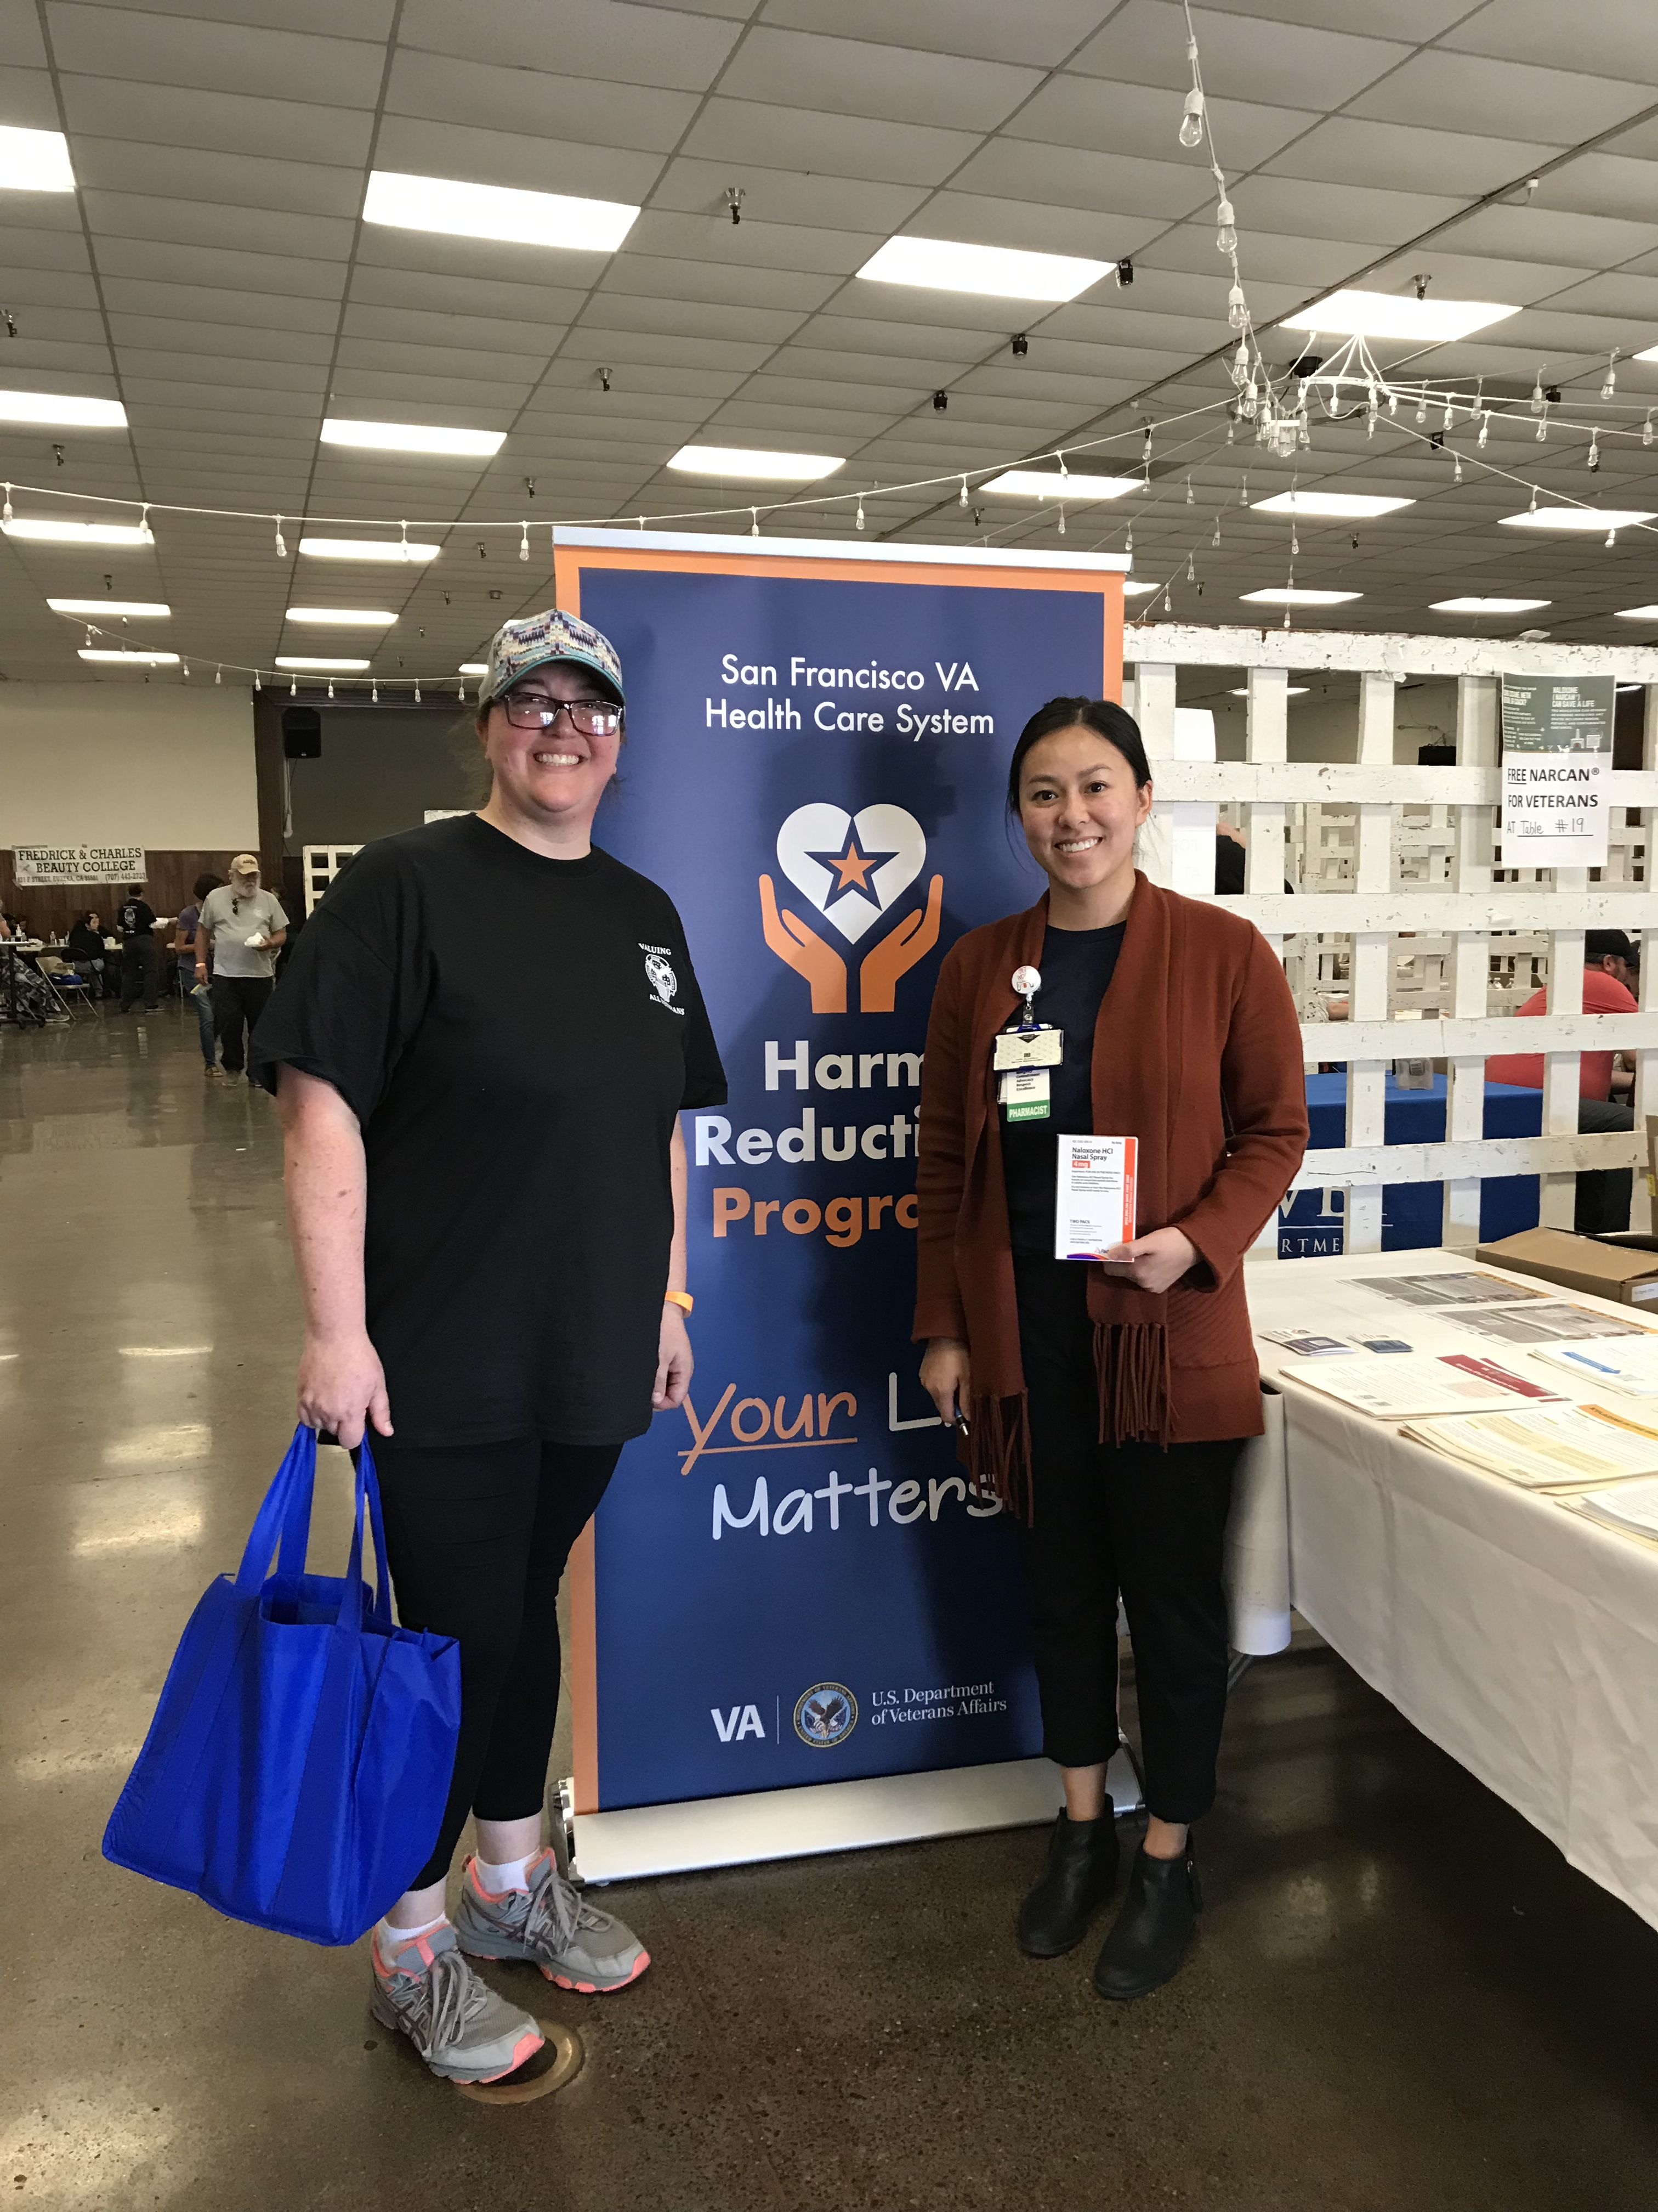
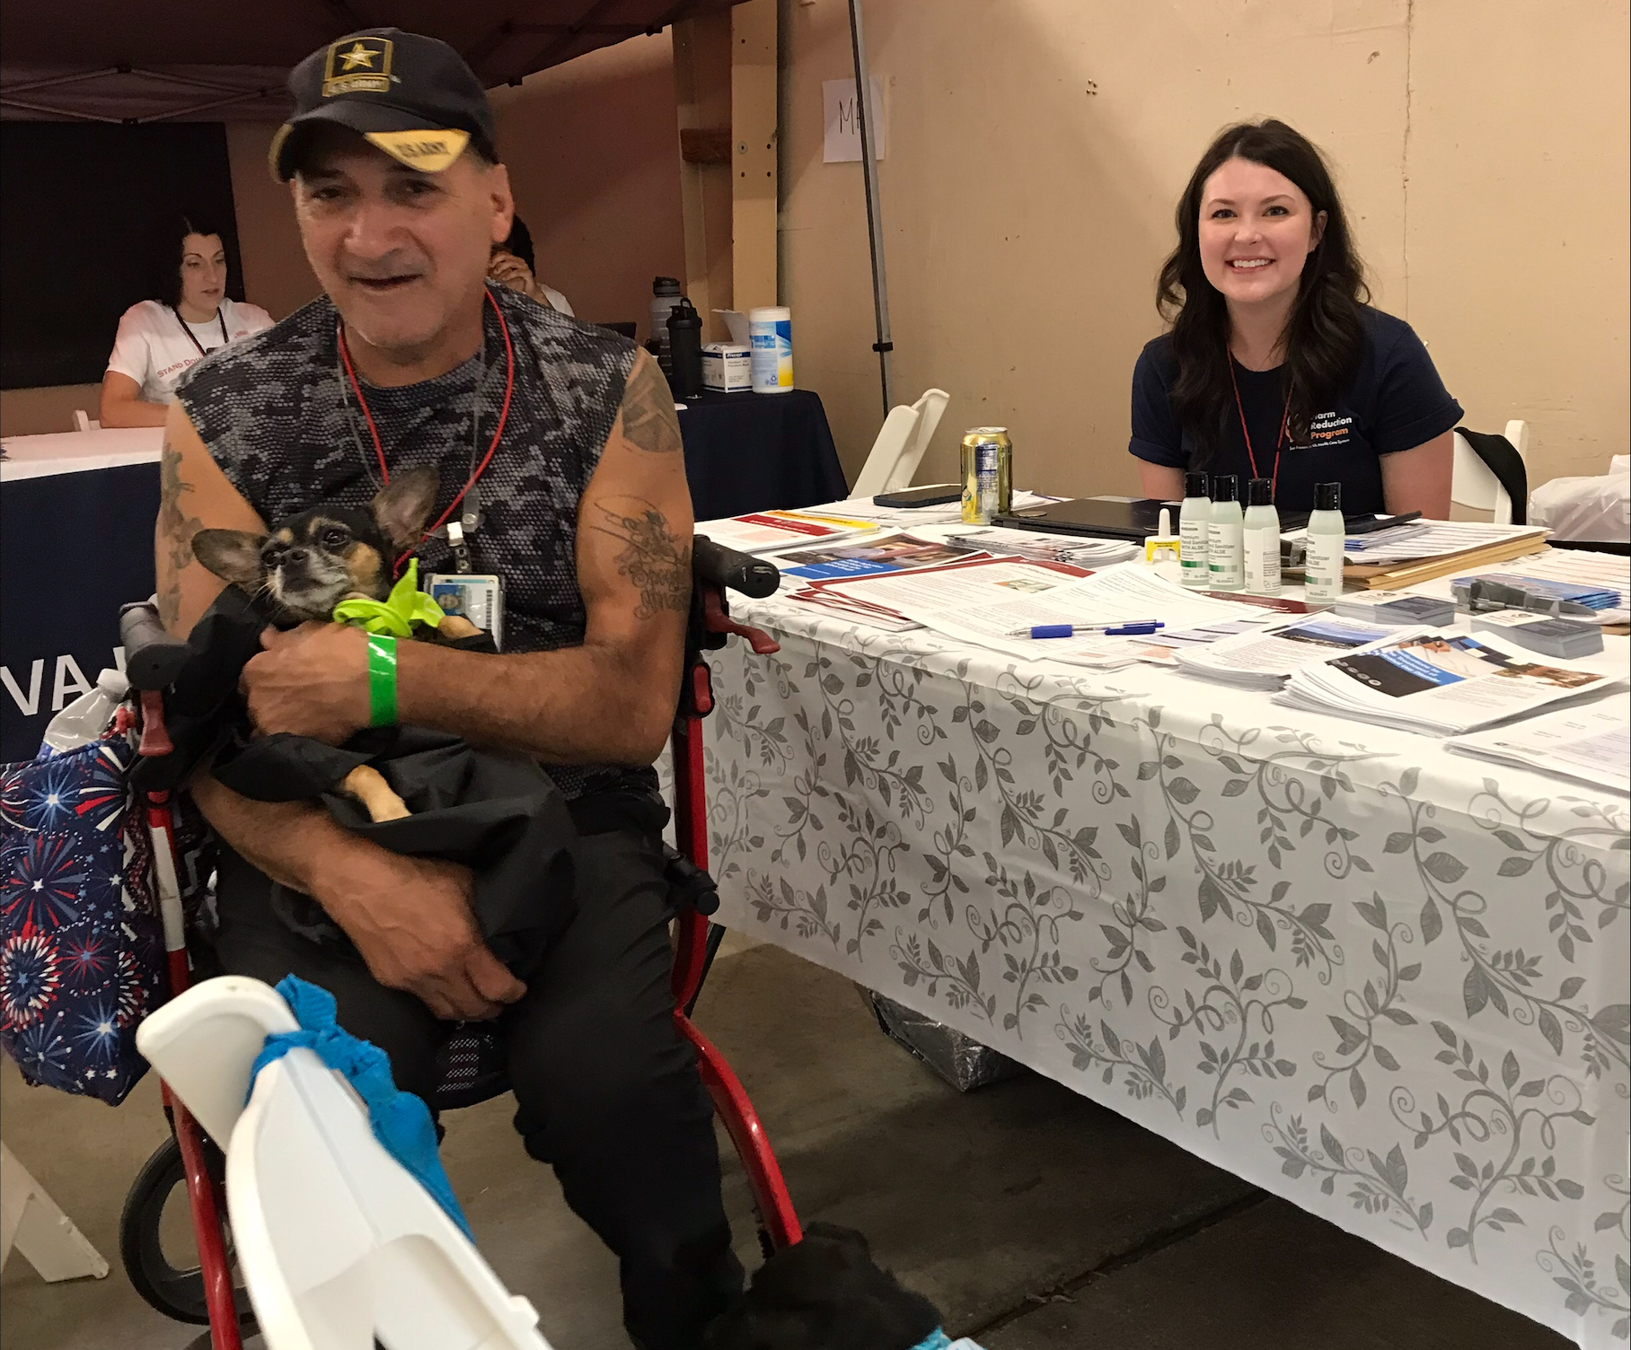
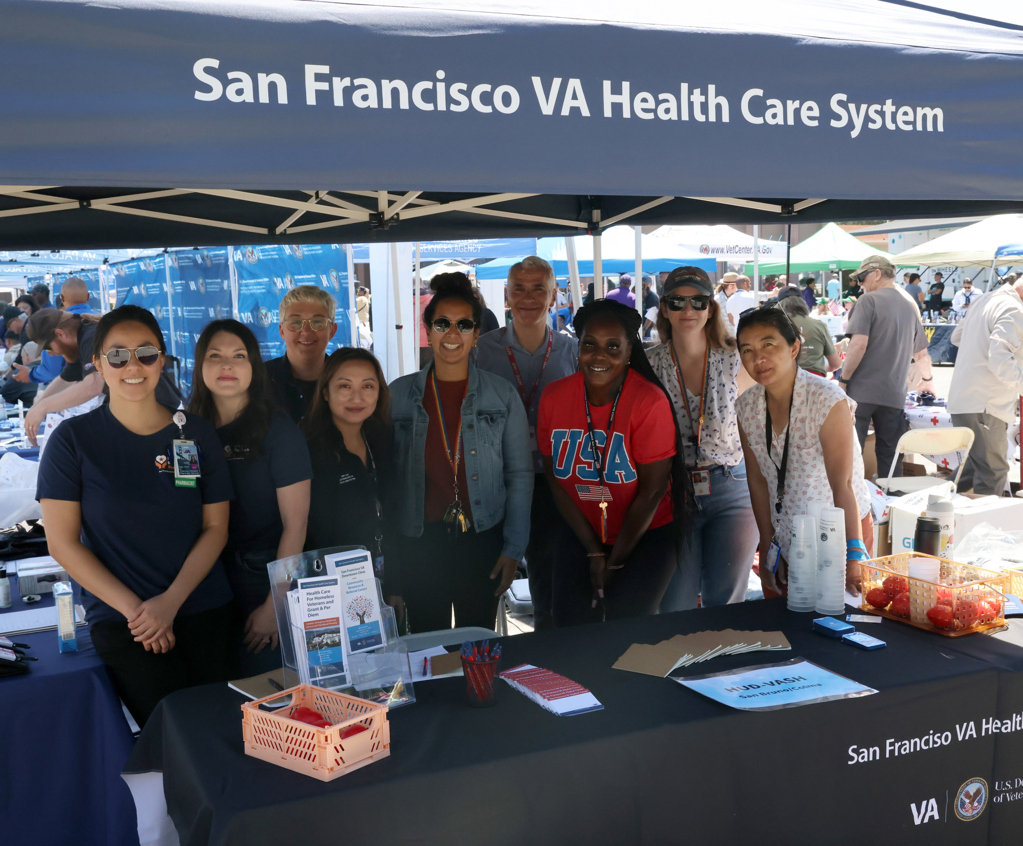
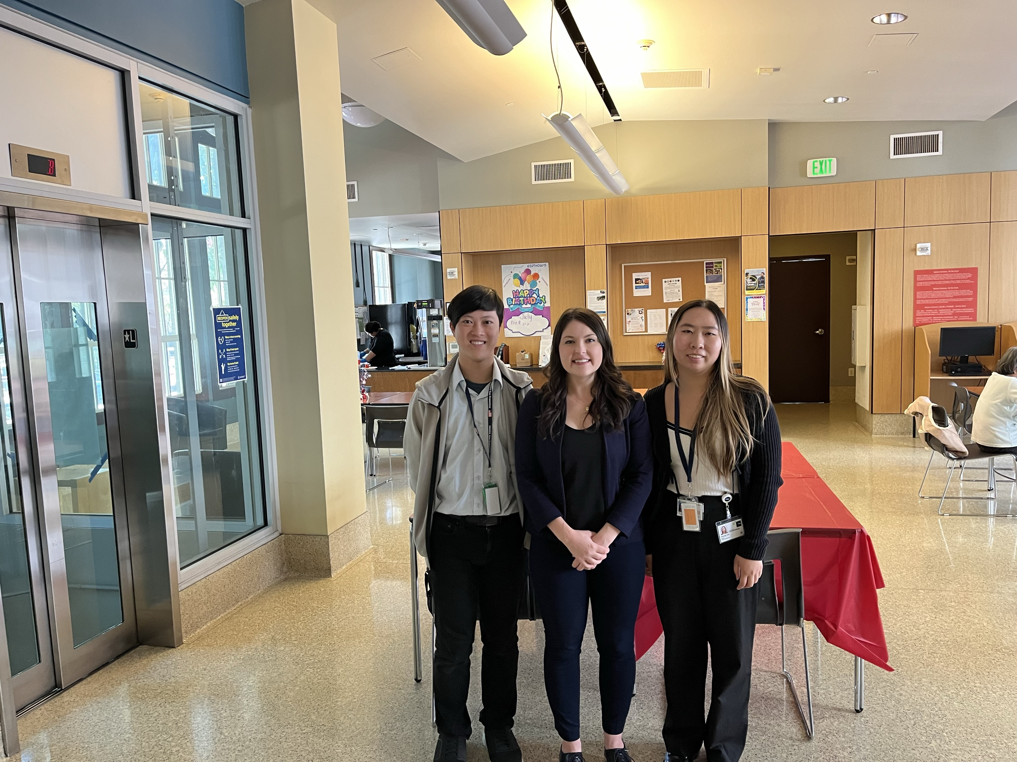
Team Members
Acknowledgements
Michael Douglas, Program Manager/Researcher
Andie Ruggles, LCSW, and team of HRVM points of contact
Thao Vu, PharmD
Wendy Furnas, LCSW
Cedric Thurman, PMHNP
Shannon Stevens, LCSW
Shalini Van Ecka, LCSW
Elbert Park, LCSW
Kyle Ahlers, LCSW
Pharmacy Service leadership team and staff
Logistics Service leadership team and staff
Susan Dugdale, Visual Information Specialist
Steve Melas, S&B Vending
Andrew Warner and Michael Robuck, VendNovation
UCSF School of Pharmacy Students Emil Tran and Wendy Xie
*Veteran consent on file for photograph inclusion.
11/15/2024
2024 AMERSA National Conference
15
Notes:
Thank you to my amazing collaborators, students, trainees, and social workers.

Slide 16





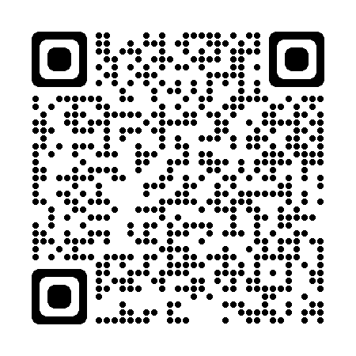
Thank you
Tessa Rife-Pennington, PharmD, BCGP
Tessa.Rife@va.gov
415-319-1193
11/15/2024
2024 AMERSA National Conference
16
Notes:
Thank you so much for joining. I’m happy to answer any questions.

