Slide 1
Harm Reduction in Peer-Assisted Telemedicine for Hepatitis C
Secondary outcomes of a randomized controlled trial.
Spencer H¹, Gregoire D¹, Leichtling G², Herink M³, Seaman A^{1,4}, Korthuis PT¹, Cook R¹
¹Oregon Health & Science University, ²Comagine Health, ³Oregon State University, ⁴Central City Concern
AMERSA 48th Annual Conference – November 14, 2024
Notes:
Going to tell you about a novel approach to rural HCV elimination centering peers and connection to telemedicine

Slide 2
Disclosures
Funding by the NIH National Institute on Drug Abuse (UH3DA044831).
Dr. Spencer (KL2TR002370) and Dr. Cook (K01 DA55130) are additionally supported by NIH; the views in this presentation are strictly of the authors.
Co-investigator Dr. Seaman has received investigator-initiated research funding from Gilead, Abbvie, and Merck pharmaceuticals, unrelated to this research.
Dr. Leichtling is a member of Comagine Health.
Other co-authors have no conflicts of interest.

Slide 3
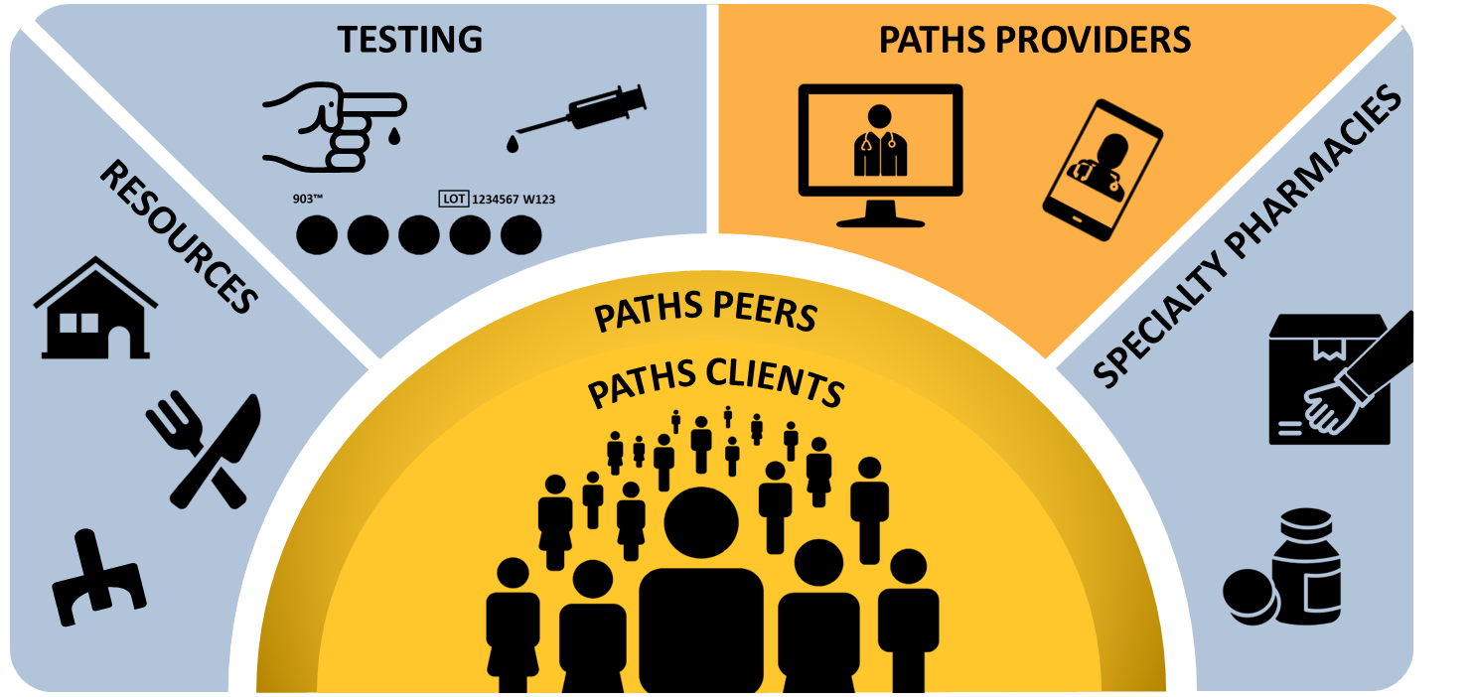
Background
Rural PWUD with HCV-antibody positivity report frequent injection drug use (72%) and injection equipment sharing (74%)¹
HCV treatment is associated with decreases in drug-related risk behaviors²
In rural people who use drugs, peer-assisted telemedicine (TeleHCV) is more effective for HCV cure than peer-assisted usual care³
63% vs 16%; RR= 4.06 (2.52, 6.52)
Hypothesis: TeleHCV is effective at reducing drug-related risk behaviors, and peers facilitate this change
1. Estadt A, et. al. IJDP. 2023 2. Artenie A, et. al. CID. 2020. 3. Seaman A, et. al. CID. 2024 in press.
Notes:
Peers = People with lived experience of substance use, usually from the community they work with.
*Study protocol published and cited for more details.

Slide 4
Background: Equity
Non-Hispanic American Indian/Alaska Native and non-Hispanic Black residents of the U.S. faced the highest HCV fatality rates in 2022, at 4.75 and 9.08 per 100,000 population, respectively ¹
Rural counties (Coos, Klamath, Curry, and Douglas) face the highest HCV mortality rates in Oregon²
1. Viral Hepatitis Surveillance, CDC, 2024. 2. HepVu, Accessed 2024.
Notes:
Peers = People with lived experience of substance use, usually from the community they work with.
*Study protocol published and cited for more details.

Slide 5
Methods
Study Design
Mixed-effects logistic regression with 2 step design
Type III LR test: Exposure x time interaction vs. exposure only
Adjusted analysis: age, gender, race, homelessness, substance use severity
Outcomes
Injection drug use and injection equipment sharing at 12 and 36 week-post treatment follow up (SVR 12 and SVR 36)
Exposures
Randomized group (TeleHCV vs peer-assisted usual care)
Frequency of contact with a peer
HCV treatment initiation
HCV cure status
Notes:
With this community-based participatory approach, we designed a new intervention for rural HCV tx access.
Peers - People with lived experience of substance use, usually from the community they work with.
*Study protocol published and cited for more details.

Slide 6
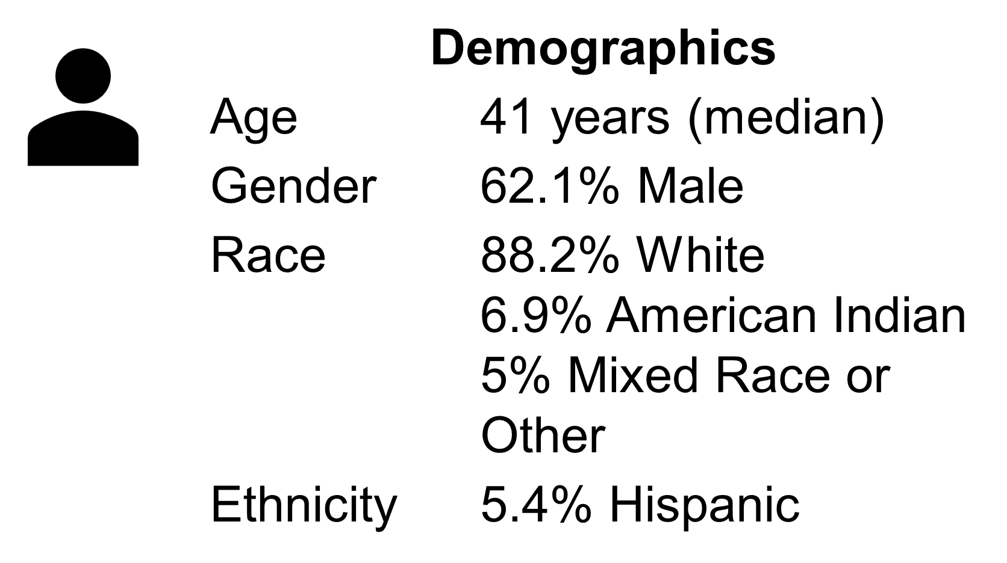
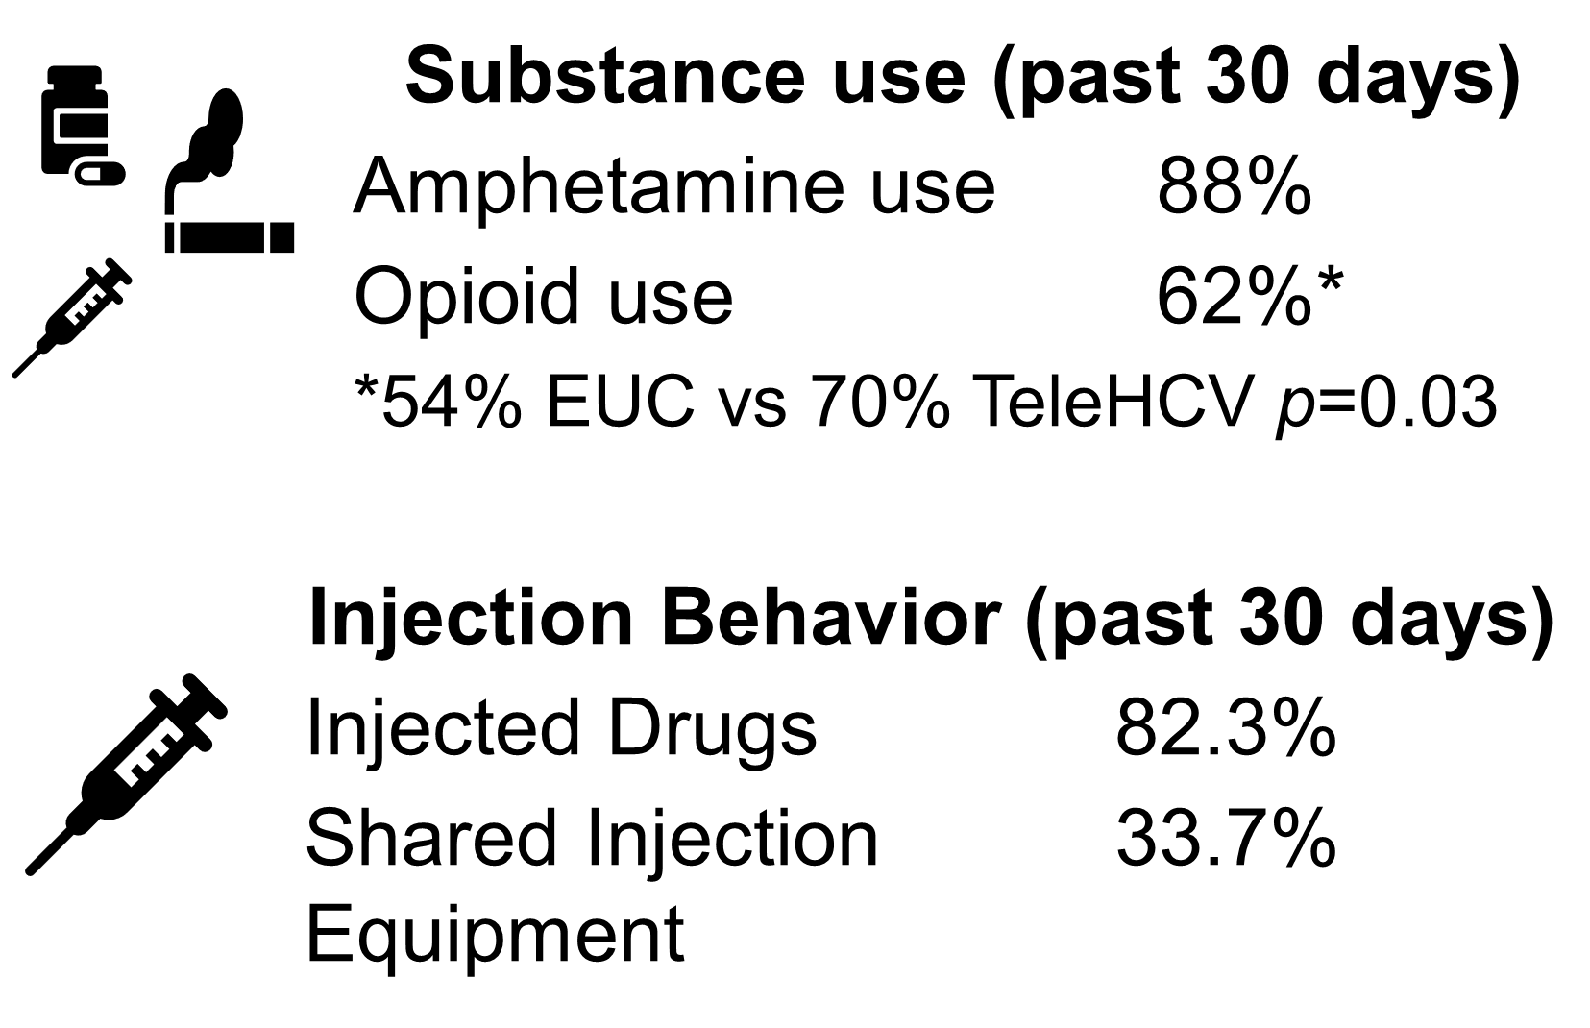
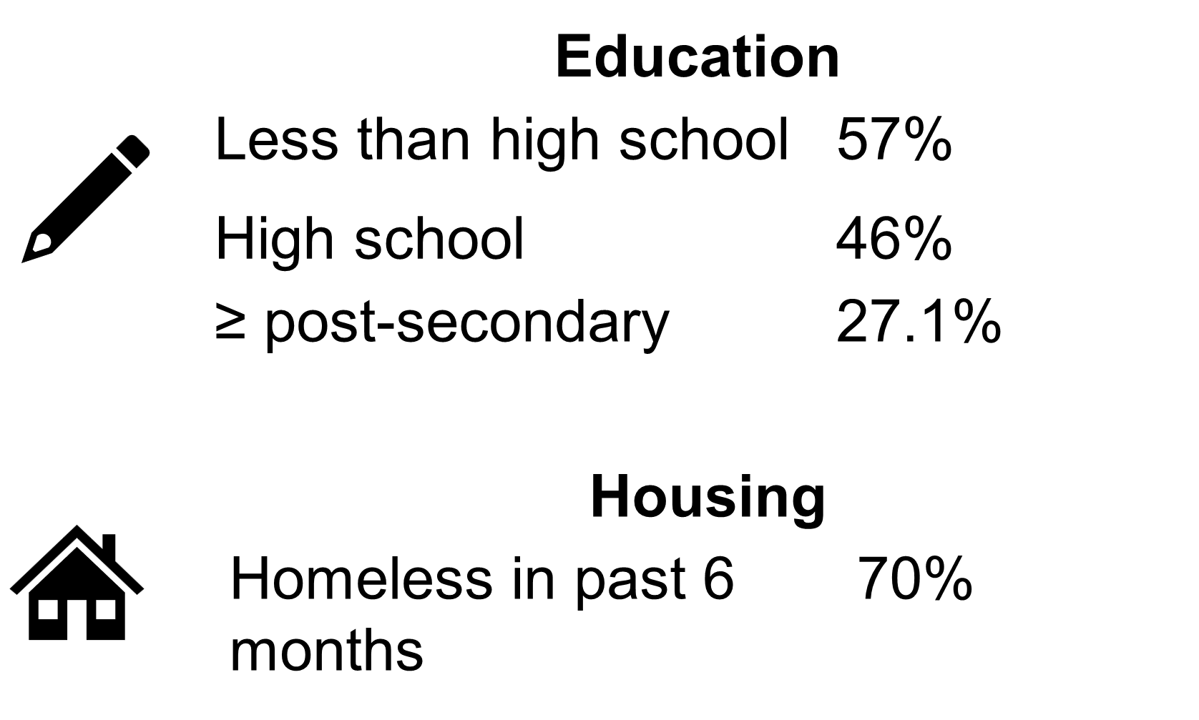
Results (n=203)
Notes:
With this community-based participatory approach, we designed a new intervention for rural HCV tx access.
Peers - People with lived experience of substance use, usually from the community they work with.
*Study protocol published and cited for more details.

Slide 7
Results
Notes:
*Study protocol published and cited for more details.

Slide 8
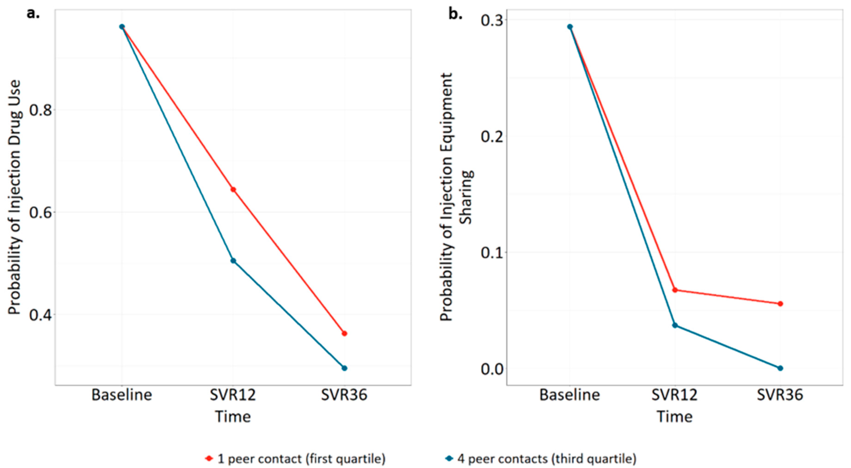
Results

Slide 9
Discussion
Injection drug use decreased over time, more so in TeleHCV
No similar decrease by treatment initiation or cure status
Greater intensity of peer contacts contributed to greater reductions in both risky behaviors
Greater reductions in injection drug use than seen in other studies of DAA^{1,2}
Peers are a differentiating factor
Strengths
Adds experimental evidence for role of peers in HCV treatment
Included high proportion of homeless participants
1. Artenie et. al., CID, 2020 2. Tsui et. al., DAD, 2023

Slide 10
Limitations
Underpowered for secondary outcome analysis
Limited generalizability to urban settings
Risky behaviors self reported
Non-random drop out at SVR 12 (84%) and SVR 36 (64%)

Slide 11
Conclusion
Peer-Assisted Telemedicine for Hepatitis C is effective at reducing drug-related risk behaviors in rural PWUD
Peers probably drive this change

Slide 12
Acknowledgements
Participants!
Peers!
Collaborators:
Oregon Health & Science University
Oregon Health Authority
Comagine Health
HIV Alliance
Bay Area First Step
Funders:
National Institute on Drug Abuse
Substance Abuse and Mental Health Services Administration
Centers for Disease Control and Prevention
The Appalachian Regional Commission
Notes:
PWUD who helped inform and create this intervention, and for whose willingness to trust and participate in this research we are forever indebted.
Peers – truly the cornerstone of this project
Personally thank my research mentor Dr. Todd Korthuis, who in kindness and generosity gave me the opportunity to lead this project.

Slide 13
Contacts
Related Article and More Information
https://doi.org/10.3390/v16091455
Hunter Spencer, DO
spencerh@ohsu.edu
Notes:
Include Hunter’s email?

