Slide 1
Harm Reduction in a Cocaine Research Study: A Case Report
Zachary Davis BS; Lily Caglianone BS; Veronica Bucci BS; Shirley Stephenson APRN; Akilah Smith BA; Sarah Messmer MD; Dillon Thorpe BA; Niranjan S. Karnik MD, PhD
Notes:
Veronica

Slide 2
Conflicts of Interest
None to declare.
Notes:
Veronica

Slide 3
Parent Study: CTN-0109, CURB-2
NIDA Clinical Trials Network Clinical Trial:
Combined injections of XR-NTX and XR-BUP
8 week medication phase for severe cocaine use disorder
Theory:
kappa opioid receptor antagonists assist in mitigating negative outcomes associated with stimulant withdrawal and subsequent cravings
University of Illinois Chicago (UIC) is one of 10 sites conducting this research
Key Inclusion Criteria:
no active endorsement or use of opioids
urine drug screens negative for opioids and positive for cocaine
DSM-5 criteria met for severe cocaine use disorder
Notes:
Veronica

Slide 4
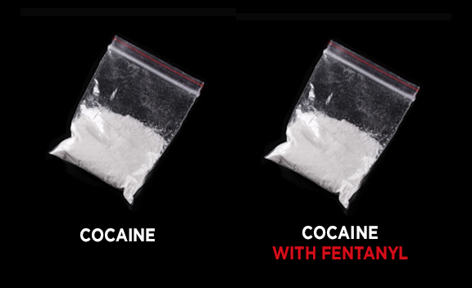
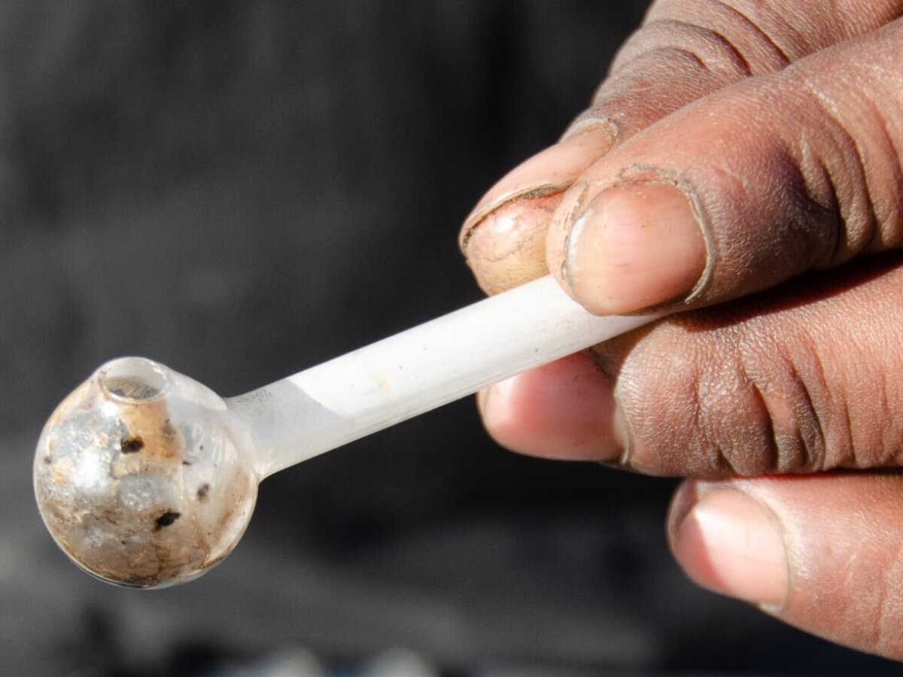
Case Presentation
Active participant in Week 3 of CURB-2 clinical trial
Presented to clinic three days after confirmed accidental overdose at emergency department
Reported smoking crack-cocaine three days prior and waking in the hospital
Received 8.0 mg of intranasal naloxone and 2.8 mg of intravenous naloxone to reverse overdose
Hospital clinical assessments determined the crack-cocaine was contaminated with fentanyl
Urine drug screen 3 days later at research clinic was positive for fentanyl
Participant denied ever knowingly ingesting opioids, and had no documented history of opioid use
Notes:
Veronica

Slide 5
Learning Objectives
Explore fentanyl in the cocaine supply and documented clusters of overdoses linked to fentanyl contamination
Identify best practices for the distribution of fentanyl test strips and naloxone in non-opioid research studies
Notes:
Zach

Slide 6
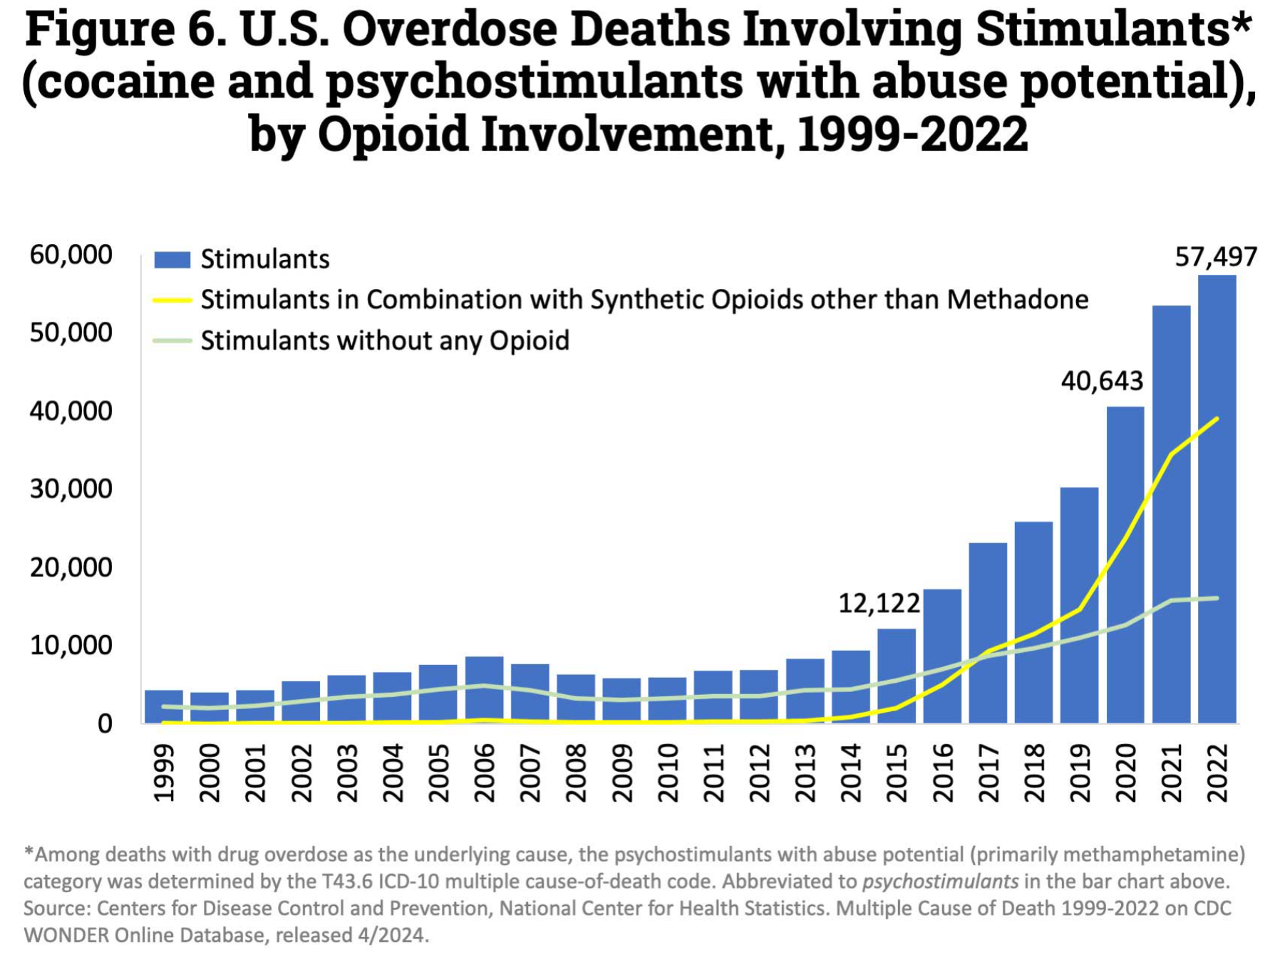
Stimulant Overdose Deaths Rising
Fentanyl contamination of stimulants:¹
Up to 12.5% of the methamphetamine supply contaminated
Up to 14.8% of the cocaine supply estimated to be contaminated
U.S. Department of Health and Human Services. (2024, Nov 11). Drug overdose death rates. National Institutes of Health. https://nida.nih.gov/research-topics/trends-statistics/overdose-death-rates
Notes:
Zach

Slide 7
Clusters of Opioid Overdoses due to Stimulant Contamination
12 OD within 6 hours in Connecticut in 2016 → 3 deaths and 4 ICU admissions²
18 OD within 4 days in Philadelphia in 2018 → 3 deaths³
22 OD within 5 days in Connecticut in 2019 → 6 deaths⁴
9 OD within 3 hours in New York in 2019⁵
At UIC for CURB-2 study, alongside this case participant:
one additional participant has undergone accidental opioid overdose from cocaine supply contamination
several participants unknowingly ingested opioids, particularly fentanyl, during cocaine use
Notes:
Zach

Slide 8
Harm Reduction Gap
Individuals who use stimulants⁶:
report less utilization of harm reduction strategies when compared to those who use opioids or multiple substances
may not perceive themselves as being at risk of opioid overdose
may be less inclined to use fentanyl test strips or intranasal naloxone
Due to these misconceptions, there is a gap in harm reduction for individuals who use stimulants.
Notes:
Lily

Slide 9
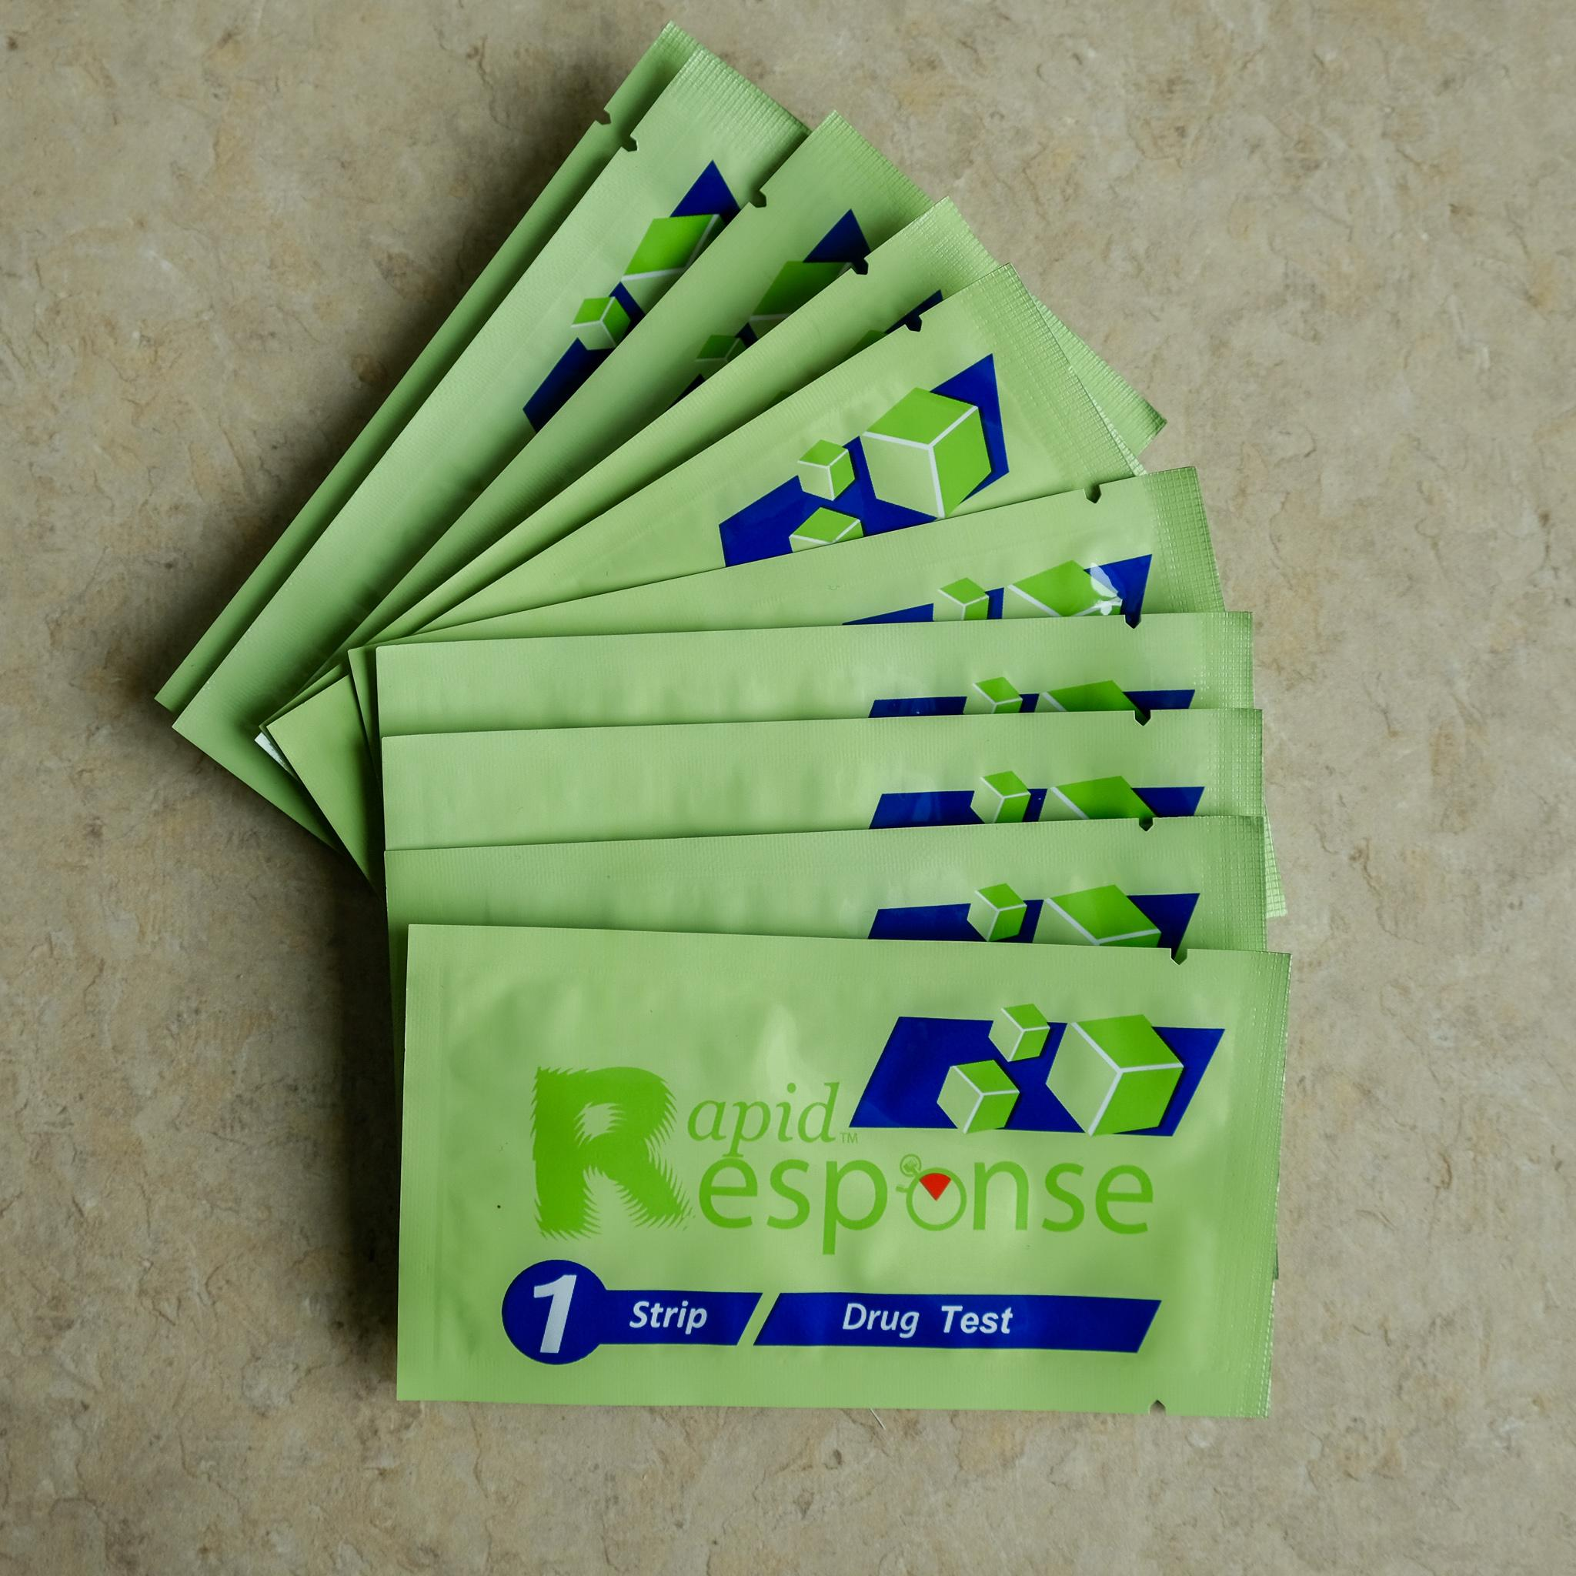
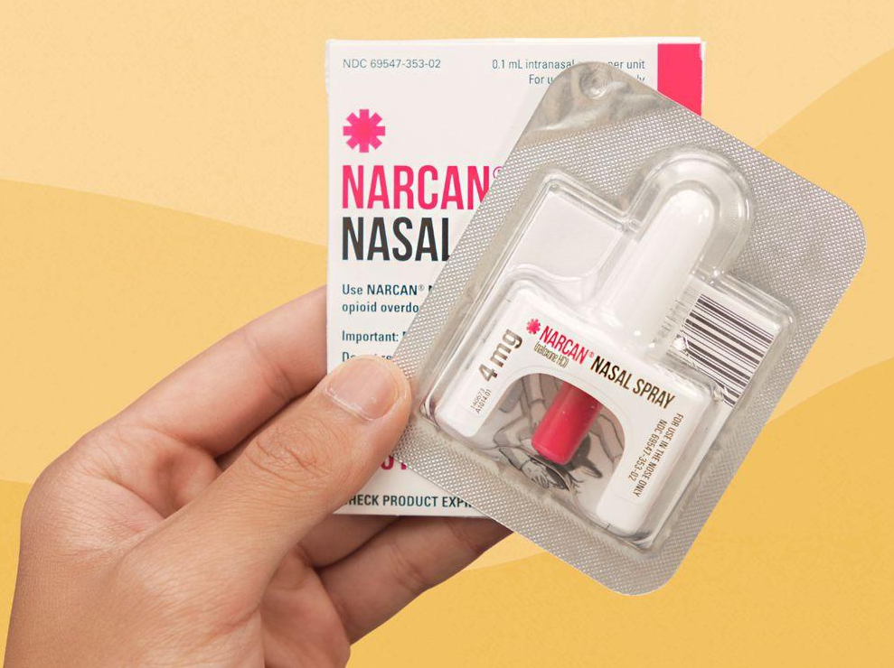
Harm Reduction Implementation in CURB-2
Each participant is provided with:
education regarding fentanyl test strips
intranasal naloxone
Never Use Alone harm reduction hotline information
Case Participant: Following the distribution of harm reduction materials, the participant did not test positive for fentanyl for the remainder of their time in the study
Several other participants have used test strips effectively after an overdose event or testing positive for fentanyl in the clinic
Notes:
Lily

Slide 10
Future Directions
Education regarding fentanyl test strips and distribution of intranasal naloxone should be offered to all people who use stimulants
Other evidence-based harm reduction supplies such as clean pipes improve health outcomes, but face funding and policy barriers
Even harm reduction efforts backed by policy (standing order for intranasal naloxone in Illinois) often face access barriers⁷
In 2019, only 24.6% of pharmacies in Illinois were registered under the standing order
only 53% of those had naloxone in stock and allowed patients to access it without a prescription.
Access has improved for those who are insured, but has stalled for those who are uninsured
Clinical Trials Research should actively incorporate harm reduction techniques as part of study protocol
Notes:
Lily

Slide 11
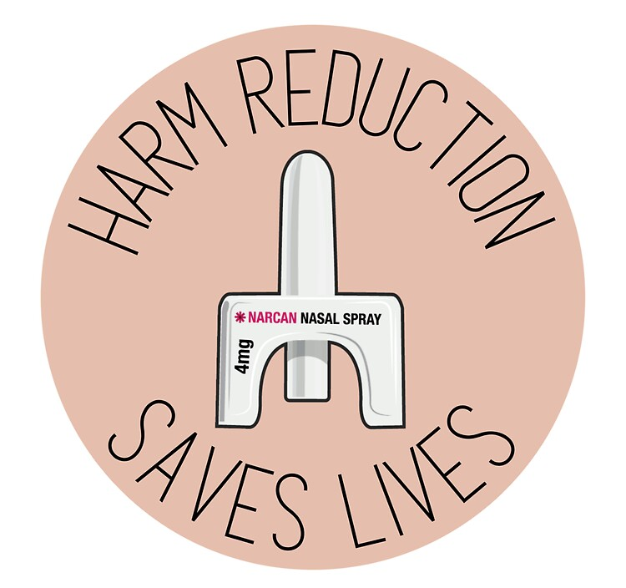
Conclusion
Stimulant contamination with fentanyl is common and a significant source of overdose mortality
CURB-2 participants have been able to use test strips to avoid overdoses and testing positive for fentanyl on urine drug screen
Further policy changes, funding, and education is needed to increase harm reduction for people who use stimulants
Research should consider implementing harm reduction education or materials distribution within protocols
Notes:
Lily

Slide 12
References
Canning, P., Doyon, S., Ali, S., Logan, S. B., Alter, A., Hart, K., Coler, R., Kamin, R., Wolf, S. C., Soto, K., Whiteman, L., & Jenkins, M. (2021). Using Surveillance With Near–Real-Time Alerts During a Cluster of Overdoses From Fentanyl-Contaminated Crack Cocaine, Connecticut, June 2019. Public Health Reports®, 136(1_suppl), 18S-23S. https://doi.org/10.1177/00333549211015662
Tomassoni, A. J. (2017). Multiple Fentanyl Overdoses—New Haven, Connecticut, June 23, 2016. MMWR. Morbidity and Mortality Weekly Report, 66. https://doi.org/10.15585/mm6604a4
Khatri, U. G., Viner, K., & Perrone, J. (2018). Lethal Fentanyl and Cocaine Intoxication. The New England Journal of Medicine, 379(18), 1782. https://doi.org/10.1056/NEJMc1809521
Canning, P., Doyon, S., Ali, S., Logan, S. B., Alter, A., Hart, K., Coler, R., Kamin, R., Wolf, S. C., Soto, K., Whiteman, L., & Jenkins, M. (2021). Using Surveillance With Near-Real-Time Alerts During a Cluster of Overdoses From Fentanyl-Contaminated Crack Cocaine, Connecticut, June 2019. Public Health Reports (Washington, D.C.: 1974), 136(1_suppl), 18S-23S. https://doi.org/10.1177/00333549211015662
DiSalvo, P., Cooper, G., Tsao, J., Romeo, M., Laskowski, L. K., Chesney, G., & Su, M. K. (2021). Fentanyl-contaminated cocaine outbreak with laboratory confirmation in New York City in 2019. The American Journal of Emergency Medicine, 40, 103–105. https://doi.org/10.1016/j.ajem.2020.12.002
Bandara S, Byrne L, Berman V, et al (2024). Harm Reduction and Treatment Among People at High Risk of Overdose. JAMA Network Open, 2024;7(8):e2427241. doi:10.1001/jamanetworkopen.2024.27241
Moore P, Ellis K, Simmer P, Waetjen M, Almirol E, Salisbury-Afshar E, Pho MT. Accessibility of Naloxone in Pharmacies Registered Under the Illinois Standing Order. West J Emerg Med. 2024 Jul;25(4):457-464. doi: 10.5811/westjem.17979.

