Slide 1
Healing the ‘Non-Healing’:
A Holistic Approach to Treating Xylazine-Associated Wounds
Tehya Johnson, AGPCNP-BC; Christina Bailey MSN-PH, RN, CARN, AACRN
Co-authors: Sam Walsh, AGPCNP; Morgan Younkin, MD
Notes:
Thank you Dan for the introduction

Slide 2
Disclosures
None of the authors have relevant financial relationships to disclose.
All images, information regarding the care and quotes obtained and presented with the consent and approval of the client.
Our deepest gratitude to our client for his consent and his trust.
Notes:
Before beginning, none of the authors have finacial relationships to disclose
We want to forewarn that this presentation contains graphic photos, obtained and presented with consent by the participant we are presenting and we extend our deepest gratitude to him for his consent and trust

Slide 3
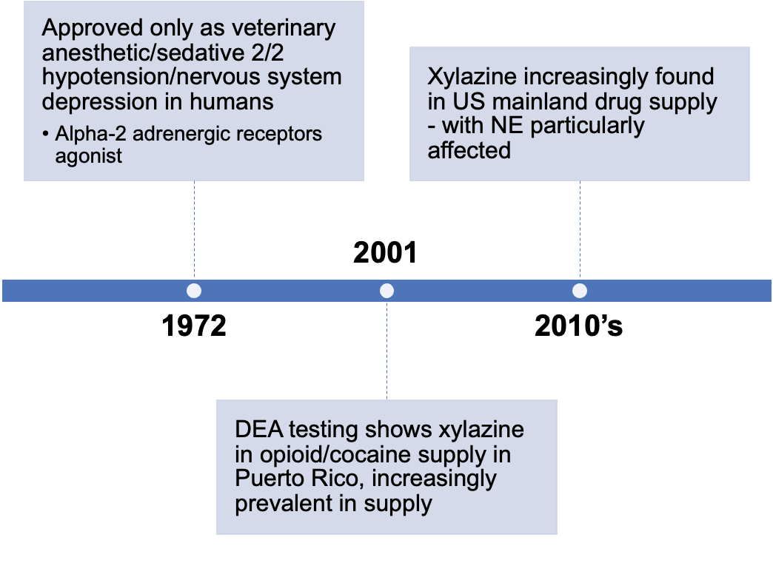
Xylazine 101
Although we know much about the depressive/sedative properties of xylazine, the processes which result in xylazine-related wounds are largely unknown
Notes:
As discussed by previous session presenters, Although we know much about the depressive/sedative properties of xylazine, the processes which result in xylazine-related wounds are largely unknown

Slide 4
Xylazine Related Wounds
First described in Puerto Rico
Common characteristics associated with suspected xylazine-related wounds include:
Ulcerations that develop at OR away from site of injection
Wounds develop small, coalesce into larger ulcers
Odorous, copious drainage, high burden of necrotic tissue
Significantly delayed healing
Varied time of wound development
(Torruella, 2011)
Notes:
These wounds were first described in puerto rico and commonly present as:

Slide 5
Xylazine Related Wounds
Processes resulting in these wounds multifactorial
What we do know:
Consistent low threshold wound care leads to improved wound healing
A multidisciplinary, holistic and individualized approach to care builds trust and in turn leads to consistent engagement and healing
Notes:
As noted, factors leading to these wounds are multifactorial but what we know and plan to discuss here is that:

Slide 6
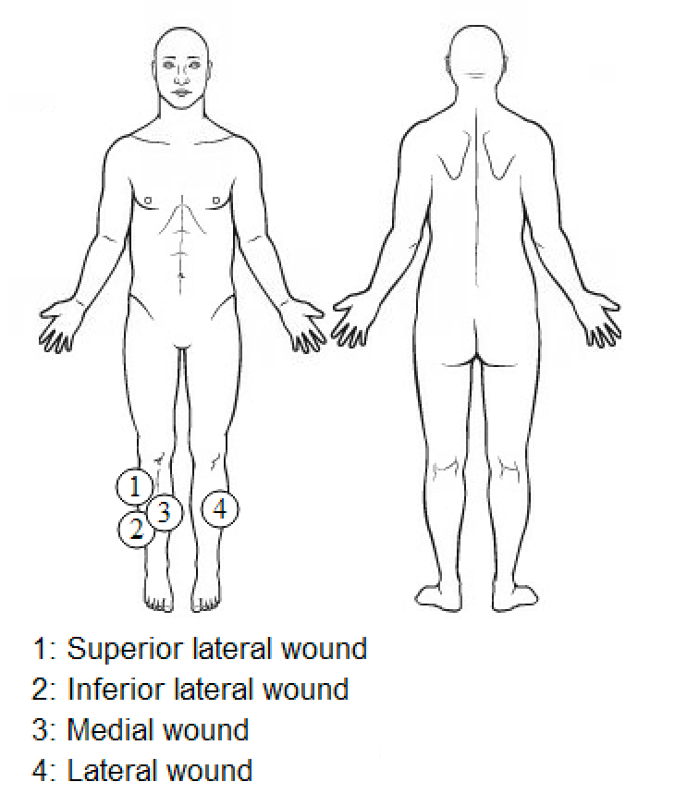
Case Presentation
42 year old Hispanic male
Originally from NJ, formerly unhoused in Boston, housed through duration of tx
PMx: HCV, GAD, MDD, PTSD, IVDU
SUD:
OUD (primary)
BenzoUD
Intermittently using MOUD, currently on methadone maintenance therapy
Initial wounds:
Notes:
The case we are presenting today is a 42yo hispanic male, formerly unhoused but was housed through the duration of treatment with active OUD which is what we believe is the source of his exposure. FOr this presentation we will be discussing chronic wounds in the four places listed on the diagram

Slide 7
Course of Tx: May 17, 2022 - August 31, 2024
136
30
27
15
9
Visits with Nursing
Wound Care/ Referrals
Visits with Providers
Hospitalizations
Courses of Antibiotics
SSTI at site and others
Medical Respite Stays
Notes:
**data collected via chart review from 5/1722 to 8/31 2024 includes:
Not all nursing visits are documented, especially if they were done on outreach
14/15 hospital visits and all medical respite stays, pt left on self directed discharge
These numbers reflect a significant engagement with this patient

Slide 8
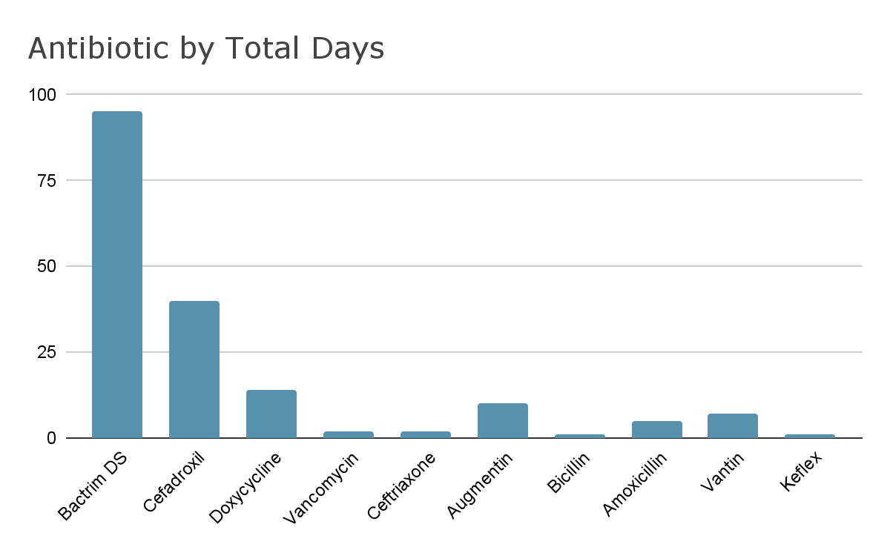
Antibiotic Detail
Notes:
**10 different antibiotics for a total of 177 days including 95 days on Bactrim or XX courses

Slide 9
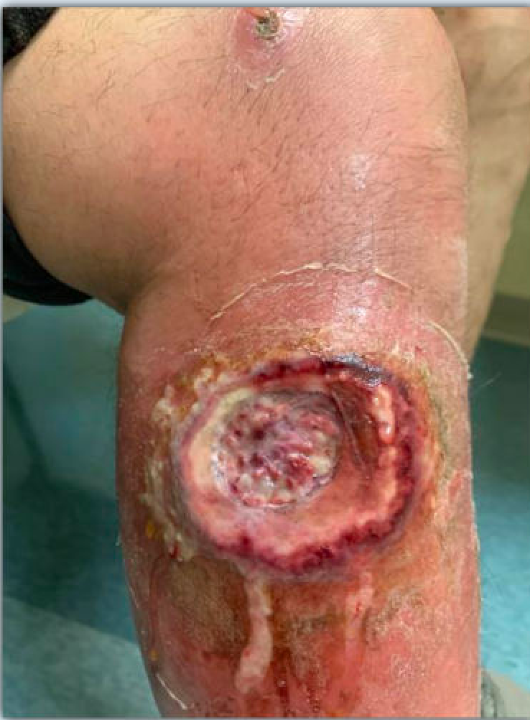
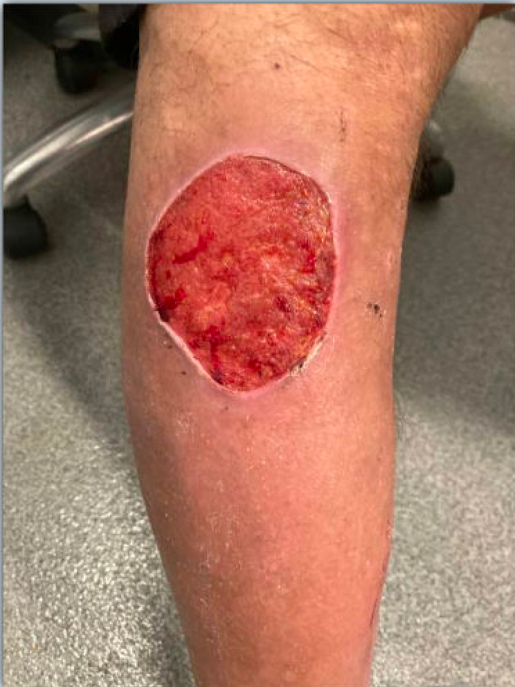
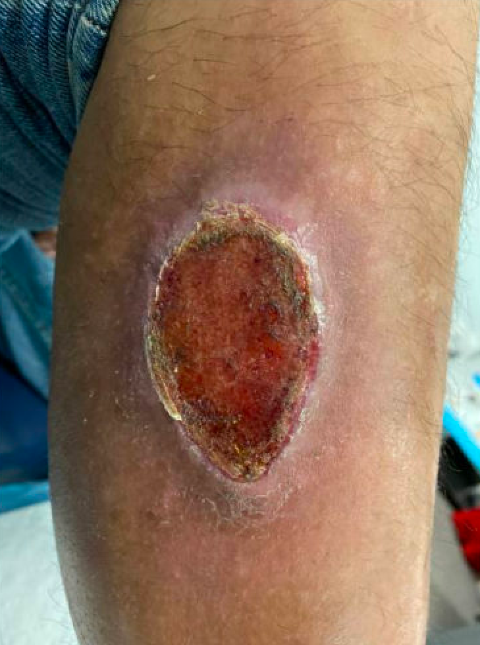
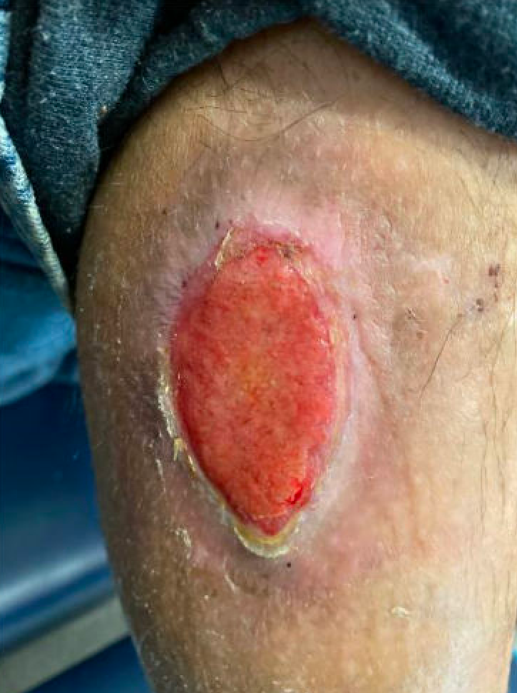
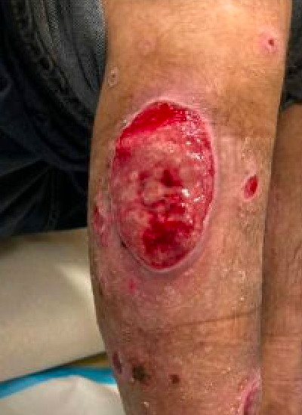
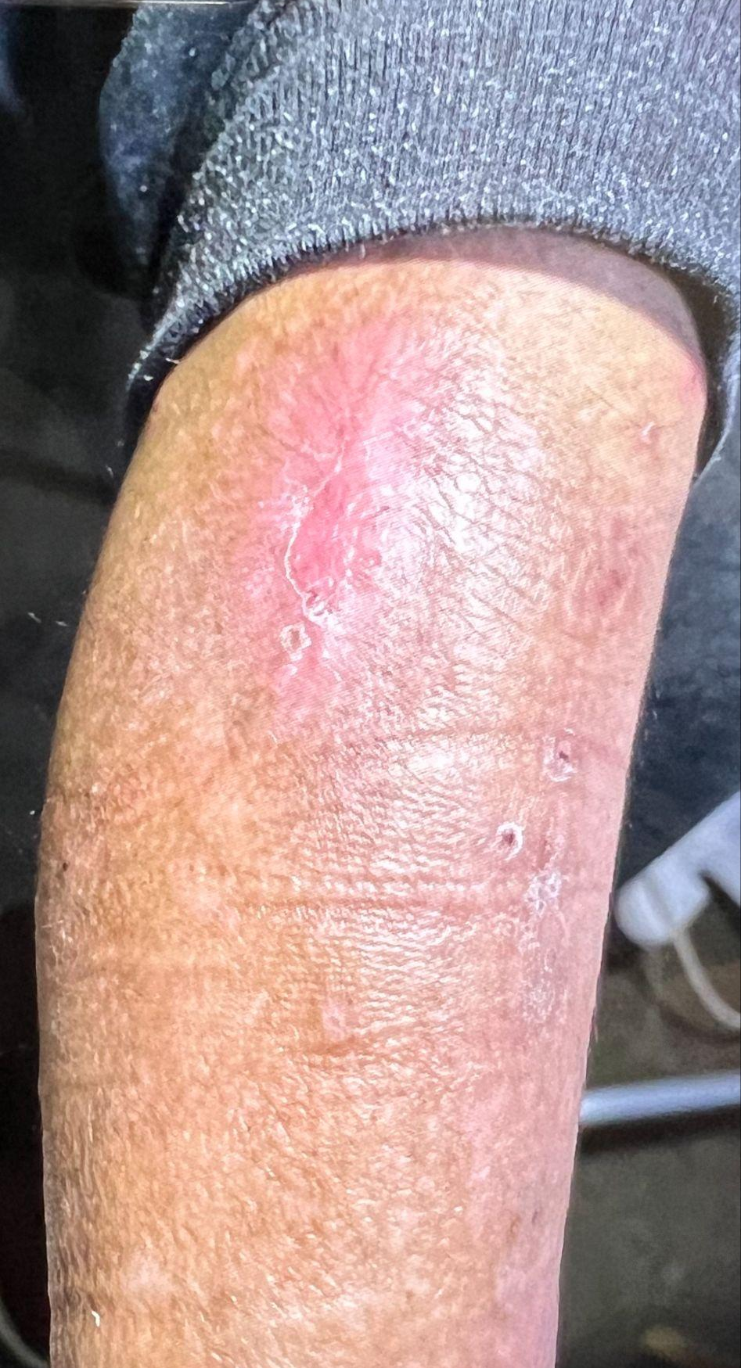
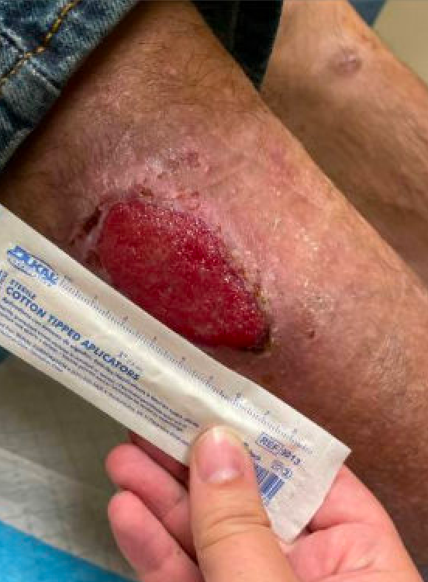
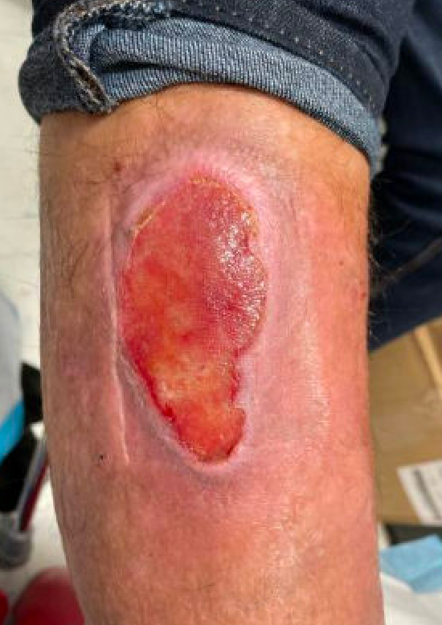
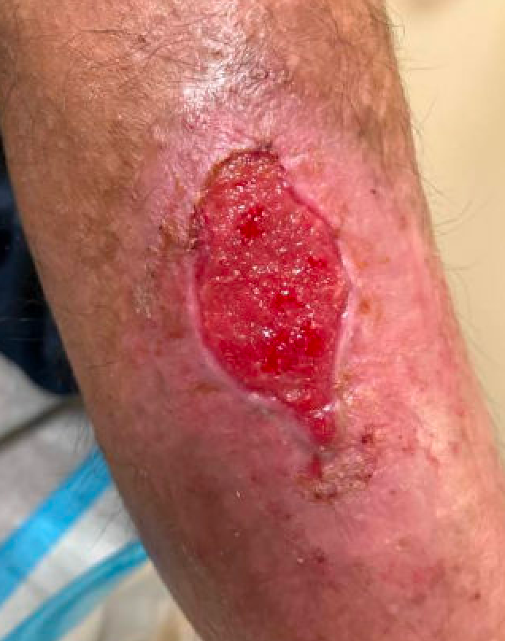
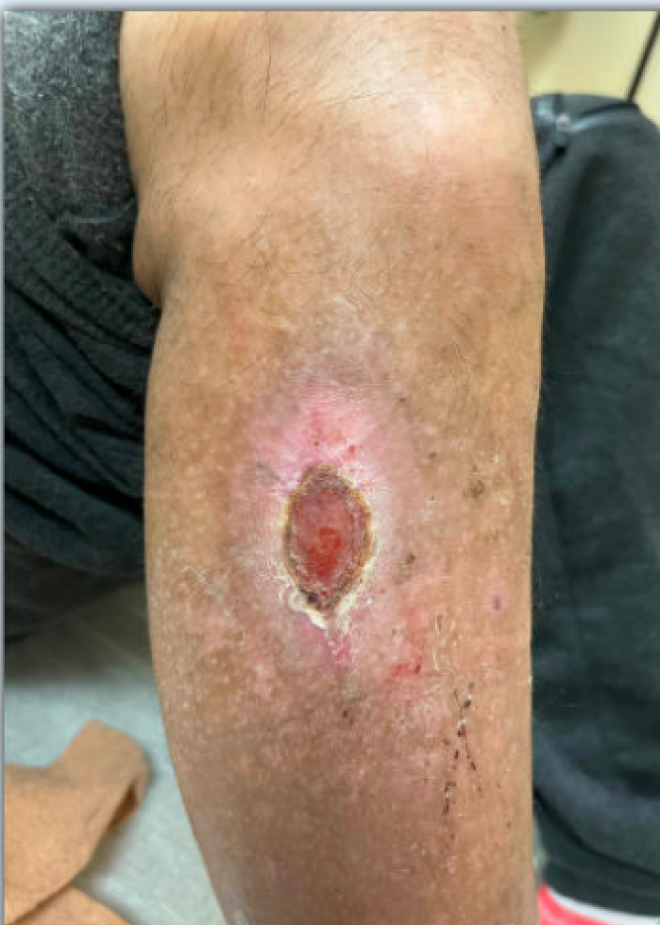
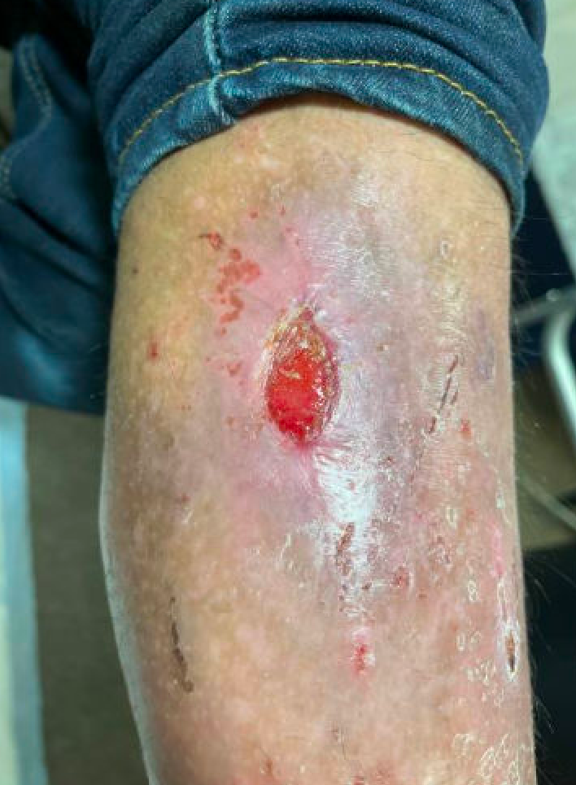
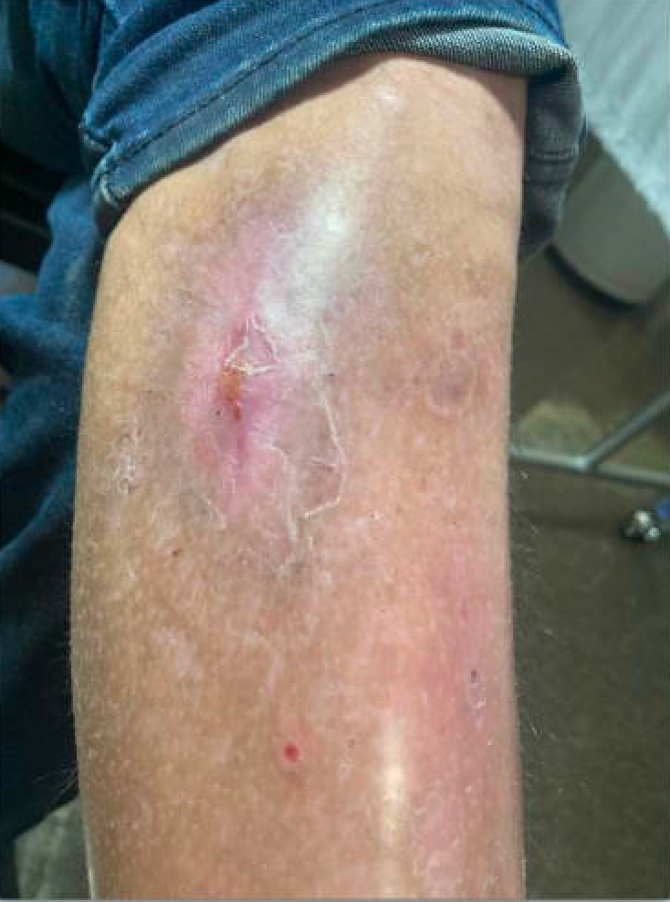
Wound #1
5/17/22
7/1/22
12/20/22
3/7/23
6/6/23
4/23/24
7/27/23
8/24/23
10/11/23
12/28/23
3/11/24
4/10/24
Notes:
The following images show the progression of wound healing over time, in most cases between 12 and 18 months. Each wound represents typical characteristics such as high necrotic tissue burden, in some cases hypergranulation of tissue, which prevents wound closure without proper treatment

Slide 10
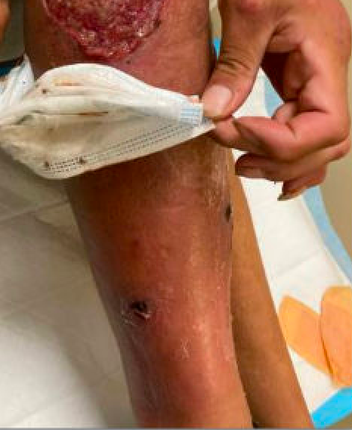
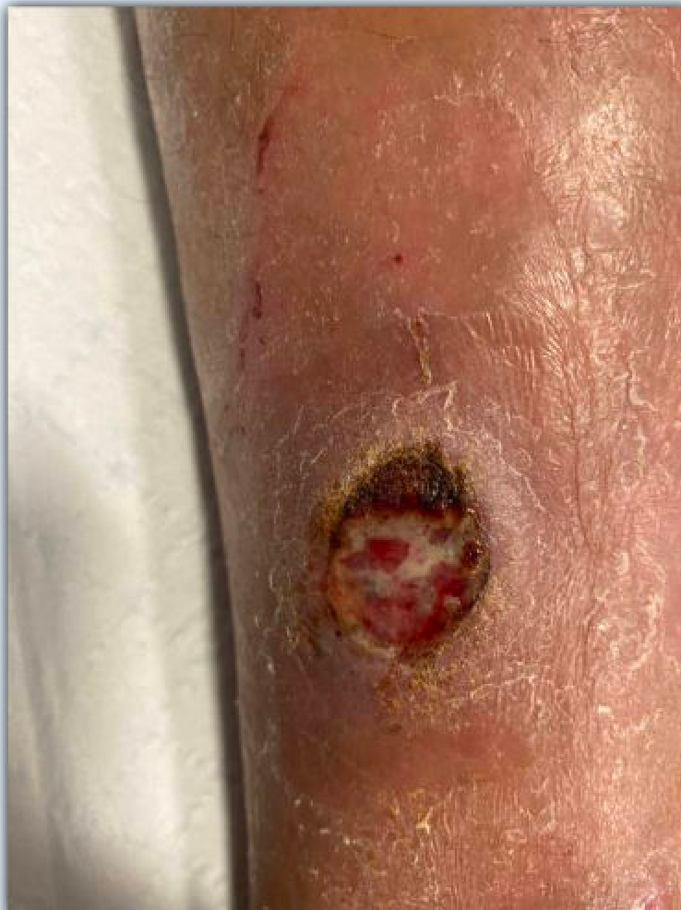
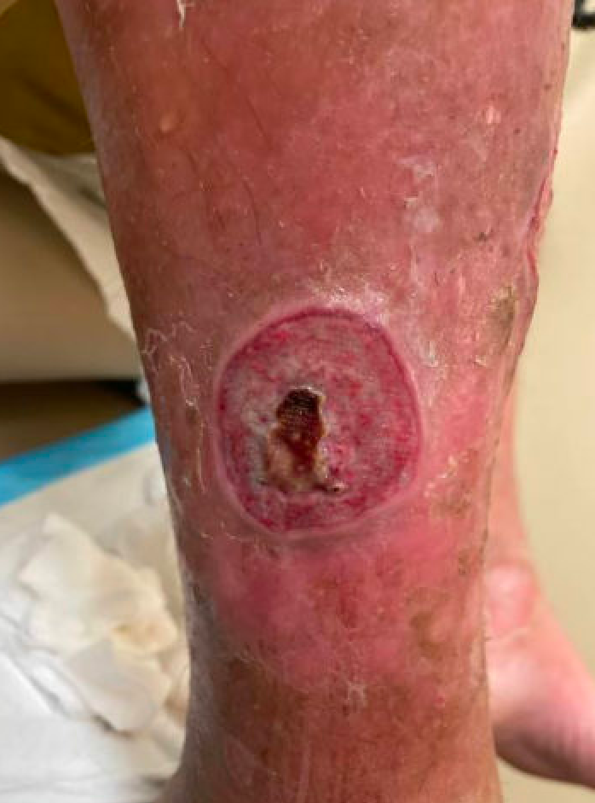
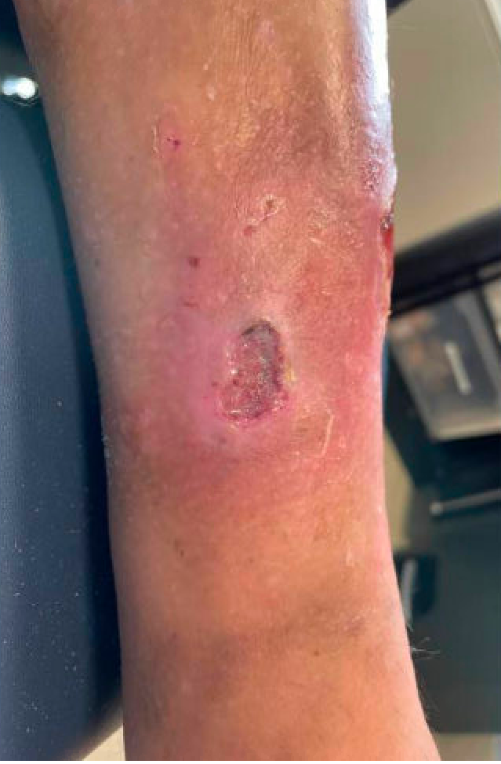
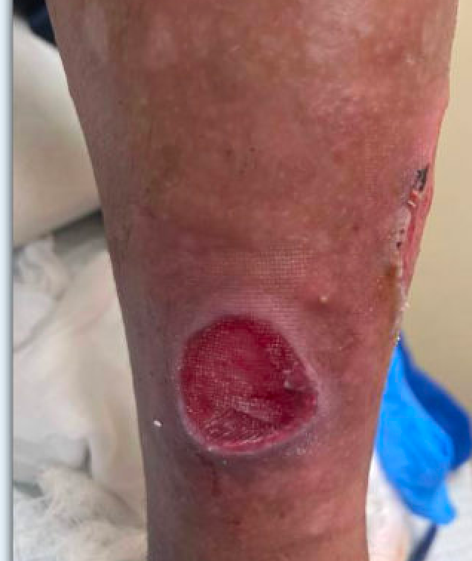
Wound #2
7/19/22
1/17/23
9/20/23
2/8/24
8/9/24

Slide 11
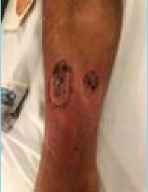
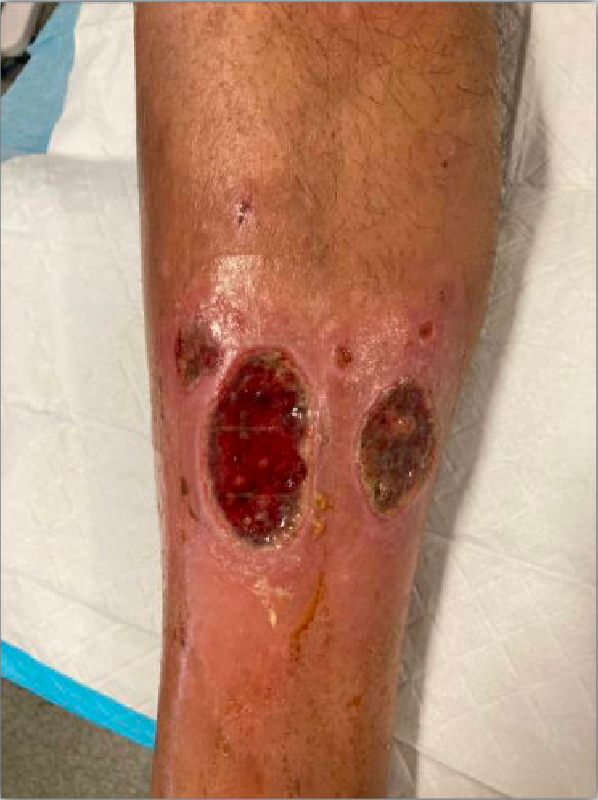
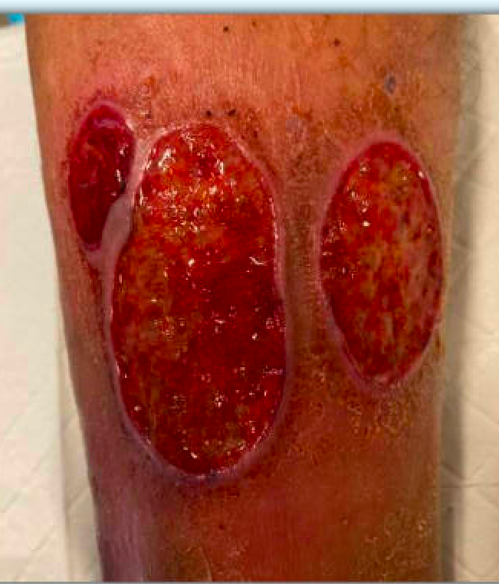
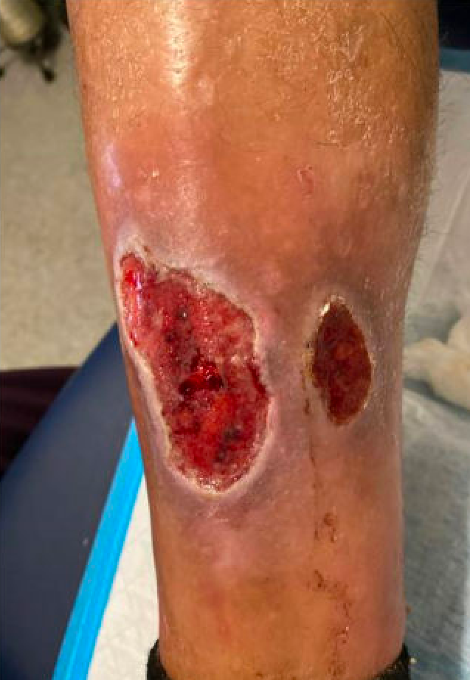
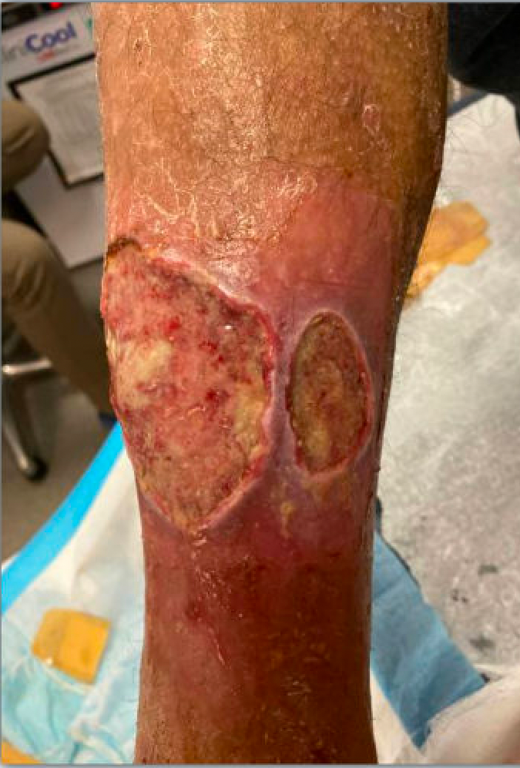
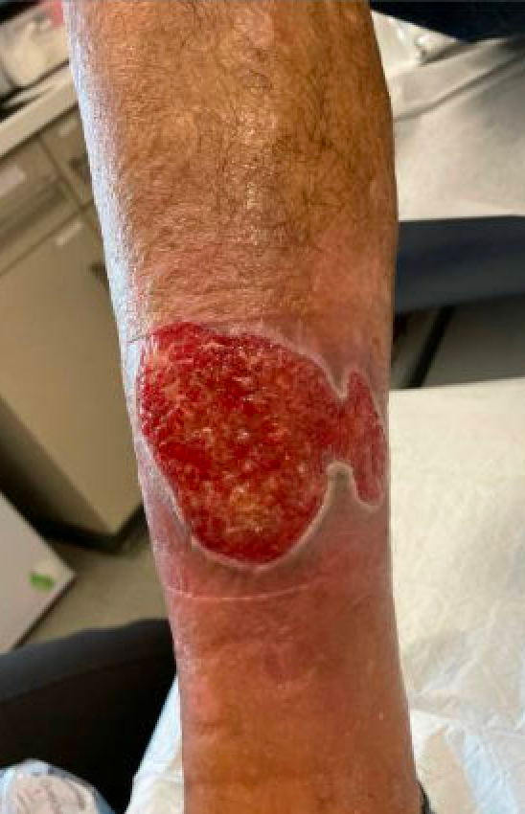
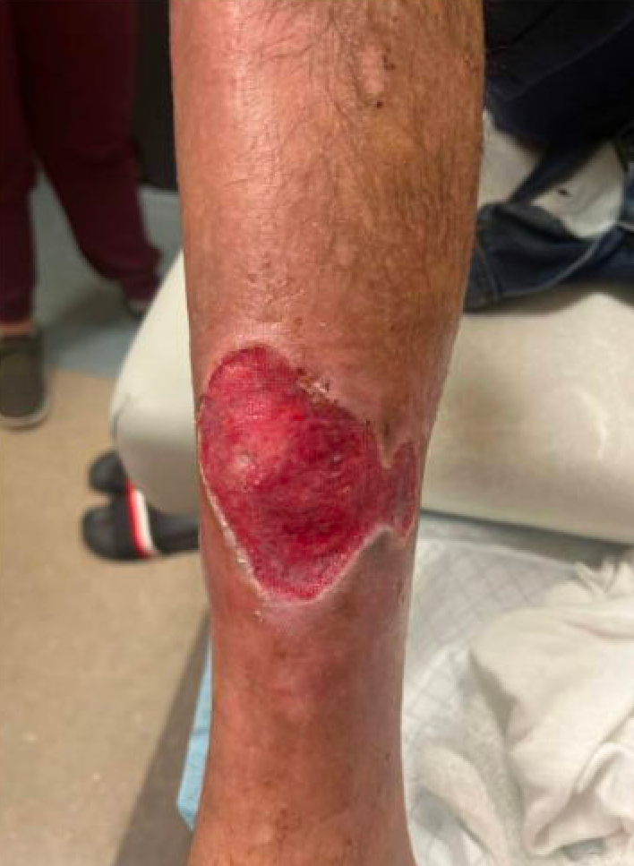
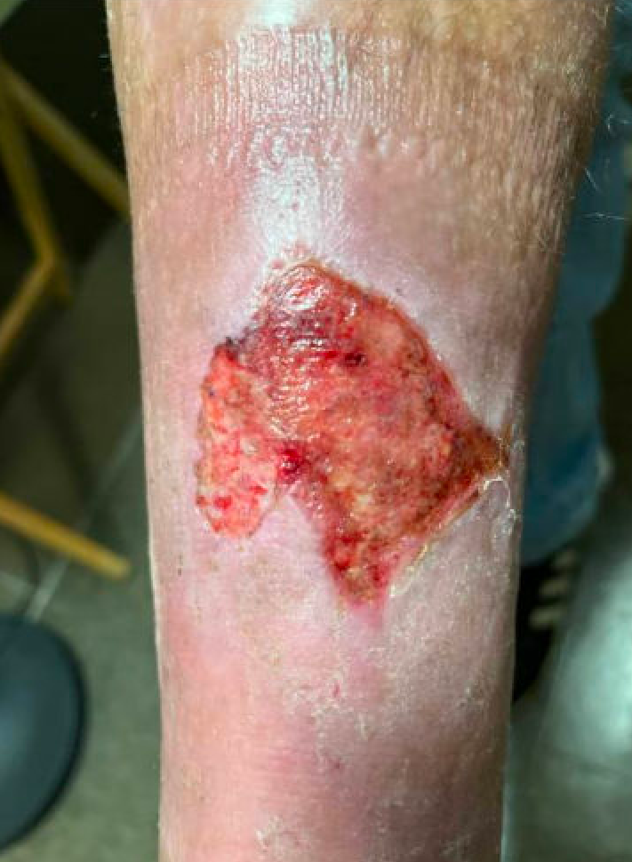
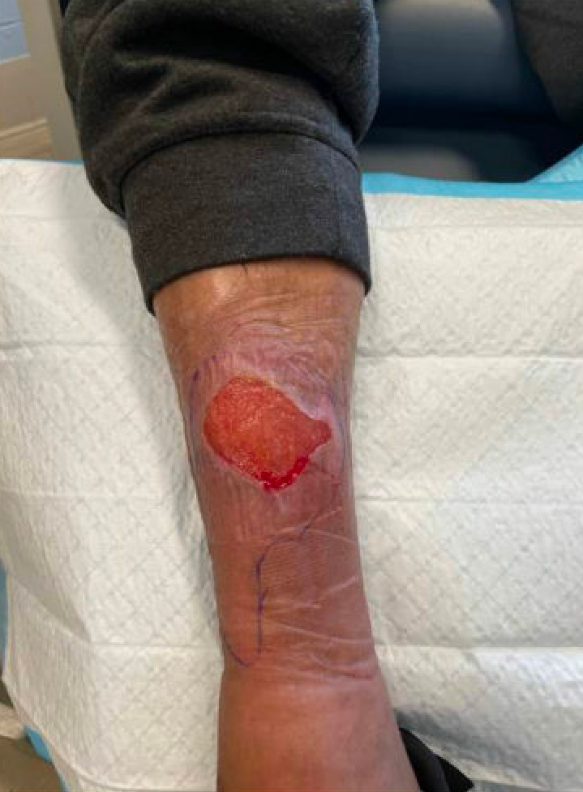
Wound #3
6/23/22
8/8/22
9/8/22
1/3/23
5/22/23
7/8/23
2/8/24
6/4/24
7/30/24
Notes:
This is a great example of smaller wounds which coalesce into larger ones

Slide 12
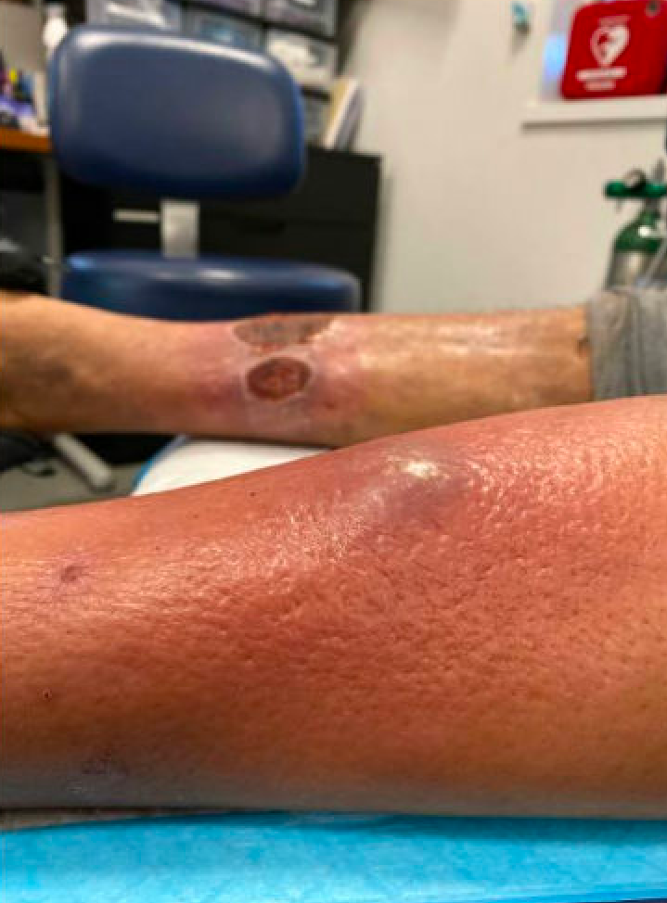
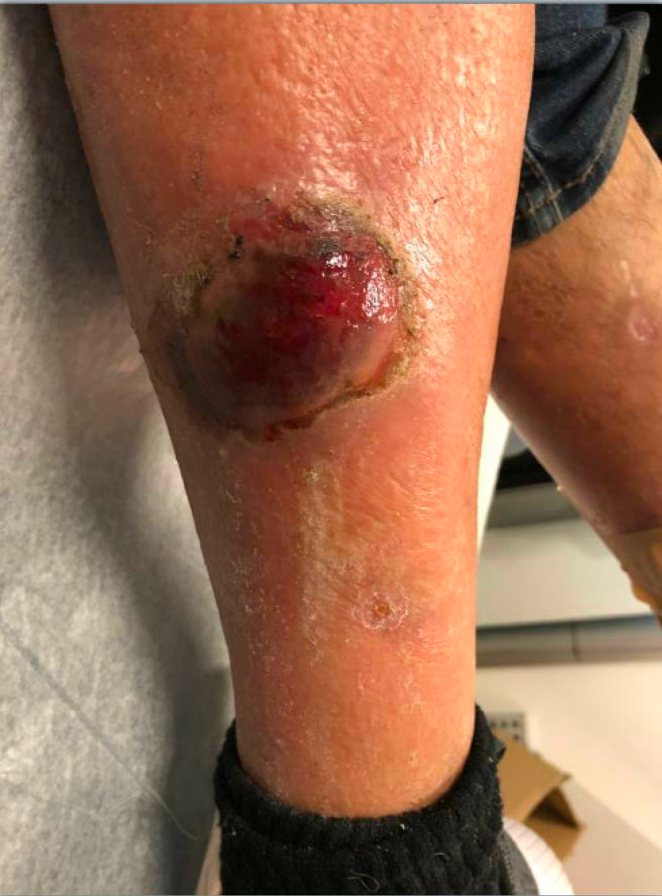
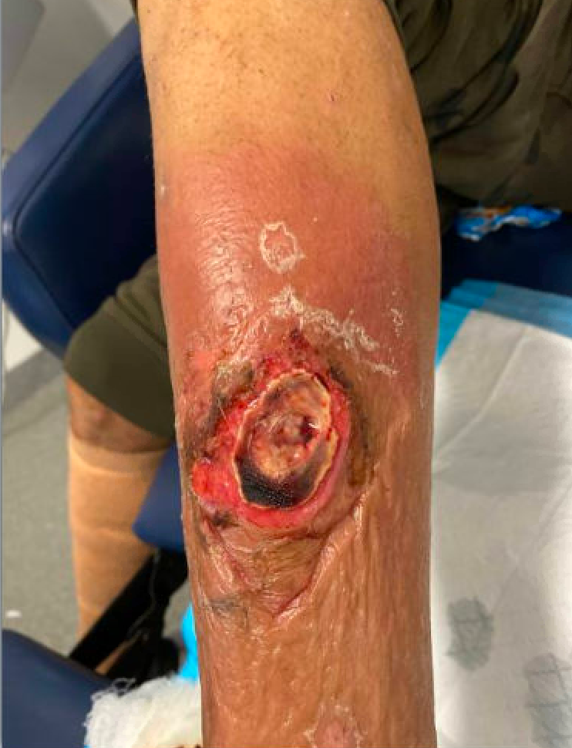
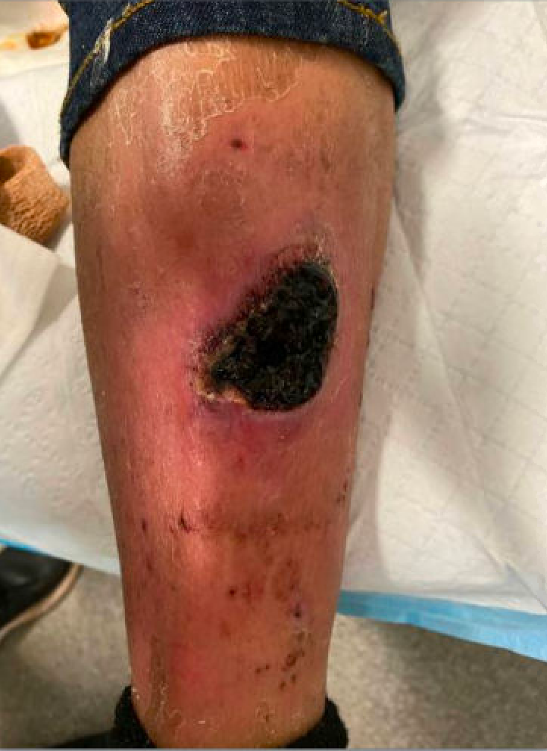
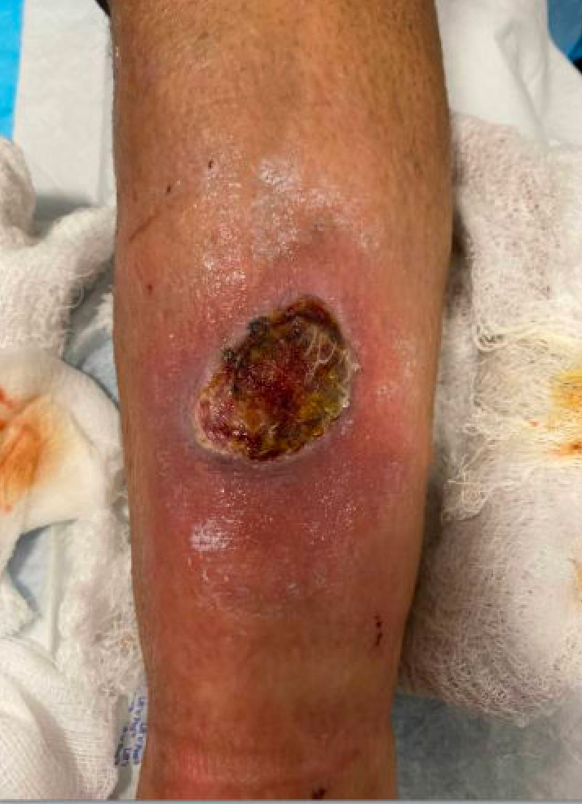
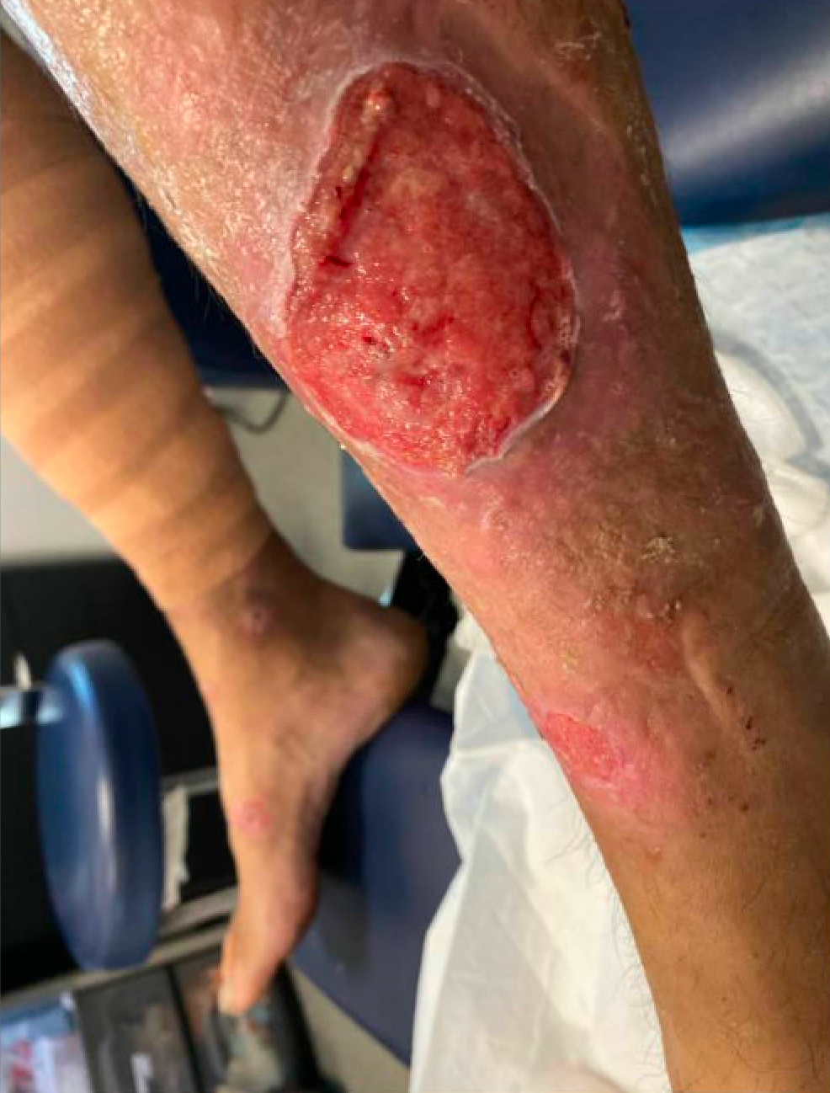
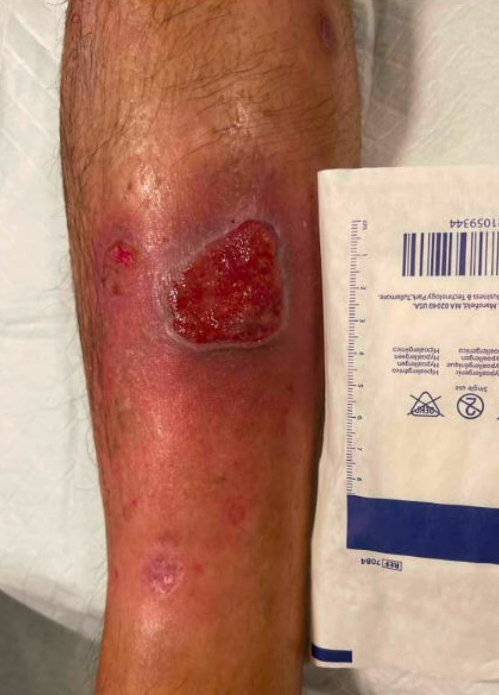
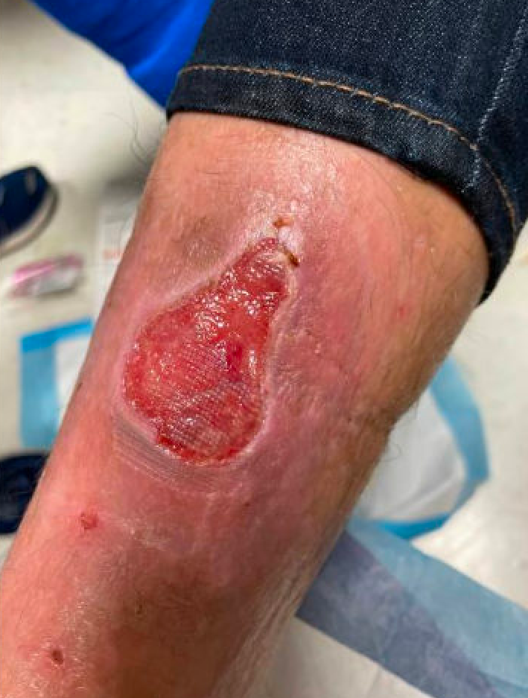
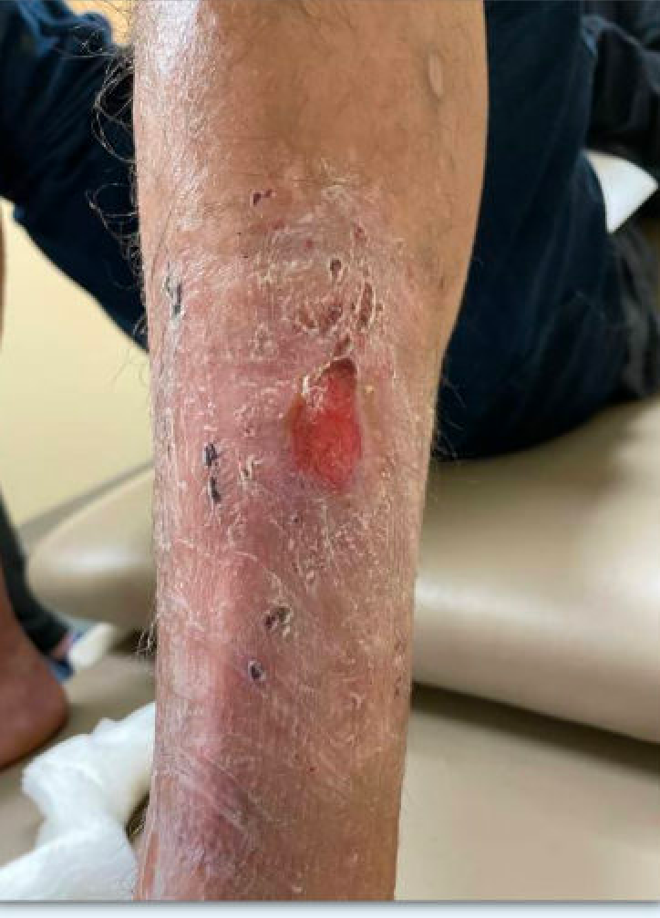
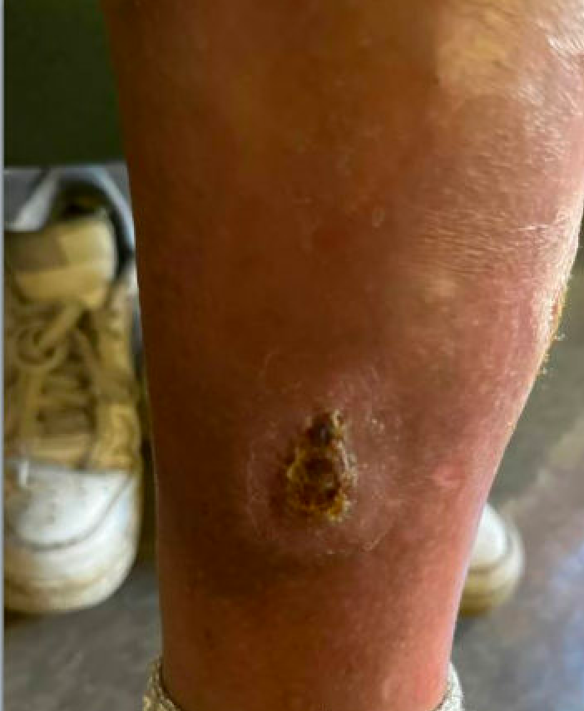
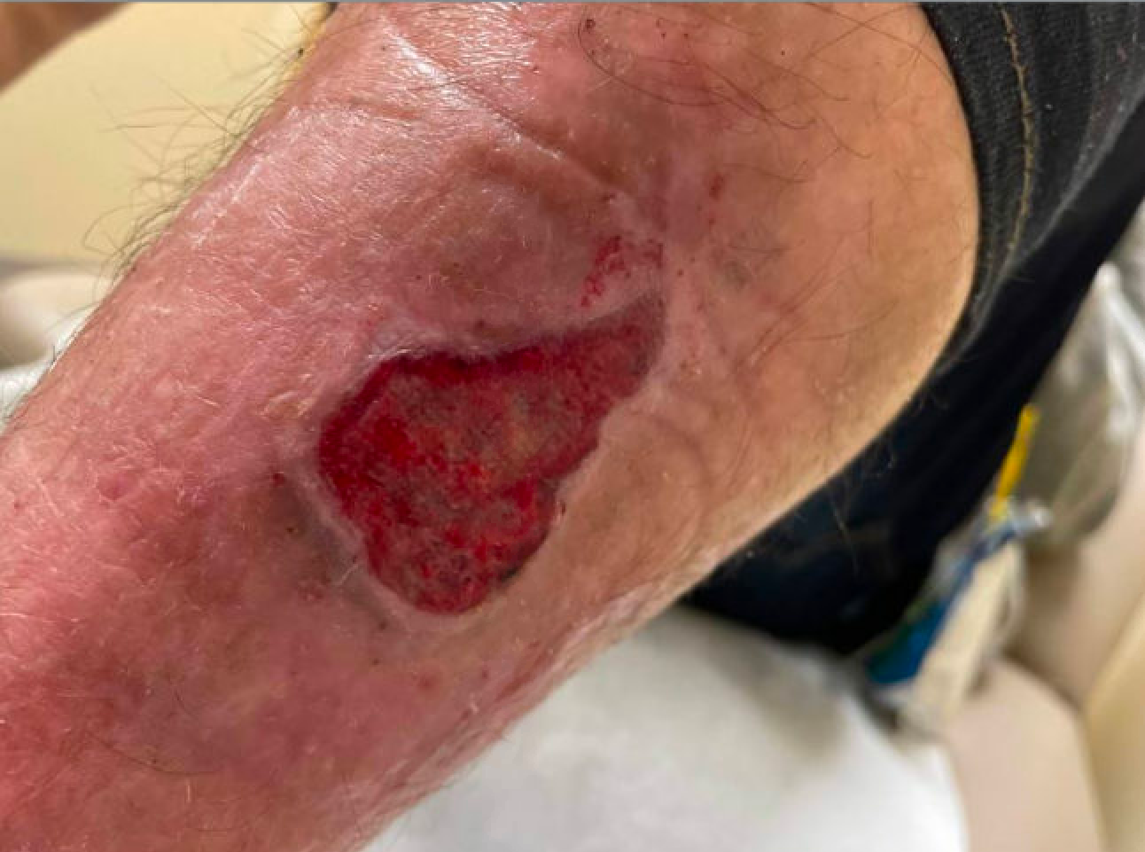
Wound #4
2/14/23
3/7/23
1/30/23
2/1/23
2/6/23
6/1/23
7/4/23
8/24/23
9/14/23
11/27/23
10/27/23
Notes:
This particular wound began with typical purple discoloration leading to a highly necrotic wound before healing, which is key across all of these images: these wounds can heal!

Slide 13
So how did we get here?

Slide 14
Wound Care Protocol
Protocol:
Initial:
Medihoney/xeroform, adaptic, ABD or foam, kerlix, coban
Dakins
Changes over time:
Did not respond well to xeroform or dakins, d/c’d
Less drainage = medihoney + non-adherent pad
Hypergranulation >> began use of triamcinolone
D/c coban >> ace bandage
(Maynell, 2024)

Slide 15
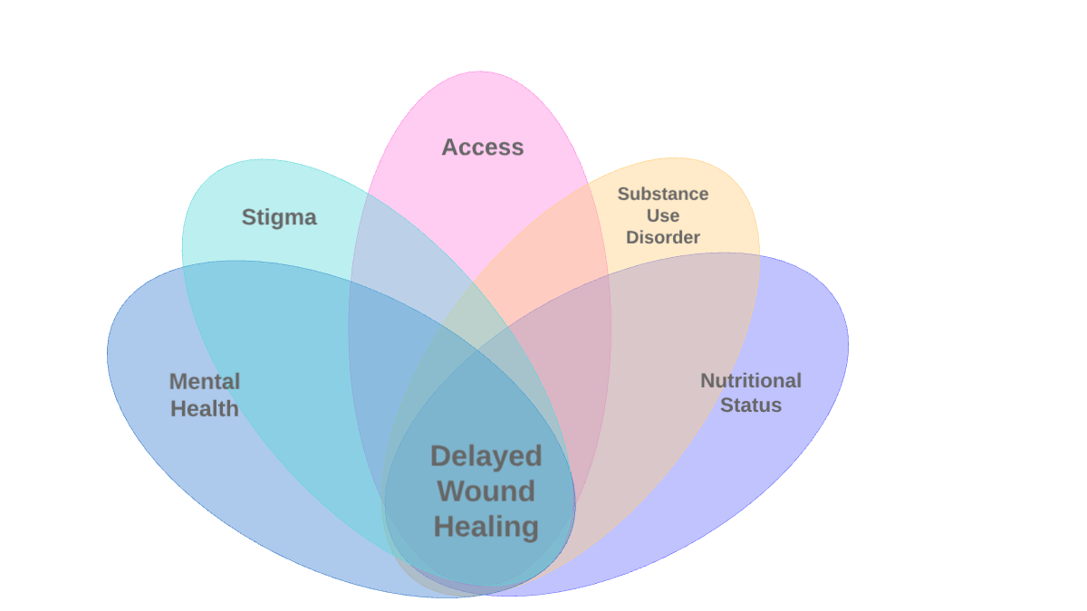
Notes:
**In thinking about what factors were affecting our patient’s ability to heal, it was so much more than wound care. So what could we address? We identified several key factors from our frequent discussions with the patient during his wound care, both concerns specific to him, as well as to our general population which include but is not limited to:

Slide 16
Access
First and foremost is Access to Care - low threshold + multiple options
Patient accessed multiple low threshold sites (LTS) and care paired with participation in DOT program
Goal of low threshold care - safe spaces without judgement
How do we know consistent care contributed to his healing?
May 2023 - EC became less accessible 2/2 occupancy caps >> wounds worsened
Similar incident after services closed at one LTS, during mental health crises
Notes:
**Note all the sites he has accessed specifically - EC, AHOPE, SPOT, lobby, finland, inpatient and traditional primary care clinic though this was his least accessed clinical site
DOT program >> explain what this is
5/18/23
Patient was not seen for wound care the entire month of April, 2023 and until May 18th. He had been using MediHoney and band-aids to care for his wounds at home. When asked why he was not presenting to clinic he stated: “I am sick of waiting to get into the [Engagement Center] for wound care.”
This occurred after occupancy caps were placed on the Engagement Center drop-in site causing long lines and barriers to care and services in the Spring of 2023.
This lack of services caused his wounds to worsen and increase in size to the point where osteomyelitis needed to be ruled out, and patient was referred to MGH ER and then medical respite.
Similar worsening of wounds occured after services ended at one low threshold site and during mental health crises including major depressive episodes and social isolation related to anxiety where he was presenting less to care sites

Slide 17
Nutritional Status
Known nutritional deficiencies delay wound healing
Since 2022, patient has lost 27% of initial weight: 199 lb >> 145lbs
How did we address this?
Housing case manager able to support access to food
Gift cards - contingency management
Referral for weekly, medically tailored meal delivery program and nutritional shake delivery
Supportive listening to client
(Banks, et al., 2023; Ghaly, Iliopoulos & Ahmad, 2021)
Notes:
**** Fron his initial recorded weight in 2022 to a more recent weight obtained in summer of 2024, pt was noted to have a Weight loss of 27% total body mass
Initial weight: 199lbs on 6/29/22
Current weight: 145lbs
How did we address this
Grocery deliveries
Grocery and restaurant gift cards that were paired with wound care and engagement in services
Referral for a weekly, medically tailored meal delivery program and nutritional shake delivery

Slide 18
Substance Use Disorder
Active substance use disorders, meaning consistent exposure to xylazine
How did we address this - strategies we worked on:
MOUD initiation: ~ 10 intakes for methadone maintenance
Currently on, now client pairing wound care with morning MMT visit
Increased MMT, decreasing xylazine exposure
“They get better when I’m doing methadone”
With education, patient began having his supply tested
Access to xylazine test strips
Low barrier confirmatory testing via local SSP
Trust building - same care regardless of use/non-use, level of somnolence
Notes:
Discussions of care and consent when patient somnolent

Slide 19
Mental Health
Reconnection to care
Less engagement with worsening mental health symptoms, including isolation, greater somnolence
How did we address this?
Permission and coordination of home visits
Increased education
Trust-building
Notes:
Increased education: More supplies sent home/left at home when patient tearful
Trust building - clinic has become place where patient can come when upset, have provided extensive supportive listening, connected to social workers in time of need, continue to foster safe space

Slide 20
Stigma
Anecdotally, known from clients, wounds physical representation of use and lead to poor tx in traditional medical settings >> difficult to present for tx
For this patient specifically:
After hospital visit: “I’m so embarrassed.”
Post period of reduced engagement: “I feel guilty.”
Reflects importance of creating safe spaces for PWUD
Notes:
***** Anecdotally, we know from patients that …..
Especially before these wounds become severe
5/16/22 During his first presentation to the hospital for these wounds, patient is described in the notes as being tearful, and states that he initially delayed seeking care and attempted to care for his wounds at home, because he felt embarrassed
6/6/23
During nursing visit after a period of fewer interactions and leaving medical respite AMA pt states “I feel guilty”
If we do not foster a sense of safety and support, people will not engage consistently which will prolong the duration of these wounds

Slide 21
In conclusion
Important to address:
Consistent low threshold care
Continued active SUD
Harm reduction
Mental health
Nutrition
Case management
Stigma in medicine >> Safe AND consistent spaces for PWUD
Notes:
Addressing the following in both direct service care and in research is key

Slide 22
In the Patient’s Words:
When discussing this presentation, our patient wanted to share the following:
“They’re still healing slowly, prolonged you know, but if I didn’t meet you all, I wouldn’t have a leg. I’ve learned how to dress my wounds better, how they feel, how they look, how best to do this. I’m not going to the hospital, that feels foreign. This, it’s been a great experience.
It’s.. been a big experience. At first, embarrassing, I was iffy about it until I got to know the nurses and have experiences with them where they now feel like, not strangers, but extended family - [I’ve] come to depend on you guys when going through things, not just this, and it made it easier to come back for care.”
Notes:
We wanted to end the case presentation by highlighting that the patient was largely the third member of the care team and was heavily involved in creating and changing the care plan including the wound care protocols and also in building this case presentation. We wanted this to be something we did with him, and not something we did with him and not to him and to focus on patient involvement and empowerment.

Slide 23
Thank you
Our client!
Our Harm Reduction Team colleagues
BHCHP for endless wound care supplies!

Slide 24
References
Banks, MD., Webster, J., Bauer, J., Dwyer, K., Pelecanos, A., MacDermott, P., Nevin, A., Coleman, K., Campbell, J., Hickling, D., Byrnes, A. & Capra, S. Effect of Supplements/Intensive Nutrition on Pressure Ulcer Healing: A Multicentre, Randomised Controlled Study. Journal of Wound Care 2023; 32(5). https://doi.org/10.12968/jowc.2023.32.5.292
Ghaly, P., Iliopoulos, J. & Ahmad, M. The Role of Nutrition in Wound Healing: An overview. British Journal of Nursing 2021; 30(5). https://doi.org/10.12968/bjon.2021.20.5.S38
Maynell, KB., West, W., Marek, J., Wright, B., Bodnar, M., Le, N., Whalen, K., Taylor, L., Troy, J., Smith, Jr, D., and Laun, J. Utilization of Topical Polysporin and Triamcinolone for the Treatment of Hypergranulation Tissue. Journal of Burn Case & Research 2024; 45(3): 669-674. doi:10.1093/jbcr/irad205.
Torruella, RA. Xylazine (veterinary sedative) use in Puerto Rico. Substance Abuse Treatment, Prevention, and Policy 2011; 6(7). doi: 10.1186/1747-597X-6-7.

