Slide 1
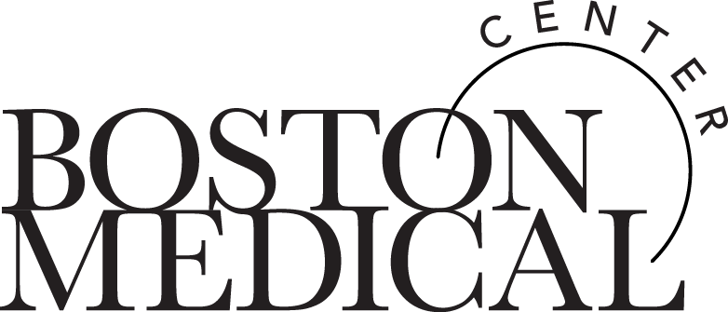
Hearing Hope: The Power of Narrative Storytelling in Addiction Medicine
Brittany L. Carney, DNP, FNP-BC, Al Ortiz, CARC, Nancy Regan-Brooks FNP, CNM, CARN-AP, Alicia S. Ventura, MPH & Justin Alves, RN, MSN, FNP-C, ACRN, CARN, CNE
2024 AMERSA National Conference
November 16, 2024

Slide 2
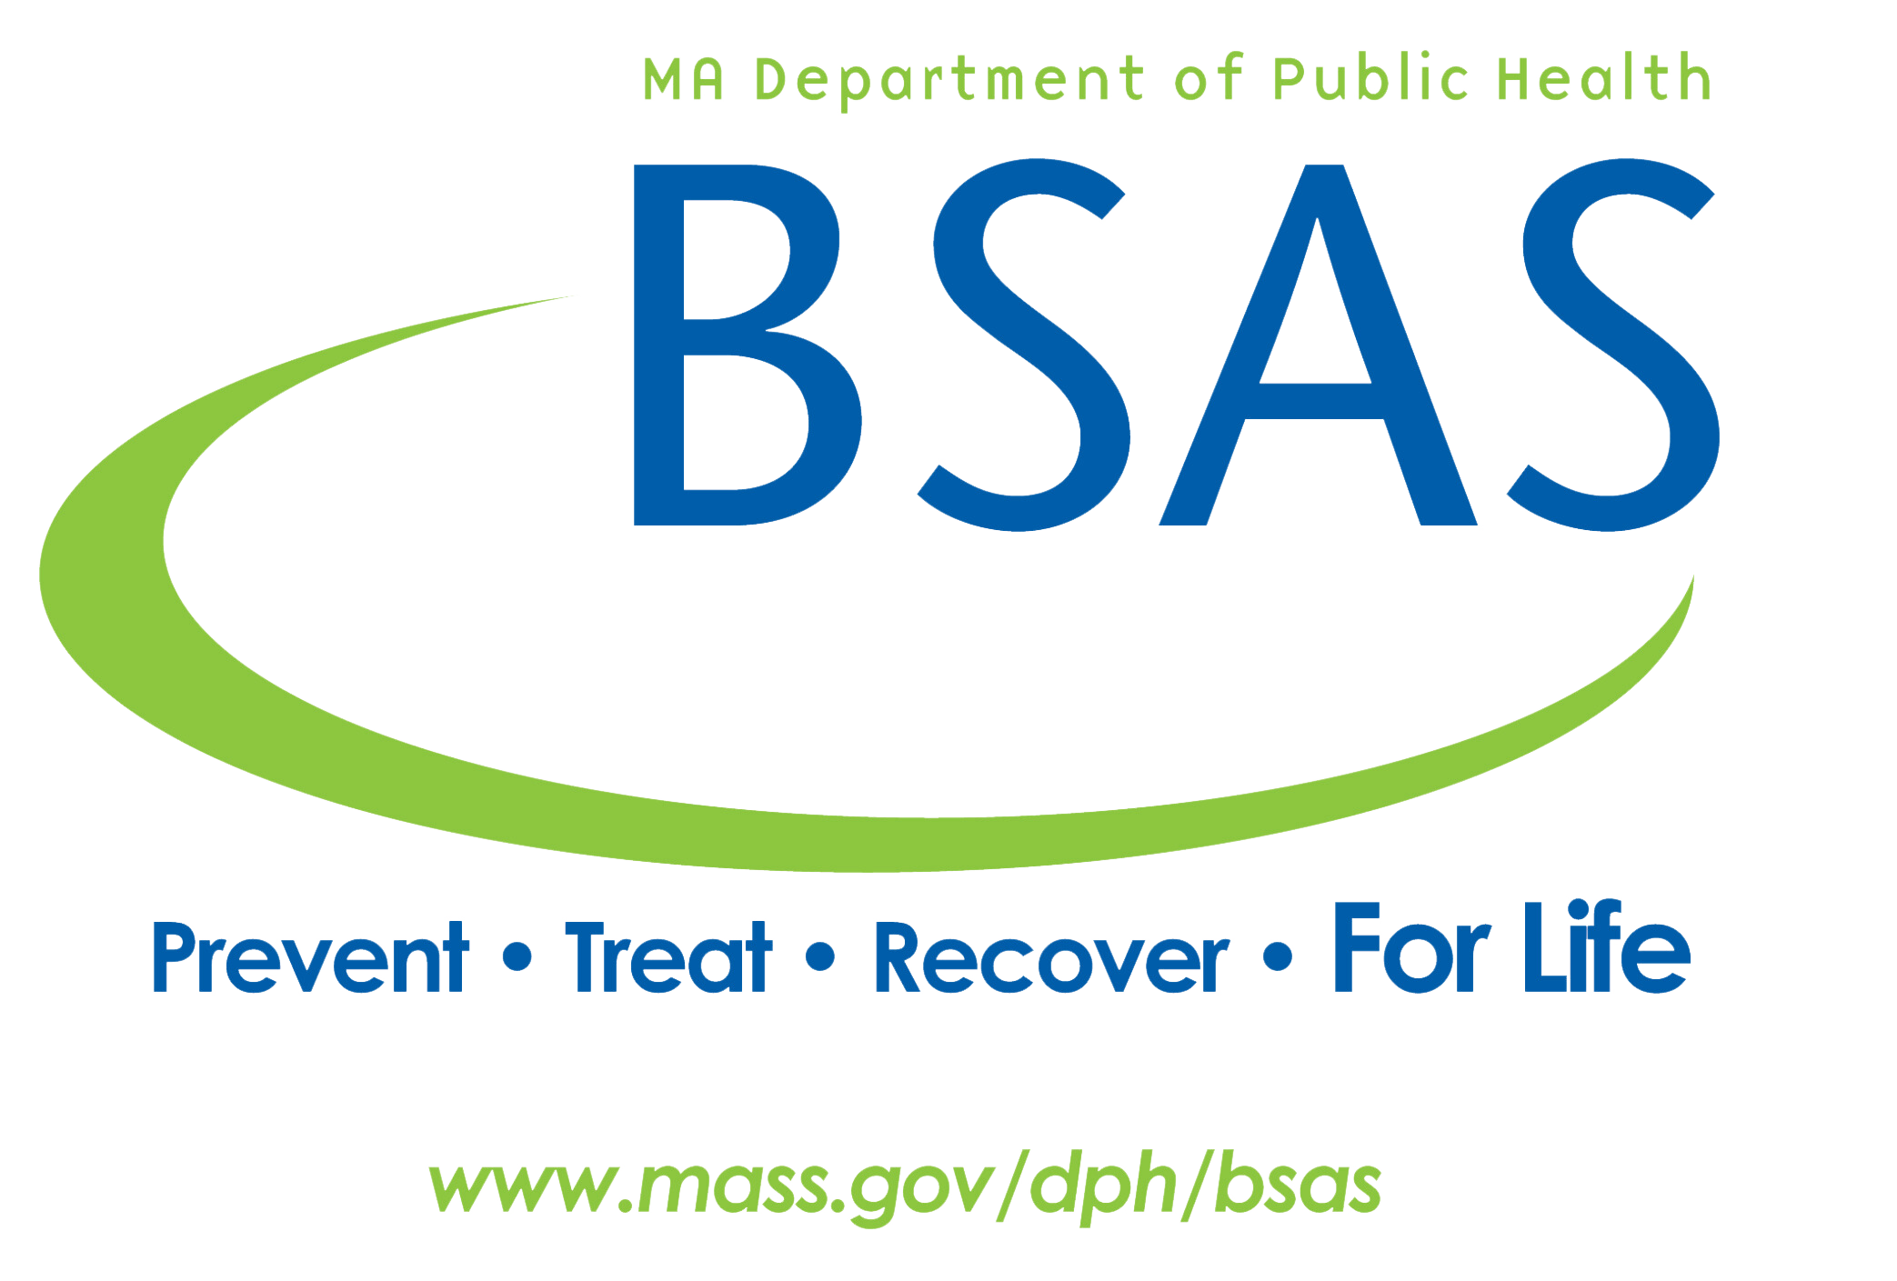
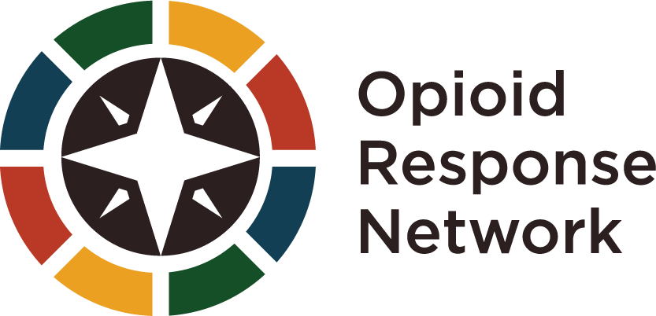
Funding provided by
Funding for this initiative was made possible (in part) by grant no. 1H79TI085588-02 from SAMHSA. The views expressed in written conference materials or publications and by speakers and moderators do not necessarily reflect the official policies of the Department of Health and Human Services; nor does mention of trade names, commercial practices, or organizations imply endorsement by the U.S. Government.

Slide 3
Disclosures
None of the authors have any relevant financial or other conflicts of interest to disclose relating to this presentation.

Slide 4
Introduction
Stigma for individuals with substance use disorder (SUD) is a significant problem that has not been resolved by traditional didactic educational strategies.
Narrative medicine focuses on sharing lived experiences through storytelling among individuals with a particular condition or experience.
Stories create connections and share hope that may catalyze a deeper understanding of SUD among healthcare team members.
The Moth (en-US) | Stories | The Art of Medicine
Palla et al (2024)
Milota et al (2019)
Lam et al (2022)
Notes:
-Milota, M. M., van Thiel, G. J. M. W., & van Delden, J. J. M. (2019). Narrative medicine as a medical education tool: A systematic review. Medical Teacher, 41(7), 802–810. https://doi.org/10.1080/0142159X.2019.1584274
-Palla, I., Turchetti, G. & Polvani, S. Narrative Medicine: theory, clinical practice and education - a scoping review. BMC Health Serv Res 24, 1116 (2024). https://doi.org/10.1186/s12913-024-11530-x
- Lam JA, Feingold-Link M, Noguchi J, Quinn A, Chofay D, Cahill K, Rougas S. My Life, My Story: Integrating a Life Story Narrative Component into Medical Student Curricula. MedEdPORTAL. 2022. https://doi.org/10.15766/ mep_2374-8265.11211
2024 scoping review of narrative medicine/storytelling - goes back 20 years to narrative storytelling
Utilized across disciplines and professions (nursing, medicine, social work)
Principle that storytelling (& listening) may improve empathy and augment provider compassion.
Lam et al suggests this approach can improve empathy among learners (medical students).

Slide 5
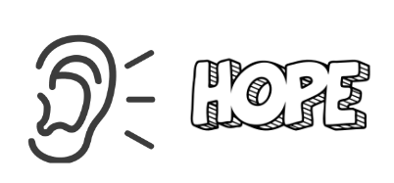
Objective
Use narrative storytelling to improve healthcare providers/caregivers’ knowledge and empathic practice in caring for individuals with SUD

Slide 6
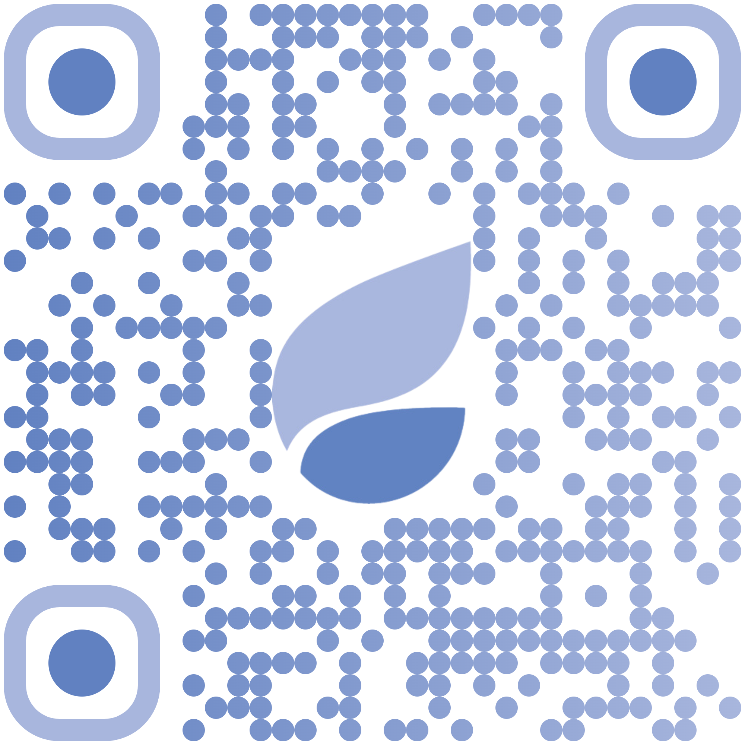
Methods
Boston Medical Center Grayken Center for Addiction Training and Technical Assistance (Grayken TTA)
Recovery Month Educational Series piloted in 09/2023
Two 60-minute narrative storytelling sessions utilized a panel/moderator format
Intended audience: health care and SUD treatment workforce
Sessions were not recorded
Post-training surveys completed
Grayken Center for Addiction Training and Technical Assistance
Notes:
Existing infrastructure that uses online platform, has existing evaluation processes, scan the QR code
Topics: “Our Recovery Stories” & “Caregivers in Recovery”
Free continuing Education Credit was offered for these sessions.
Post training surveys were offered reviewed to assess learning objectives, self-reported practice change and general feedback.

Slide 7
Methods: Learning Objectives
 | Our Recovery Stories | Caregivers in Recovery
Learning Objectives | Develop an appreciation for multiple pathways of recovery.​ Collaborate with patients to define recovery in a person-centered holistic approach to care.​ Recognize at least 1 barrier and 1 facilitator of recovery in persons with SUD in a person-centered holistic approach.​ | Recognize 2 special considerations for supporting caregivers in recovery.​ Name 2-3 supports for children of caregivers in recovery.​ Identify at least 2 examples of stigma faced by caregivers in recovery
Logistics | 3 panelists in recovery 1 nurse educator 1 training support person | 2 panelists in recovery 1 nurse educator 1 training support person
Expert Panelist
Nurse Educator
Training Support Team
Notes:
-This table summarizes our learning objectives

Slide 8
Results: Learner Professions
Profession | Our Recovery Stories, (n) | Caregivers in Recovery, (n) | TOTAL n (%)
CADC/LADC | 6 | 8 | 14 (9%)
Community Health Worker (CHW) | 6 | 4 | 10 (7%)
LMHC | 6 | 8 | 14 (9%)
Nurses | 21 | 12 | 33 (22%)
Other | 16 | 13 | 29 (19%)
Providers (MDs, NPs) | 6 | 4 | 10 (7%)
Recovery Coach | 13 | 10 | 23 (15%)
Social Worker | 12 | 8 | 20 (13%)
TOTAL | 86 | 67 | 153
Notes:
-This shows some basic demographic information of the individuals we trained
-Notes: Our recovery stories had 113 attendess
Caregivers in Recover had 120
TOTAL: 233
However 65% of those attendees completeted the survey (153)
-Key takeaways- Nurses (22%), Recovery Coaches (15%), Social workers (13%)

Slide 9
Results: Knowledge and Interprofessional Collaboration
Survey Question | Response Choice | Our Recovery Stories (n=86) | Caregivers in Recovery (n=67) | TOTAL (n=153)
Do you feel your knowledge of the topic has increased as a result of this activity? | Yes | 84 | 62 | 146/153 (95.4%)
 | No | 2 | 5 | 7/153 (4.6%)
I am better able to work effectively with interprofessional team members to enhance care. | Strongly Agree/ Agree | 77 | 61 | 138/153 (90.2%)
 | Neutral | 9 | 6 | 15/153 (9.8%)

Slide 10
Results: Feedback Survey Themes
“The need of all people to have unconditional support whether in recovery or not, understanding of the stigma that parents in recovery face.”
Hearing about stigma faced by panelists was powerful.
Shared lived experiences was unique.
- Learner from Caregiver in Recovery Session

Slide 11
Results: Feedback Survey Themes
“The rawness of this webinar changed my perspective wholly. I am still absorbing all that was shared from the stories of loss and just grateful that people are willing to share their stories for people to truly understand.”
Many learners described how they heard opportunities and times of hope that we often don't tap into or share.
- Learner from Our Recovery Stories Session

Slide 12
Results: Feedback Survey Themes
Need to incorporate voices from individuals on medication as part of treatment for SUD
Continue to include diverse panelist perspectives including:
Those caregiving (for family/loved ones)
Voices from tribal communities
Youth
Others?
"no one on the panel that spoke about utilizing medication to support their recovery…. Not having someone represent this group of people (a group that is growing but continues to face stigma in the "recovery community“) was a missed opportunity in my opinion.”
-Learner in Our Recovery Stories Panel

Slide 13
Conclusions
Narrative storytelling may improve knowledge, promote empathy and reduce stigma in caring for people with SUD.
Stories rooted in true experiences can shine a light on the many pathways to recovery and learner can hear hope first-hand.
It may be an effective approach to reduce healthcare providers’ and teams’ stigma.
The impact on the storyteller/person in recovery was not measured and something that might be helpful to quantify.

Slide 14
Acknowledgements
Guest panelists who served as part of this teaching series.
Grayken TTA Educators & Training support team.

Slide 15
Questions and Contact Information
Britt Carney, DNP, FNP-BC
Brittany.carney@bmc.org

