Slide 1
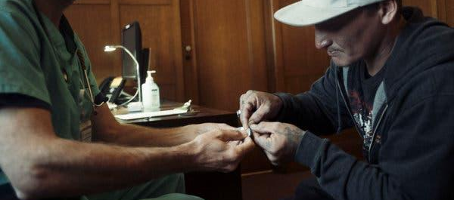
High-Dose Fentanyl and Buprenorphine Continuation as Support for the Treatment of Buprenorphine Precipitated Withdrawal
Megan Heeney, MD; Erik Anderson, MD; Kay Lind, MD
Lauren Sirey, PharmD; Monish Ullal, MD; Amy Liang, MD; Robert Benard, NP; Andrew Herring, MD
Alameda Health System
Department of Emergency Medicine
Division of Addiction Medicine

Slide 2
No Conflicts of Interest

Slide 3
Buprenorphine Precipitated Withdrawal
Buprenorphine precipitated withdrawal (BPOW) is an uncommon and challenging clinical scenario
Variably defined, hallmark is a sudden increase in COWS score within 1 hour of buprenorphine administration
May occur in between 1-12% of patients starting SL Bup in the ED or hospital setting
Thakrar et al JNO; Snyder et al JNO; D’Onofrio et al JNO
Notes:
Buprenorphine precipitated withdrawal (BPOW) is an uncommon and challenging clinical scenario. This withdrawal can be severe with symptoms of withdrawal ranging from nausea, piloerection, diffuse pain and diarrhea to delirium and critical illness.
Variably defined, the hallmark is a sudden increase in COWS score within 1 hour of buprenorphine administration
May occur in between 1-12% of patients starting SL Bup in the ED or hospital setting
Determining optimal supportive management for patients presenting with bup precipitated withdrawal is of utmost importance for patient engagement and enhancing provider capacity to manage this emergent clinical scenario.
Initiating medication for opioid use disorder is life saving and we know that a barrier to providers offering buprenorphine initiation is fear of precipitated withdrawal. Our hope is to optimize management and enhance Emergency Department provider comfort in managing precipitated withdrawal to bolster our capacities to provide this mortality reducing medication.

Slide 4
Management of Buprenorphine Precipitated Withdrawal
Foundations include additional buprenorphine, benzodiazepines, ketamine, additional adjuncts
As a rescue, fentanyl has been used to treat refractory BPOW in the ED
The evidence base for these approaches is limited
The CA Bridge BPOW Protocol was collaboratively developed with clinical experts and with consensus from large organizations
Notes:
Foundations of bup precipitated withdrawal management include additional buprenorphine to optimize bup agonism at the mu receptors, benzodiazepines, ketamine and additional adjuncts
As a rescue, fentanyl has been used to treat refractory bup precipitated withdrawal in the ED
The evidence base for these approaches is limited
The CA Bridge BPOW Protocol was collaboratively developed with clinical experts and with consensus from large organizations

Slide 5
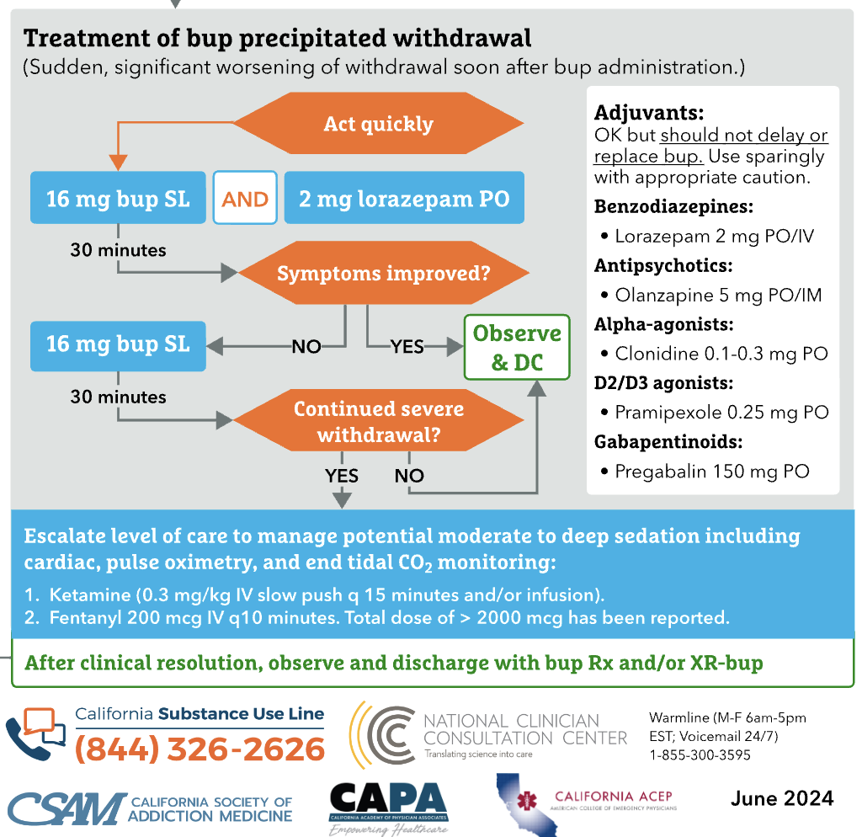
Notes:
This is our treatment of bup precipitated withdrawal protocol and we can walk through this together.
Act quickly- give high dose buprenorphine and oral benzo -> at this time it is okay to give additional adjuvants including antipsychotics such as olanzapine PO or IM, alpha agonists clonidine 0.1-0.3 orally, dopaminergic agonist for restlessness pramipexole, gabapentinoids such as pregabalin 150 mg PO.
After 30 minutes assess whether symptoms improve, at this time if yes, patient can be observed and discharged with plan for continued bup at home.
If continued worsening symptoms of withdrawal give an additional bup 16 mg SL and further adjuncts as appropriate.
If continued symptoms escalate to ketamine which potentiates bup
And to fentanyl 200 mcg q10minutes

Slide 6
Background – BPOW Protocol
Specific doses are not prescribed, including how to continue buprenorphine
Fentanyl administered 200mcg IV at a time, goal is to give q10 minutes
No maximum, titration to comfort and RASS of around 0-1
Buprenorphine continuation can be with low- or high-dose, IV or SL
Notes:
Specific doses are not prescribed, including how to continue buprenorphine post precipitated withdrawal
Fentanyl administered 200mcg IV at a time, goal is to give q10 minutes, similar protocol has been used by Dr. Azar and group in Vancouver for management of acute withdrawal and ongoing treatment of symptoms with full agonists.
No maximum dose of fentanyl, it has been important to titrate to comfort
Buprenorphine continuation can be with low- or high-dose, IV or SL

Slide 7
Methods
Retrospective cohort study of patients who had severe BPOW from SL Bup that was refractory to initial management with buprenorphine and other adjuncts and required high-dose fentanyl
October 1, 2022 to March 31, 2024
Primary Outcome: Continuation of MOUD at ED or hospital discharge
Continuation of Bup defined as tolerating therapeutic dose (>8mg SL, or any XR dose) with a decrease in COWS score
Continuation of methadone is tolerating dose resulting in a decreased COWS score
Secondary Outcomes: respiratory depression, hypoxia, airway interventions, and follow up rates in clinic
Notes:
Our Methods:
This is a Retrospective cohort study of patients who had severe Bup precipitated withdrawal after SL Bup that was refractory to initial management with buprenorphine and other adjuncts and required high-dose fentanyl
October 1, 2022 to March 31, 2024
Primary Outcome: Continuation of Medication for opioid use disorder at ED or hospital discharge
Continuation of Bup was defined as tolerating therapeutic dose (>8mg SL, or any XR dose) with a decrease in COWS score
Continuation of methadone was defined as tolerating methadone dose resulting in a decreased COWS score
Secondary Outcomes we looked at are side effects from IV fentanyl administration: respiratory depression, hypoxia, or airway interventions.
as well as follow up rates in clinic

Slide 8
Results
14 patients had severe BPOW requiring high-dose fentanyl and buprenorphine continuation
12 patients identified as male, 2 as female; mean age 47.5
12 patients were using fentanyl only, 1 was using methadone, and 1 was using methadone and fentanyl
Notes:
Results of our study:
During this study periodFourteen patients had severe BPOW requiring high-dose intravenous fentanyl with buprenorphine continuation.
The mean patient age was 47.5 (standard deviation: 13.8); 12 patients identified as male, and 2 identified as female.
Twelve of the patients were using fentanyl prior to BPOW, one was using methadone, and one was using methadone and fentanyl.

Slide 9
Results
Total SL doses in the first six hours of treatment ranged from 4mg-64mg (median 32mg; IQR: 16-40mg)
Includes the initial dose and subsequent doses used to treat BPOW
4 patients received IV Bup, doses ranged between 0.6-2.1mg
Total fentanyl doses ranged from 400-7100mcg (median 1200mcg; IQR: 800-1800mcg)
13 patients received ketamine, 12 received benzodiazepines
12 patients were admitted to the hospital (median LOS 2 days; IQR: 1-3.5)
Notes:
Total initial sublingual buprenorphine doses in the first six hours of treatment ranged from 4mg to 64mg (median 32mg, interquartile range [IQR]: 16mg-40mg);
four patients also received intravenous buprenorphine with doses (range: 0.6mg-2.1mg).
Total doses of intravenous fentanyl pushes ranged from 400-7100mcg (median: 1200mcg, IQR: 800-1800).
Thirteen patients received IV ketamine as part of their precipitated withdrawal management and 12 patients received benzodiazepines.
Twelve patients (85.7%) were admitted to the hospital for a median duration of two days (IQR: 1-3.5).

Slide 10
Results
Primary Outcome: 13/14 patients left the hospital after tolerating therapeutic MOUD
11 tolerated Bup with a decreased in COWS score prior to discharge
6 patients received XR Bup prior to discharge
2 patients continued methadone and tolerated dose with improvement in COWS score prior to discharge
1 self-directed discharge
Secondary Outcomes:
no episodes of respiratory depression, hypoxia or airway interventions
9/14 patients attended follow up appointments within 30 days; 7 were taking Bup, 2 were taking methadone
Notes:
Among the fourteen patients, eleven (78.6%) tolerated therapeutic buprenorphine doses prior to discharge, two (14.3%) patients elected to continue methadone, and there was one self-directed discharge prior to therapeutic buprenorphine. Six patients received extended-release buprenorphine prior to hospital discharge.
13 of the 14 patients left the hospital after tolerating therapeutic MOUD
There were no episodes of respiratory depression or naloxone administration. No patients required airway interventions.
64.2% attended follow up within 30 days; of the patients who followed up all were maintained on MOUD; 7 on buprenorphine and 2 on methadone.

Slide 11
Conclusions
ED-based protocol using high-dose fentanyl and buprenorphine continuation appears to be safe and well tolerated
After BPOW, most patients were admitted for a short time, nearly all continued MOUD, and a majority attended follow up in addiction clinic within 30 days of discharge
Future research should assess for optimal strategies to ensure both patient comfort and continuation of MOUD after BPOW
Notes:
In Conclusion
An ED-based protocol using high-dose fentanyl and buprenorphine continuation appears to be safe and well tolerated
After BPOW, most of our patients were admitted for a short time, nearly all continued MOUD, and a majority attended follow up in addiction clinic within 30 days of discharge
Future research should assess for optimal strategies to ensure patient comfort and continuation of MOUD after BPOW

Slide 12
Thanks! Questions?

