Slide 1
“Holding Out” in a Holding Cell: Clinical Case Demonstrates a Gap in Access to Medications for Opioid Use Disorder
Phoebe Cushman, MD, MS;
Sharif Nankoe, MD; Jeffrey Baxter, MD

Slide 2
DISCLOSURE: I have no financial or other conflicts of interest to disclose related to the material presented.

Slide 3
Background
Untreated OUD in carceral settings leads to high post-release mortality
A disproportionate number of BIPOC individuals are incarcerated, often for charges related to SUDs
As of 2021, only 13% of U.S. jails and prisons provided MOUD (methadone, buprenorphine, naltrexone)
Merall et al. Addiction 2010
Nellis, The Sentencing Project, 2021
Jail and Prison Opioid Project, 2021

Slide 4
Background
Massachusetts Act for Prevention and Access to Appropriate Care and Treatment of Addiction (CARE act) 2018:
Pilot program for MOUD in 5 jails and 4 prisons in MA
As of today, all but 3 of approximately 30 jails and prisons provide all 3 forms of MOUD in some capacity
Wikimedia.org
MAlegislature.gov
Spectrum Health Systems (internal communication)
Notes:
Massachusetts, along with RI, NY, and CA has been on the forefront of changing this
Jails = county system
Prisons = state & federal systems
Both numerator and denominator are shifting (denominator approx. 30)
Spectrum health systems operates many of the OUD programs in these facilities—but I do not work in any of them-—I work in a community OTP
In some capacity should be distinguished from what “full treatment” looks like in the outpatient/noncarceral setting=this means that some, for example do initiate patients with OUD who have never been treated with MOUD on methadone, buprenorphine, or naltrexone upon entry, but, in other cases, this may mean they start patients on buprenorphine or give them a single injection of NTX just prior release

Slide 5
Mass.Gov
Spectrum Health Systems (internal communication)
Nantucket County Jail

Slide 6
Learning Objectives
Identify existing gaps in provision of MOUD in carceral settings
2) Apply the Americans with Disabilities Act (ADA) to the treatment of persons with OUD in carceral settings
3) Highlight the role of partnerships with local and federal officials in advocating for access to MOUD in carceral settings

Slide 7
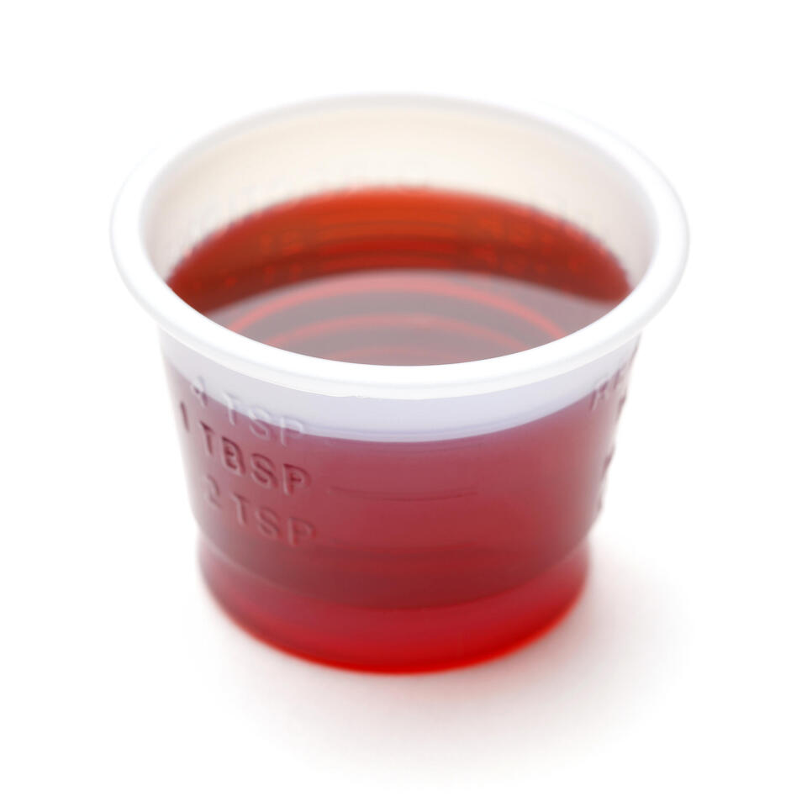
Clinical Case
State library of New South Wales
24-year-old male with OUD presented to our Opioid Treatment Program (OTP) after missing 5 consecutive days of methadone treatment
Vital signs: BP 138/93, HR 87, RR 18, T 99.1
Clinical Opiate Withdrawal Score (COWS) = 15
Urine toxicology:
+ cocaine, + fentanyl, + methadone
Last methadone dose: 40mg, 6 days prior
Notes:
Case shared with patient permission
Standard to have check in with physician after returning after 5 + missed days
I asked the patient, “WHAT HAPPENED?”

Slide 8
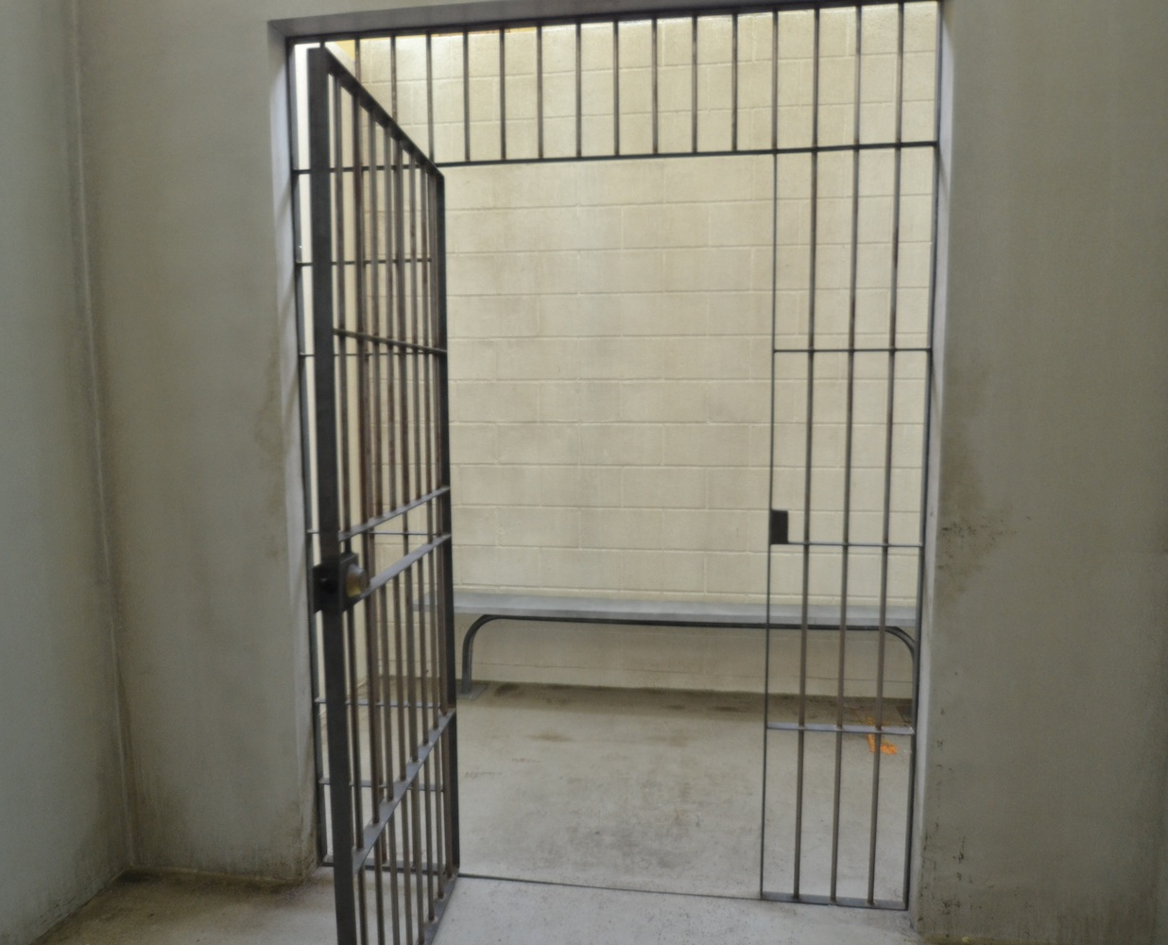
Clinical Case
The patient reported being “picked up” by the police
He had spent 5 days in a holding cell at the police department, located 1.5 blocks from the OTP
He experienced significant withdrawal (nausea, vomiting, diarrhea, cold sweats, body aches) in the cell
He used fentanyl intranasally immediately post-release
thecontextofthings.com
Notes:
This is a photo of a typical holding cell, though not an actual photo of the cell where our patient was held

Slide 9
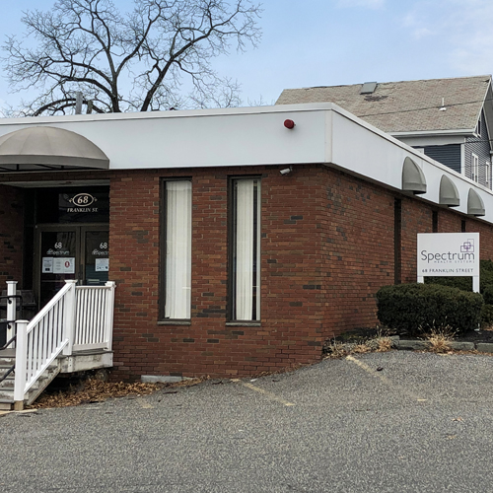
Medical Follow-Up
The patient was readmitted to our OTP and his methadone was restarted
Notes:
But then, I wanted to figure out, on a broader level, how could I keep this from happening again to our patients

Slide 10
Advocacy Follow-Up
We contacted the Massachusetts U.S. Attorney’s Office (USAO) with the question “Does the CARE act apply to patients in police custody?”
Answer: “It doesn’t matter.”
Explanation: “The ADA mandates that persons taking MOUD must receive their medication while in carceral settings, including municipal facilities.”
Precedents include: Smith v. Aroostock County (2019)
ADA.gov
www.aclumaine.org/en/cases/smith-v-aroostook-county
Notes:
Does the the CARE act apply to patients in police custody? →since this is a municipal facility, run by a city, and not a jail or prison

Slide 11
The Americans with Disabilities Act and the Opioid Crisis: Combating Discrimination Against People
In Treatment or Recovery
U.S. Department of Justice,
Civil Rights Division (4/2022)
ADA.gov
https://archive.ada.gov/opioid_guidance.pdf

Slide 12
Advocacy Follow-Up
According to a USAO brief from April 2022, the ADA:
“prohibits discrimination against people in recovery from OUD who are not engaging in illegal drug use, including those who are taking legally-prescribed medication to treat their OUD” BUT
“an individual cannot be denied health services, or services provided in connection with drug rehabilitation, on the basis of that individual’s current illegal use of drugs, if the individual is otherwise entitled to such services”
ADA.gov
https://archive.ada.gov/opioid_guidance.pdf
Notes:
Acknowledge this is confusing

Slide 13
Access to MOUD in the Local Holding Cell: Implementation
The USAO wrote a letter informing the police that the ADA requires them to address all their detainees’ medical needs, including MOUD

Slide 14
Access to MOUD in the Local Holding Cell: Implementation
OTP Physician met with Police Chief and Deputy Police Chief
Created plan for patients in police custody to be transported to the clinic to receive methadone through the police vehicle window
Since 4/2023, patients in police custody have received methadone at our OTP on 10 occasions
Notes:
I set up to “fill the gap” I had found
Adapted drive-by setup from COVID “curbside medication”
Some of these represent repeat visits of the same patient
This is probably an undercount because it is hard to consistently document this occurrence in our EMR

Slide 15
Implementation: Facilitators/Barriers
Physical proximity between Police Department and OTP (+)
Relationship with local Police Department (+/-)
Institutional buy-in from OTP system (+)
Relationship with MA USAO (+)
Massachusetts’ support for MOUD in carceral settings (+)
State and federal regulations (+/-)
Notes:
In the remaining time I would like to explain the facilitators of and barriers to the project I have commenced--namely, facilitating our OTP pts to receive methadone while they are in police custody.

Slide 16
Future Steps
Sunday and holiday “take homes”
Expansion
To the holding cells where our other OTPs are located
To patients from outside OTPs
To patients with OUD but who are not on MOUD
Ongoing collaboration between OTP and police department

Slide 17
Take Home Points
Listen to your patients
Partner with local law enforcement
Partner with your U.S. Attorney’s Office
The ADA applies to OUD and prohibits denial of MOUD in all settings across the U.S.

Slide 18
Resources
The Americans with Disabilities Act and the Opioid Crisis: Combating Discrimination Against People in Treatment or Recovery archive.ada.gov/opioid_guidance.pdf
Jail and Prison Opioid Project
prisonopioidproject.org
Legal Action Center
lac.org
Prison Policy Initiative
prisonpolicy.org
The Sentencing Project
sentencingproject.org
thecontextofthings.com

Slide 19
THANK YOU
Legal support:
Gregory Dorchak, Assistant U.S. Attorney, Civil Rights Division,
Massachusetts U.S. Attorney’s Office
phoebe.cushman@spectrumhealthsystems.org

Slide 20
EXTRA SLIDES BEYOND THIS POINT

Slide 21
Slide courtesy of Jeff Baxter

Slide 22
Slide courtesy of Sharif Nankoe

Slide 23
4/2022 The U.S. Attorney’s Office announced today that it has completed a review to ensure that state and county correctional facilities will maintain all medications used to treat Opioid Use Disorder (MOUD) for people already in treatment for Opioid Use Disorder (OUD) prior to entering a carceral facility’s custody, as required by the Americans with Disabilities Act.

