Slide 1
Substance Use in Adolescents and Transitional Age Youth: Justice Involvement and Homelessness
Produced in Partnership by:
Notes:
Hello, welcome to today’s webinar – “Substance Use in Adolescents and Transitional Age Youth: Justice Involvement and Homelessness”

Slide 2
Produced in Partnership
attcnetwork.org
amersa.org
sbirt.webs.com
Notes:
This webinar is produced in partnership with the ATTC Network Coordinating Office, AMERSA, and the Adolescent SBIRT Project by NORC at the University of Chicago.

Slide 3
The Impact of Substance Use on the Developing Adolescent Brain
Who's Doing What?: The Epidemiology of Adolescent Substance Use
Substance Use Interventions for Adolescents and Transitional Age Youth
Integrating Stigmatized Loss and Disenfranchised Grief into the SBIRT Model
Substance Use in Adolescents and Transitional Age Youth: Justice Involvement and Homelessness
amersa.org/resources/tay-webinar-series
Notes:
This webinar is a part of the Transitional Age Youth Webinar Series. I encourage you to sign up for these other titles at the AMERSA , ATTC or NORC websites.

Slide 4
Ask Questions
Ask questions at any point through the zoom “Chat” feature.
Answers will be posted on the website.
Notes:
You can ask questions at any point in this presentation through the “Chat” pane of your Zoom Control Panel.
Answers will be posted on the website.

Slide 5
Webinar Presenters
Tamara Itzel Martinez, MD
Instructor of Pediatrics/Harvard Medical School
Attending Physician/Adolescent Substance use and Addiction Program (ASAP) Division of Developmental Medicine Boston Children's Hospital
Aura M. Obando, MD
Family Team Program Director, Boston Health Care for the Homeless Program
Instructor of Medicine and Pediatrics Harvard Medical School
Notes:
Today’s webinar presenters are Dr. Tamara Itzel Martinez and Dr. Aura Obando.
Dr. Tamara Itzel Martinez earned her MD degree from the University of Illinois at Chicago and completed her Family Medicine residency at AMITA Health Saint Joseph Hospital in Chicago, where she developed an interest in addiction medicine after working at Harborview Recovery Center during her last year of residency. She went on to complete an addiction medicine fellowship at Boston Children’s Hospital in 2020 and stayed on as Assistant in Medicine and as Instructor in Pediatrics at Harvard Medical School. Dr. Martinez is certified by the American Board of Family Medicine and in her current role as addiction medicine attending in the Adolescent Substance Use and Addiction Program (ASAP), she has spearheaded the development of a collaborative partnership between ASAP and the Department of Youth Services (DYS). Clinically, Dr. Martinez has a special interest in caring for patients involved in the juvenile justice system.
Dr. Aura M. Obando was born in Bogotá, Colombia. She received her M.D. from the University of Pennsylvania and completed her residency in Internal Medicine and Pediatrics at Massachusetts General Hospital. Dr. Obando is also board certified in Addiction Medicine, and is an instructor in medicine at Harvard Medical School. As the Family Team Medical Director for Boston Health Care for the Homeless Program, Dr. Obando provides shelter-based medical care to families and unaccompanied youth experiencing homelessness in the Boston area, as well as low-barrier addiction treatment and harm reduction services with a mobile outreach team. Dr. Obando’s primary interests lie in immigration, women’s health, childhood poverty, youth homelessness, and addiction.

Slide 6
Disclosures
Dr. Martinez has no conflicts of interest to disclose.
Dr. Obando has no conflicts of interest to disclose.
Notes:
Ask questions at any point through the “Chat” pane of your zoom Control Panel on your computer or mobile device.
Answers will be posted on the website.

Slide 7
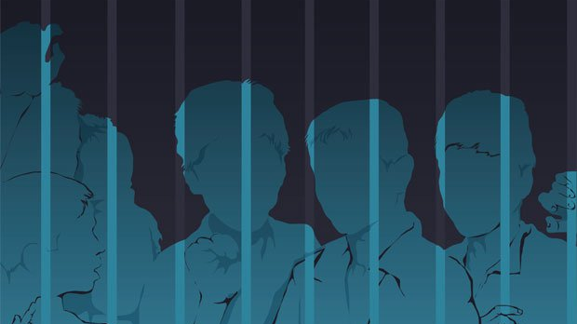
Supporting Justice-involved Youth Transition Successfully to Adulthood
Tamara Itzel Martinez, MD
Boston Children’s Hospital/Adolescent Substance Use and Addiction Program
Notes:
It’s a great pleasure to be with you. The topic I will speak about today is supporting Justice Involved youth Transition Successfully to Adulthood and exploring ways in which we can do this in our everyday life.
while preparing for this presentation, I came across this EXcerpt from campaign youth justice Annual Report 2020
“I was 16, forced to be a man when I was just a child. I didn’t understand the Court’s language and didn’t participate in my defense. My existence was erased, my adulthood shaped by those who had lost their humanity.”
--Child sentenced to natural life in FL.
Imagine if you were sentenced to life in prison at age 16 or imagine that your teenager was sentenced to spend his natural life in prison and didn’t even understand the process involved in that decision.
http://www.campaignforyouthjustice.org/images/reportthumbnails/CFYJ%20Annual%20Report.pdf
How did we get here? We are the most powerful country in the world but have one of the most inhumane disciplinary approaches towards at risk youth, particularly minority youth, LGBTQ, individuals with learning disabilities, and psychiatric problems. One of the most damaging policies which is still in place today is the Zero Tolerance Discipline Policy, which you might remember, originated out of drug policies in the 1980s.
These became popular in response to growing concerns about drugs, fighting, and possible “gang‐related” activity in schools and led to the creation of the school to prison pipeline via suspensions, expulsions, and arrests, affecting hundred of thousands of students. Contrary to what those policies were intended to do, the Committee on School Health reported that suspension and expulsion can worsen academic problems, delay development, and place youth at an increase use of substance use and involvement with the juvenile justice system. Ironically, the committee also noted that children most likely to be suspended are those who most need the assistance and supervision of professionals.
https://juvjustice.org/sites/default/files/ckfinder/files/Ensuring%20School%20Engagement%20and%20Success%20vs%20%20Exclusion%20-%20June%202012%20Update.pdf

Slide 8
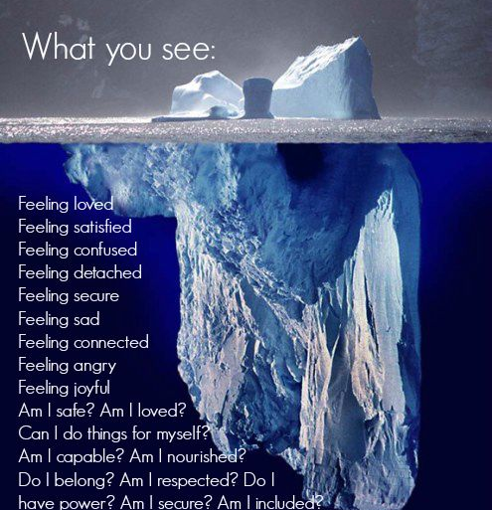
extra
acceptance
Hope
encouragement
https://www.pinterest.com/pin/171559067031579025/
Notes:
You may be wondering what sparked my interest in working with Justice-involved youth. The short answer is that there was no identifiable inflection point in my life but rather a culmination of various experiences including: youth mentoring through BBBS, my undergraduate Jesuit education at Loyola University New Orleans, and doing a fellowship in Adolescent Addiction Medicine at Boston Children’s Hospital.
When I met with my mentee for the first time, I expected a typical visit in which we would get to know a little bit about each other, attach a face to a name and gain a bit of comfort. What I did not expect was to learn about the heaviness in her heart resulting from intergenerational trauma tied to addiction and incarceration. As we got to know each other, I learned that both of her parents were incarcerated for drug offenses and her grandmother had been granted custody of her. Naturally, experiencing family separation and displacement creates psychological distress, emotional dysregulation, and academic problems. It was no surprise to me that my mentee was struggling with all 3.
I quickly learned that mentoring a child of incarcerated parents was unique in many ways and shockingly more common than I thought. Louisiana, where I grew up, is second in the nation for the most number of people incarcerated per capita, making my mentee one of many children in LA facing significant setbacks. Mentoring at-risk youth is a privilege and involves providing extra acceptance, attention, encouragement, guidance and hope. Unfortunately, many schools that enforce zero tolerance policies only “see” the tip of the iceberg (the child’s disruptive behavior, defiance, or chronic tardiness) and fail to adequately explore the feelings, emotions, struggles below the surface. These are missed opportunities to identify, intervene, and treat problems before they spiral out of control.

Slide 9
Notes:
The Jesuit education I received at Loyola University New Orleans, equipped me with an informed view of the workings and systemic failures within our sociopolitical systems, inspired me to believe we can do better, and prepared me to as “why? For ex, why haven’t we been able to improve equal access to substance use treatment? Why are medical conditions like substance use still criminalized and more so in underrepresented communities? Why is there an overrepresentation of minorities in the juvenile justice system while at the same time an underrepresentation of this medically underserved group in healthcare? Asking these questions and understanding their origins gave me insight of what I ought to do as a physician.
As fate would have it, I now work as an Addiction Medicine Attending in an adolescent and young adult substance use and addiction clinic (ASAP) located at Boston Children’s Hospital where I have clinic time dedicated to justice-involved youth with substance use problems.

Slide 10
Notes:
In response to the national prevalence of undertreated substance use problem among adolescents and young adults, we are spearheading an advocacy project that is focused on improving access to substance use treatment and health outcomes of justice involved youth. The fact that 90% of adults with addictions started using substances in their teen years, incites a sense of urgency to reach as many adolescents with SUDs at the onset of the problem. Part of our goal is to be proactive and take our addiction medicine services directly to justice involved youth committed to DYS. While DYS currently offers substance use treatment, it’s primarily in the form of psychotherapeutic counseling. The specialized field of adolescent addiction medicine has much more to offer and can compliment the services provided by DYS. Both organizations have partnered to provide full access to addiction medicine and mental health services, which would in return improve health equity for medically underserved adolescents.
The way to best illustrate this partnership is to envision a multidisciplinary team approach involved in the care of a diabetic care. The team is composed of different specialists: an endocrinologist, nutritionist, podiatrist, ophthalmologist, nurse, and social worker. Each provider’s role is distinct and does not overlap but contributes to the team’s overall goal of improving the health/wellbeing of the patient. In the same way, addiction medicine specialists are part of the larger medical-legal multidisciplinary team, which may include a case worker, residential clinician, regional clinic director, clinic manager. Our shared goal is to reduce recidivism, improve health outcomes, and foster a healthy transition to adulthood.

Slide 11
Notes:
Although evidence-based treatments exist, we know a large gap exists between the number of those with substance use problems and those who receive treatment. Studies show that more than 2/3 of Justice involved Youth report a history of at least 1 substance-related problem. Yet, over 12% of youth in residential placement are in programs that do not offer any substance-related services. This has the greatest implications for Hispanic and AA youth, who are most likely to be the programs without these services.
https://psycnet.apa.org/record/2018-02339-001

Slide 12
DYS/ASAP Team Model
*Patient evaluation *Interview with legal
guardian
Meet weekly with JIY patient
ASAP/DYS team meeting (s)
Notes:
What does the DYS/ASAP team model look like in practice? For one, the clinic is entirely virtual.
The process starts with a referral from DYS. From there, our ASAP clinic coordinator sets up initial medical appointments with the patient and parent or legal guardian. These visits occur separately. After completing these visits, I meet with the ASAP team to discuss the case and finalize the treatment plan. I then meet with the legal guardian and patient to go over our treatment recommendations. After I receive consent from the patient or legal guardian to discuss his/her treatment plan with the DYS staff, I have a separate meeting with DYS staff to coordinate care. After those steps are complete, treatment begins and I meet with DYS staff every couple of weeks to discuss the patient. If there is a grievance, concern, or change in patient care (patient is transitioning to an independent living facility) we invite the patient to attend the team meeting. This is done to show transparency and cultivate an environment of trust between the patient and his treatment teams. These meetings are valuable to the patient because they provide a safe space to practice self-advocacy.
https://www.ncbi.nlm.nih.gov/pmc/articles/PMC5854406/.

Slide 13
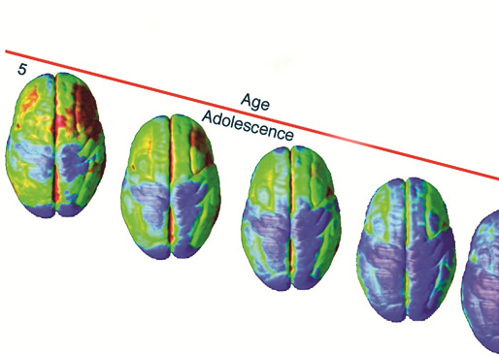
Notes:
Supporting Justice involved youth with substance use problems begins with openly discussing addiction as a brain disease. It’s important to build this foundation of knowledge during clinical encounters as it gives the patient a background to better understand addiction from a medical perspective. It’s equally important to educate medical and nonmedical providers caring for this patient population so they too can create a culture that promotes healing and reduces stigmas concerning addiction.
Successful development of youth into young adulthood includes positive psychological self-perceptions and skills building with the hopes of achieving autonomy, competence, self-advocacy and some universal societal markers or milestones (marriage, becoming a parent, owning a home, healthy interpersonal relationships). It’s important that we remind justice-involved youth that these valued societal markers can be theirs as well.
Pao M. Conceptualization of Success in Young Adulthood. Child Adolesc Psychiatr Clin N Am. 2017;26(2):191-198. doi:10.1016/j.chc.2016.12.002

Slide 14
Challenges to Successful Transition: Justice-involved Youth
Abuse and/or neglect
Multiple foster home placements
Lack of continuity in education
Losses of relationships
Mental illness
Substance use
Involvement with the justice system
Unstable housing or homelessness
Poverty
Chronic illness
Notes:
So what are some of the challenges to a successful transition in this patient population?
Research has shown that many Justice involved Youth have experienced a high number of adverse childhood experiences and disruption of normative adolescent psychological growth. When they come into contact with the juvenile justice system, many times the encounters or interactions may not be developmentally appropriate. For ex, supervising staff in detention centers and correctional facilities may have very little knowledge of child development. The lack of training can be especially damaging to youth with learning disabilities, history of abuse/trauma, and other mental health problems.
https://www.aacap.org/App_Themes/AACAP/docs/resources_for_primary_care/training_toolkit_for_systems_based_practice/Systems_Based_Practice_Module_Juvenile_Justice_201406.pdf

Slide 15
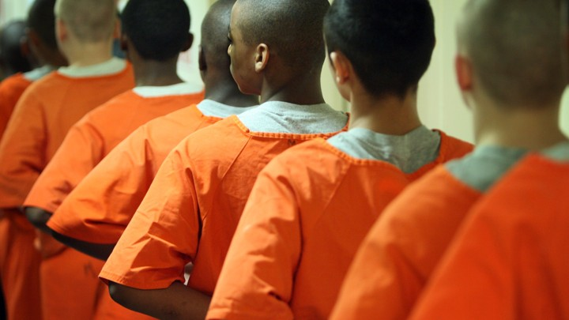
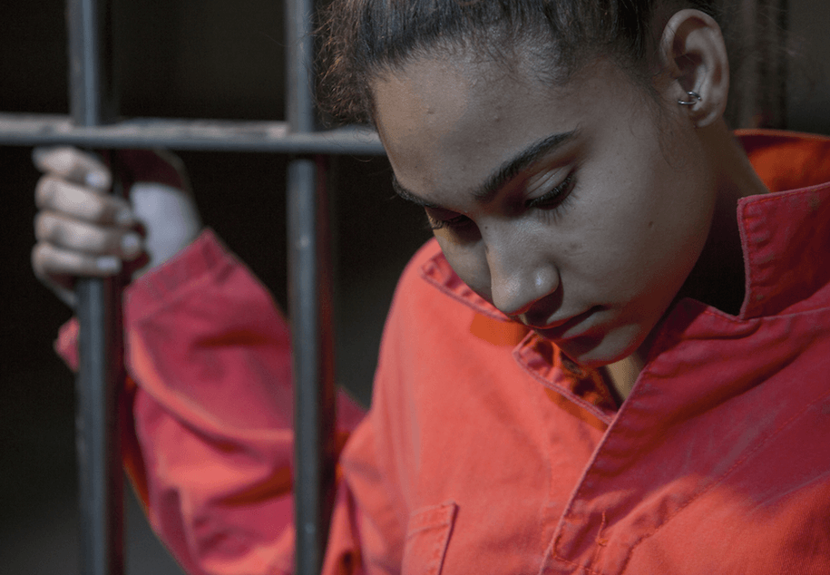
Notes:
Girl image: https://genbiz.com/youth-incarceration-juvenile-justice-system-may-harm-good
Males in single file line: https://www.theatlantic.com/education/archive/2016/01/the-cost-of-keeping-juveniles-in-adult-prisons/423201/
At risk youth with mental health disorders are a targeted group, particularly during the transition from adolescence to adulthood-a period when they are vulnerable and in need of more support. More often than not, they have more risk factors than other children and fewer protective factors.

Slide 16
Justice-involved Youth
Undiagnosed disabilities
LGBTQ Youth
Gender
Race/Ethnicity
https://www.juvjustice.org/our-work/safety-opportunity-and-success-project/national-standards/section-i-principles-responding-3
Notes:
https://www.juvjustice.org/our-work/safety-opportunity-and-success-project/national-standards/section-i-principles-responding-2
In fact, 70% of youth who enter the justice system have a mental health, sensory or learning disability, and anywhere between 28 percent and 43 percent of youth in detention or in correctional facilities have special education needs. AA youth are 43 percent more likely to have a learning disability than youth in the general population and American Indian youth are 80 percent more likely.
LGBTQ youth¹ are over-represented in the juvenile justice system, are more likely to be seriously maltreated by other youth in the system, and may receive excessive punishments, including secure confinement due to court biases or misguided attempts to keep these youth “safe.
Gender: Boys represent 83 percent of arrests for violent crimes, and, in general serve longer terms in detention than girls. Girls make up 61 percent of all runaway cases and spend twice as long in detention facilities for status offenses.
Race/Ethnicity: Underrepresented minority youth are overrepresented in the juvenile justice system. This occurs nationally. More on the next slide.
http://www.ncjj.org/pdf/jcsreports/jcs2018.pdf

Slide 17
https://latino.ucla.edu/research/the-latinx-data-gap-in-the-youth-justice-system/
Notes:
Having said this, there is a real concern about the inconsistencies of gathering and reporting data on race and ethnicity.
Specifically when looking at Justice involved Latino youth, this group continues to be almost nonexistent in juvenile justice data.
According to UCLA’s Latino Policy and Politics Initiative: Agencies across the country and within states do not collect data on Latino/a ethnicity. The lack of a consistent methodology for counting Latino youth within states and across the nation undermines efforts to assess the extent to which these youth, their families, and communities are affected by the juvenile justice system. As a result, the largest ethnic minority group continues to be invisible.
The following are the latest findings:
1. Today, Hispanic youth represent 25%, or about 8.3 million, of the total U.S. youth population between ages 10-17.
2. State agencies involved in the criminal justice system collect data that identifies Hispanic youth inconsistently if at all, creating an incomplete picture of Hispanic ethnic data.
3. States report racial/ethnic data inconsistently across the 3 points of contact: arrests, detention, and probation.
42% of states did not report racial or ethnic data for arrests
30% of states did not report racial and ethnic data for detention
52% of states did not have racial or ethnic data for probation
https://latino.ucla.edu/research/the-latinx-data-gap-in-the-youth-justice-system/

Slide 18
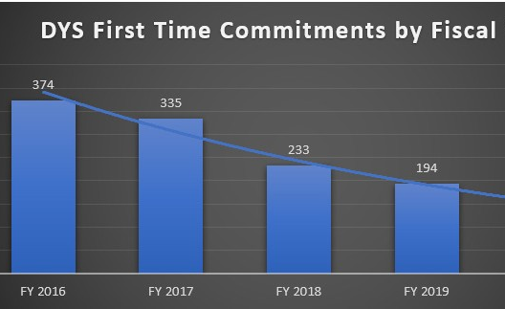
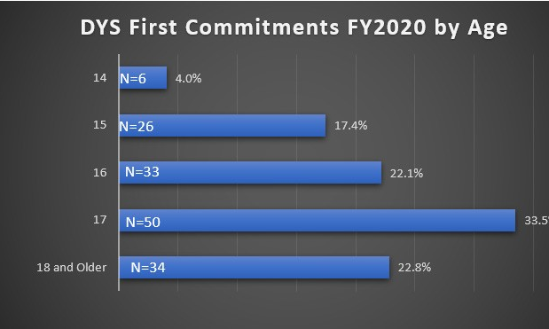
Demographics of Justice Involved Youth in Massachusetts
In FY20, 15% were females and 85% were males
The average age of the committed population was 16.6 years, and the median age was 17.0 years.
https://archives.lib.state.ma.us/bitstream/handle/2452/836761/ocn936069520-2020.pdf?sequence=1&isAllowed=y
Notes:
In preparing for this presentation, I looked up the demographics of justice involved youth in MA and was a little surprised by what I found.
The following slides were taken from the commonwealth of MA department of youth services annual report fiscal year 2020.
In MA, we can see that the average age of first DYS commitment is 17 yo, 15% were females and 85% were males
We can see that the number of first time commitments is decreasing over the past 3 years, which is good news.

Slide 19
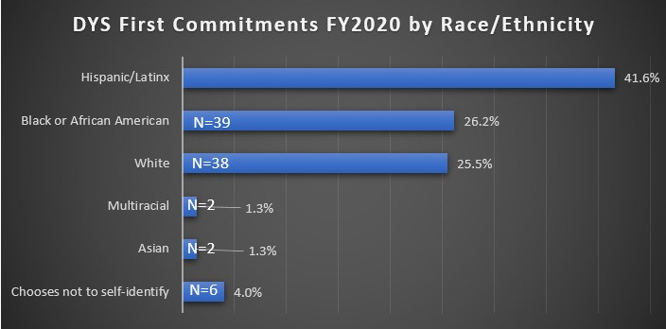
https://archives.lib.state.ma.us/bitstream/handle/2452/836761/ocn936069520-2020.pdf?sequence=1&isAllowed=y
Notes:
As we can see, there is a disproportionate % of minority youth committed to DYS. Latinos represent the majority of DYS committed population (approximately 42%, percentage could be higher given what we know about the inconsistency in data collection). While approximately 33% of youth under the age of 18 in MA are youth of color, they represent 70% of the DYS committed population.

Slide 20
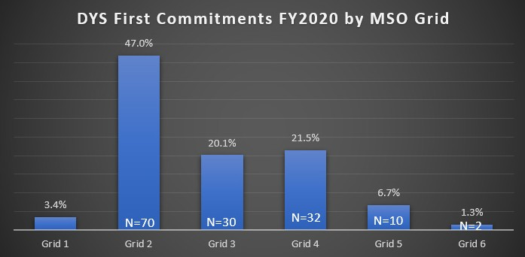
Grid 1: Operating a motor vehicle with a suspended license, marijuana possession (over 1 ounce), shoplifting, disorderly conduct, trespass.
Grid 2: OUI liquor or drugs, possession of heroin, assault, assault & battery, tagging, breaking & entering.
Notes:
https://archives.lib.state.ma.us/bitstream/handle/2452/836761/ocn936069520-2020.pdf?sequence=1&isAllowed=y
DYS uses a grid system to categorize offenses based on their severity which consists of 6 grids or levels of severity. Grids ½ involve drug possession among other offenses. Grid 1: Operating a motor vehicle with a suspended license, marijuana possession (over 1 ounce), shoplifting, disorderly conduct, trespass.
Grid 2: OUI liquor or drugs, possession of heroin, assault, assault & battery, tagging, breaking & entering. Grid 3: Robbery, stalking, burning buildings (arson). Grid 4: Indecent assault & battery on a child, assault to murder or maim, assault & battery with a dangerous weapon with significant injury, armed robbery, carjacking, kidnapping.
Grid 5: Involuntary manslaughter, assault & battery on a child with substantial injury, attempted murder, armed robbery with firearm, assault to murder (armed), armed carjacking. Grid 6: Voluntary manslaughter, home invasion, rape of a child under 16 with force, trafficking firearms (20+ weapons). 3
https://archives.lib.state.ma.us/bitstream/handle/2452/836761/ocn936069520-2020.pdf?sequence=1&isAllowed=y

Slide 21
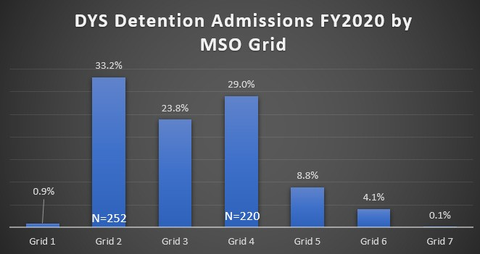
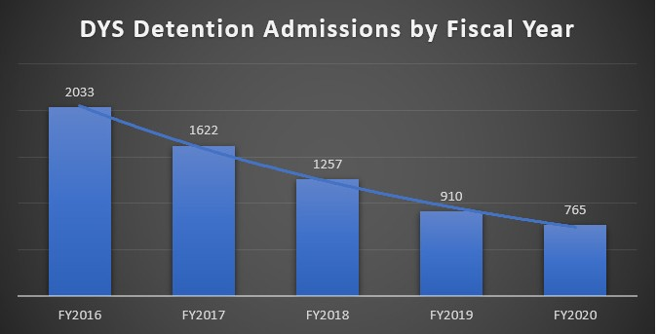
https://archives.lib.state.ma.us/bitstream/handle/2452/836761/ocn936069520-2020.pdf?sequence=1&isAllowed=y
Notes:
These charts illustrate that the majority of youth held in detention by DYS in FY 2020 was for grid level offenses 2-4.
The average age of youth in detention was 15.9 years and the median age was 16 years.
Detention is a crucial early phase in the juvenile justice process. It’s the point at which the courts decide whether to confine a young person pending their court hearing or while awaiting placement into a correctional or treatment facility rather than allowing the young person to remain at home.
https://www.aecf.org/blog/youth-detention-admissions-remain-low-but-releases-stall-despite-covid-19/
Fact:
In 2017, the median time in placement was 68 days (23 days for youth placed in detention versus 114 days for youth committed to a correctional facility).

Slide 22
Notes:
Seventy-six percent (76%) of the detention admissions in FY20 were youth of color. Latinos represent the majority of detention admissions 40.8% (may be higher) followed by AA at 30.6% and White at 21.4%
On the right, you can see that that DCF-involved youth represented 45.2% of all detention admissions in FY20-A high percentage.
https://archives.lib.state.ma.us/bitstream/handle/2452/836761/ocn936069520-2020.pdf?sequence=1&isAllowed=y

Slide 23
Supporting a Successful Transition Into Adulthood for JIY
Psychological Resilience Interventions to Reduce Recidivism in Young People: A Systematic Review
Notes:
So what can we do to support justice-involved youth?
A study published in Adolescent Research Review in July 2020 titled Psychological Resilience Interventions to Reduce Recidivism in Young people: A systemic Review, found that findings from the 14 studies reviewed showed that increasing psychological resources was associated with reduced re-offending rates, increased time to re-offend, or reduced severity of such offences. Not a surprise
Overall, increases in positive affect and coping, and decreases in negative affect and aggression positively were related to reduced re-offending. The mechanisms by which these changes take place appear to include cognitive function such as positive self-concept and reduced negative attitudes. These processes may be in turn be instrumental in supporting a successful transition into adulthood.

Slide 24
Notes:
Medical providers play a critical role in fostering a positive self-image and promoting the health and wellbeing.
“With research linking low self-esteem to mental health issues including addiction and poor quality of life, it’s imperative that we try to improve our patient’s self-esteem, with every opportunity we get.”
https://www.nami.org/Blogs/NAMI-Blog/July-2016/Why-Self-Esteem-Is-Important-for-Mental-Health
We can cultivate a positive self-image in this at risk population during every patient encounter: It’s effortless and proven to work.
We can encourage patients to make a list of their positive qualities
Encourage them to define personal goals and objectives that are reasonable and measurable
Teach patients how to refrain from comparing themselves to others.
Give positive affirmations
Remind them of how far they have come: remind them of their resilience.
Additionally, another important way to make a meaningful connection with Justice involved youth is simply to have practical knowledge of the juvenile justice system and the unique problems facing this patient population. Understanding the hardships (i.e isolation, legal concerns, embarrassment, shame) will make communication more effective.
https://pediatrics.aappublications.org/content/146/1/e20201755?utm_source=TrendMD&utm_medium=TrendMD&utm_campaign=Pediatrics_TrendMD_0

Slide 25
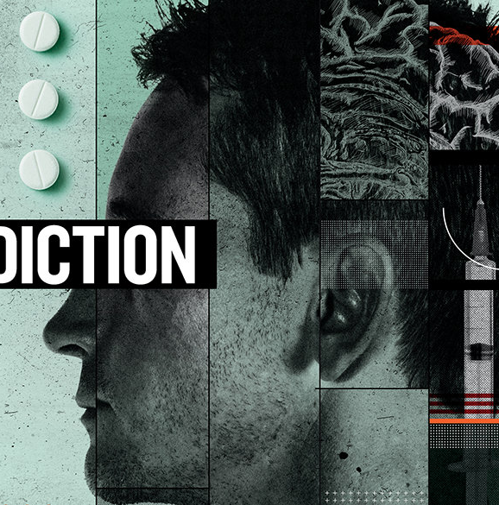
Notes:
For example imagine being 16 and having to go to your pediatrician’s medical appointment in handcuffs and shackles. These traumatic experiences are unique to justice involved youth and we simply can’t ignore them. Cultivating a positive self image is difficult. For starters, one has to convince these patients, that their true identity is not reflective of their hardened criminal appearance. The humiliation of wearing shackles and handcuffs in public can have a lasting effect on adolescent’s mental health. Patients are impacted by the effects of labelling, stigma and negative self-image associated with a criminal conviction. When substance use is involved, providers have to remove an additional layer of stigma. As medical providers, it’s important to address the stigma associated with substance use. Doing so, may be lifesaving.
Many patients I know didn’t know that addiction is a treatable brain disease from which patients can recover and continue to lead healthy lives. They believed that their willpower should be sufficient to stop drug use. Fortunately as medical providers we are in a distinguished position to educate and clarify misinformation.
https://www.nejm.org/doi/full/10.1056/NEJMp1917360?query=recirc_curatedRelated_article
https://www.drugabuse.gov/nidamed-medical-health-professionals/health-professions-education/words-matter-terms-to-use-avoid-when-talking-about-addiction

Slide 26
Words Matter-Terms to Use and Avoid When Talking About JIY
Words to Avoid | Use Instead
Offender, Inmate, Felon, Criminal, Convict, Prisoner, Delinquent | Individual with justice system involvement; individual impacted by the justice system; individual affected by the justice system
Ex-offender, Ex-con, Ex-Offender, Ex-Prisoner | Individual with prior justice system involvement; individual previously incarcerated; individual with justice history
Parolee, Probationer, Detainee | Individual on parole; individual currently under parole supervision; individual on probation; individual in detention
Juvenile Offender, Juvenile Delinquent | Young person with justice system involvement; Young adult impacted by the justice system *Justice-involved youth (preferred term by the American Academy of Pediatrics)
https://www.aappublications.org/news/2020/10/16/justice-involved-youth-pediatrics
Notes:
https://fortunesociety.org/wordsmatter/
We can begin by educating our patients as well as colleagues to avoid using terms like delinquent, offender, felon, or criminal and instead use words that acknowledge youth’s capacity to change and grow. Justice-involved youth is the preferred term.

Slide 27
Positive Youth Development (PYD)
https://www.acf.hhs.gov/fysb/positive-youth-development
Notes:
Positive youth development Is a well studied comprehensive way of thinking about the development of adolescents and the factors that facilitate their successful transition from adolescence to adulthood. Positive Youth Development, is based on a body of research suggesting that certain “protective factors,” can help young people succeed and keep them from having problems. It’s the opposite of a deficit-based approach to adolescence which focuses on what can go wrong in a young person’s development. PYD is a strength-based resilience oriented perspective on adolescence.
According to research, Young people may have fewer behavioral problems and may be better prepared for a successful transition to adulthood if they have a variety of opportunities to learn and participate at home, at school, in community-based programs and in their neighborhoods.
Experts suggest that Positive youth development may prevent further youth justice involvement. Some of the ways include:
Supporting honest discussions between adolescents and their parents that address and resolve conflict while encouraging development and recognizing strengths and accomplishments.
Encouraging youth relationships with adults other than parents who can serve as positive role models and advisors.
Encouraging healthy lifestyle choices, including exercise and nutrition.
Supporting positive organized activities, such as sports, the arts, or faith-based leagues or groups that give youth a sense of belonging.
Allowing youth to participate in activities that enable them to be engaged in and feel attached to their community and local events.
Image: https://njjn.org/our-work/juvenile-justice-with-a-focus-on-positive-youth-development?phpMyAdmin=14730ab3483c51c94ca868bccffa06ef
https://positiveyouthjustice.files.wordpress.com/2013/08/pyj2010.pdf

Slide 28
Emotional Intelligence: A Major Predictor of Success
EI Skill Areas:
Perceiving and expressing emotion.
Using emotion to facilitate thought.
Understanding emotion.
Regulating emotion
https://www.sfuhs.org/uploaded/documents/About_UHS/Strategic_Design/Emotional_Intelligence_Matters.pdf
Notes:
Emotional Intelligence is another evidence based approach that has been extensively studied. The concept of emotional intelligence is attributed to Dr. Peter SalOvAy (president of Yale University) and Dr. John Mayer (professor of Psychology at University of New Hampshire). EI refers to the capacity to both reason about emotions and use emotion to enhance thinking and problem solving. According to this theory, these abilities promote well-being and facilitate social functioning (Mayer & Salovey, 1997; Salovey & Mayer, 1990). The theory outlines four distinct skill areas: Perceiving and expressing emotion. Using emotion to facilitate thought. Understanding emotion. And Regulating emotion (Mayer & Salovey, 1997).
The 4 abilities constituting Emotional intelligence have developmental trajectories. The emotion skills within each ability area evolve from basic to more advanced and complex (Mayer & Salovey, 1997; Salovey & Mayer, 1990).
Perceiving and expressing emotion.
This skill area involves identifying emotions in one’s own feelings, thoughts, and expressions, as well as in those of other people. Expressing emotion refers to the communication of feelings and including the appropriate ways to express them. Youth who recognize the emotional cues expressed by peers, teachers, and parents can modify their own behavior and respond in ways that are socially appropriate and helpful in achieving goals (Denham et al., 2003; Ekman, 2003). In contrast, youth who have difficulty perceiving and expressing them to others often are socially disconnected (Izard, 1989).
Using emotion to facilitate thought. This ability refers to the use of emotion to think more rationally. It involves taking control of emotions and using them to prioritize thinking. Different emotional states modify thinking, such that certain emotions are more and less adaptive for various kinds of reasoning tasks (Isen, 1987; Palfai & Salovey, 1993; Schwarz, 1990; Schwarz & Clore, 1996).
Understanding emotion. This ability involves knowing the causes of emotions, what emotions signify (Stein & Levine, 1999), and how to label emotion accurately. As can be expected, youth with a deeper understanding of emotion are better able to use effective problem-solving strategies to cope with negative and positive events (Greenberg, Kusche, & Riggs, 2004) and to interpret situations from others’ perspectives and develop empathy (Denham, 1998).
Regulating emotion. This ability refers to managing the thoughts, feelings, and behaviors that occur with an emotional experience (Denham, 1998; Eisenberg et al., 2000). Youth who regulate emotions well are able to feel the full range of positive and negative emotions genuinely, share those emotions with others, and incorporate coping strategies effectively when faced with life’s challenges (Mayer & Salovey, 1997). https://www.sfuhs.org/uploaded/documents/About_UHS/Strategic_Design/Emotional_Intelligence_Matters.pdf

Slide 29
Barriers to Success: Education Inequities
Notes:
These prosocial evidence based approaches are counteracted by damaging policies like zero tolerance mentioned earlier.
Education inequities unfortunately place some students on a path to prison rather than on a path to success. Pervasive structural and systemic racism deliberately embedded in our society create Justice involved youth’s vulnerabilities. Many of us incorrectly label JIY as “vulnerable populations” without realizing that doing so evades accountability of our long history of discrimination. Numerous studies have demonstrated racial bias against youth of color at all decision points in the juvenile justice system.

Slide 30
Dismantling the School-to Prison Pipeline
RULER-evidence-based approach to social and emotional learning
EMOTIONS INFLUENCE:
attention, memory, learning, decision making, creativity, mental and physical wellbeing , academic and workplace performance
https://hundred.org/en/innovations/ruler
Notes:
One antidote to the school to prison pipeline is RULER.
RULER stands for five areas of emotional intelligence: Recognizing, Understanding, Labeling, Expressing and Regulating emotions
RULER is an evidence based approach to social and emotional learning developed at the Yale Center for Emotional Intelligence. RULER supports the entire school community in understanding the value of emotions and creating and maintaining a positive school climate. RULER helps students and educators spend more time feeling how they want to feel: valued, connected, and inspired. RULER teaches the skills of emotional intelligence—so people of all ages can thrive and build healthier, more equitable, and compassionate communities.
Studies show that students in RULER programs are less anxious and depressed, manage their emotions more effectively, are better problem solvers, have greater social and leadership skills, experience fewer attention, learning, and conduct problems, and perform better academically. Imagine a society in which children and adolescents can learn and thrive in school without the fear of being targeted or punished.
https://hundred.org/en/innovations/ruler
https://ra.nea.org/business-item/2016-pol-e01-2/

Slide 31
Components of Comprehensive Drug Abuse Treatment
Photo:: NIDA
https://www.drugabuse.gov/publications/principles-adolescent-substance-use-disorder-treatment-research-based-guide/principles-adolescent-substance-use-disorder-treatment
Notes:
https://www.aacap.org/App_Themes/AACAP/docs/resources_for_primary_care/training_toolkit_for_systems_based_practice/Systems_Based_Practice_Module_Juvenile_Justice_201406.pdf
The RULER approach is beneficial in preventing contact with the Juvenile justice system. After a person becomes justice involved, it’s important to optimize access to safety net services, especially if the Justice involved youth has substance use problems. This slide shows a model of the best treatment programs which provide a combination of therapies and other services to meet the needs of the individual patient. As addiction medicine providers we can play a critical role in the coordination of care, especially as it pertains to re-entry efforts and recidivism reduction. I’ve had the great privilege of working with a 20 yo male who recently transitioned to a community based independent living residential facility designed to provide educational, vocational, recreational, clinical and other independent living skills. I will continue to follow him in his new residence. As an addiction medicine provider I identified the patient’s short term and long term needs and provided recommendations. Coordination was extremely important as an abrupt interruption in substance use tx or delay in care can lead to major setbacks including relapse and recidivism.
https://www.juvjustice.org/our-work/safety-opportunity-and-success-project/national-standards/section-i-principles-responding-2
Fortunately this patient has family support, has a job, will transition to an adult PCP, and is engaging well in treatment. His risk of homelessness is low. Unfortunately, many communities lack state or federal funding to adequately meet the developmental, education and treatment needs of youth placed back into their community. Once a youth enters the system, they are no longer on Medicaid and once they are released, they must reapply. This delay keeps the youth from accessing the mental health services they need. For example, youth with limited education success and untreated or undertreated mental health or substance use disorders have higher rates of recidivism. The juvenile justice system or the youth may not have access to services and, if the system or the family has limited health resources, then the service may be unmet. Finally, although many states have procedures about the pathway of progression through the juvenile justice system and provide services for rehabilitation, many services may not be cost effective or have any positive outcome in rehabilitation.
https://youth.gov/youth-briefs/foster-care-youth-brief/challenges
Unstable housing or homelessness. Former foster care youth are half as likely to pay a mortgage or rent compared to their peers.⁴ Studies show a correlation between a history of foster care and homelessness as well as the impact of emancipation from state care on young adults.⁵ More than one-fifth of foster care youth experience homelessness for at least one day within a year of emancipation.⁶
Lack of adequate elementary and secondary education. Youth emancipating from foster care typically face many obstacles during their educational journeys, obstacles that can hinder their ability to graduate on time or receive a high school diploma. Prior to child welfare involvement, youth may have missed many days or even months of school due to residential movement by the biological family because of eviction, homelessness, or other issues.
Lack of employment and job training. Former foster care youth may have limited work histories and on-the-job training opportunities. Many lack the skills required to hold a steady job, or the incentive and academic preparation to attend a college or training program. Youth who do obtain employment may find only jobs with lower paying wages, which makes them vulnerable to poverty, and the inability to establish complete independence.¹²
Lack of access to health care. Some states offer Medicaid for youth until 21 years of age, but others may terminate eligibility for Medicaid and other forms of public assistance earlier, causing youth to lose access to physical and mental health care after they emancipate and no longer receive services and supports from the child welfare system. (See a listing of each state’s children’s Medicaid plan.)
Justice system involvement. Youth in foster care who have a history of abuse and/or neglect are at a heightened risk for early onset of delinquency.¹⁴ Youth emancipating from foster care may be at greater risk of becoming involved with the criminal justice system due to lack of support networks, low employment skills, and unstable living arrangements. A study of 100 former foster care youth found that, after they had been on their own for six months, 45 percent had been in trouble with law enforcement, 41 percent had spent time in jail, 26 percent were involved in the court system (with formal charges filed), and 7 percent were incarcerated.¹⁵
Lack of social connections. Permanent relationships with positive adults are a powerful protective factor against negative outcomes and can provide critical support to youth as they transition to adulthood. Youth in foster care often rely on adults who have provided professional supports through their roles in the child welfare system. Although an emancipating youth may desire autonomy from adult supervision, the transition is more successful when he or she has a strong connection to a trusted adult supporter. Establishing this relationship prior to emancipation is important, albeit not easy, given that many youth have had turbulent experiences with adults in the past.

Slide 32
REFERENCES
Pao M. Conceptualization of Success in Young Adulthood. Child Adolesc Psychiatr Clin N Am. 2017;26(2):191-198. doi:10.1016/j.chc.2016.12.002
2. Yang LH, Wong LY, Grivel MM, Hasin DS. Stigma and substance use disorders: an international phenomenon. Curr Opin Psychiatry. 2017;30(5):378-388. doi:10.1097/YCO.0000000000000351
3. Heaton LL. Racial/ethnic differences of justice-involved youth in substance-related problems and services received. Am J Orthopsychiatry. 2018;88(3):363-375. doi:10.1037/ort0000312
4. American Academy of Child and Adolescent Psychiatry. Systems-Based Practice - Juvenile Justice System.; 2013. https://www.aacap.org/App_Themes/AACAP/docs/resources_for_primary_care/training_toolkit_for_systems_based_practice/Systems_Based_Practice_Module_Juvenile_Justice_201406.pdf
5. Coalition for Juvenile Justice. Standard 11. Youth with Undiagnosed or Mistreated Disabilities. https://www.juvjustice.org/. Accessed February 23, 2021. https://www.juvjustice.org/our-work/safety-opportunity-and-success-project/national-standards/section-i-principles-responding-2
6. Hockenberry S, Puzzanchera C. Juvenile Court Statistics 2018.; 2020. http://www.ncjj.org/pdf/jcsreports/jcs2018.pdf
7. Coalition for Juvenile Justice. Zero Tolerance Policies and the Implications for Juvenile Justice.; 2012. https://juvjustice.org/sites/default/files/ckfinder/files/Ensuring School Engagement and Success vs Exclusion - June 2012 Update.pdf
8. Campaign for Youth Justice. Annual Report.; 2020. http://www.campaignforyouthjustice.org/images/reportthumbnails/CFYJ Annual Report.pdf

Slide 33
9. Commonwealth of Massachusetts Department of Youth Services. ANNUAL REPORT: Fiscal Year 2020.; 2020. https://archives.lib.state.ma.us/bitstream/handle/2452/836761/ocn936069520-2020.pdf?sequence=1&isAllowed=y
10. Diaz S, Bernal A, Aguilar J, et al. The Latinx Data Gap In The Youth Justice System.; 2020. https://latino.ucla.edu/wp-content/uploads/2020/08/LPPI-CJ-JJ-Report-copy.pdf
11. Coalition for Juvenile Justice. Standard 10. LGBTQ Youth. https://www.juvjustice.org/. Accessed February 22, 2021. https://www.juvjustice.org/our-work/safety-opportunity-and-success-project/national-standards/section-i-principles-responding-3
12. The Fortune Society. Words Matter: Using Humanizing Language. https://fortunesociety.org/. Accessed February 22, 2021. https://fortunesociety.org/wordsmatter/
13. Family and Youth Services Bureau. Positive Youth Development. https://www.acf.hhs.gov/. Published 2017. Accessed February 22, 2021. https://www.acf.hhs.gov/fysb/positive-youth-development
14. Haney S. Justice Involved Youth: What Can WE Do? AAP News. Published online 2020. https://www.aappublications.org/news/2020/10/16/justice-involved-youth-pediatrics
15. hundrED. RULER. https://hundred.org/. Accessed February 22, 2021. https://hundred.org/en/innovations/ruler
16. Rivers SE, Brackett MA, Reyes MR, Mayer JD, Caruso DR, Salovey P. Measuring emotional intelligence in early adolescence with the MSCEIT-YV: Psychometric properties and relationship with academic performance and psychosocial functioning. J Psychoeduc Assess. 2012;30(4):344-366. doi:10.1177/0734282912449443
17. Gold A. No Title. NAMI Blog. Published 2016. Accessed February 24, 2021. https://www.nami.org/Blogs/NAMI-Blog/July-2016/Why-Self-Esteem-Is-Important-for-Mental-Health

Slide 34
17. Gold A. No Title. NAMI Blog. Published 2016. Accessed February 24, 2021. https://www.nami.org/Blogs/NAMI-Blog/July-2016/Why-Self-Esteem-Is-Important-for-Mental-Health
18. Owen MC, Wallace SB. Advocacy and Collaborative Health Care for Justice-Involved Youth. Pediatrics. 2020;146(1):e20201755. doi:10.1542/peds.2020-1755
19. Volkow ND. Stigma and the Toll of Addiction. N Engl J Med. 2020;382(14):1289-1290. doi:10.1056/NEJMp1917360
20. National Institute on Drug Abuse (NIDA). Words Matter - Terms to Use and Avoid When Talking About Addiction. https://www.drugabuse.gov/. Published 2021. Accessed February 24, 2021. https://www.drugabuse.gov/nidamed-medical-health-professionals/health-professions-education/words-matter-terms-to-use-avoid-when-talking-about-addiction
21. Butts J, Bazemore G, Saa Meroe A. Positive Youth Justice - Framing Justice Interventions Using the Concepts of Positive Youth Development.; 2010. https://positiveyouthjustice.files.wordpress.com/2013/08/pyj2010.pdf
22. National Education Association. Discipline and the School-To-Prison Pipeline (2016). https://ra.nea.org/. Published 2016. https://ra.nea.org/business-item/2016-pol-e01-2/
18. Owen MC, Wallace SB. Advocacy and Collaborative Health Care for Justice-Involved Youth. Pediatrics. 2020;146(1):e20201755. doi:10.1542/peds.2020-1755
19. Volkow ND. Stigma and the Toll of Addiction. N Engl J Med. 2020;382(14):1289-1290. doi:10.1056/NEJMp1917360
20. National Institute on Drug Abuse (NIDA). Words Matter - Terms to Use and Avoid When Talking About Addiction. https://www.drugabuse.gov/. Published 2021. Accessed February 24, 2021. https://www.drugabuse.gov/nidamed-medical-health-professionals/health-professions-education/words-matter-terms-to-use-avoid-when-talking-about-addiction
21. Butts J, Bazemore G, Saa Meroe A. Positive Youth Justice - Framing Justice Interventions Using the Concepts of Positive Youth Development.; 2010. https://positiveyouthjustice.files.wordpress.com/2013/08/pyj2010.pdf
22. National Education Association. Discipline and the School-To-Prison Pipeline (2016). https://ra.nea.org/. Published 2016. https://ra.nea.org/business-item/2016-pol-e01-2/

Slide 35
Webinar Presenters
Aura M. Obando, MD
Family Team Program Director, Boston Health Care for the Homeless Program
Instructor of Medicine and Pediatrics Harvard Medical School
Notes:
Ask questions at any point through the “Chat” pane of your zoom Control Panel on your computer or mobile device.
Answers will be posted on the website.

Slide 36
Substance Use in Adolescents and Transitional-Age
Young Adults Experiencing Homelessness
Epidemiology of Youth Experiencing Homelessness
Considerations in Treatment
Low Barrier Care and Risk Mitigation
Notes:
Ask questions at any point through the “Chat” pane of your zoom Control Panel on your computer or mobile device.
Answers will be posted on the website.

Slide 37
No More Missed Opportunities
“Adolescence and young adulthood represents a key developmental window. Every day of housing instability represents missed opportunities to support healthy development and transitions to productive adulthood.”
Morton et al. Chapin Hall at the University of Chicago, 2017
Notes:
Research shows that the longer youth remain homeless, the harder it is for them to escape homelessness. Youth require housing (and other any other services) tailored to their developmental needs; this applies to medical care as well. Addiction treatment and engagement around substance use must not only be age-appropriate, but must also take into account the uncertainty of housing instability and other important social needs

Slide 38
Nick, age 18
Notes:
We first met Nick in our shelter based clinic when he presented for a cellulitis. His name has been changed to protect his privacy.
He had been staying on the street for several weeks
He reported using large quantities of crystal meth, and was in withdrawal, feeling pretty awful
He asks for STI testing because he’s been engaging in transactional sex with men in exchange for meth. He says he doesn’t use condoms and is having penetrative and receptive anal as well as oral sex.
He has a history of OUD but has been able to stay connected to a buprenorphine prescriber, but his stability with housing and treatment has become more complex since starting to use crystal meth.
On this visit, we were able to give sex injection supplies, conducted STI testing, treated cellulitis, and offered support in accessing a detox but he said he was not ready. We started low-threshold Pre exposure prophylaxis (or PrEP) and connected him to our PrEP navigator. Nick said he would return to the clinic and did so intermittently over the next few weeks, mostly for support around skin and soft tissue infections related to his injection drug use.
I share with you Nick’s story, to give you context around the topics I’ll be discussing today.

Slide 39
Prevalence of Youth Homelessness
Nationally:
Voices of Youth Count, ages 13-25, 2016-2017
1 in 10 YA aged 18-25 reported homelessness in last 12 months (3.5 million)
Most had experiences that started in childhood or adolescence
1 in 30 minors age 13-17 endured some form of homelessness (700,000)
29% of youth reported substance use problems
69% had mental health difficulties
1/3 experienced death of parent/caregiver
1/3 had experience with foster care
1/2 had been in juvenile detention, jail or prison
51.2% become homeless due to parental/caregiver rejection
-Morton et al. Chapin Hall at the University of Chicago, 2017
-Whitbeck L et al. USDHHS. 2016
Notes:
So how common is Nick’s experience?
The experience of youth homelessness is hidden and often transitory, making it very challenging to quantify. Yong people experiencing homelessness are really a hidden population. Youth may stay in abandoned buildings, in tents in the woods, or couch surfing, and may not be counted in homelessness counts if not in a shelter or on the street.
The closest thing we have to an accurate count is through the Voices of Youth Count which was conducted from 2016-2017 by the Chapin Hall Institute at the U of Chicago, which included a total of 26,000 people who participated in phone surveys and some in more in depth interviews, sharing any past or current experience of homelessness. This count yielded numbers much higher than in prior youth homelessness counts, but we have to assume that this may still represent an underestimate given the method used which assumes access to a landline.
1 in 10 YA aged 18-25 reported homelessness in last 12 months (which we can extrapolate to 3.5 million people). ½ of this group explicitly reported homelessness, and ½ couch surfing. 1 in 30 minors age 13-17 endured some form of homelessness (700,000). ¾ of this group reported explicit homelessness (including running away and getting kicked out), and ¼ reported couch surfing only
¾ reported an experience of homelessness lasting more than a month
Rates reported similar across urban, rural, and suburban populations.
29% of youth reported substance use problems. 69% had mental health difficulties
1/3 experienced death of parent/caregiver
1/3 had experience with foster care
½ had been in juvenile detention, jail or prison
In thinking about the causes of youth homelessness, in another survey of over 600 youth experiencing homelessness, 51.2% become homeless due to parental/caregiver rejection. This is something I commonly see in my clinic, that youth share they became homeless when they came out to their parents as gay, or became pregnant, or were arrested, and were asked to leave their home.

Slide 40
Relative Risk of young-adults (18-25) to experience homelessness
YYA with < a high school diploma/GED- 346%
Black or AA youth- 83%
Hispanic, non-White youth- 33%
LGBT youth- 120%
Unmarried parenting youth- 200%
Morton et al. Chapin Hall at the University of Chicago, 2017
Notes:
The Voices of youth count gave us a better sense of some of the demographics of youth experiencing homelessness
Youths who did not complete high school or a GED had a 346% chance of experiencing lifetime homelessness.
Black or African American youth had an 83% higher risk of reporting homelessness. Prevalence of Black/AA youth in the youth homelessness population mirrors racial disparities reported in school suspensions, incarceration, foster care placement
Hispanic youth had a 33% higher chance of experiencing homelessness- and it is thought that Latinx youth represent an especially hidden population as they are consistently undercounted in other federal homelessness counts.
LGBT youth had a 120% higher risk of reporting lifelessness and these high rates often stem from lack of acceptance in and out of the home.
Parenting youth had a 200% higher risk of experiencing homelessness. You can imagine this has significant impacts on their children, and in fact, housing instability in early childhood can have lifelong consequences (toxic stress, etc) and is strongly associated with risk of homelessness in the future, with this idea of intergenerational homelessness.
Lack of diploma/GED most strongly correlated with higher risk. Unclear if lower education causes homelessness, or education and other factors that support education attainment are protective

Slide 41
“Sometimes substance use is really about connecting with other people.”
-member Boston Youth Action Board
Notes:
The experience of homelessness is incredibly isolating. Substance use can be a coping mechanism, and is incredibly prevalent

Slide 42
Substance Use
-Whitbeck L et al. USDHHS. 2016
Study of 656 homeless youth
73.2% reported use of alcohol
37.5% reported use of “hard” drugs
2/3 reported cigarette use
Study of 601 street-dwelling youth
60% met DSM-IV-TR criteria for drug addiction of at least one substance
49% for substance dependence
64.6% reported use of marijuana
50% met DSM-IV-TR criteria for alcohol addiction
-Bender K et al. J of Adolescence. 2013
Notes:
USDHHS: 2013 656 young people ages 14–21 experiencing homelessness participated in interviews for the study Administration for Children and Families Street Outreach Program
Of those, there was a very high prevalence of alcohol use (73%), marijuana (64%) and tobacco (66%). With over a 1/3 reporting use of “hard drugs”
In another study, conducted prior to DSM V, looked at substance use and victimization in street dwelling youth in LA, Denver, and Austin. 60% met criteria for a substance use disorder for at least one substance, with a high prevalence of alcohol use disorder. This study looked at risk of victimization on the street, and those who met DSM-IV criteria for addiction and dependence of drugs and alcohol. This study showed high reports of drug addiction in street-dwelling youth, and importantly, that those youth meeting DSM-IV criteria for substance abuse and dependence were at much higher risk of experiencing victimization or violence on the street, including physical and sexual assault and death threats.

Slide 43
Considerations in Treatment
Relationship building
High risk for other issues: trafficking, unintended pregnancy, mental health needs
Lack of parental/family supports
Lack of basic needs
Notes:
As you encounter youth and young adults experiencing homelessness there are a few considerations that should be considered in their treatment, in order to best engage and ensure their unique needs are being adequately met. I will discuss the importance of relationship building and earning trust. We will discuss the high prevalence of other subpopulations in the YYA population including those reporting human trafficking, unintended pregnancy, and mental health needs. Lacking family support and basic survival needs can also impact how YYA are able to engage in substance use treatment and need to be considered as well.

Slide 44
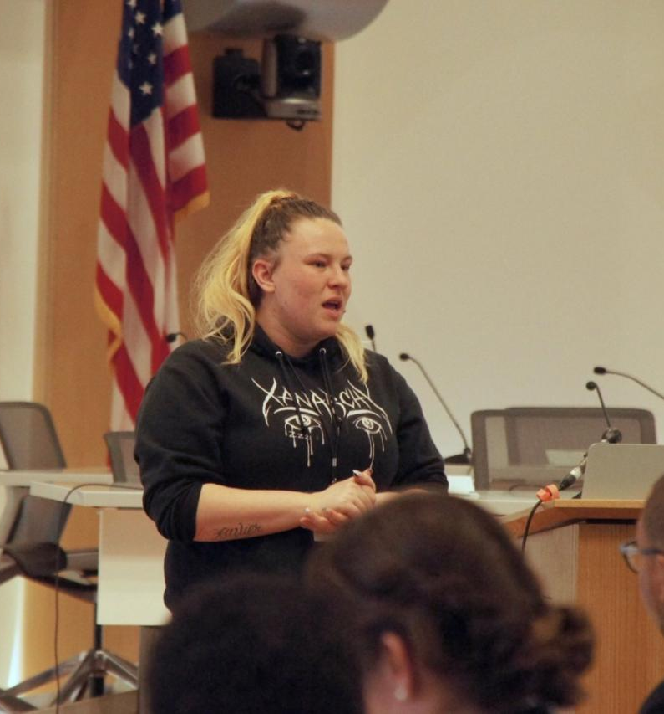
Trust
“It’s hard to trust even the people that legally have to keep your trust.”
Photo: Boston Youth Action Board
Notes:
I had mentioned the high rates of systems involvement in this population- including justice involvement and involvement with child protective services. These experiences engender a distrusts in authorities and service providers who might be seen to be in “helper” roles.
This photo is taken from the Boston Youth Action Board Facebook page and was taken at a local forum for Preventing and ending youth homelessness. The young lady pictured, Stephanie, is discussing how challenging it can be to engage in health care, saying “it’s hard to trust even the people that legally have to keep your trust.”

Slide 45
Modalities for Building Rapport
“Safe” and youth-friendly spaces
Trauma-informed approach
Motivational interviewing
Risk-mitigation approach
Reducing stigma
Cultural responsiveness and cultural humility
Co-locating services
Notes:
Trust and relationship building is imperative. It may take many visits before a youth will disclose something like high risk substance use, and many more before they feel comfortable enough to engage in treatment.
Best practices in working with youth and young adults using substances include: offering services in a space that is seen as ”safe” and youth-friendly, using a trauma-informed approach (that takes into account the very high trauma burden in the yya population),
Motivational interviewing is a collaborative, patient-centered form of communication used to elicit and strengthen a patient’s motivation for change
risk mitigation approaches (I’ll discuss this separately);
reducing stigma
Cultural responsivesness and humility- which gives us a greater understanding of cultures that are different from our own and helps us recognize each patient's unique cultural experiences.
Colocating services- as in our case in a service program and shelter where youth already feel safe, and integration of substance use services with other mental and physical health services

Slide 46
Pregnancy and High Risk Sex
48% of youth on streets and 33% in emergency shelters reported at least 1 pregnancy (<10% for general population)
Initiate sex at earlier age, more sex partners, inconsistent contraceptive use, survival sex
More likely to receive inadequate prenatal care
-Thompson et al. J Adolesc Health. 2008
Notes:
Risk factors for teen pregnancy: substance use, lack of knowledge of or access to contraceptive use, and low motivation for academic achievement, lack of intrafamilial support, sexual and physical abuse, and single-parent families

Slide 47
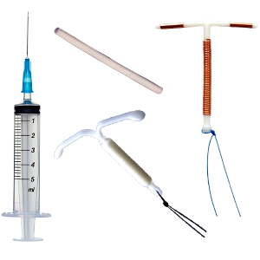
Homelessness and contraception
High rates of unintended pregnancy in women experiencing homelessness in U.S.
Women with OUD have especially high unintended pregnancy rates (86% vs. 31-47%)
ACOG recommends LARCs
-Crawford D et al, Am J Orthopsychiatry. 2011
-Heil S et al, J Subst Abuse Treat. 2011
-ACOG. Obstet Gynecol. 2013
Notes:
Long acting reversible contraceptives which include: include injections, intrauterine devices and subdermal contraceptive implants
Those of use treating addiction should screen all reproductive age women for desiring pregnancy, and be ready to offer LARCs or method of patient’s choice, or refer as appropriate

Slide 48
High Risk Sex
Substance use → higher risk sex
Unprotected sex, sex under influence of drugs/alcohol, multiple partners
Condom use:
29.8% vaginal sex
16.9% oral sex
39.3% anal sex
STI dx: 20.3% (2% HIV)
-Tucker J et al. AIDS and Behavior 2011
-Whitbeck L et al. USDHHS. 2016
Notes:
It’s imperative to have conversations about safer sex, have condoms readily available, and offer PrEP at low threshold- if possible with same day initiations, not only for those that are injecting drugs, but all those engaging in high risk sex. We’re currently have an HIV outbreak in street-dwelling people who inject drugs amongst our patient population and want to remind folks that PrEP is recommended for not only those engaged in high risk sex but also those engaging in high risk substance use.

Slide 49
Trafficking and YYA Homelessness
MA youth count: 13.5% YYA reported survival sex
25% of LGBTQ youth exchanged sex for money
Avg age of entry into commercial sex industry was 14 yo
Covenant House and trafficking: in NJ 9.2%, in NY 14% and in New Orleans 15%
MA State Plan to End Youth Homelessness, 2018
Chisolm-Straker et al, Covenant House New Jersey, 2017
Notes:
Youth may take risks to fulfill basic needs and to feel connected to others. They are also easily victimized due to other factors- lack of social supports, substance use, mental health disorders
Few resources and no support networks
→targets for exploitation
Very hidden population due to criminal nature- any count is an underestimate.
Caveat about sex work, survival sex, transactional sex when >18, but child sexual abuse <18
Recommend screening for trafficking given this prevalence.

Slide 50
Mental Health
High trauma burden (72%) compounded by new traumas
Lead to depression, anxiety, PTSD, SI, attachment issues, SUD
Rates as high as 84% of YYA meet criteria for psychiatric diagnosis
Co-occurring SUD with psychiatric disorder: exacerbate each other, more severe, more relapse, worse prognoses
-MA State Plan to End Youth Homelessness. 2018
-Spencer AE et al. Pediatrics 2021
Notes:
Have to address their traumas of their past while actively experiencing new traumas
SUD is often used to self-medicate those traumas. And sometimes early in treatment, the mental health needs are magnified as the coping mechanism of SUD and the distraction of seeking drugs is removed
Higher risk of suicide
Transition to adulthood marks a time of biological vulnerability to the effects of substances. Sud may predispose young adults to neuropsychiatric complications, including reduced cog function and episodes of psychotic and mood disorders (Pediatrics supplement)
Care should be integrated (mental health and addiction), and mindful of trauma

Slide 51
Mental Health
Barriers with access to care
Difficulties accessing and storing meds
Making appointments
“If you can’t be stable, you can’t get stable.”
MA State Plan to End Youth
Homelessness. 2018
Notes:
The catch 22 of homelessness
What can we do as providers? Make services low barrier, help with things like transportation when able, pill boxes and clinic storing meds for safety.

Slide 52
Family Engagement in Treatment
SUD Workgroup “Principles of Care for Young Adults With Substance Use Disorder” Pediatrics 2021
In some cases, family involvement may exert negative influence on recovery
But when able, safe and thoughtful involvement of family associated with improved outcomes
Young adult should invite their family themselves and control flow of information
Consider a broad view of “family”
“Street Family” or “Chosen Family”
Supportive program staff

Slide 53
Social Determinants of Health
Access to health insurance
Access to shelter/housing
Food insecurity
Clean clothes, laundry
Transportation access
Immigration status
Education & Employment
Social Isolation
Notes:
Housing as a vital sign- “where do you stay?”
“Hunger vital sign” for food insecurity: Within the past 12 months, we worried whether our food would run out before we got money to buy
more. 2. Within the past 12 months, the food we bought just didn’t last and we didn’t have money to get more.

Slide 54
“I hear a lot of the youth we work with referred to as ‘hard to reach’ or ‘service resistant,’ and I can’t disagree more with those statements. They are on our streets and in our parks; they are in plain view. How much easier can they be to reach? They want services, but the truth is they want services that accept them the way they are, provide them with the things they need by people that treat them as individuals with respect and dignity.”
Mary Howe, a service provider in San Francisco, in “Behavioral Health among Youth Experiencing Homelessness”
Notes:
86 National Health Care for the Homeless Council. (September 2016). Substance Abuse Among Youth Experiencing Homelessness. Healing Hands, 20:2. (Author: Melissa Jean, Writer). Nashville, TN: Accessed March 26, 2018. Available at: https://www.nhchc.org/wp-content/uploads/2016/09/healing-hands-substance-use-among-youth-experiencing-homelessness-v2-web-ready.pdf.
Transition to thinking about bring care to the where the patients are rather than expecting them to engage in traditional models- address their needs

Slide 55
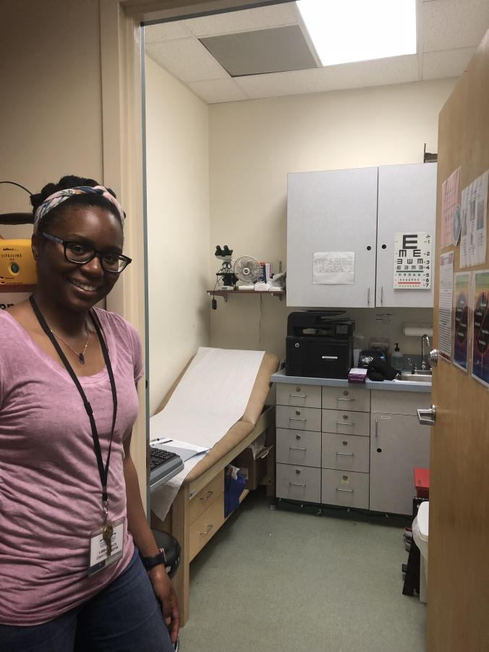
BHCHP Low Barrier Model of Care
Shelter-based care
Primary care
Gender-affirming treatment
STI testing and treatment
Same day contraception
PrEP
HCV treatment
Insurance enrollment
Psychiatry
Phlebotomy
Case management

Slide 56
Back to Nick…
Notes:
Nick came back a number of times to clinic- Intermittently using- came back in one day with a large edematous undrainable abscess from injecting meth. Said it was easier to just stick the needle into the AC and inject than to find a vein. Offered antibiotics and warm compresses. Safe injection supplies. Again, not interested in engaging in substance treatment.
Quickly thereafter diagnosed with hepatitis C.
Unable to find him to give dx but was able to coordinate with another clinic in the city to make sure he knew his dx next time he was seen.

Slide 57
Low-Barrier Care
Drop-in center approach
Normalize accessing medical care (STI testing, immunizations) by making visible
Complex care navigation: Addressing SDOH to engage youth, help with vital documents, accompanying youth to specialist referrals
Alliance building with community partners
Trust building and street outreach
Targeted mobile services (Community Care In Reach medical van)

Slide 58
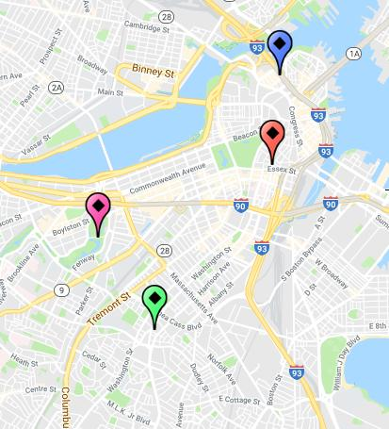
Notes:
Using heat maps to identify clusters of overdoses based on EMS data for fatal and non fatal overdoses, create mobile van that reaches encampments throughout the city of people not accessing traditional medical care

Slide 59
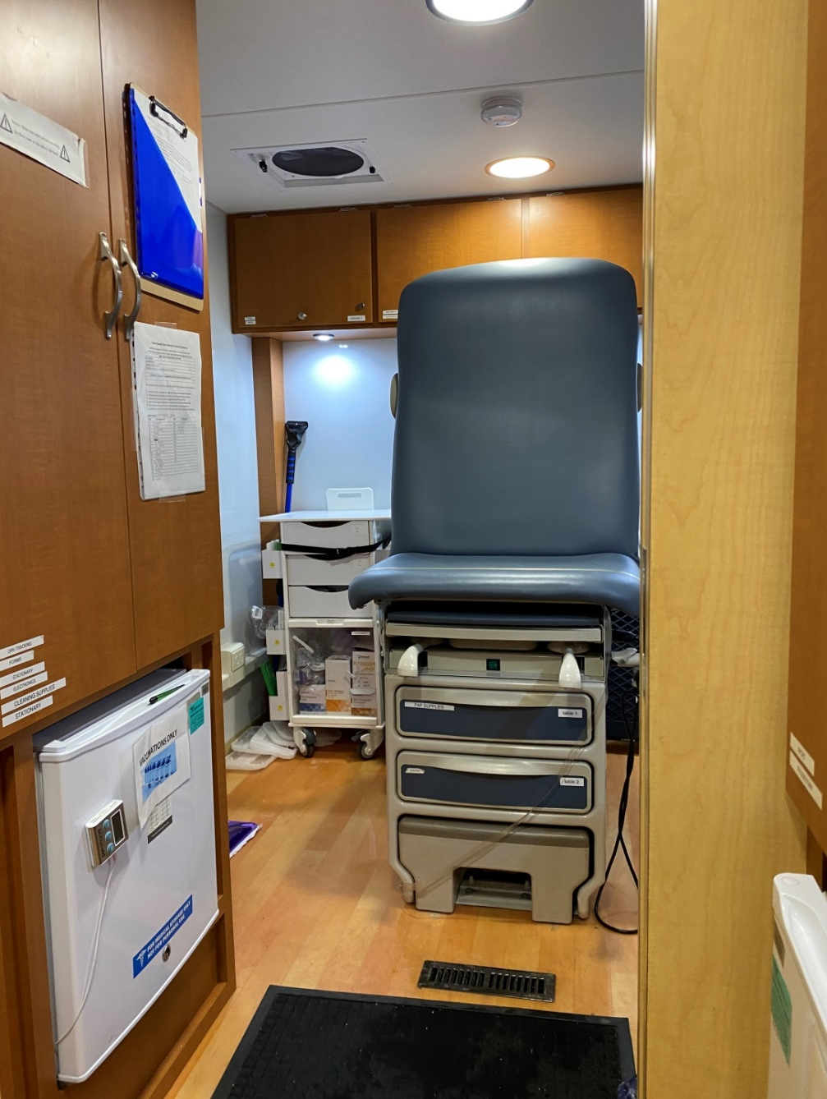
Notes:
Mobile services allow us to come equipped with naloxone, new syringes, vaccines, phlebotomy, health insurance apps, wound care supplies, medications, prescriptions
Safety issues in mobile programming are of utmost importance
Minimize unfamiliar faces
Ideal to have fixed, predictable sites AND be able to respond to evolving need
Team comprised of community-based outreach workers, and clinicians

Slide 60
Community Care in Reach Model Elements
Addictions Services
Treatment-on-Demand
Inpatient detox (transportation arranged)
Medications for addiction treatment
Buprenorphine:
Prescribed directly on van
Observed induction on the first day of treatment
Ongoing maintenance
Naltrexone oral or intramuscular, prescribed and administered directly on the van
Methadone, referral to Opioid Treatment Programs
Other Addictions Services
Naloxone distribution and overdose prevention education
Pre- and Post-exposure prophylaxis for HIV
HIV, HCV testing
Wound care for skin abscesses, including incision/drainage
Syringe access and disposal
Risk reduction counseling
Tele-behavioral health
Primary Care Services
Chronic Disease Management
(including, not limited to)
HIV /HCV Treatment
Substance Use Disorder treatment
Hypertension management
Diabetes management
Preventive Care
Immunizations (prioritize Hepatitis A and B, Influenza, Tetanus)
TB screening
Age/gender appropriate cancer screening
Screening for Sexually Transmitted Illness
Referrals
Psychiatry
Specialty medical care at BMC and MGH
Other referral locations based on patient
preference
Slide by Dr. Jessie Gaeta, BHCHP
Notes:
Clinical hours dedicated to adult patients and evening hours dedicated to youth outreach

Slide 61
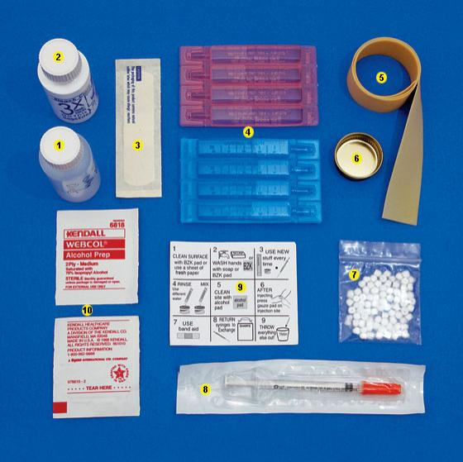
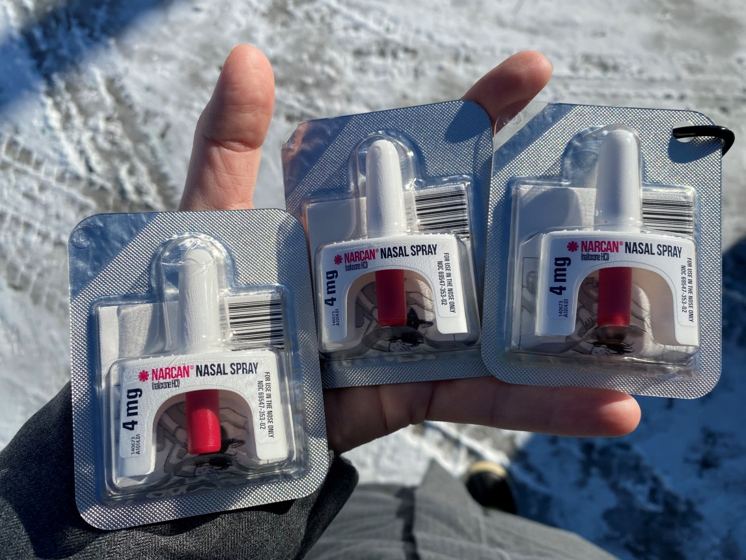
Risk Mitigation
Notes:
Despite being just as affected by the myriad harms associated with drug use, youth do not engage in traditional risk mitigation services as adults do (Noyes paper)
One of most critical goals of SUD treatment
Reduce rate of infectious disease transmission, notably hepatitis C and HIV, and reduces morbidity and mortality associated with drugs (ie naloxone distribution and overdose prevention)
Effort should be made to reduce harm at every opportunity regardless of youth’s interest in minimizing use
Risk mitigation services can be an entry point for additional resources- health care and SUD treatment
Distribution of sterile syringes and injecting equipment reduced HIV and hcv transmission and soft tissue infection. Distribution of naloxone decreases fatal opioid OD

Slide 62
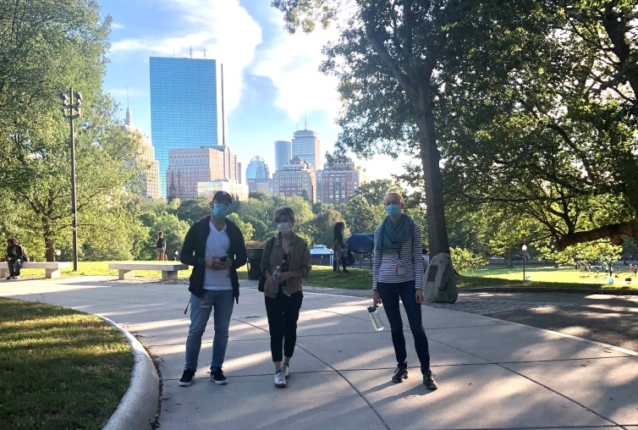
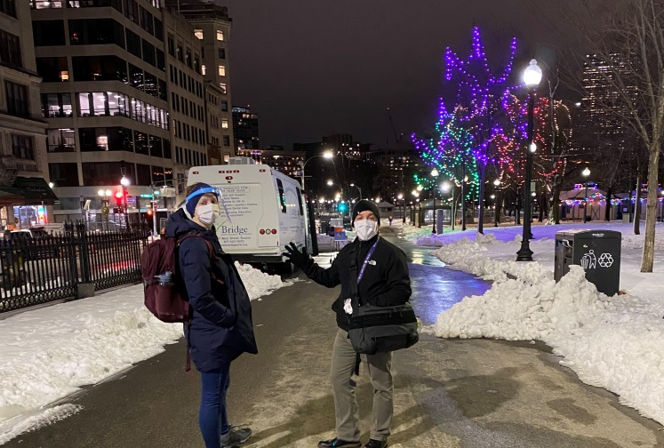

Slide 63
Youth-Friendly Risk Mitigation and Engagement
Create youth-centered spaces
De-stigmatize accessing care
Social Media
Overdose prevention guidance: FaceTime, hotlines (NeverUseAlone.com), apps (Canary, Remote Egg Timer, Kitestring)
Consistency
Incentives: charging stations, free WiFi, gift cards
Material needs: food, drink, gloves/hats, hand warmers
Include the youth voice in informing the design of the intervention
Peer education and navigation
-Noyes et al, Pub Health Rep, in press
Notes:
Youth participation in design fosters prosocial relationship and may improve program outcomes. May also promote services and resources in ways most relevant to youth
May use intranasally rather than by injection- risk mitigation services can try to target these preferences
Apps prevent OD by monitoring the user’s activity after activation- if stops moving or fails to respond to app prompts the app issues alert to others
Treatment preferences may be dynamic in this age group- regularly reassess sx and tx goals

Slide 64
Nick, continued
Notes:
Later came back after an inpatient detox, to connect with our clinic psychiatrist and for injections of long acting antipsychotics. He continued on buprenorphine. Doing well in a group home. Came back regularly for a couple of months, with plants to start hcv treatment. Then our team learned that he had left his group home. He hasn’t been seen in clinic for 2 months. He is intermittently seen by outreach workers from the shelter. When he reappears, we will continue offering support and comprehensive treatment, at his pace and in a setting in which he feels safe and welcome.

Slide 65
In Summary….
There’s a high prevalence of youth and young adult homelessness and every patient should be screened for housing status
Consider if your patient may fit one of the prevalent subpopulations of youth homelessness: pregnant/parenting, mental health needs, SUD, high-risk sex, trafficking, and connect to or offer appropriate services
Connect youth to low barrier care that emphasize the principles of risk mitigation, co-located services, drop-in access

Slide 66
References
Bender, Kimberly, Sanna Thompson, Kristin Ferguson, and Lisa Langenderfer. “Substance Use Predictors of Victimization Profiles among Homeless Youth: A Latent Class Analysis.” Journal of Adolescence 37, no. 2 (2014): 155-64. doi:10.1016/j.adolescence.2013.11.007.
Chisolm-Straker M, Einbond J, Sze J, White J. Recognizing Human Trafficking Among Homeless Youth. 2017. Covenant House New Jersey
Cochran BN, Stewart AJ, Ginzler JA, Cauce AM. Challenges Faced by Homeless Sexual Minorities: Comparison of Gay, Lesbian, Bisexual, and Transgender Homeless Adolescents With Their Heterosexual Counterparts. Am J of Pub Health. 2002;92(5):773-7
Crawford DM, Trotter EC, Hartshorn KJ, Whitbeck LB. Pregnancy and mental health of young homeless women. Am J Orthopsychiatry 2011;81:173–83.
Health care for homeless women. Committee Opinion No. 576. American College of Obstetricians and Gynecologists. Obstet Gynecol 2013;122:936–40.
Heil SH, Jones HE, Arria A, Kaltenbach K, Coyle M, Fischer G, Stine S, Selby P, Martin PR. Unintended pregnancy in opioid-abusing women. J Subst Abuse Treat. 2011 Mar;40(2):199-202.
Keuroghlian AS, Shtasel D, Bassuk EL. Out on the street: a public health and policy agenda for lesbian, gay, bisexual, and transgender youth who are homeless. Am J Orthopsychiatry. 2014;84(1):66-72
Massachusetts State Plan to End Youth Homelessness. Prepared for: Secretary Marylou Sudders, Executive Office of HHS, Chair of the MA commission on Unaccompanied Youth. 2018
Morton MH, Dworsky A, Samuels GM. Missed opportunities: Youth homelessness in America. National estimates. 2017. Chicago, IL: Chapin Hall at the University of Chicago
National Health Care for the Homeless Council. (September 2016). Substance Abuse Among Youth Experiencing Homelessness. Healing Hands, 20:2. (Author: Melissa Jean, Writer). Nashville, TN: Accessed March 26, 2018. Available at: https://www.nhchc.org/wp-content/uploads/2016/09/healing-hands-substance-use-among-youth-experiencing-homelessness-v2-web-ready.pdf.
Noyes E, Yeo E, Yerton M, Plakas I, Keyes S, Obando A, Gaeta JM, Taveras EM, Chatterjee A. Harm Reduction for Adolescents and Young Adults During the COVID-19 Pandemic: A Case Study of Community Care in Reach. Public Health Reports. In publication
Saver BG, Weinreb L, Gelberg L, Zerger S. Provision of contraceptive services to homeless women: results of a survey of health care for the homeless providers. Women Health 2012;52:151–61.
Silverstein M, Hadland SE, Hallett E, Botticelli M. Principles of Care for Young Adults with Substance Use Disorders. Pediatrics 2021 Jan;147(Supp 2): S195-S203.
Spencer AE, Valentine SE, Sikov J, Yule AM, Hsu H, Hallett E, Xuan Z, Silverstein M, Fortuna L. Principles of Care for Young Adults With Co-Occurring Psychiatric and Substance Use Disorders. Pediatrics. 2021 Jan;147(Suppl 2):229-239
Thompson SJ, Bender KA, Lewis CM, Watkins R. Runaway and pregnant: risk factors associated with pregnancy in a national sample of runaway/homeless female adolescents. J Adolesc Health. 2008;43(2):125-132
Tucker, Joan S., Gery W. Ryan, Daniela Golinelli, Brett Ewing, Suzanne L. Wenzel, David P. Kennedy, Harold D. Green, and Annie Zhou. “Substance Use and Other Risk Factors for Unprotected Sex: Results from an Event-Based Study of Homeless Youth.” AIDS and Behavior 16, no. 6 (2011): 1699-707. doi:10.1007/s10461-011-0017-9.
Whitbeck L et al. Data collection Study Final Report. Administration for Children and Families, Family and Youth Services Bureau, Street Outreach Program. April 2016. USDHHS.

Slide 67
Thank you!
Tamara Itzel Martinez, MD
Instructor of Pediatrics/Harvard Medical School
Attending Physician/Adolescent Substance use and Addiction Program (ASAP) Division of Developmental Medicine Boston Children's Hospital
Aura M. Obando, MD
Family Team Program Director, Boston Health Care for the Homeless Program
Instructor of Medicine and Pediatrics Harvard Medical School
Notes:
Thank you again to today’s presenters. You can access the links to slides from today’s presentation and the on-demand recording on the AMERSA, ATTC and NORC websites.

Slide 68
Related Products & Resources from the ATTC Network
CLAS Standards in Behavioral Health: Working with Youth and Adolescents (Recorded webinar)
Understanding Latino Youth Recovery: Issues, Assets and Creating Resiliency (Recorded webinar)
Adolescent Brain Maturation and Health: Intersections on the Developmental Highway
Recorded presentation
Handouts
Effects on Marijuana Use on Developing Adolescents (Recorded webinar)
Vaping Overview and CATCH My Breath Program (Recorded webinar)
Vaping 2: Education vs Punishment Using Deferred Citation (Recorded webinar)
Understanding Suicide Part 2 Adolescents and the Changing Brain (Recorded webinar)
attcnetwork.org/centers/global-attc/tay-webinar-series
Notes:
To augment the information provided today, you can check out these additional resources from the ATTC and PTTC Networks.

Slide 69
Related Products & Resources from the PTTC Network
Underage Alcohol Use: An Overview of Data and Strategies (Recorded webinar)
Youth Opioid Addiction: What Preventionists Need to Know (Recorded webinar)
Selecting and Implementing Evidence-Based Practices to Address Substance Misuse Among Young Adults: Webinar on SAMHSA’s Resource Guide
Preventing Youth Vaping (Webinar Series) Part 1 of 2: The Extent and Risk Factors for Youth Vaping (Recorded webinar)
Preventing Youth Vaping Part 2 of 2: Policy Recommendations and Promising Practices for Addressing Youth Vaping (Recorded webinar)
The Benefits of Engaging Youth in Communities: Insights and Evidence from Developmental Science (Recorded webinar)
Vaping and LGBTQ Youth (Recorded webinar)
Informing Prevention 6-Part Webinar Series on Adolescents: Mountain Plains PTTC
Adolescent SBIRT Pocket Card
attcnetwork.org/centers/global-attc/tay-webinar-series

Slide 70
Keep in Touch with
the AMERSA Network
For more information about AMERSA visit: www.amersa.org
Join our mailing list: https://amersa.org/contact-us/
@AMERSA_tweets
@AMERSA2021
amersa.org/resources/tay-webinar-series/
Notes:
You can also keep in touch with ATTC, NORC and AMERSA via their newsletters and social media. Sign up now for monthly emails and follow them on Twitter and Facebook.

Slide 71
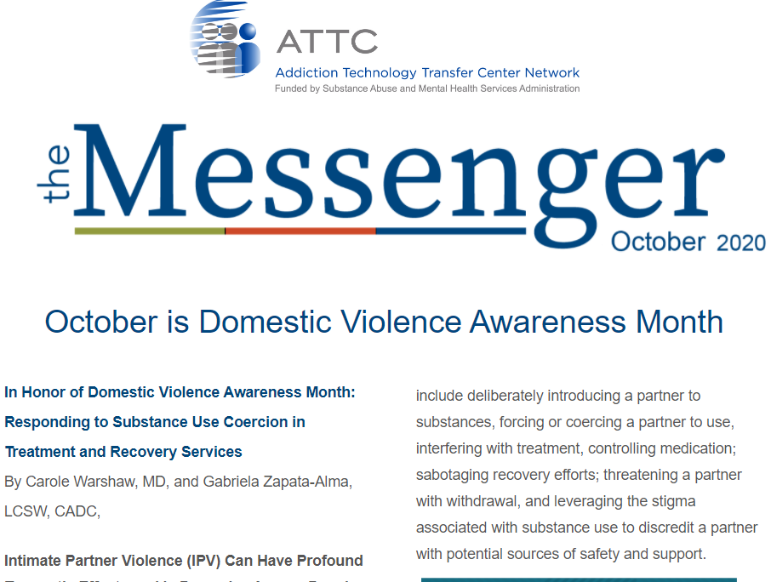
Keep in Touch with
the ATTC Network
ATTC Network Office publishes the Messenger monthly
Subscribe: https://attcnetwork.org/centers/global-attc/subscribe-attc-messenger
@ATTCnetwork
@attcNetwork
attcnetwork.org/centers/global-attc/tay-webinar-series

Slide 72
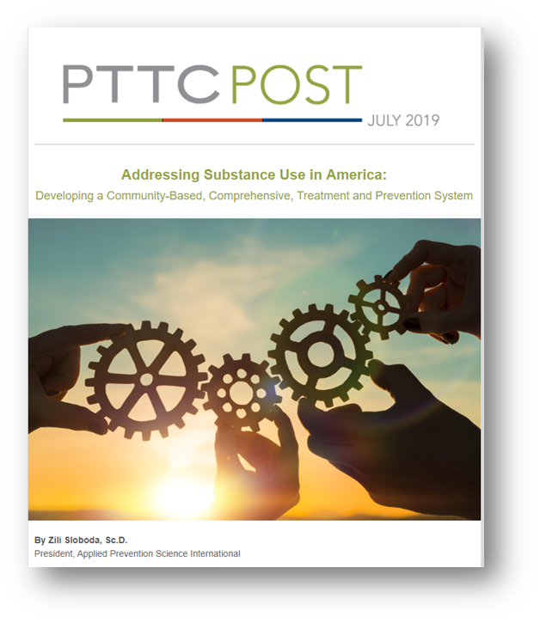
Keep In Touch with
the PTTC Network
PTTC Network Office publishes the PTTC POST monthly
Subscribe:
https://pttcnetwork.org/centers/global-pttc/pttc-subscription-page
@PTTCnetwork
@PreventionTTCnetwork
attcnetwork.org/centers/global-attc/tay-webinar-series

Slide 73
Thank you!
Produced in Partnership by:
amersa.org/resources/tay-webinar-series/
Notes:
Thank you so much for attending. And, with that, I will conclude my presentation and turn it over to Dr. Obando.

