Slide 1
Hospital-Based Navigation: A Tool for Linking to Residential Treatment
Sophie Zhai, BA

Slide 2
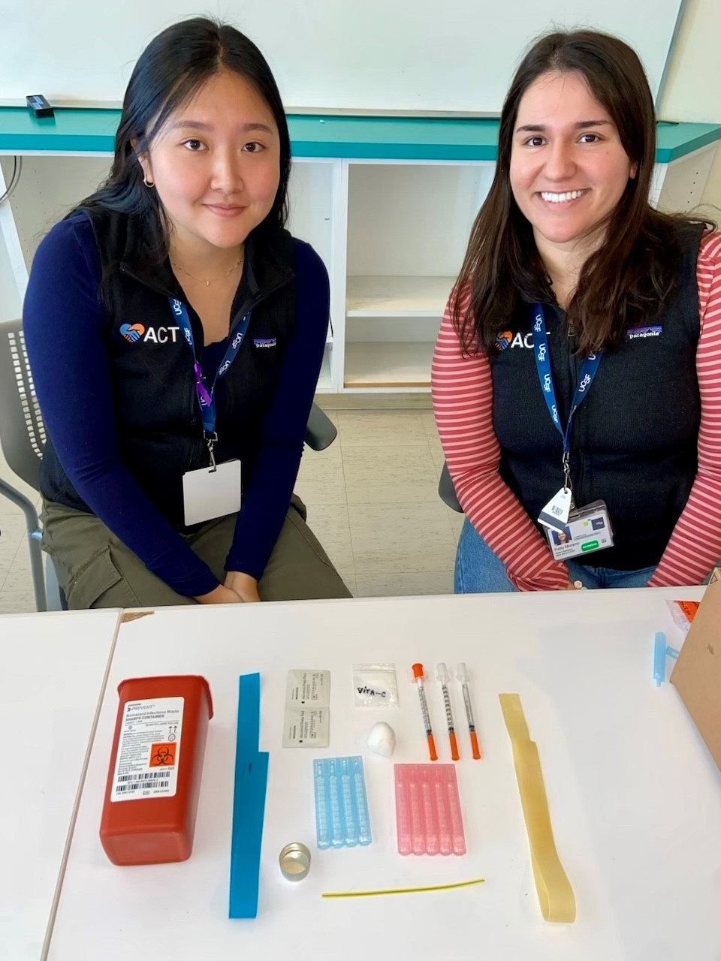
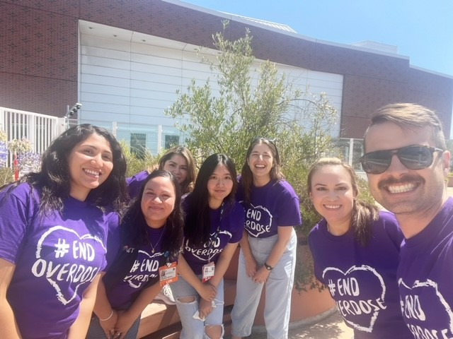
Nothing to
disclose
Notes:
Ask a question for the audience – Before I dive into the presentation, I wanted to ask you to raise your hand if you are currently a patient navigator, social worker, or anyone who works in care coordination?
Keep your hands raised. For everyone else – please raise your hand if you work on a team with someone who helps link patients to care.

Slide 3
Objectives
Describe hospital-based navigation
Identify challenges with treatment navigation
Reflect on the role navigation could play in your institution
Notes:
Learning Objectives

Slide 4
Overdoses are at an all-time high
1 in 10 people with SUD receive treatment
107,543 deaths
Overdose deaths
Year
2023
Notes:
References
2023 numbers

Slide 5
What do we know about patient navigation?
SFGH
Increased
engagement
with addiction
services
Notes:
Where is navigation effective
In what ways can navigation assist with bridging gaps in care

Slide 6
Primary Team
Patient
Outpatient Supports

Slide 7
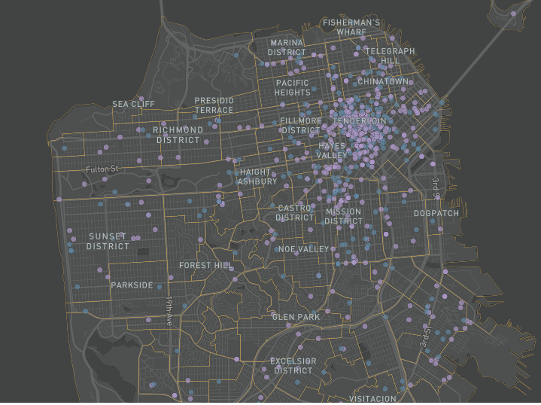
11
Free or publicly funded programs in San Francisco
3
Out-of-county or privately funded programs

Slide 8
How effective is hospital-based navigation in linking to residential treatment?

Slide 9
Methods: Data & Inclusion
Inclusion Criteria
Retrospective chart review for 206 hospital encounters between April - December 2023
Age ≥18
Met DSM-5 criteria for SUD
Expressed interest in residential treatment
Screened by ACT Patient Navigators
Notes:
184 unique patients

Slide 10
Methods: Sub-Questions
Who’s interested in residential treatment?
Who’s linking to residential treatment?
Why are patients unable to link?
Notes:
184 unique patients

Slide 11
11% Spanish speaking
54% Black & Latine
66% Homeless
45 Average Age
Study Population (N = 206)

Slide 12
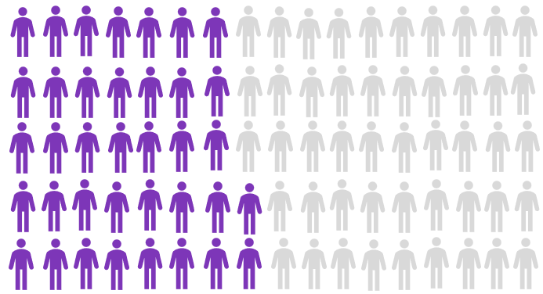
Residential Treatment Linkage Rate
15%
decided not to
pursue treatment
after ACT
43%
linked to treatment
directly after discharge

Slide 13
Overall Linkage Rate
43%
Demographic Characteristics
No significant difference in linkage rates between groups
Residential Treatment Linkage Rate (%)

Slide 14
Reasons for Non-Linkage (N = 99)
Notes:
Color code figurines
Test 18-24 pt at minimum Sans Seraf
Take Home point slides

Slide 15
Discussion & Conclusion
Navigation is effective among a population with high biopsychosocial complexity
People with
co-occurring conditions face treatment gaps
Expansion is needed to meet the demand for residential treatment
Notes:
Mental health & physical conditions

Slide 16
Surveillance Bias
Limitations
&
Challenges
Long-term Treatment Outcomes
Different Treatment Landscapes

Slide 17
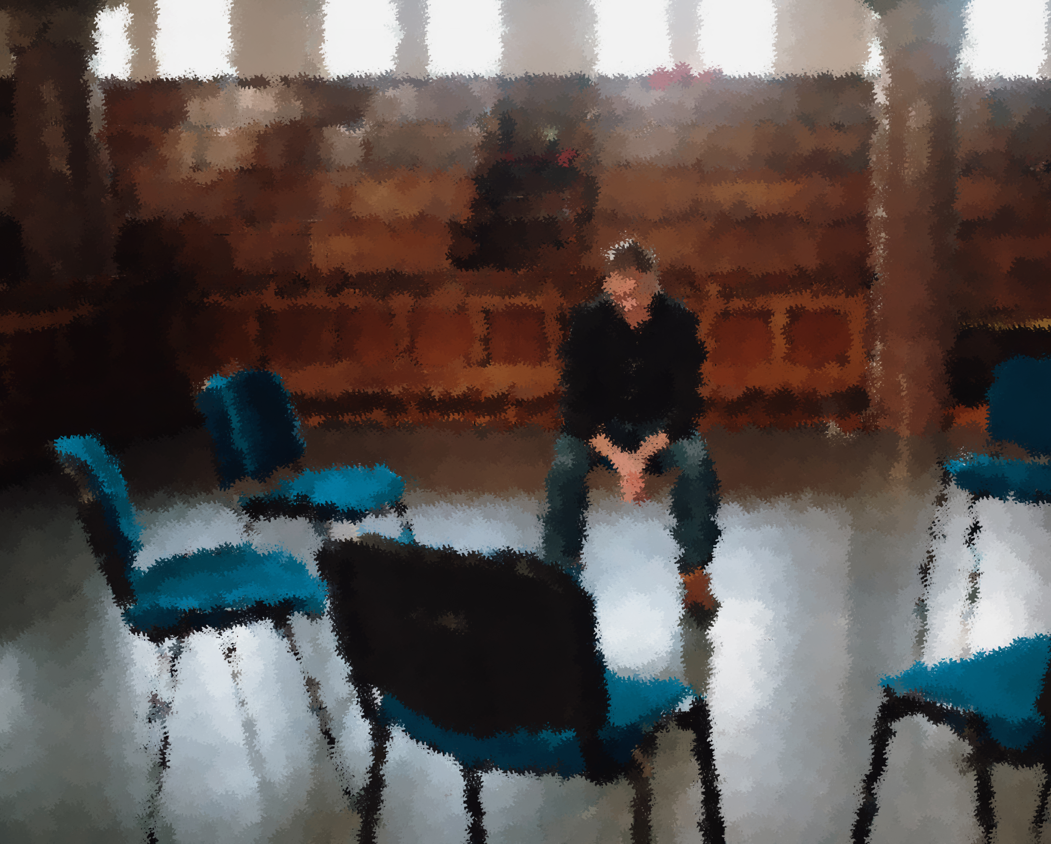
Thank You
&
Questions

