Slide 1
Identifying unintentional fentanyl exposure among people who have experienced an opioid overdose: A quality improvement investigation from the San Francisco Street Overdose Response Team
UCSF School of Medicine
UCSF Department of Psychiatry and Behavioral Sciences
Patrick Low, Bryson Gomez, Hannah Snyder, Jeffrey Hom, Barry Zevin, Michael Mason, Christine Soran, Phillip Coffin, Alexander Bazazi

Slide 2
Disclosures
Patrick Low
I have no conflicts of interests to disclose

Slide 3
Diversity, Equity, and Inclusion Statement
Our research is driven by a commitment to equity and diversity through our research participants, methodologies, and interpretations. We underscore the importance of embracing and understanding the multifaceted experiences of those affected by substance use and addiction.
Notes:
In conducting this study, all authors are driven by a commitment to equity and diversity through our research participants, methodologies, and interpretations. We would like to underscore the importance of embracing and understanding the multifaceted experiences of those affected by substance use and addiction.

Slide 4
Unintentional opioid exposure
An alarming concern for people who use drugs
First-responders reporting frequent anecdotal unintentional OD
Risk of opioid exposure in individuals intending to use a non-opioid substance is poorly understood
Growing racial disparity
Questions:
To what extent is unintentional fentanyl exposure occurring in San Francisco?
Does unintentional exposure contribute to disparities in overdoses?
Notes:
Moving into our study, the inspiration for this investigation came from multiple anecdotal reports from San Francisco’s dedicated overdose first response team responding to overdose cases where individuals reported intending to use a non-opioid substance
Generally, exposure of people who use opioids to fentanyl-adulterated or substituted heroin is well-documented in the literature, but there is surprisingly little information on unintentional fentanyl exposure among people who primarily use non-opioid substances
Additionally, a staggering and growing number of people die from fentanyl overdoses, with increasing racial disparities nationwide primarily affecting Black individuals. In San Francisco specifically, the crisis has also been found to disproportionately affect Black individuals, who had an overdose death rate five times higher than the actual city rate.
In the wake of these reports of unintentional overdoses and racial disparities, we set out to answer two main questions: To what extent is unintentional fentanyl exposure occurring in San Francisco? And 2. Does unintentional fentanyl exposure contribute to this racial/ethnic disparity?

Slide 5
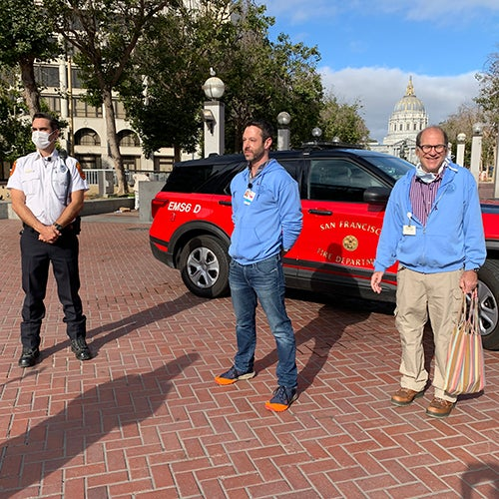
Collaboration with SFDPH/SFFD
A Quality Improvement Investigation
Notes:
To answer these questions, we conducted a quality improvement project in partnership with the San Francisco Department of Public Health/SFFD analyzing a comprehensive log from Street Overdose Response Team (SORT)
In order to address the opioid crisis in the city, SORT was founded in collaboration with the department of public health and fire department in 2021 as a a dedicated overdose emergency response unit. When a suspected overdose is called into the dispatcher, SORT monitors responses and attaches itself on top of the initial general EMS response. They are specially trained and equipped to deal with overdoses in the city, write reports of their initial encounter, and refer to specialized post-overdose response teams which reach out to clients afterward for additional follow-up. Immediately after reversal of the overdose, SORT also interviews the individual and specifically asks what substance they were intending to use at the time of overdose.

Slide 6
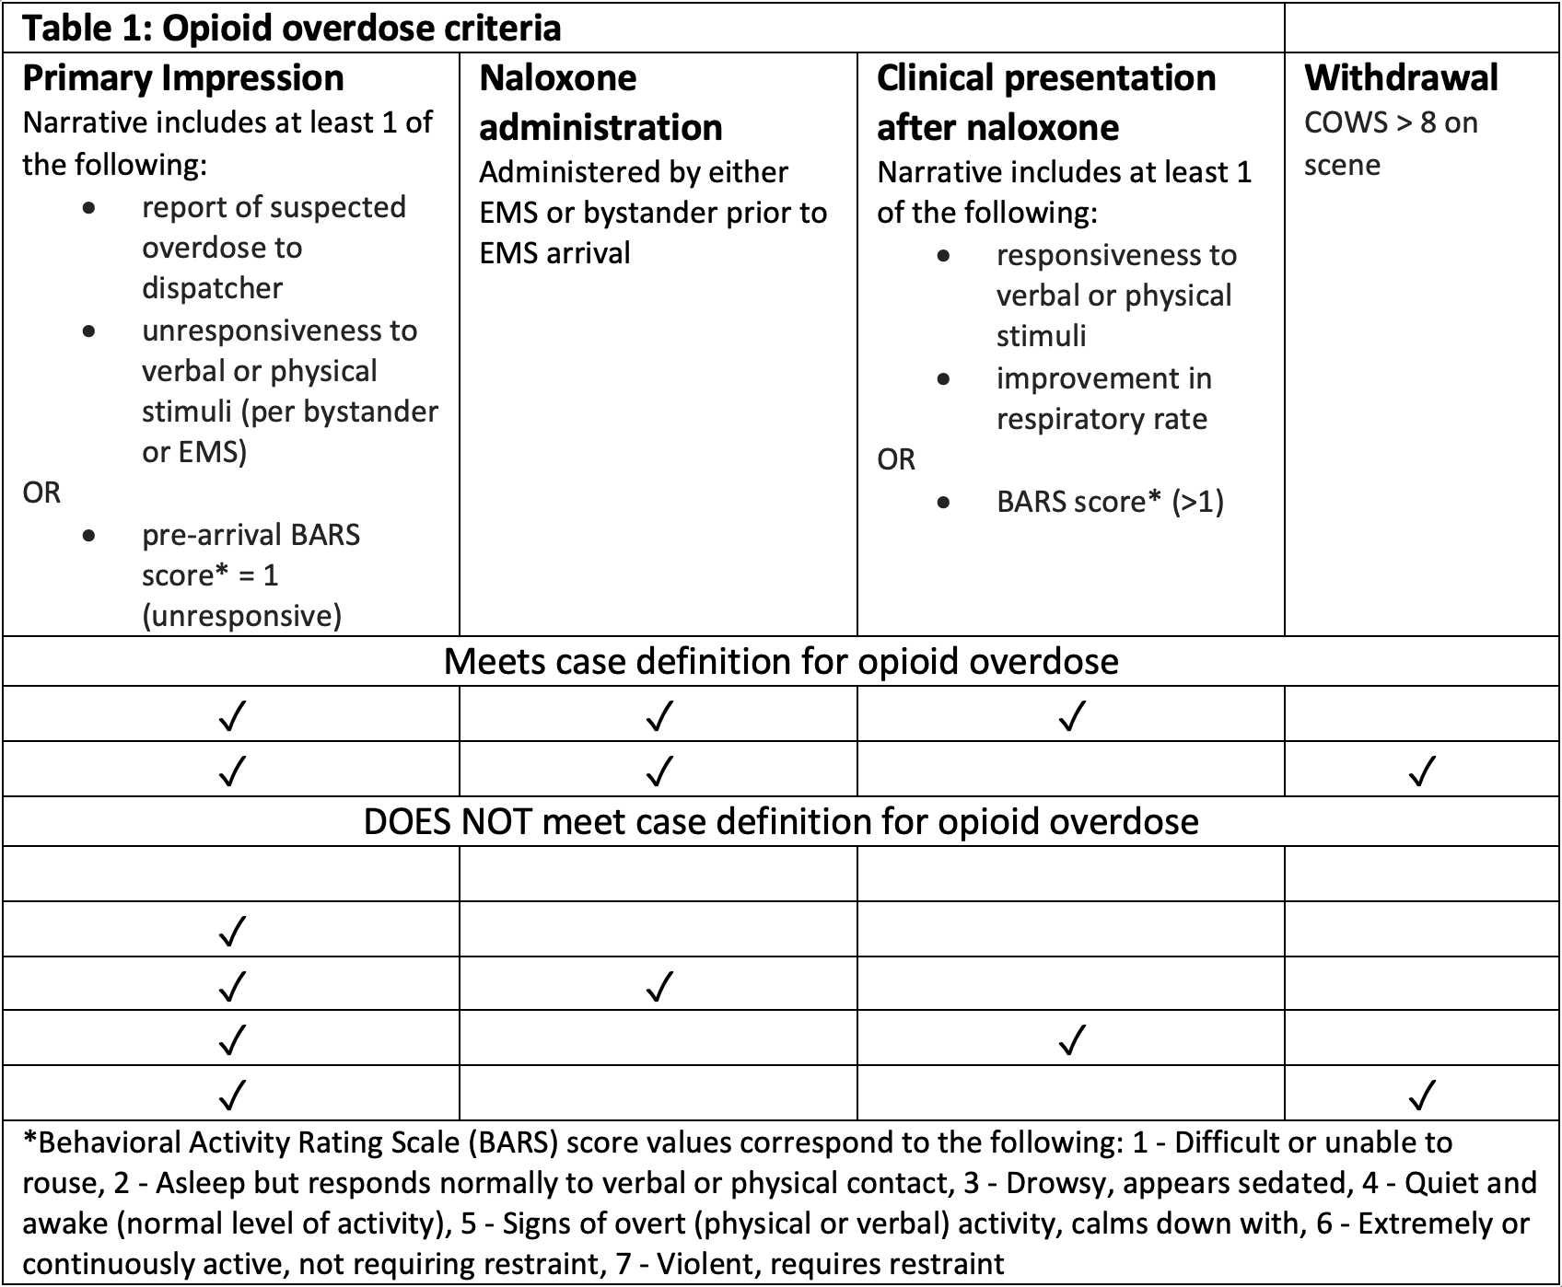
Methods
Notes:
To conduct this investigation, we examined written reports from SORT during their initial encounter of approximately 448 responses in the city of San Francisco from June to September 2022. Variables included the clinical opiate response withdrawal scale (COWS score), behavioral activity rating scale (BARS score) and demographic data such as age, race, and sex. SORT paramedics also include free-response information such as whether naloxone was administered, patient response to naloxone, and subjective information provided by the patient including the substance they were intending to use before overdose.
In preparation of our investigation, we developed an opioid overdose case definition requiring a primary impression of overdose and clinical improvement or withdrawal after naloxone administration. This definition has been adapted from the Rhode Island Criteria which is a validated instrument for opioid overdose determination published by the Rhode Island Department of Public Health.
After the relevant variables were collected, we calculated the proportion of opioid overdoses occurring among people who reported intending to use opioids and among people intending to use non-opioid substances along reported demographic factors.
All instances of opioid exposure are assumed to be caused be fentanyl in San Francisco based on statistics published in the city’s annual substance use report finding that fentanyl accounts for 91% of all opioid overdoses in the city.

Slide 7
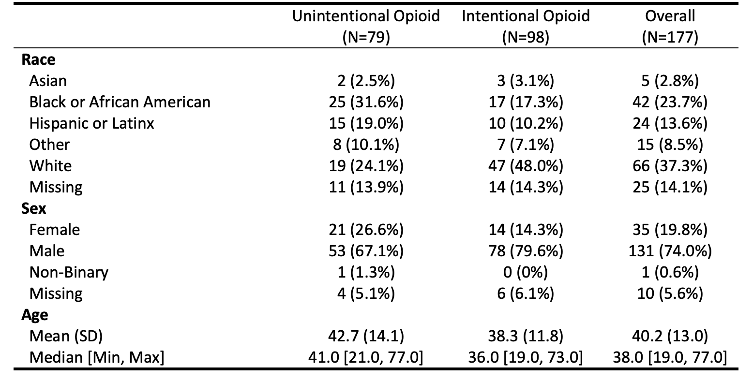
Results
Notes:
Of these 448 reviewed logs, only 177 met our case definition of confirmed opioid overdose. Of these 177, 45% or 79/177, reported that they had not intended to use opioids. In the first column, Black respondents made up 32% of those not intending to use opioids. Hispanic respondents made up 19%, and White individuals 24%. Data on race was missing for 14% of overall cases

Slide 8
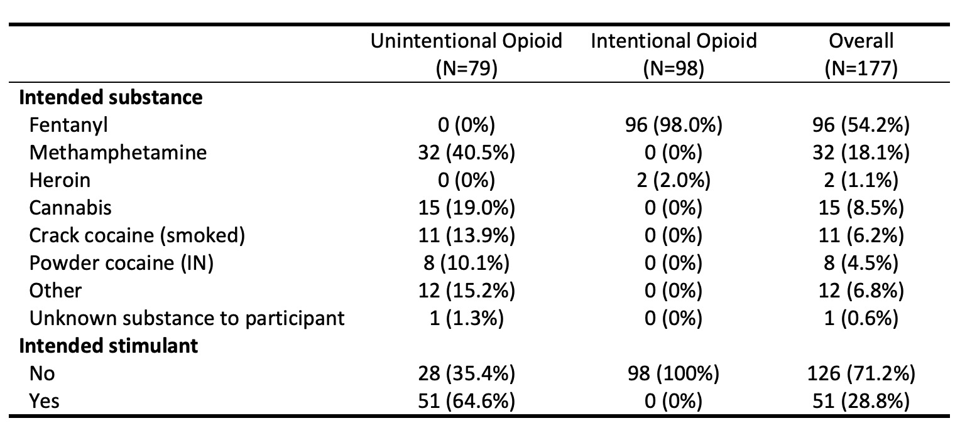
Results
Notes:
In terms of actual intended substances reported, 29% of the total 177 (18.1% + 6.2% + 4.5) reported intending to use stimulants including methamphetamine or cocaine. Additionally, 19% of individuals experiencing unintentional opioid exposure reported intended cannabis use which I will discuss in the next slide.
Notably, 86% of those reporting no intentional opioid use had a (COWS) score ≤8 after naloxone administration which suggests absence of opioid tolerance that would be expected with regular use

Slide 9
Conclusions
Unintentional opioid use primarily among individuals intending to use stimulants was common
Black individuals were more likely to report unintentional opioid exposure after overdose, raising the question of whether this contributes to disparities in OD mortality
What interventions should be deployed in this setting?
Notes:
In conclusion, 45% of individuals experiencing opioid overdose in our investigation reported not intending to use an opioid with most reporting intending to use a stimulant. Notably, low COWS scores after naloxone administration in the majority of people experiencing an overdose attributed to unintentional opioid use in this sample suggests respondents did not use opioids daily. This is significant as primary stimulant users who are often opioid naïve may be particularly susceptible to opioid overdose due to lack of tolerance.
Alarmingly, Black individuals were most likely to report not intending to use an opioid in our study. This may be explained by greater unintentional fentanyl exposure or increased pressure to underreport fentanyl use due to stigma or perceived risk.
In light of these findings, we really stress the importance of implementing additional harm reduction strategies including naloxone distribution, fentanyl test strips and other drug-testing services, distribution of safer smoking supplies, and public health education may be effective interventions in reducing unintentional overdoses

Slide 10
Limitations and Questions
Underreporting of fentanyl use
Cannabis
Using COWS
Limited certainty in opioid determination using SORT logs
Unable to determine mechanism of contamination
Notes:
Our investigation has a few notable limitations I would like to discuss. First, overall underreporting of intentional fentanyl use is a likely occurrence. Imagine this scenario where you’re waking from an OD w/ ambulances and paramedics surrounding you asking you questions about sensitive topics such as your substance use. Chances are you would be understandably very scared and confused and likely to underreport your fentanyl use. This was something that was supported by the finding that numerous individuals reported only using cannabis during their overdose which is unlikely to be mistaken for or contaminated with fentanyl. One way in which we address this is through examination of withdrawal symptoms through the Clinical Opiate Withdrawal Score (COWS) that would be suggestive of chronic opioid use when elevated after naloxone administration. However, while it’s possible that there is some underreporting, this 45% is such a substantial reporting of unintentional overdose cases that it is indicative of a much larger issue.
Another limitation is that SORT logs are recorded by paramedic first responders based on their subjective experience with the patients involved, and whether the patient actually experienced an overdose is impossible to determine with certainty. We attempt to account for this uncertainty through a standardized definition of overdose adapted from previously validated Rhode Island Criteria. However, this case definition itself is limited in its ability to accurately classify events as opioid overdoes and does not account for episodes of overdose in which improvement of mental status is not observed such as anoxic brain injury. I personally read around 500 records and there were excerpts that in my opinion were highly likely to be ODs but we were unable to classify them as ODs w/ our criteria.
Finally, we’re unable to determine how unintentional fentanyl exposure happens in the first place. We considered fentanyl contamination of stimulant supply, though this has been contradicted local drug testing reports. Currently, there is discussion of whether people are being exposed through being sold or mistaking fentanyl for stimulants or through sharing of smoking equipment used for opioids although nothing has been definitive.
At this point time permitting, I would love to hear from everyone in the audience if unintentional exposure has been an issue occurring in your region and if there is any insights can be shared, any advice on how to interpret data, and potential mechanisms of adulteration that you may have seen or heard.

Slide 11
Thank you!
Questions?
Notes:
And that concludes my presentation, thank you for listening!

