Slide 1
Impact of On-Demand Methadone on Emergency Department Utilization
AMERSA Conference
November 4th, 2023
Paul Christine, MD, PhD
Assistant Professor of Medicine
University of Colorado and Denver Health

Slide 2
Disclosures & Funding
No conflicts of interest to disclose
Funding:
Taylor: INTF2301M03163724179 (MDPH BSAS, PI: Taylor)
Christine: Research in Addiction Medicine Scholars (RAMS) Program, R25DA033211 (NIDA, PIs: Samet, O’Connor)
Notes:
PUT COAUTHORS AT THE END

Slide 3
Background: Methadone is difficult to access
Methadone for OUD treatment is life-saving but limited to highly-regulated opioid treatment programs (OTP)¹
Number and capacity of OTPs is insufficient²⁻⁴
Delays to enrollment associated with morbidity and overdose death
Significant racial and socioeconomic inequities in OTP entry and retention⁵⁻⁶
Methadone seems increasingly important in fentanyl era
1. Certification and Treatment Standards for OTPs 2. Jones 2015. 3. Rosenblum 2011. 4. Sigmon 2014. 5. Gryczynski 2011. 6. Lo 2018.
Notes:
Will go through quickly as background on the intervention itself (but focus is on ED utilization)
Highlight issues as particularly acute in Boston, exacerbated

Slide 4
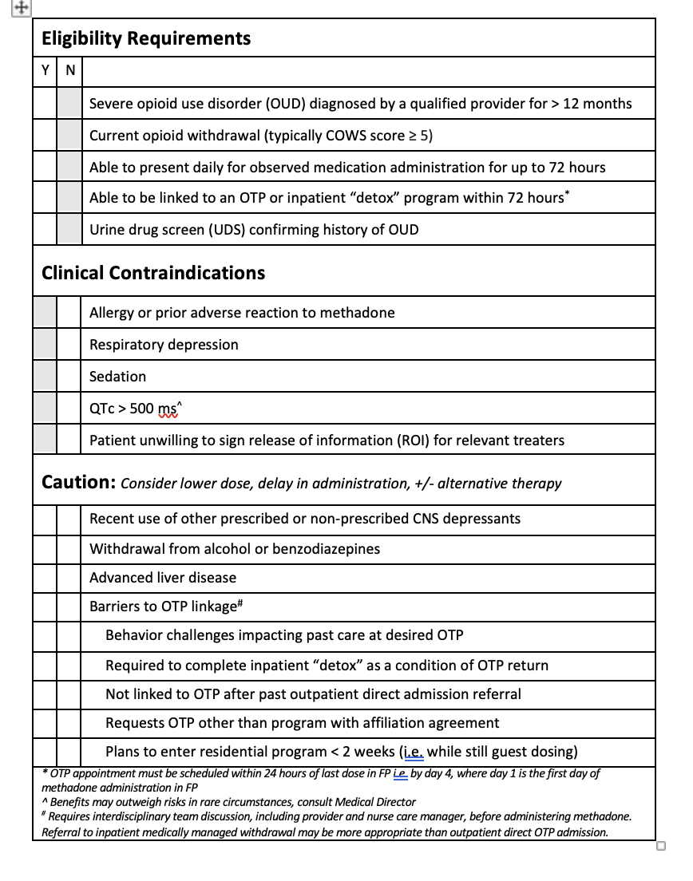
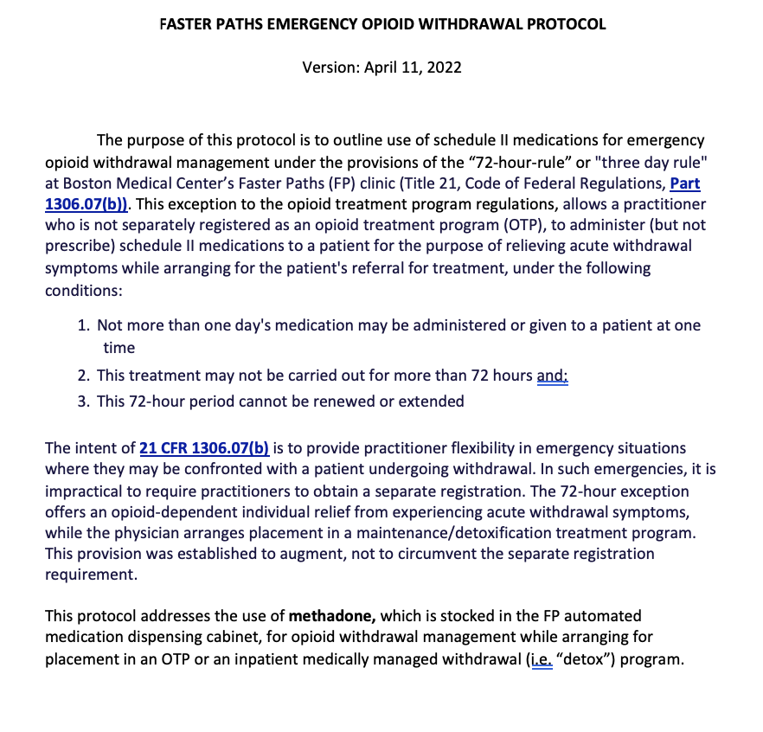
Background: Faster Paths 72-hour methadone program
The 72-hour rule is an underutilized pathway to methadone treatment entry
We developed protocol for methadone opioid withdrawal treatment + direct OTP admission under 72-hour rule in March 2021
Demand for new pathway grew rapidly
750 unique patients treated in 2022
Drawing patients with high ED utilization
First 142 unique patients had mean 4.3 ED visits/year
Often ambulatory-sensitive conditions
Laks, et al, Addict Sci Clin Pract, 2021; Taylor, et al, DAD, 2022.
Notes:
Allows non-OTP physician to administer “narcotic drugs to a person for the purpose of relieving acute withdrawal symptoms” for up to 3 days while arranging ongoing treatment1
Medications must be administered, not prescribed
No more than 1 day’s medication administered at one time*
72-hour period cannot be renewed or extended
Primarily used in Emergency Departments, but very limited data exist on this practice
Application in low-barrier Bridge Clinics promises benefits:
Reduce ongoing opioid use and risk of opioid overdose and HIV acquisition
Facilitate rapid OTP referrals using navigation infrastructure
Leverage other clinical HIV prevention resources
Patients had on average 1 ED visit every 3 months, or about 4.3 ED visits per year (range of 0 to 38) – in the first cohort of 142 unique patients
- Our clinical experience is that many of these ED visits are likely for ambulatory-sensitive conditions related to substance use withdrawal, intoxication, or complications of injection like skin and soft tissue infecitons

Slide 5
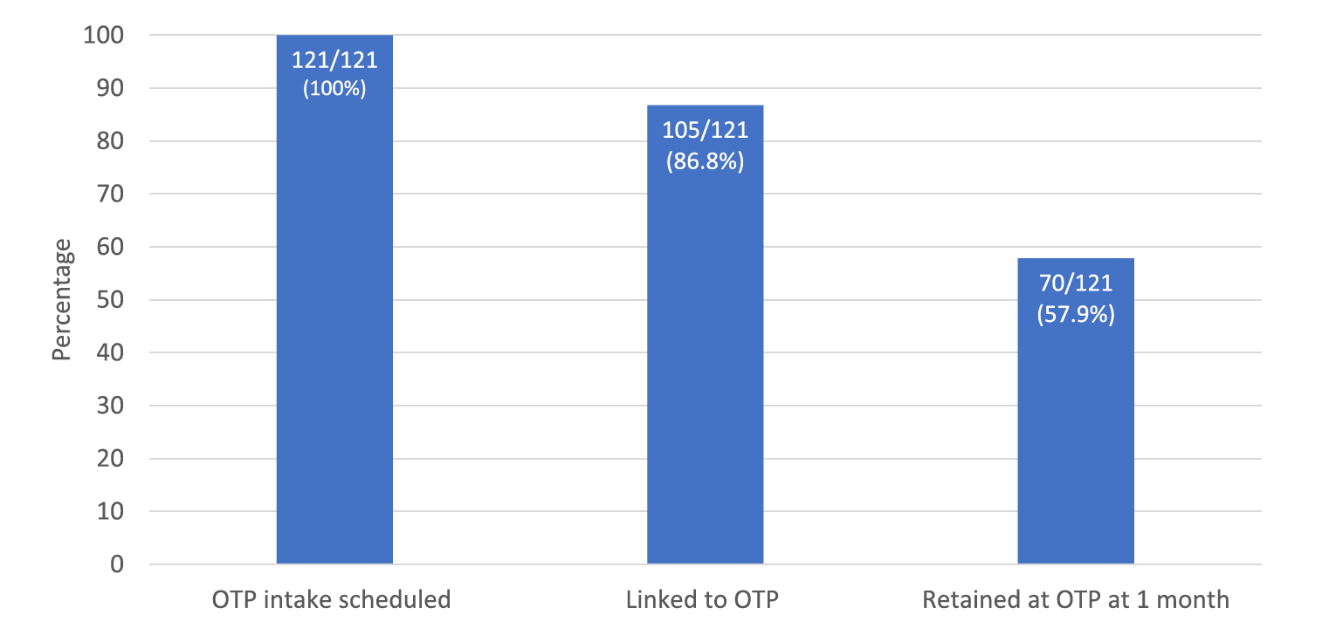
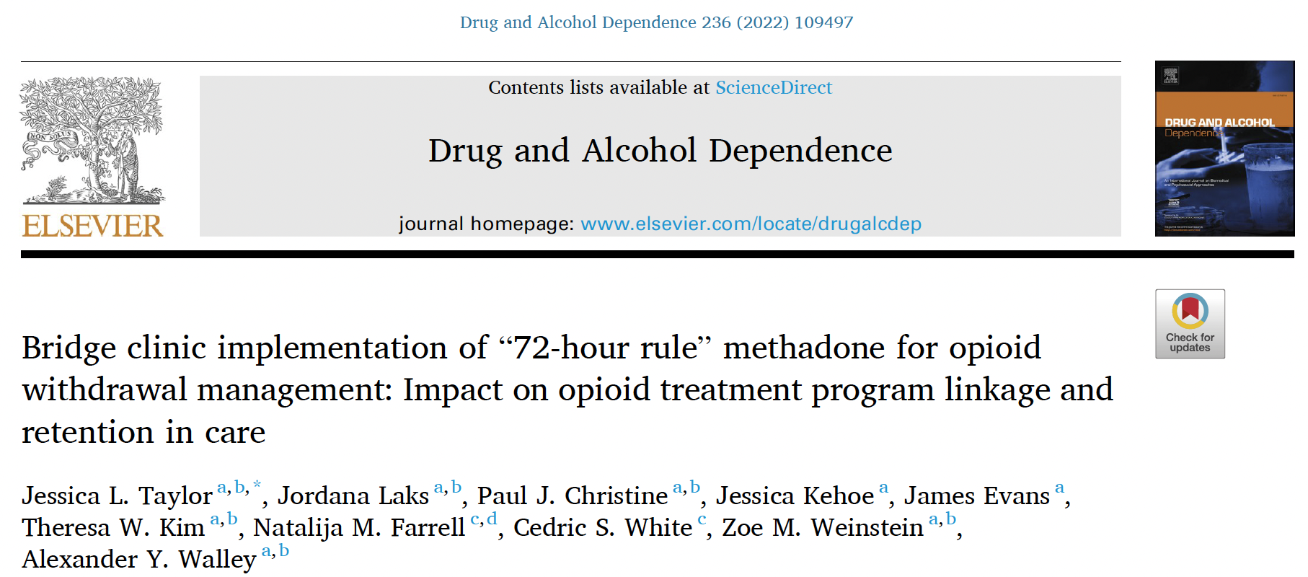
Background: Faster Paths successfully links patients to methadone care
OTP Intake, Linkage, and 1-mo Retention at 2 primary OTP Partners, March 3 – Aug 15, 2021
How does rapid methadone access impact healthcare utilization and outcomes?
Taylor, et al, DAD, 2022
Notes:
We have said that methadone WORKS to reduce overdose death and other morbidity.
Numerous pathways – decreasing injection events, overdose, SSTI, deep tissue infection….
This intervention successfully links patients to methadone treatment.
Rates of linkage similar to inpatient referrals to methadone clinics, highlighting feasibility of this pathway to expand access

Slide 6
Research questions and hypotheses
ED Utilization:
Compared to the 12 months prior to methadone initiation, did patients who were started on methadone through the Faster Paths 72-hour program experience a change in emergency department (ED) utilization in the 8 months after medication initiation?
Patients started on methadone via the 72-hour program will have decreased ED utilization in the 8 months after initiation
Notes:
*** GRAPHIC of mechanism
Decreased injection events
Engaged in primary care
Harm reduction teaching/supplies

Slide 7
Methods: Study design
Design:
Retrospective pre-post intervention study utilizing interrupted time series methods
Population:
All individuals initiated on methadone via Faster Paths 72-hour pathway who have 12 months pre- and 8 months post-data (n=532)
Exposure:
Methadone initiation
Outcome:
Boston Medical Center ED utilization rate in the 8 months post-methadone initiation (mean ED visits per patient-month), compared to 12 months pre-initiation

Slide 8
Methods: Study design
Start of Observation Period
Faster Paths Methadone Initiation
End of Observation Period
Baseline Period
FP
Follow Up Period
12 Months
1-3 Days
8 Months
Notes:
PAUL PICKS UP
Benefits:
Each patient serves as their own control → controls time-invariant confounding by design
Drawbacks
Susceptibility to regression to the mean
Absence of control group = susceptibility to common temporal trends
*** MODIFY: To exclude 1 month pre and 1 month post, discuss spikes in utilization and threat of regression to the mean; MAKE PROPORTIONAL SO THAT IT FITS TIME FRAMES ACCORDINGLY

Slide 9
Methods: Analytic Plan for ED Utilization
Interrupted time series analysis
Intervention
Counterfactual Trend
Level Change
Slope Change
Level & Slope Change
Bernal, et al, Int J Epidemiol, 2017

Slide 10
Results: Patient characteristics
Sociodemographics | Number of patients (%)
Age, years; mean (SE) | 40.7 (0.4)
Male sex | 361 (68.1%)
Race/ethnicity
White, non-Hispanic | 328 (61.9%)
Black, non-Hispanic | 79 (14.9%)
Hispanic/Latino | 109 (20.1%)
Homeless | 270 (51.3%)
Medicaid insurance | 458 (86.4%)
Psychiatric comorbidities | Number of patients (%)
Stimulant use disorder | 140 (26.4%)
Benzodiazepine use disorder | 156 (29.4%)
Alcohol use disorder | 109 (20.6%)
Serious mental illness | 111 (20.9%)
Medical comorbidities
Known HIV | 37 (7.0%)
Chronic hepatitis C | 203 (38.3%)
Notes:
Discuss difficulty is coming up with a control group
We don’t know who the similar patients are
Ex: HIV prevalence was ~15% in first 142 patients and is <1% in Boston

Slide 11
Results: ED visits pre- and post-methadone initiation
Methadone Initiation
Pre
Post
Notes:
Median ED visits per month in pre: 135
Median ED visits per month in post: 128.5

Slide 12
Revisiting the study design to account for spike in utilization
Start of Observation Period
Faster Paths Methadone Initiation
End of Observation Period
Baseline Period
FP
Follow Up Period
11 Months
1-3 Days
7 Months
Omit 1 month pre & post
Notes:
Benefits:
Each patient serves as their own control → controls time-invariant confounding by design
Drawbacks
Susceptibility to regression to the mean
Absence of control group = susceptibility to common temporal trends
*** MODIFY: To exclude 1 month pre and 1 month post, discuss spikes in utilization and threat of regression to the mean; MAKE PROPORTIONAL SO THAT IT FITS TIME FRAMES ACCORDINGLY

Slide 13
Results: ITS of ED visits pre- and post-methadone initiation
Methadone Initiation
-12 -11 -10 -9 -8 -7 -6 -5 -4 -3 -2 -1 1 2 3 4 5 6 7 8
Notes:
Discuss difficulty is coming up with a control group
We don’t know who the similar patients are
Ex: HIV prevalence was ~15% in first 142 patients and is <1% in Boston

Slide 14
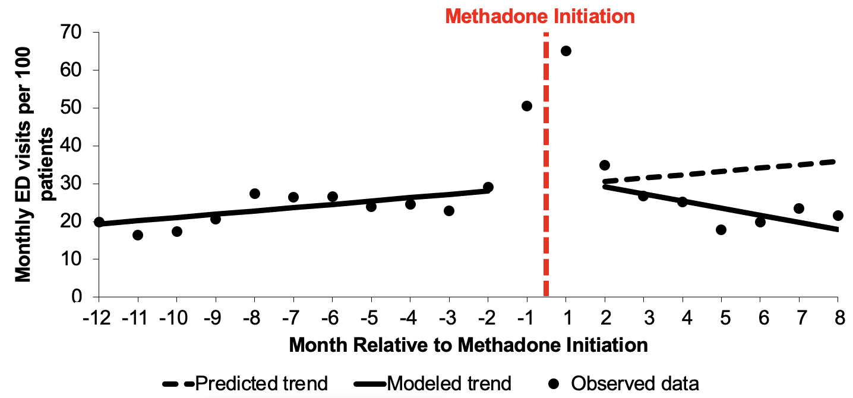
Results: ITS of ED visits pre- and post-methadone initiation
 | Model variable (95% CI)
 | Intercept | Pre-period time trend | Post-period level change | Post-period time trend change
Monthly ED visits per 100 patients | 18.5 (15.7, 21.2) | 0.9 (0.4, 1.3) | 4.0 (-2.7, 10.6) | -2.7 (-3.8, -1.7)
18.9 fewer ED visits per 100 patients
Notes:
At month 8 after methadone initiation, there was an estimated ~18.9 fewer ED visits per 100 patients, compared to the projected ED utilization based upon pre-period trends

Slide 15
Limitations
No external control group
Regression to the mean?
In-process of compiling buprenorphine patients
No ED utilization data outside of BMC
Awaiting Massachusetts Medicaid approval to include BMC ACO member claims outside BMC
Notes:
Discuss difficulty is coming up with a control group
We don’t know who the similar patients are
Ex: HIV prevalence was ~15% in first 142 patients and is <1% in Boston

Slide 16
Conclusions
Avoidable SUD-related ED visits drive costs and experiences of stigma
Methadone treatment via the 72-hour rule may temporarily increase ED utilization but decrease ED utilization over time
Short-term increased ED utilization may indicate unmet medical needs
Patients receive other high-priority medical care
PEP/PrEP for HIV, infection screening, harm reduction supplies, connection to primary care
Notes:
JESS PICKS UP

Slide 17
Acknowledgements
Jordana Laks, MD, MPH
Natalija M Farrell, PharmD
James Evans, RN
Karrin Weisenthal, MD
Andrea Stone, BS
Miriam Komaromy, MD
Marc R Larochelle, MD, MPH
Alexander Y Walley, MD, MSc
Jessica L Taylor, MD

Slide 18
THANK YOU! QUESTIONS? FEEDBACK?
Paul Christine, MD, PhD
paul.christine@cuanschutz.edu
@pauljchristine

Slide 19
Extra Slides

Slide 20
Faster Paths successfully links patients to methadone care
Unique Patients Treated & Cumulative Episodes of Care in Faster Paths, March 3 – Aug 15, 2021

Slide 21
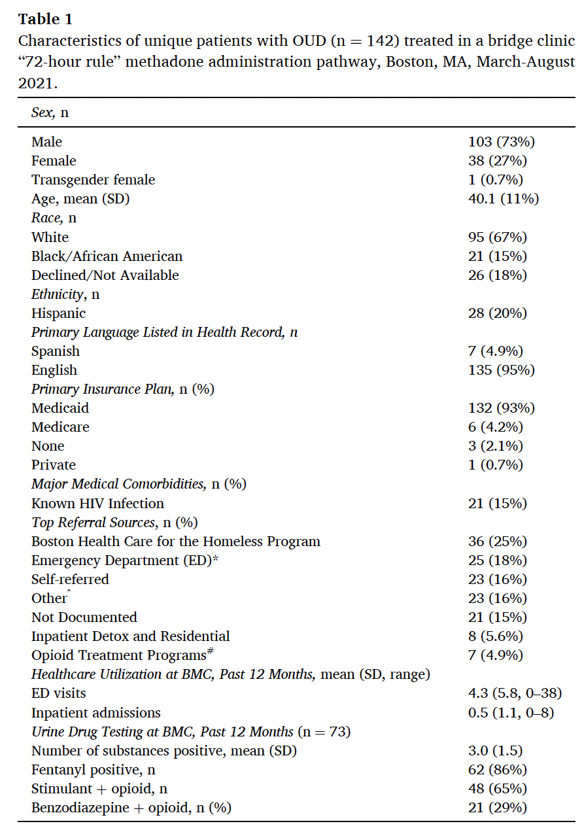
Faster Paths successfully links patients to methadone care

Slide 22
Methods: Analytic Plan for ED Utilization
Interrupted time series analysis
Linear regression
ED_{t} = mean ED visits per 100 patients in month t
Time_{t} = continuous variable indicating time in months relative to methadone start
Methadone_{t} = indicator for time t occurring before (0) or after (1) methadone start
$ε$_{t} = error term consisting of random error and error at time t
ED_{t} = β₀ + β₁(time_{t})+ β₂(methadone_{t}) + β₃(time*methadone_{t}) + $ε$_{t}

Slide 23
Methods: Analytic Plan for ED Utilization
ED_{t} = β₀ + β₁(time_{t})+ β₂(methadone_{t}) + β₃(time*methadone_{t}) + $ε$_{t}
β₂+ β₃
β₁
β₂
β₃
β₀
Level Change
Slope Change
Level & Slope Change
Bernal, et al, Int J Epidemiol, 2017

Slide 24
Methods: Sensitivity analyses
Sensitivity analyses (planned):
Restrict sample to BMC ACO members → claims data across hospital systems (pending)
Restrict sample to only those referred to methadone clinics in BMC area
Restrict to sample initiating methadone in most recent 6 months of study timeframe to account for COVID impact on ED utilization in pre-period
Control group:
Patients initiating buprenorphine during the same period
Other options considered:
Traditional referrals to OTP
Inpatient referrals to OTP
Patients with OUD with similar ED utilization but not in Faster Paths
Notes:
Discuss difficulty is coming up with a control group
We don’t know who the similar patients are
Ex: HIV prevalence was ~15% in first 142 patients and is <1% in Boston

Slide 25
Example HIV Studies in Faster Paths
New visits for HIV-negative patients (n=204), all SUDs, Jan-May 2020
86% assessed for injection-related risk
23% assessed for sexual risk
Even with gaps in risk assessment and documentation, 27% (n=55) met CDC criteria for PEP or PrEP
65% of eligible patients offered PEP or PrEP
20% of those offered prescribed PEP or PrEP
In small sample, no differences in PrEP offers or prescribing by race or ethnicity
Most PEP/PrEP prescribing during 1st visit
6 PWID offered PrEP who lacked CDC criteria
Braun, et al, J Addict Med, 2022

Slide 26
Methods: Need for additional control group? If so, who?
Control Group Options: ED Utilization
Comparison Group Options: Mortality
Historical Bup
Cohort
COPD Cohort
Detox Referral Cohort
Hospital Referral Cohort
Thoughts about control/comparison groups? Data on traditional methadone initiations?
Notes:
Ideal control group: individuals with OUD who pursued care and were not able to initiate methadone
COPD: control condition, gives baseline ED utilization trends
Detox cohort: also seeking methadone, went to detox; data available from BSAS intake form; would need to be historical control
Hospital cohort: also seeking methadone, came from inpatient direct linkage
OTP initiation via traditional pathway? Does anyone know about data availability for this?

