Slide 1
Notes:
The purpose of this talk is to describe our efforts at developing a curriculum for EM residents regarding the management of patients with opioid use disorder and use of buprenorphine to treat OUD.
There is a separate talk about our clinical process measures related to OUD that will be delivered next.

Slide 2
Authors & Affiliations
Aaron Krumheuer, MD Emergency Medicine Resident, University of Michigan
Alex M. Nickel, MD PM&R Resident, Corewell Health
Erin Kim Medical Student, University of Michigan
Carrie Bailes, MD Emergency Medicine Resident, University of Michigan
Emily E. Ager, MD, MPH Emergency Medicine Resident, University of Michigan
Ella Purington, MD Emergency Medicine Resident, University of Michigan
Syed M. J. Mahmood, MD Assistant Professor, Department of Emergency Medicine, Division of Pain Medicine, UC-Davis
Mitchell T. Hooyer, MD Emergency Medicine Resident, University of Michigan
ML Ryan, MD Emergency Medicine Resident, St. Luke's University Health Network
Jessica Baker Medical Student, University of Michigan
Megan Purdy, MD Emergency Medicine Resident, Denver Health
Carolyn Commissaris, MD Assistant EM Residency Program Director, Brigham & Womens Hospital/Harvard Medical School
Shawna Smith, PhD Assistant Professor, School of Public Health, University of Michigan
Alexander Janke, MD, MHS Fellow, National Clinician Scholars Program, University of Michigan
Christopher Fung, MD, MS Assistant Professor, Department of Emergency Medicine, University of Michigan
Eve D. Losman, MD, MHSA Clinical Associate Professor, Department of Emergency Medicine, University of Michigan
Department of Emergency Medicine
Notes:
We are a large team of residents, medical students and faculty.

Slide 3
Disclosures
No listed authors have financial relationships to disclose.
This work was supported by a SAEMF / NIDA Mentor-Facilitated Training Award.
Department of Emergency Medicine

Slide 4
For many patients, the ED is a potential point of entry for initiating Opioid Use Disorder treatment.
However, less than 10% of patients with an ED visit for non-fatal overdose are prescribed naloxone or buprenorphine at discharge.
Chua KP et al. AnnEM. 2022;79(3):225-36.
Department of Emergency Medicine
Notes:
Often, the ED functions as a gateway to healthcare for vulnerable and marginalized populations. This includes people who use drugs.
ED visits associated with opioids and opioid overdose have increased substantially in the past two decades, and the one year mortality of patients presenting to the Emergency Department (ED) with a non-fatal overdose is approximately 5-7%.
Already much work has been done to reduce the harms of opioids in the ED. Attention has focused on safer and reduced opioid prescribing, motivational interviewing with referral of patients to substance use disorder (SUD) treatment, and Take Home Naloxone (THN) initiatives. Despite these resources, the fatal opioid overdose rate in our country has only increased.

Slide 5
MOUD is the evidence based, gold standard treatment for OUD
ED based MOUD initiation has been gaining momentum over the past 15 years and is now considered the standard of care.
But . . . not all emergency physicians have embraced this treatment modality and residency-based training / education in MOUD is not universal.
Department of Emergency Medicine
Notes:
ED initiation of MOUD after an overdose has demonstrated the ability to reduce mortality, decrease non-medical opioid use, and improve retention in treatment compared to abstinence-based interventions.
Recent surveys of emergency providers regarding MOUD indicate concerns regarding . . .
unclear hospital policy
unfamiliarity with outpatient referral options
lack of confidence in counselling patients on MOUD
The stigma of OUD also continues to impede adoption.
Educational interventions show promise for reducing stigma among health professionals, suggesting that training that includes the principles of harm reduction and addresses stigma may be especially important to MOUD implementation.

Slide 6
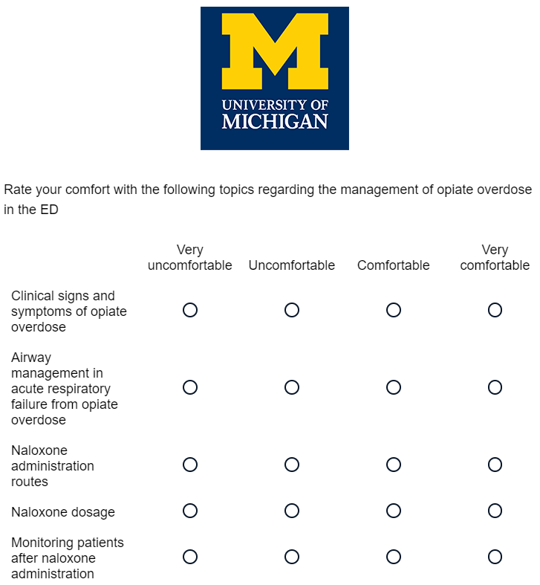
Needs Assessment Survey
4 year training program
64 residents
Already exposed to the concept of risk reduction via an ED based Take Home Naloxone program
Department of Emergency Medicine
Notes:
SO w edecidd to create a harm reduction and MOUD curriculum . . .
Using the KERN frame work,
We conducted a needs assessment to understand residents’ perceived barriers for treatment of patients with OUD. Our survey was based on a 4-point Likert scale, assessing residents’ comfort level and level of concern with various aspects of OUD and harm reduction, and 87% (56 of 64) of EM residents completed it.
Results showed that residents already feel confident in their ability to identify patients at risk for opioid overdose. They are comfortable with airway management for patients with respiratory failure secondary to opioids, and they know how to safely treat patients with naloxone.
Yet there were several areas of significant discomfort that residents routinely expressed, and these results mirrored the barriers illustrated in the existing literature.

Slide 7
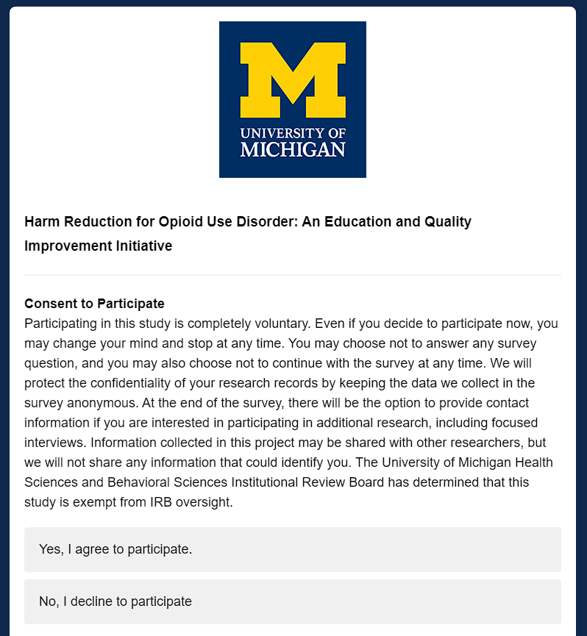
The study
We examined attitudes and knowledge at the beginning, midpoint, and end of our curriculum.
We used descriptive statistics to examine our results with regression models to evaluate changes over time.
Department of Emergency Medicine
Notes:
We distributed surveys to our residents, measuring knowledge as well as attitudes and opinions at the beginning, midpoint, and end of our curriculum.
There were several domains that we analyzed. These included:
- Use of Naloxone and Buprenorphine in the ED, along with legal aspects of prescribing
- Harm reduction strategies for people who use opiates
- Familiarity with our institutional policies and outpatient referral clinics
- Counseling patients and leading conversations about MOUD
We then used descriptive statistics to examine our results with regression models to evaluate changes over time

Slide 8
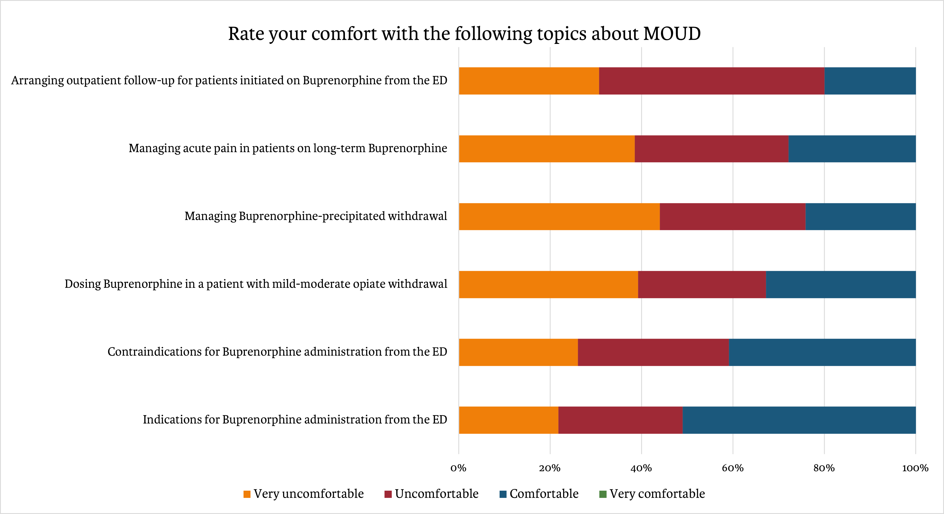
Department of Emergency Medicine
Notes:
There were many topics for which our residents felt uncomfortable and none for which they felt Very Comfortable, as evident by the absence of any green on the figure.
Residents were uncomfortable with their knowledge of
the institutional policy surrounding MOUD induction
how to connect these patients to outpatient MOUD treatment
were also uncomfortable with the indications and contraindications for MOUD and buprenorphine dosing
How to mitigate the risk of precipitated withdrawal
How to engage patients in a conversation regarding MOUD initiation.
Notably, the survey indicated less than half of participants ever received prior lectures or training regarding MOUD in medical school or residency.

Slide 9
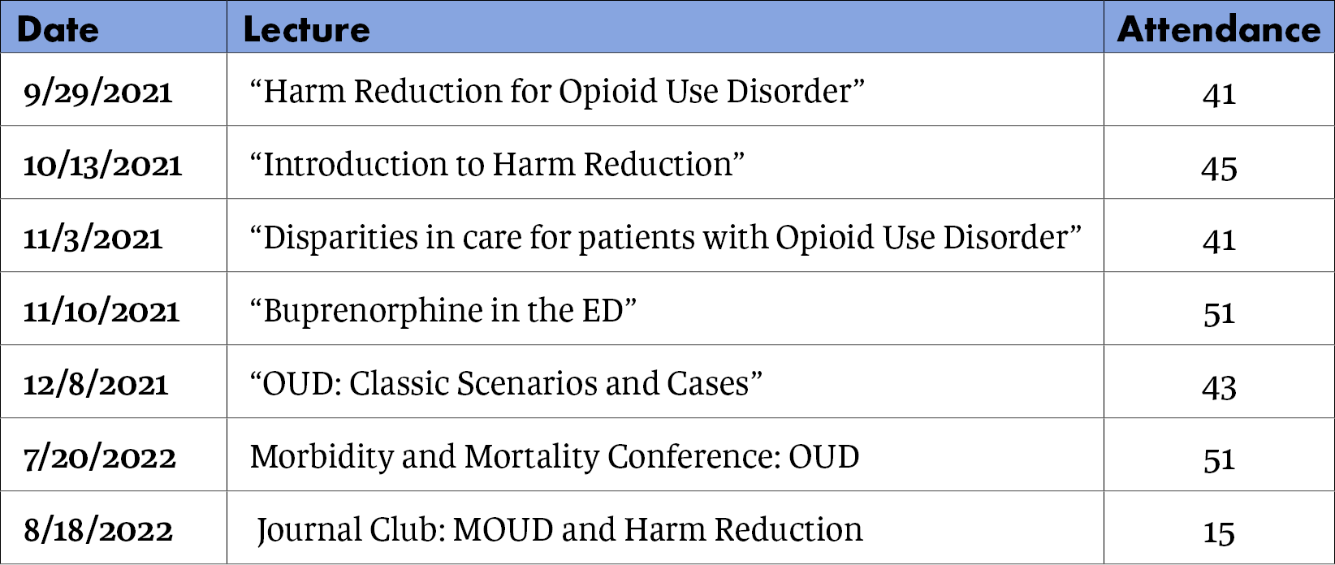
The curriculum and # of residents in attendance at each session
Department of Emergency Medicine
Notes:
Using our needs assessment, a multi-disciplinary team of emergency medicine residents, faculty, implementation scientists and addiction medicine specialists met over the course of several weeks to plan seven separate sessions to address these barriers.
Our hospital’s Addiction Consult Team leader started the curriculum with a overview of the biology of addiction, opioid use disorder, harm reduction and medication for OUD.
4 residents presented lectures: the history of harm reduction, the details of the local linkage options for MOUD, and clinical case reviews of different presentations of OUD, including pregnant patients and precipitated withdrawal.
Morbidity and Mortality Conference, highlighting missed opportunities as well as the successes.
Journal Club went over the major articles related to ED initiated MOUD and harm reduction.

Slide 10
Results
Objective knowledge transfer on a 12-question survey was not statistically significant across the study period.
However, ED residents reported greater confidence with several domains of ED based care of patients with OUD.
Department of Emergency Medicine
Notes:
Objective knowledge transfer on a 12 question survey was not statistically significant across the study period
However, attitudes and comfort level significantly changed.

Slide 11
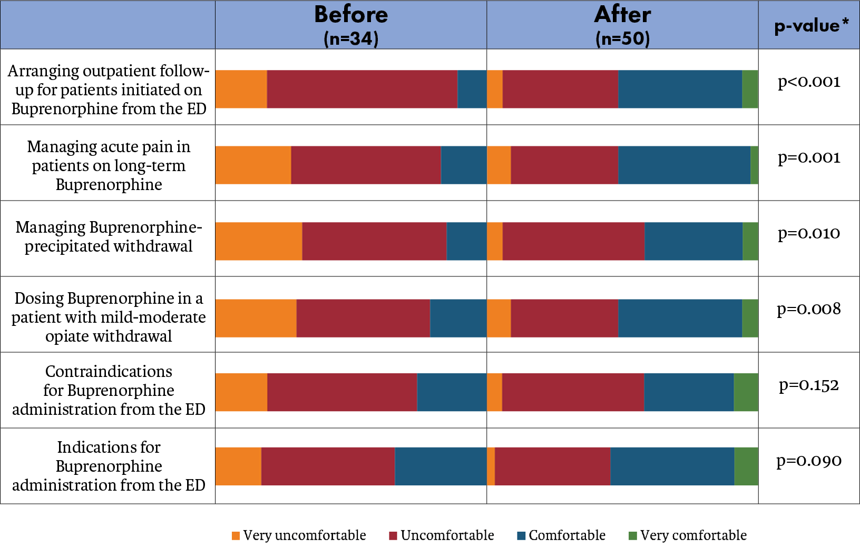
Department of Emergency Medicine
Notes:
We performed Chi-square tests for the difference in proportion between respondents before and after the intervention who reported “Comfortable” or “Very comfortable” for each question.
This showed there was a statistically significant increase in levels of comfort with the main components of prescribing MOUD, such as arranging follow-up for patients started on bup, managing acute pain in patients already on bup, managing precipitated withdrawal, dosing buprenorphine for patients in withdrawal, and the indications for initiating bup in the ED.

Slide 12
Targeted educational offerings for EM residents increased confidence and comfort with MOUD and harm reduction.
A universal curriculum for EM residents with information about local resources holds promise for improving the care of patients with OUD in the ED.
Department of Emergency Medicine
Notes:
These findings can be used to revise and target future educational offerings
A universal curriculum for EM residents with information about local resources and treatment providers holds promise for improving the care of patients with OUD in the ED

Slide 13
References
Vivolo-Kantor AM, et al. Vital Signs: Trends in Emergency Department Visits For Suspected Opioid Overdoses—United States, July 2016–September 2017. Morbidity and Mortality Weekly Report. 2018; 67(9): p.279.
Samuels EA, Coupet E, D’Onofrio G. (2021) Emergency Department Treatment of Opioid Use Disorder. In: Wakeman SE, Rich JD. (eds) Treating Opioid Use Disorder in General Medical Settings. Springer, Cham.
Larochelle MR, et al. Medication for Opioid Use Disorder After Nonfatal Opioid Overdose and Association with Mortality: A Cohort Study. Annals of Internal Medicine. 2018; 169 (3): 137-145.
Morgan JR, et al. Overdose Following Initiation Of Naltrexone And Buprenorphine Medication Treatment For Opioid Use Disorder In A United States Commercially Insured Cohort. Drug and Alcohol Dependence. 2019; 200: 34-39.
Weiner SG, Baker O, Bernson D, Schuur JD. One-year mortality of patients after emergency department treatment for nonfatal opioid overdose. Annals of Emergency Medicine. 2020; 75(1): pp.13-17.
Olfson M, et al. Causes of Death After Nonfatal Opioid Overdose. JAMA Psychiatry. 2018; 75(8): 820–827.
D'Onofrio G, et al. Emergency department-initiated buprenorphine/naloxone treatment for opioid dependence: a randomized clinical trial. JAMA. 2015; 313(16): 1636-44.
Kaczorowski J, et al. Emergency Department–Initiated Interventions for Patients With Opioid Use Disorder: A Systematic Review. Academic Emergency Medicine. 2020; 27(11): 1173-1182.
Im DD, et al. Emergency Department Clinicians’ Attitudes Toward Opioid Use Disorder And Emergency Department-Initiated Buprenorphine Treatment: A Mixed-Methods Study. Western Journal of Emergency Medicine. 2020; 21(2): 261-271.
Lowenstein M, et al. Barriers And Facilitators For Emergency Department Initiation Of Buprenorphine: A Physician Survey. The American Journal of Emergency Medicine. 2019; 37(9): 1787-1790.
Fox, L, Nelson LS. Emergency Department Initiation of Buprenorphine for Opioid Use Disorder: Current Status, and Future Potential. CNS Drugs. 2019; 33: 1147–1154.
Allen B, Nolan ML, Paone D. Underutilization of medications to treat opioid use disorder: What role does stigma play? Substance Abuse. 2019; 40(4): 459-465.
Department of Emergency Medicine

