Slide 1
Implementation of a Hospital-Based Take-Home Methadone Process is Feasible and Saves Healthcare Dollars
Yevgeniya (Jenny) Scherbak, PharmD, BCPS
Clinical Pharmacy Specialist, Internal Medicine
University of Colorado Hospital
Susan Calcaterra, MD, MPH, MS
Addiction Medicine, Hospital Medicine
University of Colorado, Anschutz Medical Campus
Notes:
Our talk today is being presented by myself, Susan Calcaterra, an addiction medicine physician, and Jenny Scherbak, and Clinical Pharmacy Specialist. We both work at the University of Colorado Hospital.

Slide 2
Disclosures
Yevgeniya (Jenny) Scherbak, PharmC, BCPS
Nothing to disclose
Susan Calcaterra, MD, MPH, MS
Funding:
National Institute on Drug Abuse (NIDA) K08DA49905
Opinions are our own, not those of the funders, the University of Colorado, or UCHealth

Slide 3
Background
219%
Hospitalizations
related to opioid use
disorder are up
Singh et al, PLoS One, 2020
Notes:
Over the past decade, hospitalizations related to opioid use disorder (OUD) increased 219%, a 3-fold increase

Slide 4
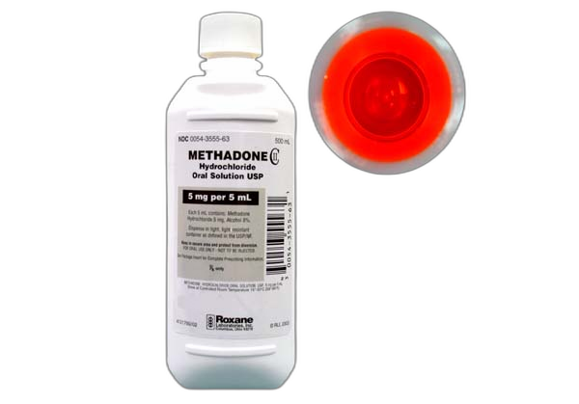
Background
219%
Methadone &
BUP are first
line for opioid
withdrawal
Calcaterra et, al, J Hosp Medicine, 2022
Notes:
Hospital guidelines recommend the use of buprenorphine or methadone for opioid withdrawal

Slide 5
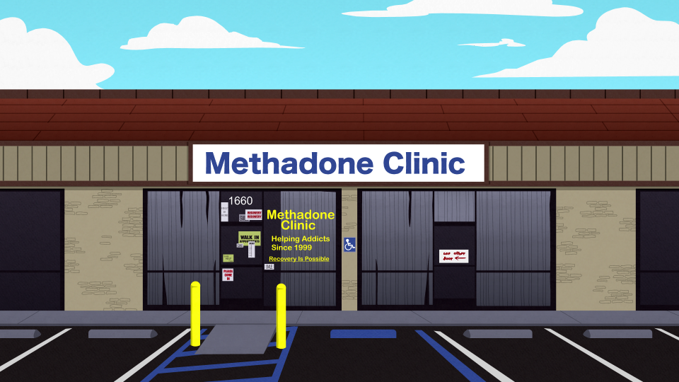
Background
Federal regs state that patients must
follow up at an OTP for ongoing treatment
219%
HHS Pub No SMA PEP15-FED, 2015
Notes:
Federal regulations state that patients initiated on methadone in the hospital must follow up at an Opioid Treatment Program (OTP) for ongoing treatment after hospital discharge

Slide 6
Background
219%
OTP linkage barriers include withdrawal,
lack of transportation or identification, &
unstable medical or mental illness
Callister et al, J Subst Abus; Calcaterra et al, JGIM, 2022; Hoover et al, J Subst Abuse Treat, 2022
Notes:
Hospital to OTP linkage within 24 hrs can be very difficult especially during the weekend when OTPs have limited hours or are closed
Patient reported linkage barriers include opioid withdrawal, pain, lack of transportation, lack of identification, and unstable medical or mental illness

Slide 7
Background
Opioid withdrawal can lead to a return to fentanyl use, overdose, and death
219%
Callister et al, J Subst Abus; Calcaterra et al, JGIM, 2022; Hoover et al, J Subst Abuse Treat, 2022
Notes:
Opioid withdrawal can lead to a return to fentanyl use, overdose, and death

Slide 8
Background
219%
Clinicians report moral
distress with weekend
hospital discharges due to
concerns for return to use
or misuse use of
costly healthcare resources
Callister et al, J Subst Abus; Calcaterra et al, JGIM, 2022; Hoover et al, J Subst Abuse Treat, 2022
Notes:
Clinicians report moral distress when discharging patients over the weekend given a concern that their patient will experience opioid withdrawal and return to use.
They also report concern about the financial cost of keeping medically stable patients in the hospital over the weekend for methadone dosing until the OTP is open on Monday.

Slide 9
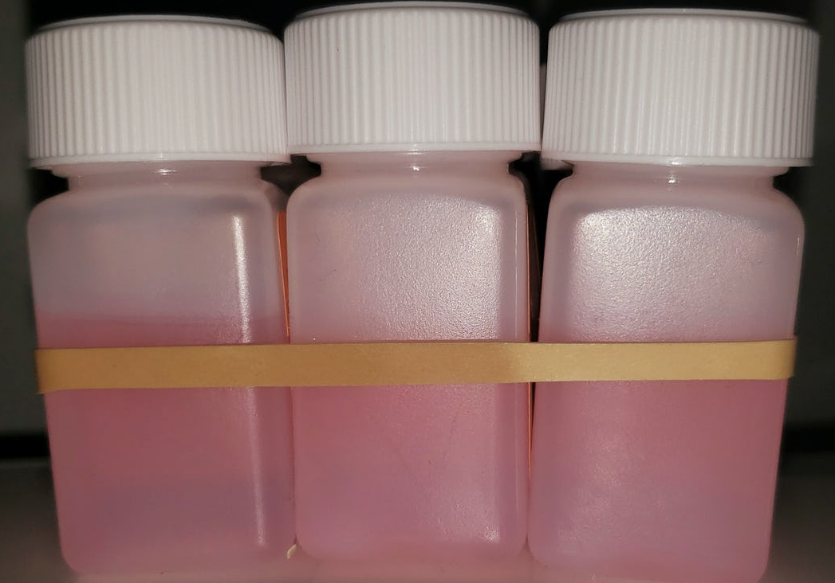
Background
In August 2023, the DEA amended its regulations to allow clinicians to dispense up to a 3-day supply of methadone for OUD
This provided new opportunities to support hospital to OTP linkage for patients with OUD
Department of Justice Drug Enforcement Administration, 21 CFR Part 1306, Docket No. DEA-702, RIN 1117-AB73

Slide 10
Purpose
Develop a federally compliant process to dispense take-home methadone doses to hospitalized patients with OUD
Facilitate weekend and holiday hospital discharges when OTPs may be closed or have limited hours
Support hospital to OTP linkage to reduce the risk of returning to fentanyl use, overdose, and death
Notes:
Our project had goals.
To develop a federally compliant process to dispense take-home methadone doses to hospitalized patients with OUD
To facilitate weekend and holiday hospital discharges when OTP may be closed or have limited hours
To support hospital to OTP linkage to reduce the risk of returning to fentanyl use, overdose, and death

Slide 11
Learning Objective
Describe processes taken to develop and implement a federally compliant methadone take-home program
Demonstrate cost savings in healthcare dollars to gain leadership buy-in for program development and implementation
Notes:
Our presentation today has three learning points:
To describe processes taken to develop and implement a federally compliant methadone take-home program
To demonstrate cost savings in healthcare dollars to gain leadership buy-in for program development and implementation

Slide 12
Federal Methadone Dispensing Exceptions: the 72 Hour Rule
Revised CFR 1306.07 (b) after August 2023:
Nothing in this section shall prohibit a practitioner, who is not specifically registered to conduct a narcotic treatment program, from dispensing (but not prescribing) narcotic drugs, in accordance with applicable Federal, State, and local laws relating to controlled substances, to one person or for one person’s use at one time for the purpose of initiating maintenance treatment or detoxification treatment (or both). Not more than a three-day supply of such medication may be dispensed to the person or for the person’s use at one time while arrangements are being made for referral for treatment. Such emergency treatment may not be renewed or extended.
Dispense vs Prescribe
Dispense: To select and appropriately label a medication for the end-user (patient) to self-administer at a later date.
Prescribe: To issue a prescription for a medication that will be filled at an outpatient pharmacy.
Notes:
Verbalize this change from 1 day at a time to 72-hours at a time
Dispense vs prescribe

Slide 13
Methods: Process Development
Meeting with stakeholders
Directors of Pharmacy
Inpatient Pharmacy Manager
Pharmacy Medication Safety Coordinator
Outpatient Pharmacy Leadership

Slide 14
Methods: Process Development
Meeting with stakeholders
Plan:
Operational Workflow
EPIC Build
Present to P&T
Directors of Pharmacy
Inpatient Pharmacy Manager
Pharmacy Medication Safety Coordinator
Outpatient Pharmacy Leadership

Slide 15
Process requirements
Ordering
Chart order process with custom dose
Allow orders to be placed ahead of time
Dispensing
Prepared by inpatient pharmacy
CANNOT report to state prescription drug monitoring program (PDMP)
Label to meet state and federal requirements
Delivery
Tracking of medication through each step
Documentation of patient receipt of medication
Patient education
Documentation of Joint Commission requirement
Notes:
Meeting with stakeholders

Slide 16
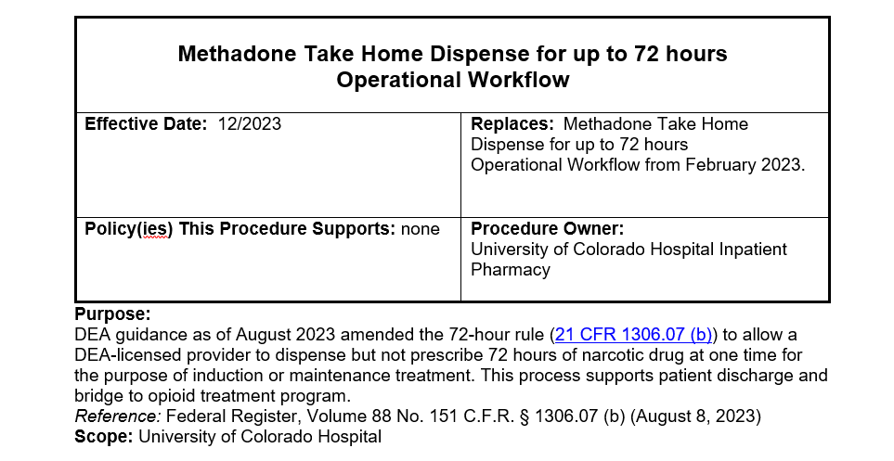
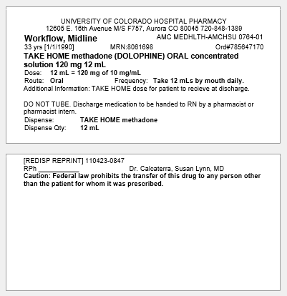
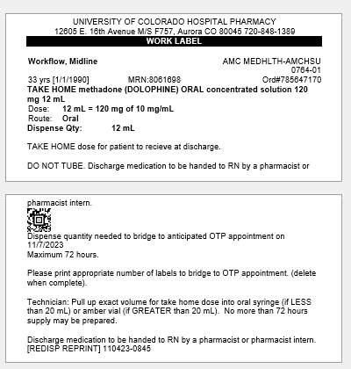
Methods: Operational Workflow
Prepared by inpatient pharmacy
Dispense not prescribe
Oral syringe
Preparation workflow:
Dispense when discharge is confirmed
Custom label
Take home label
Extempo work label
Sample Label (Test Patient)
Patient Facing Label
Work Label

Slide 17
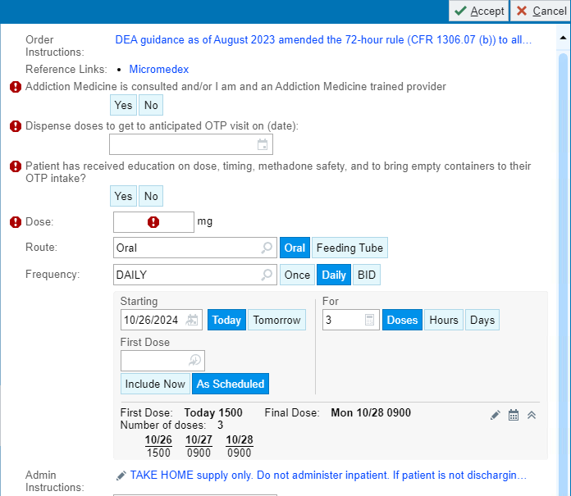
Methods: EPIC Build
Ordering:
“TAKE HOME methadone oral concentrated solution”
Custom chart order
Order questions with order validation rules
Notes:
Separate slides

Slide 18
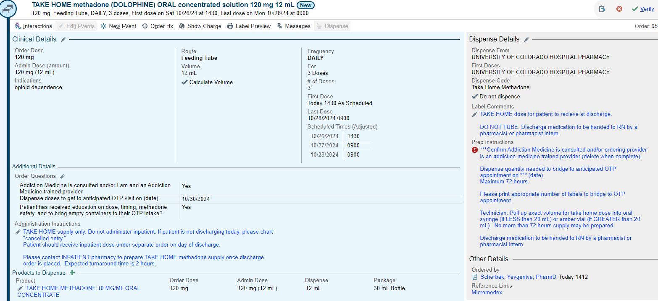
Methods: EPIC Build
Pharmacist Order Verification
Notes:
Separate slides

Slide 19
Methods: EPIC Build
MAR Documentation
Notes:
Separate slides

Slide 20
Results
CFR 1306.07 (b) updated
Process go-live
Updated Workflow approved by P&T
Operational Workflow approved by P&T
Updated Process
go-live
Original Request to dispense take home methadone
9/2022
2/2023
4/2023
8/2023
11/2023
12/2023
Notes:
Start of process development to go live: 7 months
Update the process: 3 months, restricted to add med service

Slide 21
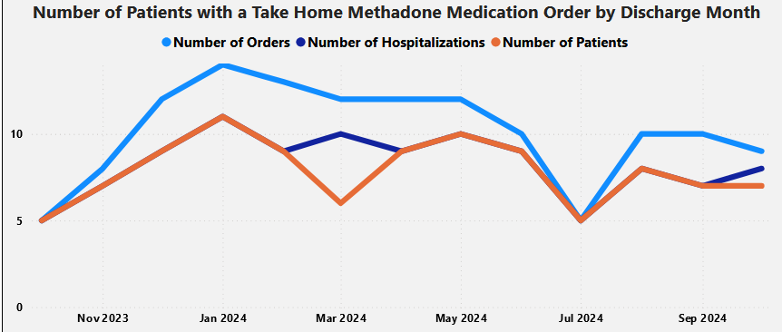
Number of Patients with Take-Homes by Month (Nov 23’-Nov 24’)
*
*
*Tracks with seasonal hospital volumes
Source: PowerBI Dashboard, accessed 11/7/2024
Notes:
This figure illustrates the number of patients who received take home methadone doses from Nov 2023 to early Nov 2024. The light blue line represents take-home methadone orders placed, the orange line is the number of patients who received take-home methadone doses, and the dark blue line, which is obscured by the orange line, represents hospital encounters.
From Nov 2023 to early Nov 2024, 81 patients with 97 hospitalizations received 216 take-home methadone doses. This means that some patients had more than 1 hospitalization during this period and received take-home doses more than once. You can see that take home doses track with hospital patient volumes with the winter being busy time in the hospital and the summer being a slower time.

Slide 22
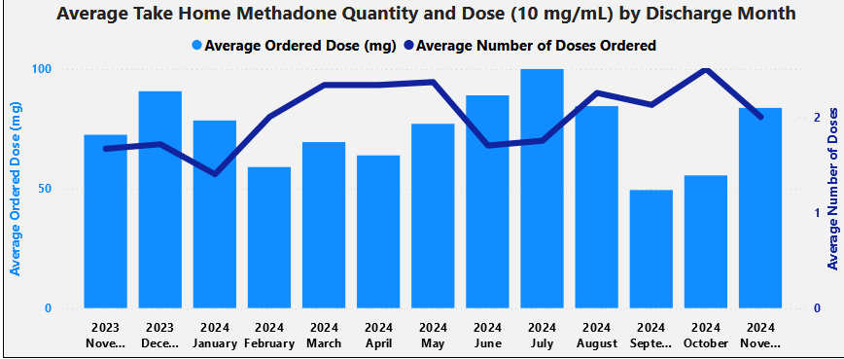
Average Take-Home Quantity & Dose (mg) by Month (Nov 23’-Nov 24’)
Source: PowerBI Dashboard, accessed 11/7/2024
Notes:
This slide illustrates the average methadone take-home quantity and dose dispensed each month between Nov 2023 to early Nov 2024. During this time, the average number of doses dispensed was two doses per person and the average dose dispensed was 73mg.

Slide 23
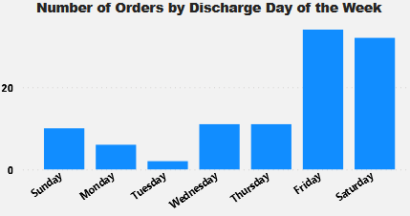
Number of Orders by Discharge Day of the Week (Nov 23’-Nov 24’)
*
*
Source: PowerBI Dashboard, accessed 11/7/2024
Notes:
The goal of this project was to support patients to get to their OTP without experiencing opioid withdrawal when the clinic was closed on weekends or holidays. As expected, most doses were dispensed on Friday and Sat for Sat and Sunday take home doses. Doses were also dispensed on the weekday to support patients who needed to travel far distances to get to their OTP.

Slide 24
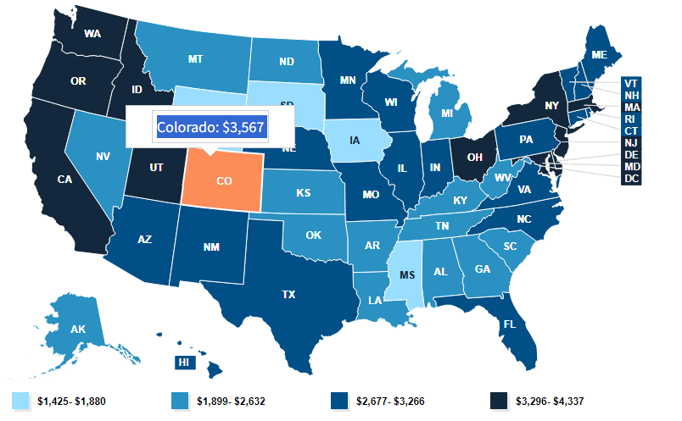
Expected Cost Savings between Nov 23’ to Nov 24’
216 doses x $3,567/hospital day = $770,472 from Nov 23 to Nov 24
1999 - 2022 AHA Annual Survey, Copyright 2022 by Health Forum, LLC, an affiliate of the American Hospital Association. Special data request, 2023. Available at https://www.ahadata.com/aha-annual-survey-database.
Notes:
To calculate expected cost savings, we identified the Hospital Adjusted Expenses per Inpatient Day reported by the American Hospital Association. The adjusted expense for one hospital day in Colorado is about $3,500. Previously, most clinicians kept medically stable patients in the hospital over the weekend to dose methadone. From Nov 2023” to Nov 2024” we dispensed 216 doses, which is approximately equivalent to 216 hospital days at a cost savings of $770,472 over the last year and likely over 1 million since program implementation last April 2023.

Slide 25
Implications
Developing a take-home methadone program is feasible when working with key partners in pharmacy
Our take-home methadone program resulted in a significant cost savings due to shortened length of hospital stay
Reporting expected cost savings may improve leadership buy-in for methadone take-home programs at other hospitals

Slide 26
Acknowledgements
Data & Analytics Team at University of Colorado
Eric Grimm, MS
Angela Keniston, PhD
Lauren McBeth, MPH
Marisha Burden, MD

