Slide 1
Implementing a Harm Reduction Safety Model for Perinatal Patients in the Inpatient Setting
AMERSA Annual Conference – 11/15/2024
Corey Davis, MSN, RN
Kelly Dimattio, MD, PhD
Ilana Hull, MD, MSC
Cambria King, BA, CRS
Samantha Stewart, crnp, CARN-AP
Lauren Sutherland, MD

Slide 2
No Disclosures

Slide 3
Learning OBJECTIVES
Identify opportunities to integrate harm reduction strategies tailored to the perinatal and parenting population into inpatient settings
Learn strategies for decreasing stigma and increasing safety among hospitalized pregnant and postpartum patients at risk of in-hospital substance use.
Enhance communication skills for discussing safety and harm reduction interventions with care team members and patients.

Slide 4
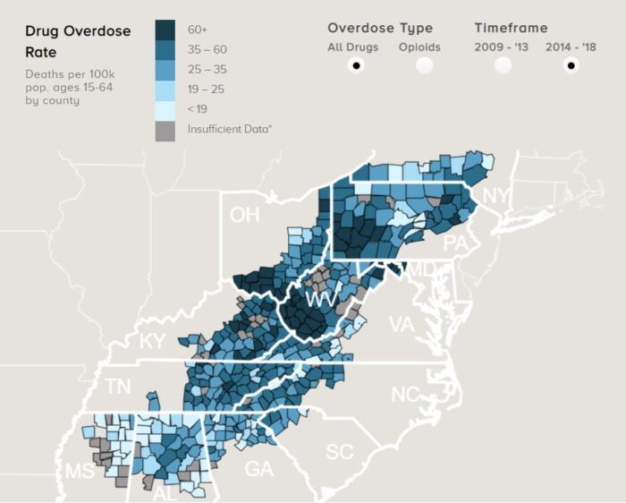
Pittsburgh, PA
Notes:
Kelly
-Magee is a large, tertiary care, safety net hospital in Pittsburgh, draw patients from around Western PA with ~10,000 births occurring each year
-Area that has been hit really hard by the opioid epidemic, pregnant population has not been spared
~2-3% of individuals who deliver at Magee have diagnosis of OUD, which is significantly greater than the national rate of OUD in pregnancy (1%), does not include individuals with other use disorders

Slide 5
Perinatal Addiction Medicine at Magee
Multidisciplinary Team: Recovery specialists, social workers, behavioral health counselor, certified addictions registered nurses, physicians and APPs
Addiction Medicine Fellowship with perinatal track
Notes:
Kelly
-Outpatient clinic created initially for pregnant individuals with OUD → anyone who identifies as women with any SUD

Slide 6
Perinatal Addiction Medicine at Magee
Multidisciplinary Team: Recovery specialists, social workers, behavioral health counselor, certified addictions registered nurses, physicians and APP
Addiction Medicine Fellowship with perinatal track
Notes:
Kelly
-Presentation focuses on newer inpatient services. 2017 created perinatal addiction medicine consult service –> see all patient admitted with SUD. Primary consults for pregnant and postpartum individuals and most common consult is for MOUD initiations during this period.
-Patients admitted to MFM service and then we consult. Almost 400 consults for pregnant individuals with SUD in 2023
-Creation of PPU – 2018 to allow and encourage families to stay together during the infant's observation period

Slide 7
Why focus on this topic
Drug overdose is a leading cause of pregnancy-related death
Reduce risk of infection and other complications that can impact both our patients and their babies
Perinatal substance use has historically been criminalized, disproportionally impacting populations of color
Increased stigma, surveillance, and punitive approaches negatively impact engagement in medical care, substance use treatment, and breastfeeding
We all meet patients who choose not to seek care during pregnancy as a result of the barriers
We can all agree any level of engagement is favorable to none at all
A harm reduction approach tries to create a more welcoming, inclusive environment where patient goals are at the forefront
Notes:
Corey
My name is Corey Davis and I am the nurse navigator for our inpatient perinatal AMCS. Now that you know who we are, our goal today is to share with you why we are so passionate about integrating a harm reduction model of care into our practice and our hope is that you will leave here with some tangible ways to do the same for your own.
So why do we need to focus on this? Why is it imperative to caring well for perinatal patients with substance use disorder?
As we know, the maternal mortality rate in our country is almost triple the rate of other high-income countries. As direct care providers - and as human beings- it is our ethical obligation to aim to reduce preventable deaths. Of all of the various causes for pregnancy related mortality, one of the leading causes is drug overdose.
Increasing access to substance use treatment significantly decreases the risk of drug related deaths. Unfortunately, the reality is that there are many barriers to doing so, many of which become even more challenging during pregnancy.
Historically, our system has criminalized perinatal substance use and utilized punitive approaches that have a negative impact on the likelihood of patients engaging in medical care, substance use treatment, and breastfeeding.
As providers, I think we can all universally agree that any level of engagement in care is favored over nothing at all. So… with a problem that seems so daunting, how can we come together to make incremental change to our practices in order to support positive change.
One simple, yet effective strategy is to ground our care in harm reduction practices. The strategies we will discuss throughout our presentation today will allow us to create a more inclusive and welcoming environment where we partner with our patients and help empower them to reach their goals.
One of the most impactful ways we have found to really showcase the changes these strategies support is through the sharing of lived and living experience. Our beautiful, intelligent, and comapssionate certified recovery specialist, Cambria King, is gracious enough today to share with us portions of how her story has evolved and we are truly blessed to have her on our team.
Cam
Thank you, Corey, for that kind introduction and for highlighting why harm reduction is so critical in perinatal care. My story shows just how much harm reduction can mean—not only for preventing overdose but for changing the entire trajectory of a family’s life.
When I became pregnant with my son, Colton, my partner, Baily, and I were facing significant challenges. Baily was falling deeper into opioid dependency, and I had my own complicated history with substances. During my pregnancy, I fully supported Baily’s opioid use, not understanding what opioid use disorder was or how to navigate the situation. Toward the end of my pregnancy, Baily tried Suboxone, but he experienced precipitated withdrawal. It was a terrifying experience for both of us, and we didn’t feel safe seeking help from the healthcare system. The fear of stigma, punitive actions, and potential CYF involvement kept us silent and isolated.
When I delivered my son, Colton, none of our struggles with substance use were addressed. I didn’t feel safe disclosing what was happening at home, and harm reduction practices were not part of the care I received. The hospital didn’t have a peer, and no one asked me about substance use or substance use in the home. Because of my privilege and lack of documented history, I wasn’t screened or referred to social work. After a straightforward delivery, I was prescribed Percocet—opioids I didn’t need for pain—which became a reason for my brain to rationalize daily opioid use.
Shortly after we were discharged from the hospital, Baily attempted ambulatory detox. I tried my best to support him while also caring for myself and our newborn baby. I stayed with my parents during his detox to avoid 'enabling' him, (lying to my parents saying he was visiting friends). We were trying to navigate this process in complete secrecy, without support from friends or family. STIGMA! The stress of being separated from my partner, combined with the weight of what was riding on his success, became overwhelming. That’s when my own substance use escalated. During this time, I snorted my first bag of heroin. Within three months, I was using 50 bags a day just to feel normal.
At that time, methadone wasn’t even on the table for us because of the stigma surrounding it. It wasn’t until we were desperate—spending $300 a day on heroin just to function—that we finally sought methadone treatment. Methadone became a turning point, helping us stabilize our lives. But I can’t help but think about how harm reduction practices could have changed things earlier. If Bailey’s treatment attempts with Suboxone or detox had been supported, if I’d been given non-opioid options for pain management after delivery, or if we’d felt safe disclosing what was happening, harm reduction could have prevented so much of the suffering we experienced.
My story illustrates that harm reduction isn’t just about naloxone or preventing overdose—it’s about creating a system where patients feel safe enough to be honest without fear of punitive actions. Had harm reduction practices been accessible to us, our outcomes could have been profoundly different.

Slide 8
Harm Reduction
Harm reduction emphasizes engaging directly with people who use drugs to prevent overdose and infectious disease transmission; improve physical, mental, and social wellbeing; and offer low barrier options for accessing health care services, including substance use and mental health disorder treatment
-Substance Abuse and Mental Health Services Administration
Notes:
Ilana -- SAHMSA definition of harm reduction

Slide 9
Reducing Harm in Pregnancy
Harm reduction emphasizes engaging directly with people who use drugs to prevent overdose and infectious disease transmission; improve physical, mental, and social wellbeing; and offer low barrier options for accessing health care services, including substance use and mental health disorder treatment
Notes:
Ilana

Slide 10
Reducing Harm in Pregnancy
Harm reduction emphasizes engaging directly with people who use drugs to prevent overdose and infectious disease transmission; improve physical, mental, and social wellbeing; and offer low barrier options for accessing health care services, including substance use and mental health disorder treatment
Pregnant
^
Notes:
Ilana

Slide 11
Reducing Harm in Pregnancy
Harm reduction emphasizes engaging directly with people who use drugs to prevent overdose and infectious disease transmission; improve physical, mental, and social wellbeing; and offer low barrier options for accessing health care services, including substance use and mental health disorder treatment
Pregnant
^
Notes:
Ilana -- Many efforts in pregnancy to improve maternal and fetal health and reduce pregnancy risks – every OB appointment has counseling topics to do just that

Slide 12
Reducing Harm in Pregnancy
Harm reduction emphasizes engaging directly with people who use drugs to prevent overdose and infectious disease transmission; improve physical, mental, and social wellbeing; and offer low barrier options for accessing health care services, including substance use and mental health disorder treatment
Pregnant
^
Notes:
Ilana Many efforts in pregnancy to improve maternal and fetal health and reduce pregnancy risks – every OB appointment has counseling topics to do just that

Slide 13
Reducing Harm in Pregnancy
Harm reduction emphasizes engaging directly with people who use drugs to prevent maternal and fetal complications infectious dise ; improve physical, mental, and social wellbeing; and offer low barrier options for accessing health care services, including substance use and mental health disorder treatment
Pregnant
^
Notes:
Ilana - Many efforts in pregnancy to improve maternal and fetal health and reduce pregnancy risks – every OB appointment has counseling topics to do just that

Slide 14
Reducing Harm in Pregnancy
Harm reduction emphasizes engaging directly with people who use drugs to prevent maternal and fetal complications infectious dise ; improve physical, mental, and social wellbeing; and offer low barrier options for accessing health care services, including substance use and mental health disorder treatment
Pregnant
^
Notes:
Ilana Many efforts in pregnancy to improve maternal and fetal health and reduce pregnancy risks – every OB appointment has counseling topics to do just that

Slide 15
Reducing Harm in Pregnancy
Harm reduction emphasizes engaging directly with people who use drugs to prevent maternal and fetal complications infectious dise ; improve physical, mental, and social wellbeing; and offer low barrier options for accessing health care services, including substance use and mental health disorder treatment
Pregnant
^
= PRENATAL CARE
Notes:
Many efforts in pregnancy to improve maternal and fetal health and reduce pregnancy risks – every OB appointment has counseling topics to do just that

Slide 16
Harm Reduction Counseling IN Routine Prenatal Care
Vaccines
Reduce caffeine consumption
Management of chronic disease in pregnancy
Recommending frequent walks/stretching during long car trips
Glucose management
OTHERS?

Slide 17
"Perinatal harm reduction is a powerful paradigm that deconstructs the stigmatizing narratives about pregnant and parenting people who use substances and employs evidence-based interventions to reduce harms associated with substance use"
-Echols, et al 2024 (citing SAMHSA, Academy of Perinatal Harm Reduction, National Harm Reduction Coalition)
Notes:
Sam
Hi! I'm Samantha. I am a nurse practitioner and a certified addictions advanced practice provider.
The National Harm Reduction Coalition writes: "Perinatal harm reduction is a powerful paradigm that deconstructs the stigmatizing narratives about pregnant and parenting people who use substances and employs evidence-based interventions to reduce harms associated with substance use".
So you all have come up with several examples [of harm reduction] that are widely used by providers during pregnancy for the purposes of minimizing harm to the parent and fetus while also promoting the best possible outcomes.
Implementing harm reduction strategies for patients who use substances in the setting of pregnancy is no different and should be as widely used as the others you mentioned.
When we do this, we acknowledge that substance use disorders are chronic health conditions like all other chronic health conditions and we can and should utilize evidence-based practices to keep our patients as safe as possible.

Slide 18
UNCONDITIONAL POSITIVE REGARD
You respect people's right to make decisions about their body and health
You want what is best for them
You believe they are capable of making decisions that are right for them based on their unique circumstances
Notes:
Sam
Most of you are probably aware of this wonderful resources, but I wanted to draw your attention to the Harm Reduction Tool Kit for Pregnancy and substance use that we will reference thorughout the presentation.
It describes this principle of unconditional positive regard, one of the most basic harm reduction principles that we can adopt. It is the practice of accepting and supporting someone without judgment or evaluation, regardless of what they say or do.
So think about the love someone may have for a child. A conditional love hinges on that child’s performance or character. I love you…because you got an A on your test. Or I love you….because you won first place in a race. People who are exposed to this type of affection tend to be more insecure and seek validation and are less likely to be open and honest during interactions for fear of disappointing the other party.
On the flip side of that, unconditional love is…I love you…even though you failed that test. I love you…even though you came in last place. Children who grow up with this unconditional love become confident and independent humans. And most importantly they feel comfortable sharing their thoughts and feelings without fear of repercussions or losing your love.
When we apply this same mindset to our patients, where we care and support them regardless of the choices they make, we create a safe environment for them to open up about their use disorder and what is going on in their lives that may be impacting it.
This open dialogue fosters a partnership between the clinician and the patient and allows us to gain critical insight into how we can be most helpful to keep patients healthy and safe.

Slide 19
Scenarios we see most commonly in the hospital setting
Pregnant patients presenting to the hospital for initiation of medications for opioid use disorder (MOUD) or withdrawal management
Pregnant patients with substance use disorder (SUD) admitted to the hospital for a medical or obstetrical concerns – some may be interested in engaging in SUD treatment and some may not
Pregnant patients with active SUD admitted to the hospital for delivery – some may be interested in engaging in SUD treatment and some may not
Notes:
Kelly -- Most common substance use disorder we see is opioid use disorder (OUD) but very frequent there is polysubstance use

Slide 20
Medications for Opioid Use Disorder in Pregnancy
Americal College of Obstetrics and Gynecology (2017): "For pregnant women with an opioid use disorder, opioid agonist pharmacotherapy is the recommended therapy and is preferable to medically supervised withdrawal because withdrawal is associated with high relapse rates, which lead to worse outcomes"
Improves physical and mental health outcomes, including decreasing maternal overdose risk
Stabilizes opioid serum levels
Decreases risk of intrauterine withdrawal, preterm labor, placental abruption, and low birthweight
Increases engagement with providers
Engages parents with resources and support for a stable postnatal environment
One aspect of treatment, engagement with MOUD does not mean the patient is ready to fully engage or that their goal is complete abstinence
Notes:
Kelly
Choosing a medication is not a crutch but a harm reduction tool
Patients who are on a stable dose of methadone or buprenorphine prior to pregnancy may need dose adjustments due to physiologic and pharmacologic changes in pregnancy, especially in the third trimester. Patients may need increased dosage or frequency of doses (ex split dosing of methadone)
Naltrexone (for OUD or AUD) is not well studied in pregnancy, just a small case series and case reports, with no evidence of adverse fetal effects. Concern for risk of recurrent use and overdose. Continuation of the medication in patients who are stable on it prepregnancy can be considered with shared decision making
Pharmacotherapy for other SUDs are limited in pregnancy, and many traditional inpatient treatment facilities do not accept pregnant persons, withdrawal management may require inpatient hospitalization (ex patients with AUD with a history of complicated withdrawal)

Slide 21
General Principles of Perinatal Harm Reduction in Inpatient Setting
Acknowledge that abstinence from non-prescribed substances and initiation of MOUD is safest option in pregnancy but may not align with goals or reality of individual
Move away from telling pregnant person what is best for them or what they "have to" or "should" do
Discuss substance use in non-judgmental way
Use motivational interviewing to elicit patient's goals
Ask specifically about parenting goals without making assumptions
Notes:
Kelly
Like all aspects of prenatal care, helping patients to manage substance use in pregnancy should be patient centered and should utilize harm reduction principles. While abstinence is considered the safest option in pregnancy, we can acknowledge that this is not the goal for all of our patients. These conversations should be approached without judgement and can be informative while still acknowledging that the goals and next steps will be different for each person. Using open ended questions and motivational interviewing can be helpful to assess the patient's motivations, strengths, resources and barriers.

Slide 22
General Principles of Perinatal Harm Reduction in Inpatient Setting
Present all treatment options to a patient and acknowledge that they have the right to make decisions about their body and their health
Engage patient in making decisions about care plan whenever possible
Acknowledge that use of any non-prescribed substances in the hospital is unsafe and stress role of providers to ensure symptoms are appropriately managed
Focus on opportunities to increase maternal and fetal safety even when current goal is not abstinence
Notes:
Lauren
As there are many options for inpatient management of substance use in pregnancy, it is important that patients are informed of all options including their risks and benefits. In the inpatient setting, we often see that patients are initially uncertain about their goals for treatment or are facing acute withdrawal or medical complications that make conversations about treatment difficult. In these settings, we address the acute need, including management of withdrawal symptoms, and continue the conversation throughout their admission. For example, for patients who present for OAT but are uncertain about whether they would like methadone or buprenorphine, we will often start with methadone for management of their acute withdrawal while also utilizing a buprenorphine patch to allow patients to start low-dose buprenorphine induction. Throughout their admission, patient's goals and life circumstances can change, and it is important to continue to engage with the patient when making decisions about a care plan. As we will discuss with some of our upcoming cases, use of non-prescribed substances in the hospital is one of the challenges we can face when managing withdrawal or initiating OAT, and it is important to find solutions that emphasize patient safety while addressing any unmet needs that can lead to use. Throughout pregnancy, individuals may experience recurrence of use or may not have a goal of abstinence. In these settings, it is critical to focus on maternal and fetal safety including incorporating principles of safe use and reducing barriers in access to care.

Slide 23
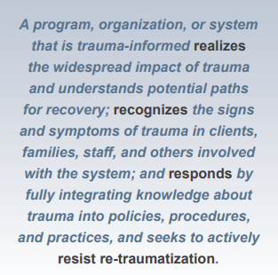
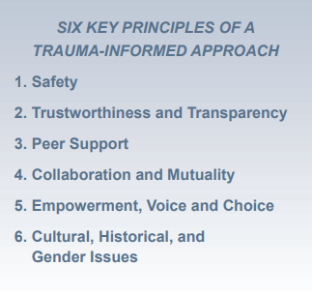
Principles of Trauma-Informed Care (TIC)
SAMHSA’s Concept of Trauma and Guidance for a Trauma-Informed Approach
Notes:
Lauren
Not meant to be a full review of TIC, could certainly be its own workshop but important to acknowledge and recognize that all of our patients come to us having experienced trauma, many times in their personal lives and almost certainly have experienced trauma caused by medical professionals or the health care system in the past
Harm reduction strategies should be informed by six-key principles of trauma-informed approach

Slide 24
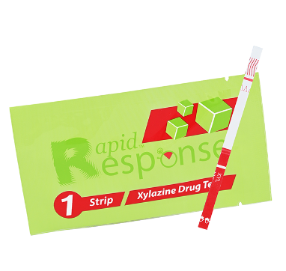
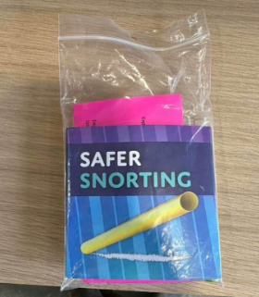
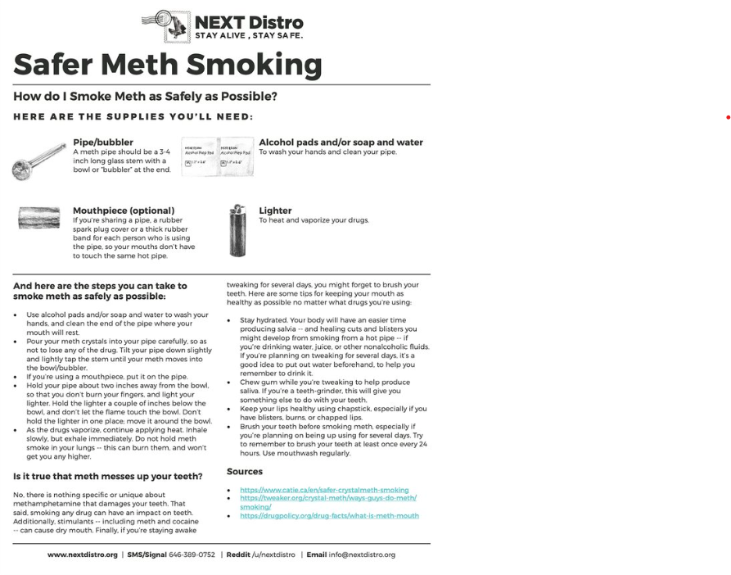
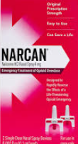
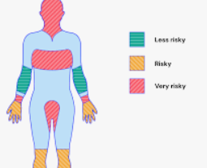
DON'T FORGET SAFER USE COUNSELING
Notes:
Lauren
You are talking to people who know what these things are. Historically it has been abstinence or nothing in OB.

Slide 25
Small-Group Activity
Each group will be given a case to discuss. Imagine that you are the addiction medicine consult team caring for the patient in the hospital. Discuss as a group how you would respond using a harm reduction/trauma-informed approach as the care team, focusing on prompts provided
Please discuss the case for 10 minutes
Let us know if you have questions
Each group will report back to the group
Notes:
Ilana describes

Slide 26
Case 1:
Sarah is a 24yo G3P2 at 30 weeks gestational age. She is admitted to the hospital for vaginal bleeding and concern for placental abruption. Her obstetrical care team recommend she be admitted for at least a few days so she and the baby can be monitored. She reports using 10-20 bags of IV fentanyl daily for the past two years and smokes cocaine a few times a week. She has never engaged in treatment and does not think she is interested in taking a medication like methadone or buprenorphine. She reports she is likely to return to use after leaving the hospital.

Slide 27
Case 1:
Sarah is a 24yo G3P2 at 30 weeks gestational age. She is admitted to the hospital for vaginal bleeding and concern for placental abruption. Her obstetrical care team recommend she be admitted for at least a few days so she and the baby can be monitored. She reports using 10-20 bags of IV fentanyl daily for the past two years and smokes cocaine a few times a week. She has never engaged in treatment and does not think she is interested in taking a medication like methadone or buprenorphine. She reports she is likely to return to use after leaving the hospital.
Main take home points
Use MI to elicit patient goals
Ensure patient educated about all options and risks/benefits
Educate about implications of continued use during pregnancy
Talk about options other than medication if she is open
Provide appropriate withdrawal management no matter what choice to allow to stay for care
Discuss safer use strategies, naloxone, home testing supplies

Slide 28
Case 2:
Jane is a 38yo G1P0 at 28 weeks gestation admitted for pyelonephritis (kidney infection). She has no other significant medical history. On the second day of the admission, a nurse finds her very sedated (but breathing) and notes some bags of white powder by her bedside. Once she wakes up, she tells you that she has been using cocaine intermittently to manage her stress and is unsure why it made her so tired.

Slide 29
Case 2:
Jane is a 38yo G1P0 at 28 weeks gestation admitted for pyelonephritis (kidney infection). She has no other significant medical history. On the second day of the admission, a nurse finds her very sedated (but breathing) and notes some bags of white powder by her bedside. Once she wakes up, she tells you that she has been using cocaine intermittently to manage her stress and is unsure why it made her so tired.
Main take home points:
Immediate response to in-hospital use should focus on safety
Assess unmet psychological, physiologic needs
Strengthen therapeutic alliance with patient
Increase safety protocols for hospital stay while trying to minimize retraumatizing patient or increasing stigma

Slide 30
Case 3:
Rachel is a 29yo G4P2 at 39 weeks gestation who presents in early labor with no prenatal care. She reports daily use of fentanyl and methamphetamine. She tells your team that she has been on methadone treatment in the past and that it worked well for her. She expresses an interest in restarting methadone while admitted. Her partner, Robert, is providing labor support and Rachel tells you that he also uses substances. The obstetric team would like to initiate methadone but nursing expresses concerns about administering methadone as they are afraid that the couple may use substances in the hospital.

Slide 31
Case 3:
Rachel is a 29yo G4P2 at 39 weeks gestation who presents in early labor with no prenatal care. She reports daily use of fentanyl and methamphetamine. She tells your team that she has been on methadone treatment in the past and that it worked well for her. She expresses an interest in restarting methadone while admitted. Her partner, Robert, is providing labor support and Rachel tells you that he also uses substances. The obstetric team would like to initiate methadone but nursing expresses concerns about administering methadone as they are afraid that the couple may use substances in the hospital.
Main take home points:
Administration of recommended treatment (medications) should not be withheld but could be tied to objective signs of withdrawal to minimize risk of harm
Consider safety interventions to accommodate unique patient/family needs that support patient autonomy and self determination
Need for interdisciplinary communication to ensure consistent messaging
Recovery resources for support person, if desired
Highlight engagement in treatment as a strength

Slide 32
improving the process
Communication
Patient Experience
Safety
Notes:
Corey
These cases bring up common barriers we face on a daily basis as we do our best to provide quality care to patients with SUD and take steps to move toward unit wide, hospital wide, or system wide change.
We recognize this can seem overwhelming and it can be hard to know where to start. In these next few slides, we would love to share with you all some of the initiatives we have taken on to support a cultural shift towards a harm reduction model of care in our hospital.
It is important to preface this by saying that these changes are not perfect. We absolutely still have room for continued growth, but the steps we have taken have resulted in positive change. We hope you find encouragement and tangible ideas you can take back to your own work environments. We will be discussing improvements in communication, safety, and the patient experience.

Slide 33
Interdisciplinary Communication
Rounding with primary team
One-on-one discussions with bedside nursing
Just in time huddles
Notes:
Corey
we will start with communication. In order to be successful in implementing any sort of cultural change it is imperative to have open communication and build a shared goal amongst all team members involved in the change. We have worked to provide additional education initiatives to nurses, providers, peer services, pharmacists, and social work teams to ensure we are all working from a shared foundation. We specifically focused on initiatives to increase interdisciplinary communication.
Before these changes were in place, we were experiencing confusion amongst care team members about the plan of care for patients, inconsistent communication to the patient, and an overall environment of frustration and mistrust not only among care team members but also with our clients.
We implemented 3 key communication initiatives that have helped correct these concerns.
First, is interdisciplinary rounding. We began attending daily rounds with the primary OB team. At rounds there are representatives from nursing, discharge planning, pharmacy and the obstetric providers. This provides a venue for any concerns to be discussed in the moment and allows all care team members who may interact with the patient that day to be on the same page.
Another initiative is to consistently have one on one conversations with the bedside nurse caring for the patient. We want to clearly communicate the plan of care, allow them to ask clarifying questions, and let them know that our team is there to support them during the rest of their shift.
Finally, one of the most impactful communication initiatives has been our “just in time huddles.” These are virtual team meetings that are arranged in the moment when complex needs arise for a patient.
It ropes in hospital leadership, security, bedside staff, and attending providers to come up with a safety plan for that day. Here we can create a plan and designate who will work to communicate this plan with the patient. This is one of the opportunities for continued growth as we just mentioned. Currently, our team speaks with the patient to illicit their goals and wishes for their plan of care. We then are able to advocate for their needs. We would love to move toward a process where the patient themselves are included in the huddle as this best supports transparency and keeping our care patient centered.
But overall, we have had a lot of buy in from various team leaders and have seen improvements in teamwork, a reduction in deviations from care plans, and most importantly, it has helped to build rapport with our patients.

Slide 34
Safety
One-on-one discussions with bedside nursing
Changes to safety search protocols
Distribution of harm reduction supplies
Notes:
Lauren
Addressing safety for inpatients with substance use disorders has posed many challenges, including mitigating bias and assumptions as well as consolidating different perspectives on what is safest for our patients in and out of the hospital. Initially, safety protocols for inpatients with substance use disorders were focused on certain rules and restrictions rather than shared decision making and harm reduction.
An example of this was our previous "Behavioral Contract" which was a specific document that patients were required to sign before being admitted to the hospital or receiving medication for withdrawal. It included restrictions including limiting visitors and leaving the unit, as well as requirements such as regular urine drug testing. While some of these protocols can be appropriate for certain patients, each person and their needs are different and this document in the way that it was presented often established a culture of bias and mistrust. In extensive discussions with our antepartum unit, including nursing, social work, security, providers, and administrators, we worked to create a protocol for patient safety that was more individualized. The solution isn’t perfect; our patients who present specifically for initiation of opioid agonist therapies are still required to sign a "behavioral contract" during their admission. But we have implemented several improvements including not predicating access to withdrawal medication on signing paperwork, and providing more flexible safety discussions for patients presenting for management of other medical problems or for labor and delivery.
Another example of this is our work to improve patient search protocols. Searches were initially a requirement for admission for care and involved a security guard searching a patient and their belongings for non-prescribed substances or objects related to use. When approaching changes to this search protocol, we wanted to incorporate changes that were patient centered and trauma informed. Rather than being universal, searches are considered if there are concerns for in hospital use or specific concerns regarding patient safety.

Slide 35
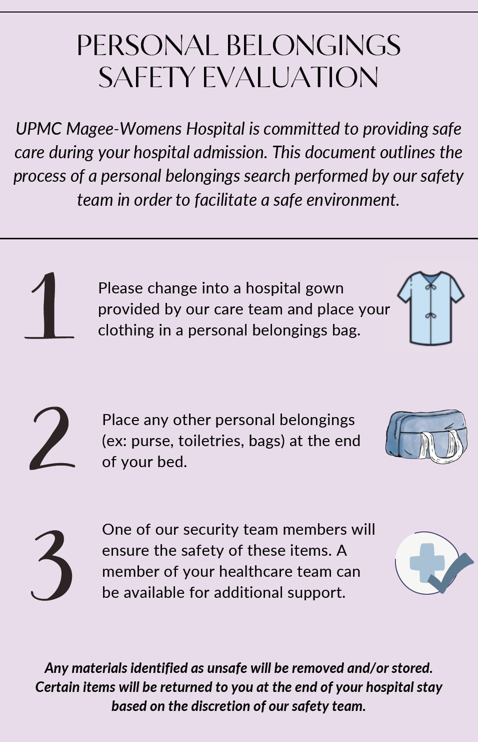
Notes:
Lauren
Addressing safety for inpatients with substance use disorders has posed many challenges, including mitigating bias and assumptions as well as consolidating different perspectives on what is safest for our patients in and out of the hospital. Initially, safety protocols for inpatients with substance use disorders were focused on certain rules and restrictions rather than shared decision making and harm reduction.
An example of this was our previous "Behavioral Contract" which was a specific document that patients were required to sign before being admitted to the hospital or receiving medication for withdrawal. It included restrictions including limiting visitors and leaving the unit, as well as requirements such as regular urine drug testing. While some of these protocols can be appropriate for certain patients, each person and their needs are different and this document in the way that it was presented often established a culture of bias and mistrust. In extensive discussions with our antepartum unit, including nursing, social work, security, providers, and administrators, we worked to create a protocol for patient safety that was more individualized. The solution isn’t perfect; our patients who present specifically for initiation of opioid agonist therapies are still required to sign a "behavioral contract" during their admission. But we have implemented several improvements including not predicating access to withdrawal medication on signing paperwork, and providing more flexible safety discussions for patients presenting for management of other medical problems or for labor and delivery.
Another example of this is our work to improve patient search protocols. Searches were initially a requirement for admission for care and involved a security guard searching a patient and their belongings for non-prescribed substances or objects related to use. When approaching changes to this search protocol, we wanted to incorporate changes that were patient centered and trauma informed. Rather than being universal, searches are considered if there are concerns for in hospital use or specific concerns regarding patient safety.

Slide 36
Safety
One-on-one discussions with bedside nursing
Changes to safety search protocols
Distribution of harm reduction supplies
Notes:
Lauren
Addressing safety for inpatients with substance use disorders has posed many challenges, including mitigating bias and assumptions as well as consolidating different perspectives on what is safest for our patients in and out of the hospital. Initially, safety protocols for inpatients with substance use disorders were focused on certain rules and restrictions rather than shared decision making and harm reduction.
An example of this was our previous "Behavioral Contract" which was a specific document that patients were required to sign before being admitted to the hospital or receiving medication for withdrawal. It included restrictions including limiting visitors and leaving the unit, as well as requirements such as regular urine drug testing. While some of these protocols can be appropriate for certain patients, each person and their needs are different and this document in the way that it was presented often established a culture of bias and mistrust. In extensive discussions with our antepartum unit, including nursing, social work, security, providers, and administrators, we worked to create a protocol for patient safety that was more individualized. The solution isn’t perfect; our patients who present specifically for initiation of opioid agonist therapies are still required to sign a "behavioral contract" during their admission. But we have implemented several improvements including not predicating access to withdrawal medication on signing paperwork, and providing more flexible safety discussions for patients presenting for management of other medical problems or for labor and delivery.
Another example of this is our work to improve patient search protocols. Searches were initially a requirement for admission for care and involved a security guard searching a patient and their belongings for non-prescribed substances or objects related to use. When approaching changes to this search protocol, we wanted to incorporate changes that were patient centered and trauma informed. Rather than being universal, searches are considered if there are concerns for in hospital use or specific concerns regarding patient safety.

Slide 37
Patient Experience
Changes to PPU participation requirements
Adding peer to care team
Adequate withdrawal management
Notes:
Cam

Slide 38
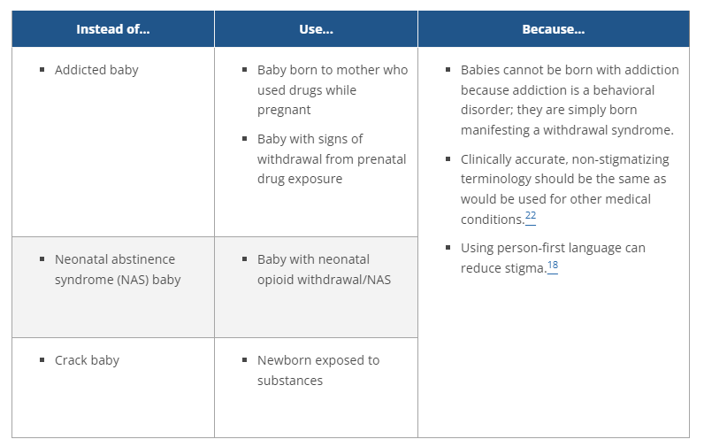
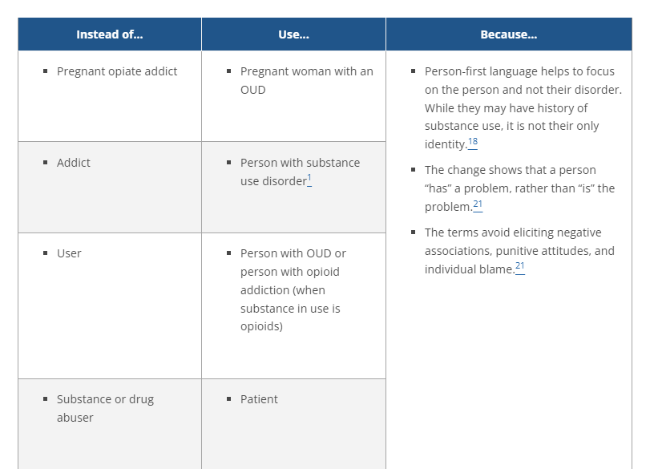
Communication Exercises
Use first-person, non-stigmatizing language when talking to patients and model this for other care team members
National Institute of Drug Abuse
Notes:
Sam
As Cam has just discussed, interactions between a patient and provider are fundamental in building trust and improving the patient experience. A simple, yet impactful, action that every person in here can easily do is ensure they are using appropriate language.
Language plays a major role in shaping people’s thoughts and perceptions about SUD. Research tells us that stigmatizing language contributes to poorer health outcomes in patients and discourages them from seeking treatment. So it is imperative that when talking to…and about…patients with substance use disorders we are using first person, non-stigmatizing language during all interactions to foster a safe and supportive environment for patients to seek care.
It is just as important, if not more important, to use the appropriate words when talking with other members of the healthcare team. Modeling these behaviors can promote their widespread use amongst clinicians which can overall lead to improved patient outcomes.
National Academies of Sciences, Engineering, and Medicine. Ending Discrimination Against People with Mental and Substance Use Disorders: the Evidence for Stigma Change. Washington, DC: The National Academies Press; 2016. https://doi. org/10.17226/23442.

Slide 39
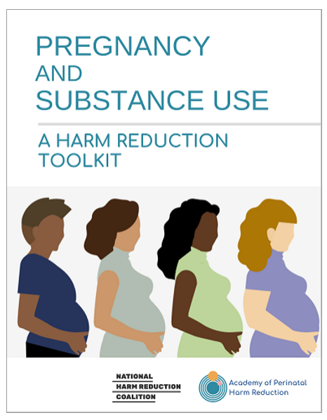
Communication Exercises
Notes:
Sam
Another technique we can use when focusing on patient-centered care is motivational interviewing. I’m sure most of you are familiar with this concept but it can be particularly effective for patients when they are ambivalent to change.
The idea is for the provider to show understanding and acceptance of the patient’s feelings while also helping the patient identify areas of discordance between their current behaviors and long terms goals. The Ask, Tell, Listen approach can facilitate this tactic.
The purpose of ASK is to understand the patient’s perspective and assess their thoughts and reasons for change. Utilizing open-ended questions for this can encourage the patient to talk more about their experiences and help identify their motivations. For example: “what are some reasons you want to cut back on your substance use?”
A provider can then tailor the information they want to convey or “TELL” to the patient in response to the patient’s narrative. “Would it be okay if I shared some information about how reducing your substance use can improve your health and the pregnancy?”
And finally, the provider "LISTENS" reflectively as the patient processes that information and provides their own response to it. “So it sounds like you are concerned about how substance use can affect your baby, but you’re also concerned about how you might manage your anxiety if you stop using substances.”
So this ask, tell, listen approach further supports that patient-provider partnership and empowers patients to make their own informed decisions about their health.

Slide 40
Video 1
Scenario: A pregnant patient is admitted to the hospital to start medication for opioid use disorder. The nurse is asked to perform regular withdrawal scores for patient and ensure appropriate medications are used to treat withdrawal symptoms. It takes a few days to get to a therapeutic dose of MOUD and for pregnant patients we offer to do this in the inpatient setting. Your team does not feel the patient is receiving appropriate withdrawal management and wants to discuss the plan of care with the bedside nurse.

Slide 41
Video 1
What did you notice?
What might you have said or handled differently?

Slide 42
Video 2 (Part 1)
Scenario: A pregnant patient is admitted to the hospital to start methadone. Your team goes to see her and finds she is very oversedated and there is concerned she used non-prescribed substances.

Slide 43
Video 2 (Part 1)
What did you notice?
What might you have said or handled differently?

Slide 44
Video 2 (Part 2)
Scenario: You go back later in the day to talk to the patient about what happened earlier and to discuss ways to make her hospitalization safer going forward.

Slide 45
Video 2 (Part 2)
What did you notice?
What might you have said or handled differently?

Slide 46
What is one harm reduction strategy you will bring home?

Slide 47
REFERENCES
Echols A, Collins S, Akbarali S, Dronamraju R, Uesugi K. Public Health Approaches to Perinatal Substance Use: An Overview of Strategic Directions. Matern Child Health J. 2023 Dec;27(Suppl 1):1-4. doi: 10.1007/s10995-023-03792-4. Epub 2023 Nov 6. Erratum in: Matern Child Health J. 2024 Apr;28(4):787. doi: 10.1007/s10995-023-03869-0. PMID: 37930561; PMCID: PMC10691984.
Gunja, M. Z., Gumas, E.D., Masitha, R., & Zephyrin, L.C. (2024). Insights into the U.S. maternal mortality crisis: An international comaprison. The Commonwealth Fund. https://www.commonwealthfund.org/publications/issue-briefs/2024/jun/insights-us-maternal-mortality-crisis-international-comparison#:~:text=In%202022%2C%20there%20were%2022,deaths%20per%20100%2C000%20live%20births.
National Academies of Sciences, Engineering, and Medicine. Ending Discrimination Against People with Mental and Substance Use Disorders: the Evidence for Stigma Change. Washington, DC: The National Academies Press; 2016. https://doi. org/10.17226/23442.
National Harm Reduction Coalition and the Academy of Perinatal Harm Reduction. Pregnancy and Substance Use: A Harm Reduction Tool. Updated October 2022. Toolkit: Pregnancy + Substance Use | APHR
SAMHSA’s Concept of Trauma and Guidance for a Trauma-Informed Approach. Prepared by SAMHSA’s Trauma and Justice Strategic Initiative July 2014. SAMHSA's Concept of Trauma and Guidance for a Trauma-Informed Approach
National Institute of Drug Abuse. Words Matter – Terms to Use and Avoid When Talking About Addiction. https://nida.nih.gov/nidamed-medical-health-professionals/health-professions-education/words-matter-terms-to-use-avoid-when-talking-about-addiction

