Slide 1
Implementation of Post-Overdose Outreach Program Strategies and Toolkit Modules for overdose Survivors Who Use Cocaine and Methamphetamine
Sarah Bagley, MD, MSc on behalf of PRONTO team
November 14, 2025
AMERSA's Annual National Conference

Slide 2
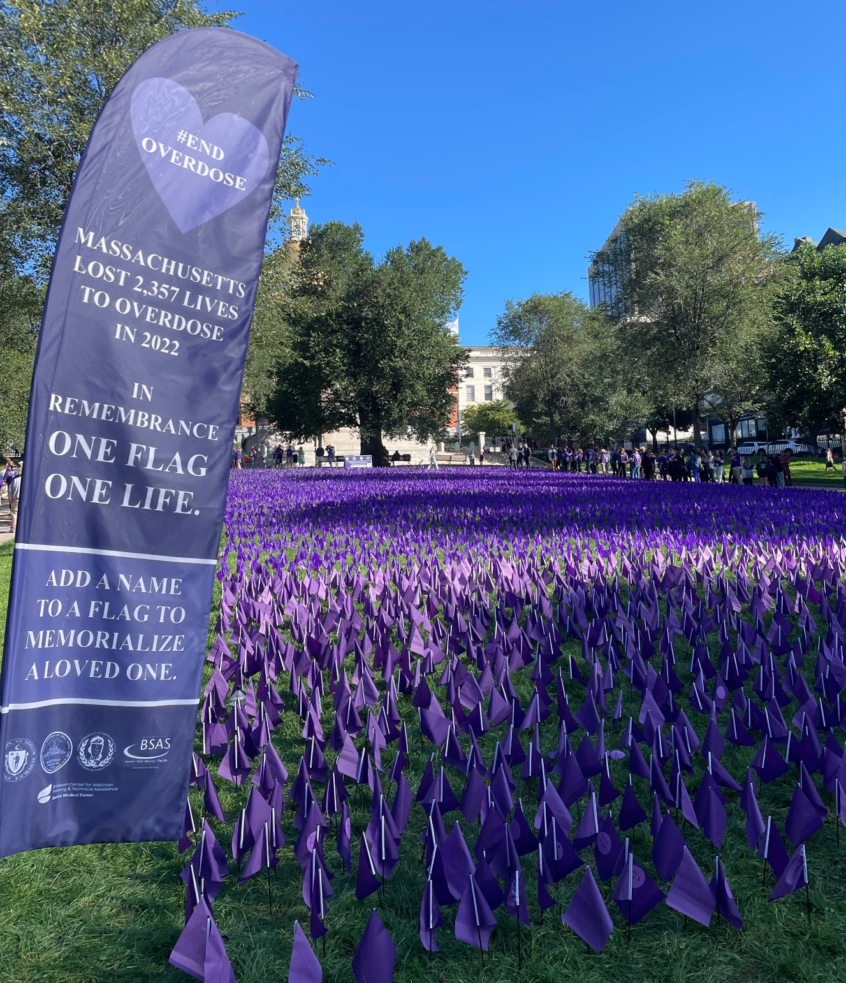
Reminder
Behind every statistic presented here today is a person
Opioid overdose deaths are preventable
We must remember the individual, family, and community behind the numbers

Slide 3
Disclosure
Funded by Centers for Disease Control and Prevention (CDC) - R01CE003357

Slide 4
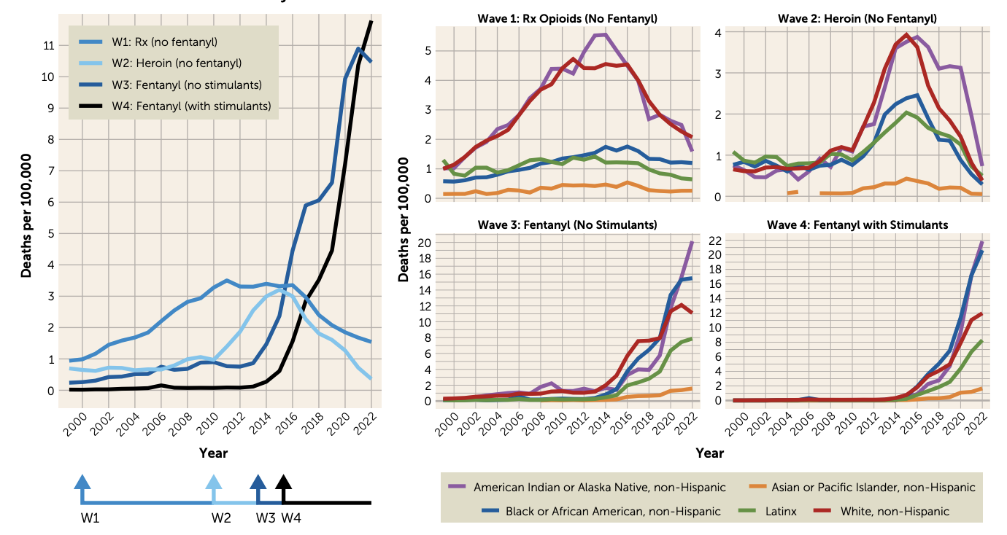
Overlapping Waves of Opioid Overdose Deaths
From 1999–2022:
> 760,000 Americans died from an overdose involving any opioid
Notes:
Friedman JR, Nguemeni Tiako MJ, Hansen H. Understanding and Addressing Widening Racial Inequalities in Drug Overdose. Am J Psychiatry. 2024 May 1;181(5):381-390. doi: 10.1176/appi.ajp.20230917. PMID: 38706336; PMCID: PMC11076008.
a On the left is shown a simplified representation of the four waves of the United States overdose mortality crisis. The arrows at the bottom of the graph highlight the onset year of each wave. Wave 1 (W1), starting in the early 2000s, is characterized by deaths involving prescription opioids (shown here with fentanyl-involved deaths removed). Wave 2 (W2), starting in 2010, is characterized by deaths involving heroin opioids (shown here with fentanylinvolved deaths removed). Wave 3 (W3), starting in 2013, is characterized by deaths involving fentanyl and other synthetic opioids (shown here with stimulant-involved deaths removed). Wave 4 (W4), starting in 2015, is characterized by deaths involving fentanyl and stimulants. The graphs on the right show trends by racial/ethnic group in each wave of the overdose crisis. Each racial/ethnic group is shown by color, separately for each wave of the overdose crisis (as defined in the left panel). All data were obtained from CDC WONDER. Records from 2022 are provisional and trends may change slightly in final numbers.

Slide 5
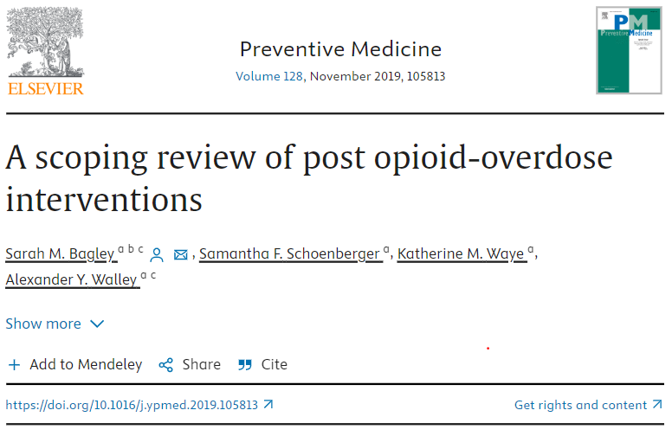
What is post-overdose outreach?
Emerged to address the critical touchpoint after a nonfatal overdose
Often are public health-public safety partnerships
Little evaluation or research has been done
Bagley SM, Schoenberger SF, Waye K, Walley AY. Preventive Med 2019
Notes:
Can add here that in this scoping review we found little formal evaluation of the programs, inconsistent outcomes

Slide 6
Rationale for Post-Overdose Outreach
Issue
Opioid-Related Overdose Deaths
Individuals who survive an overdose are at elevated risk for fatal and repeat non-fatal overdose
Opportunity
Opportunity to Engage with Overdose Survivors and Social Network
Days following non-fatal overdose are an opportunity to connect and offer evidence-based interventions
naloxone, medication for opioid use disorder, linkages to services
Need / Gap
Hidden and Under-Served Populations
Some refuse transport to emergency department (ED)
ED not always best venue for prevention
CAVEAT: Systemic stigmatization, particularly of Native, Black, and Latino people, can challenge engagement
Intervention
Home or Location-Based Outreach
Following up survivor and/or family, friends in person or by phone, following up at residence or location where the overdose event occurred
AW
Notes:
c

Slide 7
Post-overdose outreach programs
Aim 1 – Develop and implement a toolkit
Overdose Fatality
Stimulant-specific training
Risk reduction
Treatment linkage
Support for family and friends
Partnering with police
Opioids present
People who use stimulants
Population
Engagement of Native, Black, Latinx, and youth populations
Stimulants & opioids present
Aim 2
Conduct a process evaluation of the toolkit
Qualitative interviews with program staff, overdose survivors, family and friends
Quantitatively assess frequency of each adaptation
Stimulants present
Aim 3
Determine the effectiveness of the toolkit to improve:
Contact with people who use stimulants
Stimulant risk behaviors
Treatment access for stimulant use disorder

Slide 8
In Convened POST programs and conducted a series of focus groups to understand how these programs were responding to rising stimulant overdose
Stimulant-specific training
Risk reduction
Treatment linkage
Support for family and friends
Partnering with police
Engagement of Native, Black, Latinx, and youth populations

Slide 9
Examples of toolkit items
(There are 21 items in the final toolkit, including: infographics, trainings, community planning exercises, and educational videos)
“Making Post-Overdose Outreach Work for Black Overdose Survivors and Families”
– Webinar Training
“Harm Reduction 201 for People Who Use Cocaine or Methamphetamine”
– Webinar Training

Slide 10
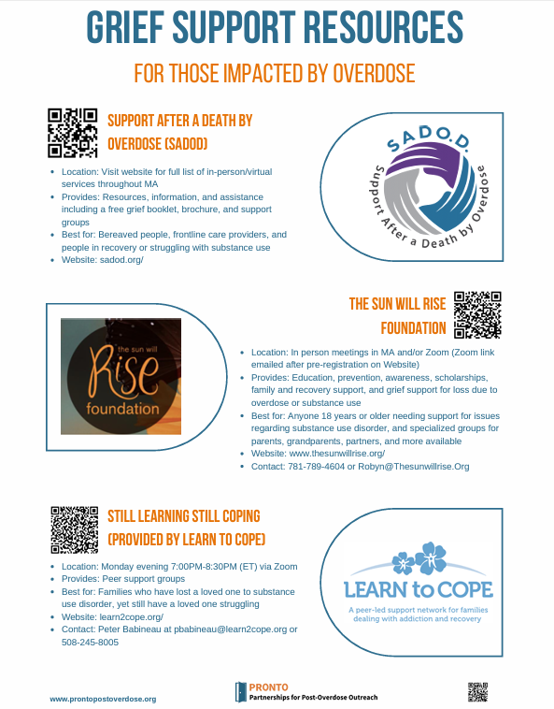
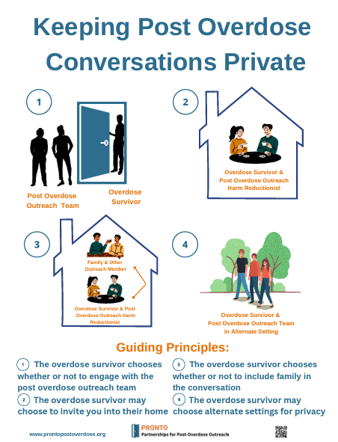
Examples of toolkit items
(There are 21 items in the final toolkit, including: infographics, trainings, community planning exercises, and educational videos)
Infographic examples

Slide 11
Objective
To describe the implementation of toolkit strategies and training modules among post-overdose outreach programs.

Slide 12
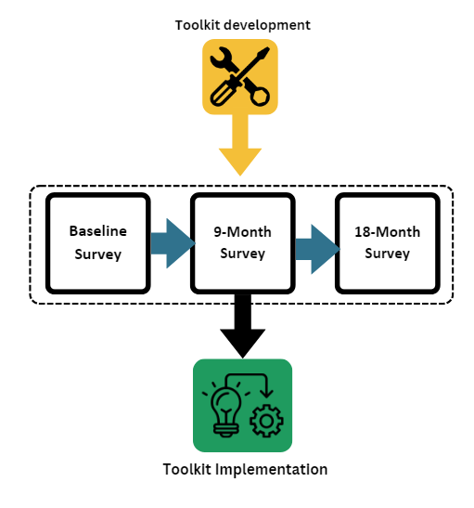
Methods
Launched Toolkit in 2023 at in-person convening
Conducted baseline, 9 month, and 18 month surveys of programs to evaluate their implementation of the toolkit
Staff supported implementation in the community

Slide 13
Number of programs implementing toolkit strategies (n=12)
 | Baseline | 9 Months | 18 Months
Fentanyl Test Strips | 12 | 12 | 12
Naloxone | 12 | 12 | 12
Safer Smoking Kits | 11 | 12 | 11
Safer Snorting Kits | 8 | 9 | 9
Brown Bags for HR supplies | 7 | 9 | 8
Grief Support Referral | 5 | 8 | 4
Family Support Referral | 7 | 8 | 6
Online referral to POST program | 1 | 6 | 2
Referral to stimulant specific treatment | 3 | 4 | 4
Proactive outreach to hotspots | 9 | 11 | 11

Slide 14
Number of programs implementing training modules (n=12)
 | Baseline | 9 Months | 18 Months
Stimulant Identification Training | 3 | 4 | 1
Stimulant 101 | 2 | 6 | 3
Vein/Wound Care | 3 | 10 | 5
Identifying and Engaging Youth | 1 | 4 | 2
Culturally responsive training for working with Black, Latine, and Native populations | 2 | 6 | 4

Slide 15
Access to data sources diminished substantially from March 2023 to Sept 2024
 | Baseline | 9 Months | 18 Months
911 (police) | 7 | 1 | 0
911 (fire) | 2 | 0 | 0
911 (EMS) | 2 | 0 | 0
Critical Incident Management System | 4 | 0 | 2
Community Organizations or health departments | 4 | 2 | 0

Slide 16
Conclusions
Highest uptake of strategies and training modules after 9 months
Offering supplies such as naloxone, FTS, and safer smoking and snorting kits was common at baseline and follow-up
High uptake of referrals to family and grief support and archived trainings
Access to overdose survivor contact data decreased substantially from spring 2023 to fall 2024
New ways to engage survivors are needed

Slide 17
Next steps
Complete analysis of qualitative data to help contextualize survey data
Begin work on Aim 3 to examine changes in program contacts and services provided to people who use stimulants
Disseminate the PRONTO Stimulant Toolkit

Slide 18
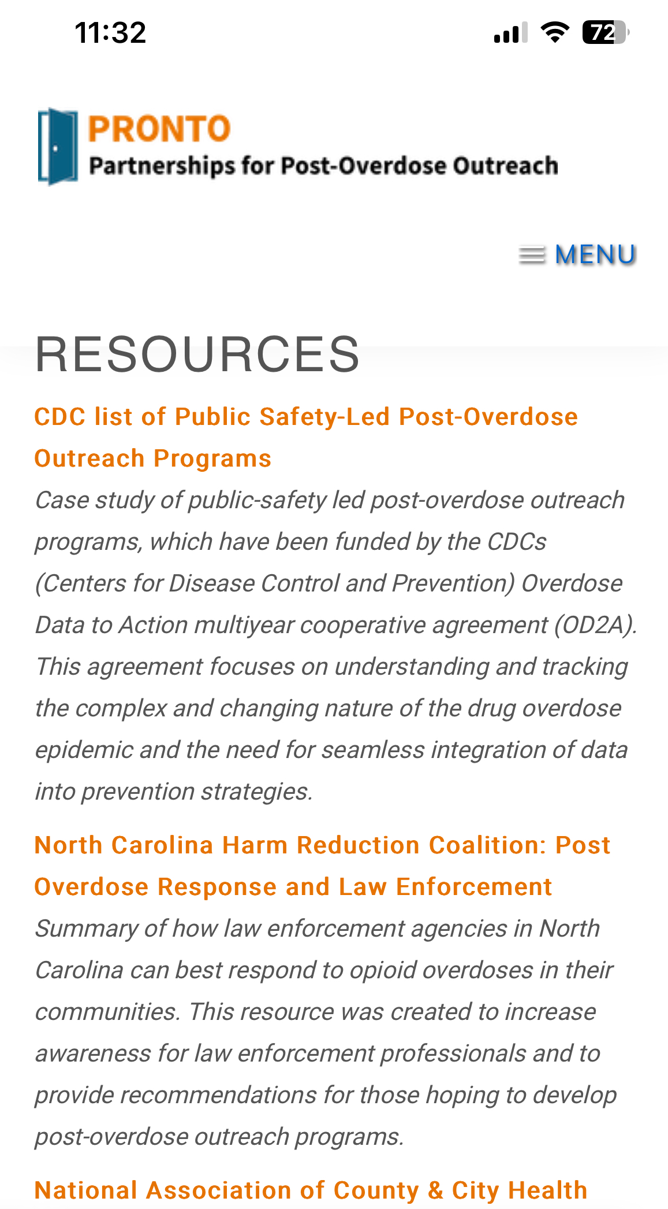
Check out the PRONTO website at: www.prontopostoverdose.org Toolkit now available

Slide 19
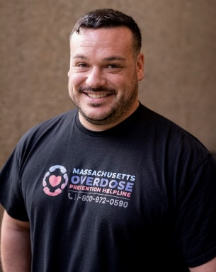
Grateful for our PRONTO Team !!!!!
Scott Formica
Co-Investigator
Sarah Kosakowski
Associate Director
of Research
Sarah Bagley
Principal Investigator
Alex Walley
Principal Investigator
Justeen Hyde
Co-Investigator
Ziming Xuan
Co-Investigator
Moriah Wiggins
Research
Coordinator
Shapei Yan
Sr Data Analyst
Jiayi Wang
Data Analyst
Andrew Rolles
Research Assistant
Ally Cogan
Research Manager
Stephen Murray
Harm Reduction Manager

Slide 20
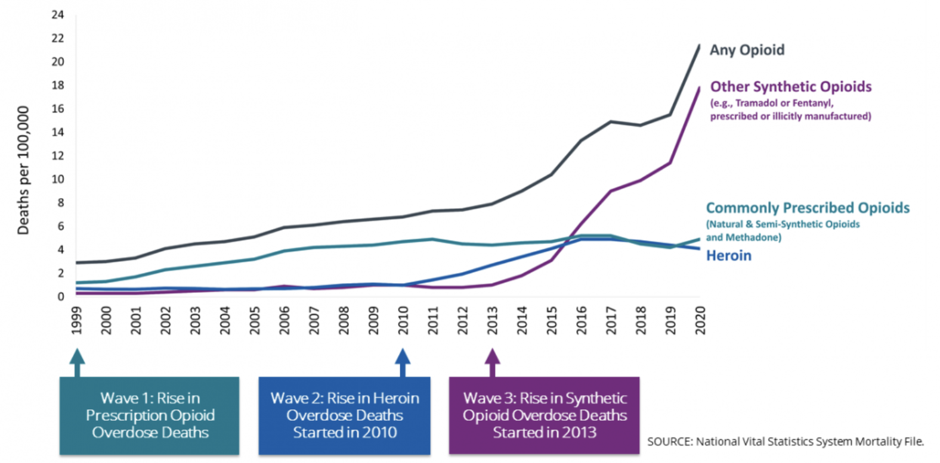
Overlapping Waves of Opioid Overdose Deaths
From 1999–2022:
> 760,000 Americans died from an overdose involving any opioid
2020
28.3 overdose deaths per 100,000 population
age-distribution adjusted
Notes:
This rise in opioid overdose deaths can be outlined in three distinct waves.
The first wave began with increased prescribing of opioids in the 1990s, with overdose deaths involving prescription opioids (natural and semi-synthetic opioids and methadone) increasing since at least 1999³.
The second wave began in 2010, with rapid increases in overdose deaths involving heroin⁴.
The third wave began in 2013, with significant increases in overdose deaths involving synthetic opioids, particularly those involving illicitly manufactured fentanyl^{5,6,7}. The market for illicitly manufactured fentanyl continues to change, and it can be found in combination with heroin, counterfeit pills, and cocaine.⁸
Many opioid-involved overdose deaths also include other drugs^{9.10}.
https://www.cdc.gov/opioids/basics/epidemic.html
Ciccarone D. The triple wave epidemic: supply and demand drivers of the US opioid overdose crisis. Int J Drug Policy. 2019;71:183-188. doi:10.1016/j.drugpo.2019.01.010 2.
Ciccarone D. The rise of illicit fentanyls, stimulants and the fourth wave of the opioid overdose crisis. Curr Opin Psychiatry. 2021;34(4):344-350. doi:10.1097/YCO.0000000000000717

Slide 21
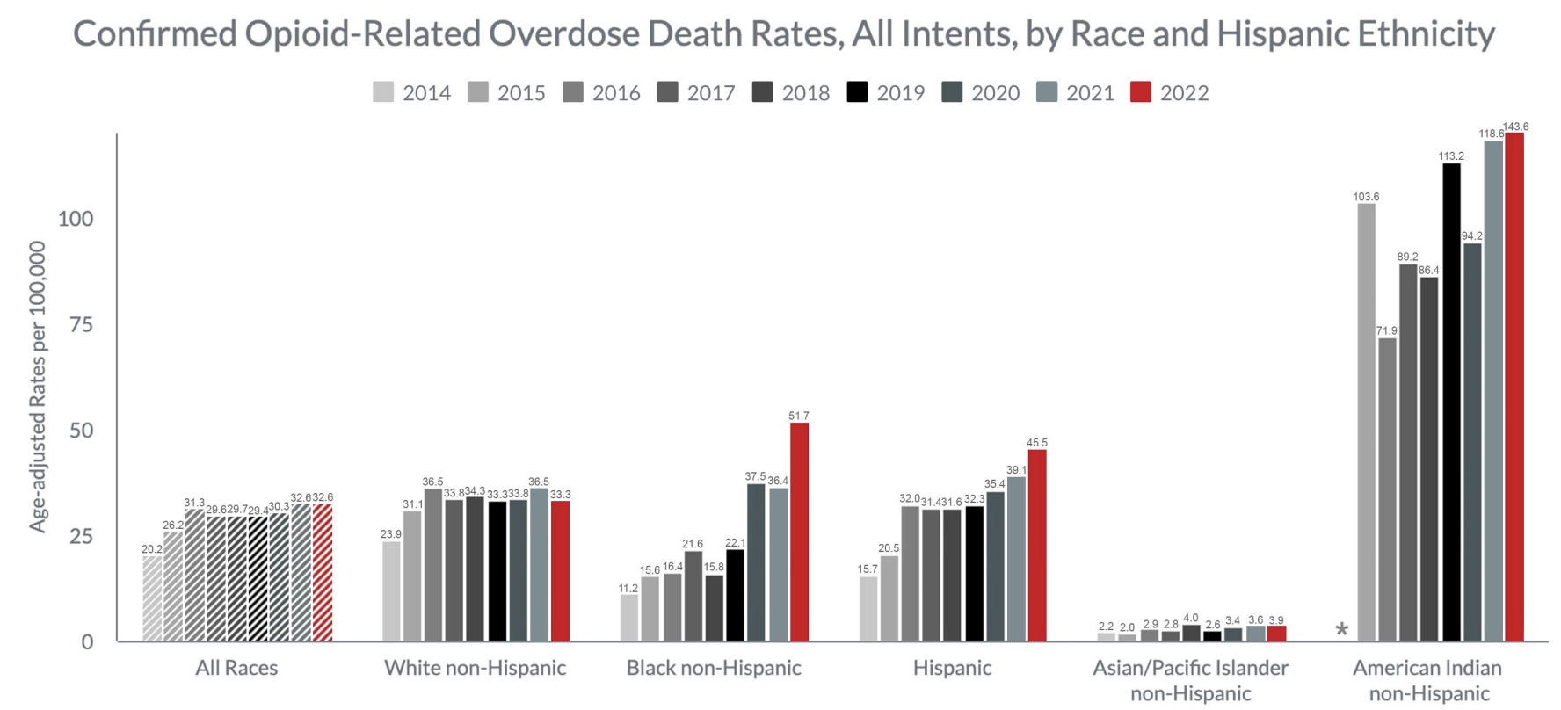
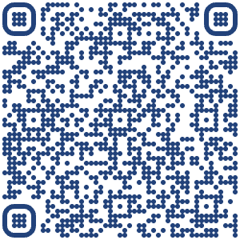
Increases in overdose deaths since 2019, especially among Black, Hispanic, and American Indian people
Notes:
https://www.mass.gov/doc/opioid-related-overdose-deaths-demographics-june-2022/download

Slide 22
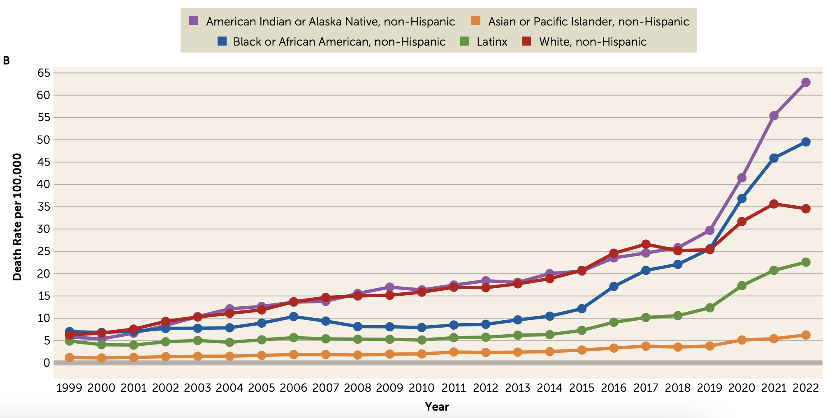
Increases in overdose deaths since 2019, especially among Black, Hispanic, and American Indian people
Notes:
Friedman JR, Nguemeni Tiako MJ, Hansen H. Understanding and Addressing Widening Racial Inequalities in Drug Overdose. Am J Psychiatry. 2024 May 1;181(5):381-390. doi: 10.1176/appi.ajp.20230917. PMID: 38706336; PMCID: PMC11076008.

