Slide 1
TEACH UP: Teaching Excellence in Addiction Care at the Hospitals of the University of Pennsylvania Implementation of a Substance Use Curriculum in an Academic Medical Center
Gilly Gehri, BA, MBE (c) (they/them)
Project Manager, Center for Addiction Medicine and Policy, University of Pennsylvania
AMERSA Annual Meeting
November 14, 2024

Slide 2
Disclosures
This work was funded by SAMHSA opportunity TI-21-003: FY 2021 Provider’s Clinical Support System

Slide 3
Background
Fewer than 25% of patients with opioid use disorder (OUD) receive medications for opioid use disorder (MOUD) in hospital settings
Barriers
Insufficient training for providers in evidence-based treatments like buprenorphine (Jakubowski et al., 2023)
Importance
Closing the gap in training is essential for increasing MOUD initiation.
Problem
Dowell D, Brown S, Gyawali S, et al. Treatment for Opioid Use Disorder: Population Estimates — United States, 2022. MMWR Morb Mortal Wkly Rep 2024;73:567–574. DOI: http://dx.doi.org/10.15585/mmwr.mm7325a1

Slide 4
Background
Fewer than 25% of patients with opioid use disorder (OUD) receive medications for opioid use disorder (MOUD) in hospital settings
Barriers
Insufficient training for providers in evidence-based treatments like buprenorphine
Closing the gap in training is essential for increasing MOUD initiation.
Problem
Importance
Dowell D, Brown S, Gyawali S, et al. Treatment for Opioid Use Disorder: Population Estimates — United States, 2022. MMWR Morb Mortal Wkly Rep 2024;73:567–574. DOI: http://dx.doi.org/10.15585/mmwr.mm7325a1
Notes:
(Jakubowski et al., 2023)

Slide 5
Background
Fewer than 25% of patients with opioid use disorder (OUD) receive medications for opioid use disorder (MOUD) in hospital settings
Barriers
Insufficient training for providers in evidence-based treatments like buprenorphine
Importance
Closing the gap in training is essential for increasing MOUD prescribing and administration.
Problem
Dowell D, Brown S, Gyawali S, et al. Treatment for Opioid Use Disorder: Population Estimates — United States, 2022. MMWR Morb Mortal Wkly Rep 2024;73:567–574. DOI: http://dx.doi.org/10.15585/mmwr.mm7325a1
Notes:
(Jakubowski et al., 2023)

Slide 6
Project Aims
Increase clinician preparedness across the continuum of learners to prescribe buprenorphine for OUD.
Implement and evaluate educational interventions targeting different learners: medical students, housestaff, APPs, and faculty.
Assess the impact on buprenorphine prescribing across inpatient and outpatient settings.
Notes:
Goal 1: Increase clinician preparedness across the continuum of learners to prescribe buprenorphine for patients with OUD.
Goal 2: developing a pipeline of future clinicians as well as residents and faculty to guide and mentor care of patients with OUD and equitably offer buprenorphine.
Goal 3: Assess impact on buprenorphine prescribing rates across inpatient and outpatient settings where our enhanced curriculum and trainings were offered.

Slide 7
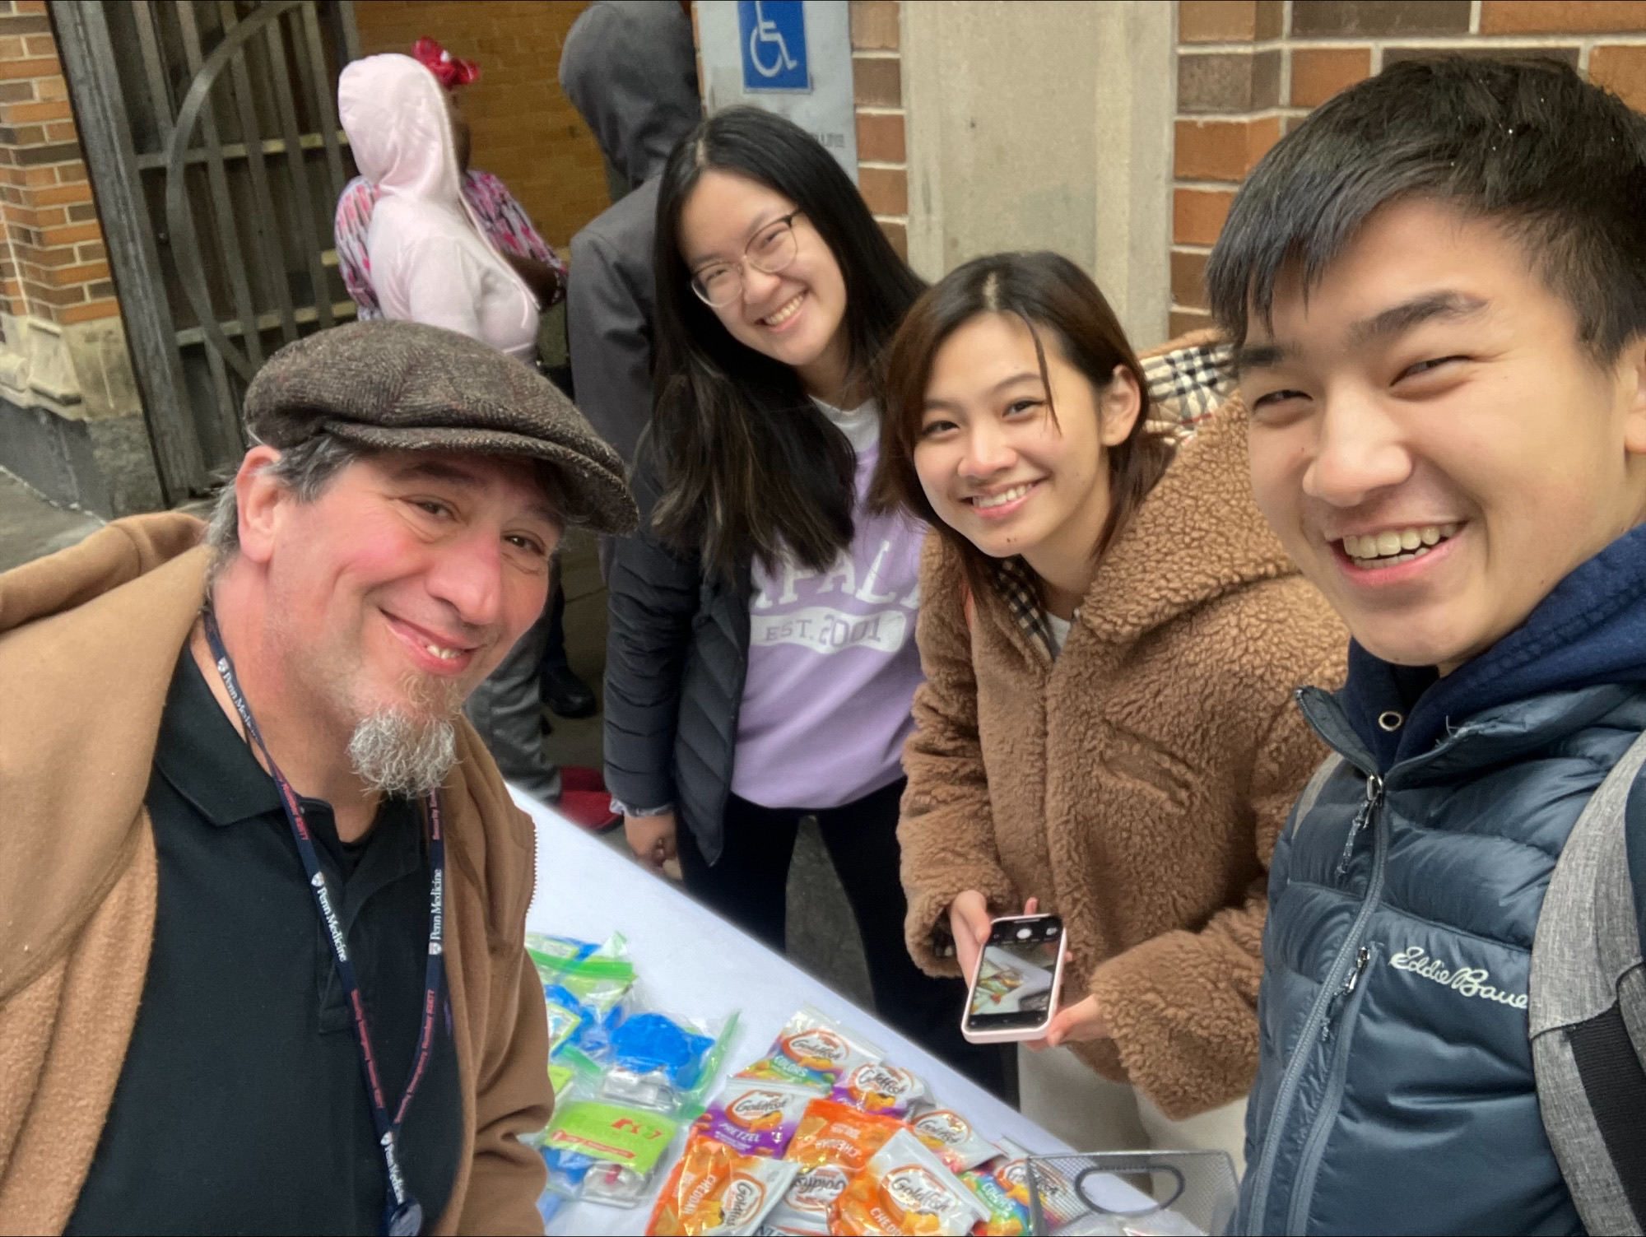
Program Participants
Learner Groups:
Medical Students: 1st and 2nd-year at Perelman School of Medicine
Nursing Students: Psychiatric-Mental Health Nurse Practitioners
Housestaff: Internal, Family, Emergency Medicine residents
APPs and Faculty (hospital and outpatient)

Slide 8
Methods
Interventions​
Multi-pronged interventions including lecture, didactic, and shadowing opportunities
Evaluation​
Four survey instruments used to assess MS1, MS2, APP students, and CME attendees using electronic post-test surveys
Prescribing Rates​
Quantified buprenorphine prescribing rates before and after trainings
Notes:
I will go into more detail about the interventions in the coming slides

Slide 9
Process
Students Housestaff/Faculty
Built-in time to complete X-waiver
Medical school curriculum accredited; X-waiver training completed by all
4+4 hour hybrid or fully remote trainings offered to obtain X-waiver
Additional trainings offered
Interactive stigma and Narcan trainings
Live CME DEA-required training provided
Addiction Medicine Interest Group + Harm Reduction Outreach
MOUD Clinic shadowing
Year 1
Year 2
Year 2.5
(removal
of X-waiver)
Notes:
Note: X Waiver was still in place
For 4+4 trainings for housestaff and faculty:
The trainings provided an overview of SUD; initiation of MOUD; and addressed stigma in SUD care. The live trainings were provided by clinical champions in our health system so were able to provide a local framework for learners.

Slide 10
Process
Students Housestaff/Faculty
Built-in time to complete X-waiver
Medical school curriculum accredited; X-waiver training completed by all
4+4 hour hybrid or fully remote trainings offered to obtain X-waiver
Additional trainings offered
Interactive stigma and Narcan trainings
Live CME DEA-required training provided
Addiction Medicine Interest Group + Harm Reduction Outreach
MOUD Clinic shadowing
Year 1
Year 2
Year 2.5
(removal
of X-waiver)
Notes:
Amazingly, X Waiver was removed! This was fantastic for decreasing barriers to prescribing, but we still needed to find ways to incentivize these trainings, since we think back to providers citing insufficient training as reason for prescribing gaps.
How we did this…
-Interest Group and Outreach events
-Interactive stigma and Narcan trainings: A number of these events were provided all medical students. (Narcan training at MS1 orientation, Half day event for MS1s to focus on SUD stigma - (small group discussions led by guest speakers with lived experience of SUD)
Built in time during MS2 Famlily Medicine Clerkship. All MS2s participated in a minimum of four hours of shadowing in MOUD clinics
CME:
Although the waiver is not longer necessary for buprenorphine prescribing, our CME events count to fulfill a new DEA mandate for training about opioid prescribing effective for DEA renewals or new applications. Local experts provided information about approaches to SUD in both hospital and outpatient setting with an emphasis on MOUD.

Slide 11
Educational Evaluation Results
Experiential Learning
Rated highly valuable by students (medical and nursing).
Improved Competence
76% of housestaff and faculty reported significant improvements in knowledge and competence in buprenorphine prescribing
Notes:
“Collected data in many different ways, above all – the experiential leaning components was consistently rated “highly valuable”

Slide 12
Results – MS2s on MOUD Clinic Shadowing
“I absolutely loved this part of the FM clerkship. Arguably my favorite day. It was amazing to see the work that MOUD physicians do – it's something we get very little exposure to in our preclinical curriculum. It even sparked an interest in addiction medicine for me! 10/10 would recommend keeping, maybe even expanding to two half days.”

Slide 13
Results – Clinical Impacts
Outpatient Buprenorphine Prescribing
Increased by 68% (p = .03).
Inpatient Buprenorphine Orders
Increased by 33% (p = .01).
Discrete Providers
Increased by 77% (p = .03)
Notes:
Highlight - Would make it clear that we dont know the the trainings directly caused these increases but that we think increasing the skills was at least part of that process

Slide 14
Conclusions
Educational Interventions
Positive impact on learner competency and knowledge across all training levels.
Increased Buprenorphine Prescribing
Associated with the implementation of these trainings.
Importance of SUD Education
Key to preparing future clinicians for MOUD initiation and supporting patients with SUDs.
Notes:
Enhanced SUD curriculum had a positive impact on learner competency and knowledge across all training levels
Buprenorphine prescribing and administration rates increased with the implementation of our enhanced training and curriculum. Again, there were other factors at play to influence prescribing patterns, but we think increasing the education and skills through our trainings was a factor.
Overall, I want to highlight the importance of comprehensive SUD education built into medical education – this work is key to preparing future clinicians to support patients with SUD and equitably provide evidence-based treatment such as MOUD

Slide 15
Implications
Integrating SUD education in medical curricula enhances readiness.
Experiential learning opportunities are critical for translating knowledge into practice.
Expanding similar training programs can address gaps in MOUD availability.

Slide 16
Dr. Judy Chertok
Dr. Rachael Truchil
Dr. Margaret Lowenstein
Nicole O’Donnell
Jasmine Barnes
Dr. Kyle Kampman
Dr. Jeff Jaeger
Dr. Jeanmarie Perrone
Perelman School of Medicine​
Providers Clinical Support System​
SAMHSA​
Clinical Champions​
Continuing Education Trainers
Contact Information
Gilly Gehri
Gilly.Gehri@pennmedicine.upenn.edu
267-693-4188
Notes:
Thank you to the entire CAMP team.
Dr Perrone and Dr Chertok for being the true champions in getting this work moving and embedded.

