Slide 1
Reimagining Alcohol Use Screening – A Digital Approach for Comprehensive Assessment
Kevin Pearlman, MD
Neda Laiteerapong, MD
Mim Ari, MD

Slide 2
Disclosures
None

Slide 3
Background
Alcohol Use
USPSTF recommends screening all adult patients for AUD (Grade B)
Medication effective (NNT to prevent 1 patient from returning to any drinking: 11 for Acamprosate, 18 for Naltrexone)
Brief behavioral counseling intervention associated w/ 40% reduction in # of patients exceeding recommended amounts
Alcohol Use Disorders (11%)
Unhealthy Use (28%)
Unhealthy Alcohol Use in Adolescents and Adults: Screening and Behavioral Counseling Interventions (USPSTF, 2018)
Pharmacotherapy for Alcohol Use Disorder: A Systematic Review and Meta-Analysis (JAMA, 2023)
Unhealthy Alcohol Use (NEJM, 2005)
Notes:
https://www.uspreventiveservicestaskforce.org/uspstf/document/evidence-summary/unhealthy-alcohol-use-in-adolescents-and-adults-screening-and-behavioral-counseling-interventions
https://jamanetwork.com/journals/jama/article-abstract/2811435?resultClick=1#google_vignette
https://www.nejm.org/doi/full/10.1056/NEJMcp042262

Slide 4
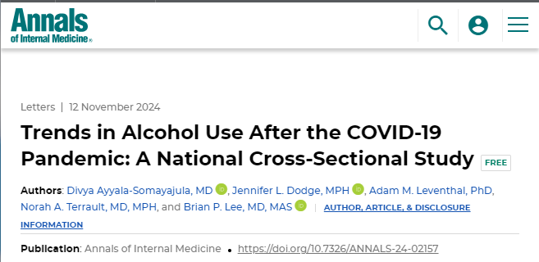
Recent Trends in Alcohol Use
JGIM: Screening Occurs During 2.5% of Primary Care Visits
Alcohol Screening During US Primary Care Visits, 2014–2016 (JGIM, 2022)
Trends in Alcohol Use After the COVID-10 Pandemic: A National Cross Sectional Study (Annals of Internal Medicine, 2024)
Notes:
https://www.ncbi.nlm.nih.gov/pmc/articles/PMC9640516/

Slide 5
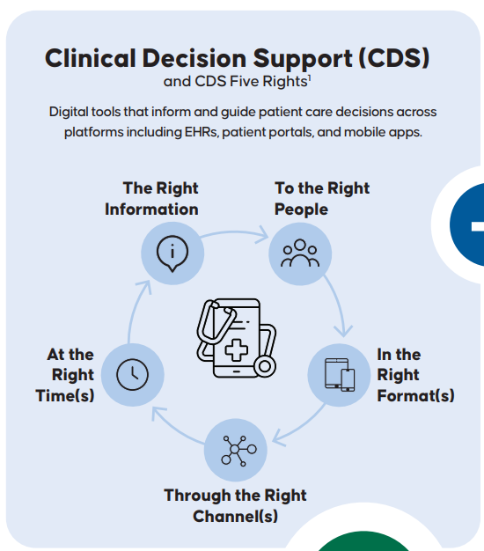
Objective
Improve quality of AUD diagnosis and management by implementing a clinical decision support system
Patient-Centered Clinical Decision Support Explained (AHRQ, 2024)
Notes:
https://cdsic.ahrq.gov/cdsic/patient-centered-clinical-cds-infographic

Slide 6
Study Overview
Method: Continuous QI project leveraging a pre-post study design
Setting & Population: Adult patients who received care at an academic GIM clinic between 1/1/2022 and 9/30/2024
Intervention: Implemented an AUD clinical decision support system on 12/20/2023
Analysis: Monitored rates of alcohol screening, alcohol use diagnoses, prescriptions for MAUD, and referrals to behavioral health

Slide 7
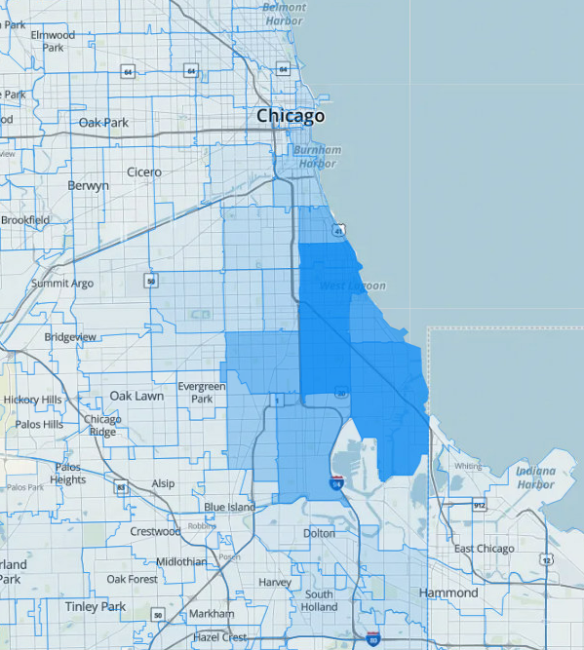
UCMC Primary Care Group Population Overview
Provides care to ~20k patients in ~60k clinic visits per year
Insurance mix: 47% private insurance, 43% Medicare, and 10% dual Medicare-Medicaid
Demographics: 56% Black, 25% white, 5% Hispanic
37 attending physicians, 105 resident physicians
AMERSA Conference
University of Chicago Medical Center

Slide 8
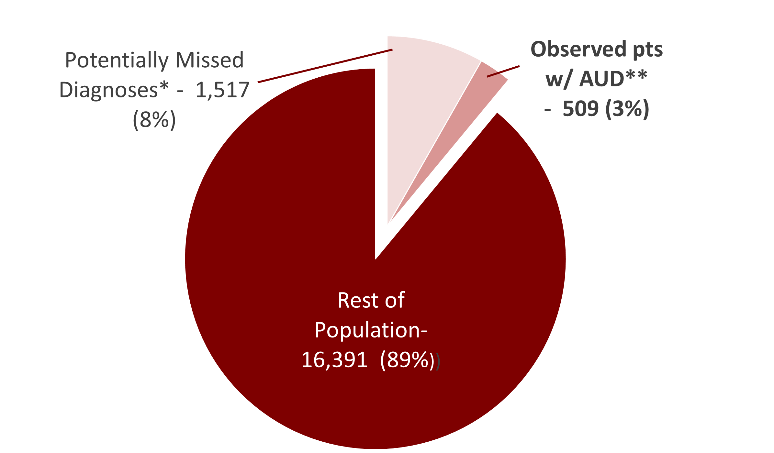
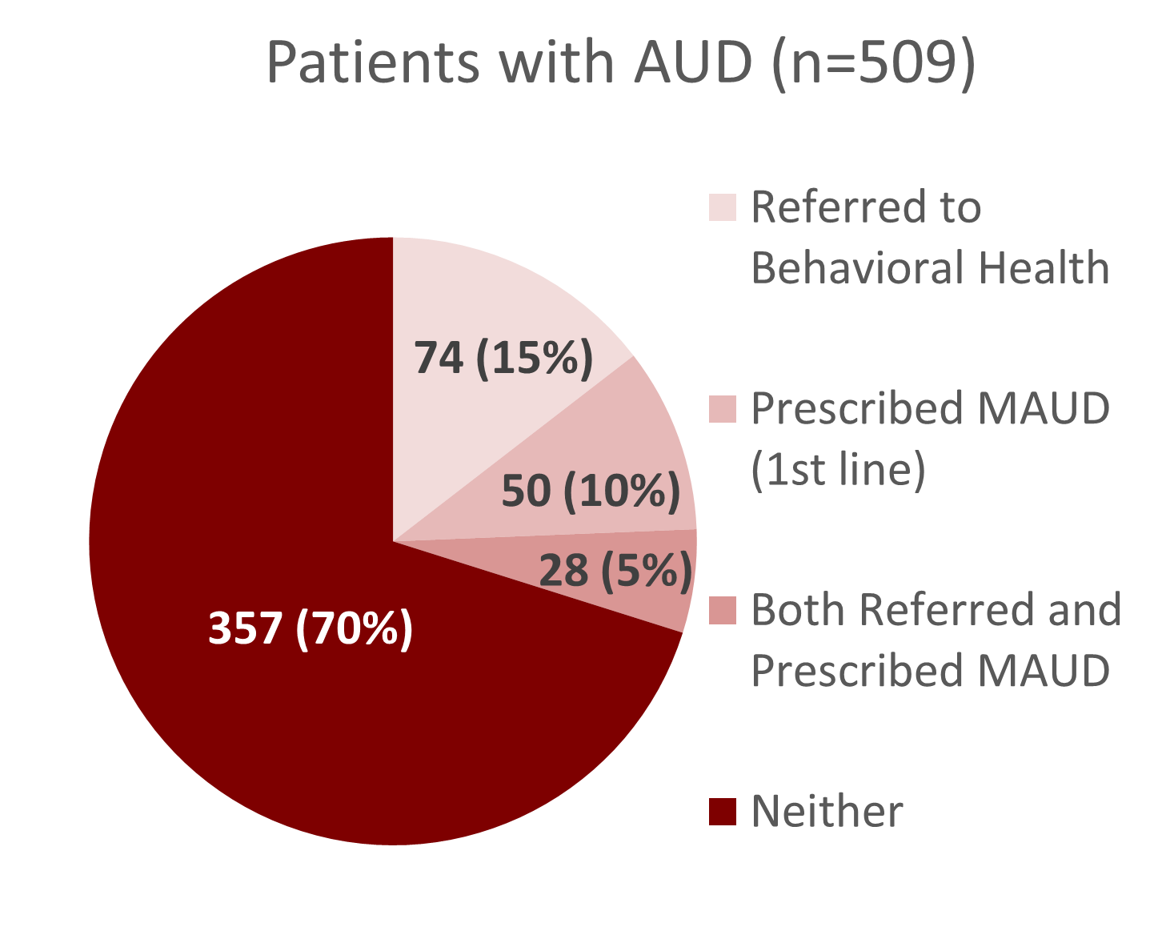
AUD Diagnosis and Treatment Among UChicago Primary Care Patients in 2023
*Based on estimated national prevalence of 11%
**AUD-related diagnosis documented as an encounter/billing diagnosis, active problem, or on past medical history

Slide 9
Disparities in Likelihood of AUD Diagnosis and MAUD Rx Among UChicago Primary Care Patients
Black patients 38% more likely than non-Black patients to be diagnosed w/ AUD (p<0.01)
Black patients 31% less likely than non-Black patients to receive MAUD prescription (p = 0.05)

Slide 10
Clinical Decision Support Tool
Passive alert (Our Practice Advisory) to screen all adult patients using an EHR-based AUDIT-C/AUDIT screener
1,498 screens completed since launch (3.7% of visits)
Triggers every other year for patients w/ no history of AUD
Triggers annually for patients w/ history of AUD
Notes:
1498/40,673 visits

Slide 11
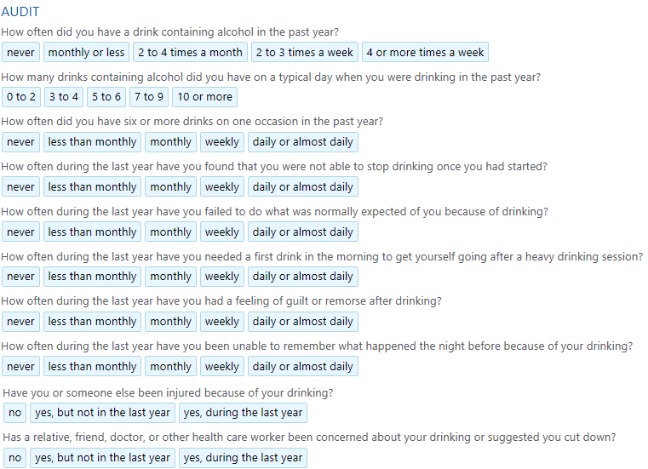
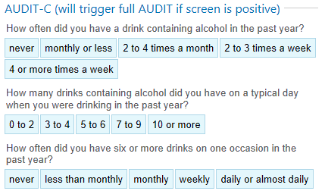
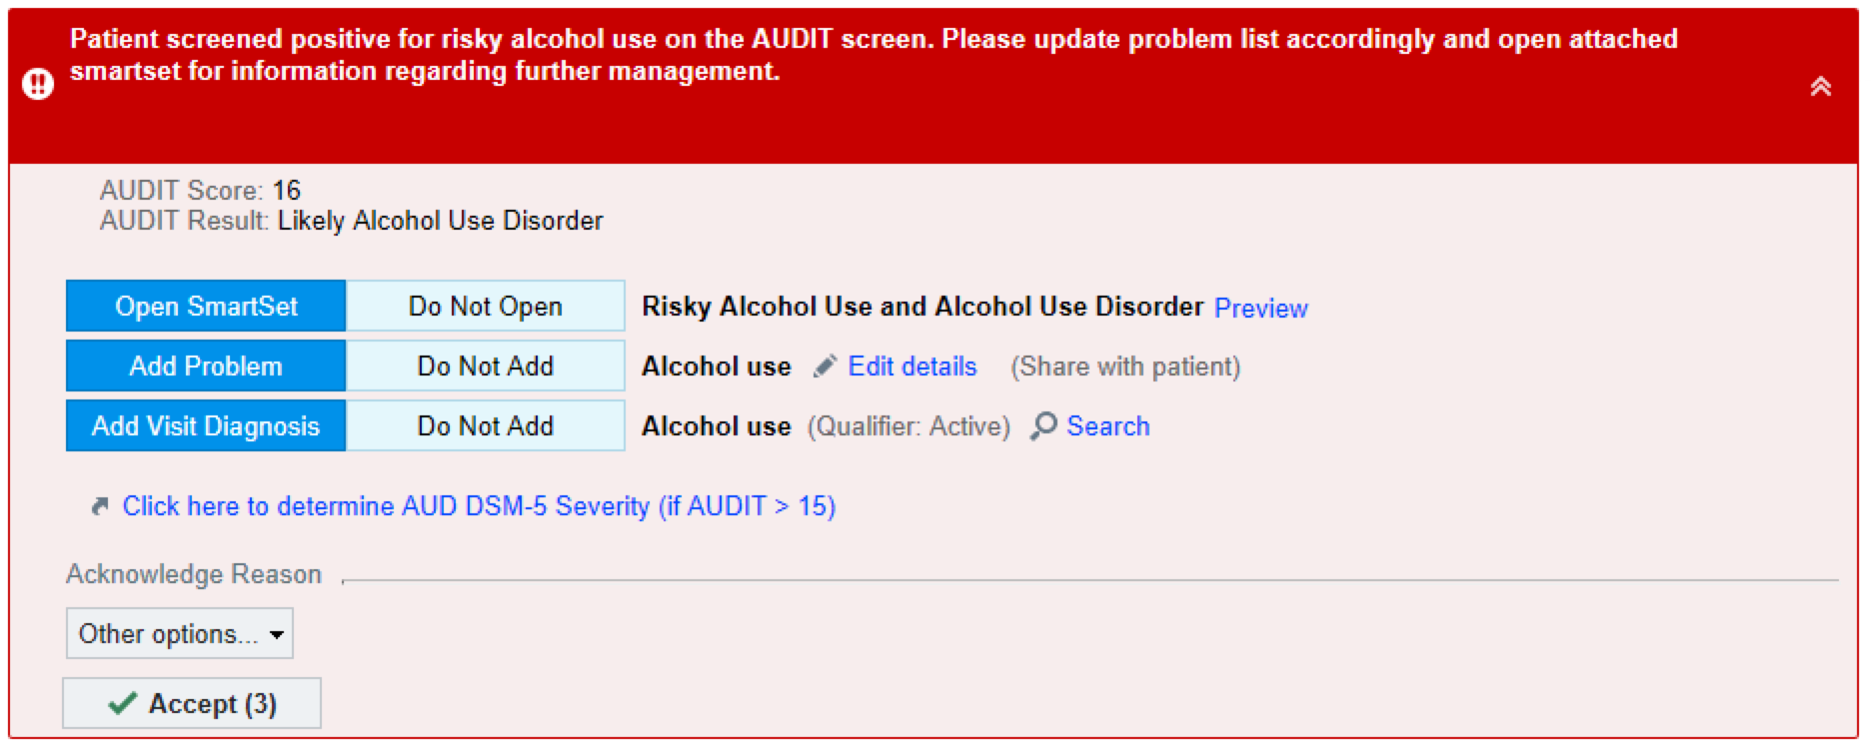
AUDIT-C SmartForm
Reflexes to Full AUDIT
IF Positive
High Risk OPA Populates

Slide 12
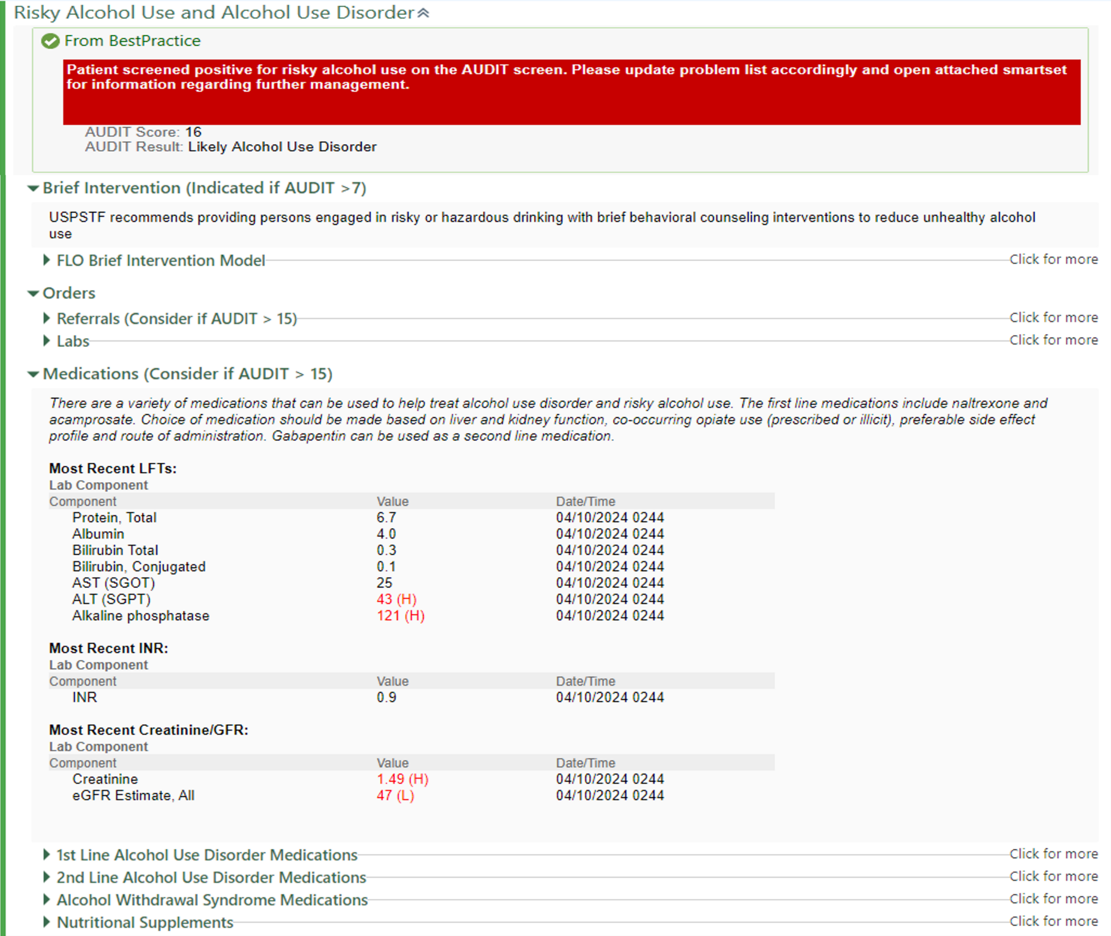
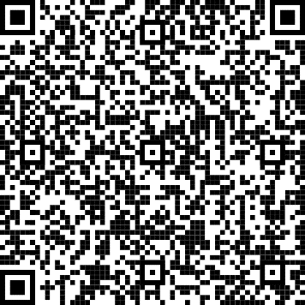
Order Set Containing Clinical Decision Support
Clinical Decision Support Algorithm Embedded in Order Set

Slide 13
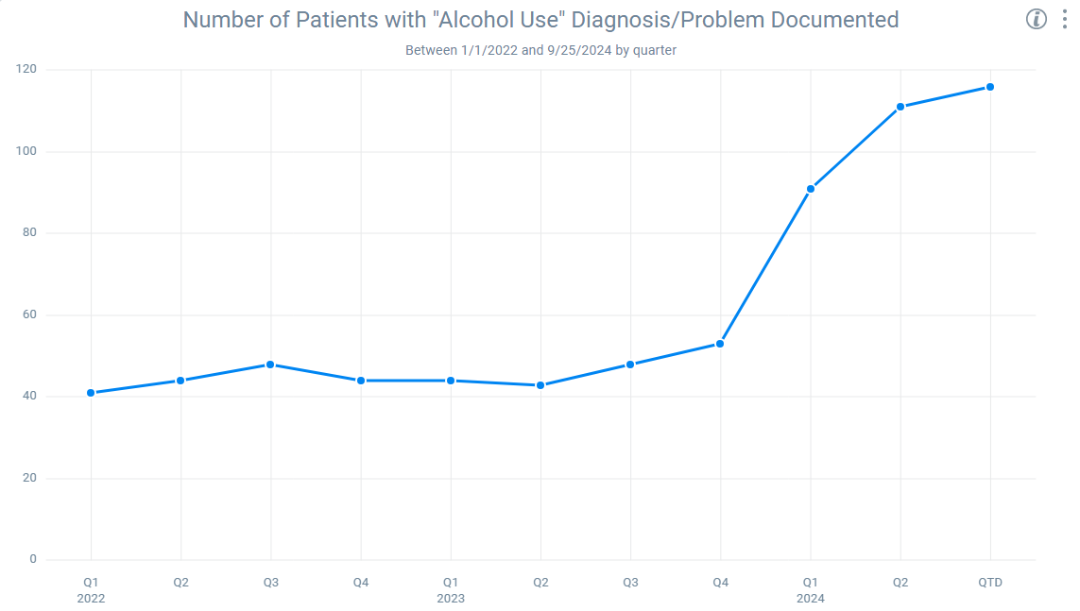
Results: Number of Patients with “Alcohol Use” Diagnosis/Problem Documented
120
100
Patient Count
80
Q1-Q3 2024 vs. Q1-Q4 2022/2023: 132% relative increase (chi-squared p < 0.05)
60
40
12/20/2023: Clinical Decision Support Tool Launched
20
0
Q1
2022
Q2
Q3
Q4
Q1
2023
Q2
Q3
Q4
Q1
2024
Q2
Q3

Slide 14
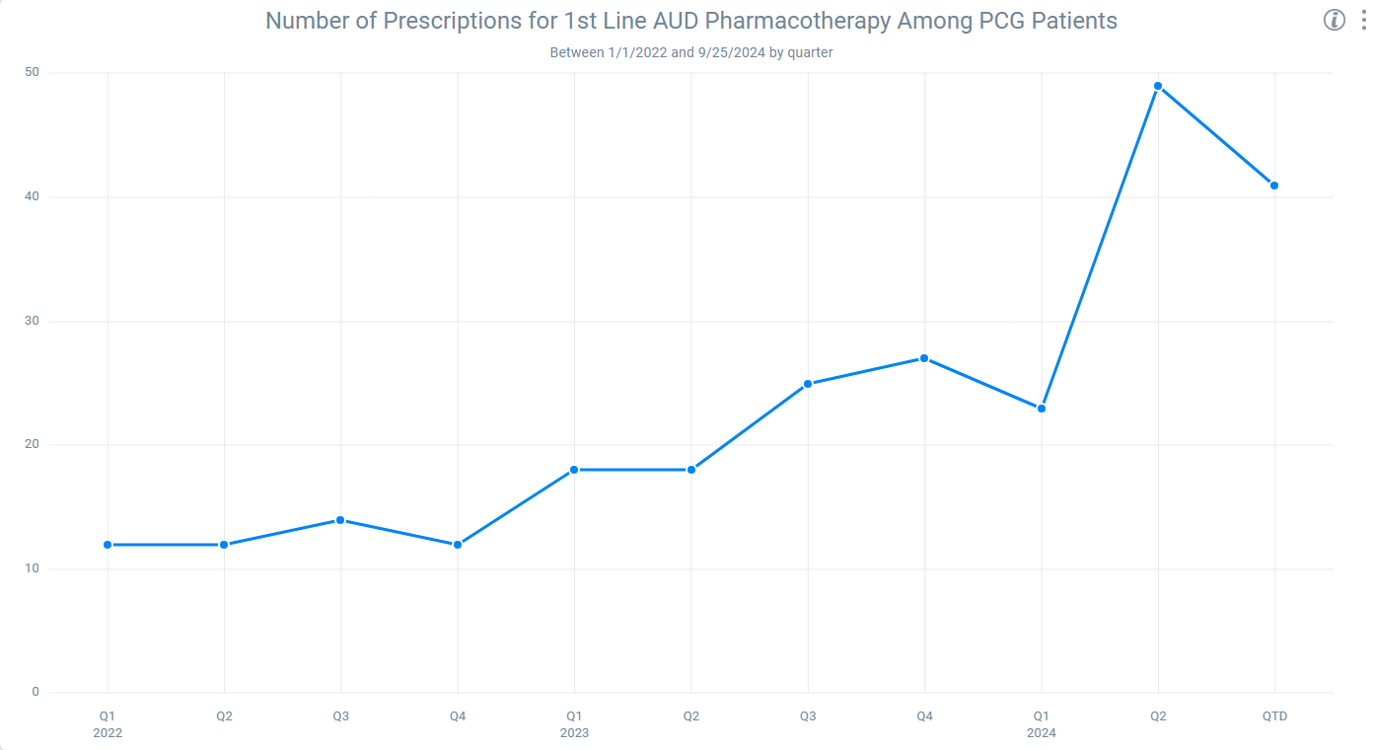
Results: Number of Patients Prescribed Naltrexone and/or Acamprosate by Primary Care Provider
50
40
Patient Count
Q1-Q3 2024 vs. Q1-Q4 2022/2023:
118% relative increase (chi-squared p < 0.05)
30
20
12/20/2023: Clinical Decision Support Tool Launched
10
0
Q1
2022
Q2
Q3
Q4
Q1
2023
Q2
Q3
Q4
Q1
2024
Q2
Q3

Slide 15
Discussion and Limitations
EHR-based screening linked to clinical decision support tools may be an effective mechanism to improve detection and treatment of AUD
Small percentage of visits where screening occurred (3.7%) – alert fatigue and busy workflows may limit bandwidth to screen
Black patients seen at UCM more likely to be diagnosed w/ AUD and less likely to receive treatment for AUD
Need to address bias in diagnosis/management of AUD
Limitations: No changes in AUD diagnosis and/or BH referral rates to-date, pre-post QI study (can’t prove causation), single academic medical center, EHR data may not capture all aspects of clinical care (i.e., behavioral counseling interventions)
Racial and Ethnic Bias in the Diagnosis of Alcohol Use Disorder in Veterans (AM J Psychiatry, 2023)
Disparities in the Use and Quality of Alcohol Treatment Services and Some Proposed Solutions (Psychiatric Services), 2015)

Slide 16
Summary
Implementation of a clinical decision support system was associated with increases in alcohol use documentation and MAUD
Future areas of work:
Evaluating for long-term changes in AUD treatment/diagnosis
Ensuring equitable diagnosis & treatment among patients of color
Scaling intervention to additional primary care clinics and specialty clinics (launched in Hepatology clinic 10/2024, anticipating launch in Psychiatry 1/2025)

Slide 17
Sources
Racial and Ethnic Bias in the Diagnosis of Alcohol Use Disorder in Veterans (AM J Psychiatry, 2023)
Disparities in the Use and Quality of Alcohol Treatment Services and Some Proposed Solutions (Psychiatric Services), 2015
Unhealthy Alcohol Use in Adolescents and Adults: Screening and Behavioral Counseling Interventions (USPSTF, 2018)
Pharmacotherapy for Alcohol Use Disorder: A Systematic Review and Meta-Analysis (JAMA, 2023)
Unhealthy Alcohol Use (NEJM, 2005)
Alcohol Screening During US Primary Care Visits, 2014–2016 (JGIM, 2022)
Patient-Centered Clinical Decision Support Explained (AHRQ, 2024)
Trends in Alcohol Use After the COVID-10 Pandemic: A National Cross Sectional Study (Annals of Internal Medicine, 2024)

Slide 19
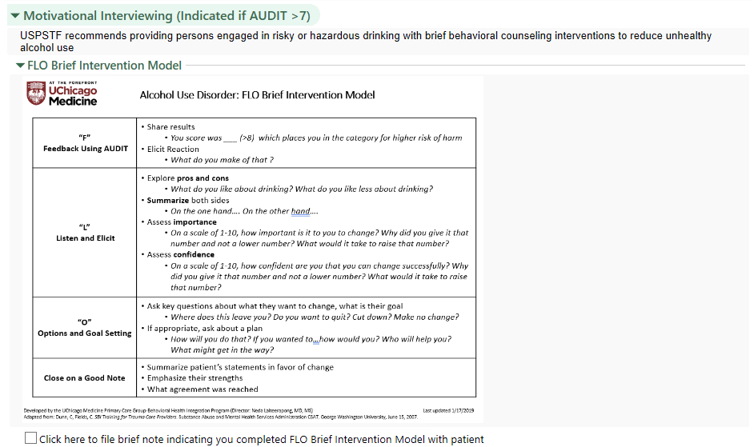
Appendix – Order Set Sections

Slide 20
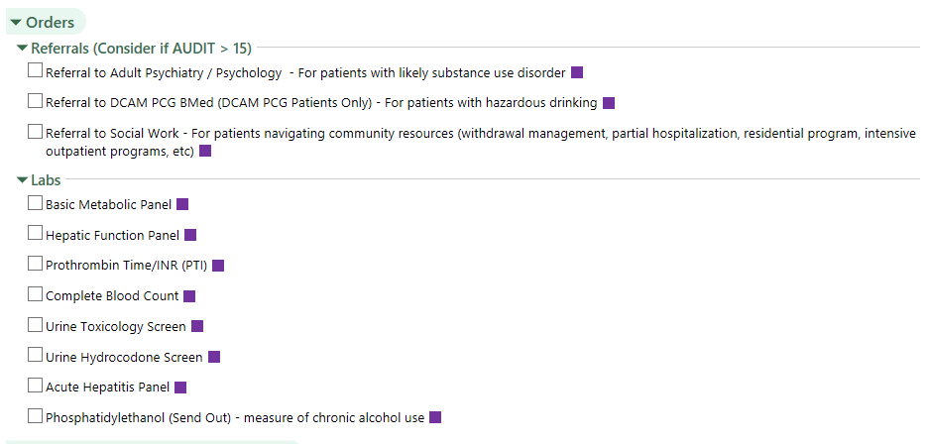
Appendix – Order Set Sections

Slide 21
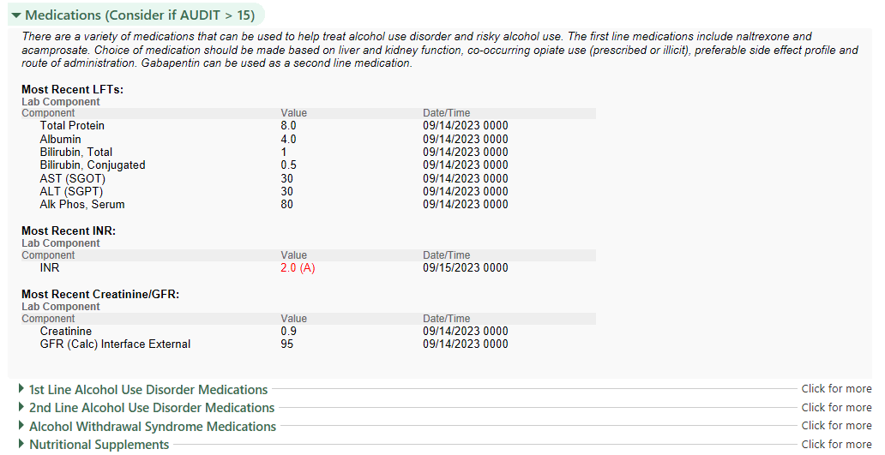
Appendix – Order Set Sections

Slide 22
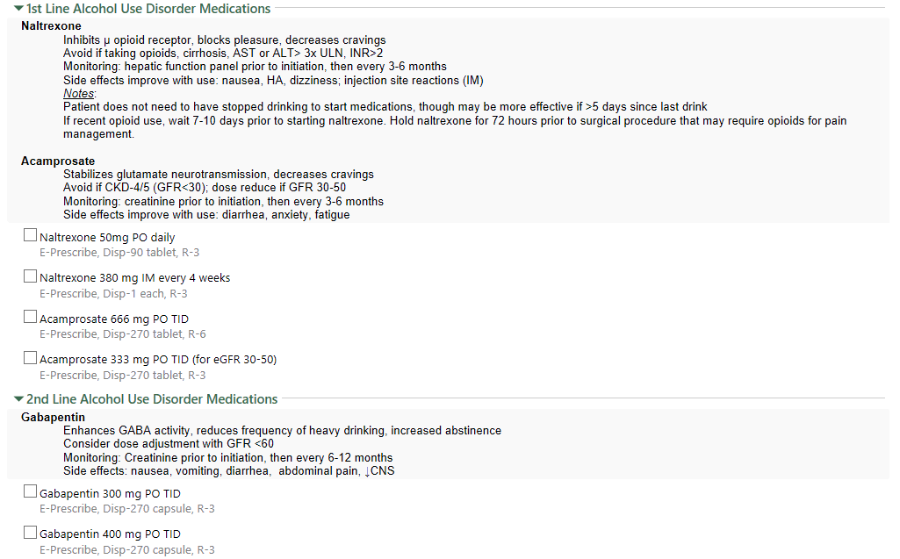
Appendix – Order Set Sections

Slide 23
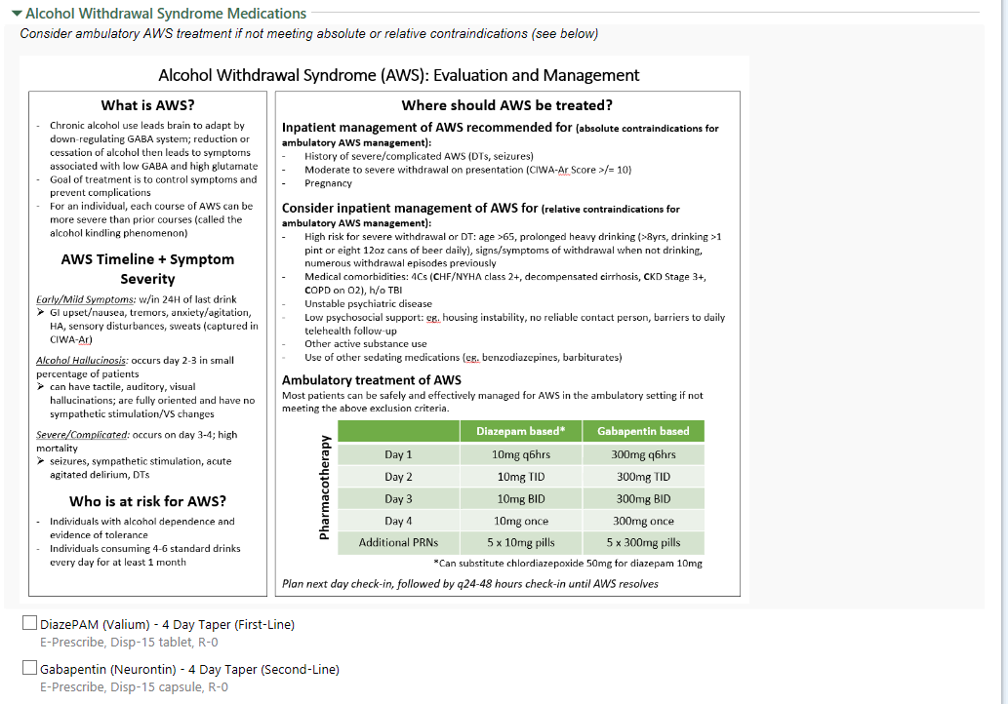
Appendix – Order Set Sections

Slide 24
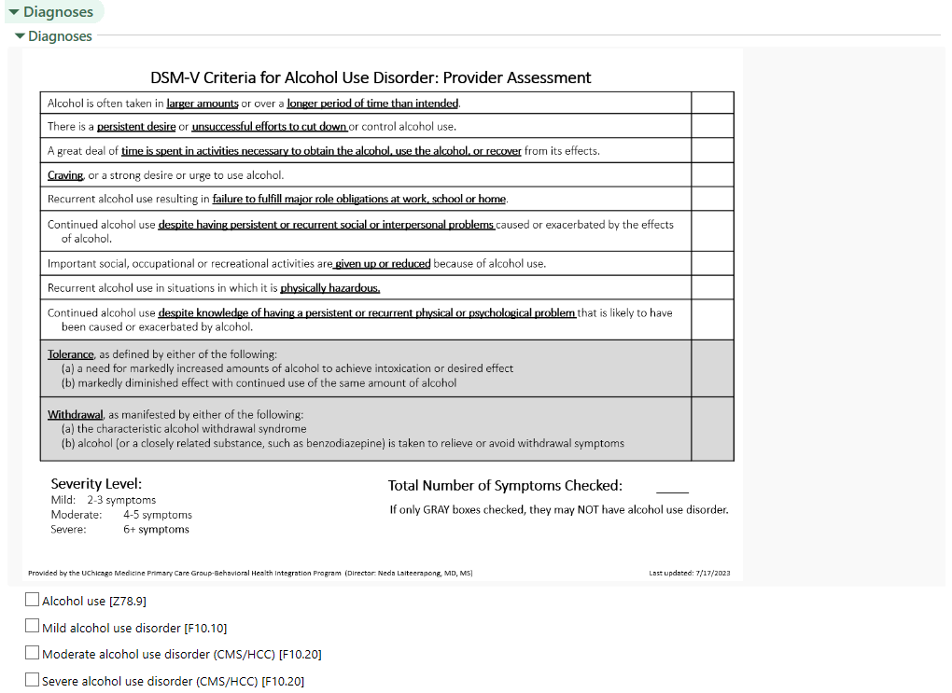
Appendix – Order Set Sections

Slide 25
Appendix – Order Set Sections

